Slide 1

Adaptive finite element method with a local element parametrization of nested meshes
J. Ramírez ⁽¹⁾, A. Oliver ⁽¹⁾, R. Montenegro ⁽¹⁾
⁽¹⁾ University Institute SIANI, University of Las Palmas de Gran Canaria, Spain

Slide 2
Outline
Motivation and introduction
Objective of our method
Basic idea
Description of the method
Numerical example
Conclusions
Future work

Slide 3
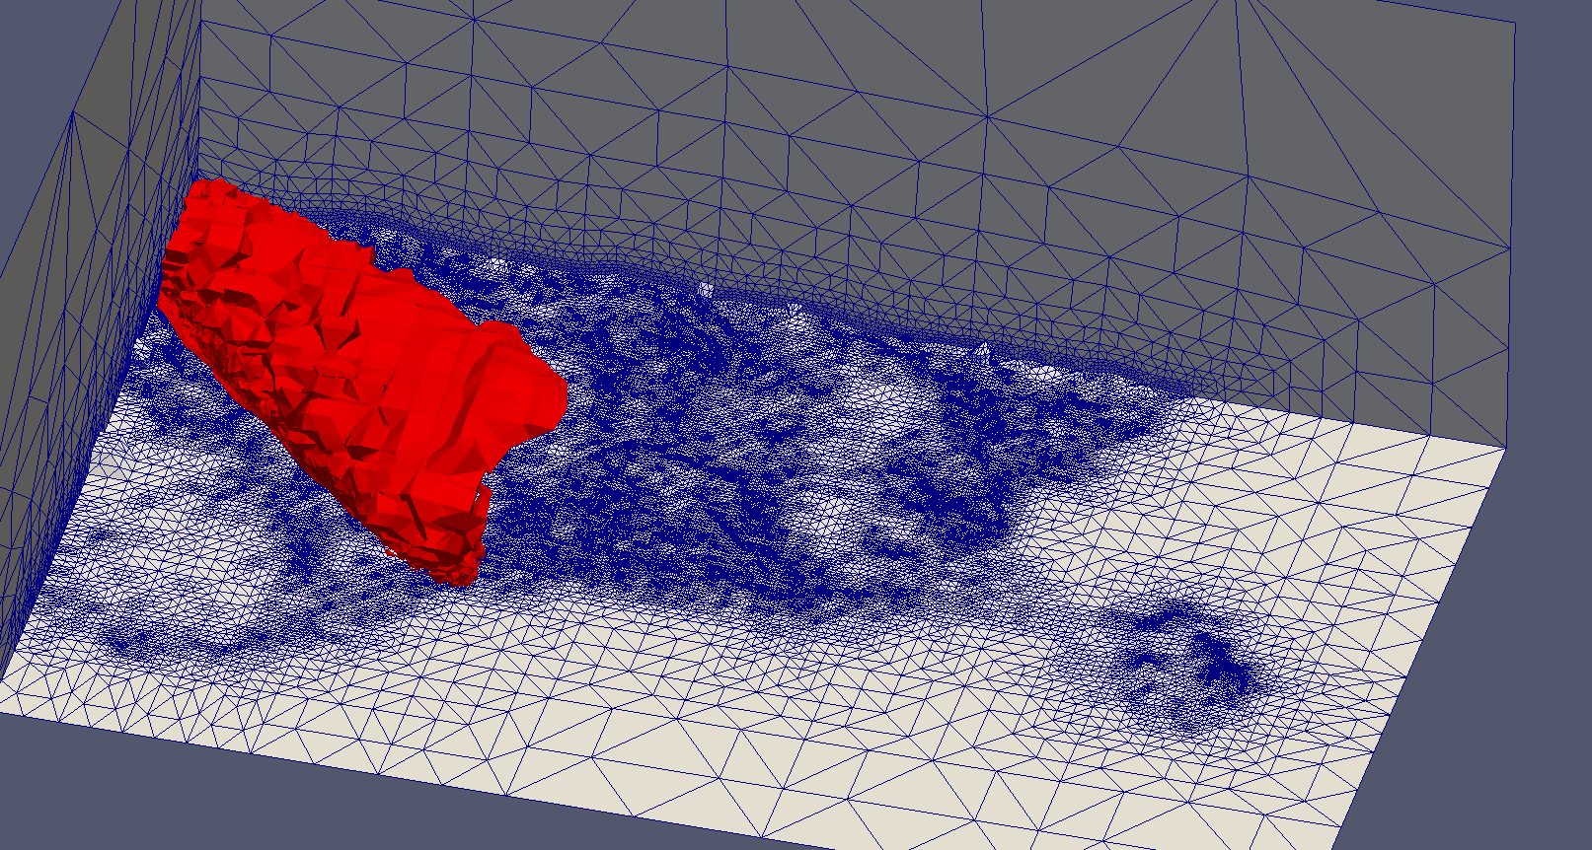
Motivation
Pollutant dispersion :
Large domains with smooth or constant solution
Level of refinement is impossed by the geometry

Slide 4
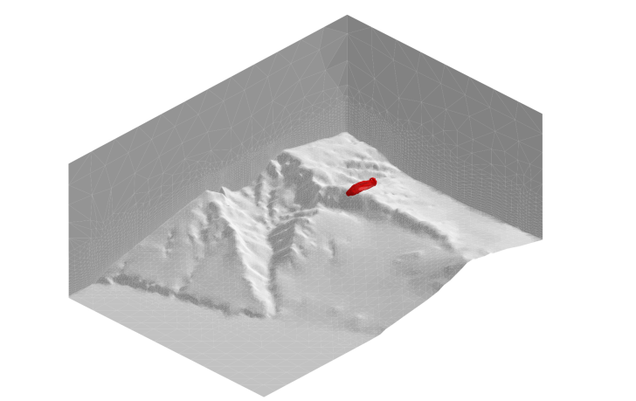
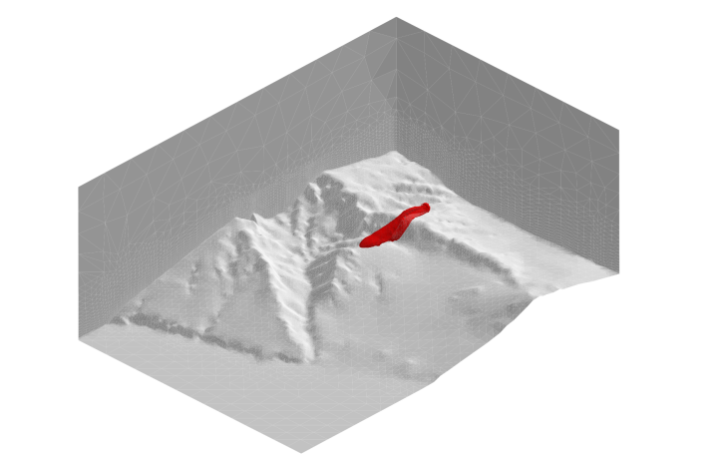
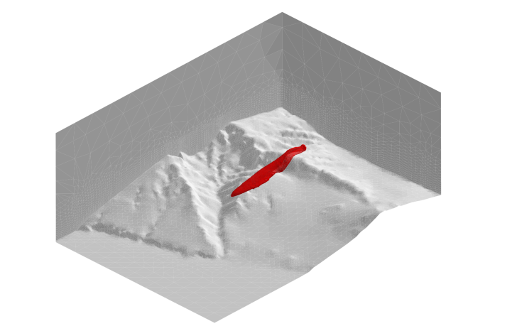
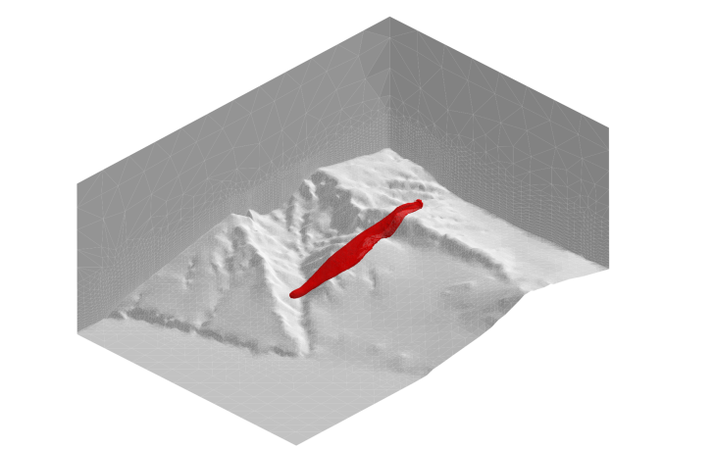
Motivation
Transient problem, changes in wind direction can lead to new propagation zones
Overrefined mesh for the solution needs

Slide 5
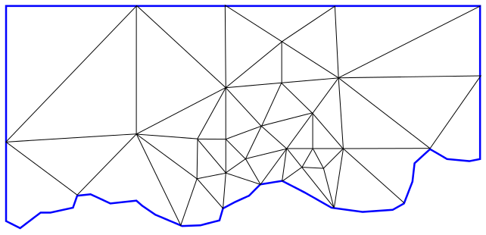
Objective
Solve the problem, with a mesh adapted to the solution without losing the problem geometry

Slide 6
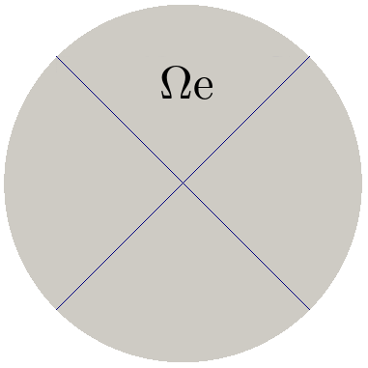
Basic idea
Generate a nested mesh that describes the problem geometry, with DOF from the solution

Slide 7
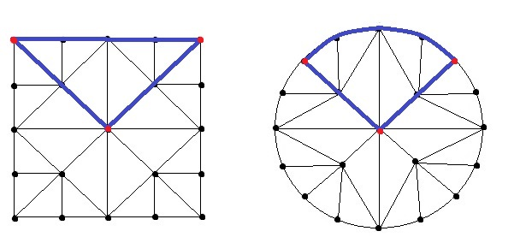

Basic idea
Generate a nested mesh that describes the problem geometry, with DOF from the solution
Construct a mapping from the reference element to the physical element
$$Ψ_{m}$$

Slide 8
Nested mesh generator
Requirements
Mesh adapted to the geometry
Creation of hierarchical nested meshes in parametric space
Transformation between parametric and physical space

Slide 9
Nested mesh generator
Requirements
Mesh adapted to the geometry
Creation of hierarchical nested meshes in parametric space
Transformation between parametric and physical space
The Meccano method is able to generate such kind of meshes

Slide 10

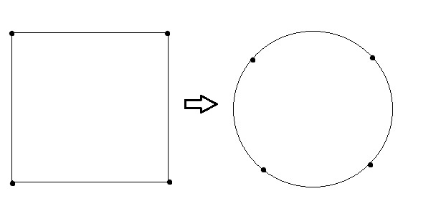
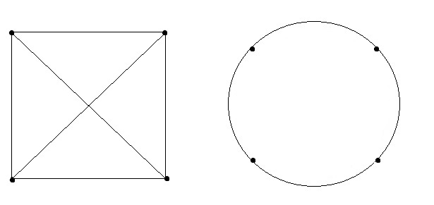
Meccano mesher
1. Construct a meccano approximation
2. admissible mapping between meccano and solid boundaries
3. Construct a coarse mesh of the meccano

Slide 11
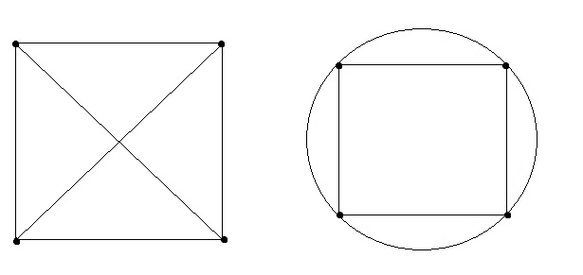
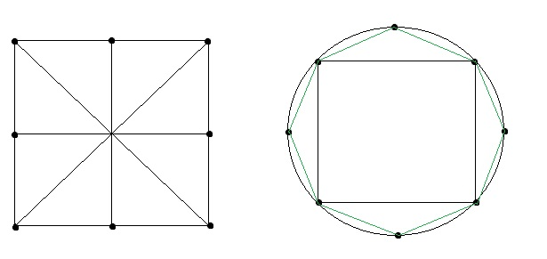
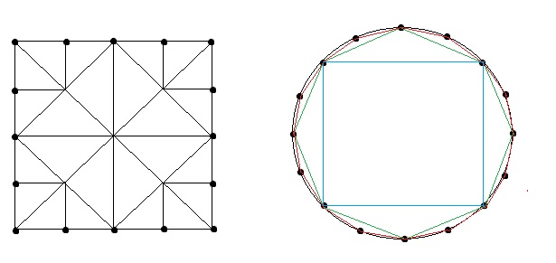
Meccano mesher
4. Refined mesh of the meccano that approximates the solid boundary

Slide 12
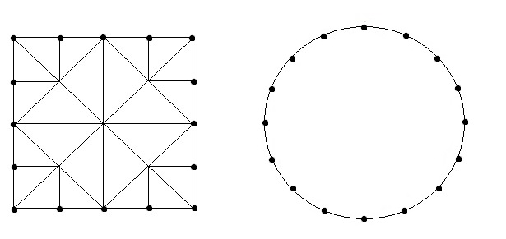
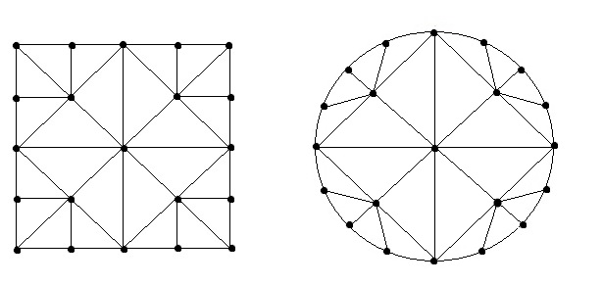
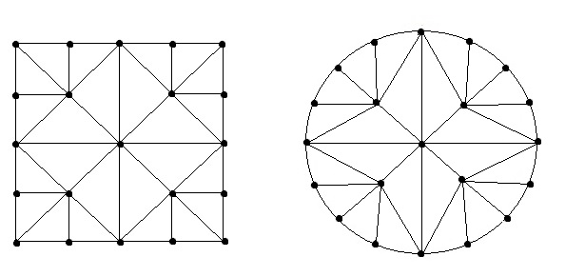
Meccano mesher
5. Relocate the inner nodes of the meccano
6. Optimize the mesh

Slide 13
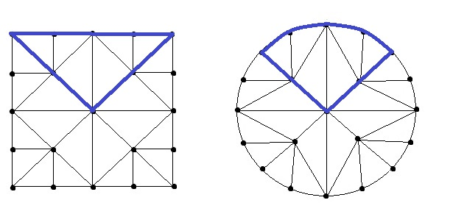
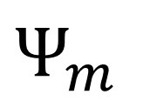
Piecewise transformation
$$Ψ_{m}$$

Slide 14
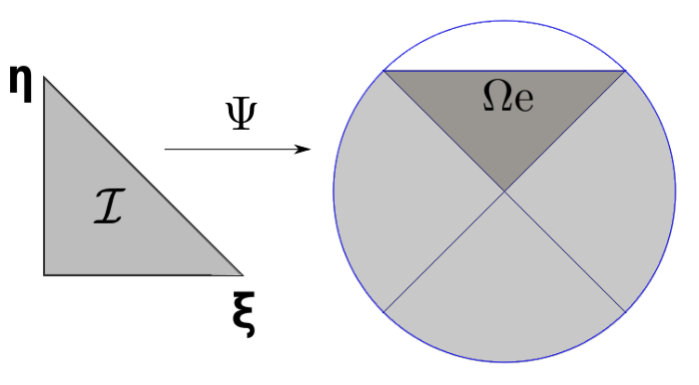

Piecewise transformation
Classic FEM transformation, is not able to get curved edges
$$Ψ_{m}$$

Slide 15
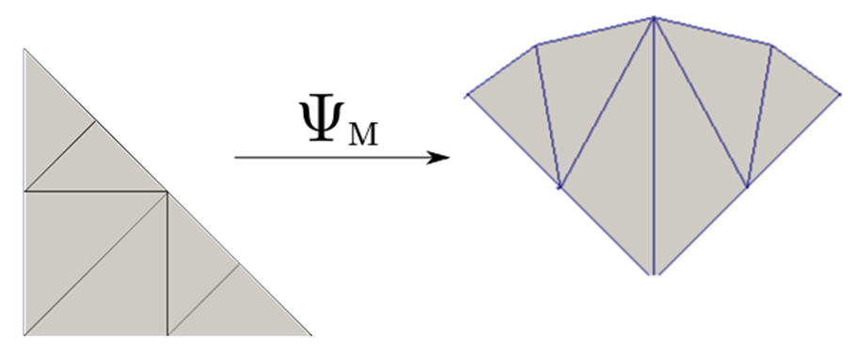
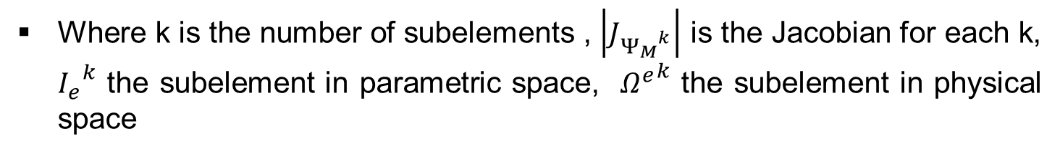
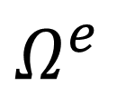
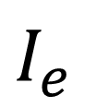
Weak formulation
This would lead to the following formulation
$$I_{e}$$
$$Ω^{e}$$
Where k is the number of subelements , $\left|J_{{Ψ_{M}}^{k}}\right|$ is the Jacobian for each k, ${I_{e}}^{k}$ the subelement in parametric space, ${Ω^{e}}^{k}$ the subelement in physical space

Slide 16
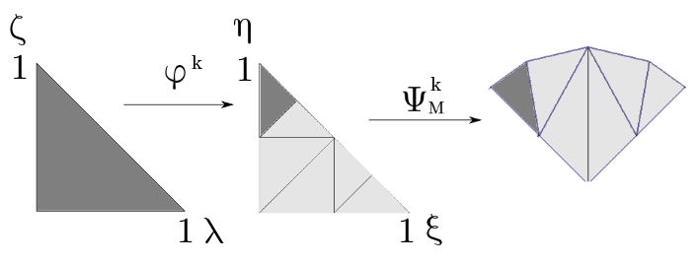
Numerical Integration(quadrature)
Then we perform the integration, for that purpose a transformation φ is introduced from the integration space to each subelement in parametric space.

Slide 17

Numerical integration
Finally the numerical integration would result:
Where $n_{ip}$ is the number of integration points, $ξ_{i}=φ{(λ}_{i},ς_{i}),\left\{λ_{i},ς_{i}\right\}$ is the position of integration points, $ω_{i}$ is the weight of integration points, and $J_{φ}$ is the Jacobian of transformation $φ$

Slide 18
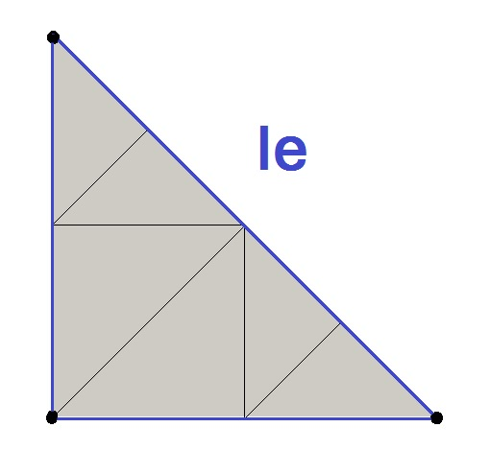
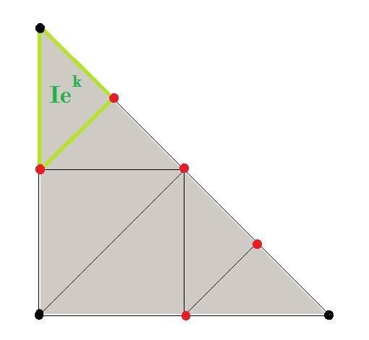
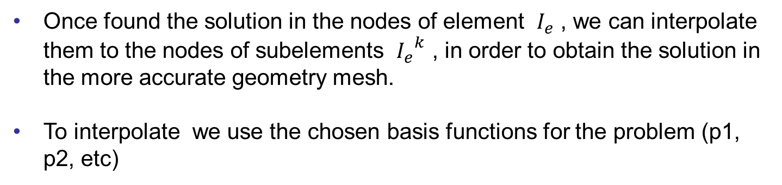
Interpolation
Once found the solution in the nodes of element $I_{e}$ , we can interpolate them to the nodes of subelements ${I_{e}}^{k}$ , in order to obtain the solution in the more accurate geometry mesh.
To interpolate we use the chosen basis functions for the problem (p1, p2, etc)
Interpolate

Slide 19
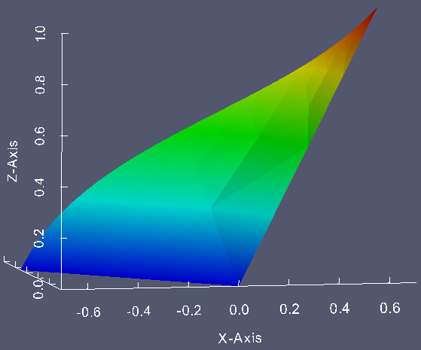
Interpolation
Once found the solution in the nodes of element $I_{e}$ , we can interpolate them to the nodes of subelements ${I_{e}}^{k}$ , in order to obtain the solution in the more accurate geometry mesh.
To interpolate we use the chosen basis functions for the problem (p1, p2, etc)

Slide 20
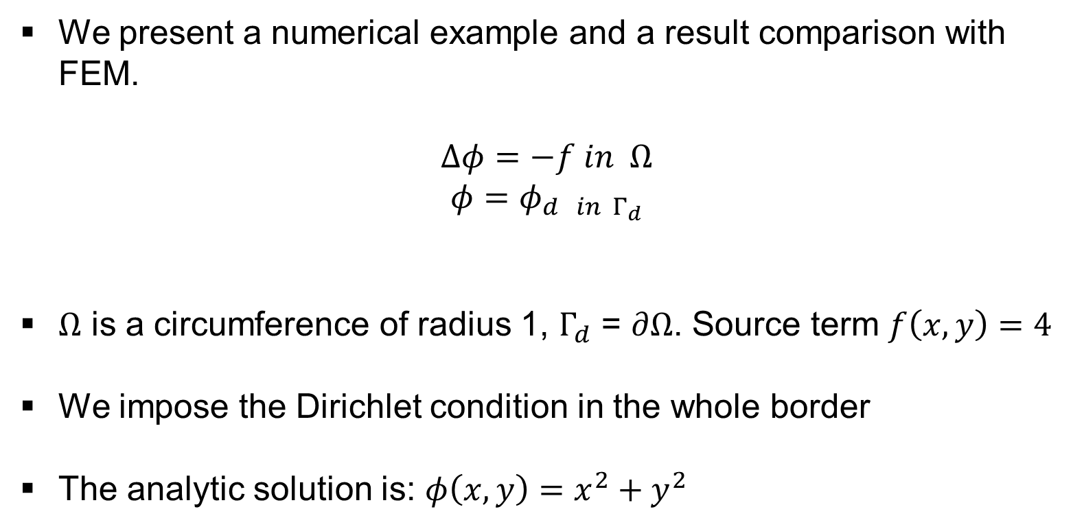
Numerical example
We present a numerical example and a result comparison with FEM.
$$Δφ=−f in Ω$$
$$φ=φ_{d in Γ_{d}}$$
$Ω$ is a circumference of radius 1, $Γ_{d}$ = $∂Ω$. Source term $f\left(x,y\right)=4$
We impose the Dirichlet condition in the whole border
The analytic solution is: $φ\left(x,y\right)=x^{2}+y^{2}$

Slide 21
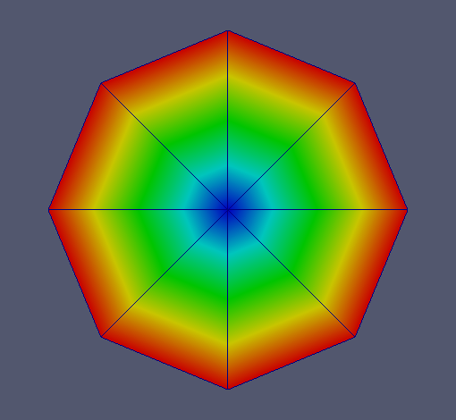
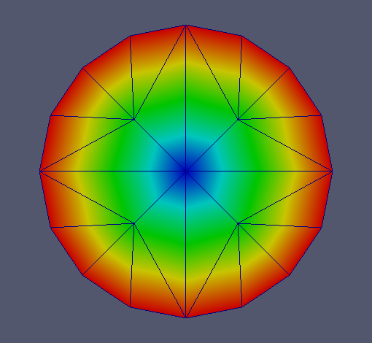
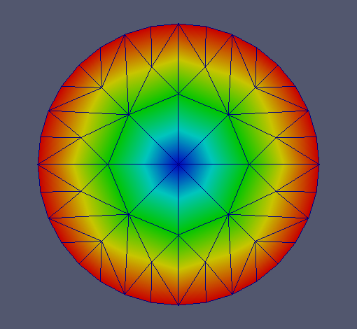
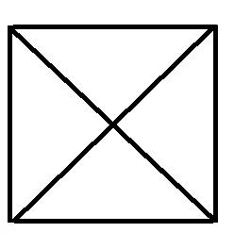
Numerical example
Different solutions ( 2, 3, 4 levels of refinement in integration mesh), for the same solution mesh of 5 degrees of freedom

Slide 22
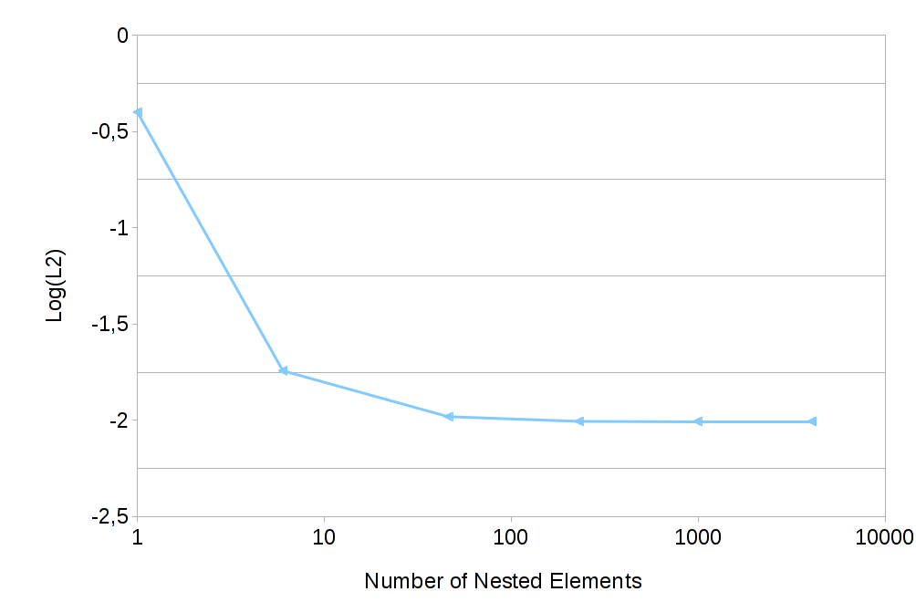
Numerical example

Slide 23
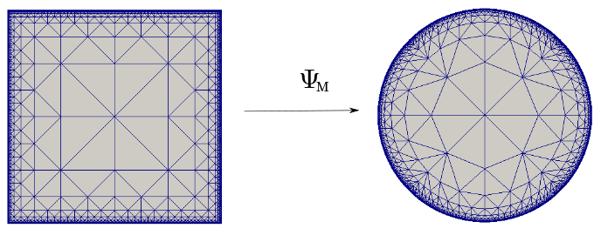
Numerical example
The meccano transformation between parametric and physical space of the nested mesh:

Slide 24
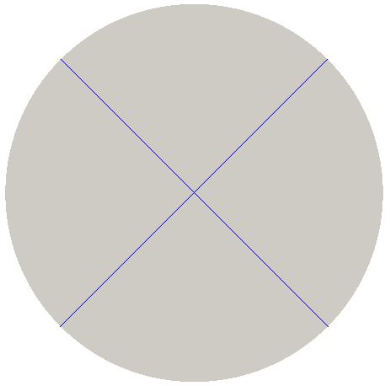
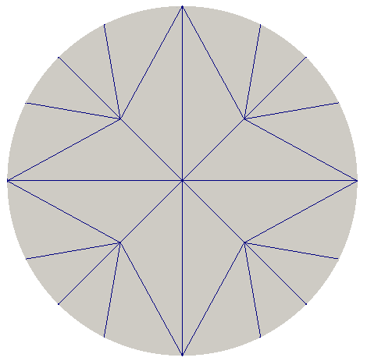
Numerical example

Slide 25
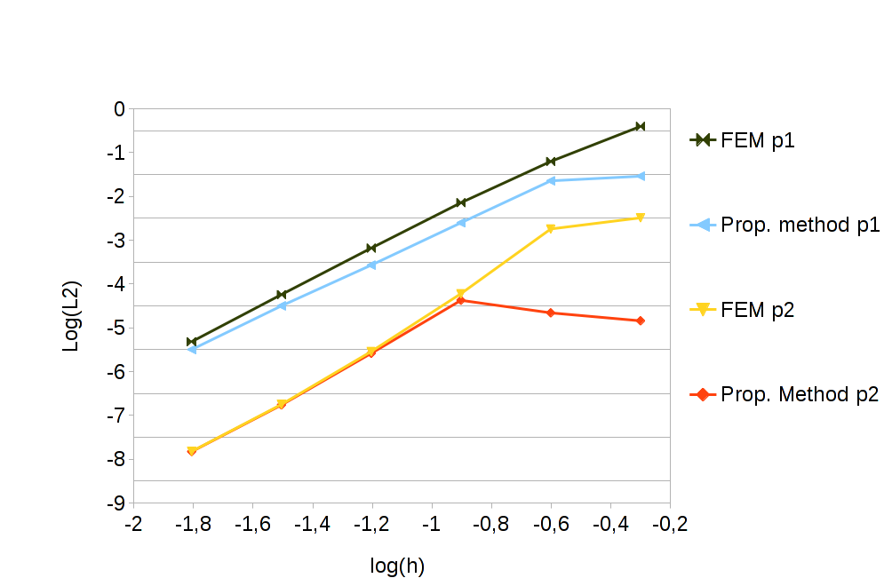
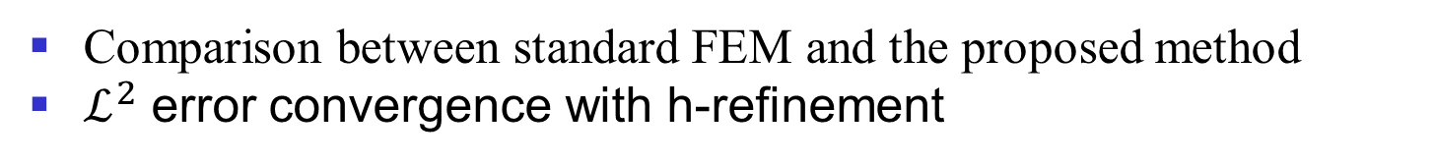
Numerical example
Comparison between standard FEM and the proposed method
$ℒ^{2}$ error convergence with h-refinement

Slide 26
Conclusions
The problem can be solved using a coarse mesh for the solution, but integrating in a refined mesh that captures the details of geometry.
This method allows to use a mesh adapted to the solution without the constraints of the geometry.
Straightforward implementation in 3D

Slide 27
Future work
Application to unsteady problems using adaptivity
Application to convection-diffusion-reaction equations for pollutant dispersion

Slide 28
Adaptive finite element method with a local element parametrization of nested meshes
J. Ramírez ⁽¹⁾, A. Oliver ⁽¹⁾, R. Montenegro ⁽¹⁾
⁽¹⁾ University Institute SIANI, University of Las Palmas de Gran Canaria, Spain

