Slide 1
Ensemble Wind Forecasting Based on the HARMONIE Model and
Adaptive Finite Elements in Complex Orography
Albert Oliver (1), Eduardo Rodríguez (1), José María Escobar (1), Gustavo Montero (1), Mariano Hortal (2), Javier Calvo (2), José Manuel Cascón (3), and Rafael Montenegro (1)
University Institute SIANI, University of Las Palmas de Gran Canaria
Agencia Estatal de Meteorología (AEMET)
University of Salamanca
http://www.dca.iusiani.ulpgc.es/proyecto2012-2014

Slide 2
Contents
Ensemble Wind Forecasting Based on the HARMONIE Model and
Adaptive Finite Elements in Complex Orography
Motivation
The Local Scale Wind Field Model
Coupling with HARMONIE
Calibration
Ensemble method
Conclusions
Notes:
Decimos que un tetraedro es de Tipo I si está marcado con el indicador de error. Se introducen 6 nuevos nodos en el punto medio de sus aristas y se subdividen cada una de sus cuatro caras en 4 triángulos, uniendo los puntos que se han introducido.
Cuatro subtetraedros quedan determinados a partir de los cuatro vértices del tetraedro original y las nuevas aristas.
Los otros cuatro tetraedros se obtienen al unir los dos vértices opuestos más cercanos del octaedro que resulta en el interior. Estudios de Löhner y Baum aseguran que esta elección produce el menor número de tetraedros distorsionados en la malla refinada. Existen otras dos opciones para subdividir el octaedro, y se podría analizar la calidad de las divisiones, pero aumentaría el coste computacional del algoritmo.
Una vez marcados los tetraedros de Tipo I, para asegurar la conformidad de la malla nos podemos encontrar con tetraedros vecinos que pueden tener 6, 5,..., 1, ó 0 nuevos nodos introducidos.
Aquellos tetraedros que por razones de conformidad tengan marcadas sus 6 aristas pasa automáticamente al conjunto de tetraedros de Tipo I.

Slide 3
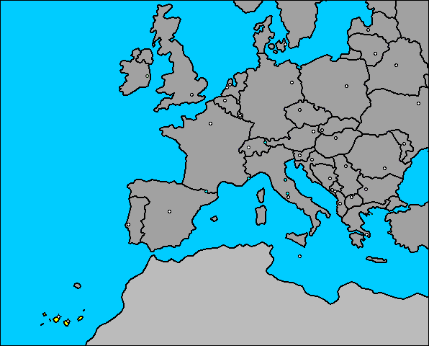
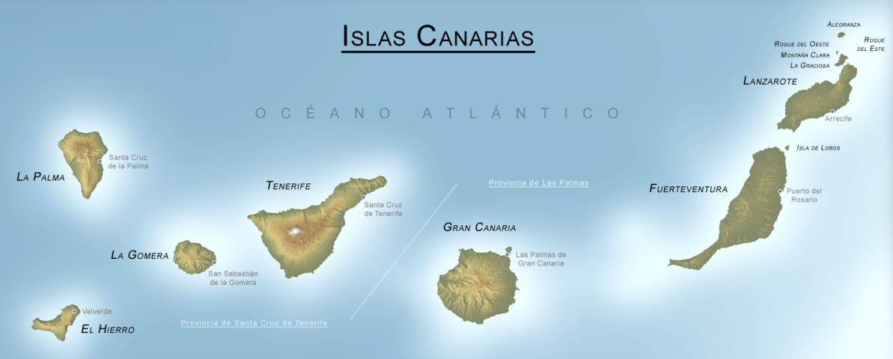
Motivation
Wind field forecasting for complex terrain
Ensemble methods
Gran Canaria island (Canary Islands)
Notes:
Decimos que un tetraedro es de Tipo I si está marcado con el indicador de error. Se introducen 6 nuevos nodos en el punto medio de sus aristas y se subdividen cada una de sus cuatro caras en 4 triángulos, uniendo los puntos que se han introducido.
Cuatro subtetraedros quedan determinados a partir de los cuatro vértices del tetraedro original y las nuevas aristas.
Los otros cuatro tetraedros se obtienen al unir los dos vértices opuestos más cercanos del octaedro que resulta en el interior. Estudios de Löhner y Baum aseguran que esta elección produce el menor número de tetraedros distorsionados en la malla refinada. Existen otras dos opciones para subdividir el octaedro, y se podría analizar la calidad de las divisiones, pero aumentaría el coste computacional del algoritmo.
Una vez marcados los tetraedros de Tipo I, para asegurar la conformidad de la malla nos podemos encontrar con tetraedros vecinos que pueden tener 6, 5,..., 1, ó 0 nuevos nodos introducidos.
Aquellos tetraedros que por razones de conformidad tengan marcadas sus 6 aristas pasa automáticamente al conjunto de tetraedros de Tipo I.

Slide 4
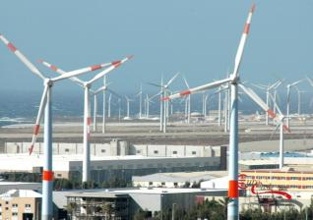
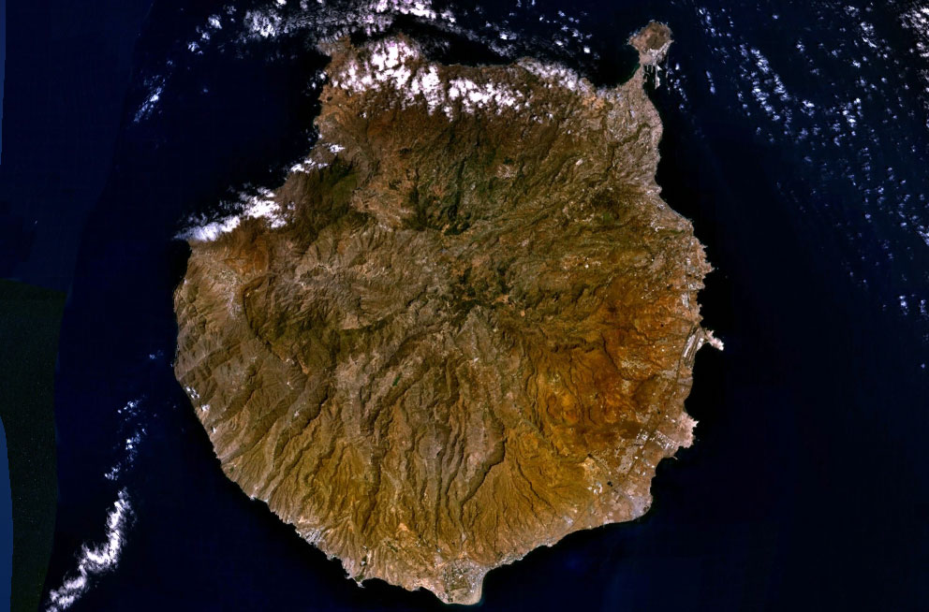
Motivation
Wind farm energy
Air quality
Notes:
Decimos que un tetraedro es de Tipo I si está marcado con el indicador de error. Se introducen 6 nuevos nodos en el punto medio de sus aristas y se subdividen cada una de sus cuatro caras en 4 triángulos, uniendo los puntos que se han introducido.
Cuatro subtetraedros quedan determinados a partir de los cuatro vértices del tetraedro original y las nuevas aristas.
Los otros cuatro tetraedros se obtienen al unir los dos vértices opuestos más cercanos del octaedro que resulta en el interior. Estudios de Löhner y Baum aseguran que esta elección produce el menor número de tetraedros distorsionados en la malla refinada. Existen otras dos opciones para subdividir el octaedro, y se podría analizar la calidad de las divisiones, pero aumentaría el coste computacional del algoritmo.
Una vez marcados los tetraedros de Tipo I, para asegurar la conformidad de la malla nos podemos encontrar con tetraedros vecinos que pueden tener 6, 5,..., 1, ó 0 nuevos nodos introducidos.
Aquellos tetraedros que por razones de conformidad tengan marcadas sus 6 aristas pasa automáticamente al conjunto de tetraedros de Tipo I.

Slide 5
The Local Scale Wind Field Model

Slide 6
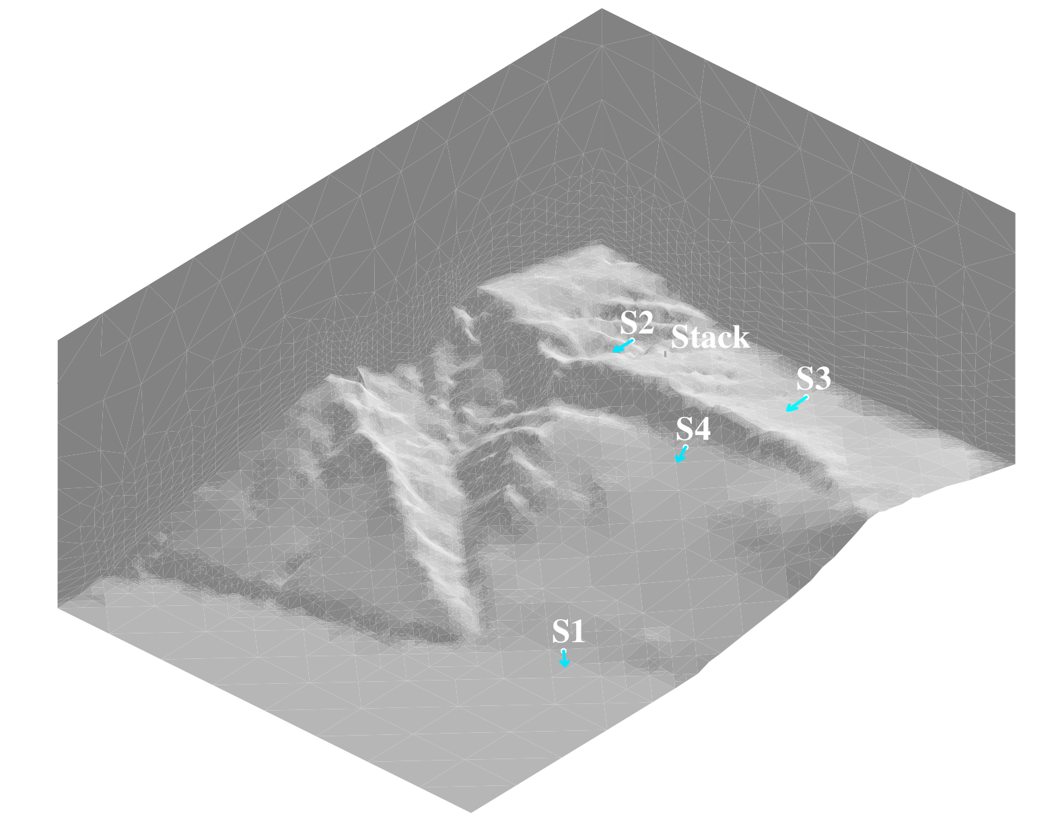
Mass Consistent Wind Model
Problem description
Experimental data from 4 stations (10 m over terrain)

Slide 7
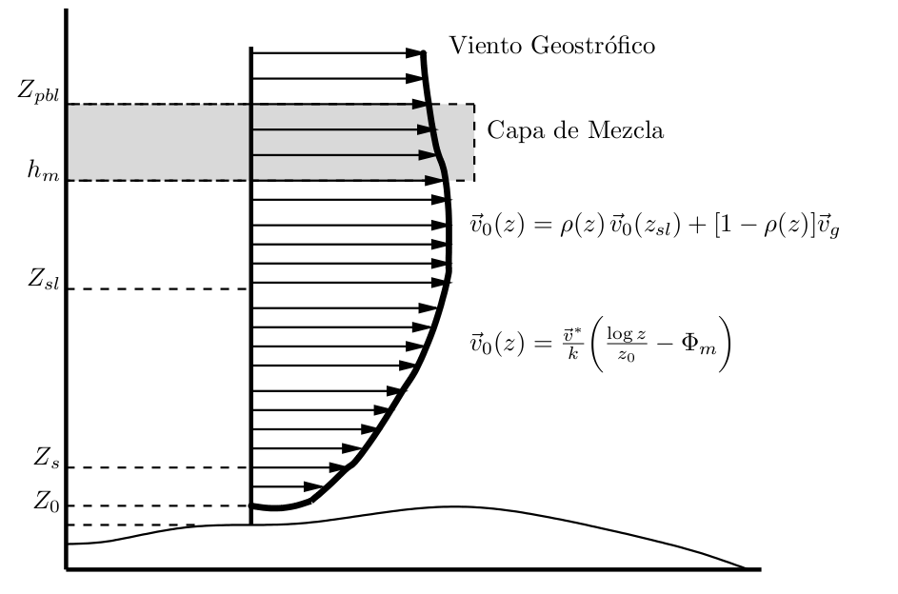
Mass Consistent Wind Model
Construction of the observed wind
Vertical extrapolation (log-linear wind profile)
geostrophic wind
mixing layer
terrain surface

Slide 8
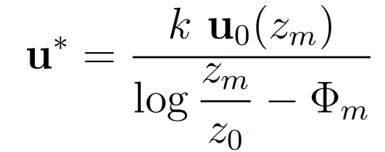
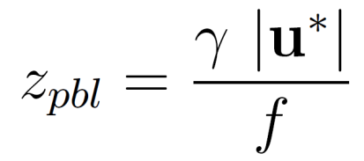
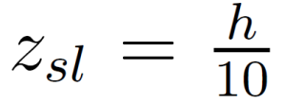
Mass Consistent Wind Model
Construction of the observed wind
● Friction velocity:
● Height of the planetary boundary layer:
is the Coriolis parameter, being
the Earth rotation and
is the latitude
is a parameter depending on the atmospheric stability
● Mixing height:
in neutral and unstable conditions
in stable conditions
● Height of the surface layer:

Slide 9
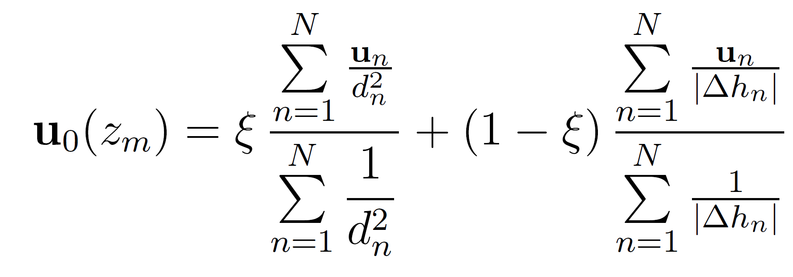
Mass Consistent Wind Model
Construction of the observed wind
Horizontal interpolation

Slide 10
Mass Consistent Wind Model
Mathematical aspects
Mass-consistent model
Lagrange multiplier

Slide 11
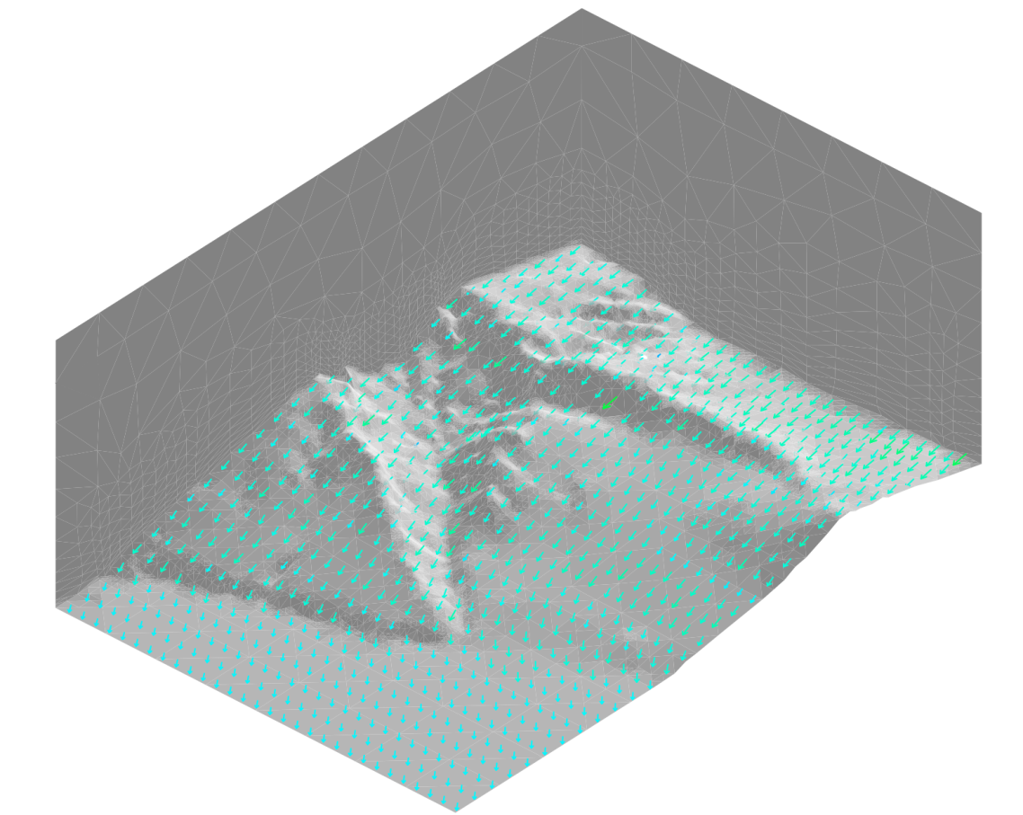
Mass Consistent Wind Model
Construction of the observed wind
Interpolated
Resulting
20 m

Slide 12
Coupling with HARMONIE

Slide 13
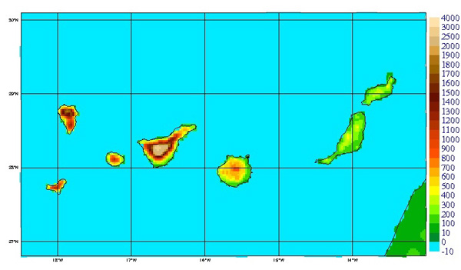
HARMONIE-FEM Wind Forecast
HARMONIE model
Non-hydrostatic meteorological model
From large scale to 1km or less scale (under developed)
Different models in different scales
Assimilation data system
Run by AEMET daily
24 hours simulation data
HARMONIE on Canary islands
(http://www.aemet.es/ca/idi/prediccion/prediccion_numerica)

Slide 14
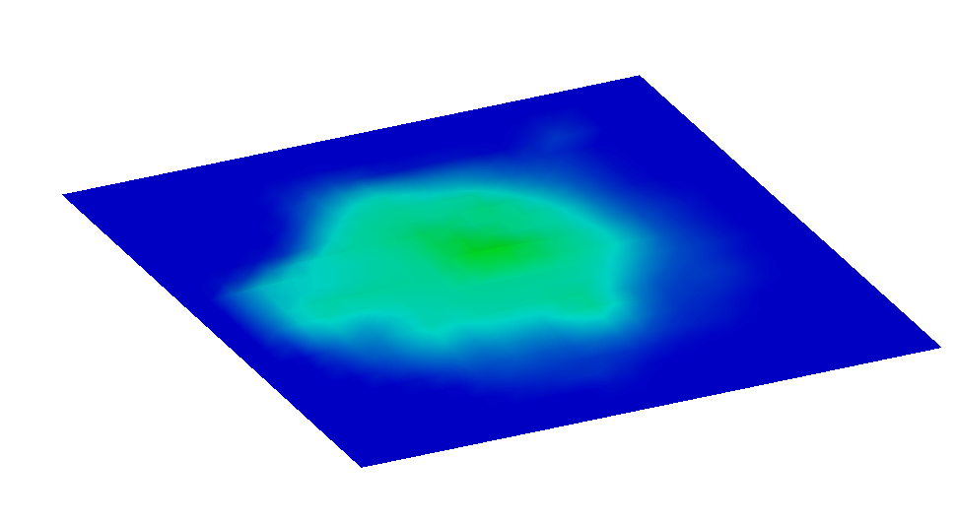
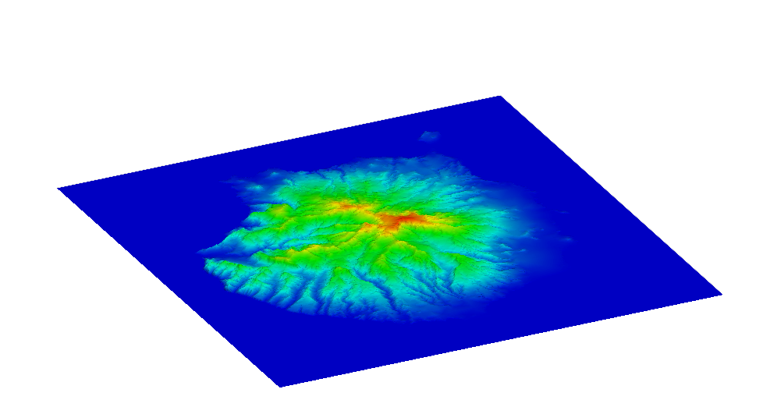
HARMONIE-FEM wind forecast
Terrain approximation
Max height 925m
Max height 1950m
HARMONIE discretization of terrain
Topography from Digital Terrain Model
Terrain elevation (m)
Notes:
Here we can appreciate the big difference between the terrain used by HARMONIE, and the real one

Slide 15
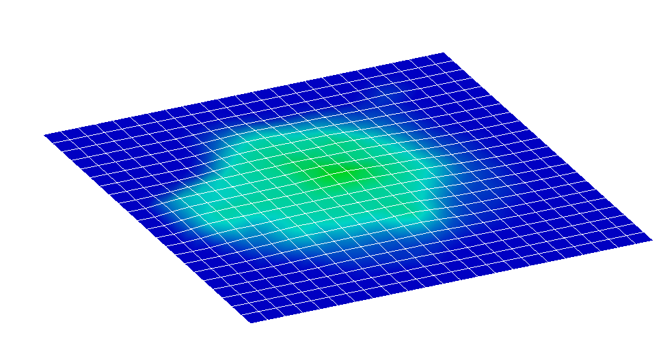
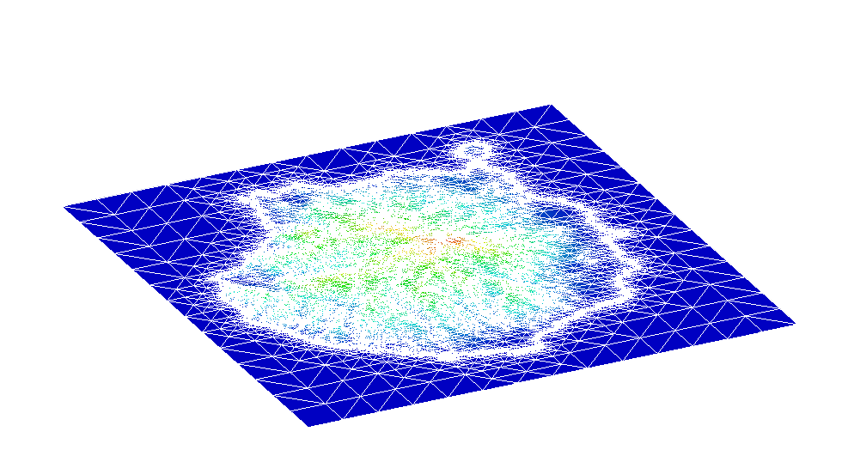
HARMONIE-FEM wind forecast
Spatial discretization
HARMONIE mesh
Δh ~ 2.5km
FEM computational mesh
Terrain elevation (m)
Notes:
There’s also a big difference in the discretization of the problem. In FEM it’s possible to capture the details of the orography

Slide 16
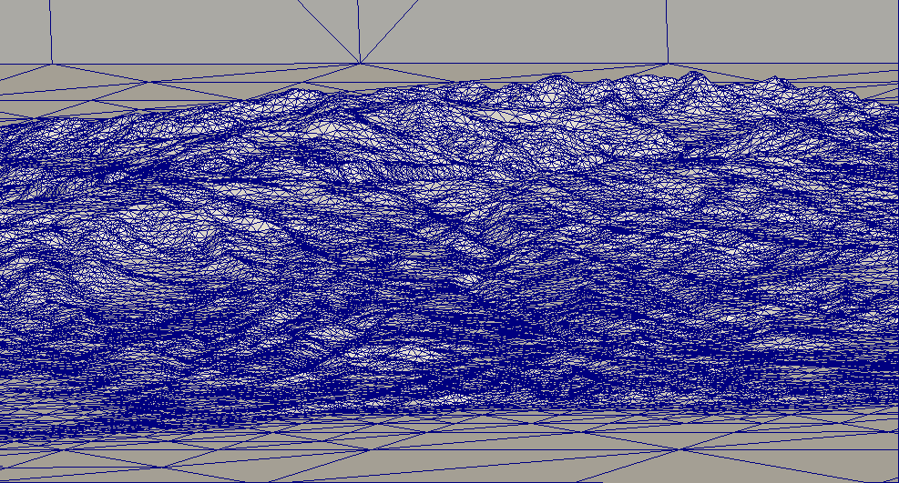
HARMONIE-FEM wind forecast
Terrain approximation
Notes:
Here we can appreciate the big difference between the terrain used by HARMONIE, and the real one

Slide 17
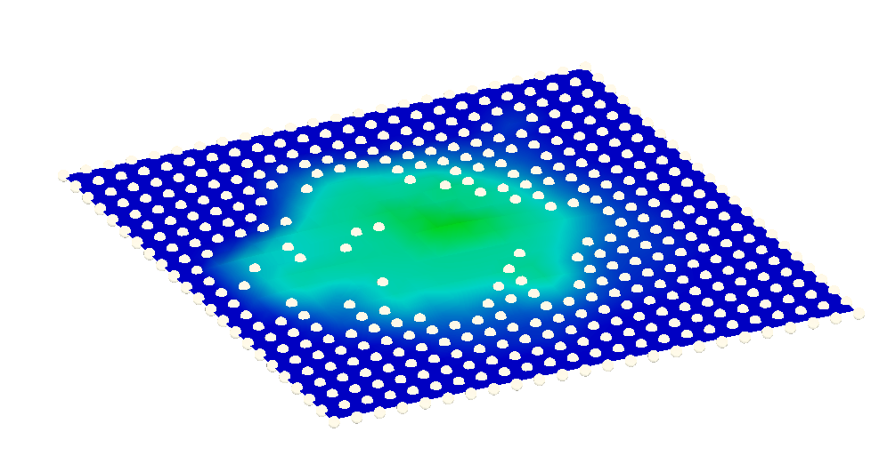
HARMONIE-FEM wind forecast
HARMONIE data
U₁₀ V₁₀ horizontal velocities
Geostrophic wind = (27.3, -3.9)
Used data (Δh < 100m)
Notes:
In order to compute our wind field we have to use some data from HARMONIE i.e. U10 V10, the Geostrophic velocity, and the Pasquill stability class

Slide 18
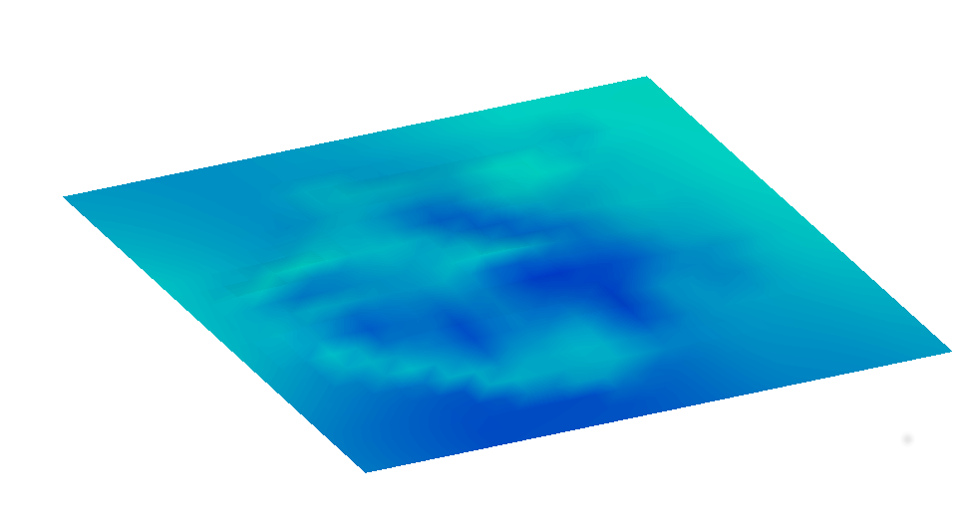
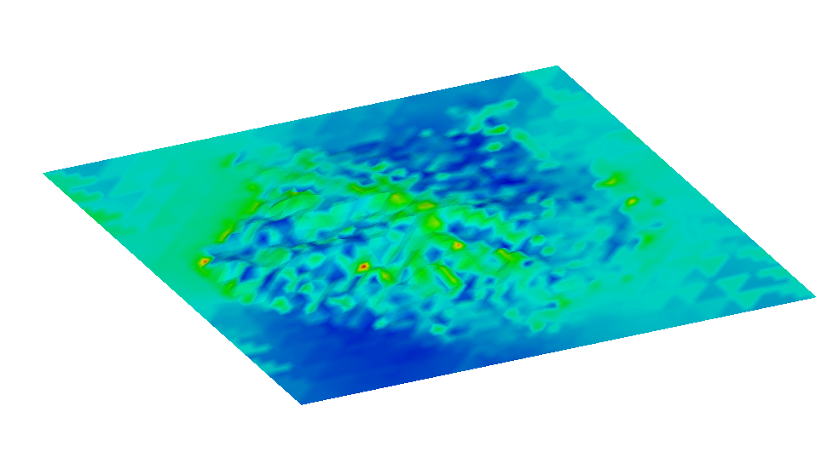
HARMONIE-FEM wind forecast
Wind magnitude at 10m over terrain
HARMONIE wind
FEM wind
Wind velocity (m/s)
Notes:
We can compare the wind velocities obtained at 10m over the terrain with the ones that were given by HARMONIE. We can see that, more or less, the big picture stands, but at the crest line the wind velocity is clearly higher. Max velocity in HARMONIE is 3m/s vs 11.5 in mass consistent

Slide 19
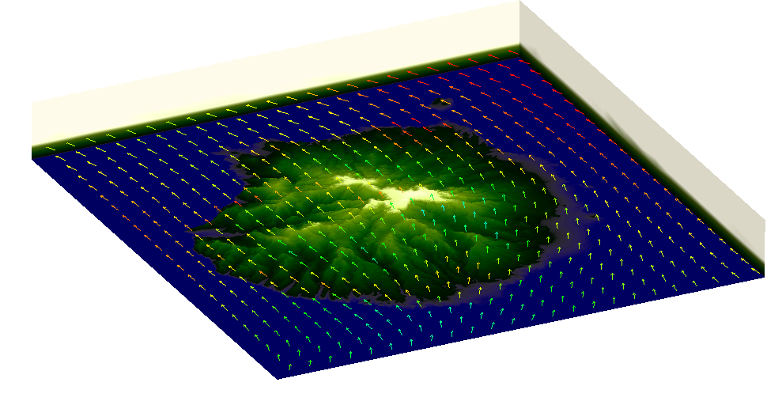
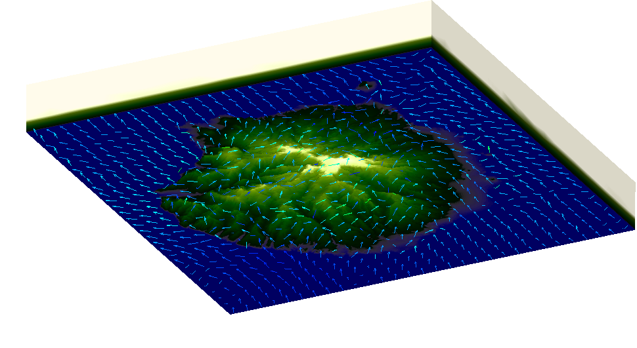
HARMONIE-FEM wind forecast
Wind field at 10m over terrain
HARMONIE wind
FEM wind
Wind velocity (m/s)
Notes:
Here we can compare the direction of the field. We have to note that HARMONIE doesn’t “see” the island, and the wind field just crosses it. In the FEM solution we can see the way that the island has an effect to the field, while maintaining its S-N principal direction. Although the field in the island looks mess, we zoom it and can see…

Slide 20
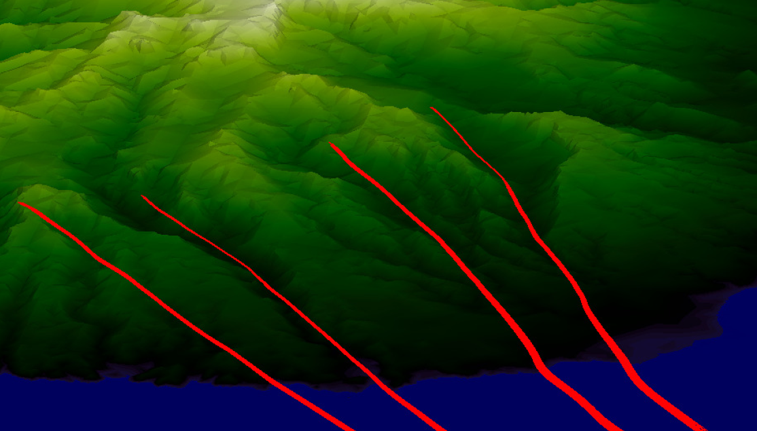
HARMONIE-FEM wind forecast
Wind field over terrain (detail of streamlines)
Zoom
Notes:
And, looking at both wind fields overlapped we can see how similar they are.

Slide 21
Calibration

Slide 22
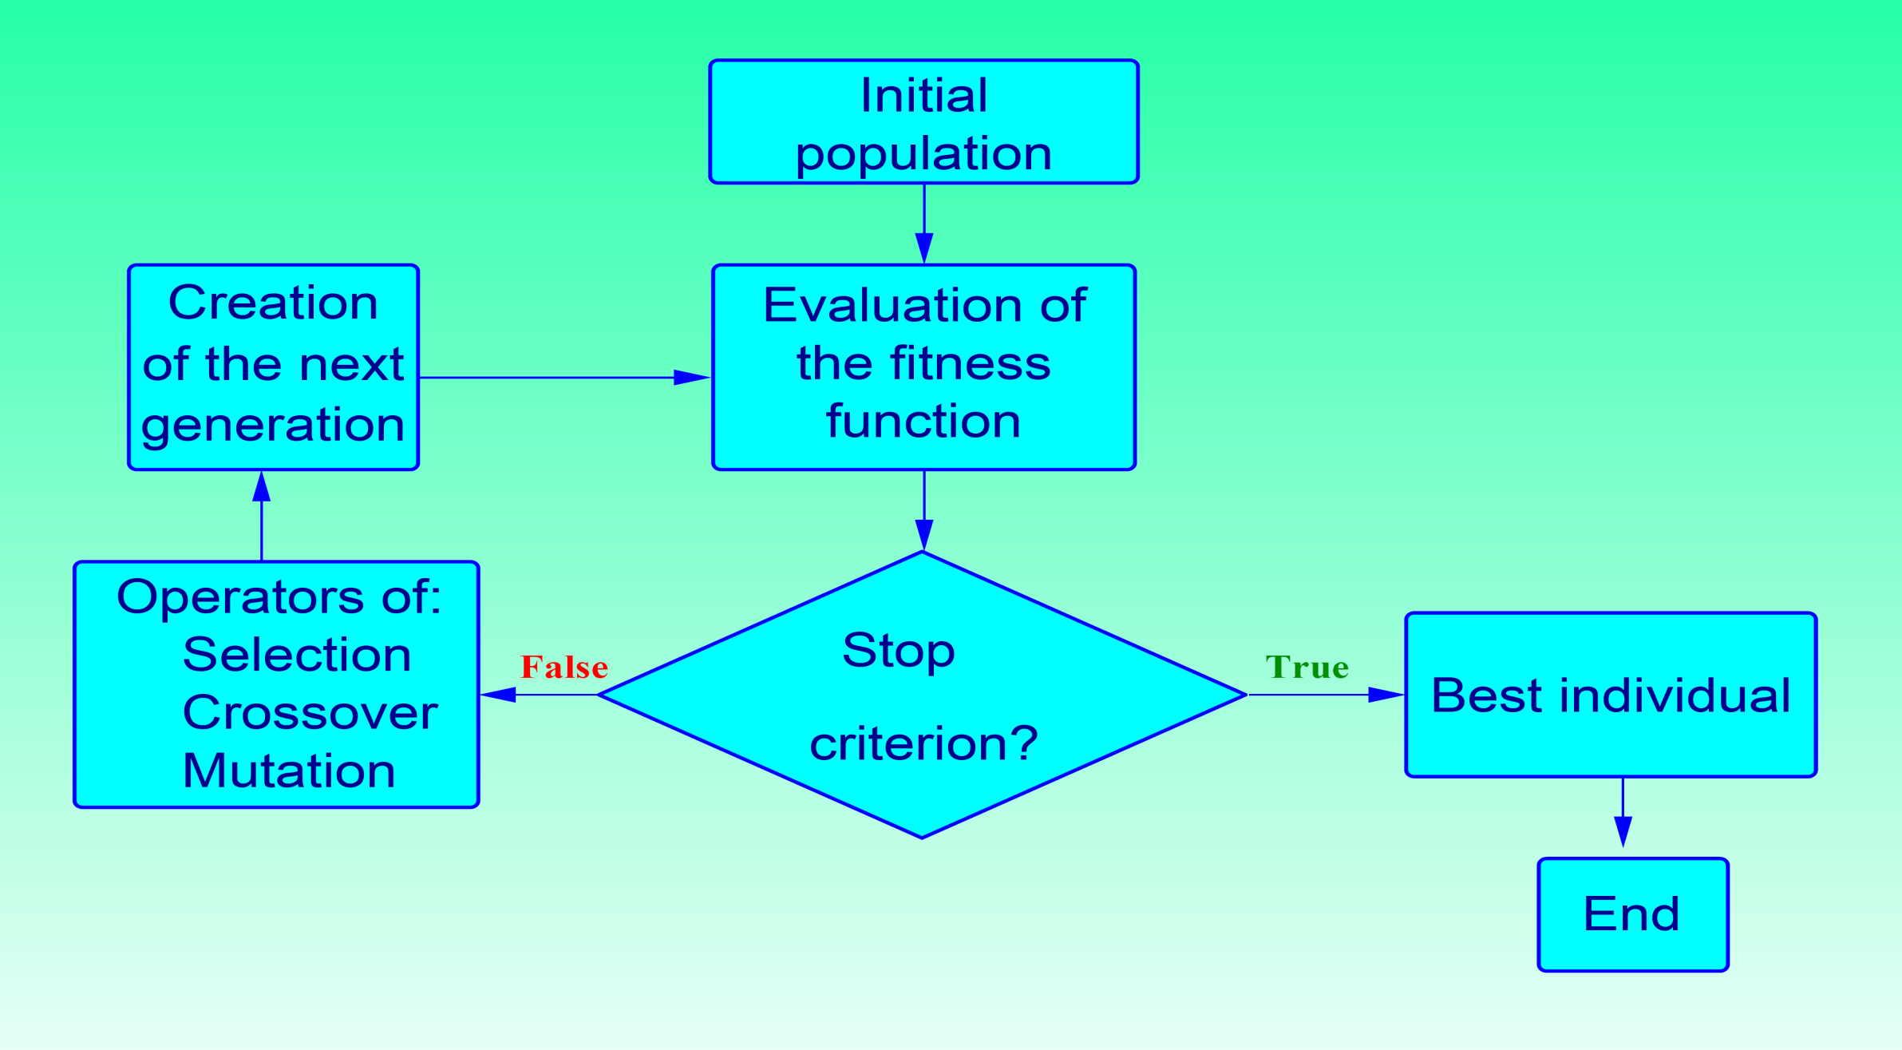
Estimation of Model Parameters
Genetic Algorithm
FE solution
is needed
for each individual

Slide 23
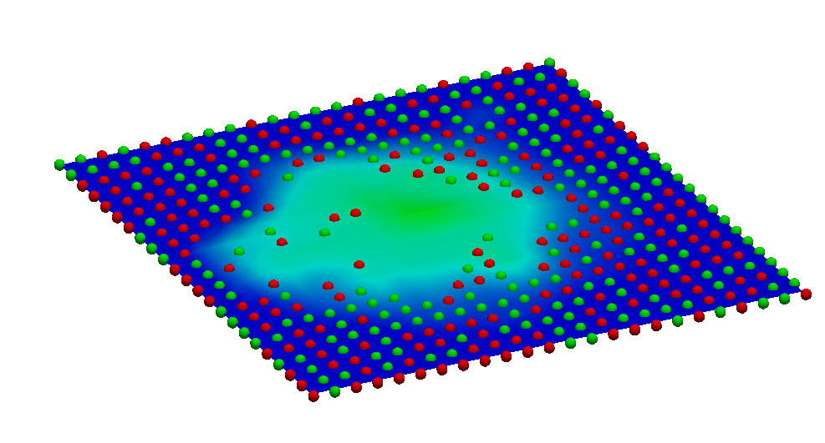
HARMONIE-FEM wind forecast
Stations election
Stations
Control points
Stations and control points
Notes:
The other 2/3rds are used as known data, and control data for genetic algorithm

Slide 24
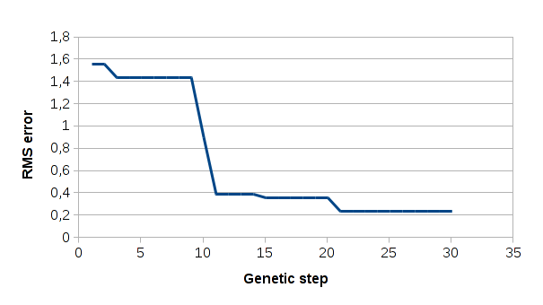
HARMONIE-FEM wind forecast
Genetic algorithm results
Optimal parameter values
Alpha = 2.302731
Epsilon = 0.938761
Gamma = 0.279533
Gamma‘ = 0.432957
Notes:
We run the genetic algorithm and after 30 iterations with an initial population of 124 individuals, we get the following parameters, with the RMS error seen in plot

Slide 25
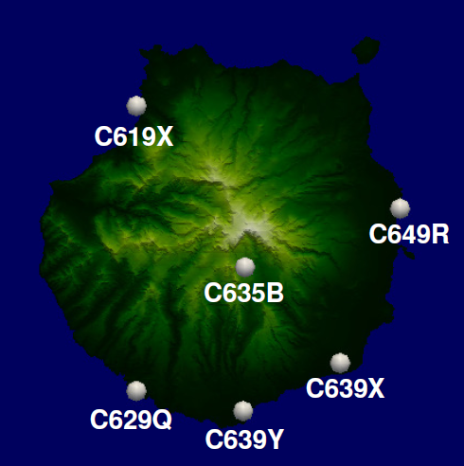
HARMONIE-FEM wind forecast
Forecast wind validation (location of measurement stations)
Notes:
Finally with this strategy, we can run all the timesteps given by HARMONIE, and we get the forecasting wind at any point.

Slide 26
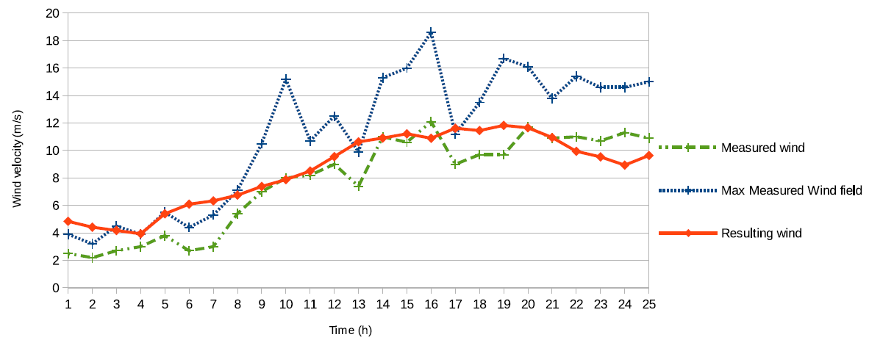
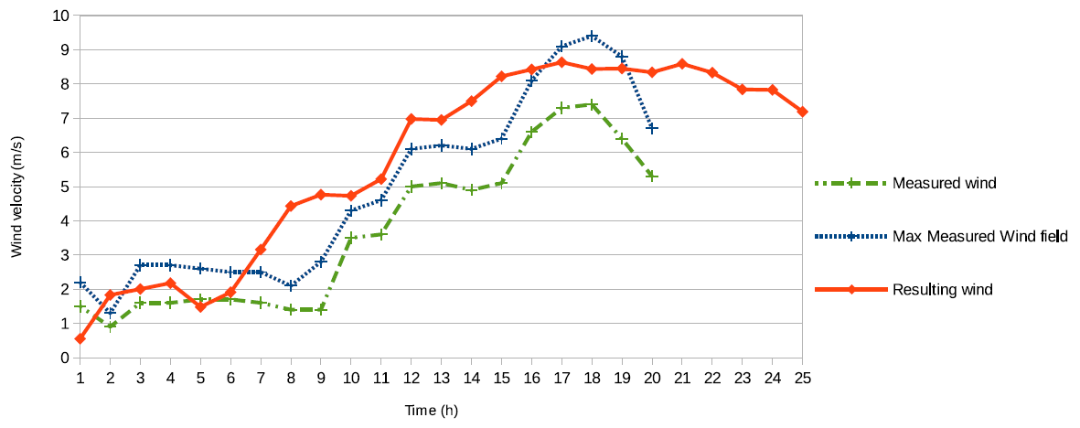
HARMONIE-FEM wind forecast
Forecast wind along a day
Notes:
Finally with this strategy, we can run all the timesteps given by HARMONIE, and we get the forecasting wind at any point.

Slide 27
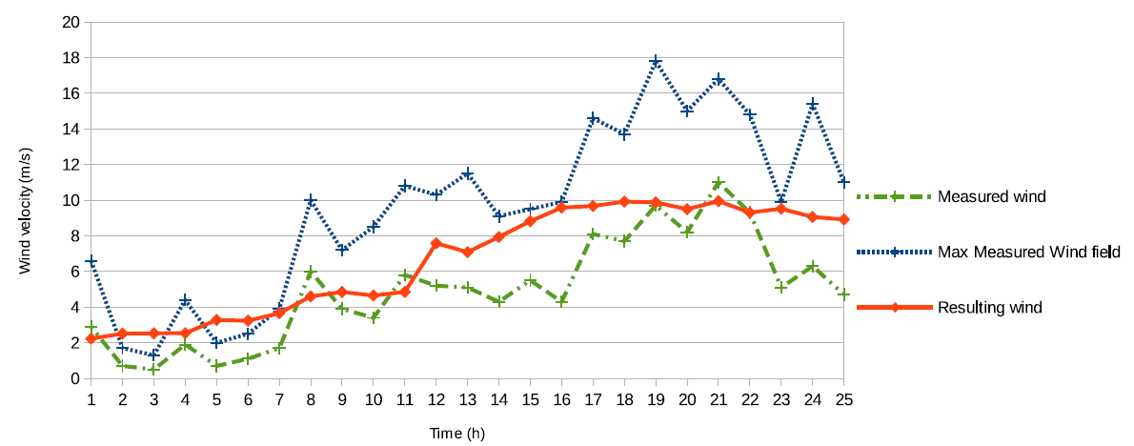
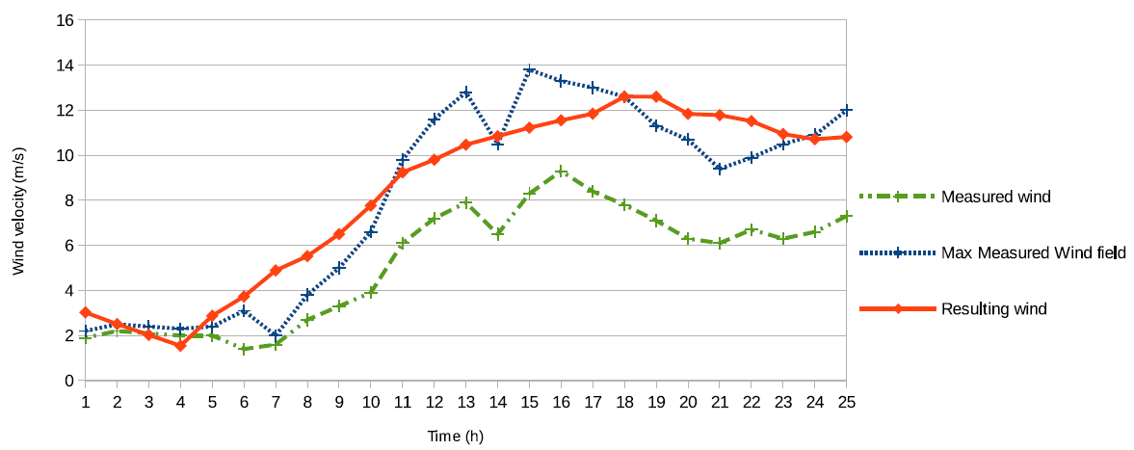
HARMONIE-FEM wind forecast
Forecast wind along a day
Notes:
Finally with this strategy, we can run all the timesteps given by HARMONIE, and we get the forecasting wind at any point.

Slide 28
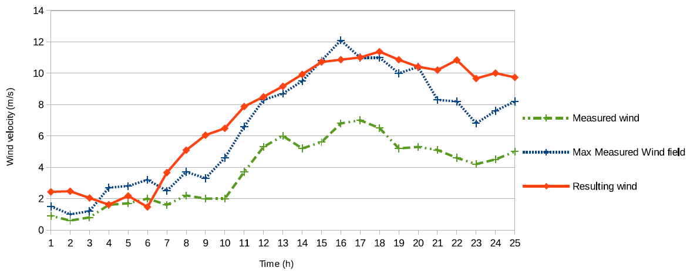
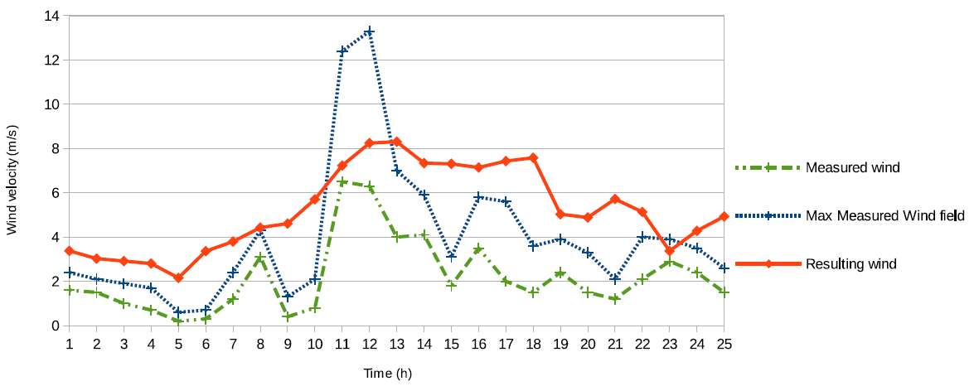
HARMONIE-FEM wind forecast
Forecast wind along a day
Notes:
Finally with this strategy, we can run all the timesteps given by HARMONIE, and we get the forecasting wind at any point.

Slide 29
Ensemble method

Slide 30
Ensemble methods
Stations election
Stations
Control points
Stations (1/3) and control points (1/3)
Notes:
The other 2/3rds are used as known data, and control data for genetic algorithm

Slide 31
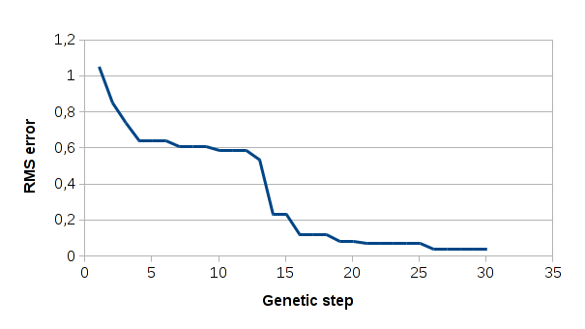
Ensemble methods
New
Alpha = 2.057920
Epsilon = 0.950898
Gamma = 0.224911
Gamma' = 0.311286
Previous
Alpha = 2.302731
Epsilon = 0.938761
Gamma = 0.279533
Gamma' = 0.432957
Small changes

Slide 32
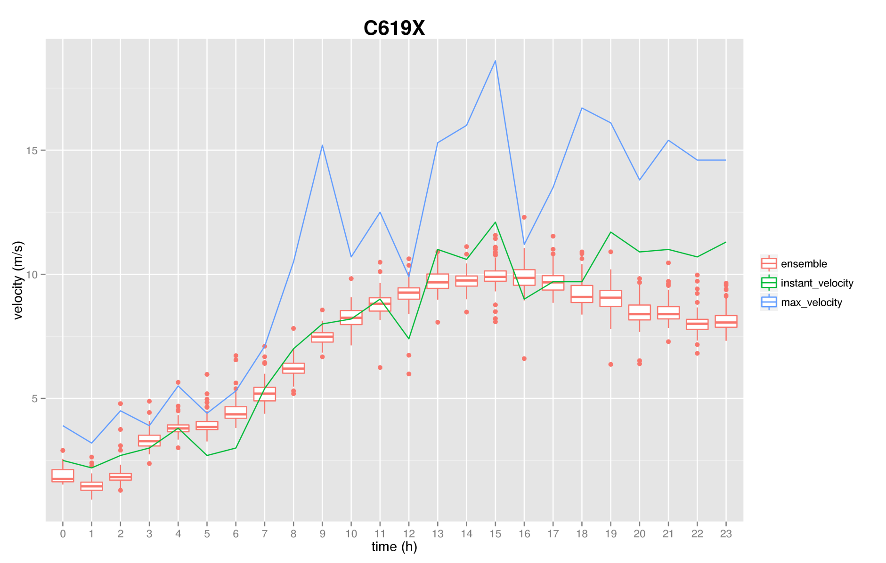
Ensemble mthods
Ensemble forecast wind along a day
Notes:
Finally with this strategy, we can run all the timesteps given by HARMONIE, and we get the forecasting wind at any point.

Slide 33
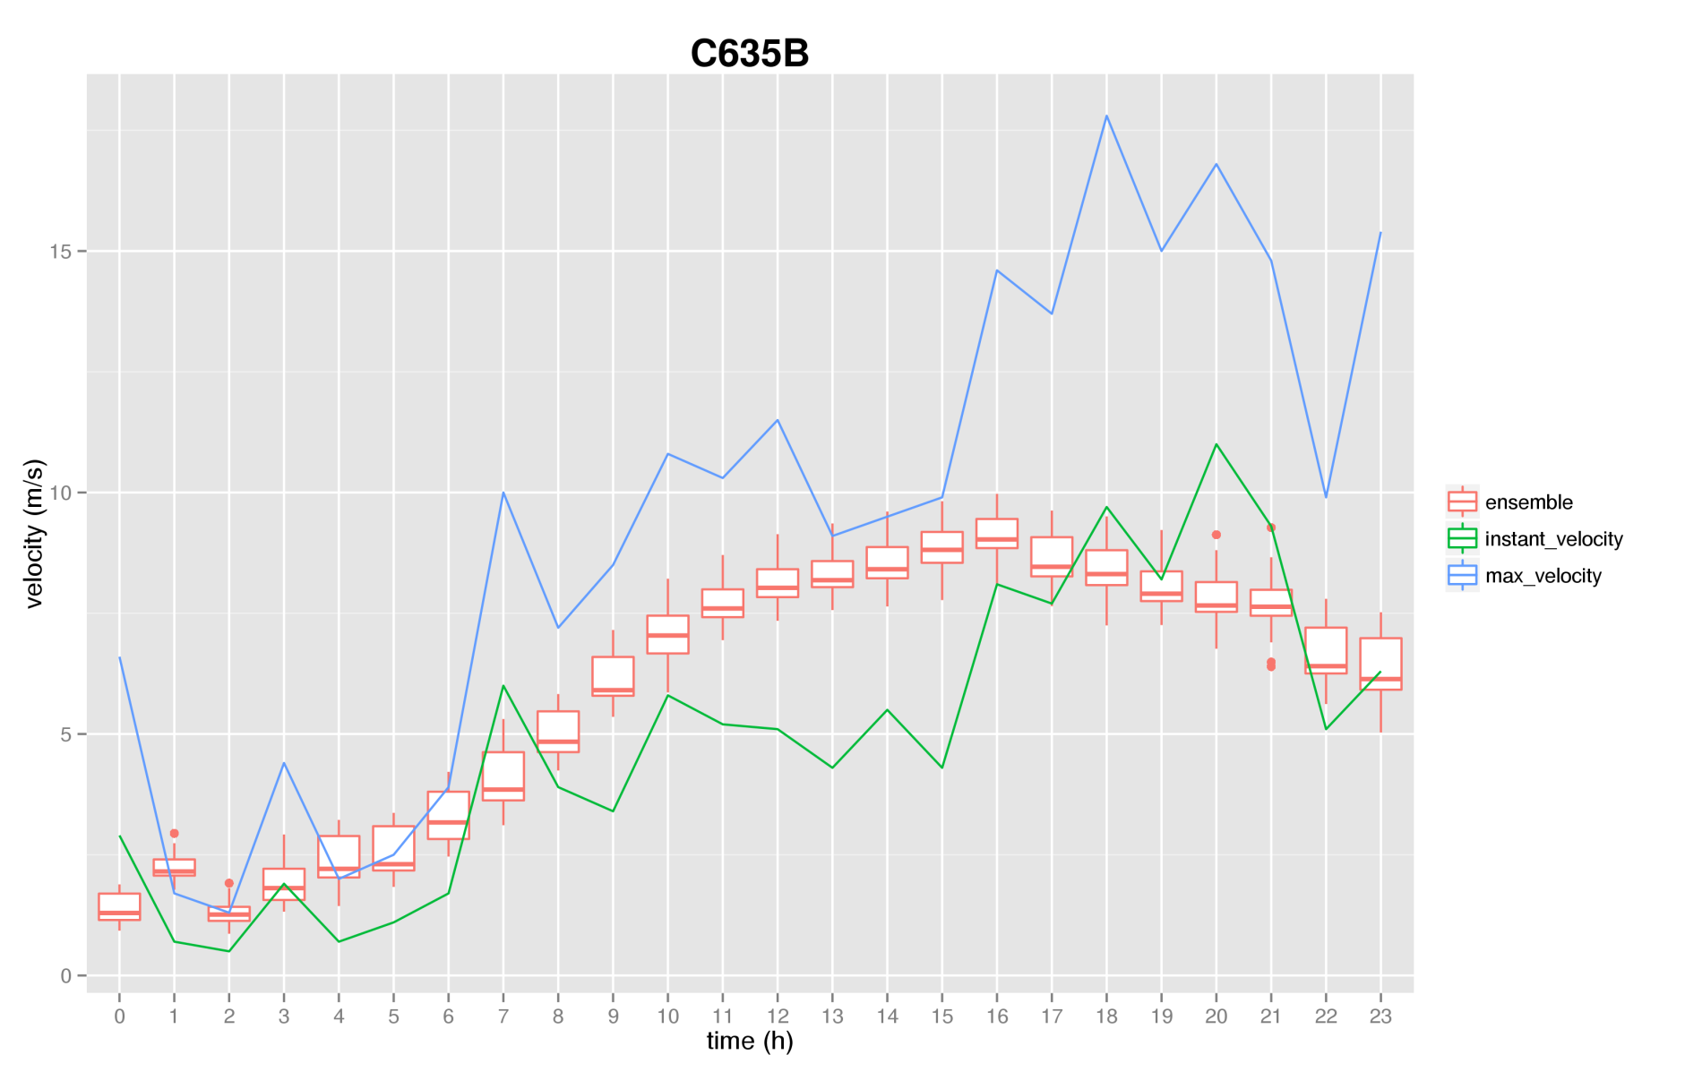
Ensemble mthods
Ensemble forecast wind along a day
Notes:
Finally with this strategy, we can run all the timesteps given by HARMONIE, and we get the forecasting wind at any point.

Slide 34
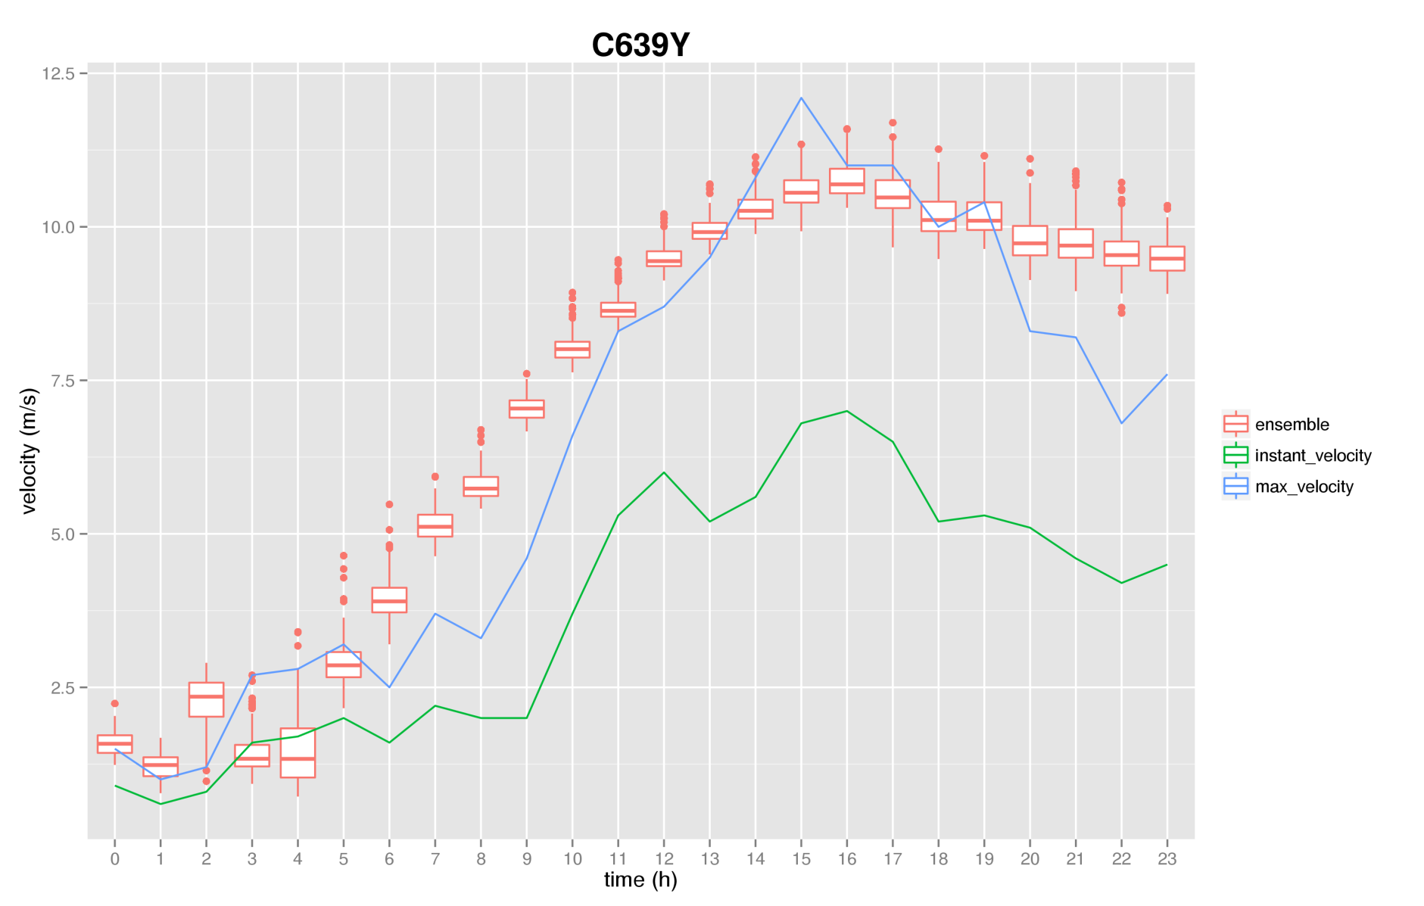
Ensemble mthods
Ensemble forecast wind along a day
Notes:
Finally with this strategy, we can run all the timesteps given by HARMONIE, and we get the forecasting wind at any point.

Slide 35
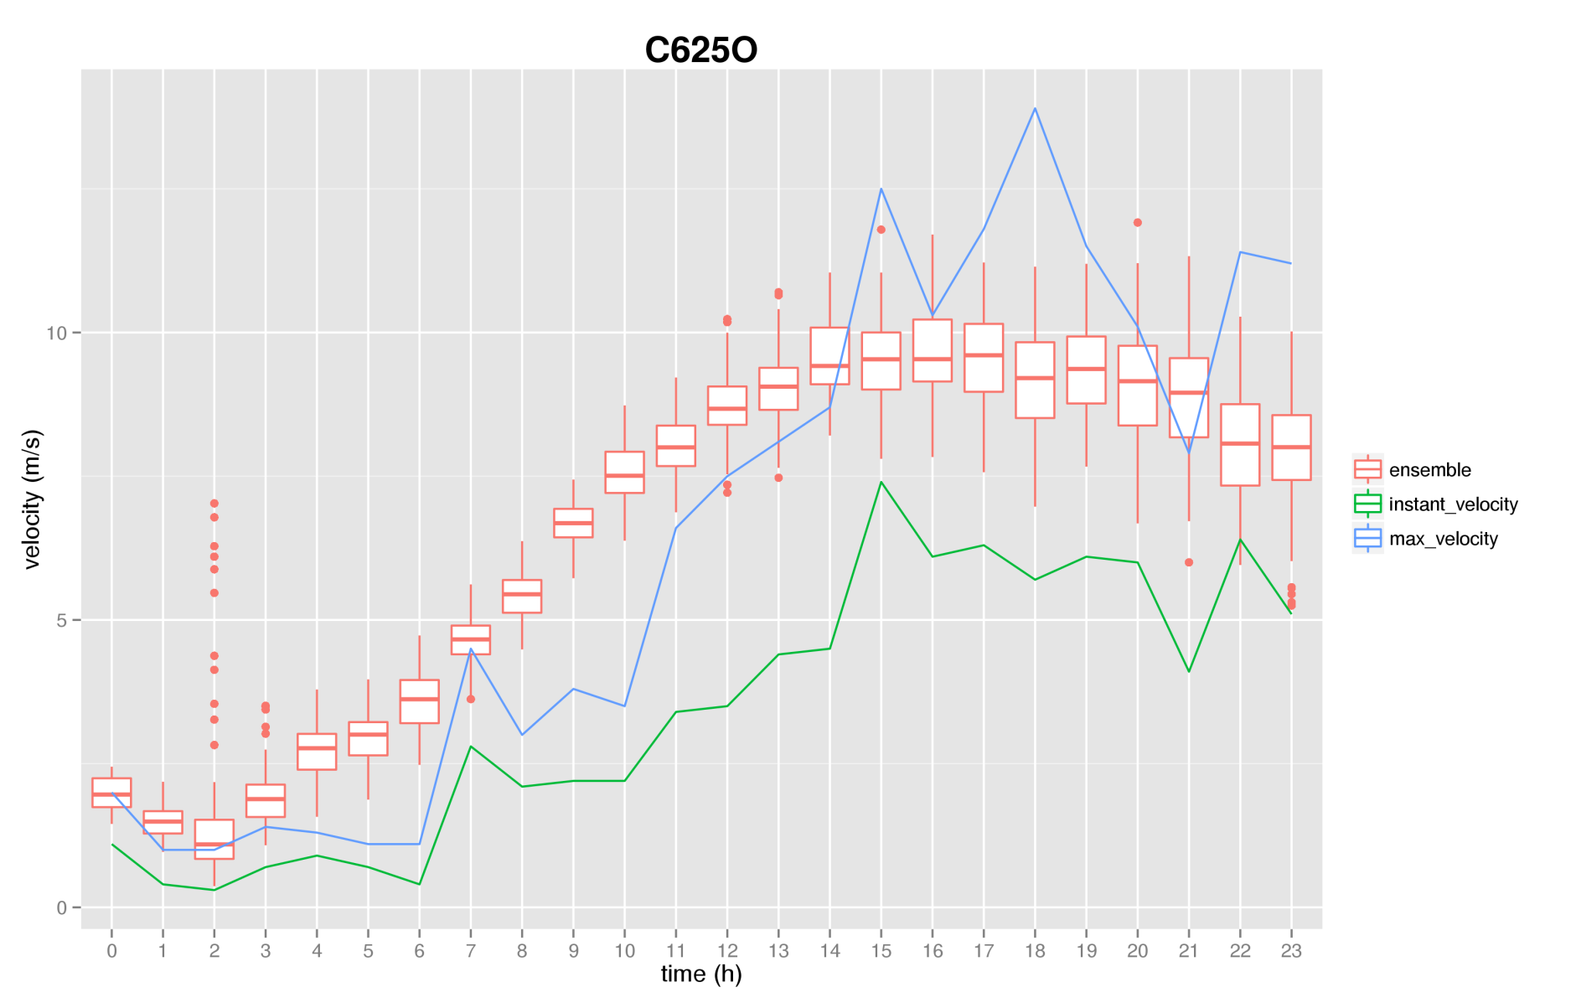
Ensemble mthods
Ensemble forecast wind along a day
Notes:
Finally with this strategy, we can run all the timesteps given by HARMONIE, and we get the forecasting wind at any point.

Slide 36
Conclusions

Slide 37
Conclusions
Local Scale wind field model is suitable for complex orographies http://www.dca.iusiani.ulpgc.es/Wind3D
Local wind field in conjunction with HARMONIE is valid to forecast wind velocities A. Oliver, E. Rodríguez, J. M. Escobar, G. Montero, M. Hortal, J. Calvo, J. M. Cascón, and R. Montenegro. “Wind Forecasting Based on the HARMONIE Model and Adaptive Finite Elements.” Pure Appl. Geophys. (Online). doi:10.1007/s00024-014-0913-9.
The proposed method is a work in progress that looks promising
Ensemble methods provide a promising framework to deal with uncertainties

Slide 38
Thank you for your attention

