Slide 1
Desarrollo de un método ensemble para la predicción del viento a escala local usando elementos finitos
A. Oliver, E. Rodríguez, R. Montenegro, G. Montero
CMN - 2015
June 29 – July 2, 2015, Lisbon, Portugal
MINECO
PROGRAMA ESTATAL DE I+D+I ORIENTADA A LOS RETOS DE LA SOCIEDAD
Project: CTM2014-55014-C3-1-R
http://www.dca.iusiani.ulpgc.es/Wind3D

Slide 2
Contents
Ensemble Wind Forecasting Based on the HARMONIE Model and
Adaptive Finite Elements in Complex Orography
Local scale wind field model
Coupling with HARMONIE meso-scale model
Ensemble method
Numerical experiments
Conclusions
Notes:
Decimos que un tetraedro es de Tipo I si está marcado con el indicador de error. Se introducen 6 nuevos nodos en el punto medio de sus aristas y se subdividen cada una de sus cuatro caras en 4 triángulos, uniendo los puntos que se han introducido.
Cuatro subtetraedros quedan determinados a partir de los cuatro vértices del tetraedro original y las nuevas aristas.
Los otros cuatro tetraedros se obtienen al unir los dos vértices opuestos más cercanos del octaedro que resulta en el interior. Estudios de Löhner y Baum aseguran que esta elección produce el menor número de tetraedros distorsionados en la malla refinada. Existen otras dos opciones para subdividir el octaedro, y se podría analizar la calidad de las divisiones, pero aumentaría el coste computacional del algoritmo.
Una vez marcados los tetraedros de Tipo I, para asegurar la conformidad de la malla nos podemos encontrar con tetraedros vecinos que pueden tener 6, 5,..., 1, ó 0 nuevos nodos introducidos.
Aquellos tetraedros que por razones de conformidad tengan marcadas sus 6 aristas pasa automáticamente al conjunto de tetraedros de Tipo I.

Slide 3



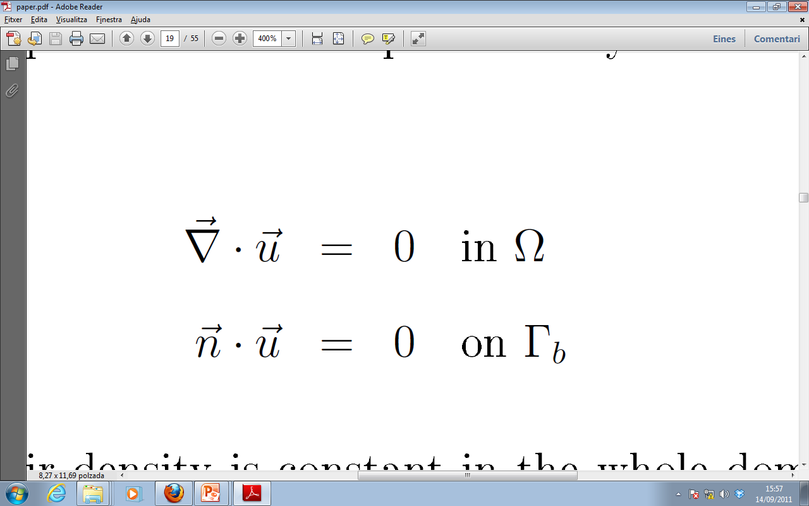
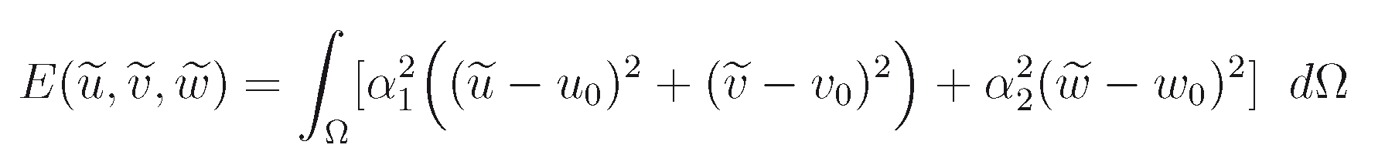
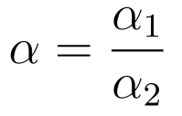
A diagnostic wind model
Governing equations
: observed wind, which is obtained from horizontal interpolation
and vertical extrapolation of experimental or forecasted data
Objective:
Find the velocity field
that adjusts to
verifying
- Incompressibility condition in the domain
- Non flow-through condition on the terrain
Let state the least square problem:

Slide 4
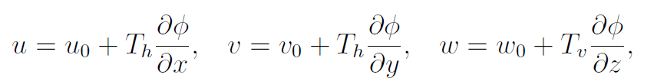
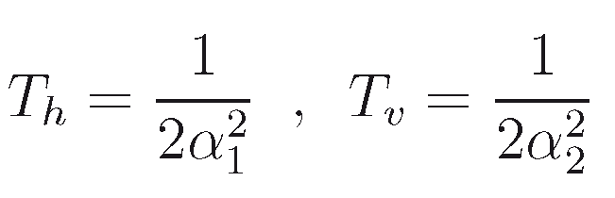
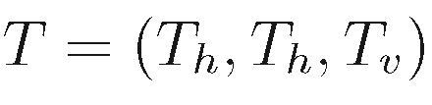
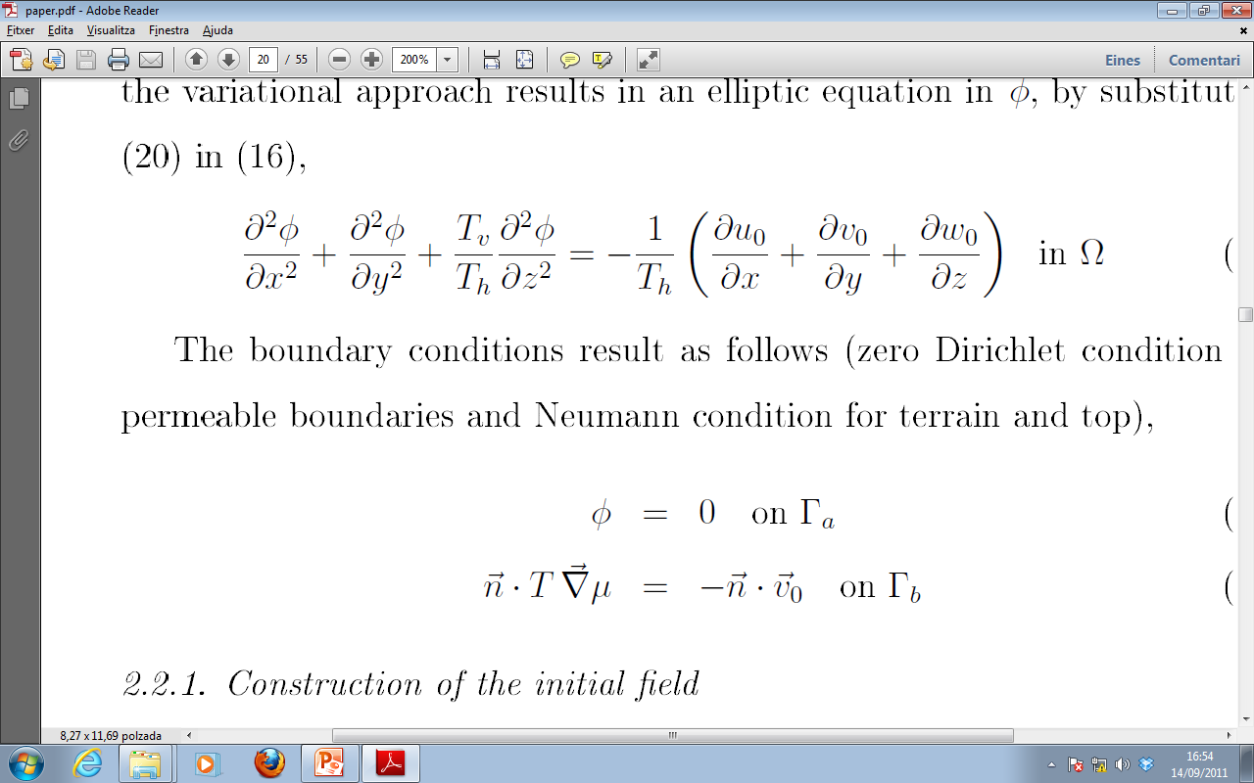
Mass Consistent Wind Model
Mathematical aspects
The solution produces the Euler-Lagrange equations
where
it yields the governing equations,

Slide 5
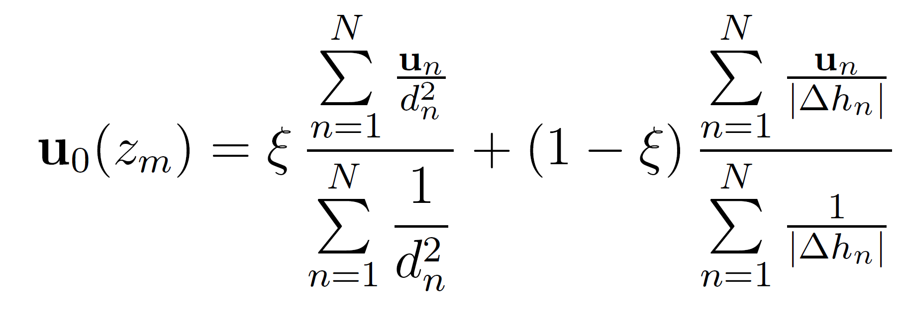

Mass Consistent Wind Model
Construction of the observed wind
Horizontal interpolation

Slide 6
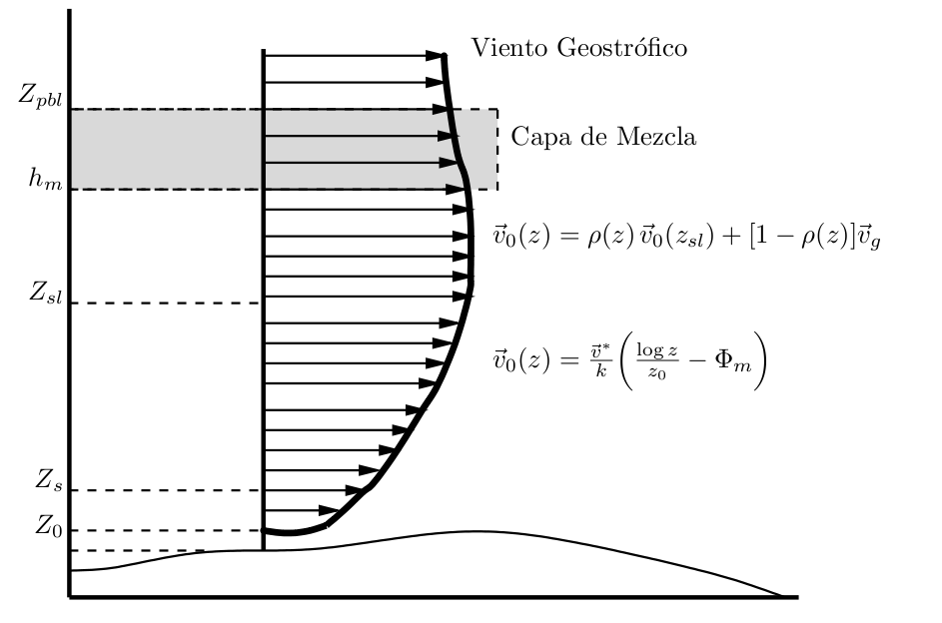






Mass Consistent Wind Model
Construction of the observed wind
  Vertical extrapolation (log-linear wind profile)
geostrophic wind
mixing layer
terrain surface

Slide 7
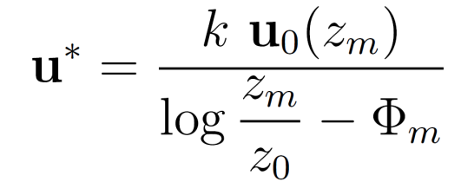
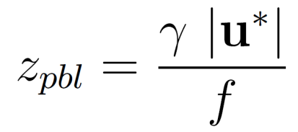





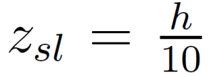
Mass Consistent Wind Model
Construction of the observed wind
● Friction velocity:
● Height of the planetary boundary layer:
is the Coriolis parameter, being
the Earth rotation and
is the latitude
is a parameter depending on the atmospheric stability
● Mixing height:
in neutral and unstable conditions
in stable conditions
● Height of the surface layer:

Slide 8
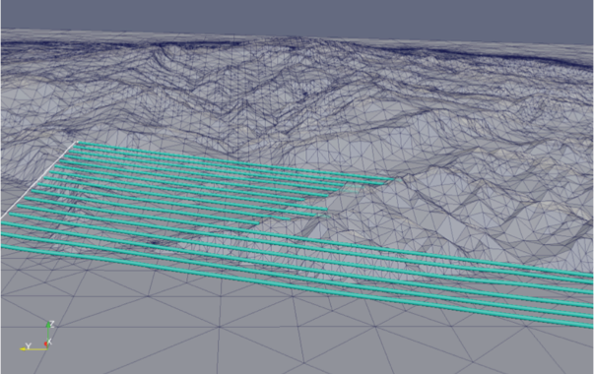
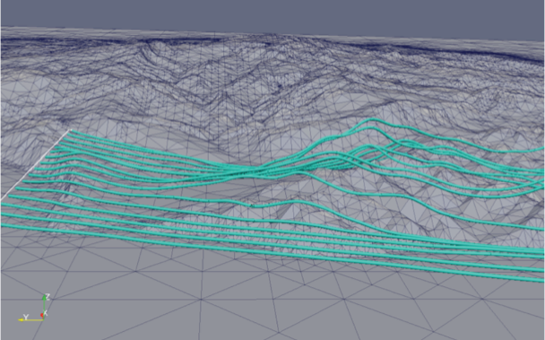
Mass Consistent Wind Model
Interpolated and resulting wind fields
Interpolated wind field
Resulting wind field

Slide 9
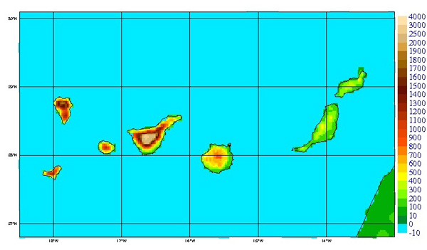
HARMONIE-FEM Wind Forecast
HARMONIE model
Non-hydrostatic meteorological model
From large scale to 1km or less scale (under developed)
Different models in different scales
Assimilation data system
Run by AEMET daily
24 hours simulation data
HARMONIE on Canary islands
(http://www.aemet.es/ca/idi/prediccion/prediccion_numerica)

Slide 10

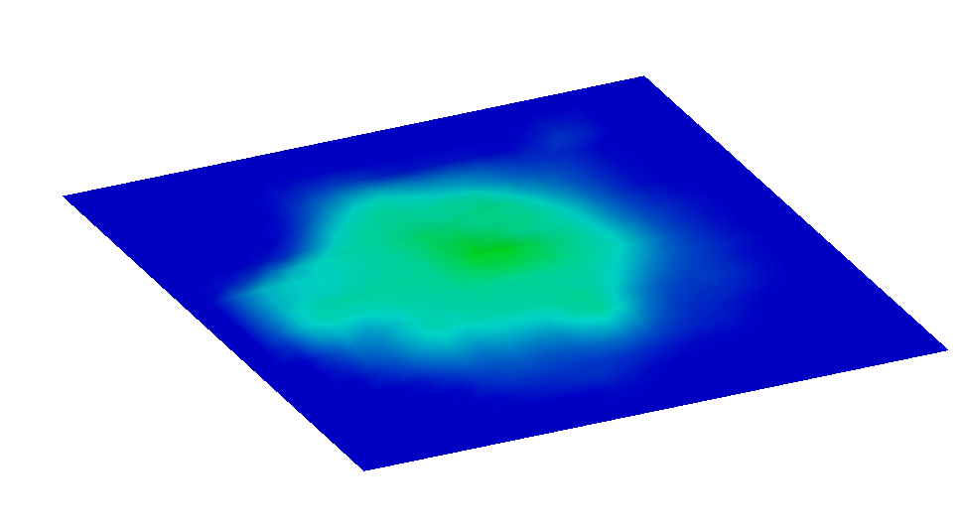
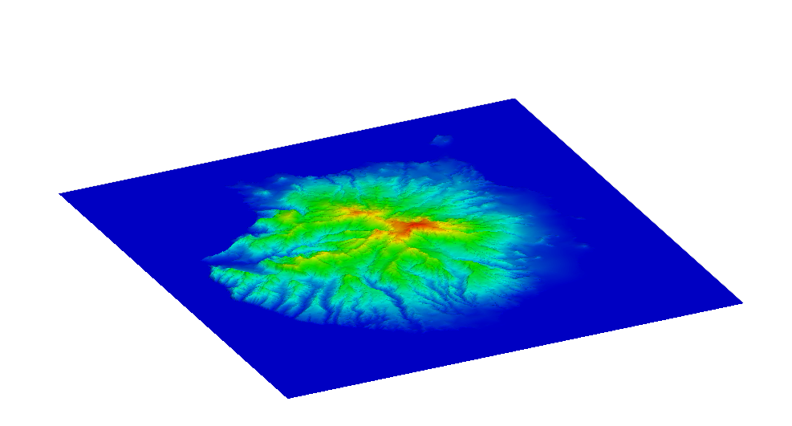
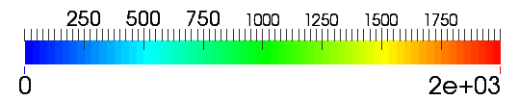
HARMONIE-FEM wind forecast
Terrain approximation
Max height 925m
Max height 1950m
HARMONIE discretization of terrain
Topography from Digital Terrain Model
Terrain elevation (m)
Notes:
Here we can appreciate the big difference between the terrain used by HARMONIE, and the real one

Slide 11
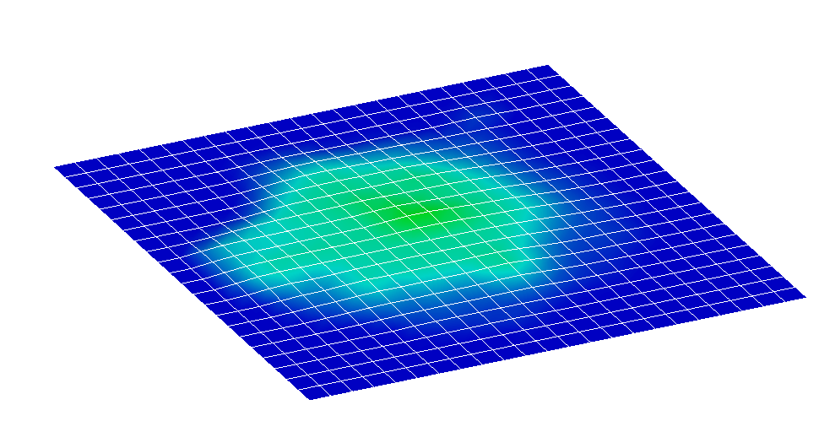
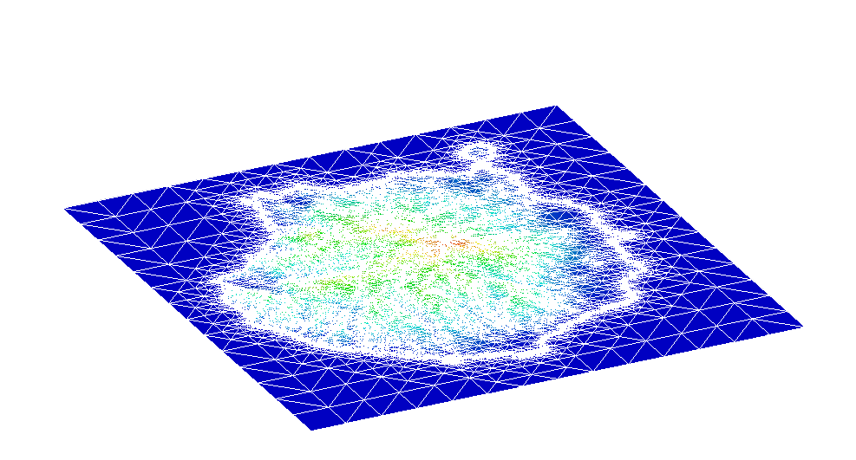
HARMONIE-FEM wind forecast
Spatial discretization
HARMONIE mesh
Δh ~ 2.5km
FEM computational mesh
Terrain elevation (m)
Notes:
There’s also a big difference in the discretization of the problem. In FEM it’s possible to capture the details of the orography

Slide 12
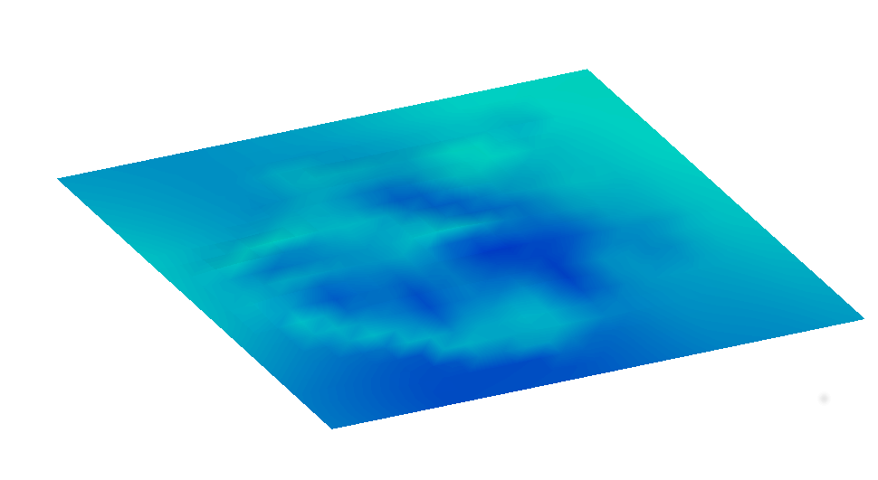
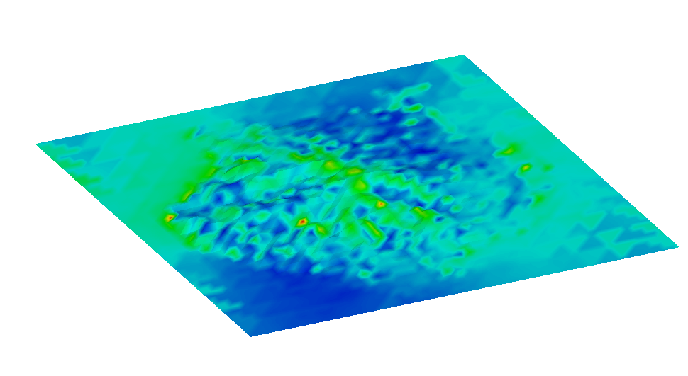
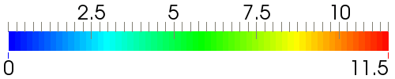
HARMONIE-FEM wind forecast
Wind magnitude at 10m over terrain
HARMONIE wind
FEM wind
Wind velocity (m/s)
Notes:
We can compare the wind velocities obtained at 10m over the terrain with the ones that were given by HARMONIE. We can see that, more or less, the big picture stands, but at the crest line the wind velocity is clearly higher. Max velocity in HARMONIE is 3m/s vs 11.5 in mass consistent

Slide 13

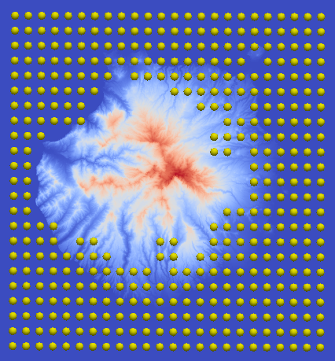
HARMONIE-FEM wind forecast
HARMONIE data
HARMONIE Grid points with U₁₀ V₁₀ horizontal velocities
Used data (Δh < 500m)
Used data (Δh < 100m)
Notes:
In order to compute our wind field we have to use some data from HARMONIE i.e. U10 V10, the Geostrophic velocity, and the Pasquill stability class

Slide 14
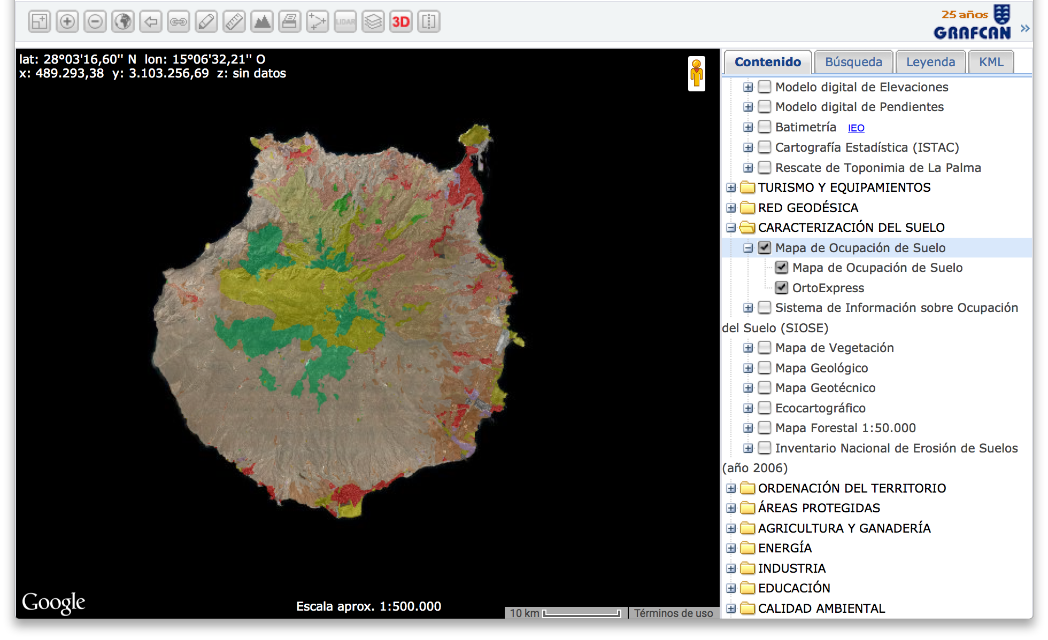
Terrain data
GIS image

Slide 15
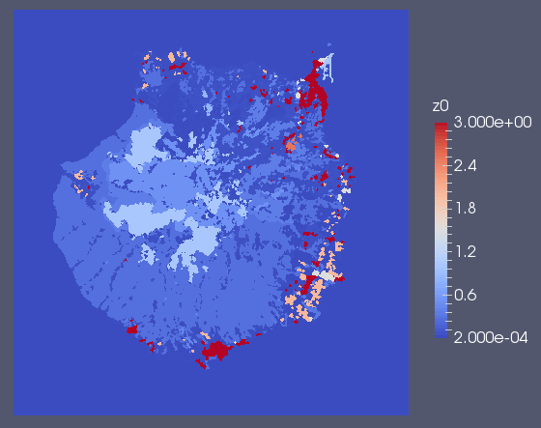
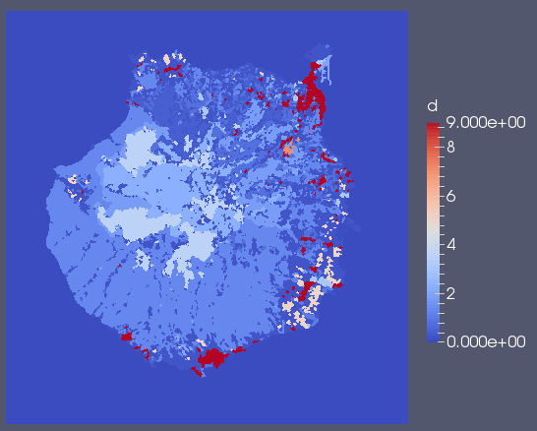
Terrain data
Image segmentation
Roughness length
Obstacles height

Slide 16
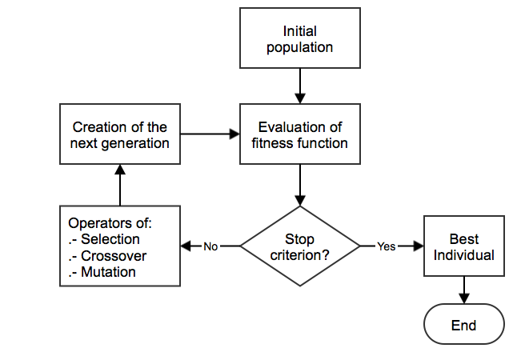
Estimation of Model Parameters
Genetic Algorithm
FE solution
is needed
for each individual

Slide 17
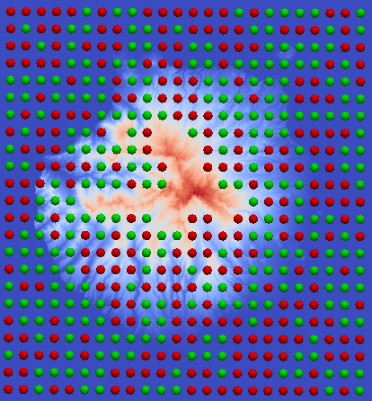
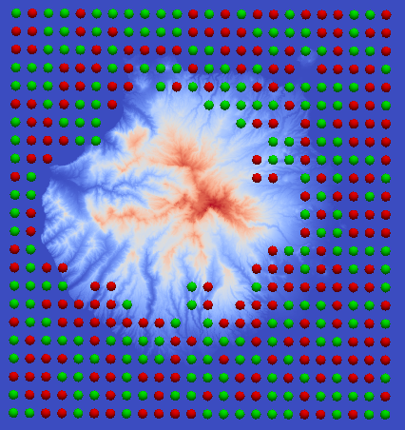


Ensemble methods
Stations election
Stations
Control points
Δh < 500m
Δh < 100m
Number of genetic experiments
% points | Height tolerances
 | Infinite | 500 m | 100 m
100 % | 1 | 1 | 1
50 % | 10 | 10 | 10
33 experiments x 24 hours = 792 genetic experiments
Notes:
The other 2/3rds are used as known data, and control data for genetic algorithm

Slide 18
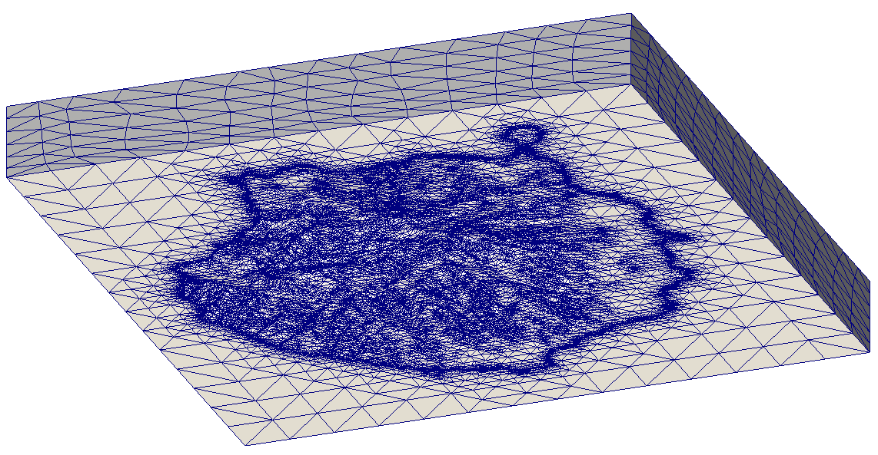
Mass Consistent Wind Model
Problem description
Domain: Gran Canaria Island (60 Km x 60 Km)
Mesh: 84325 nodes, 437261 tetrahedra

Slide 19
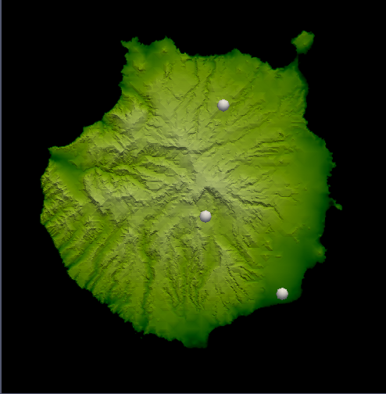
HARMONIE-FEM wind forecast
Location of measurement stations
C656V
C635B
C639X
Notes:
Finally with this strategy, we can run all the timesteps given by HARMONIE, and we get the forecasting wind at any point.

Slide 20
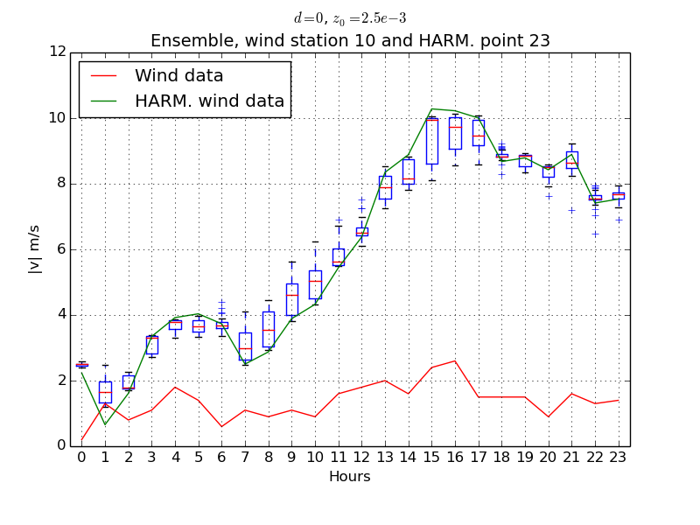
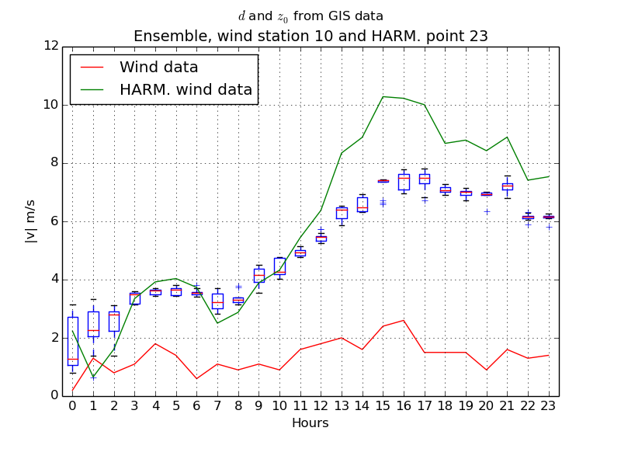
Ensemble methods
Ensemble forecast wind along a day
Notes:
Finally with this strategy, we can run all the timesteps given by HARMONIE, and we get the forecasting wind at any point.

Slide 21
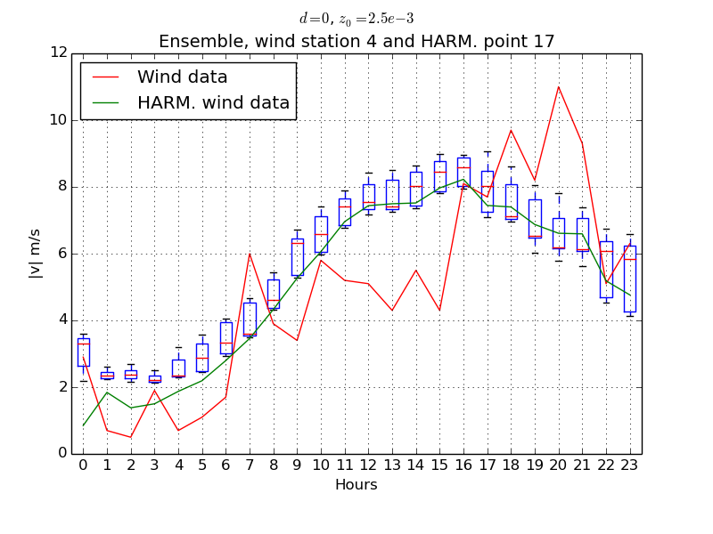
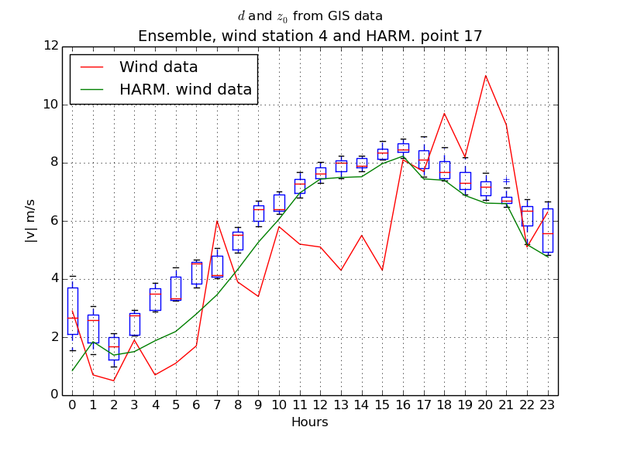
Ensemble methods
Ensemble forecast wind along a day
Notes:
Finally with this strategy, we can run all the timesteps given by HARMONIE, and we get the forecasting wind at any point.

Slide 22
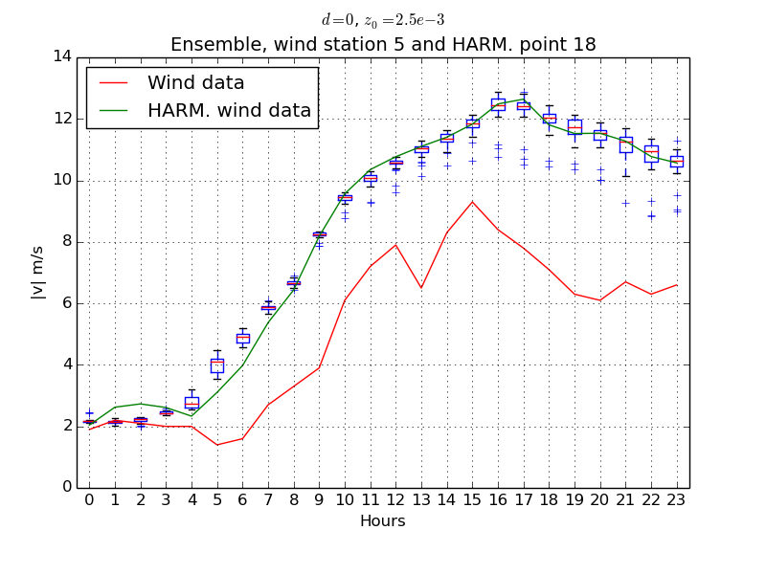
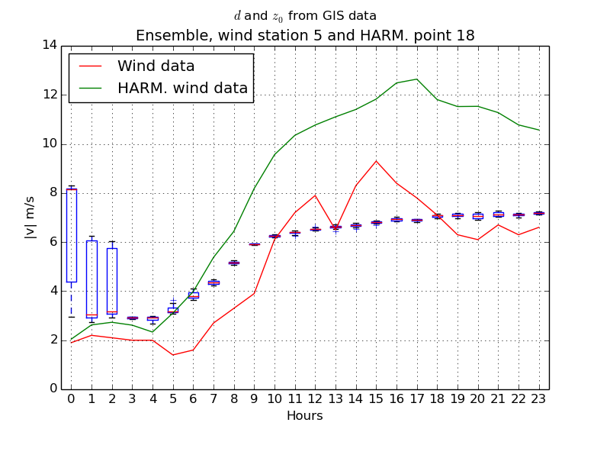
Ensemble methods
Ensemble forecast wind along a day
Notes:
Finally with this strategy, we can run all the timesteps given by HARMONIE, and we get the forecasting wind at any point.

Slide 23
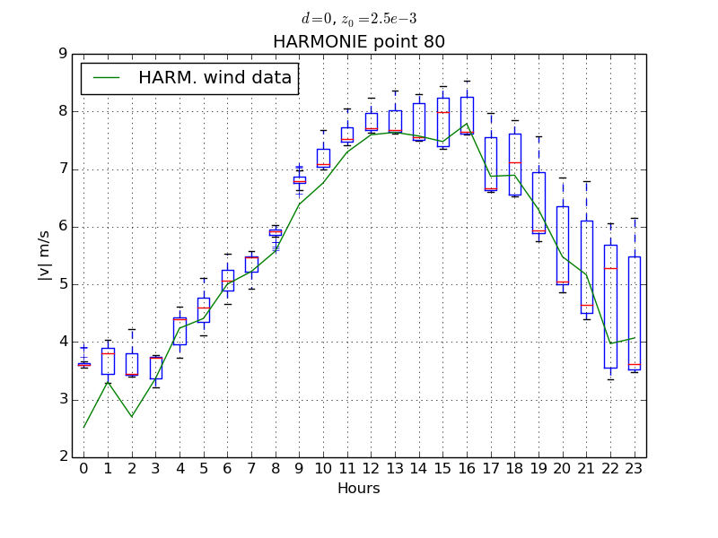
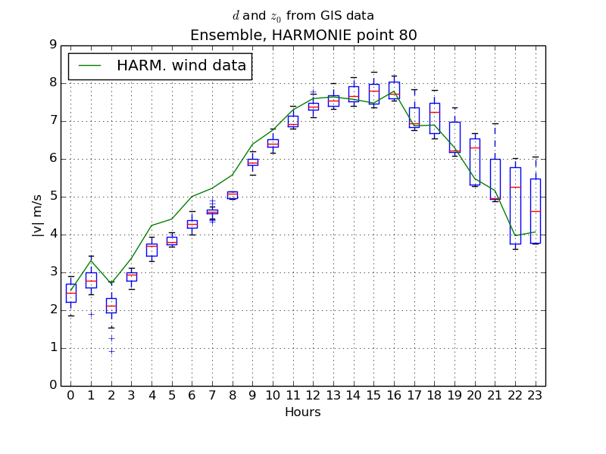
Ensemble methods
Ensemble forecast wind along a day
Notes:
Finally with this strategy, we can run all the timesteps given by HARMONIE, and we get the forecasting wind at any point.

Slide 24
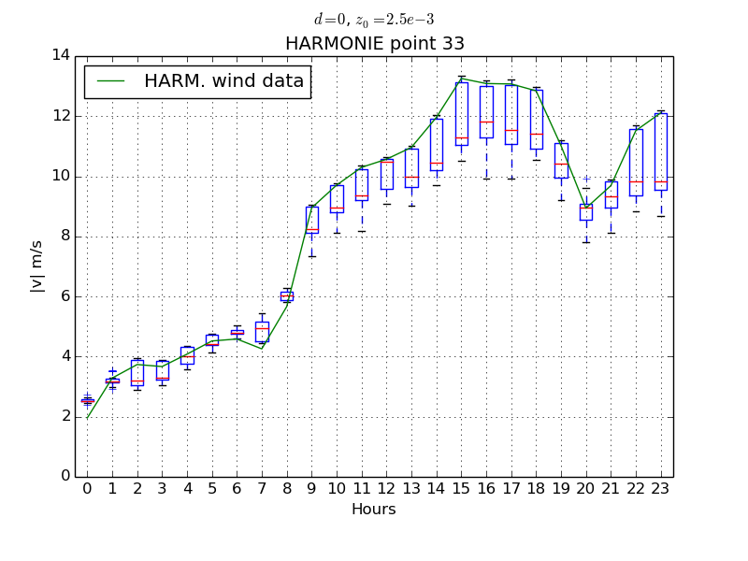
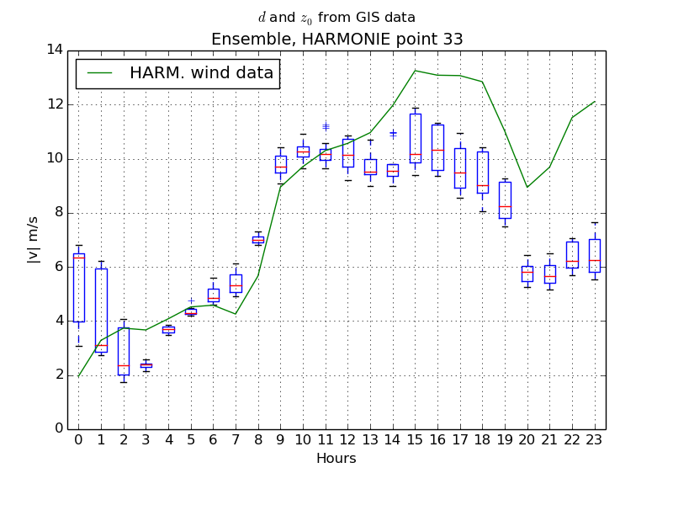
Ensemble methods
Ensemble forecast wind along a day
Notes:
Finally with this strategy, we can run all the timesteps given by HARMONIE, and we get the forecasting wind at any point.

Slide 25
Conclusions and future research
Local Scale wind field model is suitable for complex orographies http://www.dca.iusiani.ulpgc.es/Wind3D
Adaptive meshes improve results from HARMONIE
Local wind field in conjunction with HARMONIE and ensemble method is valid to forecast wind velocities
A. Oliver, E. Rodríguez, J. M. Escobar, G. Montero, M. Hortal, J. Calvo, J. M. Cascón, and R. Montenegro. “Wind Forecasting Based on the HARMONIE Model and Adaptive Finite Elements.” Pure Appl. Geophys. (Online). doi:10.1007/s00024-014-0913-9.
Futher research on definition
Study model results under different wind conditions

Slide 26
Thanks
Ensemble Wind Forecasting Based on the HARMONIE Model and
Adaptive Finite Elements in Complex Orography
Thank you for your attention

