Slide 1
Uso de métodos Ensemble para la predicción de la radiación solar
G. Montero, F. Díaz, H. Montero, E. Rodríguez, J.M. Escobar, R. Montenegro
University Institute of Intelligent Systems and
Numerical Applications in Engineering
CMN - 2015
June 29 – July 2, 2015, Lisbon, Portugal
MINECO
PROGRAMA ESTATAL DE I+D+I ORIENTADA A LOS RETOS DE LA SOCIEDAD
Project: CTM2014-55014-C3-1-R
http://www.siani.es/

Slide 2
The Wind Field Model
Solar radiation prediction
Contents
1. Introduction
2. Adaptive mesh of the terrain surface
3. Detection of shadows
4. Solar radiation modelling
-Solar radiation equations for clear sky
      Beam radiation
      Diffuse radiation
      Reflected radiation
    -Solar radiation under overcast sky (real sky)
    Connection with HARMONIE
    Ensemble methods
5. Numerical experiments
6. Conclusions and future research

Slide 3
The Wind Field Model
Solar radiation prediction
Introduction
Solar power is one of the most appreciate renewable energies in the world
Three groups of factors determine the interaction of solar radiation with the earth’s atmosphere and surface
a. The Earth’s geometry, revolution and rotation (declination, latitude, solar hour angle)
b. Terrain (elevation, albedo, surface inclination/orientation, shadows)
c. Atmospheric attenuation (scattering, absorption) by
  c.1. Gases (air molecules, ozone, CO₂ and O₂)
  c.2. Solid and liquid particles (aerosols, including non-condensed water)
  c.3. Clouds (condensed water)
We focus the study on the accurate definition of the terrain surface and the produced shadows by using an adaptive mesh of triangles

Slide 4
The Wind Field Model
Solar radiation prediction
Introduction
Topography
Albedo
Shadows
Clear Sky
Beam Radiation
Diffuse Radiation
Reflected Radiation
Global Radiation
Experimental Data
Prediction Mesoscale Data
Real sky

Slide 5
The Wind Field Model
Solar radiation prediction
Construction of the terrain surface mesh
Build a sequence of nested meshes from a regular
triangulation of the rectangular region, such
that the level j is obtained by a global refinement
of the previous level j−1 with the 4-T Rivara’s algorithm
The number of levels m of the sequence is determined
by the degree of discretization of the terrain
Define a new sequence until level m’ ≤ m applying a
derefinement algorithm
Two derefinement parameters ε_{h} and ε_{a} are introduced
and they determine the accuracy of the approximation
to terrain surface and albedo, respectively

Slide 6
The Wind Field Model
Solar radiation prediction
Construction of the terrain surface mesh

Slide 7
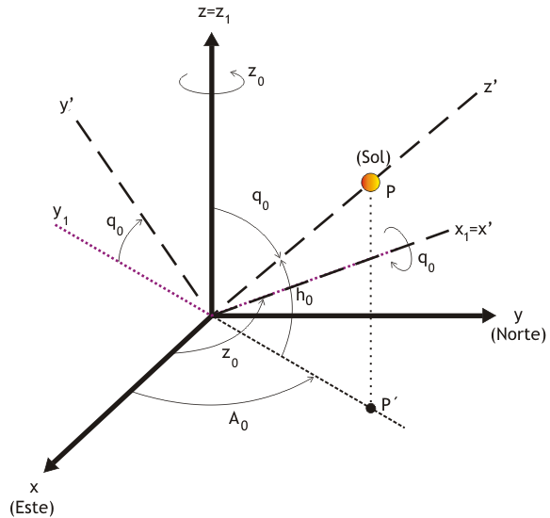
Solar radiation prediction
Shadow detection
Accurate evaluation of radiation
Shadow detection
(Sun)
(North)
(East)

Slide 8
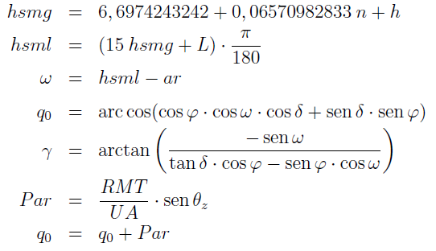
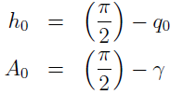
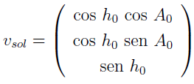
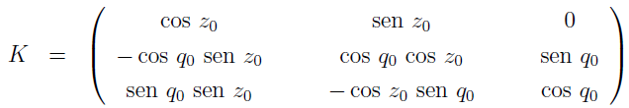
Solar radiation prediction
Shadow detection

Slide 9
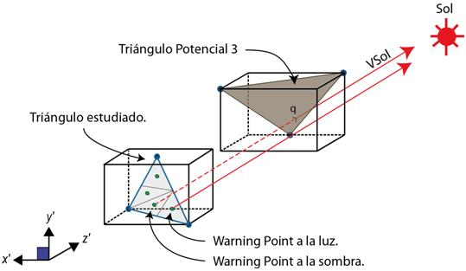
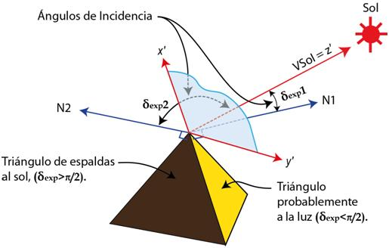
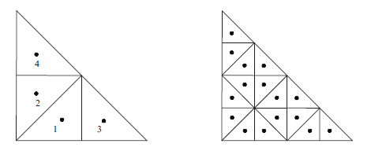


Solar radiation prediction
Shadow detection
Incidence angle (δ_{exp})
Projected shadows
Sun
Incidence angle
Potential triangle 3
Studied triangle
Triangle in the shade
Likely
sunlit triangle
Sunlit warning point
Warning point in the shade
Own shadows
0 if
(|δ_{exp}| ≥ (π/2))
L_{fss}=
1 if
((π/2) > |δ_{exp}| ≥ 0)

Slide 10
Solar radiation prediction
Shadow detection
14:00 hours
12:00 hours
18:00 hours
16:00 hours

Slide 11
Solar radiation prediction
General aspects
This solar radiation model is based on the work of Šúri and Hofierka about a GIS-based model.
Use of adaptive meshes for surface discretization and a new method for detecting the shadows over each triangle of the surface.
We first calculate the solar radiation under the assumption of clear sky for all the triangles of the mesh, taking into account the lighting factor of each triangle.
Next, the total clear-sky solar radiation is obtained integrating all the instantaneous values in each triangle.
Finally, these solar radiation values are corrected for a real sky by using the available data of the measurement stations or mesoscale predictions each day along an episode.

Slide 12
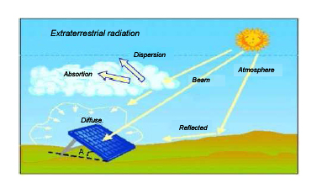
Solar radiation prediction
Solar radiation equations for clear sky
Solar radiation types
Beam
Diffuse
Reflected

Slide 13
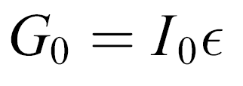
The Wind Field Model
Solar radiation prediction
Solar radiation equations for clear sky
Solar constant
Beam radiation
Extraterrestrial irradiance G₀ normal to the solar beam
Correction factor
Beam irradiance normal to the solar beam G_{b0c}
Linke atmospheric
turbidity factor
G_{b0c} = G₀ exp{−0,8662T_{LK}mδ_{R}(m)}
Relative optical air mass
Beam irradiance on a horizontal surface
G_{bc}(β) = G_{b0c} L_{f} K_{δ} = G_{b0c}L_{f} cos(δ_{exp})
h₀: Solar altitude angle
L_{f}: Lighting factor
Beam irradiance on an inclined surface
G_{bc}(0) = G_{b0c} L_{f} K_{δ} = G_{b0c} L_{f} sen(h₀)
δ_{exp}: Incidence solar angle

Slide 14
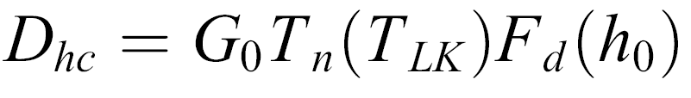
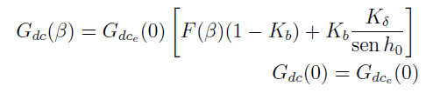

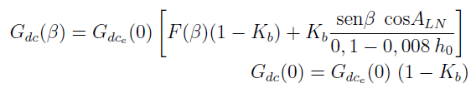


Solar radiation prediction
Solar radiation equations for clear sky
Diffuse radiation
Diffuse transmission
Diffuse radiation on horizontal surfaces
Diffuse radiation on inclined surfaces
Function depending on the solar altitude
Sunlit surfaces
h_{o} ≥ 0.1
h_{o} < 0.1
Shadowed surfaces

Slide 15


Solar radiation prediction
Solar radiation equations for clear sky
Reflected radiation
Mean ground albedo

Slide 16


The Wind Field Model
Solar radiation prediction
Solar radiation under overcast sky
The values of global irradiation on a horizontal surface for overcast conditions H(0) are calculated as a correction of those of clear sky H_{c}(0) with the clear sky index k_{c}
If some measures of global radiation H_{s} are available at different measurement stations, the value of the clear sky index at those points may be computed as
Then k_{c} may be interpolated in the whole studied zone

Slide 17
Solar radiation prediction
Connecting to a prognostic mesoscale model

Slide 18
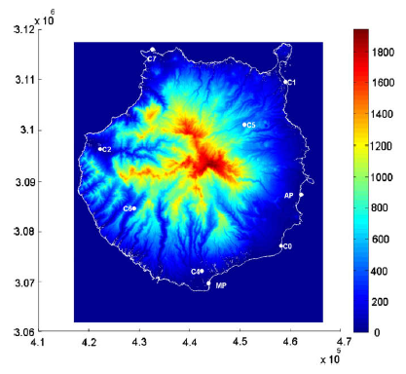
The Wind Field Model
Solar radiation prediction
Numerical experiments
The studied case corresponds to Gran Canaria, Canary Islands, in the Atlantic Ocean at 28.06 lat, −15.25 long.
The selected episode includes the period from June 1st, 2015, until June 15th, 2015
Elevation map of Gran Canaria
Albedo map of Gran Canaria

Slide 19
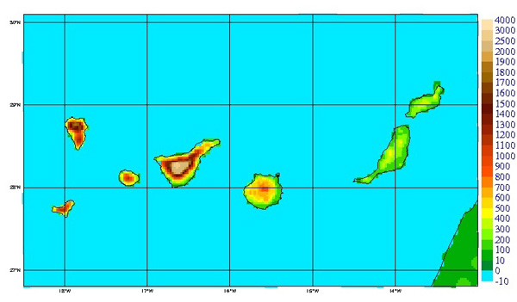
Solar radiation prediction
Ensemble methods
Non-hydrostatic meteorological model based on HIRLAM
From large scale to 1km or less scale (under development)
Different models in different scales
Assimilation data system
Run by AEMET daily
HARMONIE on Canary islands
(http://www.aemet.es/ca/idi/prediccion/prediccion_numerica)

Slide 20
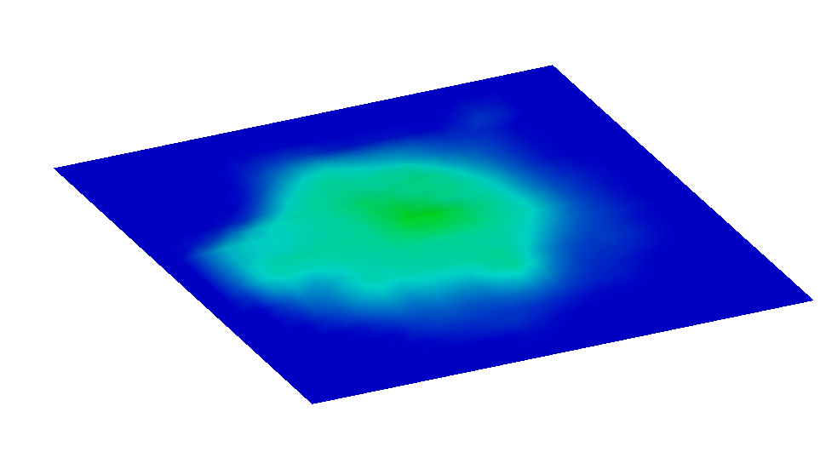
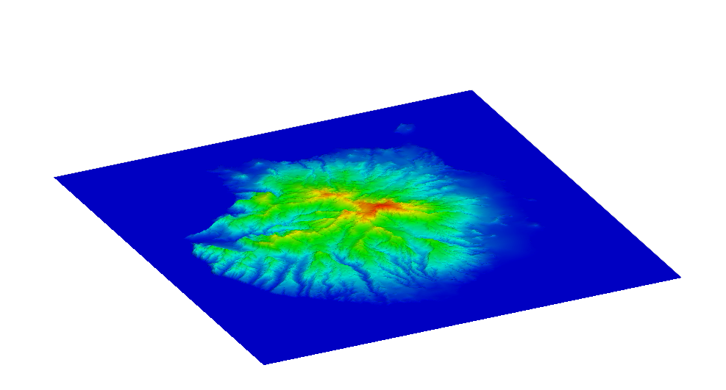
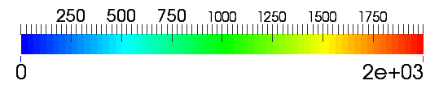
Solar radiation prediction
Ensemble methods
Terrain approximation
Max height 925m
Max height 1950m
HARMONIE discretization of terrain
Topography from Digital Terrain Model
Terrain elevation (m)

Slide 21
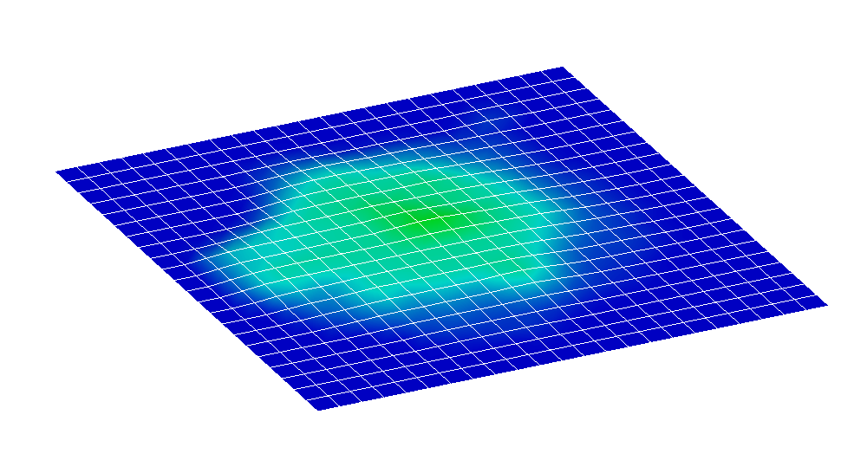
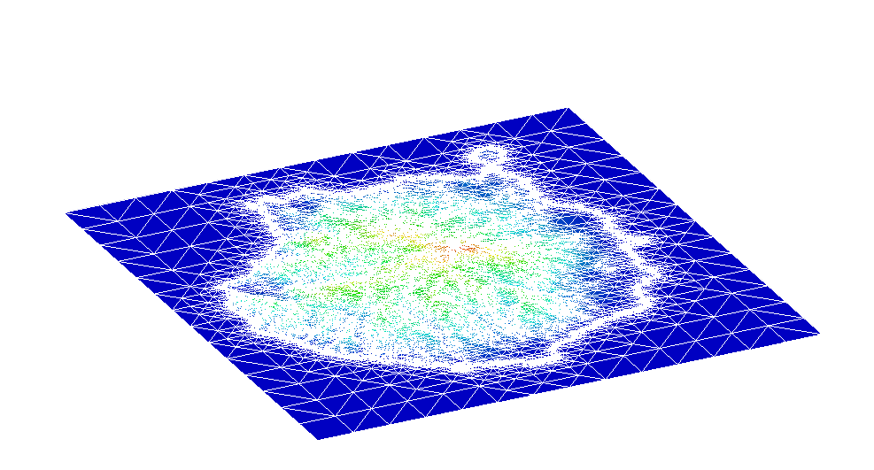
Solar radiation prediction
Ensemble methods
Spatial discretization
HARMONIE mesh
Δh ~ 2.5km
Adaptive Model computational mesh
Terrain elevation (m)

Slide 22
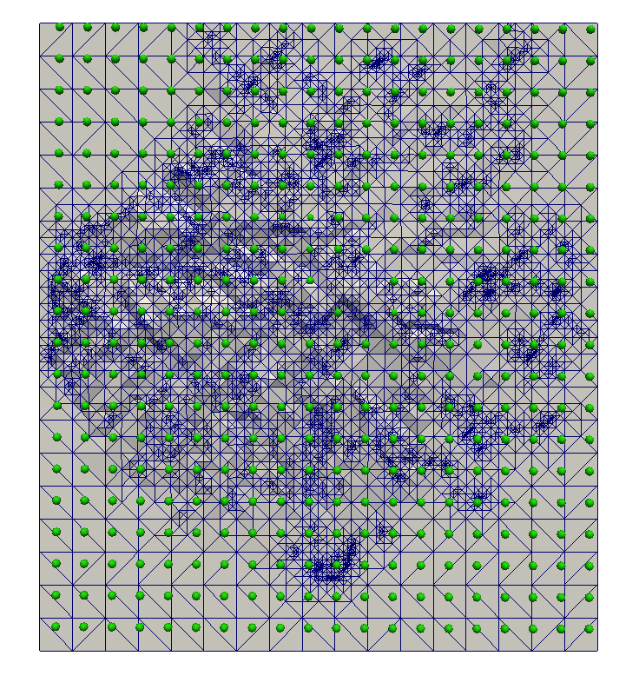
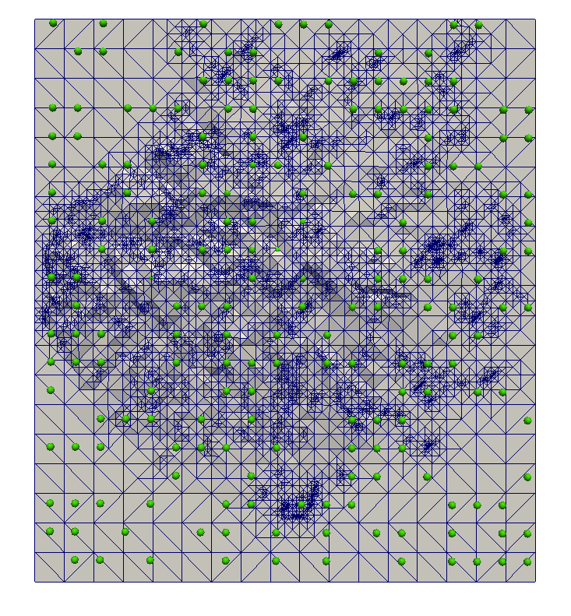
Solar radiation prediction
Ensemble methods
HARMONIE data points
Used data (1/2 of total)
100 different configurations

Slide 23
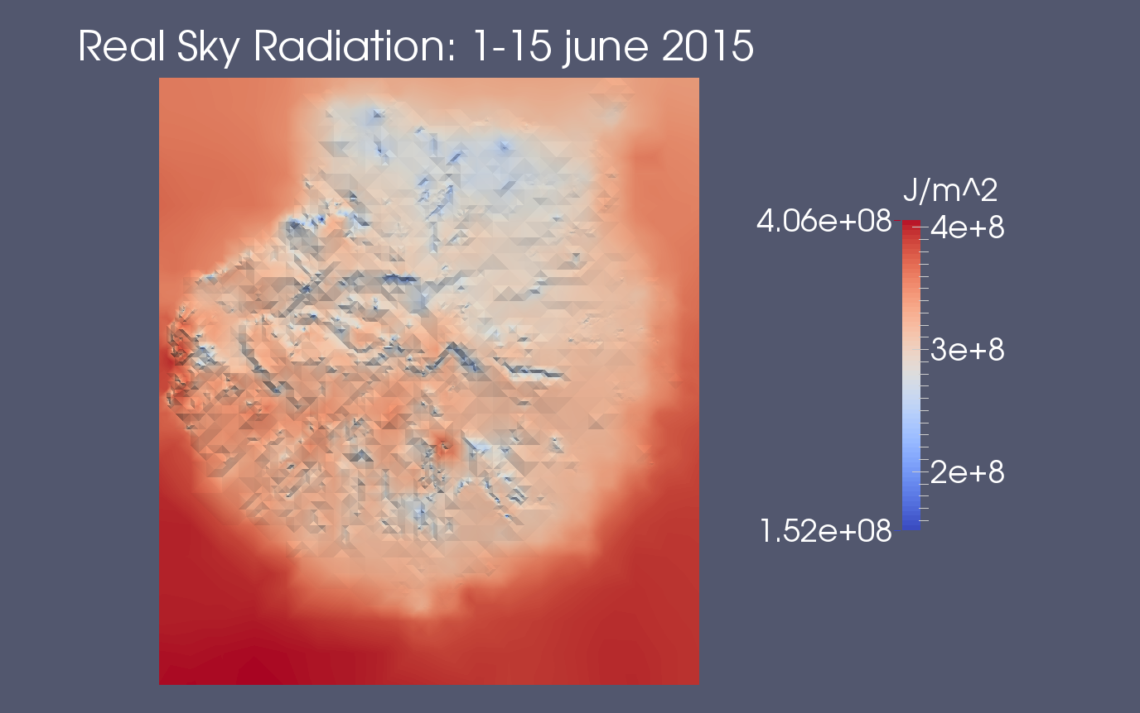
Solar radiation prediction
Ensemble methods

Slide 24
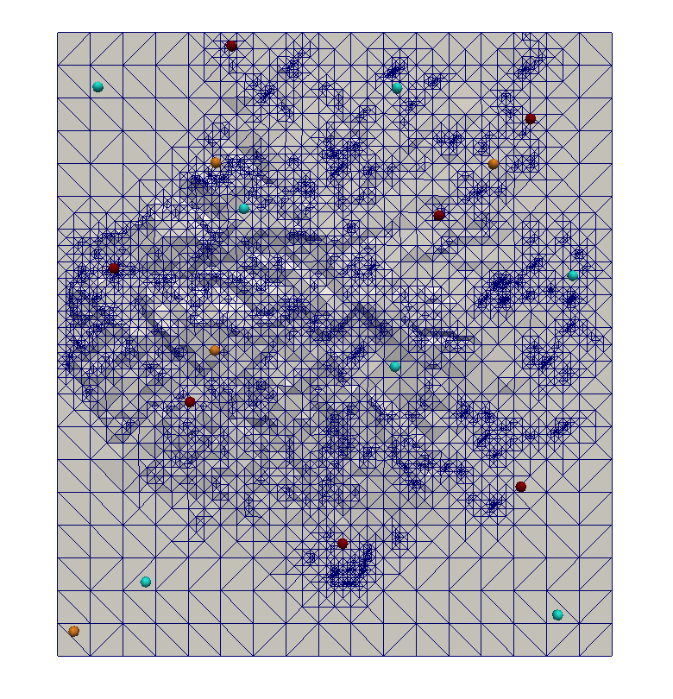



Solar radiation prediction
Ensemble methods
Analyzed points
s₆
p₀
p₁
s₁
h₃
h₄
Station point
p₂
s₄
s₂
p₃
Harmonie point
Control point
h₂
s₅
p₄
s₀
s₃
p₅
p₆
h₁

Slide 25
Solar radiation prediction
Ensemble methods

Slide 26
Solar radiation prediction
Ensemble methods

Slide 27
Solar radiation prediction
Ensemble methods

Slide 28
Solar radiation prediction
Ensemble methods

Slide 29
Solar radiation prediction
Ensemble methods

Slide 30
Solar radiation prediction
Ensemble methods

Slide 31
Solar radiation prediction
Ensemble methods

Slide 32
Solar radiation prediction
Ensemble methods

Slide 33
Solar radiation prediction
Ensemble methods

Slide 34
Solar radiation prediction
Ensemble methods

Slide 35
Solar radiation modeling
Conclusions and Future research
Conclusions
Adaptive solar model
Refined meshes allow to improve the results from HARMONIE.
The shadow procedure correct the overestimation of HARMONIE.
Ensemble methods
Ensemble methods provides a valid range for solar radiation prediction.
Future research
Clear Sky Index
Obtain the clear sky index from the cloudiness information of HARMONIE.
Further research on the interpolation procedure used to compute the clear sky index.
Parameters
Estimate some unknown parameters of the model using GAs or ANN.

