Slide 1
T-spline Parameterization of 2D Geometries Based on
the Meccano Method with a New T-mesh Optimization Algorithm
J.I. López⁽¹⁾, M. Brovka⁽¹⁾, J.M. Escobar⁽¹⁾, J.M. Cascón⁽²⁾ and R. Montenegro^{(1)*}
⁽¹⁾ University Institute SIANI, University of Las Palmas de Gran Canaria, Spain
⁽²⁾ Department of Economics and History of Economics, University of Salamanca, Spain
22nd International Meshing Roundtable, October 13-16, 2013, Orlando, USA
MINECO y FEDER Project: CGL2011-29396-C03-00
CONACYT-SENER Project, Fondo Sectorial, contract: 163723
http://www.dca.iusiani.ulpgc.es/proyecto2012-2014

Slide 2

16th IMR (2007)

Slide 3
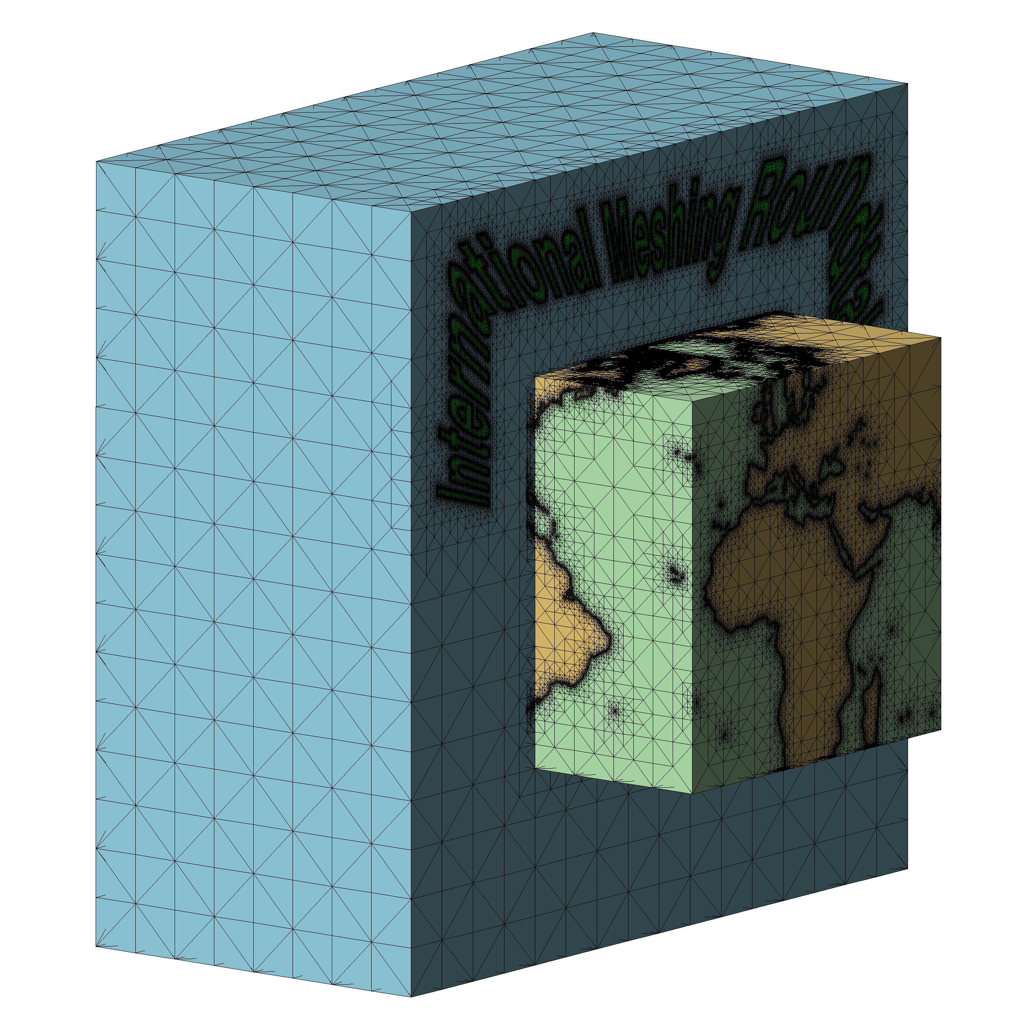
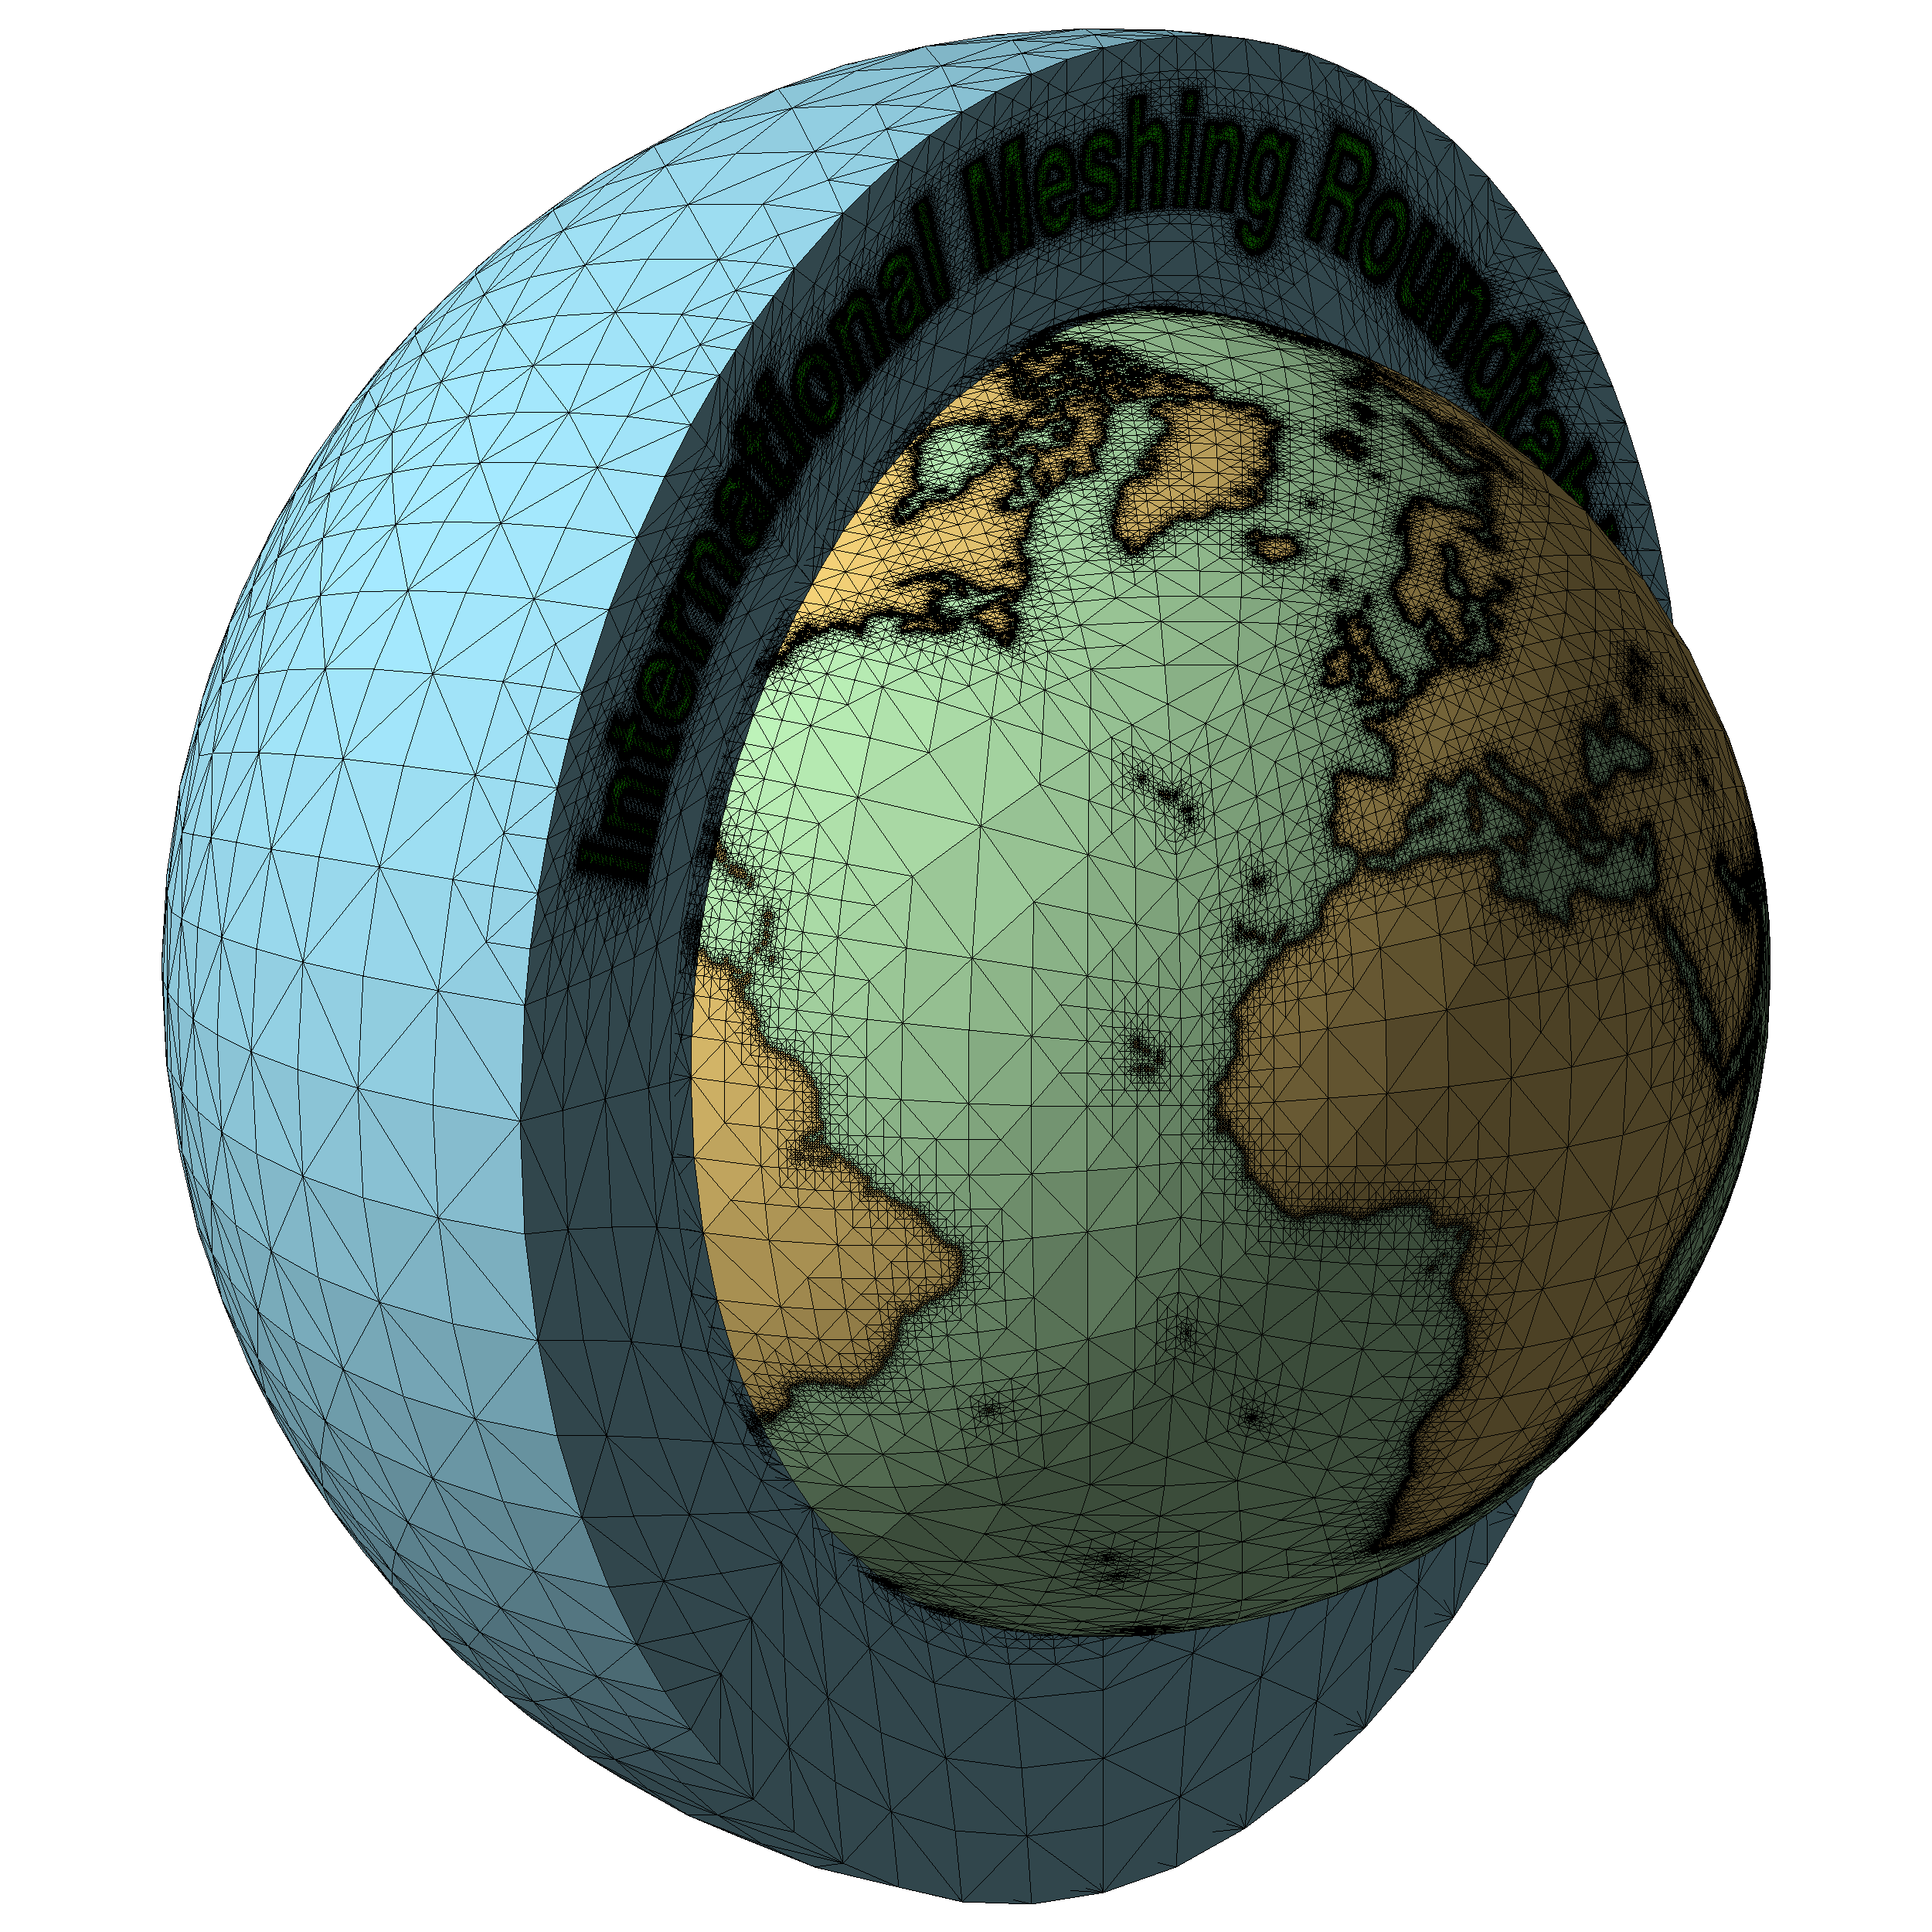
16th IMR (2007)

Slide 4

Contents
Mesh Generation, Volume Parameterization and Isogeometric Modeling
The Meccano Method (based on tetrahedral mesh optimization)
The initial algorithm for tetrahedral mesh generation
Volumetric parameterization of the tetrahedral mesh
Application to isogeometric solid modeling and analysis
The Meccano Method (based on a new 2D T-mesh optimization)
The new algorithm for two-dimensional T-mesh generation
T-spline parameterization of 2D geometries
Application to isogeometric modeling and analysis
Conclusions, Comments and Future Research
Notes:
Decimos que un tetraedro es de Tipo I si está marcado con el indicador de error. Se introducen 6 nuevos nodos en el punto medio de sus aristas y se subdividen cada una de sus cuatro caras en 4 triángulos, uniendo los puntos que se han introducido.
Cuatro subtetraedros quedan determinados a partir de los cuatro vértices del tetraedro original y las nuevas aristas.
Los otros cuatro tetraedros se obtienen al unir los dos vértices opuestos más cercanos del octaedro que resulta en el interior. Estudios de Löhner y Baum aseguran que esta elección produce el menor número de tetraedros distorsionados en la malla refinada. Existen otras dos opciones para subdividir el octaedro, y se podría analizar la calidad de las divisiones, pero aumentaría el coste computacional del algoritmo.
Una vez marcados los tetraedros de Tipo I, para asegurar la conformidad de la malla nos podemos encontrar con tetraedros vecinos que pueden tener 6, 5,..., 1, ó 0 nuevos nodos introducidos.
Aquellos tetraedros que por razones de conformidad tengan marcadas sus 6 aristas pasa automáticamente al conjunto de tetraedros de Tipo I.

Slide 5
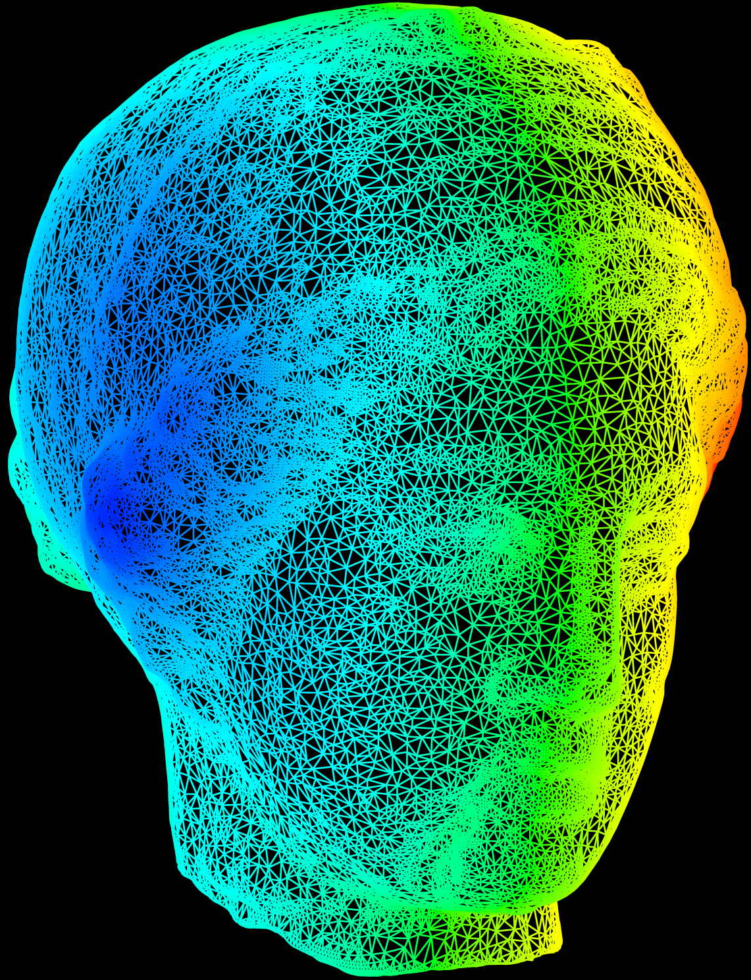
INPUT DATA: Surface Triangulation
http://www.cyberware.com/

Slide 6
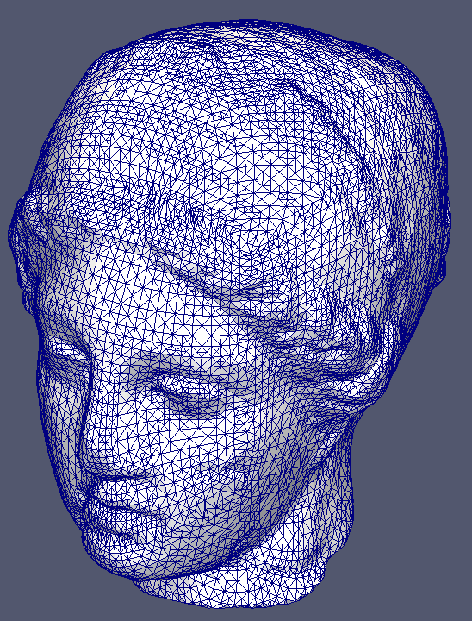
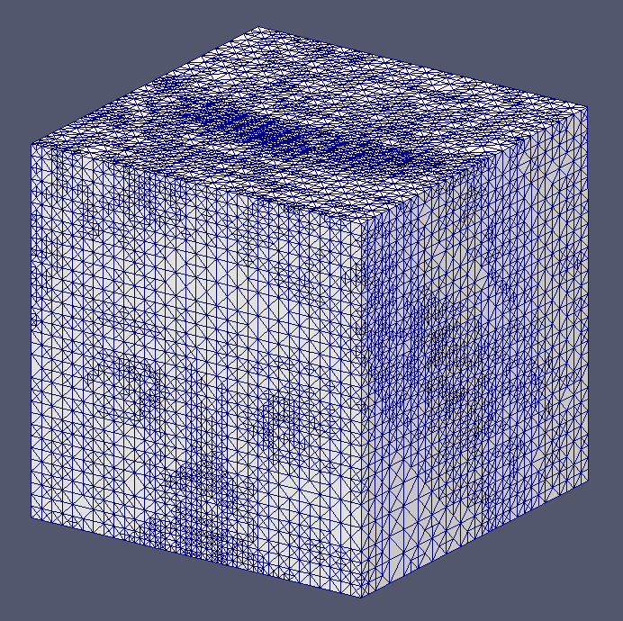

Slide 7
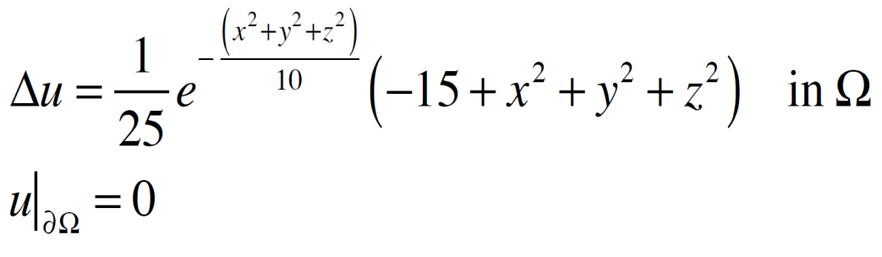
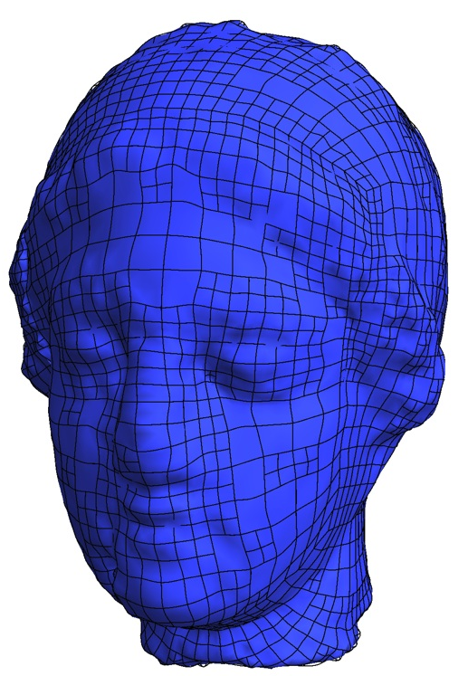
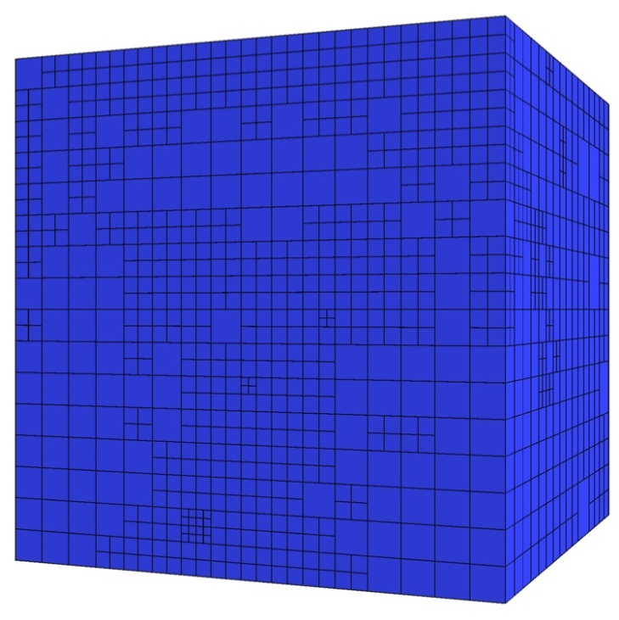
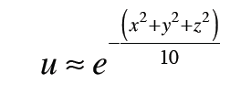
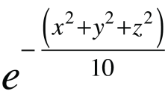

Adaptive Isogeometric Refinement
Application in Igea: Poisson problem with a central source
Exact solution:
T-mesh
T-spline

Slide 8
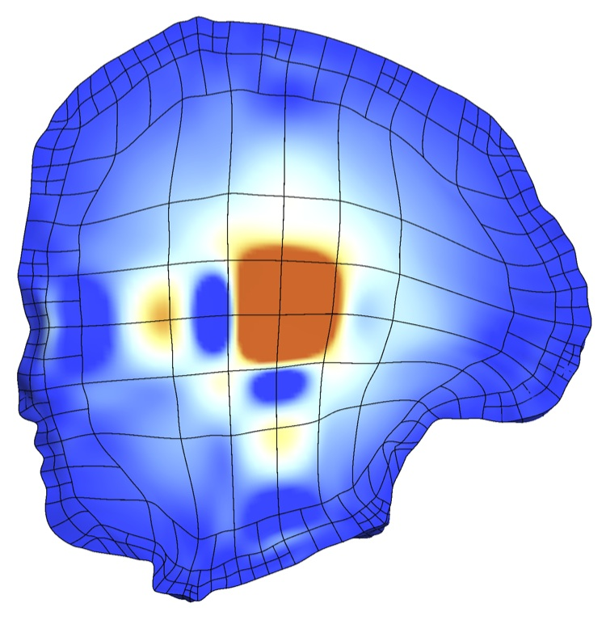
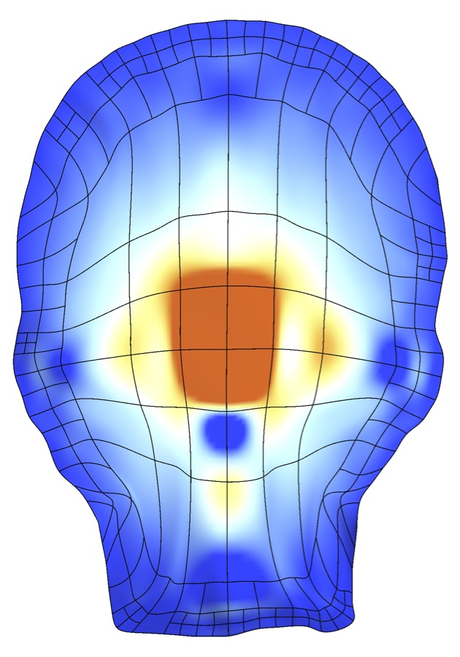
Adaptive Isogeometric Refinement
Igea: T-spline of Numerical Solution
Initial T-mesh
5692 cells, 9304 DOF

Slide 9

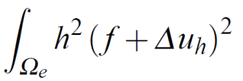

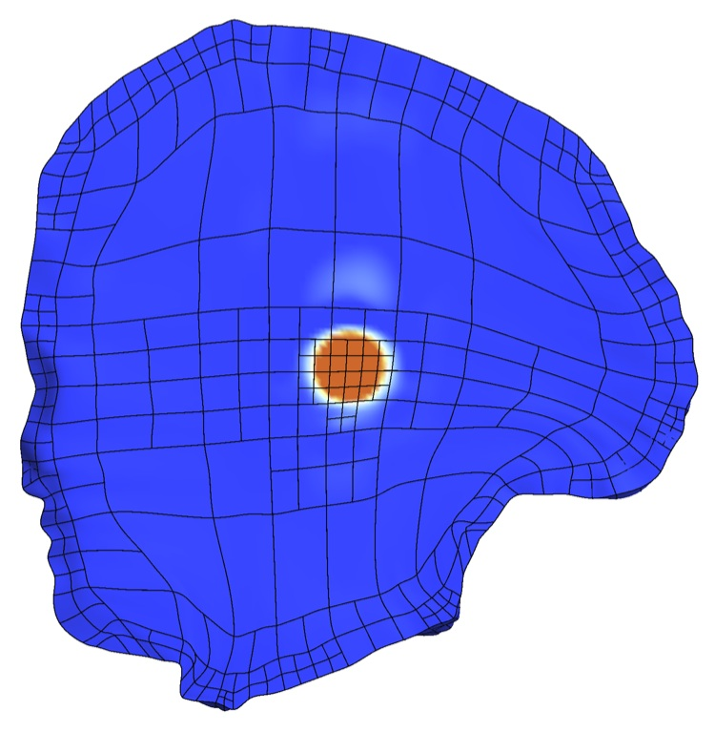
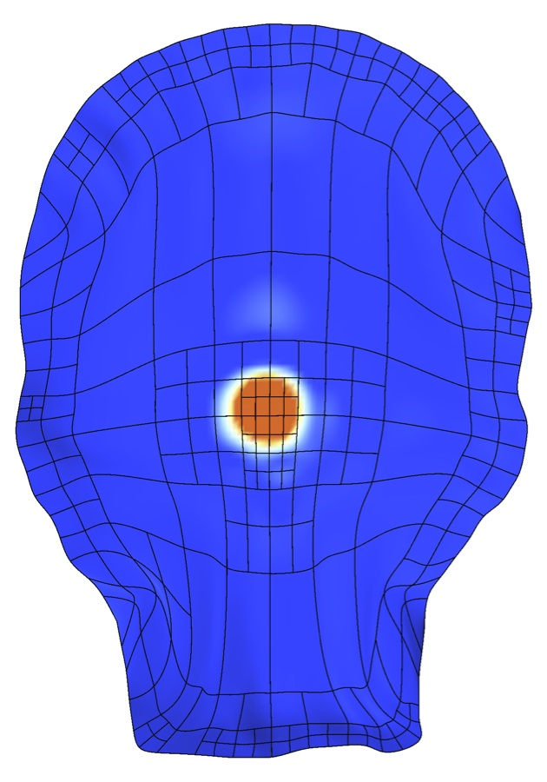
Adaptive Isogeometric Refinement
Igea: T-spline of Numerical Solution
Error indicator :
d
2nd local refinement
6021 cells, 9807 DOF

Slide 10

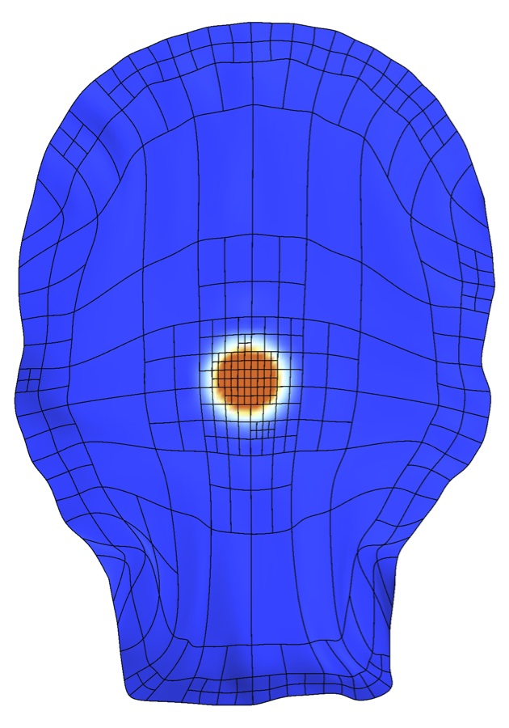
Adaptive Isogeometric Refinement
Igea: T-spline of Numerical Solution
Error indicator :
d
5th local refinement
6756 cells, 10838 DOF

Slide 11
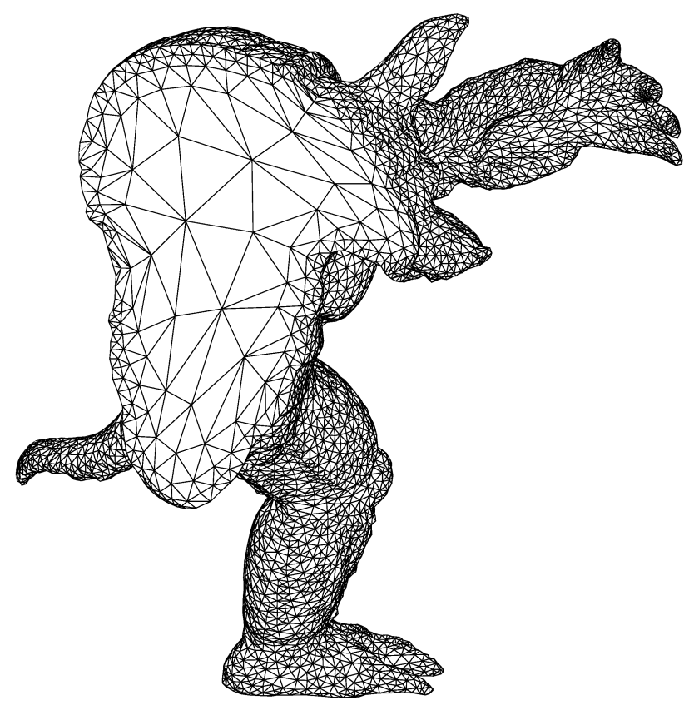
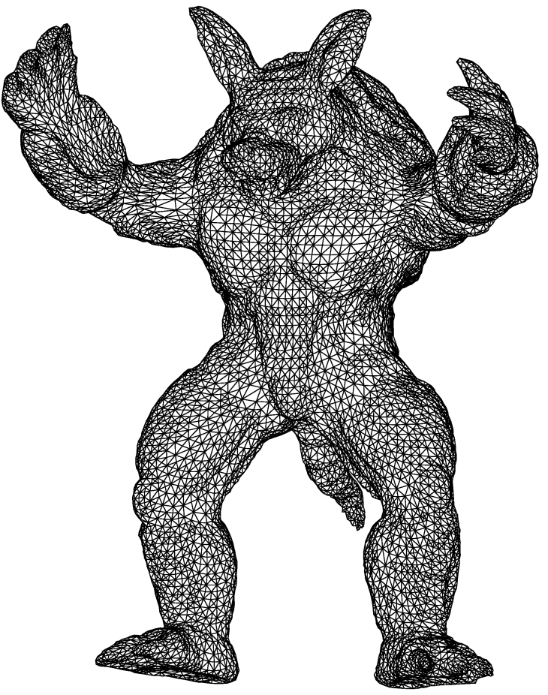
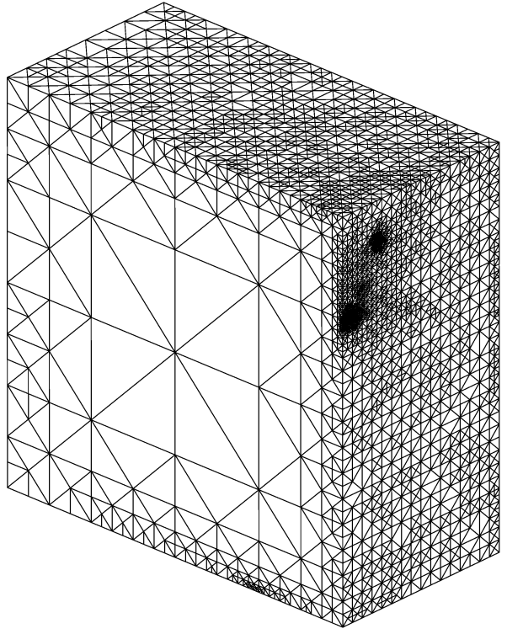
Meccano Method for Complex Solids
Volume parameterization based on SUS of tetrahedral meshes
T
T_{t}
Optimization
Optimization
Physical Element T Target Element T_{t}
(to get less distortion in the parameterization)

Slide 12
Meccano Method on T-meshes for Complex Solids
Volume parameterization based on SUS of T-meshes
1. The key of the meccano method is the simultaneous untangling and smoothing
(SUS) procedure.
2. The quality of the T-spline mapping (i.e., positive Jacobian, good uniformity and orthogonality of the isoparametric curves) depends on the quality of the T-mesh in the physical space. We have to fix a quality metric for this mapping.
3. In order to simplify the procedure and to get less distortion in the volume
parameterization, it should be interesting to directly apply the meccano
method on T-meshes instead of tetrahedral meshes.
4. We have started analysing the problem in 2-D.

Slide 13
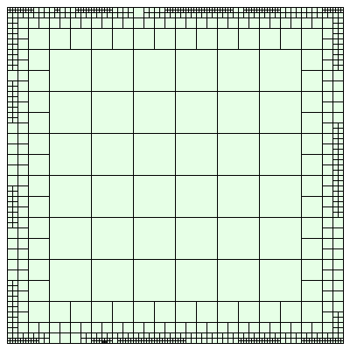
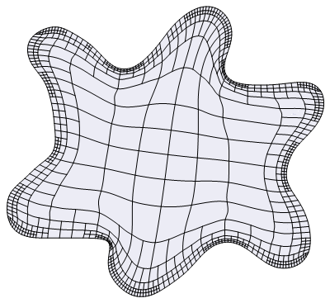
The Meccano Method on T-meshes in 2-D
Input data: Boundary representation of the object
Objective: Construction of a high quality T-spline parameterization
T-mesh
T-spline mesh
Parameter space
Physical space

Slide 14
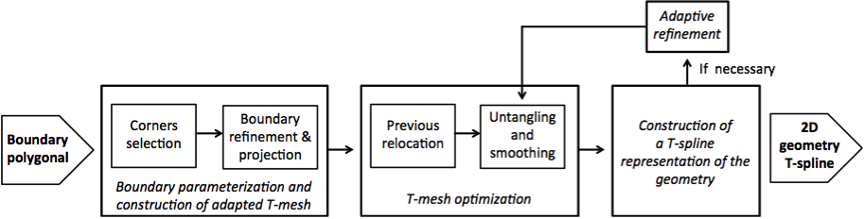
The Meccano Method on T-meshes in 2-D
General scheme of the method
Boundary parameterization and adapted T-mesh construction.
T-mesh optimization.
Construction of a T-spline representation of the geometry.
Adaptive refinement to remove negative Jacobians and to improve the parameterization.
(d)
(a)
(b)
(c)
Notes:
These are the stages of the method. Leer.

Slide 15

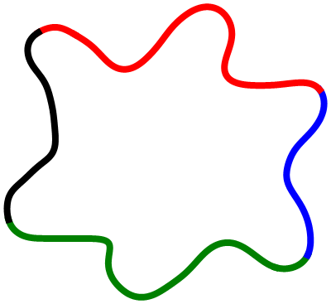
The Meccano Method on T-meshes in 2-D
Step 1: Input boundary (image, polyline, curve, etc.) and boundary mapping
A
B
C
D
Select four points (A, B, C, D) of the input boundary
Boundary parameterization via chord-length

Slide 16
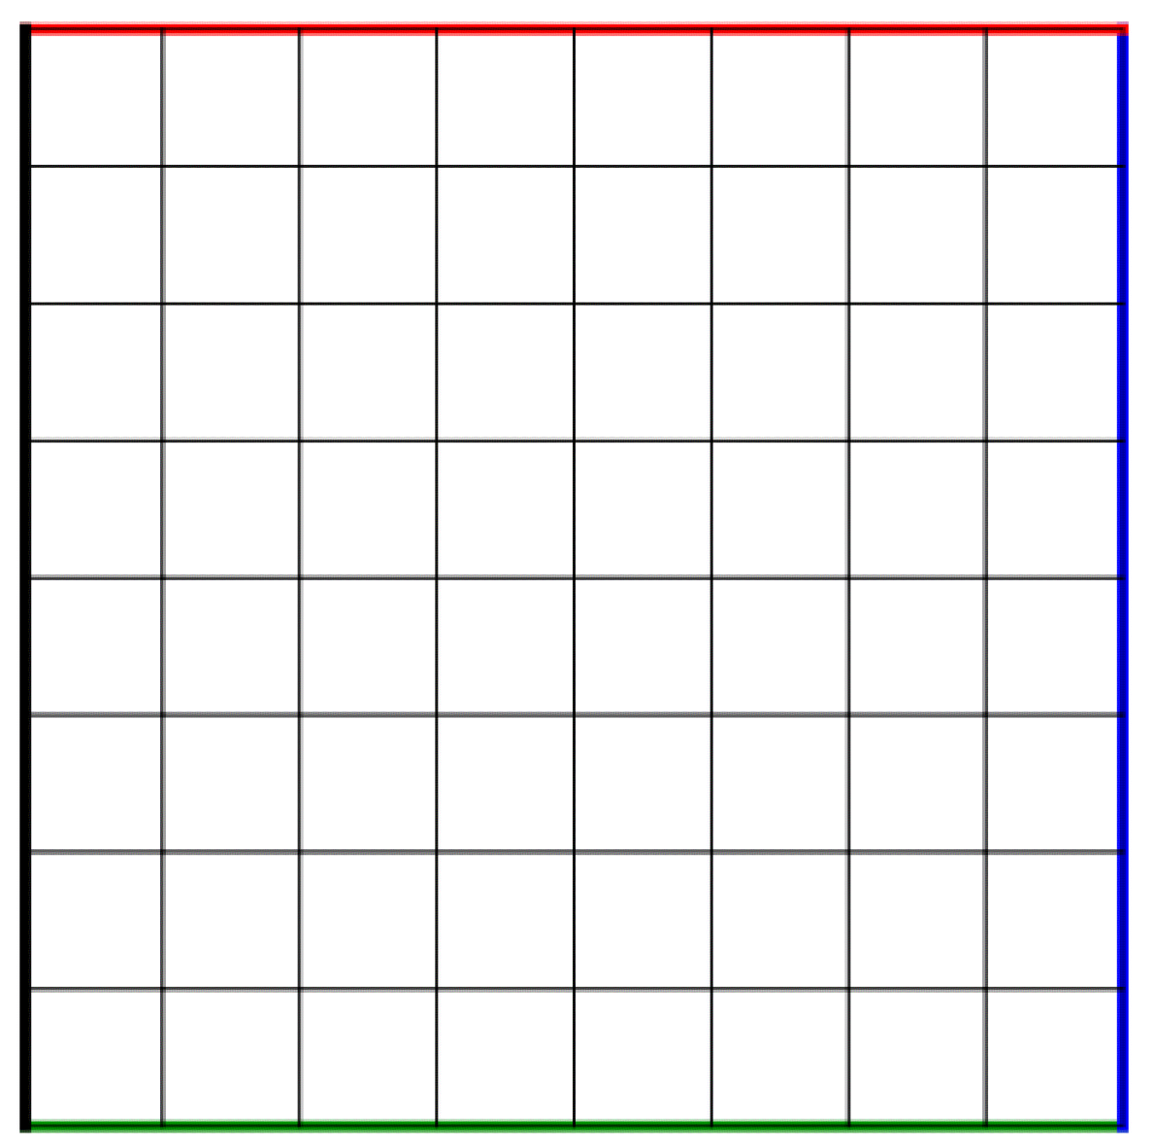
The Meccano Method on T-meshes in 2-D
Step 2: Coarse quadrilateral mesh of the meccano (parameter space)

Slide 17
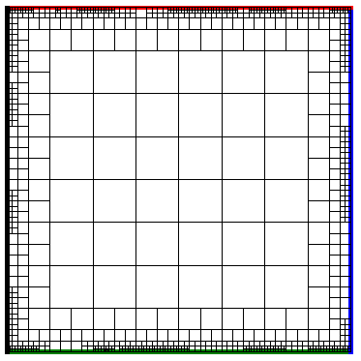
The Meccano Method on T-meshes in 2-D
Step 3: Refine mesh with quadtree subdivisions to approach the boundary

Slide 18
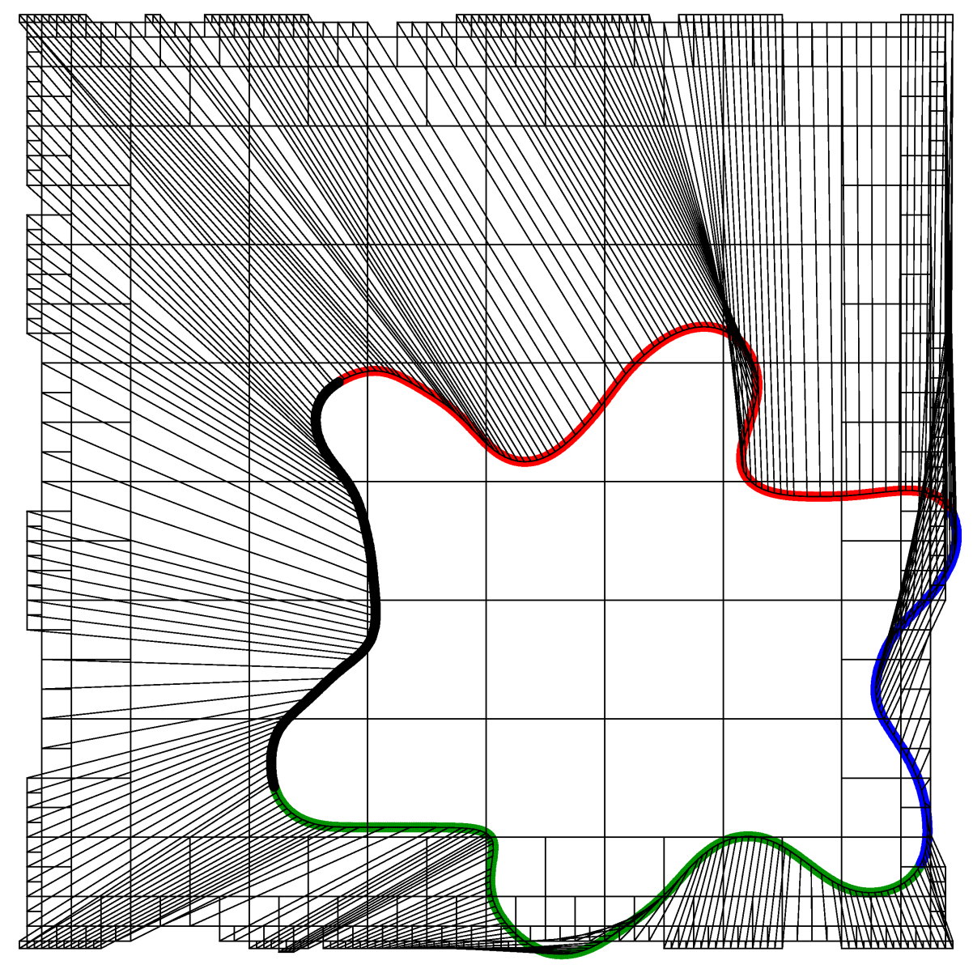
The Meccano Method on T-meshes in 2-D
Step 4: Move the meccano boundary nodes to the object boundary

Slide 19
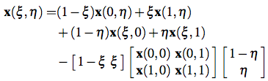
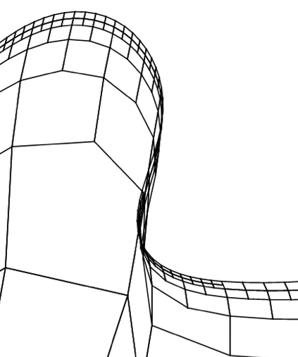
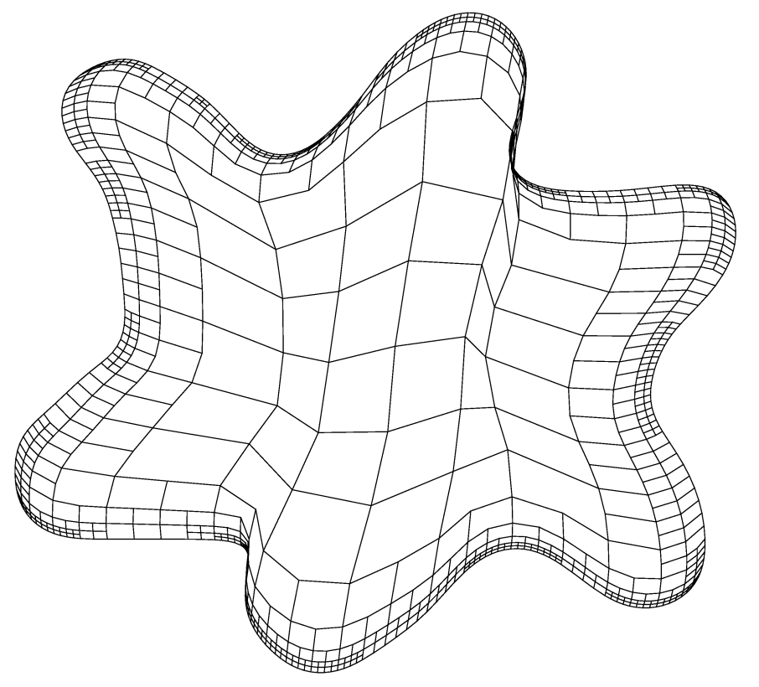

The Meccano Method on T-meshes in 2-D
Step 5: Inner node relocation with Coons patch to facilitate the optimization
Mesh folder

Slide 20
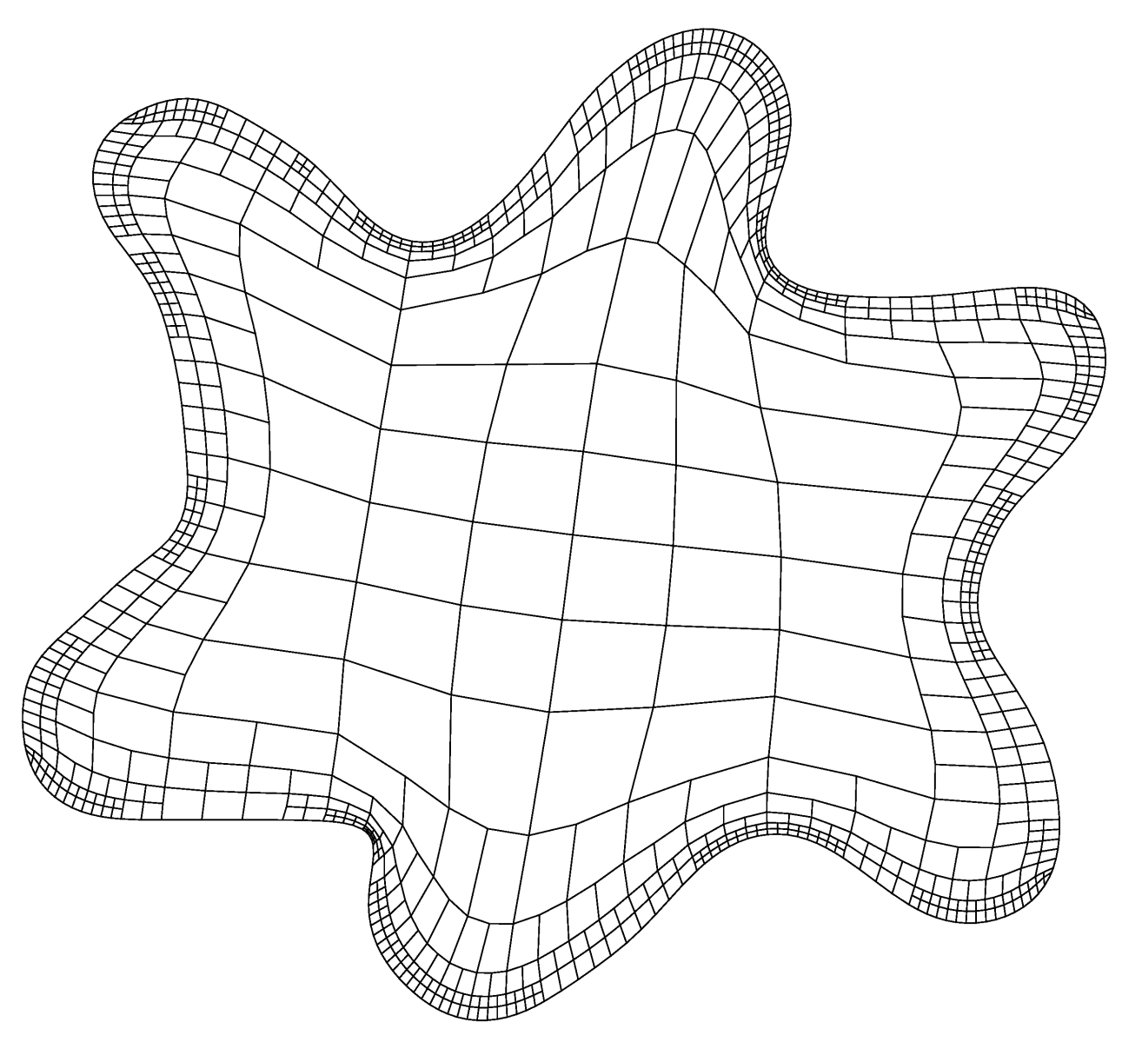
The Meccano Method on T-meshes in 2-D
Step 6: Simultaneous Untangling and Smoothing (SUS) of the T-mesh

Slide 21
The Meccano Method on T-meshes in 2-D
Step 7: T-spline representation of the spot

Slide 22
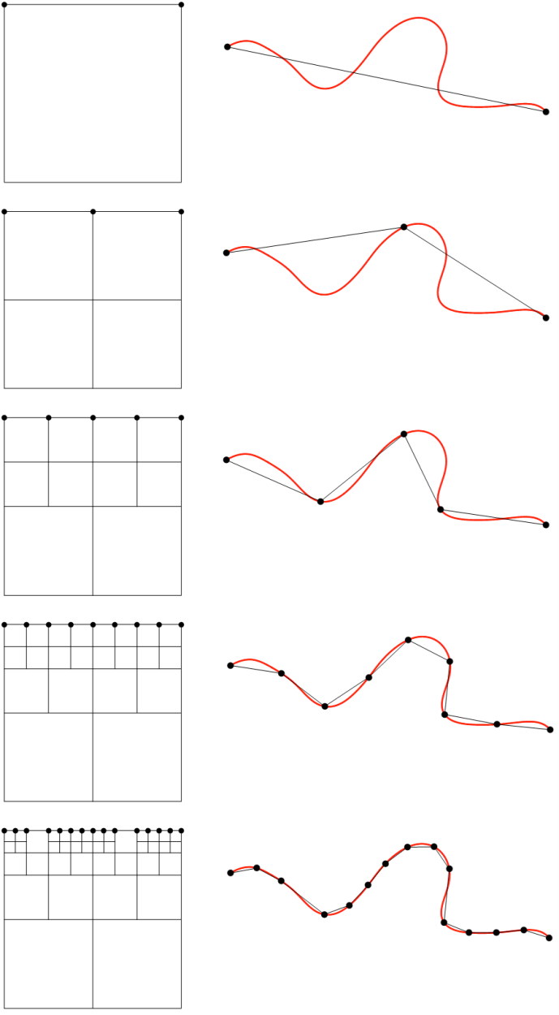
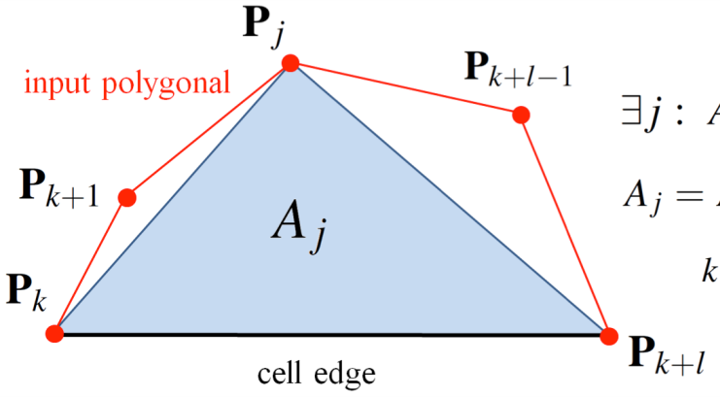
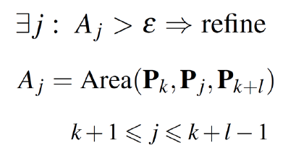
Boundary Approach in 2-D
Input data: Boundary polyline approximation (red color line)
Boundary edge refinement criterion:
T-mesh adaptation in parameter space
Boundary approximation in physical space

Slide 23
Simultaneous Untangling and Smoothing
Case of plane T-meshes (EWC 2013)
Local optimization
Objective: Improve the quality of the local mesh by minimizing an objective function
Free node
New position for the free node
?
Local mesh
Optimized local mesh
Notes:
The T-mesh optimization is an iterative process in which the free nodes are placed in position that improve the quality of the local mesh. This process is repeated for all the nodes of the mesh several times.

Slide 24
Simultaneous Untangling and Smoothing
Case of plane triangulations (CMAME 2003)
Local optimization
Objective: Improve the quality of the local mesh by minimizing an objective function
Free node
New position for the free node
Local mesh
Optimized local mesh

Slide 25
Simultaneous Untangling and Smoothing (CMAME 2003)
Weighted Jacobian Matrix on a Plane
Reference triangle
Physical triangle
Ideal triangle
y
A
y
y
2
S = AW ⁻¹
2
2
t
t_{R}
0
1
t_{I}
1
x
x
0
1
x
0
W
S
t_{I} t
: Weighted Jacobian matrix
An algebraic quality metric of t
(mean ratio)
where:

Slide 26
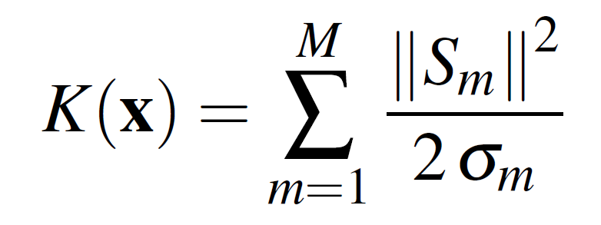
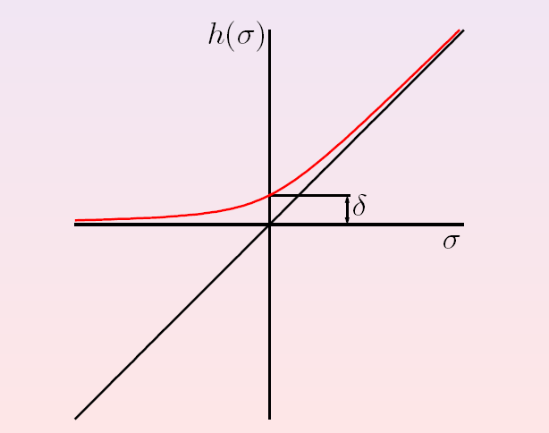
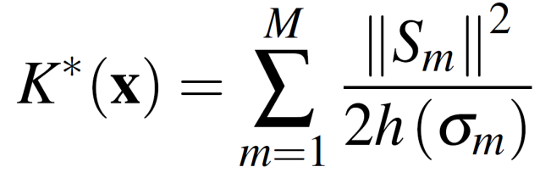

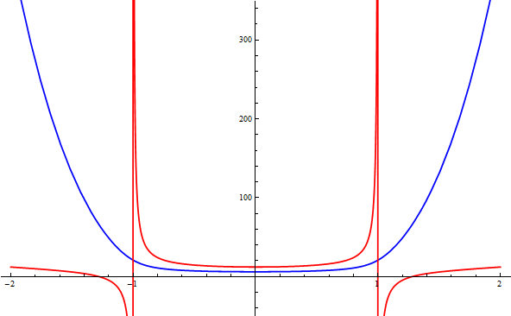
Simultaneous Untangling and Smoothing (CMAME 2003)
Local objective function for valid plane triangulations
SUS Code: Freely-available in http://www.dca.iusiani.ulpgc.es/proyecto2012-2014
Original function:
Modified function:
Modified function (blue) is regular in all R² and it approximates the same minimum that the original function (red). Moreover, it allows a simultaneous untangling and smoothing of triangular meshes

Slide 27
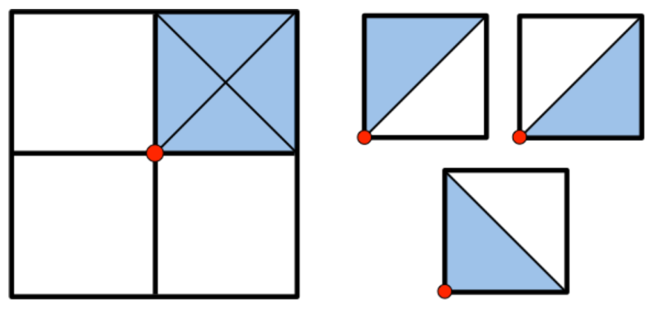
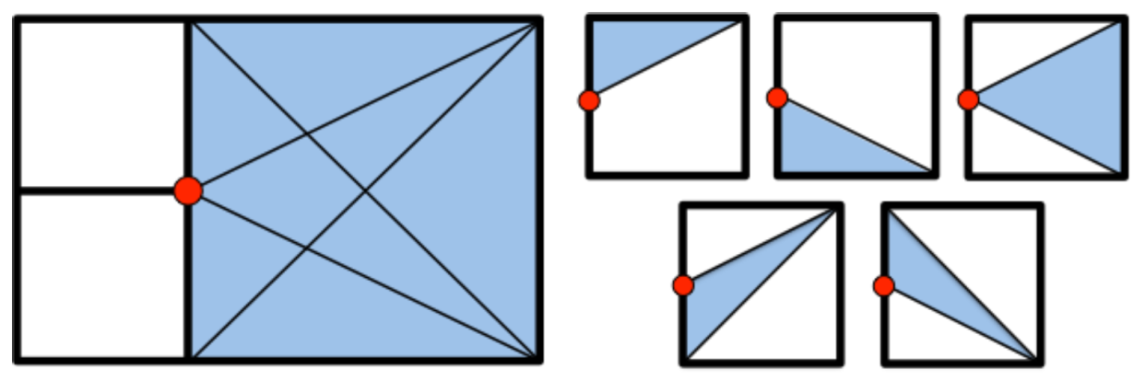
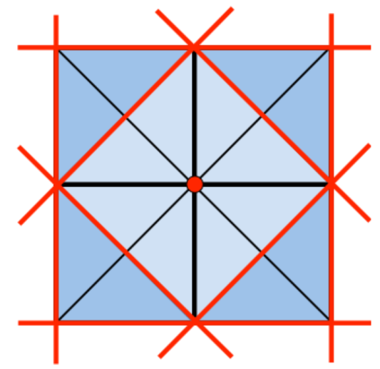
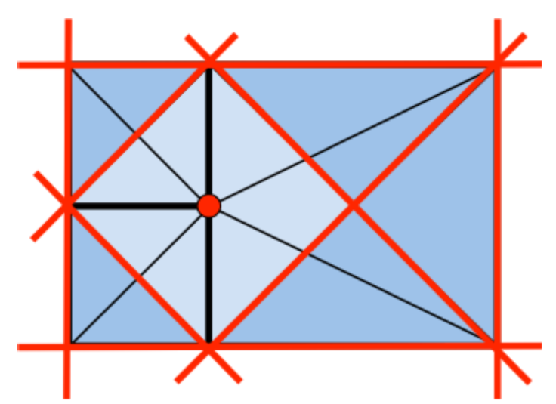
Simultaneous Untangling and Smoothing of T-meshes
Triangle decomposition of the T-mesh cells
Case 1: Free node is a regular node
Case 2: Free node is a hanging node
Barriers and feasible region for a regular node
Barriers and feasible region for a hanging node

Slide 28
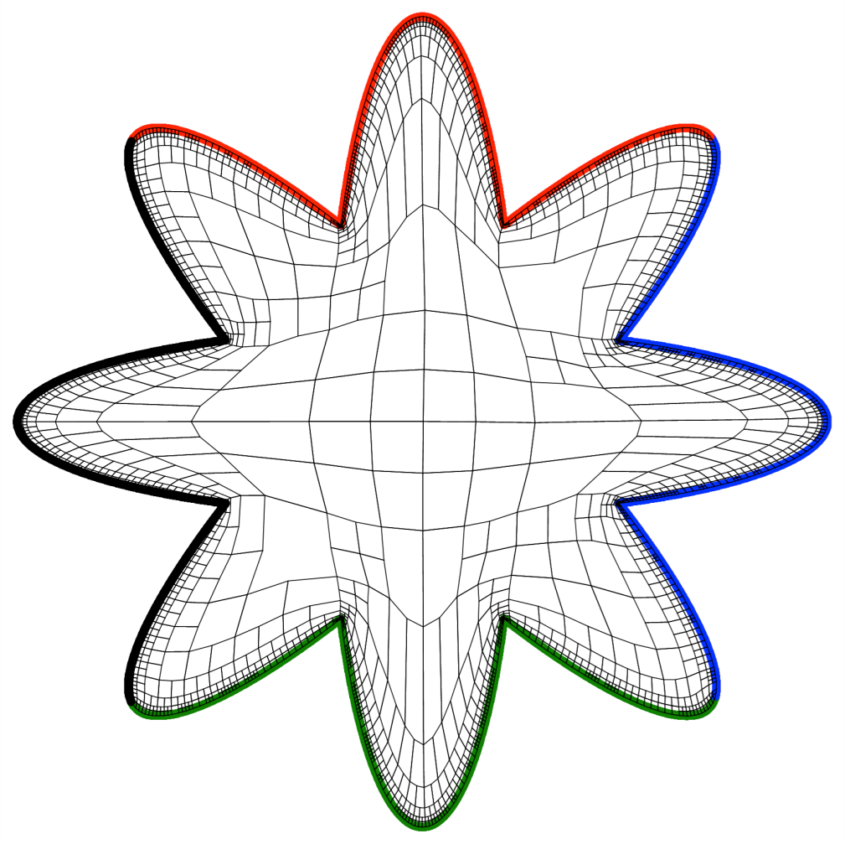
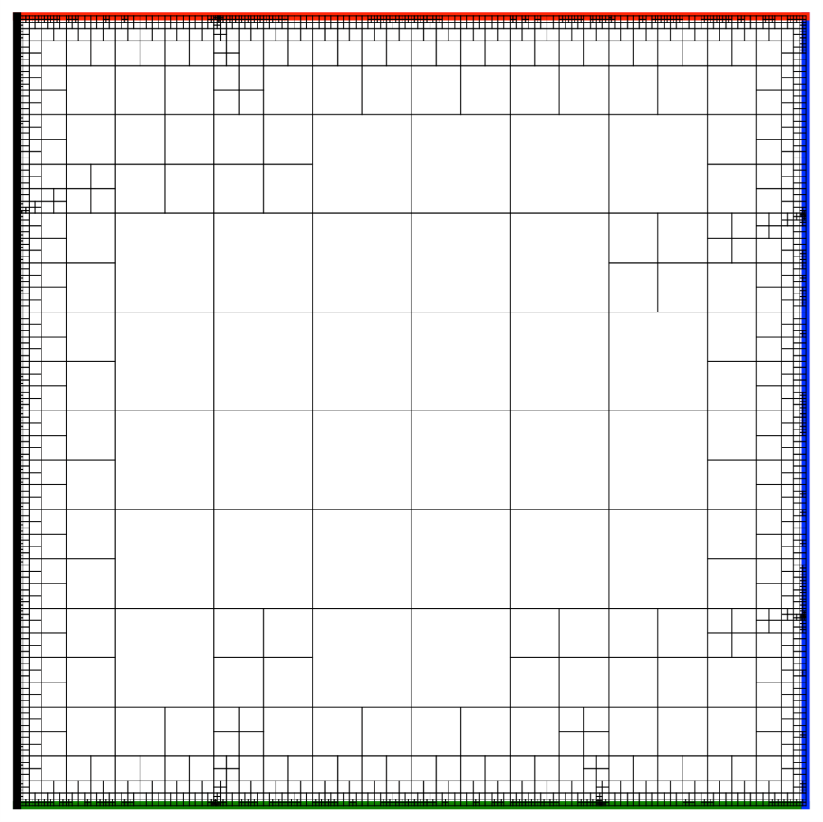
Simultaneous Untangling and Smoothing of T-meshes
Optimization is guided by the parametric T-mesh
Physical cell C must be as similar as possible to the counterpart in the parametric space C_{p}
C_{p}
C
Parametric T-mesh
Optimized physical T-mesh

Slide 29




Simultaneous Untangling and Smoothing of T-meshes
Problems appears with the non-weighted objective function K*
Satisfactory result for a conformal submesh using K*
Not satisfactory result for a
non-conformal submesh using K*
(a)
(b)
Desirable result: Orthogonal
mesh for a non-conformal case
(weighted objective function )
(c)

Slide 30
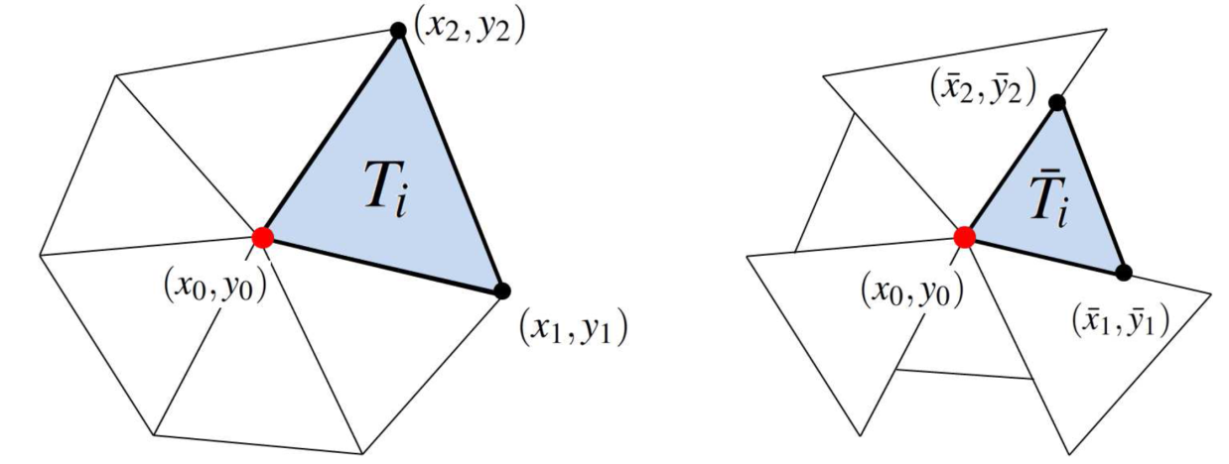
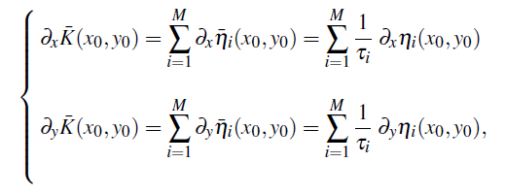

Simultaneous Untangling and Smoothing of T-meshes
Solution by using weighted objective functions (regular node)
Objective: The optimal position for non-conformal mesh is the same as for the conformal case
Non-conformal mesh
Conformal mesh
τ_{i} is scale factor of the element

Slide 31
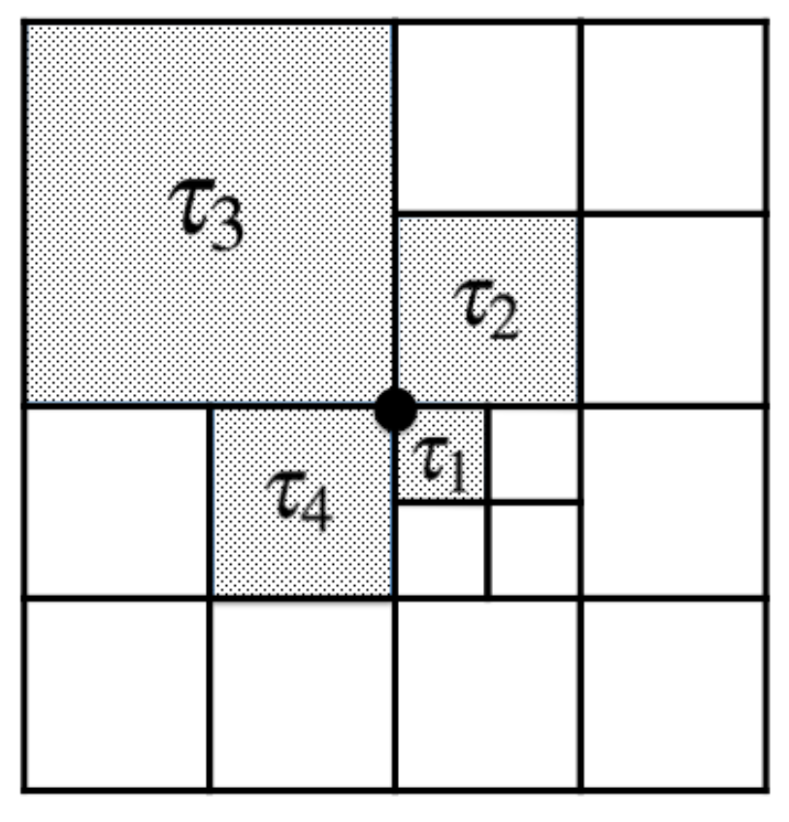
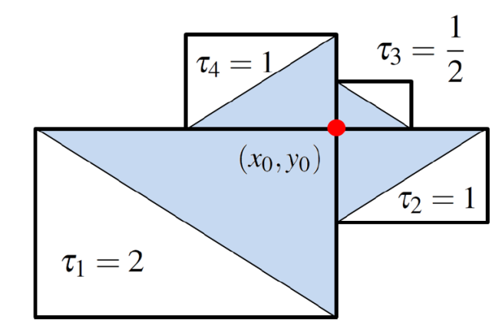
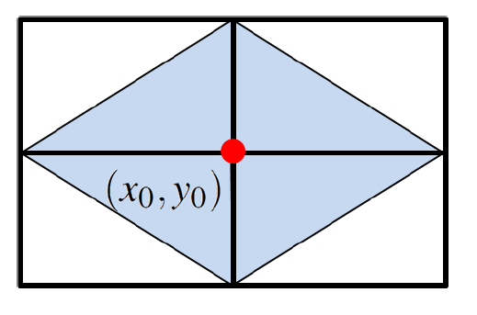
Simultaneous Untangling and Smoothing of T-meshes
Solution by using weighted objective functions (regular node)
All possible weights for balanced quadtrees:
Non-conformal mesh
Conformal mesh

Slide 32
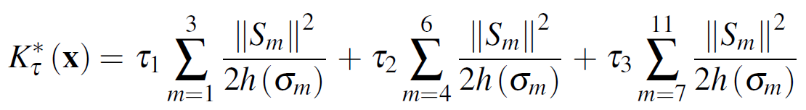
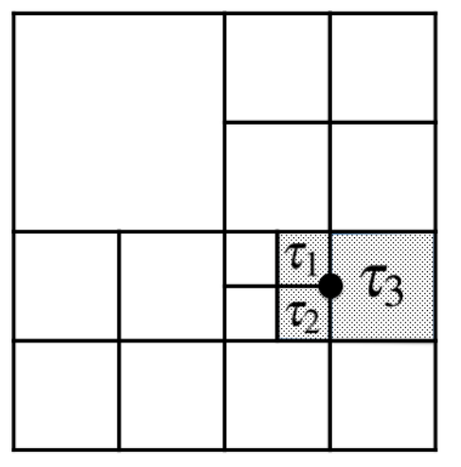


Simultaneous Untangling and Smoothing of T-meshes
Solution by using weighted objective functions (hanging node)
All possible weights for balanced quadtrees:
Optimized mesh without weights
Optimized mesh
with weights

Slide 33


Simultaneous Untangling and Smoothing of T-meshes
T-mesh transformation along the SUS process: Example
T-mesh
T-spline
Parameter space
Physical space

Slide 34

Simultaneous Untangling and Smoothing of T-meshes
T-mesh transformation along the SUS process: Video

Slide 35



T-spline Parameterization
Determination of control points by imposing interpolation conditions

Slide 36


Mean Ratio Jacobian of Parametric Transformation
A quality metric of the T-spline mapping at any point P₀
-1 ≤
≤ 1
where J is the jacobian matrix of the
T-spline mapping S

Slide 37

Mean Ratio Jacobian of Parametric Transformation
Comparison between mean ratio Jacobian and scaled Jacobian
Scaled Jacobian = 1
Mean ratio Jacobian = 1
Square Square
Scaled Jacobian = 1
Mean ratio Jacobian = close to 0
Square Flattened Rectangle

Slide 38


Mean Ratio Jacobian of Parametric Transformation
Comparison between mean ratio and scaled Jacobian
Parameter space
Physical space

Slide 39



Mean Ratio Jacobian of Parametric Transformation
Comparison between mean ratio and scaled Jacobian
Scaled Jacobian
Mean ratio Jacobian

Slide 40


Applications: Isogeometric Modeling
The Spot (Mean Ratio Jacobian)

Slide 41


Applications: Isogeometric Modeling
The Flower (Mean Ratio Jacobian)

Slide 42

Applications: Isogeometric Modeling
Gran Canaria Island (Adaptive refinement to improve the Mean Ratio Jacobian)
Initial T-mesh
Refined T-mesh
Initial T-spline
Refined T-spline
No negative Jacobian after refinement!
Mean ration Jacobian
Mean ration Jacobian

Slide 43


Applications: Isogeometric Modeling
Gran Canaria Island (Mean Ratio Jacobian)

Slide 44



Applications: Isogeometric Analysis
Numerical solution of a Poisson problem
Solution in parameter space
Solution in physical space

Slide 45


Local Nested Adaptive Refinement
Numerical solution of a Poisson problem
Concentrate source in relation to the initial mesh size
Exact solution:
Residual-type error indicator:

Slide 46



Local Nested Adaptive Refinement
Numerical solution of a Poisson problem
Error indicator :
d
Numerical solution across a section
Convergence behavior

Slide 47


Final Comments and Future Works
Isogeometric modeling of geometries with several materials

Slide 48


Final Comments and Future Works
Isogeometric modeling of geometries with holes

Slide 49

Final Comments and Future Works
Automatic Construction of the Meccano

Slide 50


Final Comments and Future Works
Automatic Construction of the Meccano

Slide 51
T-spline Parameterization of 2D Geometries Based on
the Meccano Method with a New T-mesh Optimization Algorithm
J.I. López⁽¹⁾, M. Brovka⁽¹⁾, J.M. Escobar⁽¹⁾, J.M. Cascón⁽²⁾ and R. Montenegro^{(1)*}
⁽¹⁾ University Institute SIANI, University of Las Palmas de Gran Canaria, Spain
⁽²⁾ Department of Economics and History of Economics, University of Salamanca, Spain
22nd International Meshing Roundtable, October 13-16, 2013, Orlando, USA
MINECO y FEDER Project: CGL2011-29396-C03-00
CONACYT-SENER Project, Fondo Sectorial, contract: 163723
http://www.dca.iusiani.ulpgc.es/proyecto2012-2014

Slide 52


