Slide 1
Some advances in open problems of isogeometric analysis
M. Brovka^{(1)*}, J.I. López⁽¹⁾, J.M. Escobar⁽¹⁾, J.M. Cascón⁽²⁾ and R. Montenegro⁽¹⁾
⁽¹⁾ University Institute SIANI, University of Las Palmas de Gran Canaria, Spain
⁽²⁾ Department of Economics and History of Economics, University of Salamanca, Spain
XXIV Congreso de Ecuaciones Diferenciales y Aplicaciones (XXIV CEDYA / XIV CMA)
Junio 8–12, 2015, Cadiz, Spain
MINECO y FEDER Project: CGL2011-29396-C03-00
CONACYT-SENER Project, Fondo Sectorial, contract: 163723
http://www.dca.iusiani.ulpgc.es/proyecto2012-2014

Slide 2
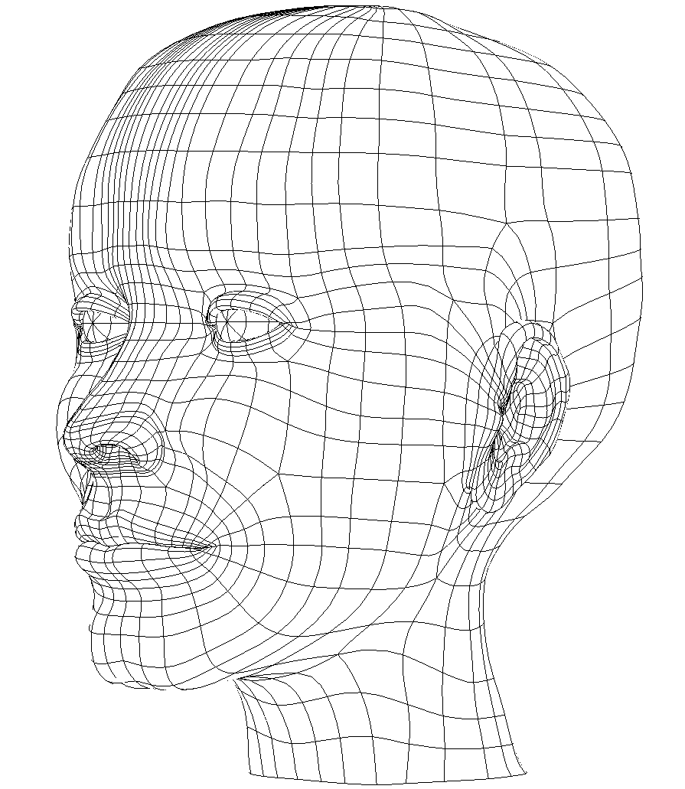
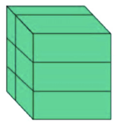
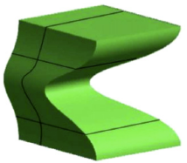


Isogeometric analysis: integrating FEA and CAD
Isogeometric analysis (IGA) has arisen as an attempt
to unify the field of CAD and classical finite element method
The main idea: using for analysis the same functions that are
used in CAD representation of the computational domain,
preserving thus the “exact” geometry
Global parameterization of the physical domain
G
Basis functions: cubic splines
Higher smoothness:
C² instead of C⁰ of FEM

Slide 3
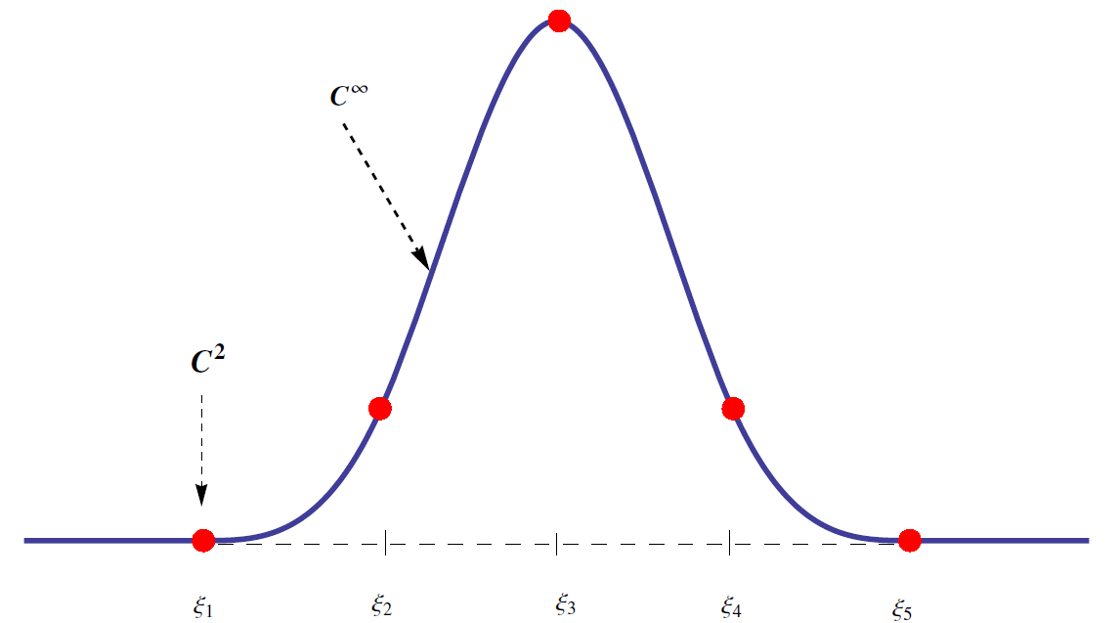

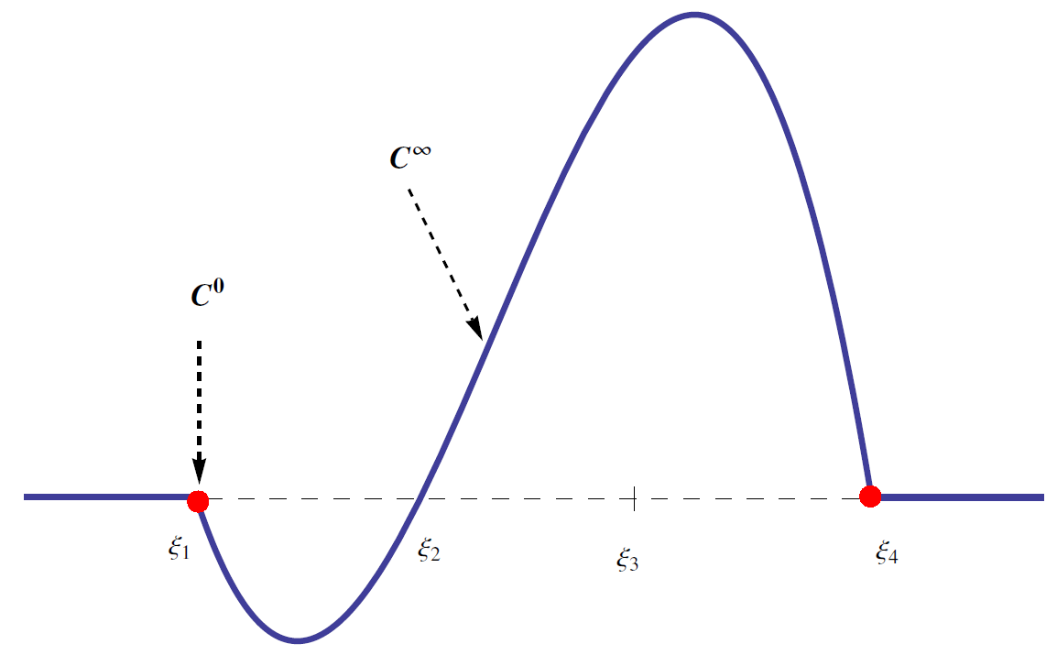
Isogeometric analysis: integrating FEA and CAD
B-spline basis functions
Cubic B-spline
with knot vector
Langrange basis function of order 3

Slide 4
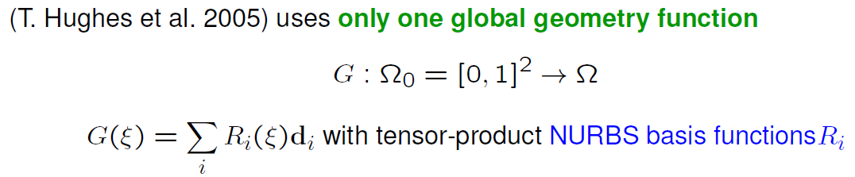
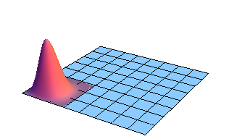
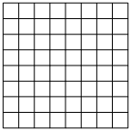
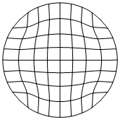

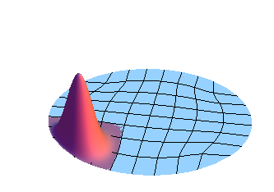

Isogeometric analysis: integrating FEA and CAD
Isoparametric approach in IGA
G

Slide 5
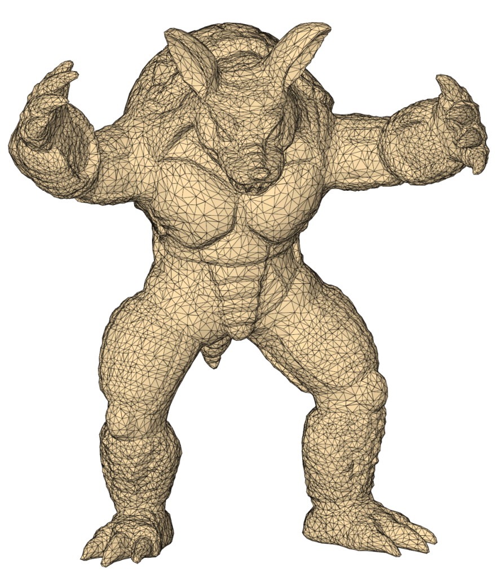
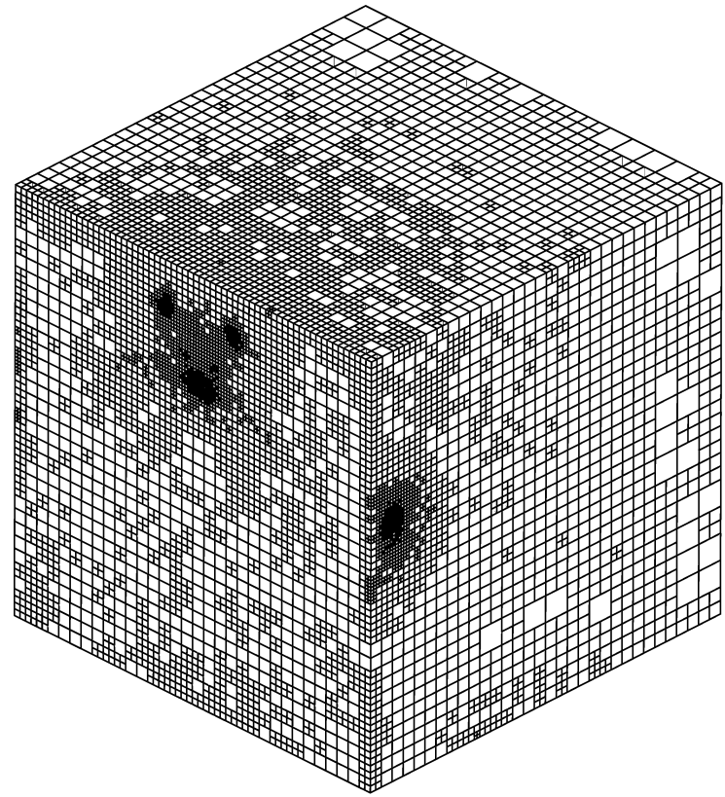
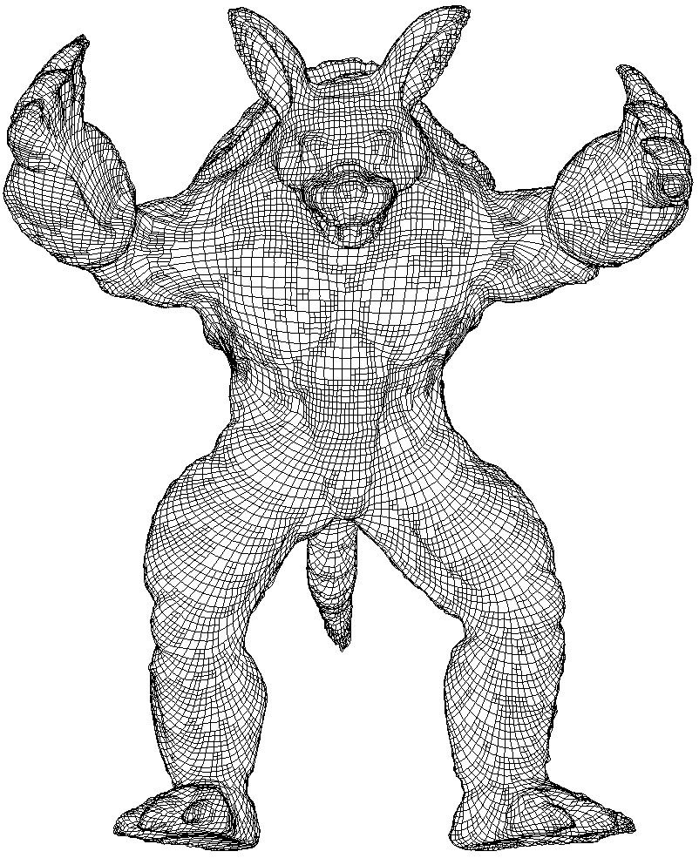
Isogeometric analysis: integrating FEA and CAD
Open problems
Volumetric parameterization of computational domain from its surface
representation.
CAD provides only surface representation of the geometry. For application of IGA it is necessary to have robust and effective method to obtain analysis-suitable volume parameterization
Input surface
spline volume parameterization

Slide 6
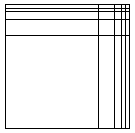
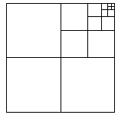
Isogeometric analysis: integrating FEA and CAD
Open problems
Local refinement.
Tensor product structure does not allow local enrichment of approximation space: knot insertion propagates thru the domain. A strategy for defining spline spaces over meshes with T-juntions (T-meshes) is needed.
global refinement
local refinement

Slide 7
Our results
A method for spline parameterization of 2D and 3D
geometries
A new strategy for constructing cubic spline spaces over
quadtree (2D) and octree (3D) T-meshes

Slide 8
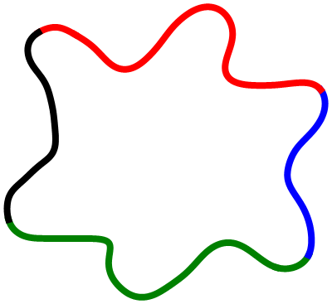
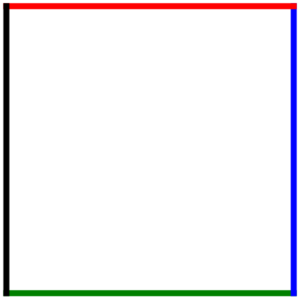
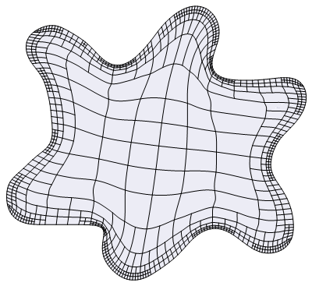
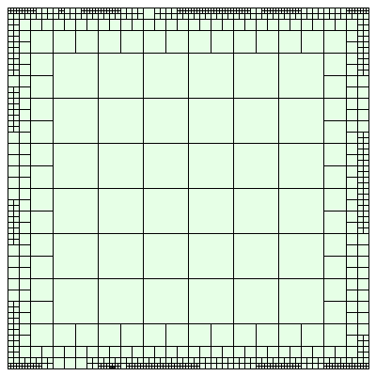
Our results: spline parameterization of 2D geometries
Goal: construct a global transformation from parametric to physical domain from boundary representation of the geometry
Good quality parameterization:
Strictly positive Jacobian
Good orthogonality and uniformity of isoparametric curves
S

Slide 9
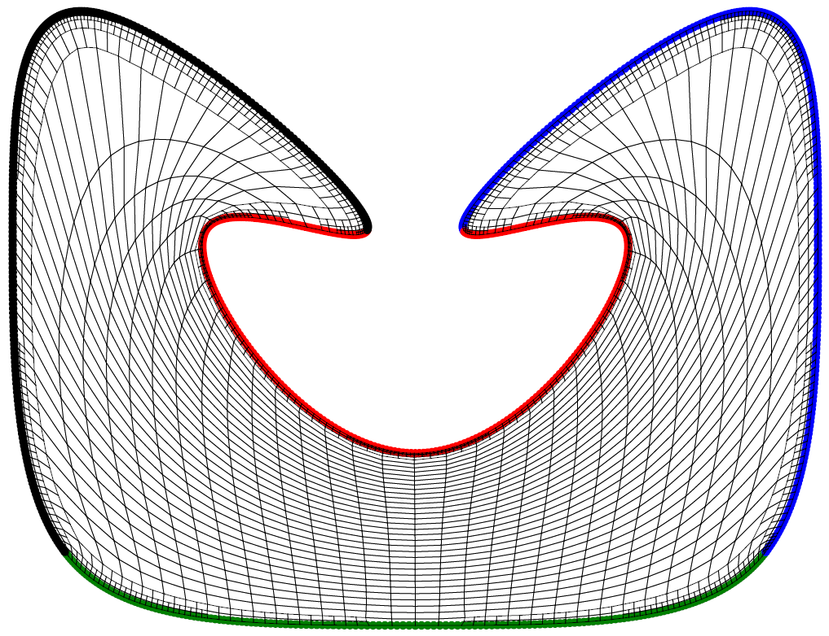
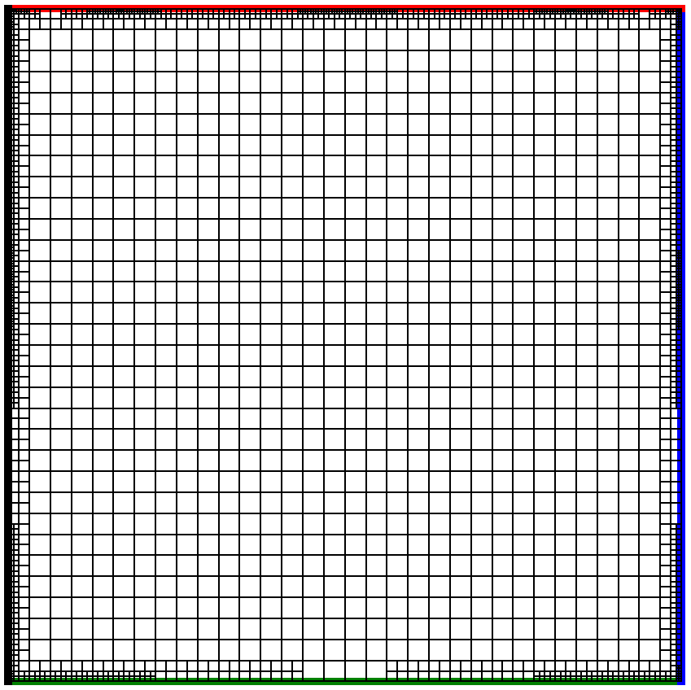

Spline parameterization of 2D geometries
The key: untangling and smoothing procedure for T-mesh
Parametric T-mesh is deformed
isomorphically into
the physical T-mesh
Local optimization: determine a new position of the free node to improve mesh quality
free node
Minimize the objective function K(x)
to find the optimal position x₀ of the free node
local mesh
optimized local mesh

Slide 10
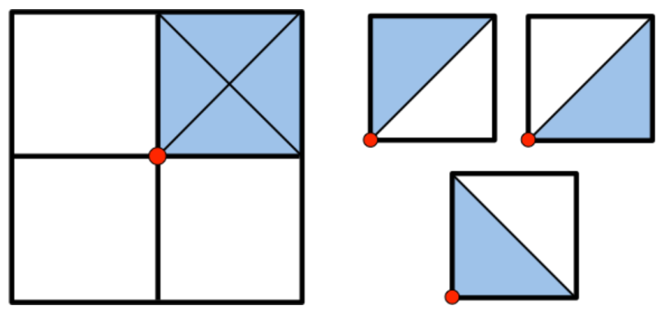
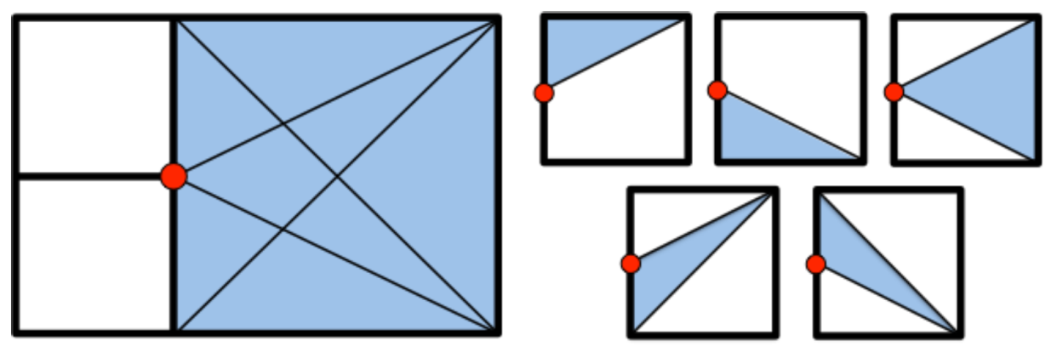
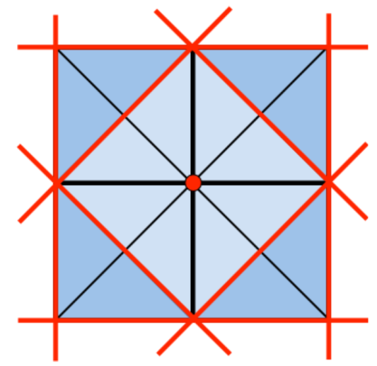
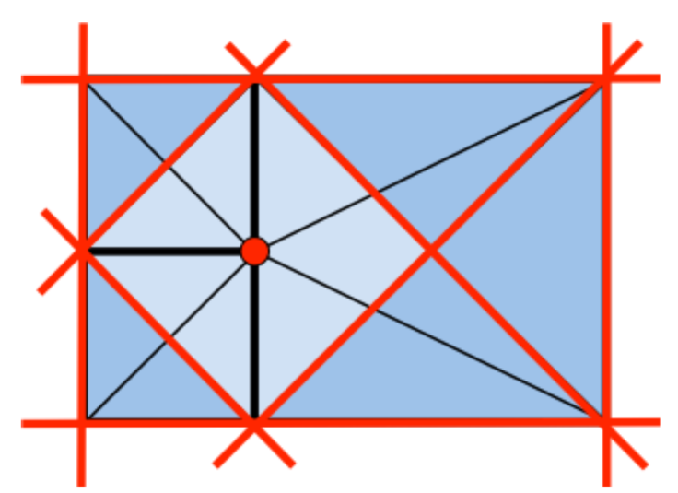
Simultaneous Untangling and Smoothing of T-meshes
Triangle decomposition of the T-mesh cells
Case 1: Free node is a regular node
Case 2: Free node is a hanging node
Barriers and feasible region for a regular node
Barriers and feasible region for a hanging node

Slide 11
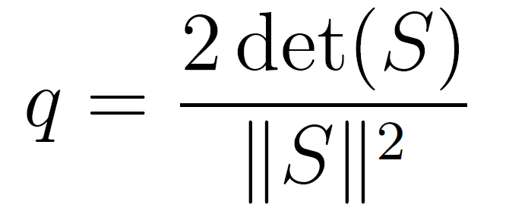
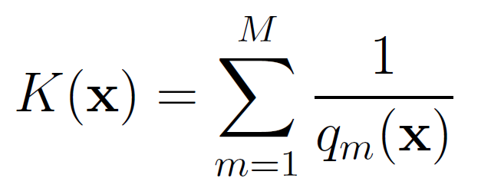
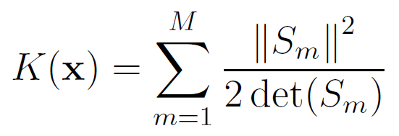
Simultaneous Untangling and Smoothing of T-meshes
Quality measure. Objective function
Local submesh is decomposed in triangles.
Shape quality measure for a triangle: mean ratio
Objective function:
S
M: number of elements of the local submesh
ideal triangle
physical triangle

Slide 12
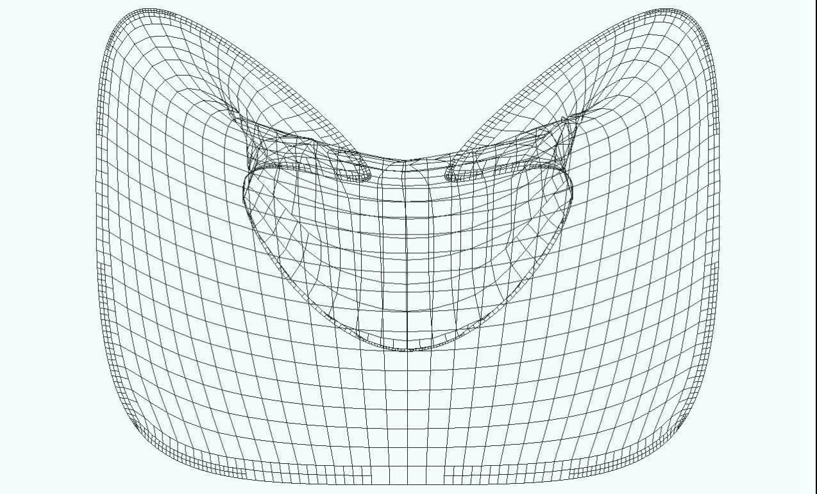
Simultaneous Untangling and Smoothing of T-meshes
T-mesh transformation along the SUS process: Video

Slide 13
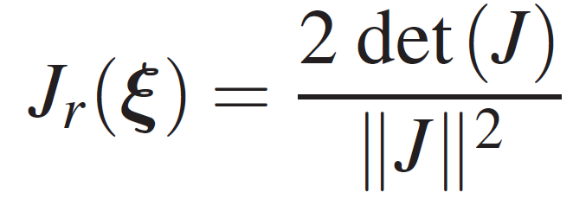
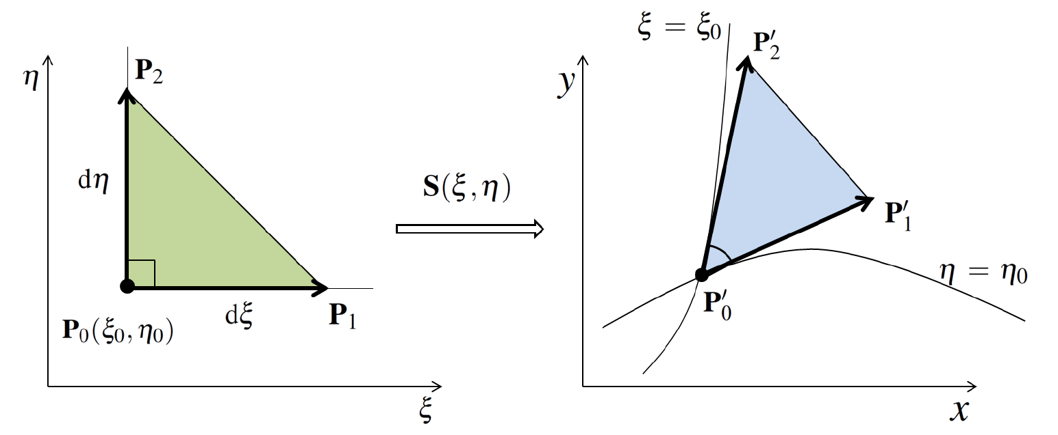
Mean Ratio Jacobian J_{r}(ξ) of Parametric Transformation
A quality metric of the mapping at any point P₀
-1 ≤
≤ 1
where J is the jacobian matrix of the
spline mapping S

Slide 14
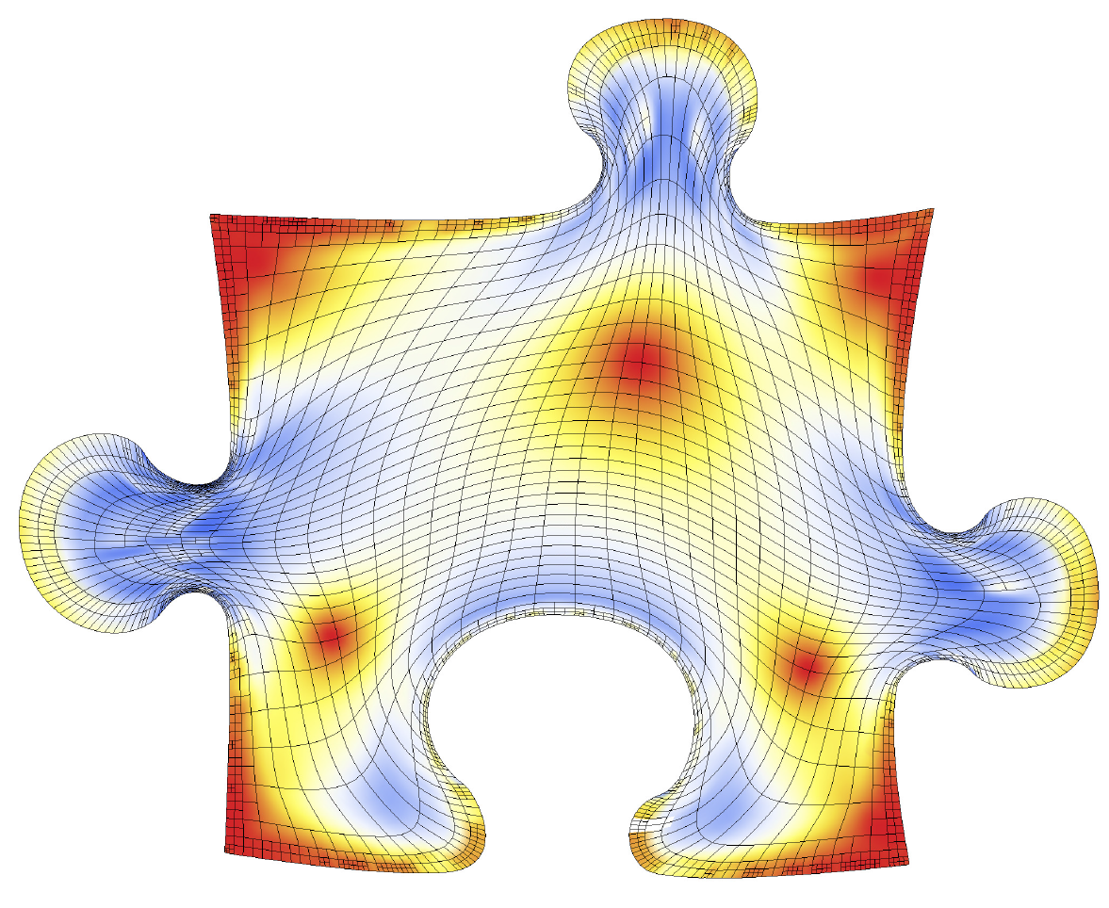
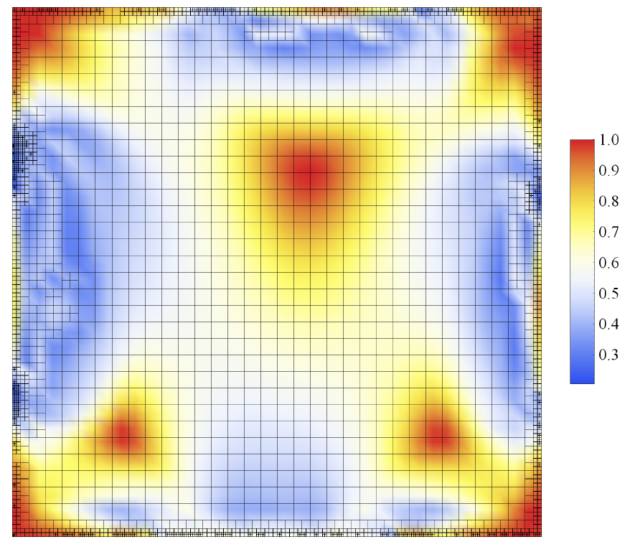
Spline parameterization of 2D geometries
Puzzle piece (Mean Ratio Jacobian)

Slide 15
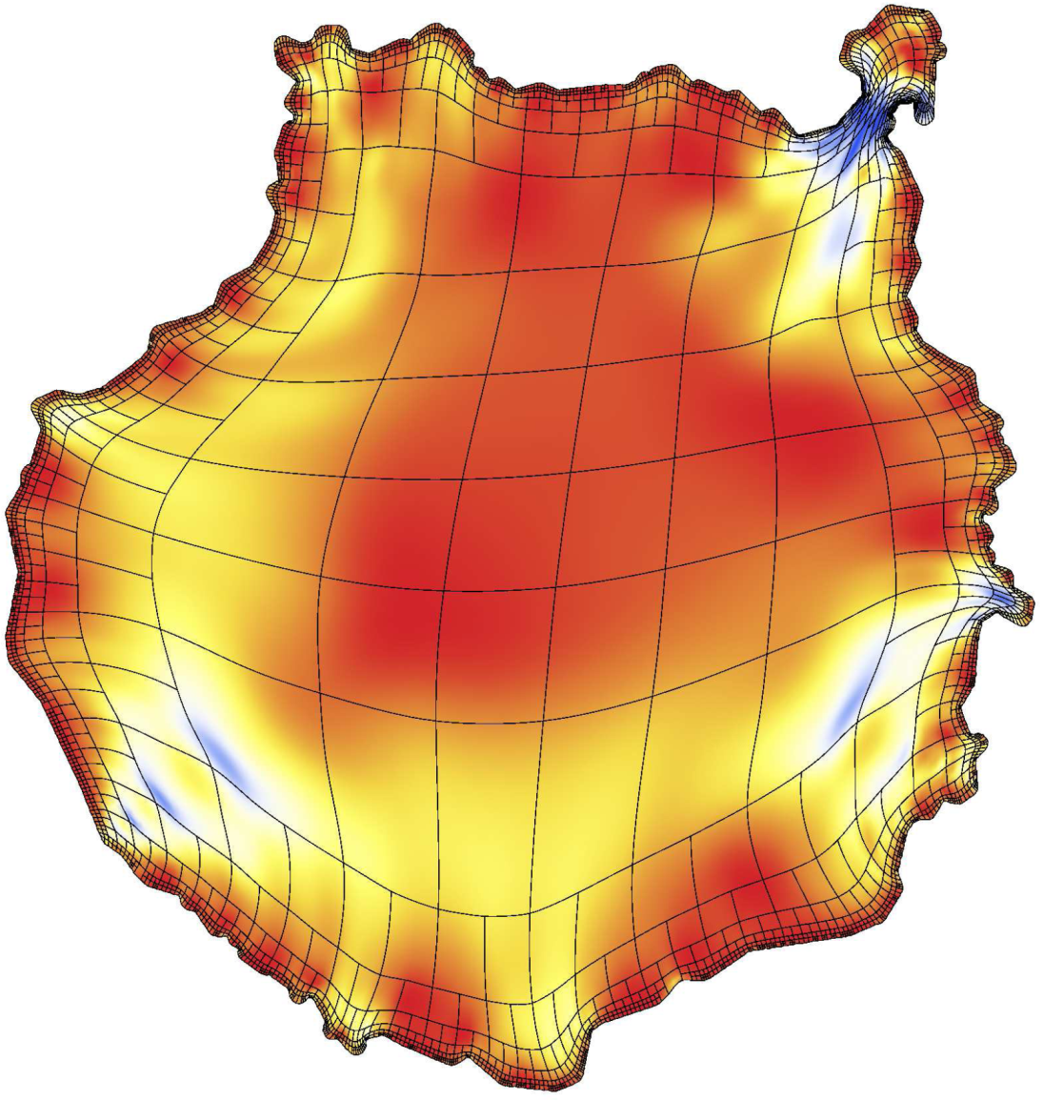
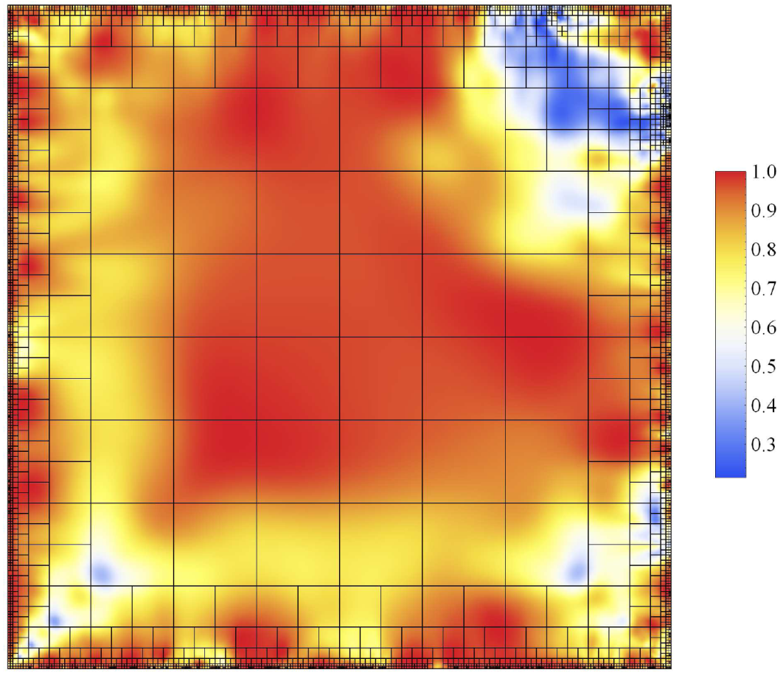
Good quality parameterization for application of IGA
Mean ratio Jacobian as a quality metric

Slide 16
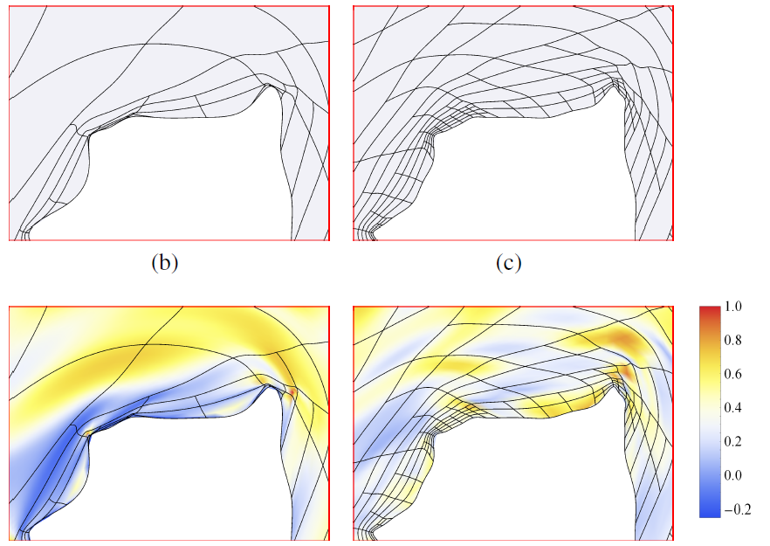
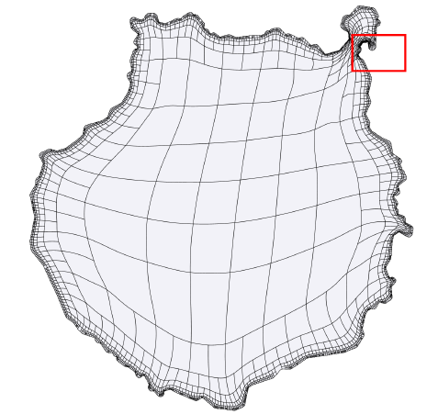
Spline parameterization of 2D geometries
Adaptive refinement to improve parameterization quality
Low quality zone is refined and optimized again
inicial T-spline
improved T-spline
Isla de Gran Canaria
Mean ratio Jacobian
Mean ratio Jacobian

Slide 17
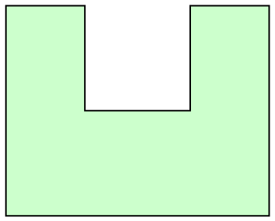
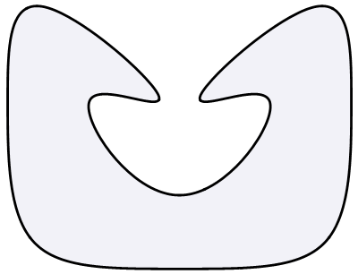
Spline parameterization of 2D geometries
Limitations and future research
What can we parameterize with a square? Something similar to a square and a little bit more.
We need more complex polycube-type parametric domain that fits better the geometry
[ Li (2007), Liu (2014)]

Slide 18
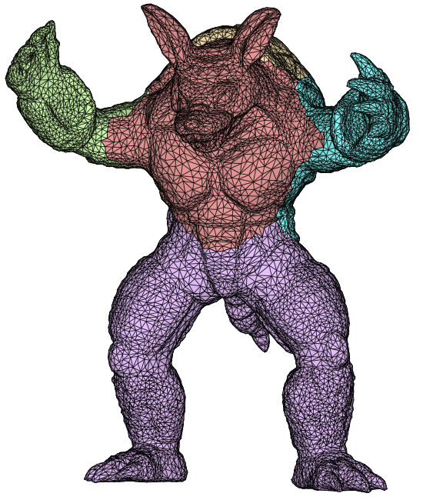
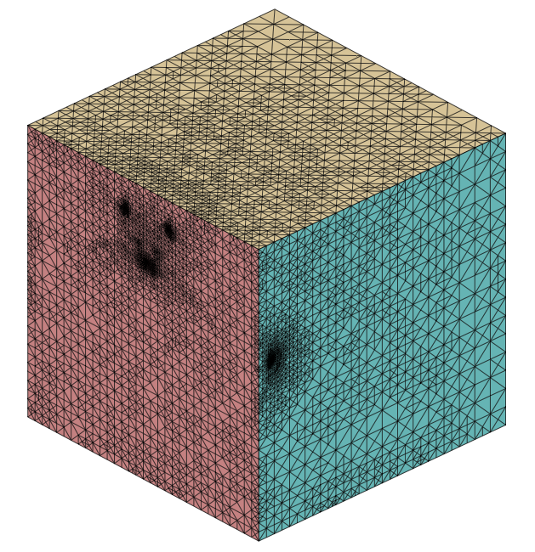
Spline parameterization of 2D and 3D geometries
Limitations and future research
All the above mentioned problems for 2D domain are aggravated considerably for 3D object:
An appropiate selection of the edges may not exist
More complex untangling and optimization procedure, the number of options increases a lot
(O. Ushakova: Nondegeneracy tests for hexahedral cells, CMAME 2011)
Jacobian close do cero along the edges of the object
Tensor product structure is too rigid.

Slide 19
Our results:
Polynomial spline spaces over hierarchical T-meshes
A new strategy for constructing cubic spline space over
arbitrary quadtree (2D) and octree (3D) T-meshes
For a given T-mesh, it allows to obtain a set of cubic spline functions that span
a space with nice properties: C² continuous, nested spaces, linear independence
Simple rules for inferring local knot vectors to define spline blending functions
Straightforward implementation in 2D and 3D

Slide 20
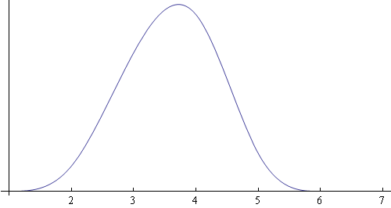
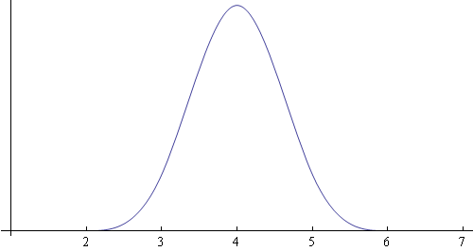
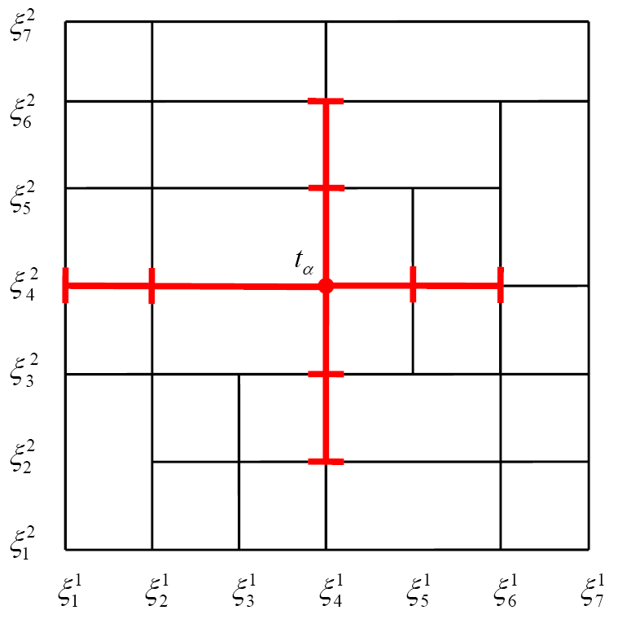
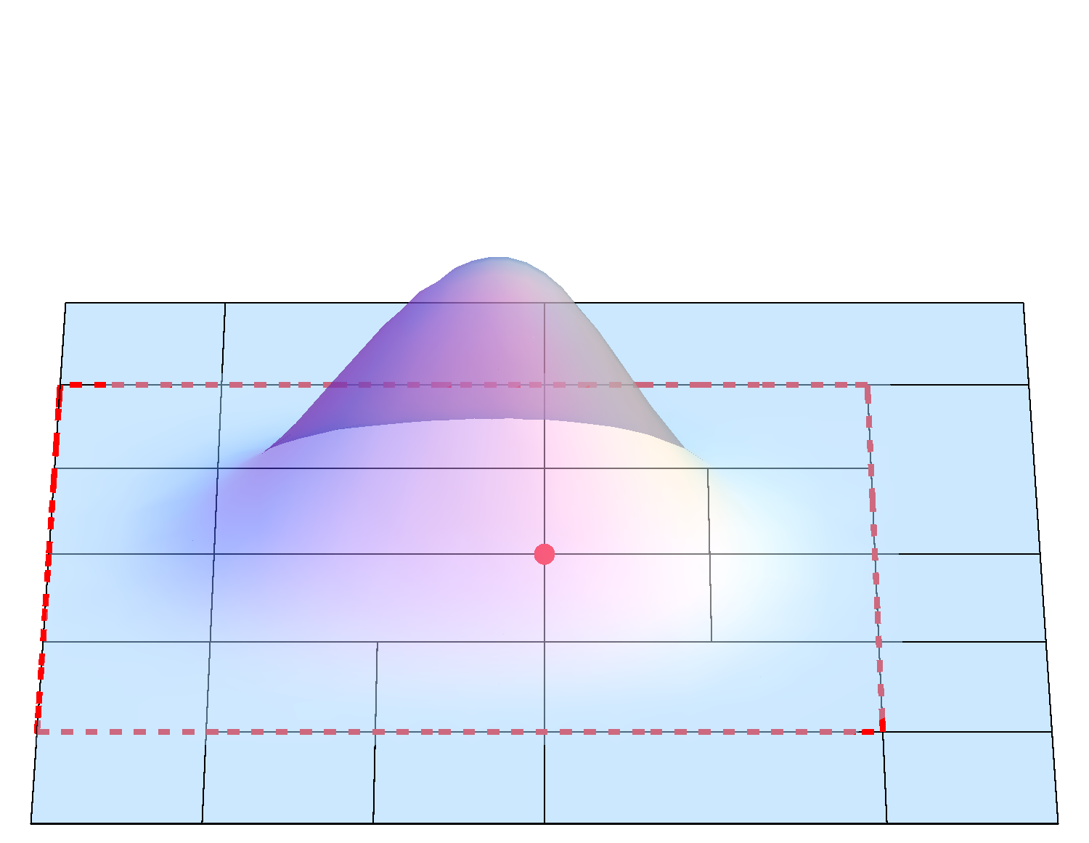
Spline spaces over T-meshes
T-splines, Sederberg (2003)
T-mesh and anchor t_{α}
support of the T-spline
Bivariate Cubic T-spline Basis Function
Knots associated to anchor t_{α} :
Normalized rational T-splines

Slide 21
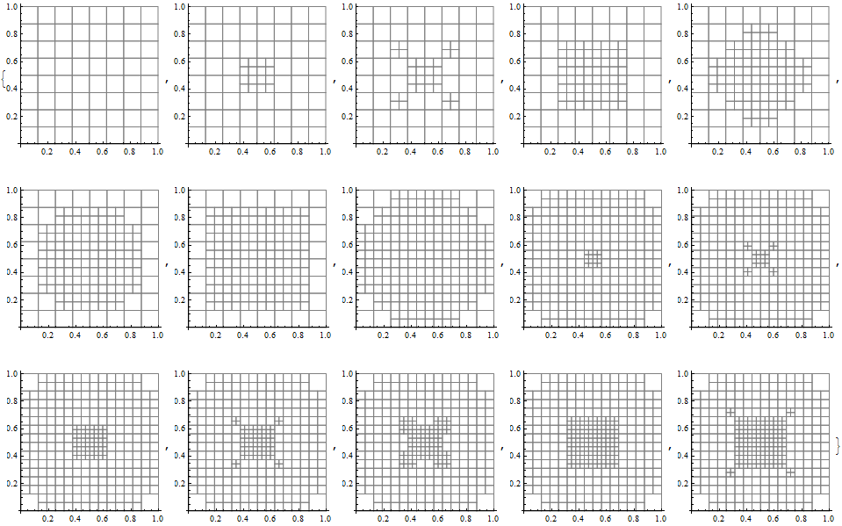
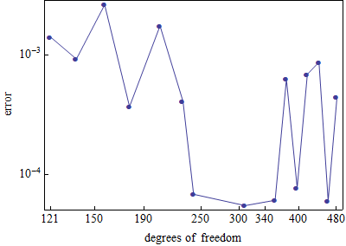
Spline spaces over T-meshes
T-splines, Sederberg (2003). Approximation capability of rational basis functions.
Adaptive refinement for the approximation of smooth gaussian-type function
via interpolation with rational T-splines
Error convergence en L² norm
It is time to drop the ‘‘R’’ from NURBS, EWC, 2014
Les A. Piegl • Wayne Tiller • Khairan Rajab

Slide 22
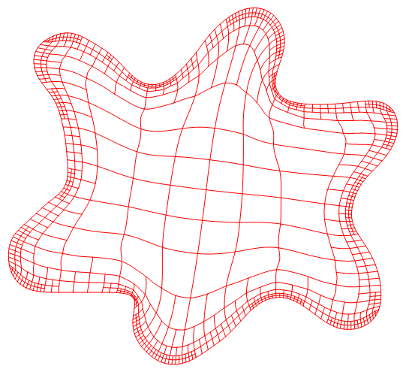
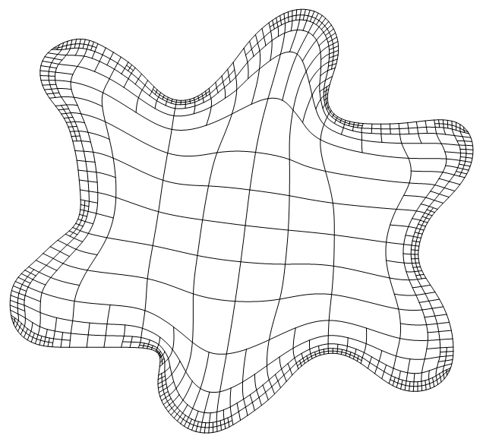
Spline spaces over T-meshes
T-splines, Sederberg (2003). Aproximation capability?
T-spline parameterization, Sederberg
(rational blending functions )
Spline parameterization with the new strategy
(polynomial blending functions)

Slide 23
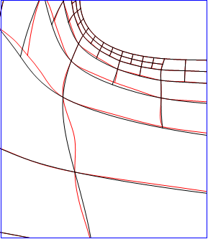


Good quality parameterization for application of IGA
Comparison of rational T-spline parameterization with the new strategy
rational T-spline parameterization presents more oscillation

Slide 24



Spline spaces over T-meshes
Available strategies
Analysis suitable T-spline, Scott (2011)
nested spaces
linear independence
optimal support overlapping
topoligical restriction for the T-mesh
difficult to implement => Does not exist in 3D yet!
Hierachical refinement for IGA, Vuong (2011), Schillinger (2012), Bornemann(2012)
nested spaces
linear independence
relatively easy implementation
excesive support overlapping
imposibility to define spline
space over an arbitrary mesh

Slide 25
Spline spaces over T-meshes
Our strategy
Our objective
simple and easy implementation
nice properties: linear independence and nested spaces
We work with 0-balanced quadtree and octree T-meshes
unbalanced T-mesh
0-balanced T-mesh

Slide 26



Spline spaces over T-meshes
Construction of spline space. 3 Steps
Steps to define spline basis functions over a given T-mesh:
Mesh pretreatment: 0-balancing
Inferring local knot vectors
Modification of local knot vectors
Condition 1: Local knot vectors verify:
Condition 2: The frame of the function support should
be situated over the mesh skeleton:

Slide 27

Spline spaces over T-meshes
Definition of polynomial spline functions. Extension rules in 2D
Support modification
to fulfill the imposed conditions
Simple extension rules:
duplicate some knot intervals

Slide 28

Spline spaces over T-meshes
Definition of polynomial spline functions. Extension rules in 3D
Support modification
to fulfill the imposed conditions
Simple extension rules in 3D as well !

Slide 29





Isogeometric analysis on 2D domain
Poisson problem with Dirichlet boundary condition
Analytical solution:
Residual-type error indicator:

Slide 30







Adaptive refinement for 2D Poisson problem
Error indicator :
d

Slide 31


Adaptive refinement for 2D Poisson problem
Monotonous convergence: L²-norm and H¹-seminorm error

Slide 32




Isogeometric analysis on 2D complex domain
Poisson problem with Dirichlet boundary condition on a puzzle piece
● Analytical solution: Steep wave front given by
,
,
● Adaptive strategy: Residual-type error indicator:

Slide 33
Isogeometric analysis for 2D Poisson problem
Parameterization of computational domain

Slide 34


Adaptive refinement for 2D Poisson problem
Adaptive T-mesh after 13 refinement steps
final refinement in the parametric
domain
final refinement in the physical domain

Slide 35

Adaptive refinement for 2D Poisson problem
Numerical solution
numerical solution in the parametric domain
numerical solution in the physical domain

Slide 36

Adaptive refinement for 2D Poisson problem
Convergence behavior
Convergence of L²-norm and H¹-seminorm error
expected order for 2D problem:
L²-norm: 2
H¹-seminorm: 3/2

Slide 37





Isogeometric analysis for 3D Poisson problem
Computational domain: sphere portion
Analytical solution:
oscillation parameter
numerical solution in the physical domain
numerical solution in the parametric domain

Slide 38


Adaptive refinement for 3D Poisson problem
Adaptive refinement
final refinement in the physical domain
final refinement in the parametric domain

Slide 39




Adaptive refinement for 3D Poisson problem
A section of the parametric and physical domain
final refinement in the physical domain
final refinement in the parametric domain
numerical solution in the physical domain
numerical solution in the parametric domain

Slide 40

Adaptive refinement for 3D Poisson problem
Convergence behavior
Convergence of L²-norm and H¹-seminorm error
expected order for 3D problem:
L²-norm: 3/2
H¹-seminorm: 1

Slide 41



Application in CAD
Surface representation
Spline representation of the surface from its triangulation
input triangulation
spline representation
parametric T-mesh

Slide 42
Spline spaces over T-meshes
Limitations and future research
Excesive overlapping of function support in some situations
Possible improvement of the locallity of function supports
Rigorous proof of the properties of the spaces defined with our strategy:
linear independence
nestedness of the spaces

Slide 43

Isogeometric analysis
Future research
And another interesting question.
Is IGA always better than FEM ?
C² is alwais better than C⁰ ?
It seems to be a lot better for approximation of very smooth function.
And not so smooth ??? Should be studied.
Spline approximation of a steep function

Slide 44
GRACIAS !

