Slide 1
Mesh Generation and Isogeometric Analysis
J.I. López⁽¹⁾, M. Brovka⁽¹⁾, J.M. Escobar⁽¹⁾, J.M. Cascón⁽²⁾, A. Oliver⁽¹⁾, J. Ramírez⁽¹⁾,
G.V. Socorro⁽¹⁾, E. Rodríguez⁽¹⁾, G. Montero⁽¹⁾ and R. Montenegro⁽¹⁾*
⁽¹⁾ University Institute SIANI, University of Las Palmas de Gran Canaria, Spain
⁽²⁾ Department of Economics and History of Economics, University of Salamanca, Spain
AGH University of Science and Technology, Department of Computer Science,
April 2, 2014, Kraków, Poland
MINECO y FEDER Project: CGL2011-29396-C03-00
CONACYT-SENER Project, Fondo Sectorial, contract: 163723
http://www.dca.iusiani.ulpgc.es/proyecto2012-2014

Slide 2
http://www.dca.iusiani.ulpgc.es/proyecto2012-2014

Slide 3
Contents
Mesh generation, volume parameterization and isogeometric analysis
The Meccano Method (based on tetrahedral mesh optimization)
The initial algorithm for tetrahedral mesh generation
Volumetric parameterization of tetrahedral meshes
Application to finite element and isogeometric solid modeling and analysis
The Meccano Method (based on a new 2D T-mesh optimization)
The new algorithm for two-dimensional T-mesh generation
T-spline parameterization of 2D geometries
Geometries with several materials or holes
Application to isogeometric modeling and analysis
Comments and Future Research
Notes:
Decimos que un tetraedro es de Tipo I si está marcado con el indicador de error. Se introducen 6 nuevos nodos en el punto medio de sus aristas y se subdividen cada una de sus cuatro caras en 4 triángulos, uniendo los puntos que se han introducido.
Cuatro subtetraedros quedan determinados a partir de los cuatro vértices del tetraedro original y las nuevas aristas.
Los otros cuatro tetraedros se obtienen al unir los dos vértices opuestos más cercanos del octaedro que resulta en el interior. Estudios de Löhner y Baum aseguran que esta elección produce el menor número de tetraedros distorsionados en la malla refinada. Existen otras dos opciones para subdividir el octaedro, y se podría analizar la calidad de las divisiones, pero aumentaría el coste computacional del algoritmo.
Una vez marcados los tetraedros de Tipo I, para asegurar la conformidad de la malla nos podemos encontrar con tetraedros vecinos que pueden tener 6, 5,..., 1, ó 0 nuevos nodos introducidos.
Aquellos tetraedros que por razones de conformidad tengan marcadas sus 6 aristas pasa automáticamente al conjunto de tetraedros de Tipo I.

Slide 4
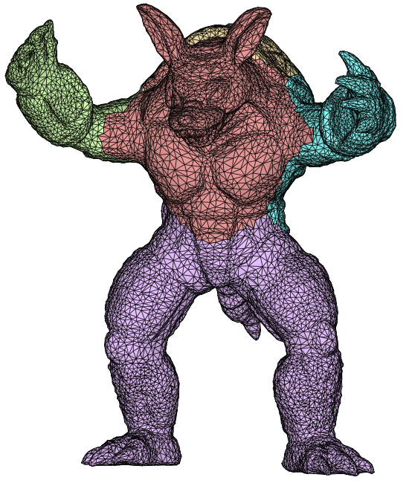
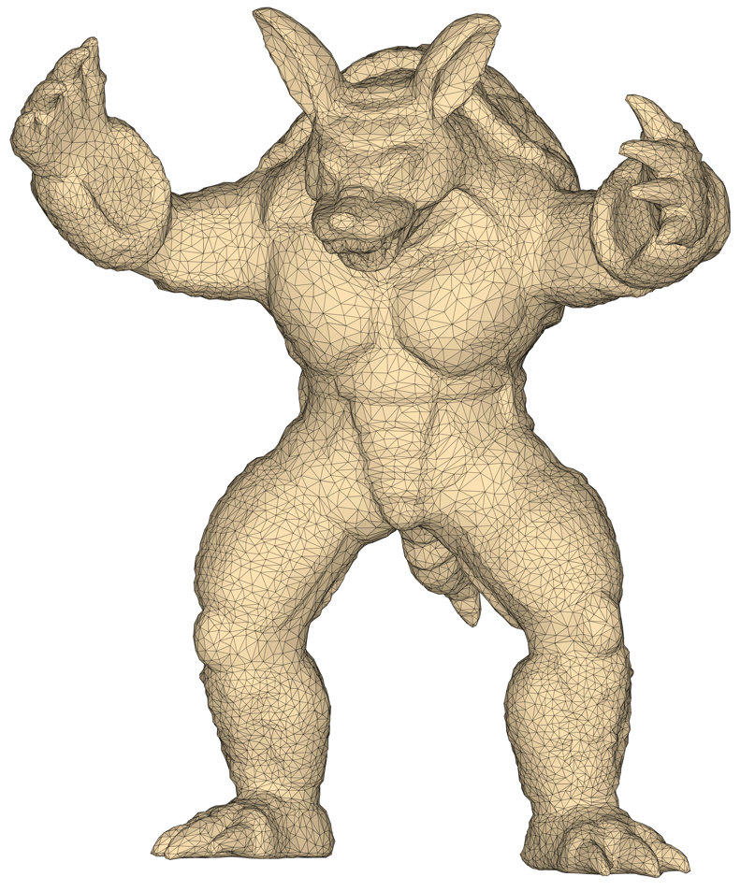
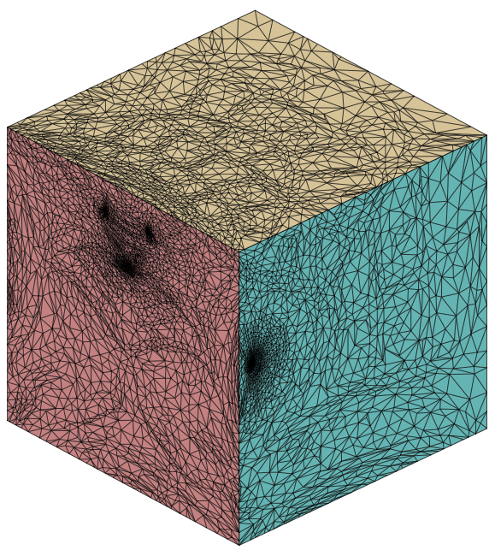
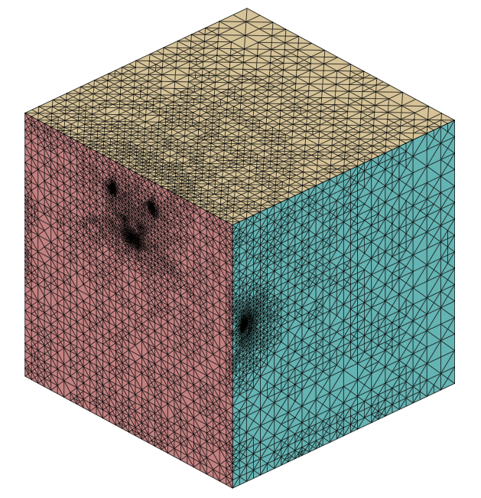
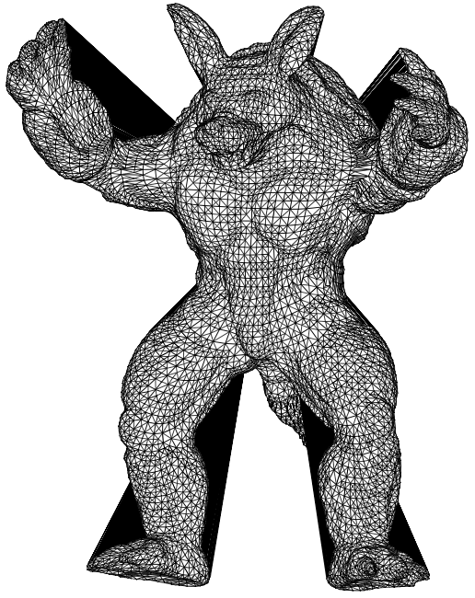
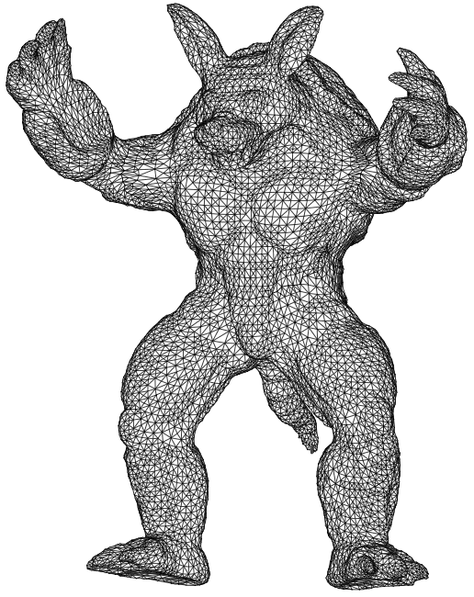
Meccano Method for Complex Solids
Volume parameterization based on SUS of tetrahedral meshes
Parameterization
Refinement
Untangling/Smoothing

Slide 5
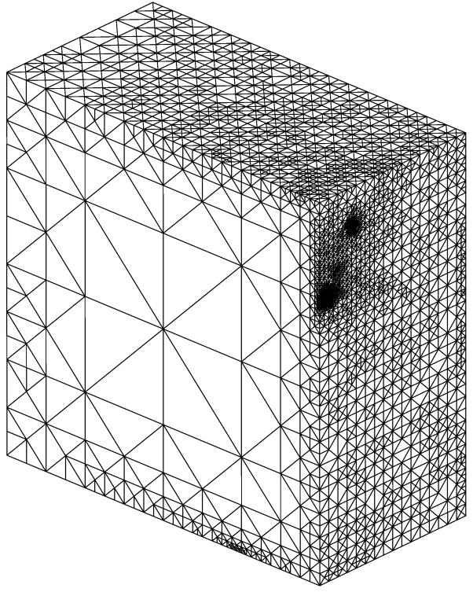
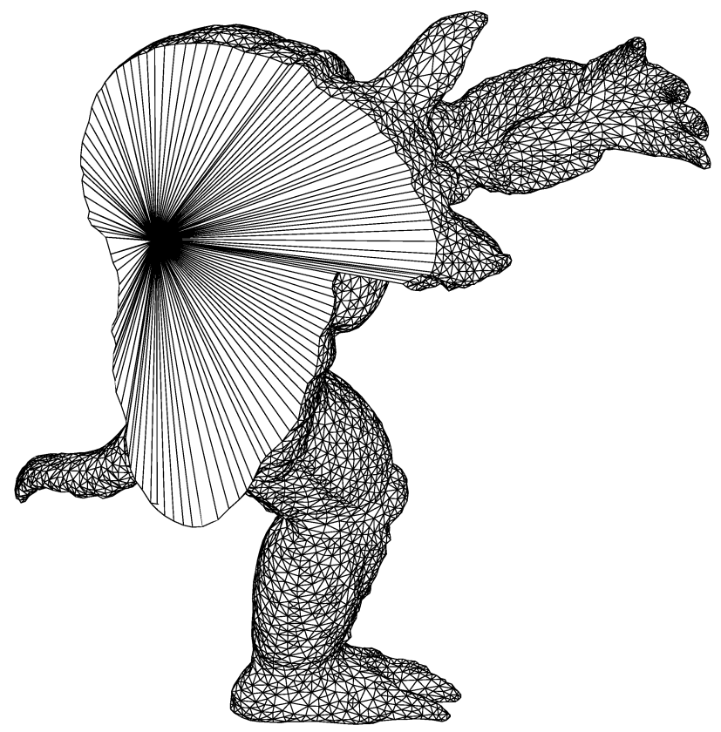
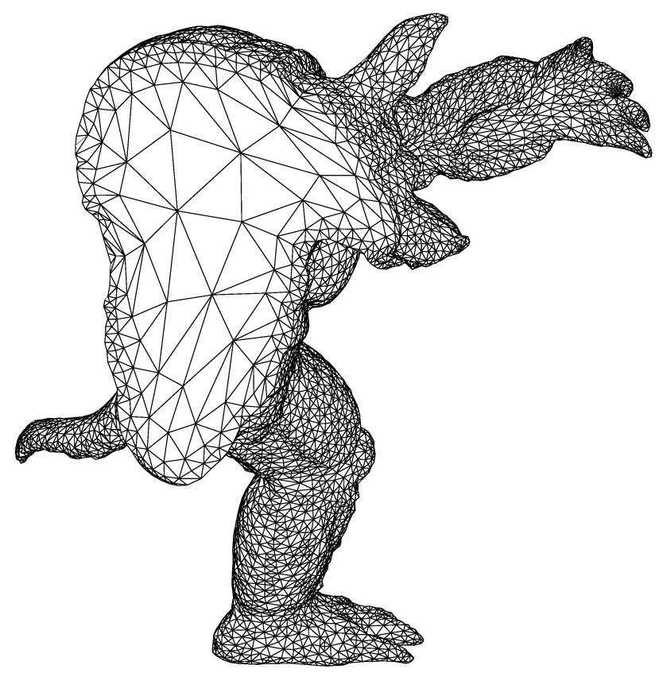
Meccano Method for Complex Solids
Volume parameterization based on SUS of tetrahedral meshes
T
T_{t}
Optimization
Parameter space (meccano mesh)
Physical space
(tangled mesh)
Physical space
(optimized mesh)
Optimization
Target Element T_{t} Physical Element T
(to get less distortion in the parameterization)

Slide 6
Meccano Method for Complex Solids
Algorithm steps
Parameterization of the solid surface
Coarse tetrahedral mesh of the meccano
Solid boundary approximation
Inner node relocation
Simultaneous untangling and smoothing
Solid boundary partition
Kossaczky’s refinement
Distance evaluation
Coons patches
SUS
Hexahedron subdivision into six tetrahedra
Meccano construction
Floater’s parameterization
Partition into hexahedra

Slide 7
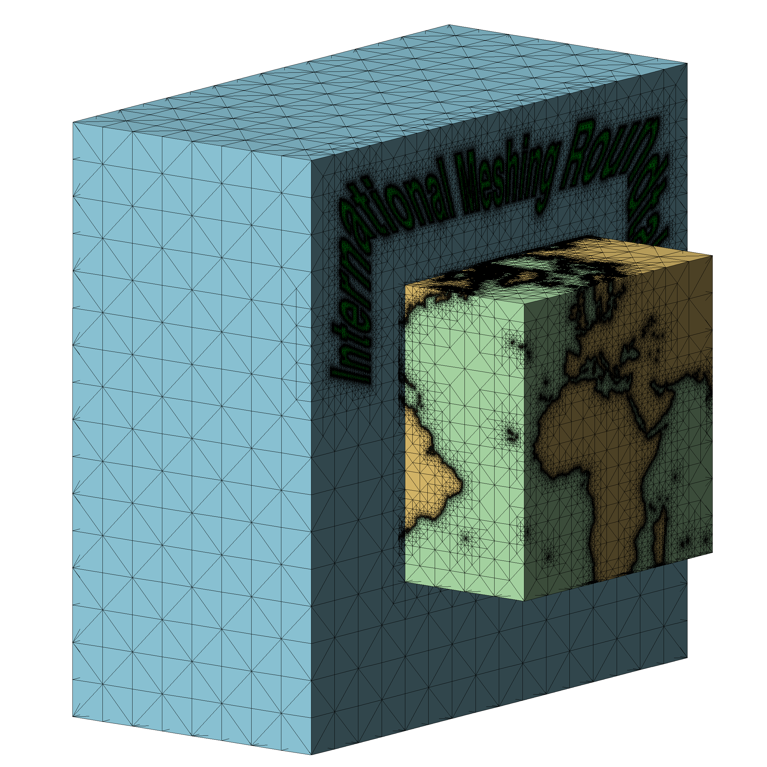
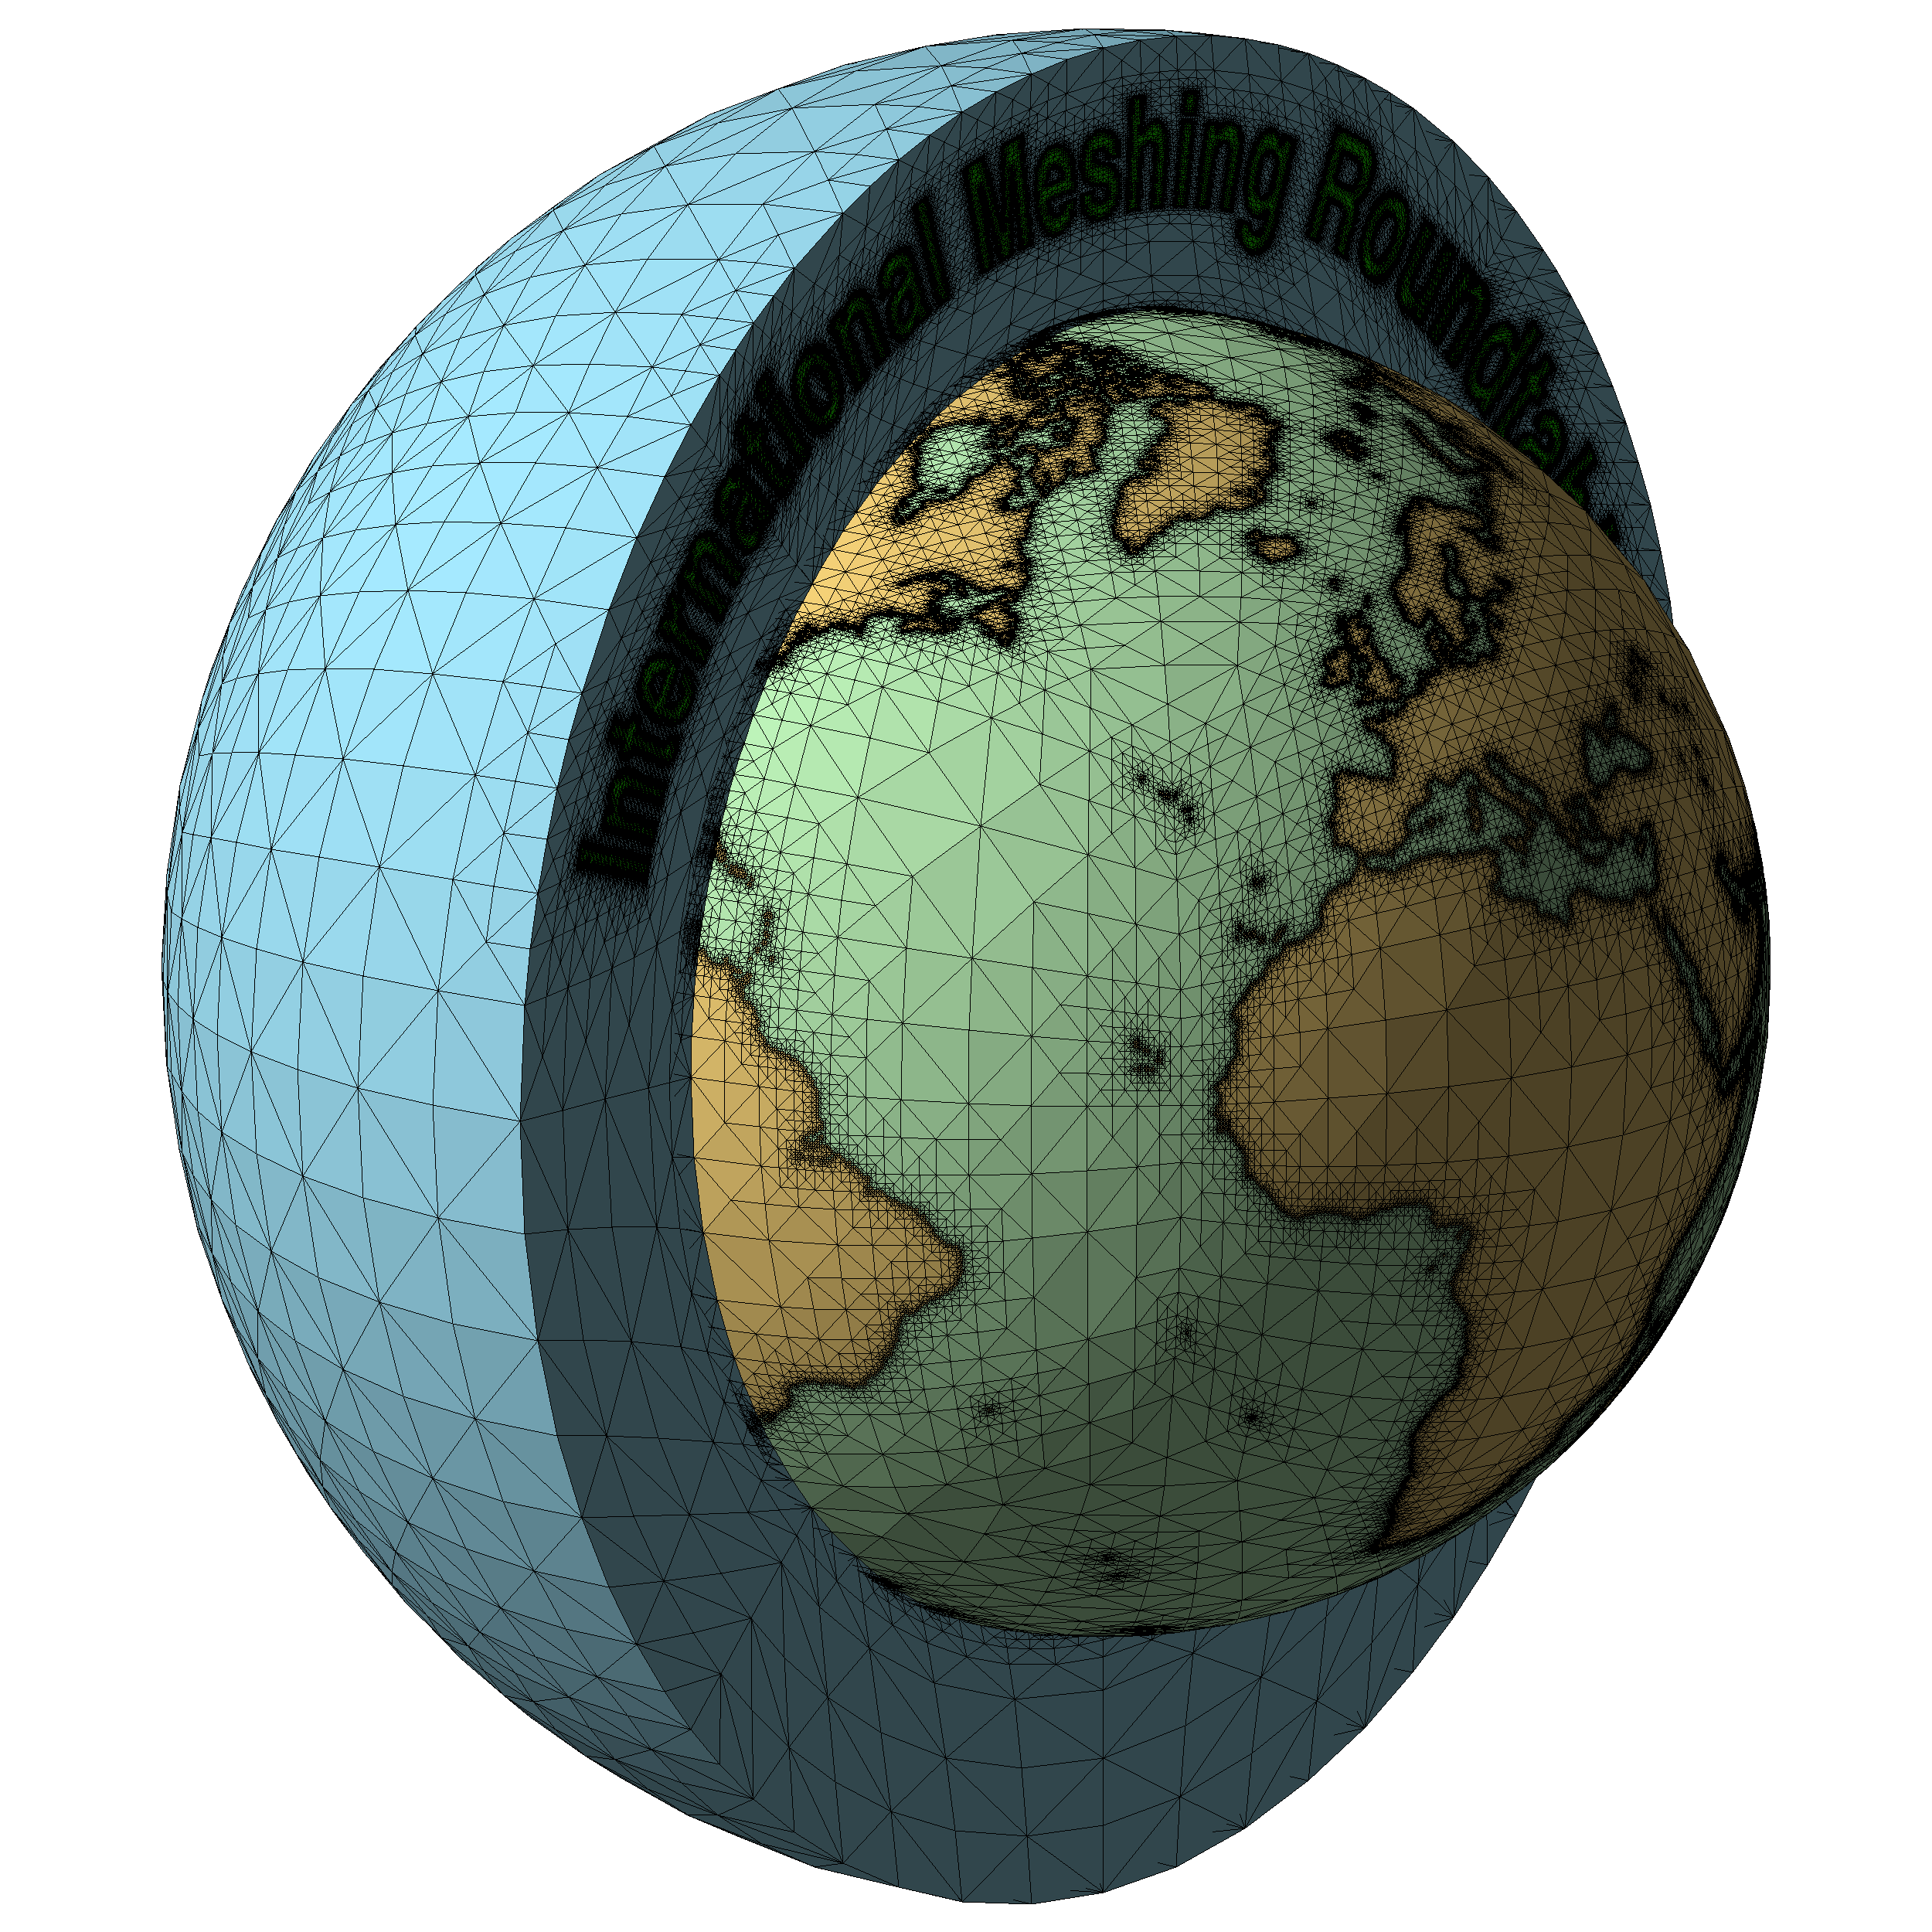

Slide 8
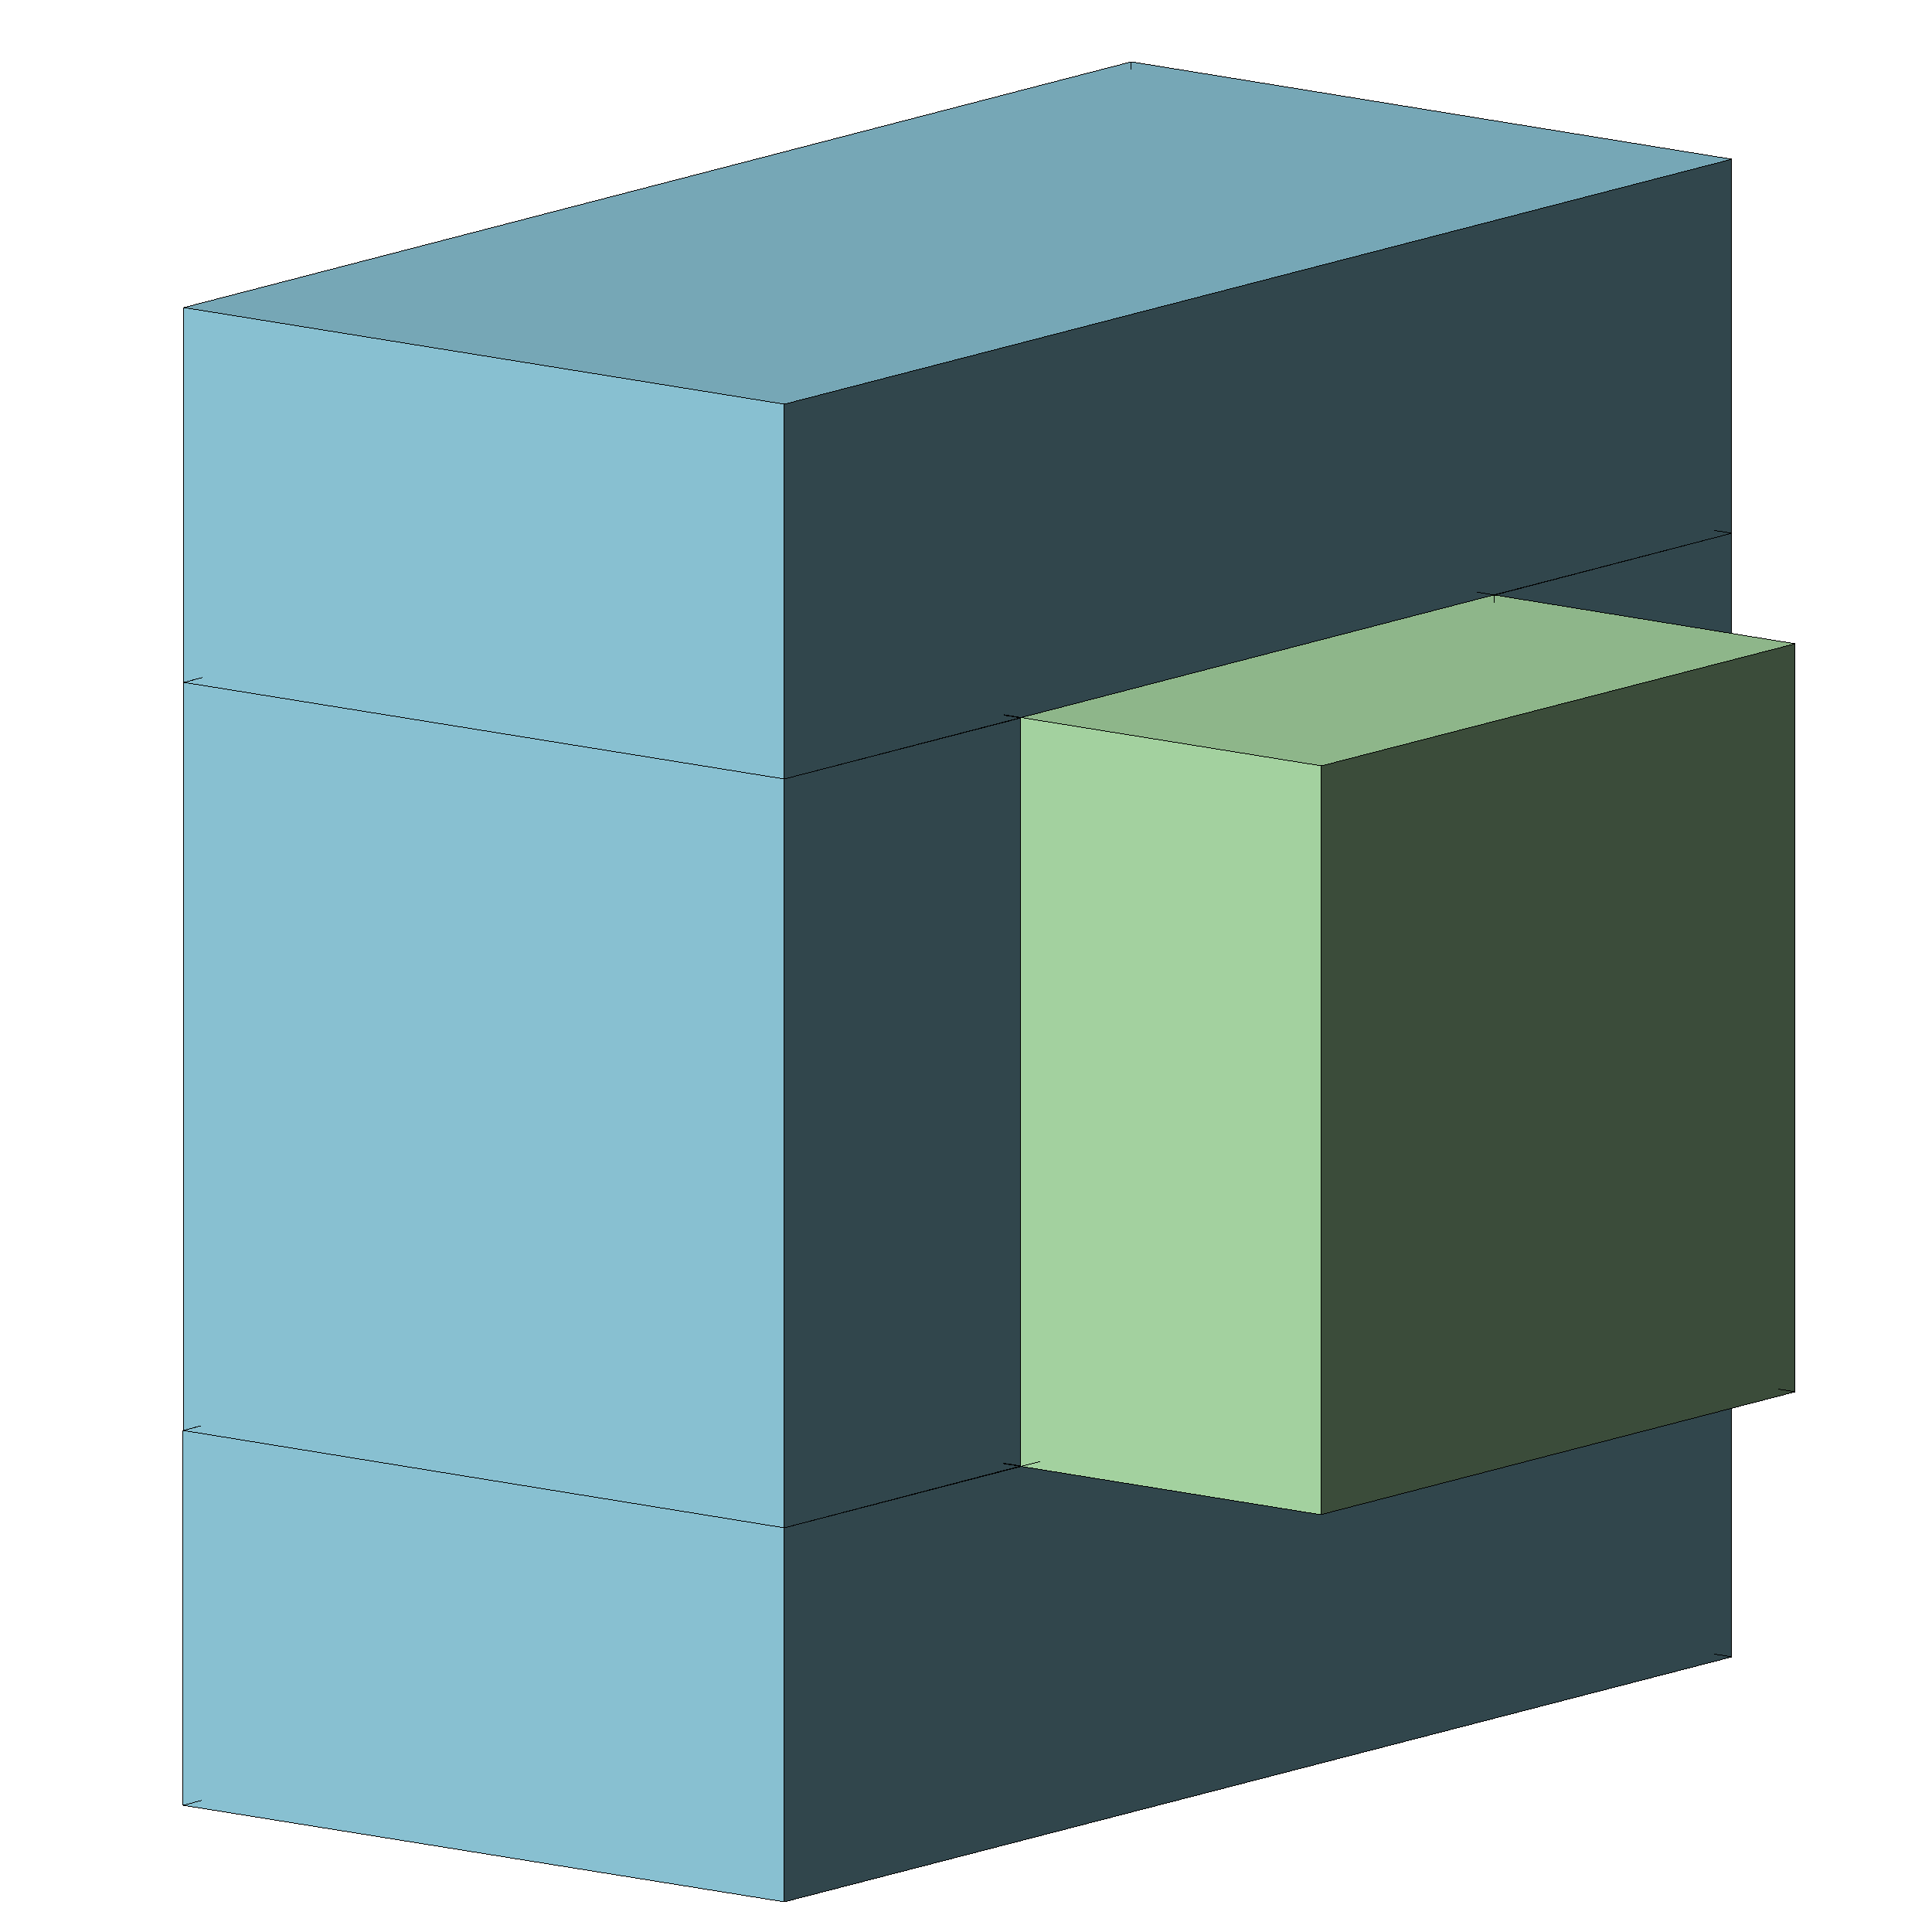

Slide 11
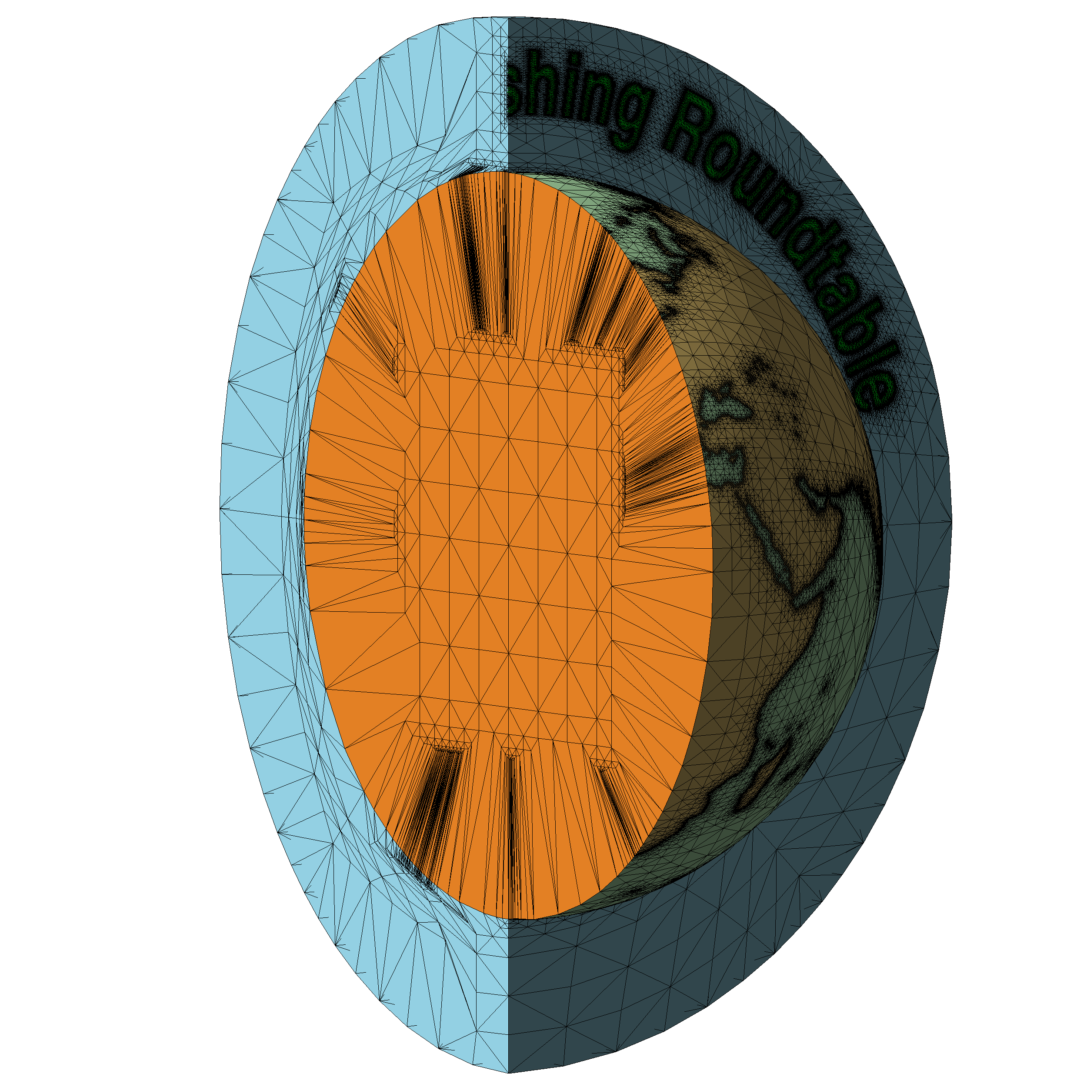

Slide 12
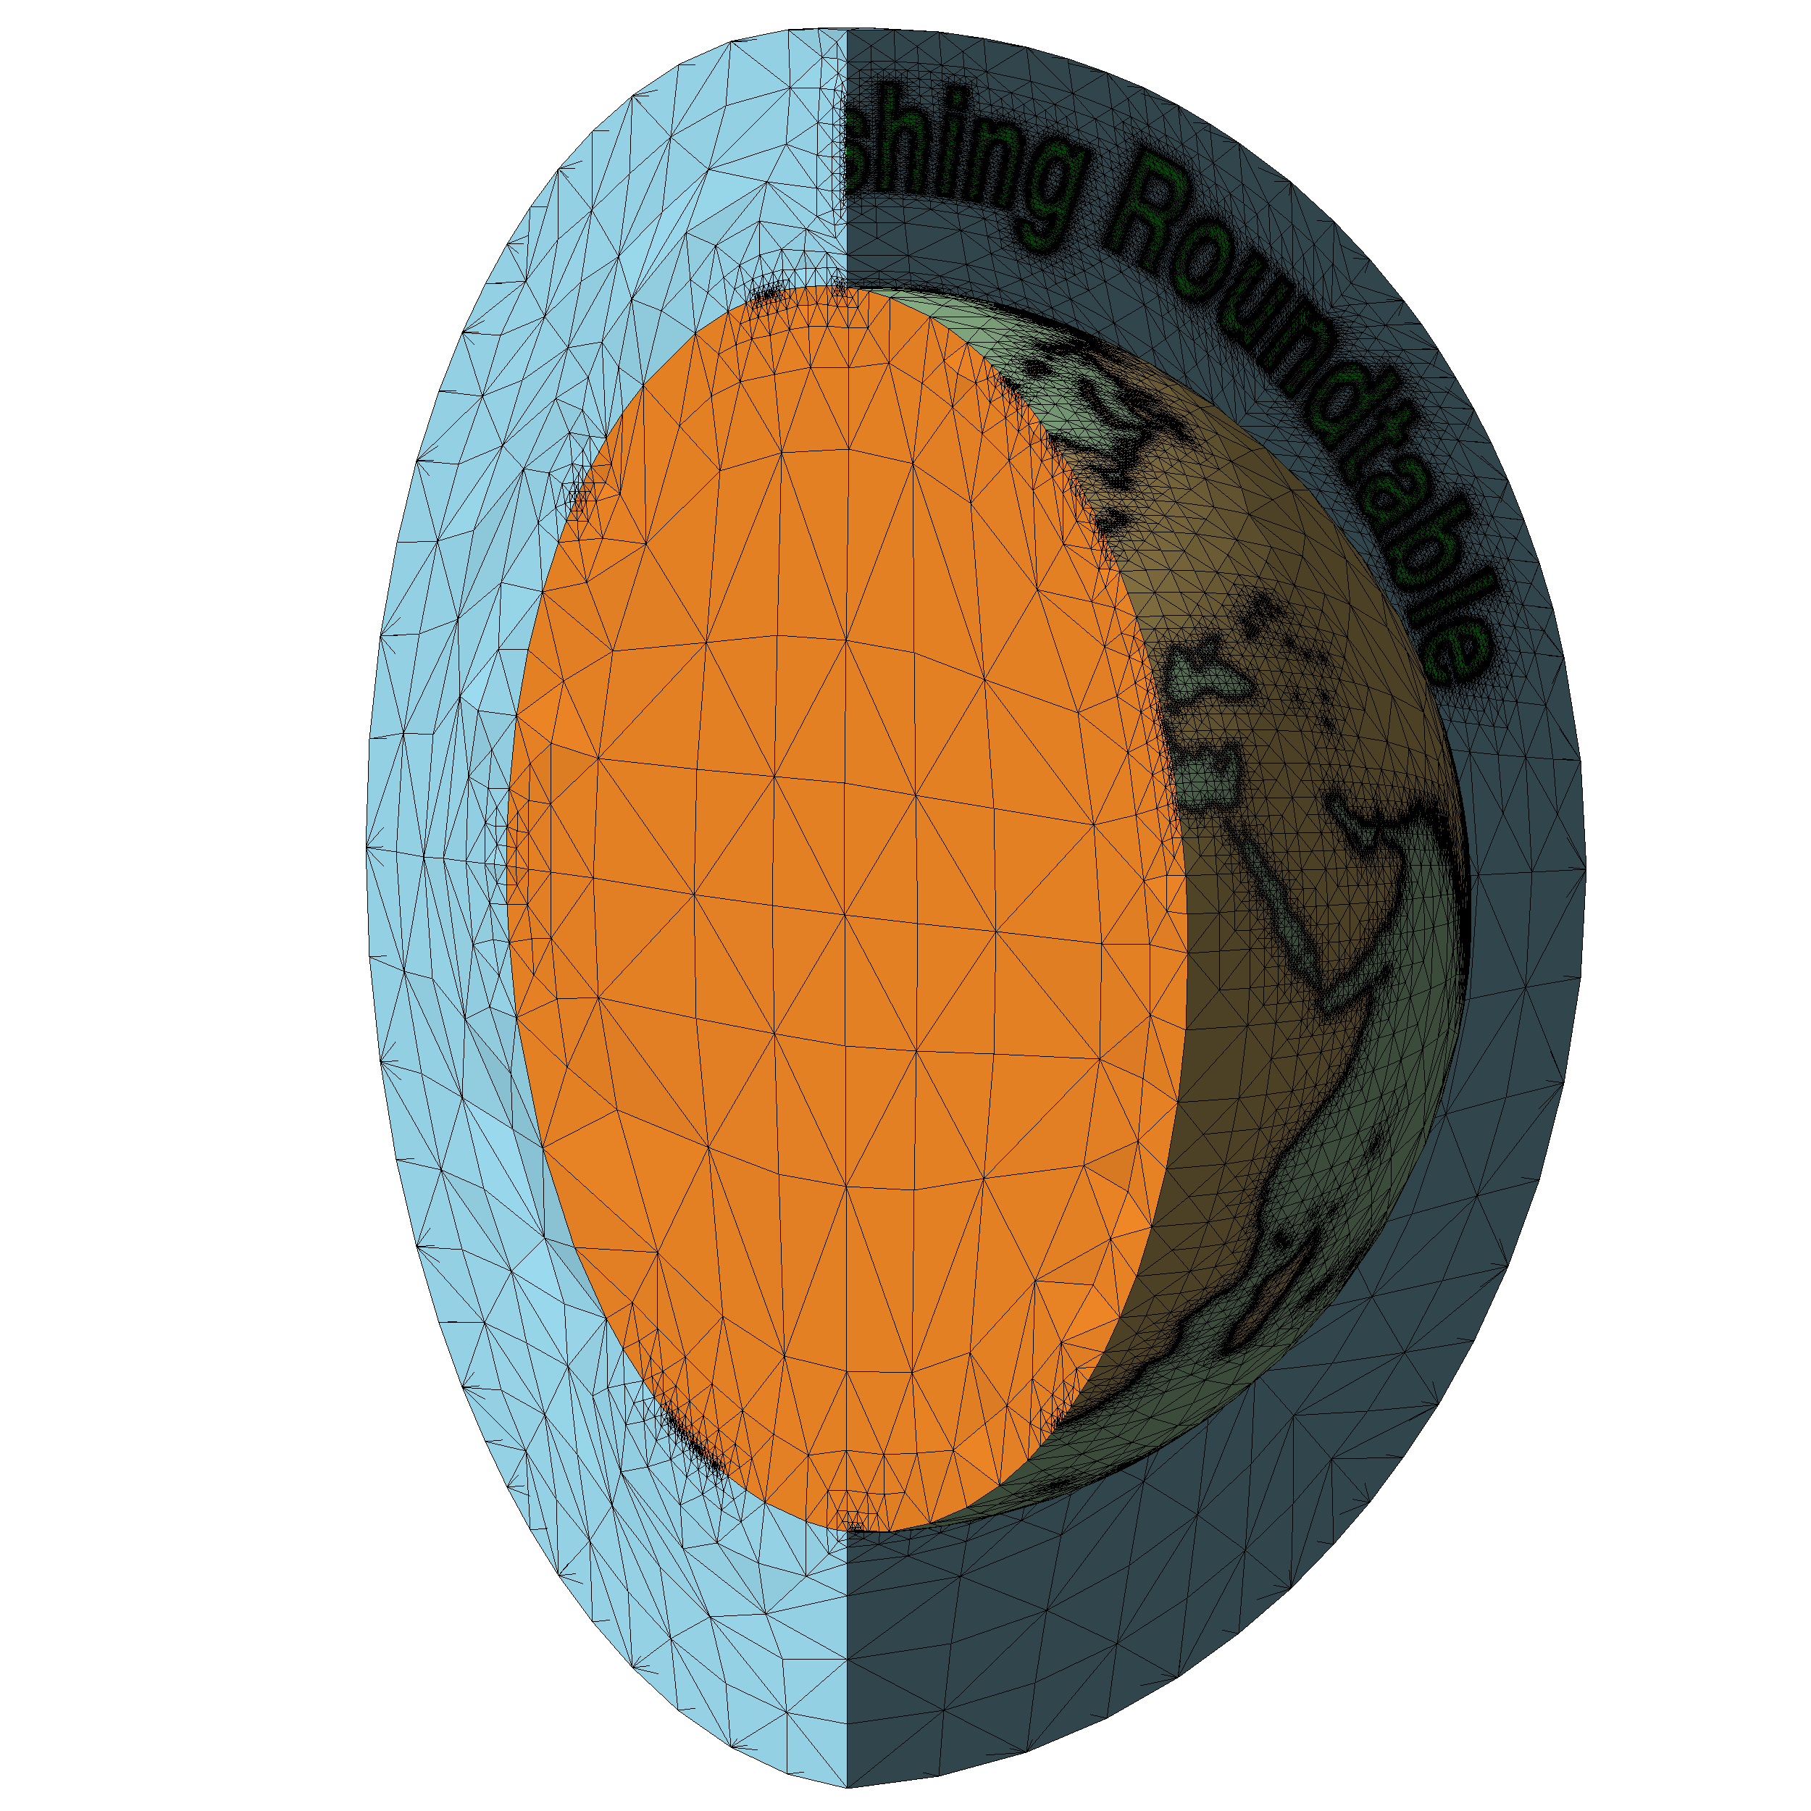

Slide 16
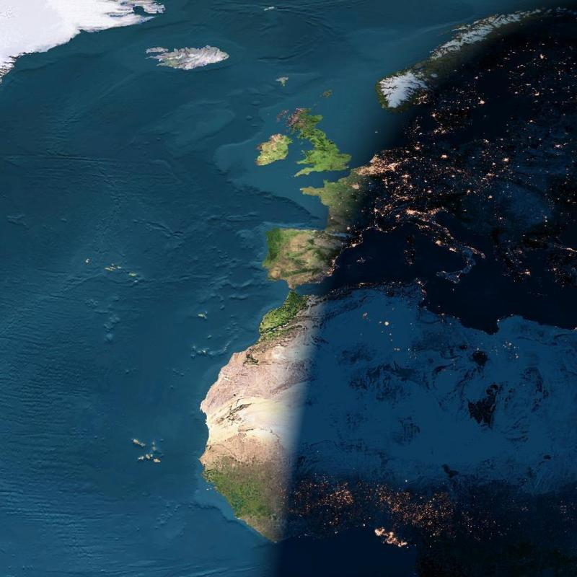

Slide 17
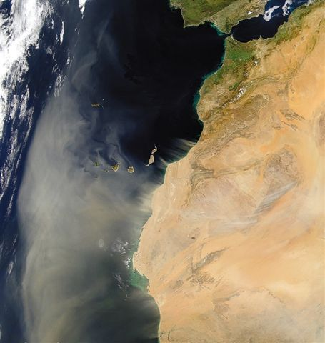

Slide 18
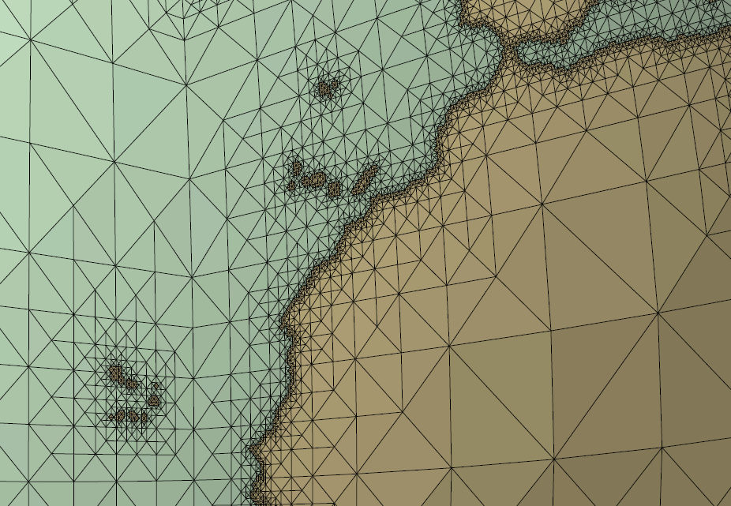

Slide 19
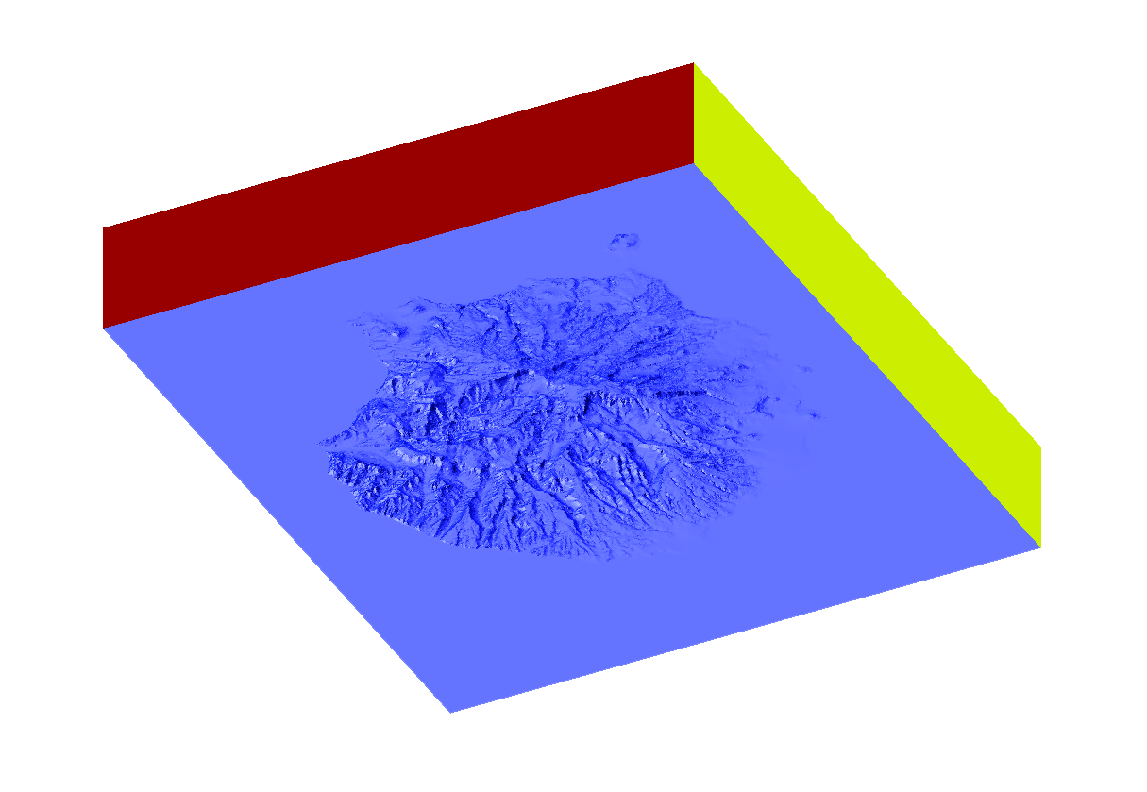
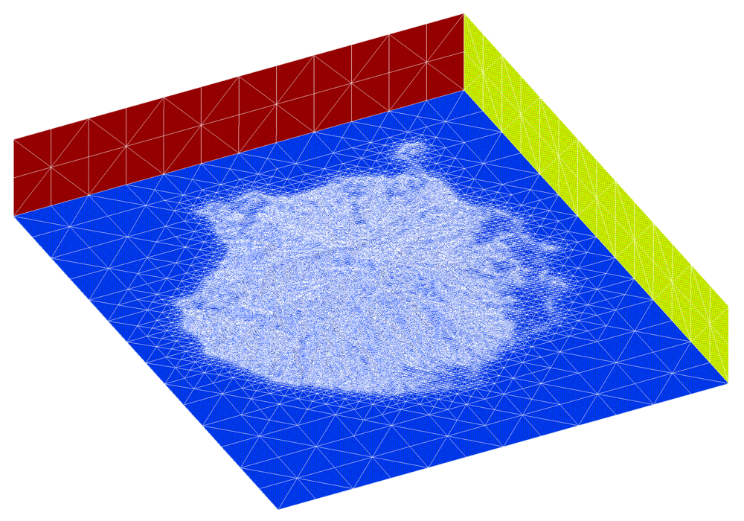
Meccano Method for Tetrahedral Mesh Generation
Application to Gran Canaria Island

Slide 20
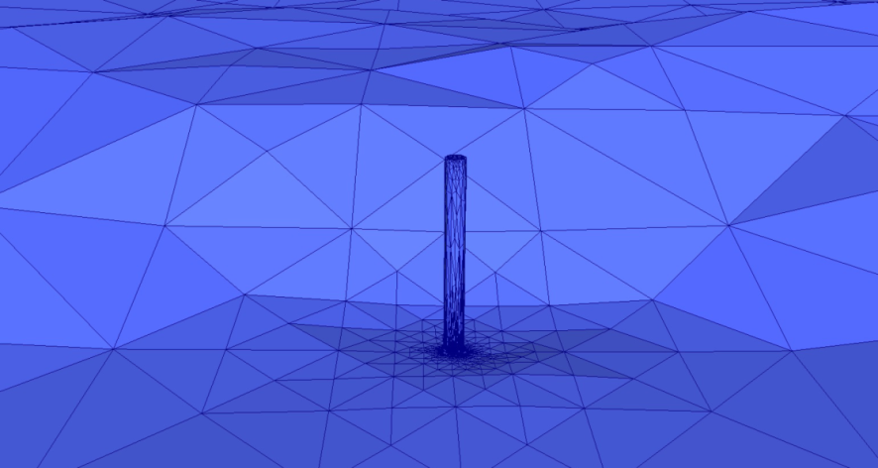
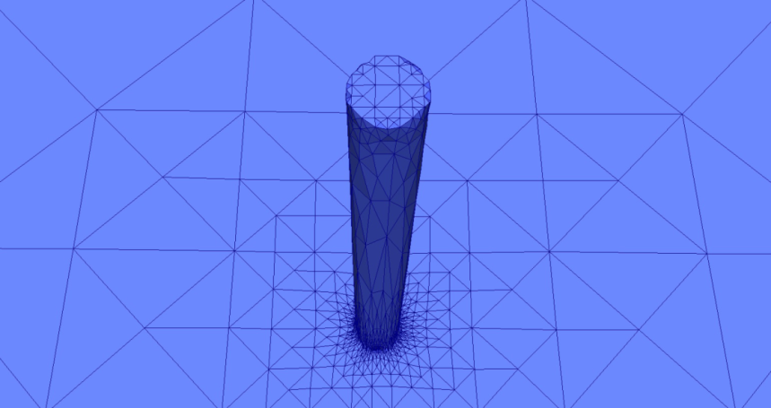
Meccano Method for Tetrahedral Mesh Generation
Application to Gran Canaria Island

Slide 21
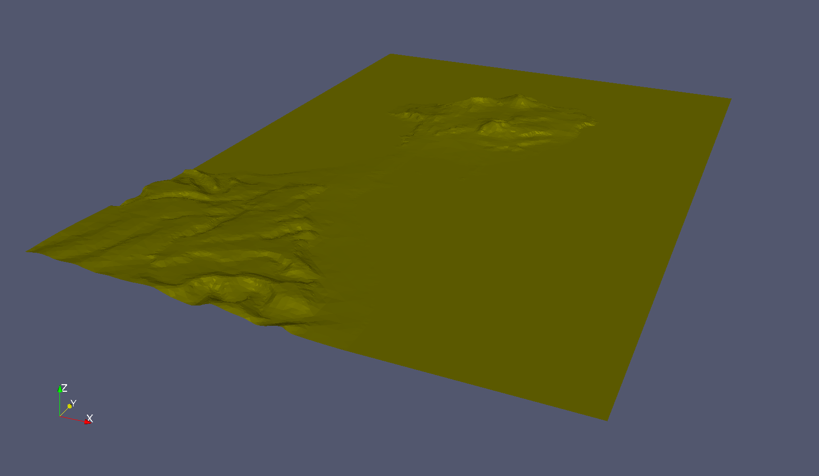
Meccano Method for Tetrahedral Mesh Generation
Gran Canaria: The city of Las Palmas de Gran Canaria (Orography)

Slide 22
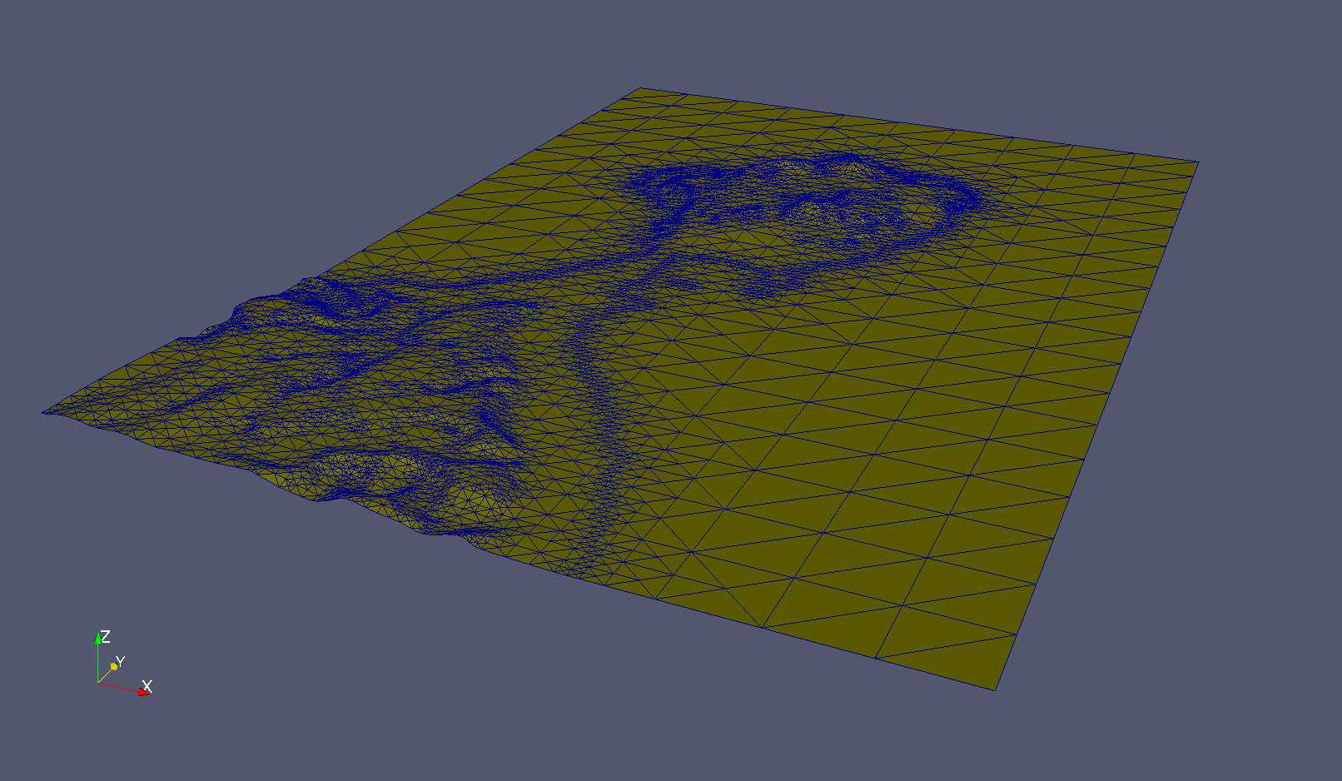
Meccano Method for Tetrahedral Mesh Generation
Gran Canaria: The city of Las Palmas de Gran Canaria (The Mesh)

Slide 23
Local Refinement: Kossaczky’s Algorithm (JCAM 1994)
Refinement of a cube
http://www.alberta-fem.de/, ALBERTA code
❑ Initial cube and its subdivision after three consecutive tetrahedron bisection
Notes:
Decimos que un tetraedro es de Tipo I si está marcado con el indicador de error. Se introducen 6 nuevos nodos en el punto medio de sus aristas y se subdividen cada una de sus cuatro caras en 4 triángulos, uniendo los puntos que se han introducido.
Cuatro subtetraedros quedan determinados a partir de los cuatro vértices del tetraedro original y las nuevas aristas.
Los otros cuatro tetraedros se obtienen al unir los dos vértices opuestos más cercanos del octaedro que resulta en el interior. Estudios de Löhner y Baum aseguran que esta elección produce el menor número de tetraedros distorsionados en la malla refinada. Existen otras dos opciones para subdividir el octaedro, y se podría analizar la calidad de las divisiones, pero aumentaría el coste computacional del algoritmo.
Una vez marcados los tetraedros de Tipo I, para asegurar la conformidad de la malla nos podemos encontrar con tetraedros vecinos que pueden tener 6, 5,..., 1, ó 0 nuevos nodos introducidos.
Aquellos tetraedros que por razones de conformidad tengan marcadas sus 6 aristas pasa automáticamente al conjunto de tetraedros de Tipo I.

Slide 24
Surface Parameterization of M.S. Floater (CAGD 1997)
From a the i-th solid surface triangulation patch to the i-th meccano face
http://www.sintef.no/math software, GoTools from SINTEF ICT
C
Q_{k}
C’
B’
D
Q’_{k}
B
A
D’
A’
Physical Space
Fixed boundary nodes,
Parametric Space
Q’_{k} =∑_{j} λ_{j,k} Q’_{j}

Slide 25
Simultaneous Untangling and Smoothing (CMAME 2003)
Case of plane triangulations
Local optimization
Objective: Improve the quality of the local mesh by minimizing an objective function
Free node
New position for the free node
Local mesh
Optimized local mesh

Slide 26
Simultaneous Untangling and Smoothing (CMAME 2003)
Weighted Jacobian Matrix on a Plane
Reference triangle
Physical triangle
Ideal triangle
y
A
y
y
2
S = AW ⁻¹
2
2
t
t_{R}
0
1
t_{I}
1
x
x
0
1
x
0
W
S
t_{I} t
: Weighted Jacobian matrix
An algebraic quality metric of t
(mean ratio)
where:

Slide 27
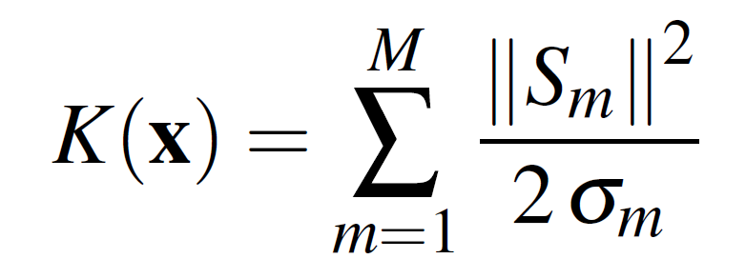
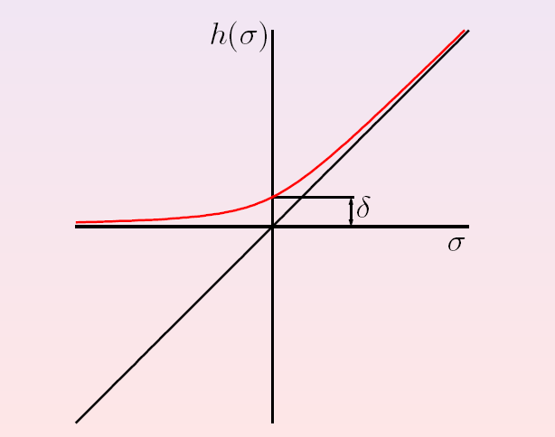
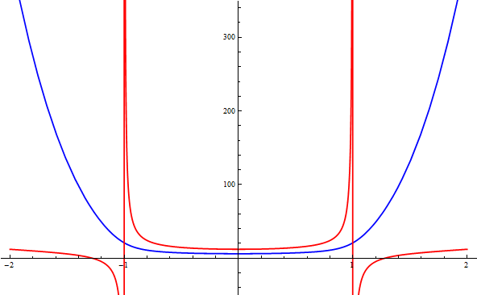
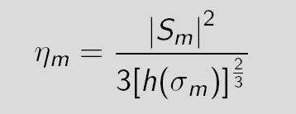
Simultaneous Untangling and Smoothing (CMAME 2003)
Local objective function for plane triangulations
SUS Code: Freely-available in http://www.dca.iusiani.ulpgc.es/proyecto2012-2014
Original function:
Modified function:
Modified function (blue) is regular in all R² and it approximates the same minimum that the original function (red). Moreover, it allows a simultaneous untangling and smoothing of triangular meshes
The extension to tetrahedral meshes is straightforward:

Slide 28
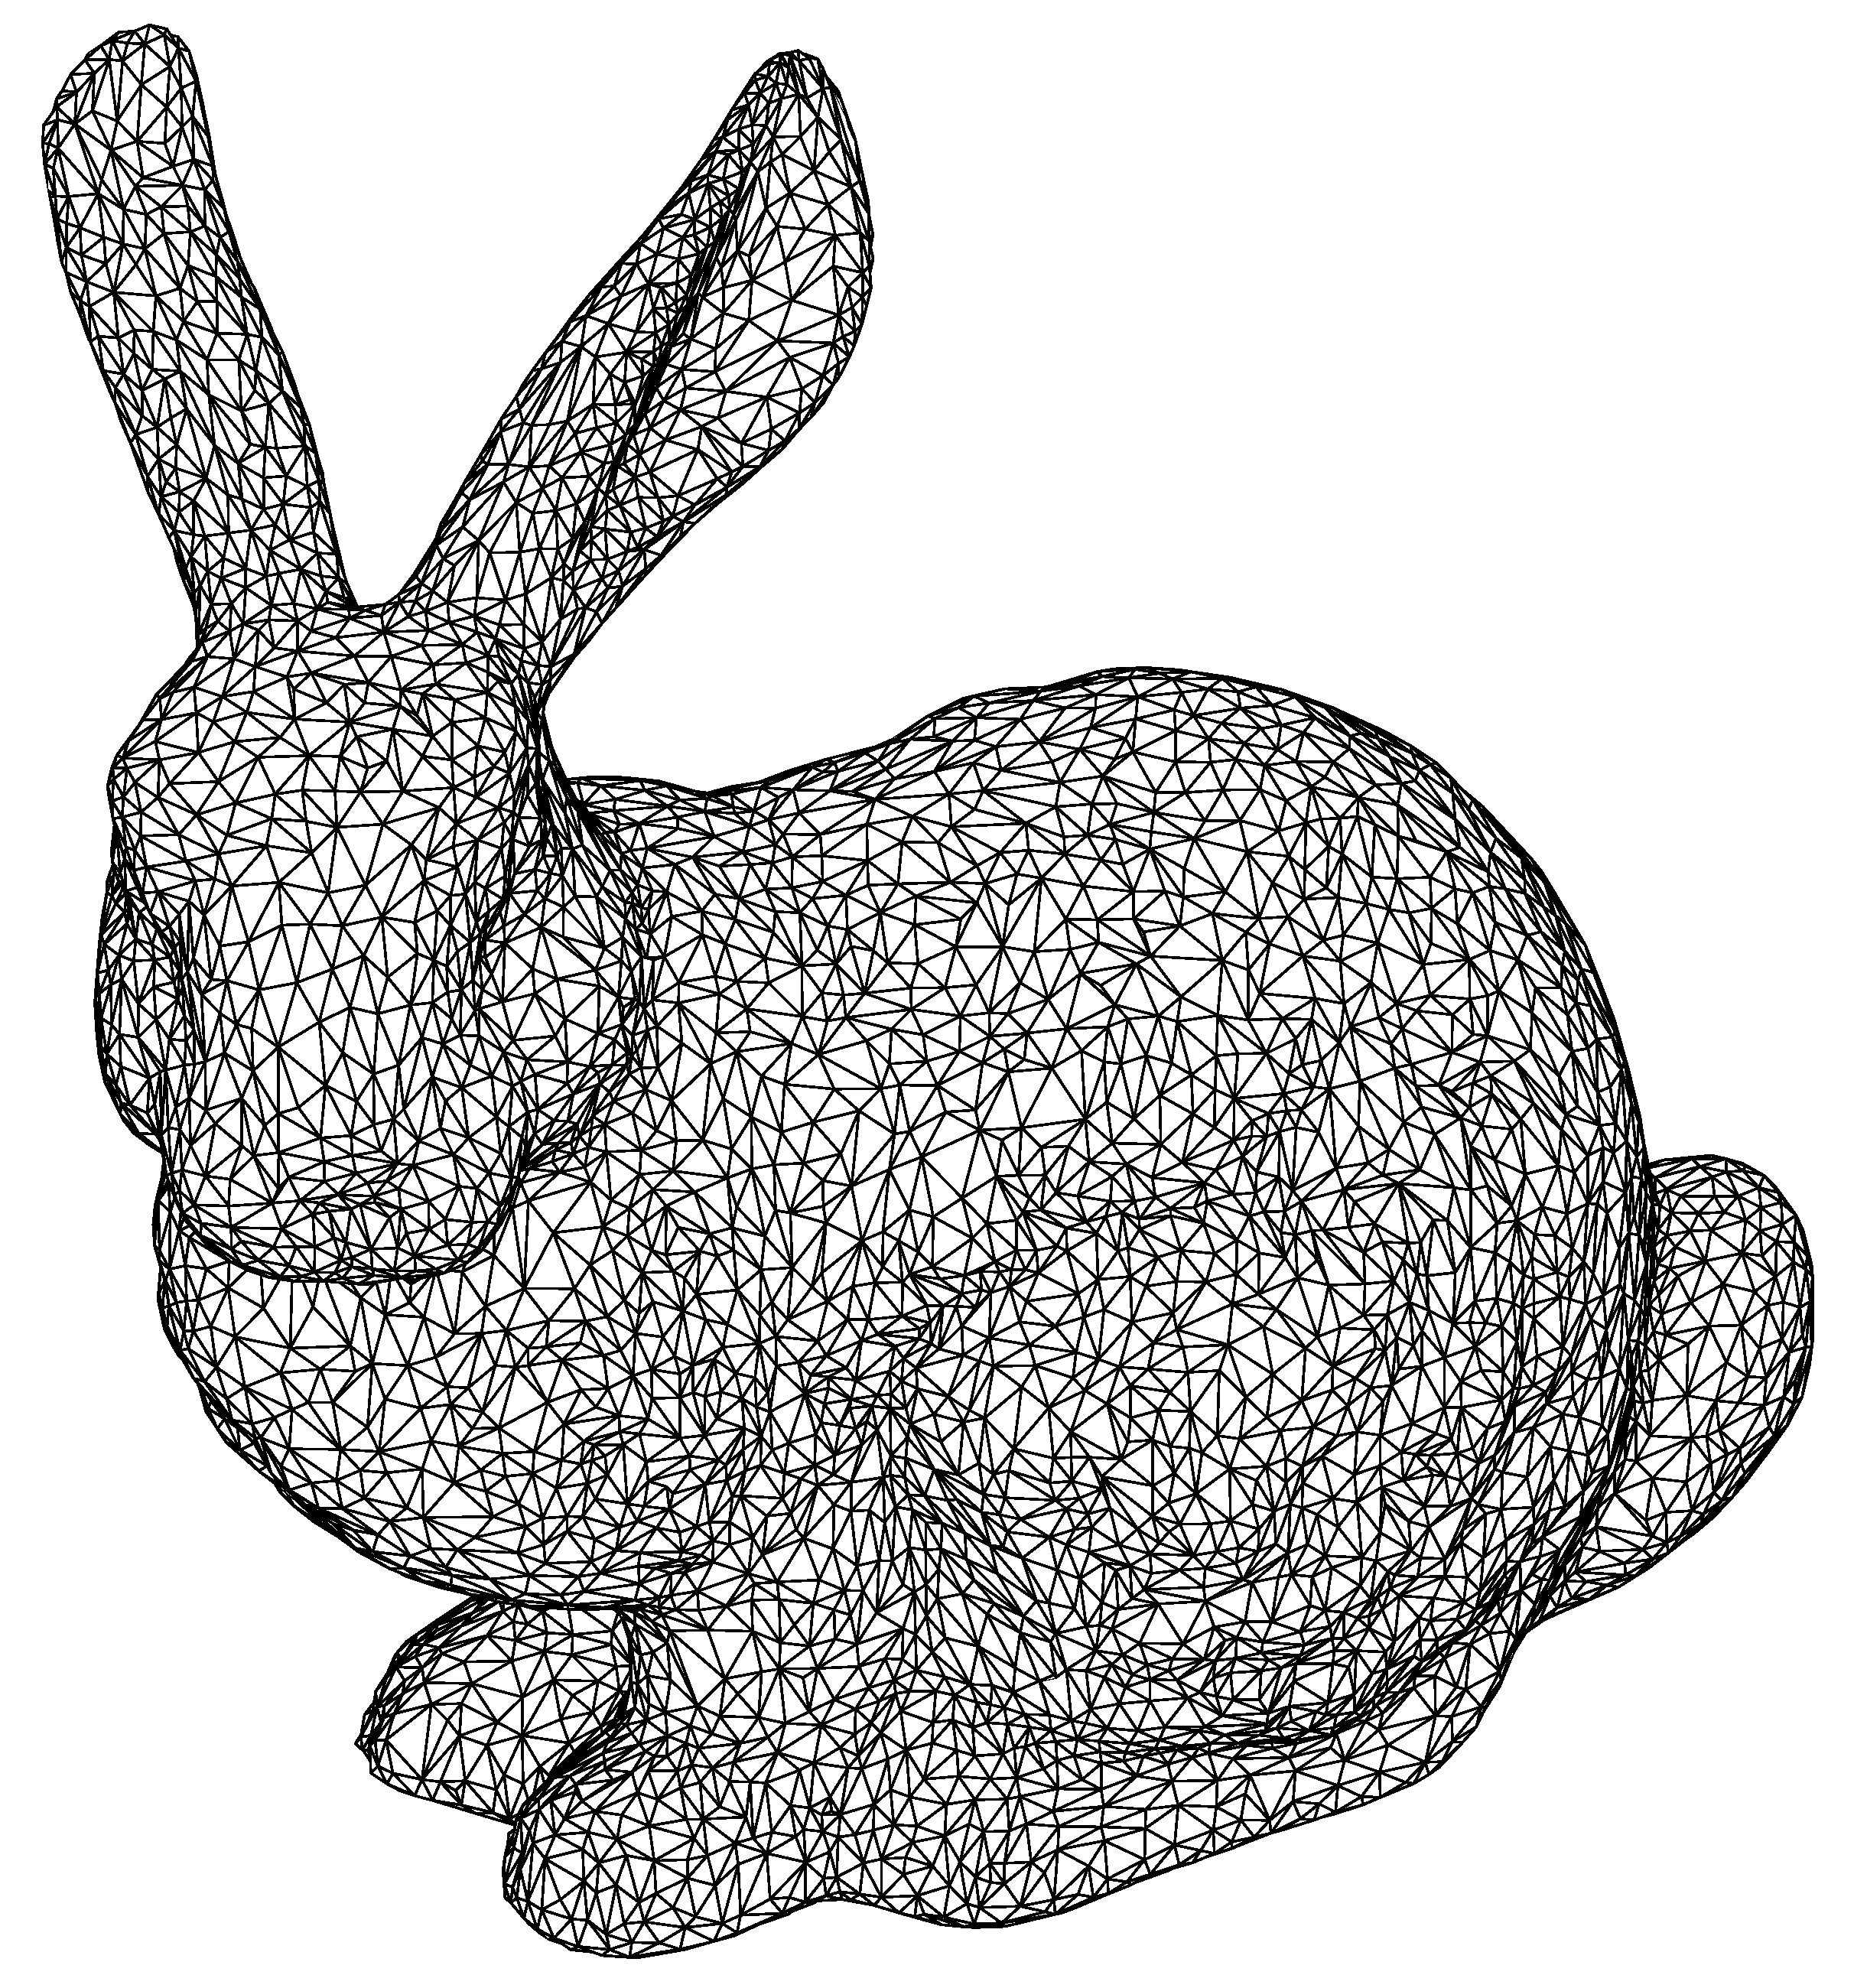
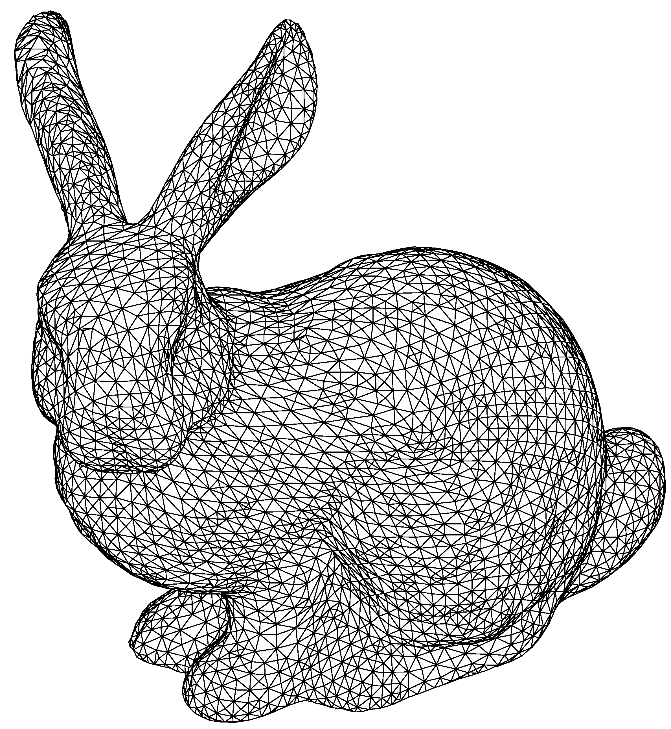
Meccano Method for a Complex Genus-Zero Solid
Application to the Stanford Bunny
http://graphics.stanford.edu/data/3Dscanrep/, Stanford Computer Graphics Laboratory

Slide 29
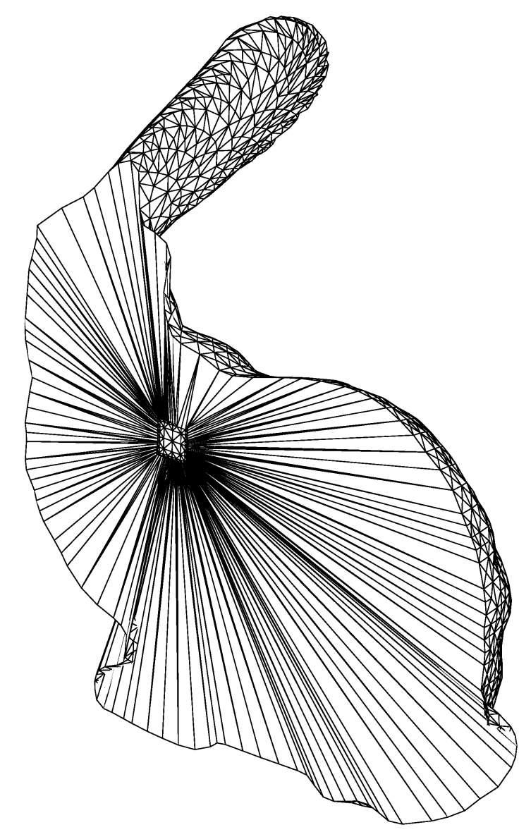
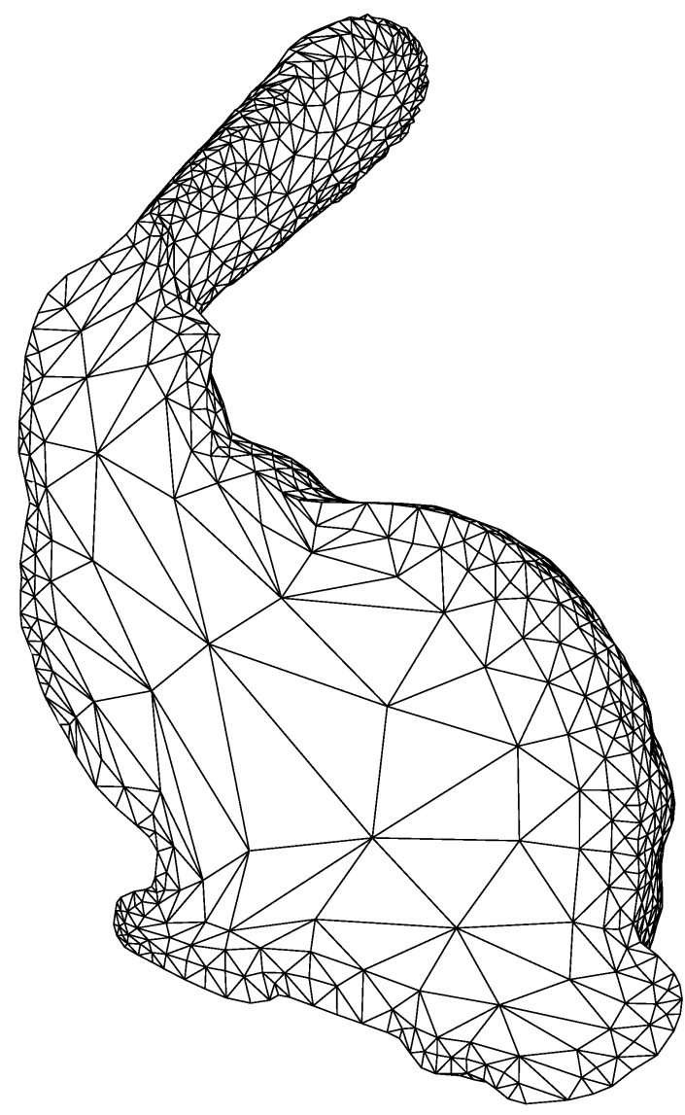
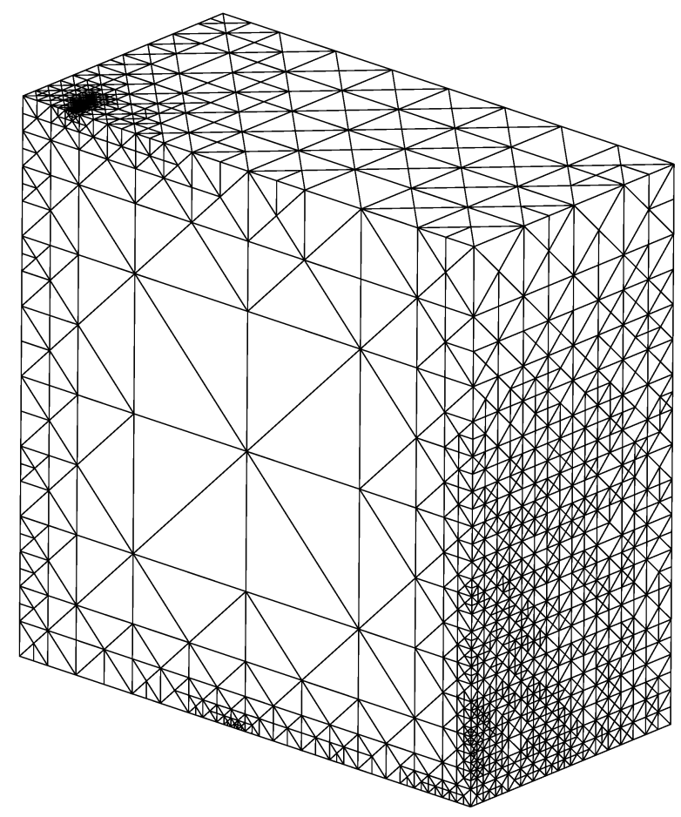
Meccano Method for a Complex Genus-Zero Solid
Application to the Stanford Bunny

Slide 30
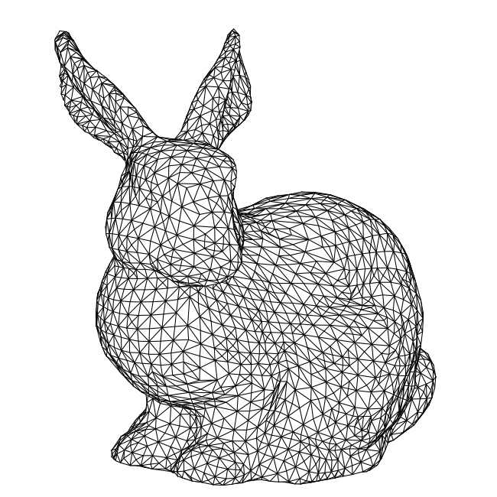
Adaptive Finite Element Solution
Stanford Bunny Example
Parabolic Problem:
Adaptive Algorithm: Solve → Estimate → Mark → Refine/Derefine
3-D Domain:
Stanford bunny

Slide 31
Predicción de Viento sobre Orografía Irregular
Wind3D Code (software libre)
http://www.dca.iusiani.ulpgc.es/Wind3D/
Notes:
Decimos que un tetraedro es de Tipo I si está marcado con el indicador de error. Se introducen 6 nuevos nodos en el punto medio de sus aristas y se subdividen cada una de sus cuatro caras en 4 triángulos, uniendo los puntos que se han introducido.
Cuatro subtetraedros quedan determinados a partir de los cuatro vértices del tetraedro original y las nuevas aristas.
Los otros cuatro tetraedros se obtienen al unir los dos vértices opuestos más cercanos del octaedro que resulta en el interior. Estudios de Löhner y Baum aseguran que esta elección produce el menor número de tetraedros distorsionados en la malla refinada. Existen otras dos opciones para subdividir el octaedro, y se podría analizar la calidad de las divisiones, pero aumentaría el coste computacional del algoritmo.
Una vez marcados los tetraedros de Tipo I, para asegurar la conformidad de la malla nos podemos encontrar con tetraedros vecinos que pueden tener 6, 5,..., 1, ó 0 nuevos nodos introducidos.
Aquellos tetraedros que por razones de conformidad tengan marcadas sus 6 aristas pasa automáticamente al conjunto de tetraedros de Tipo I.

Slide 32
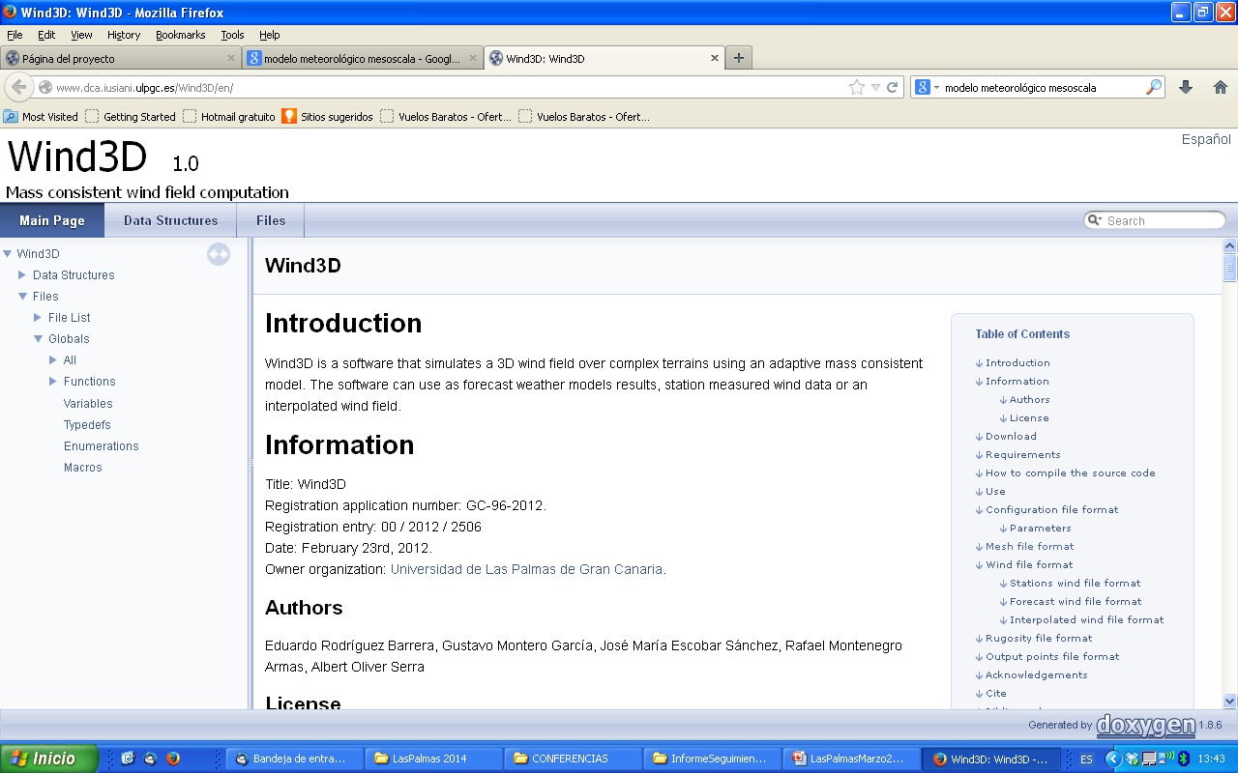
http://www.dca.iusiani.ulpgc.es/Wind3D/

Slide 33
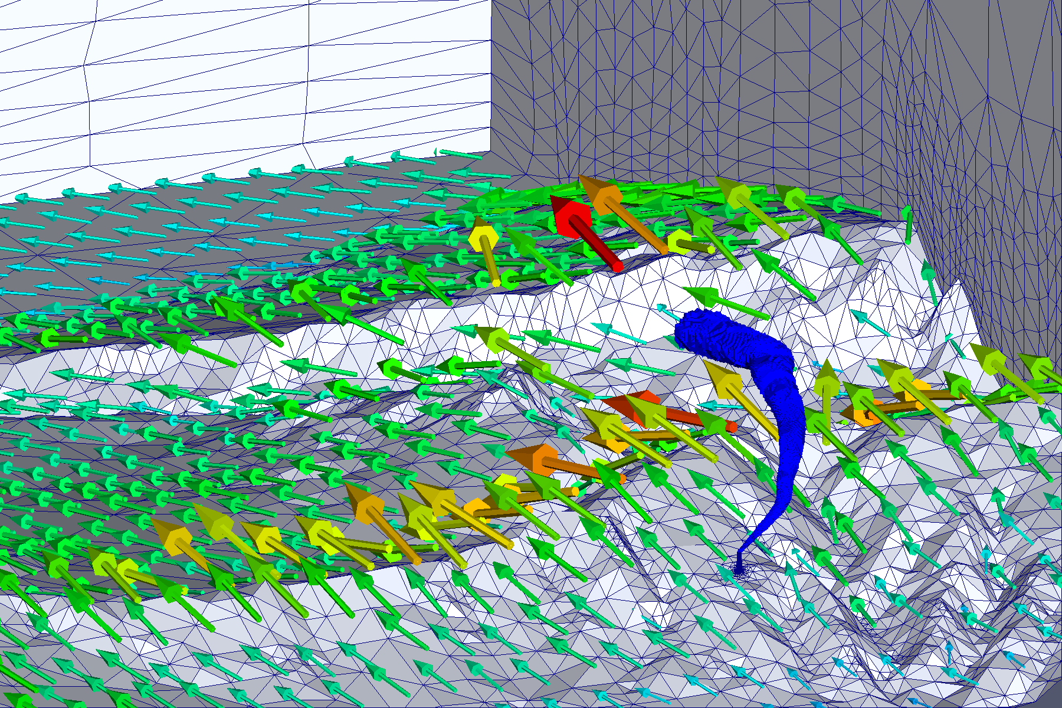
Wind Field for Air Quality Simulation
Mesh adaptation to geometry and gaussian plume

Slide 34
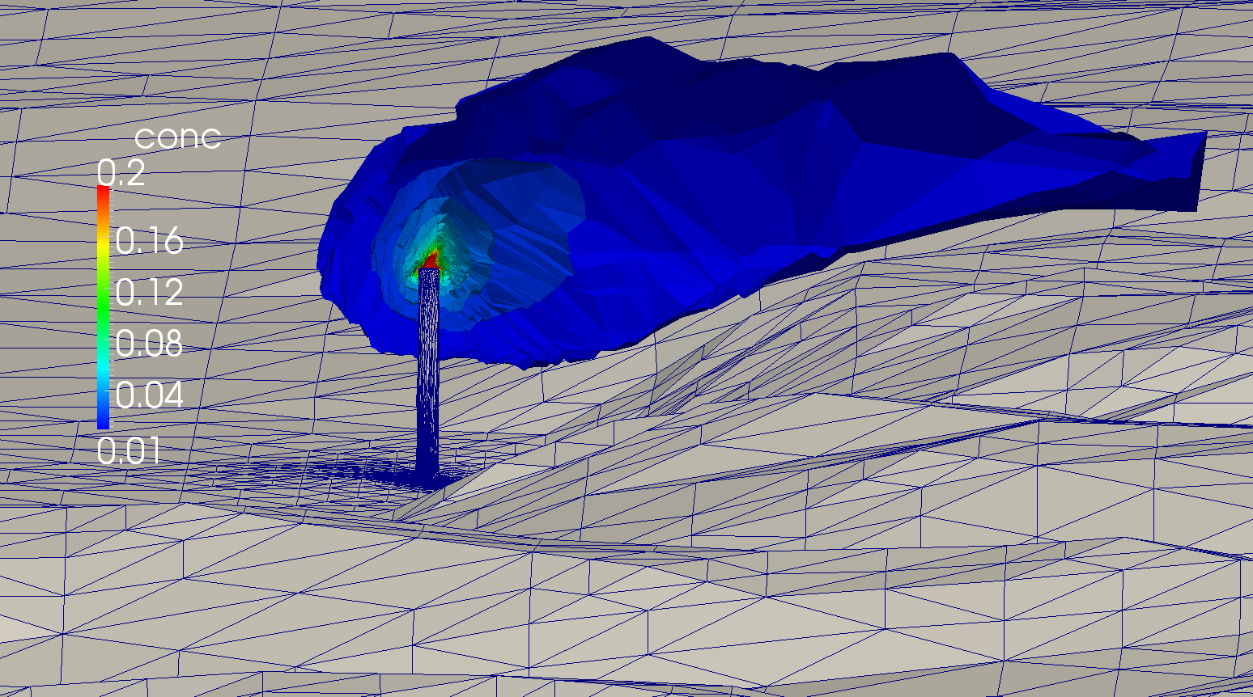
Wind Field for Air Quality Simulation
Mesh adaptation to geometry and gaussian plume

Slide 35
The Meccano Method for
Isogeometric Modeling and Analysis
Isogeometric Analysis:
Exact geometry
C^{K} continuity
FEM:
Approximate geometry
C⁰ continuity

Slide 36
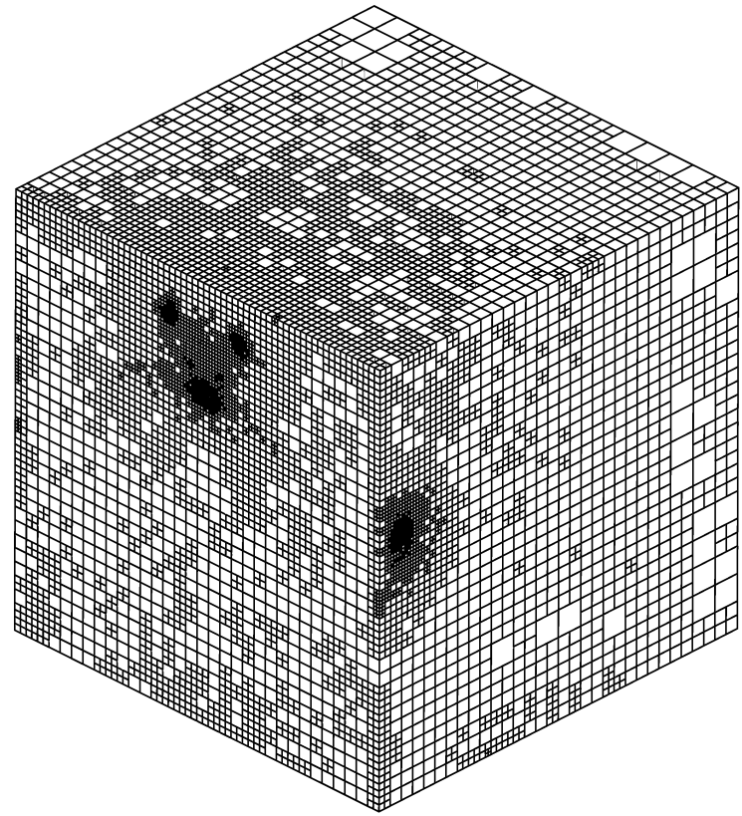
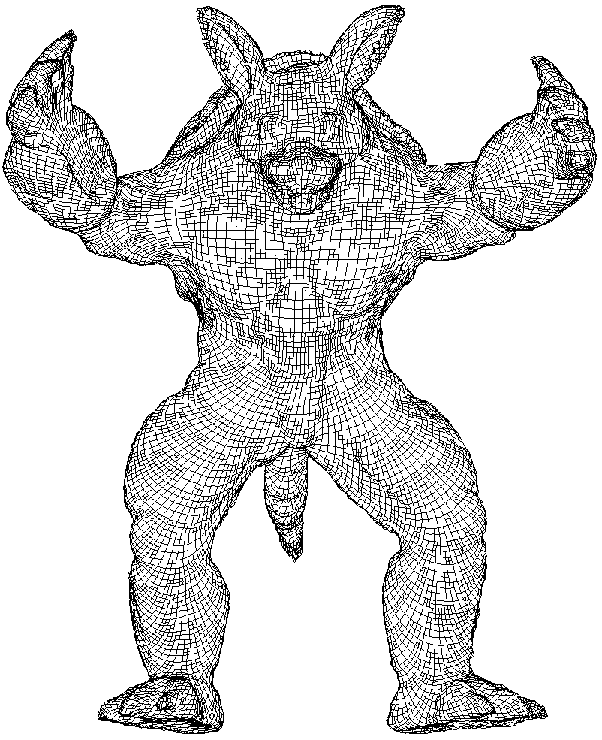
Meccano Method for Complex Solids
Volume parameterization based on SUS of tetrahedral meshes
Solid T-spline representation
Octree subdivision

Slide 37
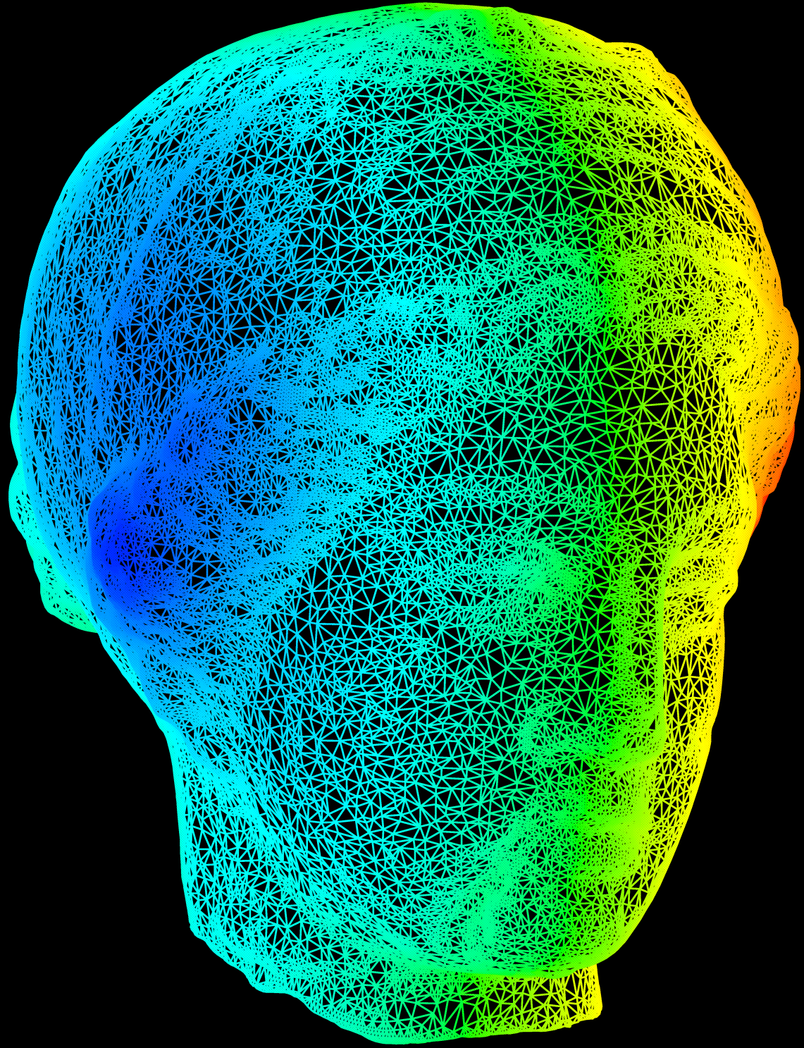
INPUT DATA: Surface Triangulation
http://www.cyberware.com/

Slide 38
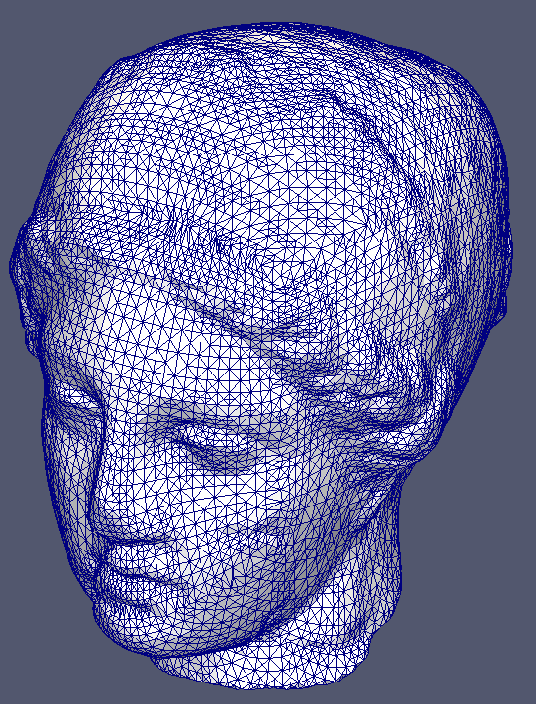
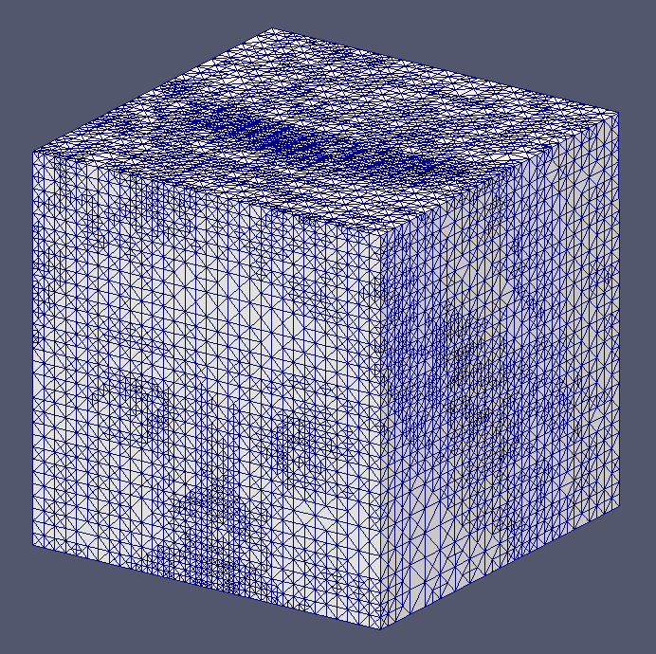

Slide 39
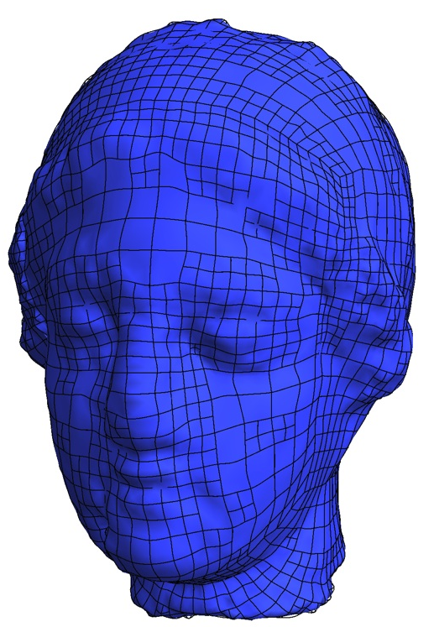
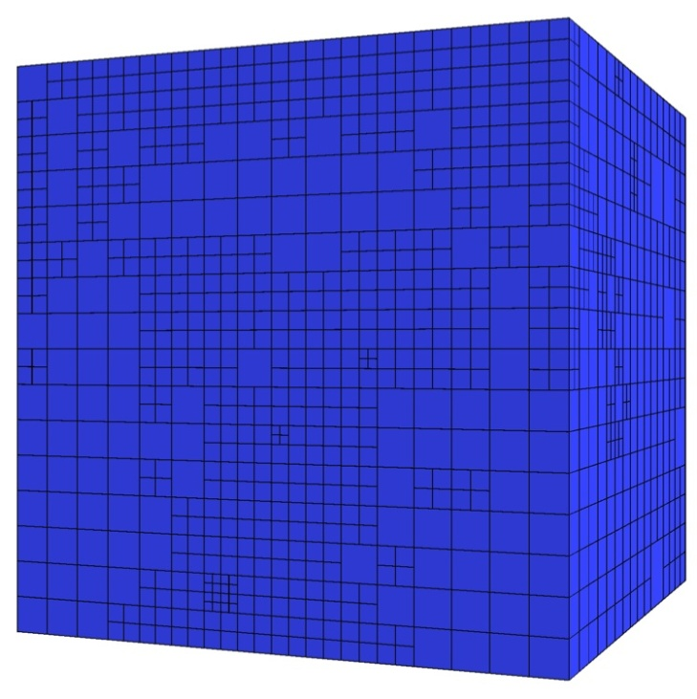
T-mesh
T-spline

Slide 40
The Spline Interpolation
Calculation of Control Points by Fulfilling the Interpolation Conditions
With:
Blending functions
Trivariate basis splines
volumetric
parameterization
Parametric space location
Physical space location
Control points are calculated by solving the sparse linear system

Slide 41
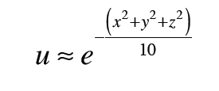
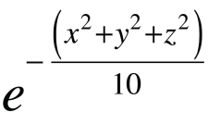
Adaptive Isogeometric Refinement (EWC 2012)
Application in Igea: Poisson problem with a central source
Exact solution:
T-mesh
T-spline

Slide 42
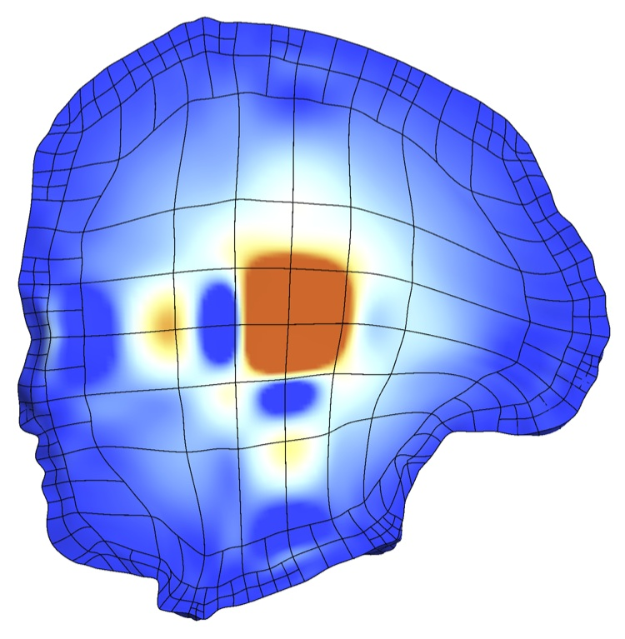
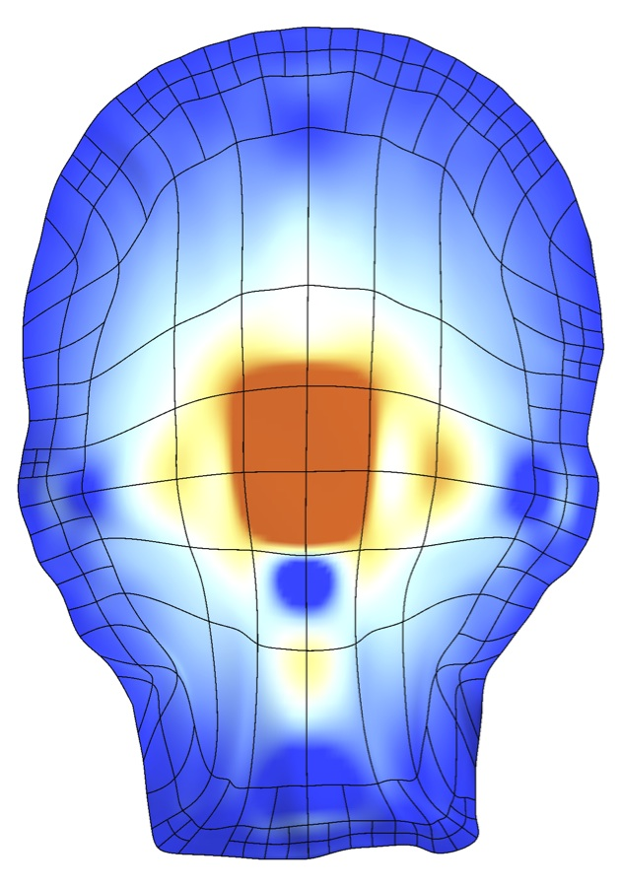
Adaptive Isogeometric Refinement (EWC 2012)
Igea: T-spline of Numerical Solution
Initial T-mesh
5692 cells, 9304 DOF

Slide 43
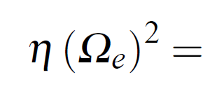
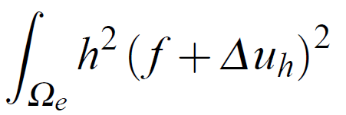
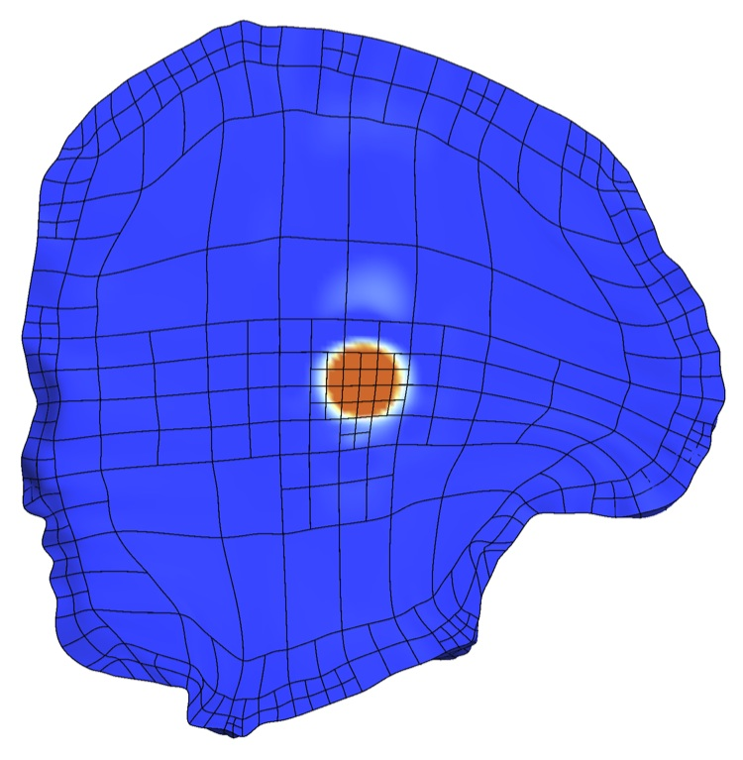
Adaptive Isogeometric Refinement (EWC 2012)
Igea: T-spline of Numerical Solution
Error indicator :
d
2nd local refinement
6021 cells, 9807 DOF

Slide 44
Adaptive Isogeometric Refinement (EWC 2012)
Igea: T-spline of Numerical Solution
Error indicator :
d
5th local refinement
6756 cells, 10838 DOF

Slide 45
Meccano Method on T-meshes for Complex Solids
Volume parameterization based on SUS of T-meshes
1. The key of the meccano method is the simultaneous untangling and smoothing
(SUS) procedure.
2. The quality of the T-spline mapping (i.e., positive Jacobian, good uniformity and orthogonality of the isoparametric curves) depends on the quality of the T-mesh in the physical space. We have to fix a quality metric for this mapping.
3. In order to simplify the procedure and to get less distortion in the volume
parameterization, it should be interesting to directly apply the meccano
method on T-meshes instead of tetrahedral meshes.
4. We have started analysing the problem in 2-D.

Slide 46
The Meccano Method on T-meshes in 2-D
Input data: Boundary representation of the object
Objective: Construction of a high quality T-spline parameterization
T-mesh
T-spline mesh
Parameter space
Physical space

Slide 47
The Meccano Method on T-meshes in 2-D
Step 1: Input boundary (image, polyline, curve, etc.) and boundary mapping
A’
B’
A
B
C
D
C’
D’
Select four points (A, B, C, D) of the input boundary
Boundary parameterization via chord-length

Slide 48
The Meccano Method on T-meshes in 2-D
Step 2: Coarse quadrilateral mesh of the meccano (parameter space)

Slide 49
The Meccano Method on T-meshes in 2-D
Step 3: Refine mesh with quadtree subdivisions to approach the boundary

Slide 50
The Meccano Method on T-meshes in 2-D
Step 4: Move the meccano boundary nodes to the object boundary

Slide 51
The Meccano Method on T-meshes in 2-D
Step 5: Inner node relocation with Coons patch to facilitate the optimization
Mesh folder

Slide 52
The Meccano Method on T-meshes in 2-D
Step 6: Simultaneous Untangling and Smoothing (SUS) of the T-mesh

Slide 53
The Meccano Method on T-meshes in 2-D
Step 7: T-spline representation of the spot

Slide 54
Boundary Approach in 2-D
Input data: Boundary polyline approximation (red color line)
A’
B’
A
Boundary edge refinement criterion:
B
T-mesh adaptation in parameter space
Boundary approximation in physical space

Slide 55
Simultaneous Untangling and Smoothing
Case of plane T-meshes (EWC 2013)
Local optimization
Objective: Improve the quality of the local mesh by minimizing an objective function
Free node
New position for the free node
?
Local mesh
Optimized local mesh
Notes:
The T-mesh optimization is an iterative process in which the free nodes are placed in position that improve the quality of the local mesh. This process is repeated for all the nodes of the mesh several times.

Slide 56
Simultaneous Untangling and Smoothing of T-meshes
Triangle decomposition of the T-mesh cells
Case 1: Free node is a regular node
Case 2: Free node is a hanging node
Barriers and feasible region for a regular node
Barriers and feasible region for a hanging node

Slide 57
Simultaneous Untangling and Smoothing of T-meshes
Optimization is guided by the parametric T-mesh
Physical cell C must be as similar as possible to the counterpart in the parametric space C_{p}
C_{p}
C
Parametric T-mesh
Optimized physical T-mesh

Slide 58
Simultaneous Untangling and Smoothing of T-meshes
Weighted objective functions (regular node)
All possible weights for balanced quadtrees:
Non-conformal mesh
Conformal mesh

Slide 59
Simultaneous Untangling and Smoothing of T-meshes
Weighted objective functions (hanging node)
All possible weights for balanced quadtrees:
Optimized mesh without weights
Optimized mesh
with weights

Slide 60
Simultaneous Untangling and Smoothing of T-meshes
T-mesh transformation along the SUS process: Example
T-mesh
T-spline
Parameter space
Physical space

Slide 61
Simultaneous Untangling and Smoothing of T-meshes
T-mesh transformation along the SUS process: Video

Slide 62
T-spline Basis Functions in 2-D
Example of a bivarite basis on a T-mesh
T-mesh and anchor t_{α}
support of the T-spline
Knots associated to anchor t_{α} :
Bivariate Cubic T-spline Basis Function

Slide 63
T-spline Parameterization
Determination of control points by imposing interpolation conditions
where

Slide 64
Mean Ratio Jacobian J_{r}(ξ) of Parametric Transformation
A quality metric of the T-spline mapping at any point P₀
-1 ≤
≤ 1
where J is the jacobian matrix of the
T-spline mapping S

Slide 65
Applications: Isogeometric Modeling
The Spot (Mean Ratio Jacobian)

Slide 66
Applications: Isogeometric Modeling
The Flower (Mean Ratio Jacobian)

Slide 67
Applications: Isogeometric Modeling
Puzzle Piece (Mean Ratio Jacobian)

Slide 68
Applications: Isogeometric Modeling
Gran Canaria Island (Mean Ratio Jacobian)

Slide 69
Applications: Isogeometric Modeling
Gran Canaria Island (adaptive refinement to improve the mean ratio Jacobian)
Initial T-mesh
Refined T-mesh
No negative Jacobian after refinement!
Initial T-spline & Mean ratio Jacobian
Refined T-spline & Mean ratio Jacobian

Slide 70
Applications: Isogeometric Modeling
Geometries with several materials

Slide 71
Applications: Isogeometric Modeling
Strategy for embedded planar geometries: Three steps
Individual quadtree approximation for each geometry (they can be processed in parallel)
Insert a quadtree in a region of another quadtree
Balance the resulting quadtree
Resulting
Parametric T-mesh
(3)
(1)
(2)
Unbalanced quadtree after merging
2:1 balanced quadtree
Notes:
Generar mallas para el análisis isogeomético

Slide 72
Applications: Isogeometric Modeling
Geometries with holes

Slide 73
Applications: Isogeometric Modeling
Embedded planar geometries (T-spline representation in physical space)
T-spline representation with different materials
T-spline representation with a hole
Notes:
Generar mallas para el análisis isogeomético

Slide 74
Applications: Isogeometric Modeling
Strategy for embedded planar geometries: Other example
Resulting Physical and Parametric T-mesh
Notes:
Generar mallas para el análisis isogeomético

Slide 75
Applications: Isogeometric Modeling
Strategy for embedded planar geometries: Other example
Mean ratio Jacobian
Notes:
Generar mallas para el análisis isogeomético

Slide 76
Local Nested Adaptive Refinement
Numerical solution of a Poisson problem
Concentrate source in relation to the initial mesh size
Ω
Exact solution:
Residual-type error indicator:

Slide 77
Local Nested Adaptive Refinement
Numerical solution of a Poisson problem
Error indicator :
d
Numerical solution across a section
Convergence behavior

Slide 78
Local Nested Adaptive Refinement
Influence of isoparametry in the convergence behavior

Slide 79
Poisson Problem for a Domain with Two Materials
Statement of the problem
Ω₁
>>
Ω₂

Slide 80
Poisson Problem for a Domain with Two Materials
Numerical solution in parametric and physical domain

Slide 81
Poisson Problem for a Domain with Two Materials
Dielectric cylinder in an uniform horizontal electric field E₀
b
Ω₁
The analytic solution in cylindrical coordinates (ρ,ϕ) is given by:
Ω₂
T-spline detail

Slide 82
Poisson Problem for a Domain with Two Materials
Dielectric cylinder in an uniform electric field
Numerical solution detail (potential and electric field) in physical domain
Comparing with the analytic solution, we have measured a
maximum error in the potential of 0.88%.

Slide 83
Final Comments and Future Works
Automatic Construction of the Meccano
Octree Subdivision – Petrosoft (México)

Slide 84
Final Comments and Future Works
Automatic Construction of the Meccano
Octree Subdivision – Petrosoft (México)

Slide 85
Final Comments and Future Works
Automatic Construction of the Meccano

Slide 86
Final Comments and Future Works
Automatic Construction of the Meccano

Slide 87
Video of University Institute SIANI

Slide 88
Mesh Generation and Isogeometric Analysis
J.I. López⁽¹⁾, M. Brovka⁽¹⁾, J.M. Escobar⁽¹⁾, J.M. Cascón⁽²⁾, A. Oliver⁽¹⁾, J. Ramírez⁽¹⁾,
G.V. Socorro⁽¹⁾, E. Rodríguez⁽¹⁾, G. Montero⁽¹⁾ and R. Montenegro⁽¹⁾*
⁽¹⁾ University Institute SIANI, University of Las Palmas de Gran Canaria, Spain
⁽²⁾ Department of Economics and History of Economics, University of Salamanca, Spain
AGH University of Science and Technology, Department of Computer Science,
April 2, 2014, Kraków, Poland
MINECO y FEDER Project: CGL2011-29396-C03-00
CONACYT-SENER Project, Fondo Sectorial, contract: 163723
http://www.dca.iusiani.ulpgc.es/proyecto2012-2014

Slide 90
Meccano Technique for a Complex Genus-Zero Solid
Refinement Criterion
F(p) = p’
F(a) = a’
δ
F(c) = c’
q
F(b) = b’
c
a
p
b
T
d
Notes:
Decimos que un tetraedro es de Tipo I si está marcado con el indicador de error. Se introducen 6 nuevos nodos en el punto medio de sus aristas y se subdividen cada una de sus cuatro caras en 4 triángulos, uniendo los puntos que se han introducido.
Cuatro subtetraedros quedan determinados a partir de los cuatro vértices del tetraedro original y las nuevas aristas.
Los otros cuatro tetraedros se obtienen al unir los dos vértices opuestos más cercanos del octaedro que resulta en el interior. Estudios de Löhner y Baum aseguran que esta elección produce el menor número de tetraedros distorsionados en la malla refinada. Existen otras dos opciones para subdividir el octaedro, y se podría analizar la calidad de las divisiones, pero aumentaría el coste computacional del algoritmo.
Una vez marcados los tetraedros de Tipo I, para asegurar la conformidad de la malla nos podemos encontrar con tetraedros vecinos que pueden tener 6, 5,..., 1, ó 0 nuevos nodos introducidos.
Aquellos tetraedros que por razones de conformidad tengan marcadas sus 6 aristas pasa automáticamente al conjunto de tetraedros de Tipo I.

