Slide 1
Construction of polynomial spline spaces
over T-meshes for its application in
Isogeometric Analysis
Marina Brovka
Doctoral Thesis Defence
^{Programa de doctorado}
Sistemas Inteligentes y Aplicaciones Numéricas en Ingeniería
^{Instituto Universitario SIANI}

Slide 2
Contents
Introduction and state of the art
Main result of the thesis. Construction of spline spaces
Discussion of the properties of the proposed spaces
Spline parameterization method for 2D geometries
Testing of the proposed strategies. Computational
examples
Conclusions and future works

Slide 3
Introduction and state of the art
Problem statement. Available strategies.
Motivation of our work

Slide 4
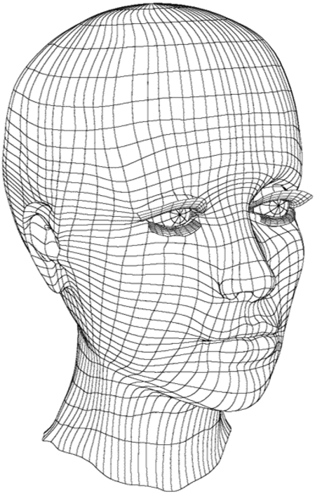
Isogeometric Analysis concept
Isogeometric analysis (Hughes et al, 2005) has arisen as an attempt
to unify the Computer Aided Design (CAD) and Finite Element Analysis industries.
The main idea: use for analysis the same functions
that are used for CAD representation of the computational
domain: B-splines, NURBS, preserving thus the exact geometry
http: // www.3drender. com/

Slide 5
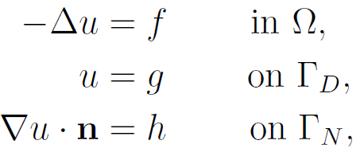
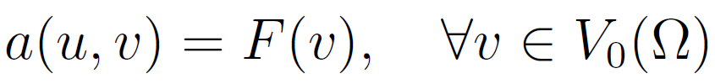
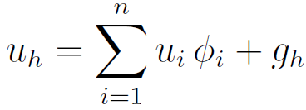
Isogeometric Analysis vs Finite Element Method
Isogeometric analysis
Variational formulation
Galerkin projection
Isoparametric concept

Slide 6
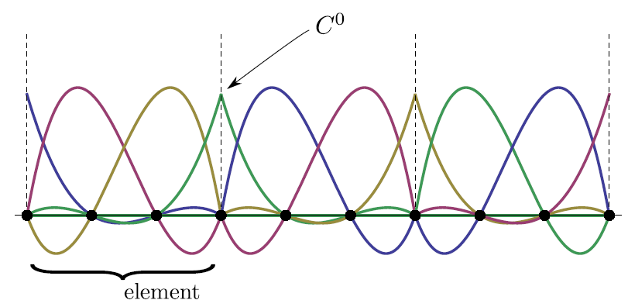
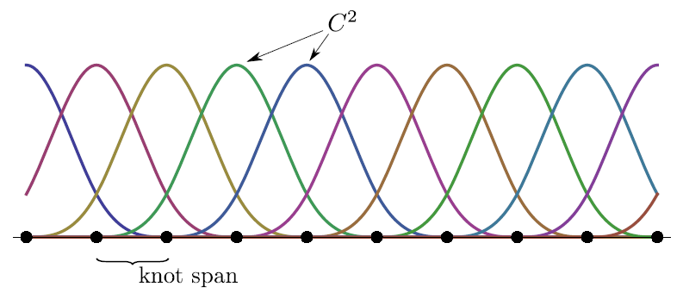
Isogeometric Analysis vs Finite Element Method
Basis functions for FEM and IGA:
FEM basis. Lagrange function order 3.
IGA basis. B-splines function order 3.

Slide 7
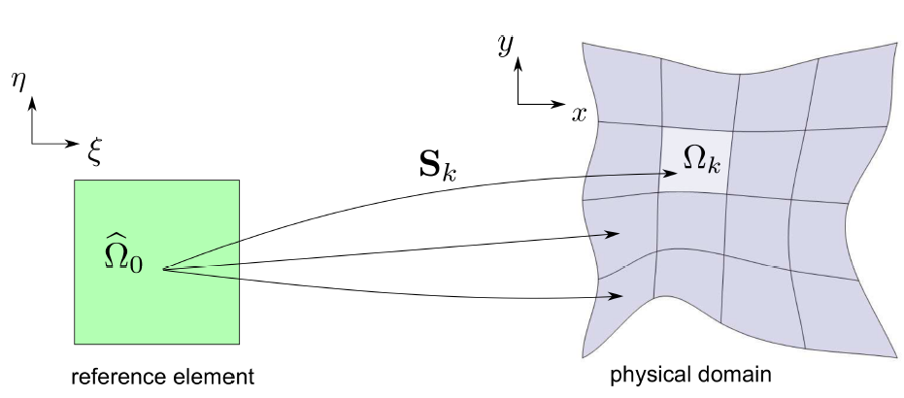
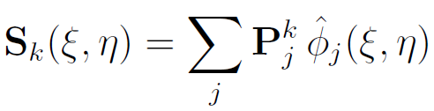
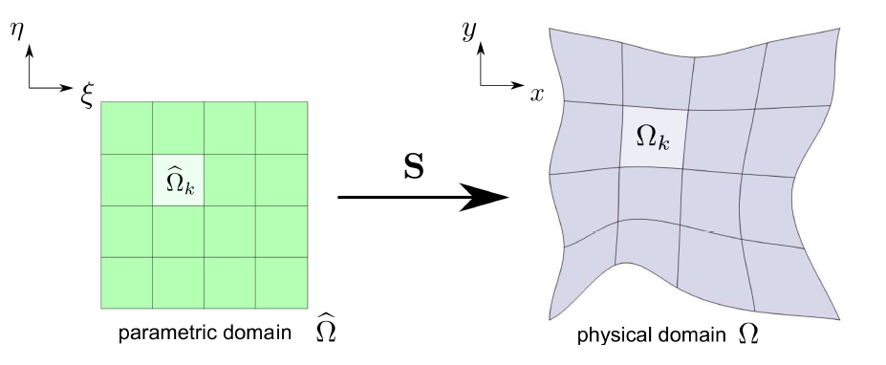

Isogeometric Analysis vs Finite Element Method
FEM: Local parametric mapping for each element
IGA: Global parametric mapping

Slide 8
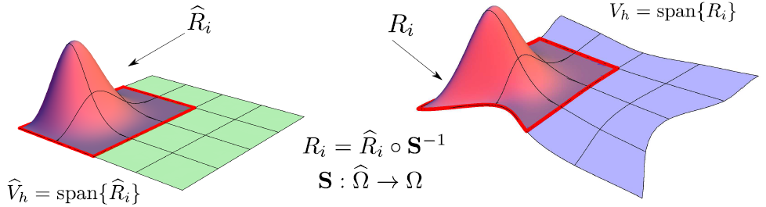
Isogeometric Analysis vs Finite Element Method
Isoparametric concept. Basis functions:

Slide 9
Open problems
Parameterization of the domain from its boundary representation.
CAD models provide only the boundary surface of a solid. Application of Isogeometric
Analysis requires a full volumetric representation of the geometry.
Local refinement.
Tensor product structure of B-spline spaces does not allow local enrichment of the approximation space. A strategy for construction of spline spaces with local refinement is needed.

Slide 10
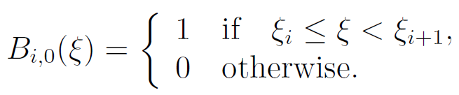
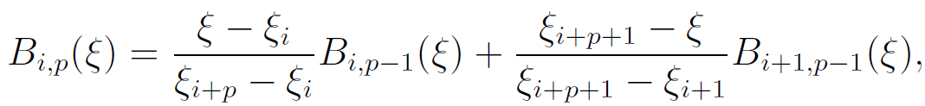

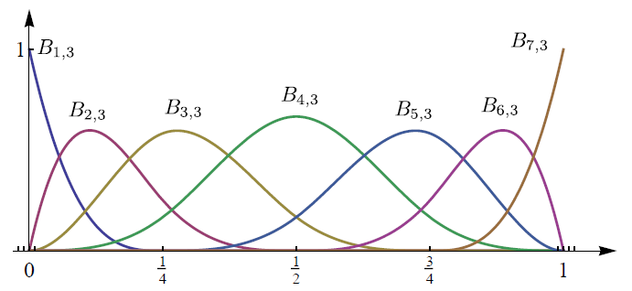
B-splines
Cox- de Boor recursion formula
for a set of B-spline functions defined
over a knot vector
A set of cubic B-splines inferred from the open knot vector
{0, 0, 0, 0, 1/4,1/2, 3/4, 1, 1, 1,1}.

Slide 11
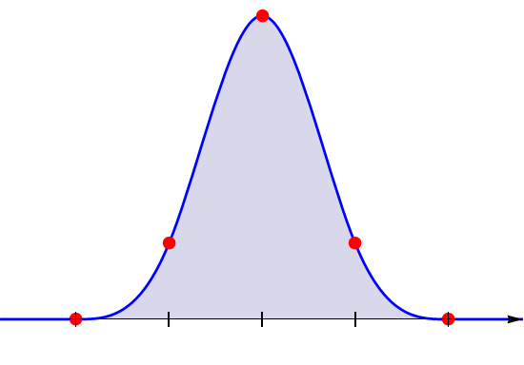
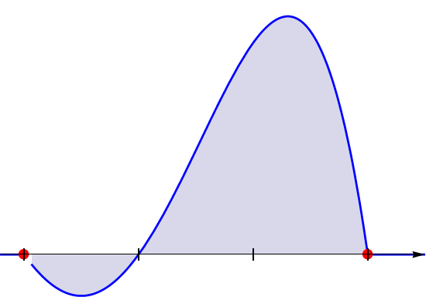
B-splines
Cubic B-spline function with knot vector
Lagrange basis function of degree 3

Slide 12
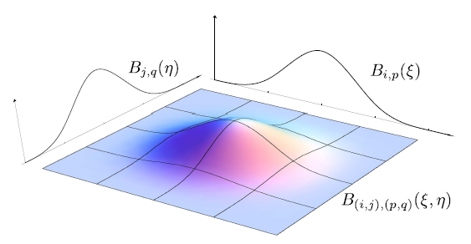



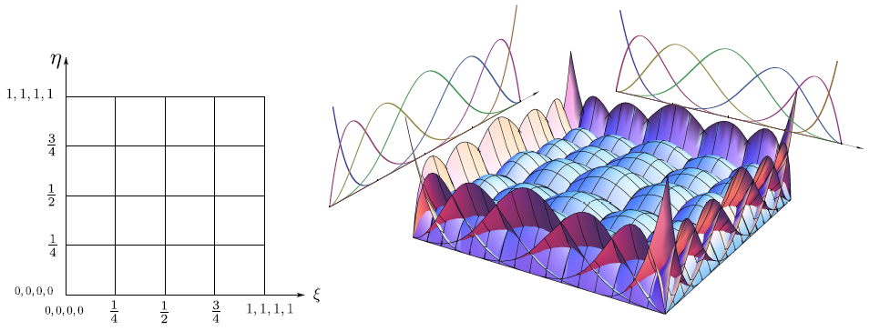
B-splines
Bivariate B-splines for two global knot vectors:

Slide 13
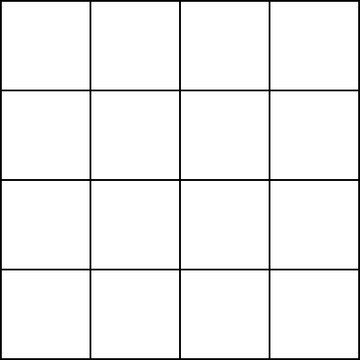
Local refinement problem for B-splines
A new knot insertion induces the insertion of a knot line extended through the entire domain
Superfluous
control points!
global refinement

Slide 14
T-splines
T-splines ( T. Sederberg et al. 2003)
T-mesh
T-junction
local refinement

Slide 15
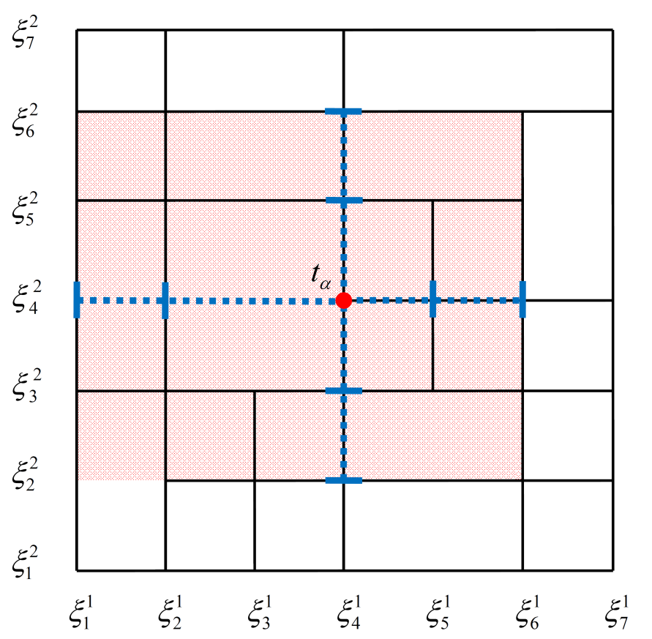
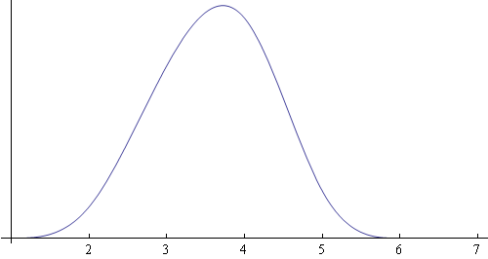
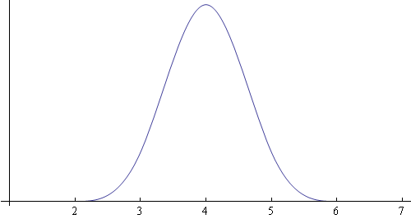
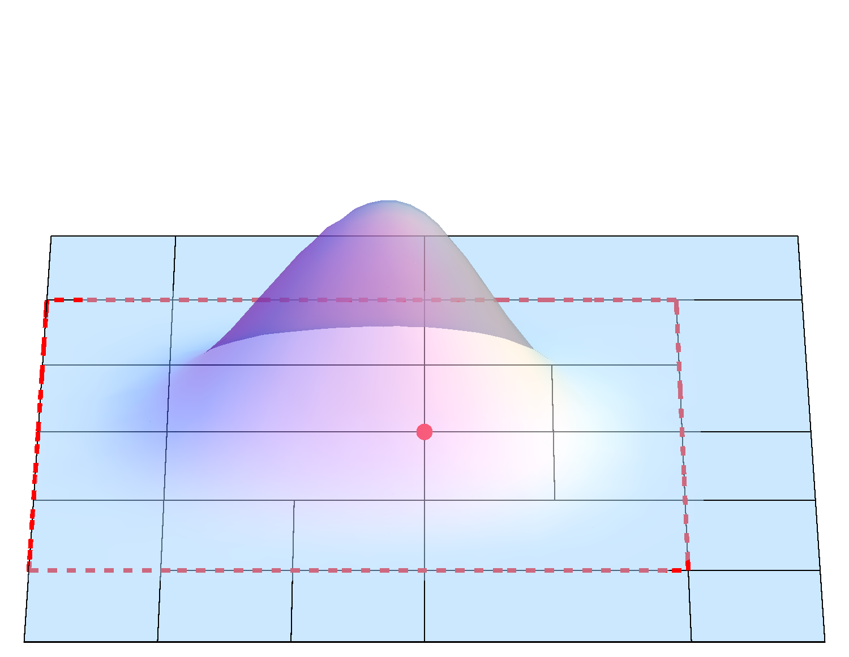
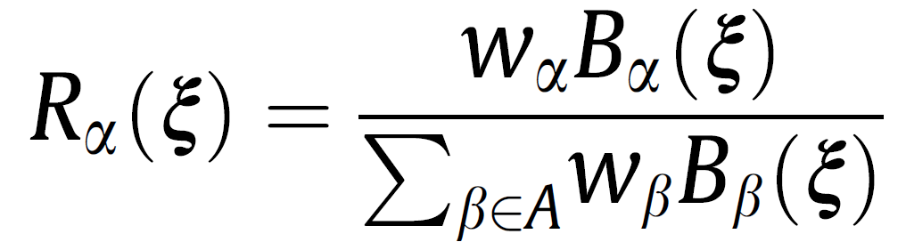
T-splines
Inferring local knot vectors for each blending function by traversing T-mesh edges
Bivariate Cubic T-spline
Local knot vectors associated to anchor t_{α} :
Rational blending functions

Slide 16
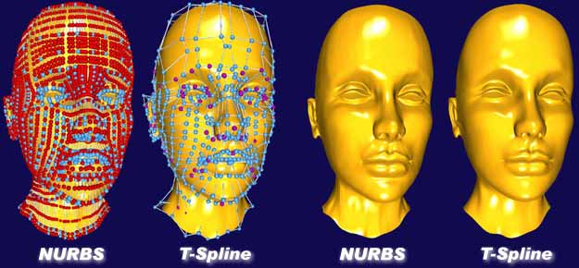
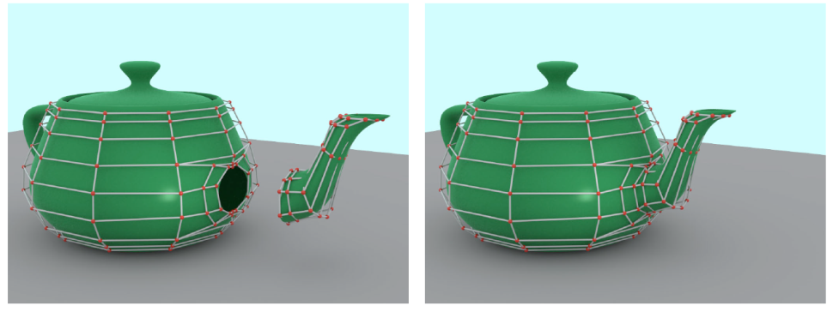
T-splines
Local details representation,
no superfluous control points!
Sederberg et al. “T-spline simplification and local refinement”
Watertight merging of patches,
no gaps, no overlaps!
Sederberg et al. “Watertight Trimmed NURBS”

Slide 17
T-splines
T-splines for Isogeometric Analysis?
Good properties:
Local refinement
Simplicity of the idea and straightforward implementation (2D and 3D)
Drawbacks:
No polynomial reproduction property
No nested spaces
No suitable for analysis!
Rational blending function: costly derivatives calculus, etc.

Slide 18

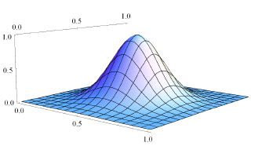
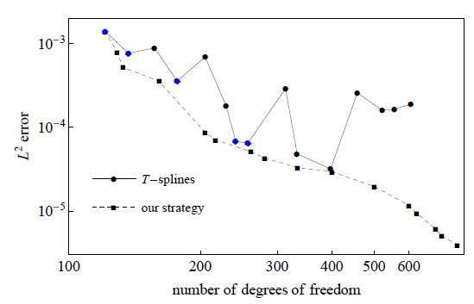
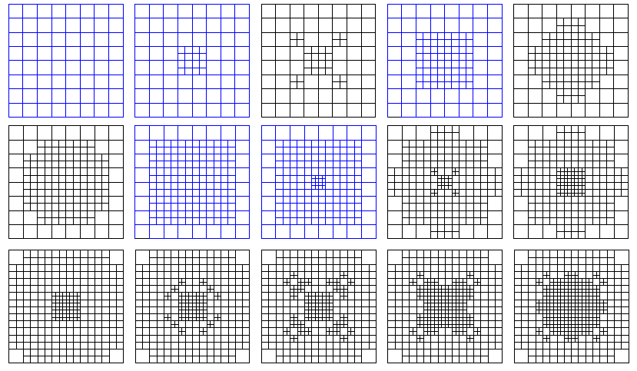
T-splines
Poor approximation capacity of T-splines. Improper error convergence
Adaptive refinement for interpolation problem, using error indicator:
L² error convergence

Slide 19
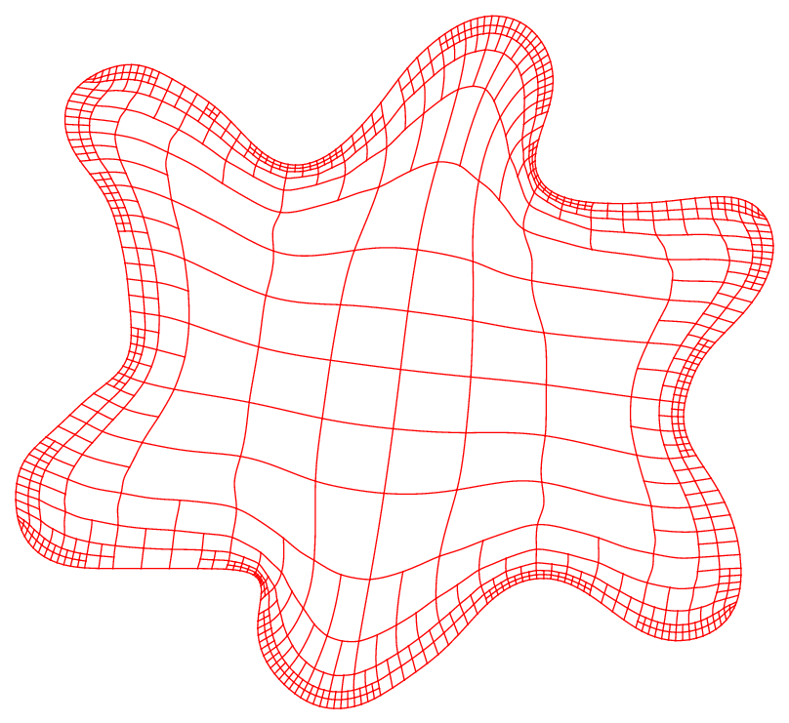
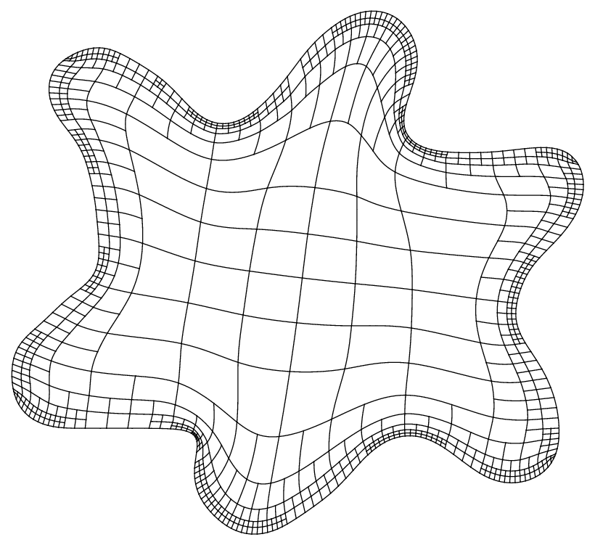
T-splines
Domain parameterization using rational T-splines
T-spline parameterization
(rational blending functions )
Spline parameterization with the new strategy (polynomial blending functions)

Slide 20
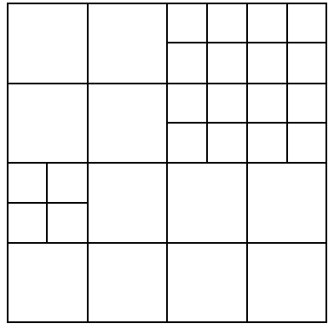
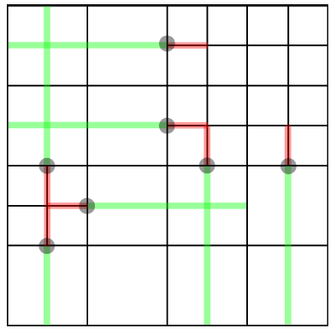
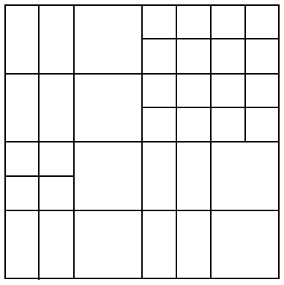
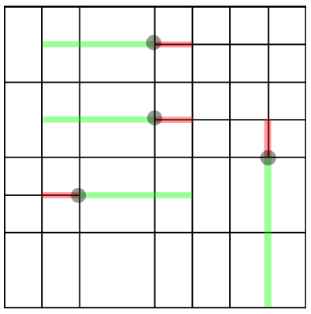
Analysis-suitable T-splines
Analysis-suitable T-splines, (M. Scott, 2011)
Topological restriction for T-meshes in terms of T-junction intersection
nested spaces
linear independence
optimal locality of the supports
polynomial reproduction property
partition of unity
Complex implementation
Still no examples for 3D
no analysis-suitable T-mesh
analysis-suitable T-mesh

Slide 21
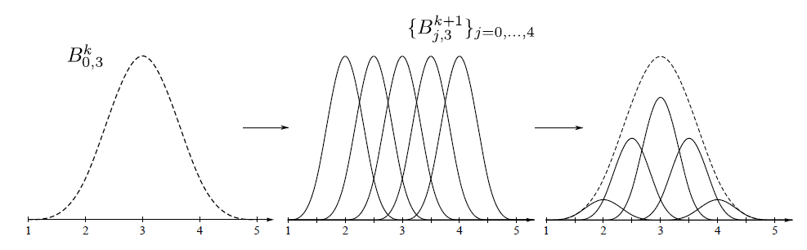
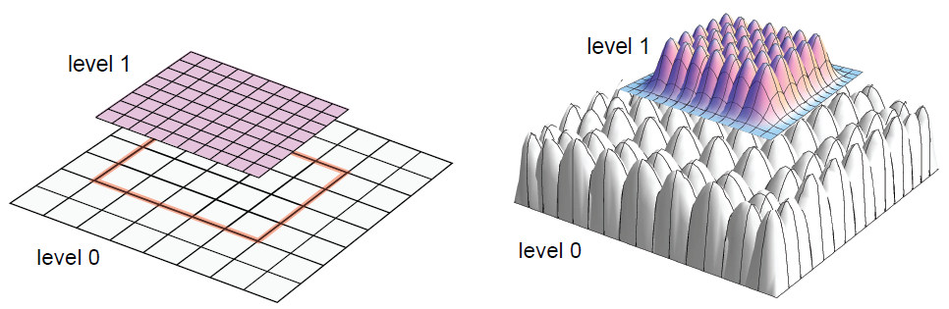
Hierarchical refinement scheme
Hierarchical refinement scheme for IGA
Refinability property of B-splines:
Coarse level functions are replaced by the functions of finer level

Slide 22
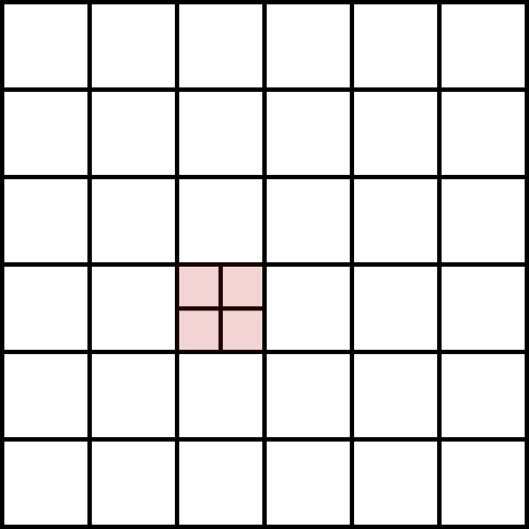
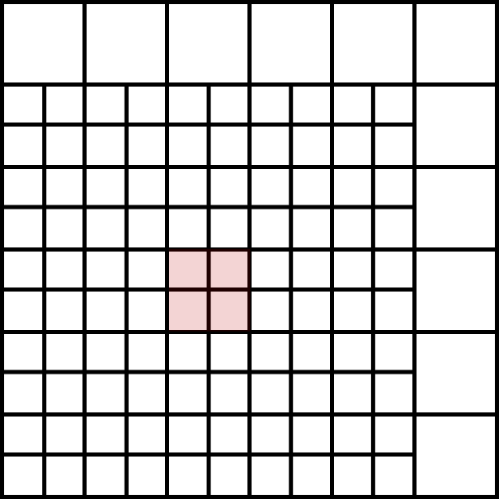
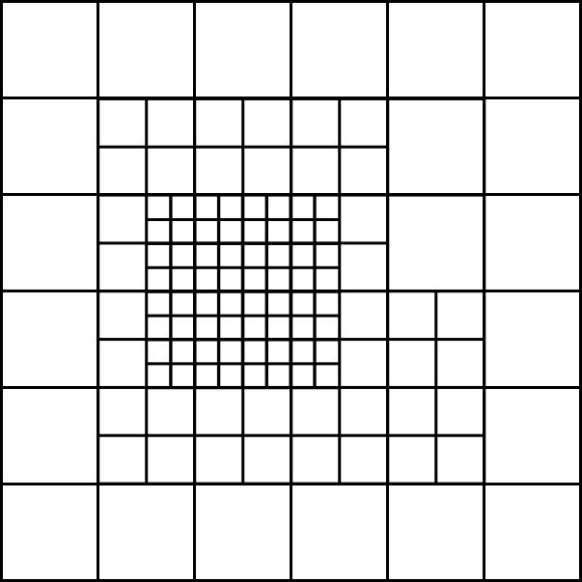
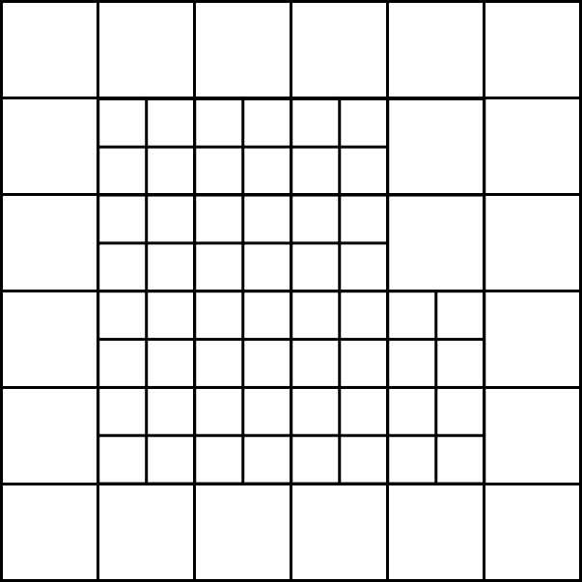
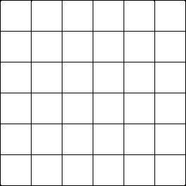
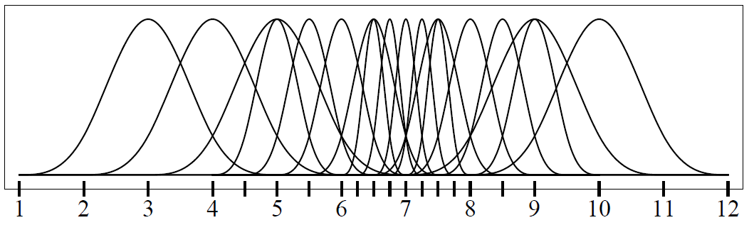
Hierarchical refinement scheme
Excessive extension of the refined area
Not possible to define spline space over a
arbitrary mesh
nested spaces
linear independence
polynomial reproduction property
weighted partition of unity
relatively easy implementation
49 new basis functions
Sequential construction of the spaces
Excessive support overlapping:
(Truncated Hierarchical splines)

Slide 23
Our goal
A practical solution to the problem of local refinement
Multivariate cubic spline spaces with nice properties:
Not too much restrictions over the mesh structure y the refinement pattern
Straightforward implementation both in 2D and 3D
Polynomial reproduction property
Linear independence
Nesting behavior of the spaces
Partition of unity
C²-continuous
Local supports

Slide 24
Strategy for construction of polynomial
spline spaces over hierarchical T-meshes
Mesh pretreatment
Inferring local knot vectors
Modification of local knot vectors

Slide 25
General scheme
Three main steps
Mesh pretreatment: 0-balancing
Inferring local knot vectors traversing T-mesh edges
Modification of local knot vectors

Slide 26
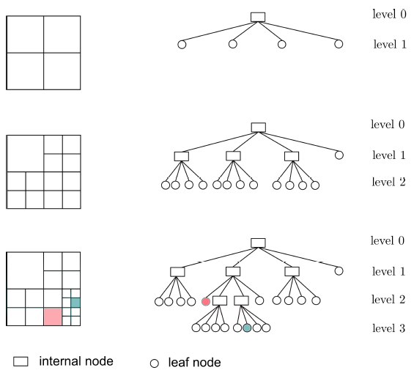
Step 1 - Mesh pretreatment
Hierarchical meshes with quadtree/octree subdivision scheme:

Slide 27
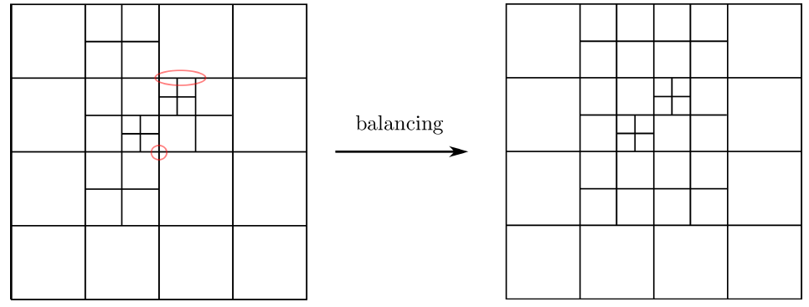
Step 1 - Mesh pretreatment
0-balanced quadtree mesh
Any node is shared by cells that differ at most in one level of depth
unbalanced mesh
0-balanced mesh

Slide 28
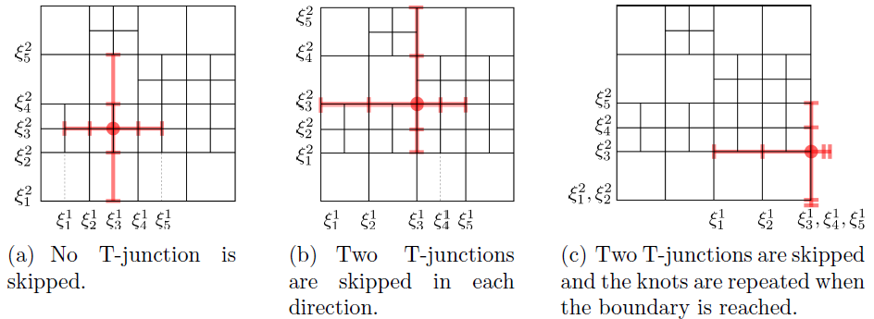
Step 2 - Inferring local knot vectors
Inferring local knot vectors
Local knot vectors are inferred by traversing T-mesh edges
Blending functions are associated only to regular nodes of the mesh.
Hanging nodes are skipped while walking across the mesh
T-spline (Sederberg)
our strategy

Slide 29


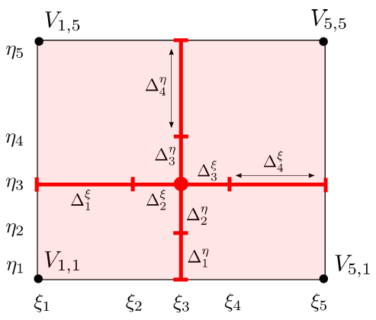
Step 3 - Modification of local knot vectors, 2D
Support of the bivariate function N_{α} with knot vectors:
Knot intervals:
Frame of the support:

Slide 30

Step 3 - Modification of local knot vectors, 2D
Modification of local knot vectors
Knot vectors of each blending function N_{α} have to fulfil two conditions:
Condition 1: Local knot vectors of the d-variate function N_{α} verify:
Condition 2: The frame of the function support should be situated
over the mesh skeleton:

Slide 31
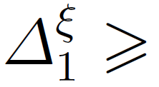
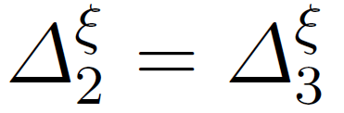
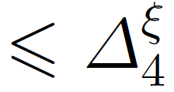
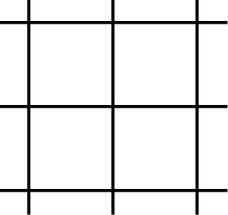
Step 3 - Modification of local knot vectors, 2D
Condition 1:
two central knot intervals should have the same size, and the other two exterior knot intervals should not be smaller than the central intervals
Condition 2:
the four corners of a function support should be situated over the mesh edges
no admissible !
point is not over the mesh edges
point is over the mesh edges

Slide 32
Step 3 - Modification of local knot vectors, 2D
Extension rules:
If any condition is not verified, we modify the local knot vectors by redefining some knots.
Algorithm
Check Condition 1
Extension rule 1
Check Condition 2
Extension rule 2

Slide 33

Step 3 - Modification of local knot vectors, 2D
Extension rule 1:
Extension rule 2:
corner is not over mesh edges
corner is over mesh edges

Slide 34




Step 3 - Modification of local knot vectors, 2D
Extension rule 1
Condition 1 is not satisfied
Extension rule 2
Condition 2 is not satisfied

Slide 35

Step 3 - Modification of local knot vectors, 3D
Support of the trivariate function N_{α} with knot vectors:
Knot intervals:
Frame of the support:
12 edges

Slide 36


Step 3 - Modification of local knot vectors, 3D
Condition 2: Edges of the cuboidal function support should be situated over the mesh faces.

Slide 37



Some remarks
Support classification
possible knot vector configuration
0
1
2
level of the function support

Slide 38
Properties of the constructed spline spaces
Non-negative weighted partition of unity
Excessive support overlapping

Slide 39


Properties of the constructed spline spaces

Slide 40





Properties
Non-negative weighted partition of unity
partition of unity
New basis :
But some weights can be zero !

Slide 41

Properties
Non-negative weighted partition of unity:
Redundant functions for partition of unity:

Slide 42


Properties
Possible excessive support overlapping
Situation that leads to support accumulation:
Additional refinements to avoid support accumulation:

Slide 43
Parameterization method for 2D geometries from representation of its boundary

Slide 44
Our result
Parameterization method for 2D geometries from
its boundary representation
The proposed method demands a boundary representation of the geometry
as input data.
The algorithm obtains, as a result, high quality parametric transformation
between 2D objects and the parametric domain.
The key of the method lies in defining an isomorphic transformation between the
parametric and physical T-mesh using a new T-mesh untangling and
smoothing procedure.
Based on Meccano method

Slide 45



Objective
Good quality parameterization:
Strictly positive Jacobian
Mapping is as conformal as possible
parametric domain
physical domain

Slide 46




General scheme of the method
Boundary parameterization and construction of an adapted T-mesh
adapted parametric T-mesh
tangled physical T-mesh
input boundary
Objective:
untangle and smooth the T-mesh
chord-length parameterization of the boundary

Slide 47

General scheme of the method
T-mesh optimization
Parametric T-mesh is deformed isomorphically into the physical T-mesh via optimization procedure
parametric T-mesh
optimized physical T-mesh

Slide 48



Construction of a spline representation of the geometry
Parametric mapping:
Interpolation:
parametric domain
physical domain

Slide 49



T-mesh transformation along the SUS process: Video
optimized physical T-mesh
parametric T-mesh

Slide 50


Mean Ratio Jacobian of the transformation:
A quality metric of the spline mapping at any point P₀

Slide 51



Mean ratio Jacobian as a quality metric

Slide 52


Adaptive refinement to improve parameterization quality
Low quality zone is refined and optimized again
inicial T-spline
improved T-spline
Isla de Gran Canaria
Mean ratio Jacobian
Mean ratio Jacobian

Slide 53




3D spline parameterization using tetrahedral mesh
Meccano method
tetrahedral parameterization
Spline parameterization
T-mesh vertices are located via tetrahedral parameterization in order to construct spline parameterization

Slide 54
Testing of the strategy.
Computational examples

Slide 55




Surface modelling
Floater parameterization
parametric domain, triangulation
spline representation of the surface
quadtree T-mesh
input surface triangulation

Slide 56


Surface modelling
input surface triangulation
spline representation of the surface

Slide 57




Interpolation problem
function to approximate:

Slide 58


Interpolation problem
Adaptive refinement using error indicator based on the exact L² error:

Slide 59


Interpolation problem
Error convergence:
adaptive and uniform refinement with our spline functions

Slide 60



Interpolation problem
Comparison with Lagrange functions:
Lagrange cubic basis functions
our spline basis functions
adaptive refinement for Lagrange basis functions

Slide 61





Poisson problem in a complex domain
Analytical solution: Steep wave front given by
Residual-type error indicator:

Slide 62

Poisson problem in a complex domain
Domain parameterization. Mean ratio Jacobian as a quality metric
parametric domain
physical domain

Slide 63

Poisson problem in a complex domain
Final refinement:
parametric domain
physical domain

Slide 64

Poisson problem in a complex domain
Numerical solution:
parametric domain
physical domain

Slide 65

Poisson problem in a complex domain
Error convergence:
adaptive and uniform refinement, IGA

Slide 66



Poisson problem. Collocation method
Collocation method
- collocation points

Slide 67




Poisson problem. Collocation method
Greville collocation point for the function N_{i} with local knot vectors

Slide 68


Poisson problem. Collocation method
Superconvergent collocation points
Gauss-Legendre
quadrarture points:
uniform mesh
T-mesh

Slide 69

Poisson problem. Collocation method
Error convergence

Slide 70





Eigenvalue problem
Exact solution:
Generalized algebraic eigenvalue problem:

Slide 71


Eigenvalue problem
Comparison of the exact eigenvalues and numerical eigenvalues
obtained with IGA and FEA.
spectrum
relative error of spectrum

Slide 72

Eigenvalue problem
Adaptive refinement to approximate the 11-th eigenpair:

Slide 73



Eigenvalue problem
Residual-type error indicator:

Slide 74

Eigenvalue problem
Error convergence:

Slide 75




Kellogg function
Discontinuous diffusion coefficient:
Solution:

Slide 76




Kellogg function
Error estimator:
Adaptive refinement for FEM and IGA with C⁰ –splines along the axes:
Final mesh, IGA
Final mesh, FEM

Slide 77





Kellogg function
Strategy with additioanal refinements to avoid excessive support accumulation:
normal adaptive refinement
adaptive process with additioanal refinements

Slide 78




3D Poisson problem
Analytical solution:
oscillation parameter
spline approximation of sphere portion domain

Slide 79


3D Poisson problem
Final mesh of adaptive refinement:
parametric domain
physical domain

Slide 80


3D Poisson problem
Numerical solution:
parametric domain
physical domain

Slide 81

3D Poisson problem
Error convergence:
adaptive and uniform refinement, IGA

Slide 82




3D Helmholtz equation with variable frequency
Solution:

Slide 83


3D Helmholtz equation with variable frequency
Adaptive refinement:
initial mesh, IGA
final mesh, FEM
initial mesh, FEM
final mesh, IGA

Slide 84

3D Helmholtz equation with variable frequency
Error convergence:
adaptive refinement for IGA and FEM

Slide 85
Summary, conclusions and future works

Slide 86
Our result
We have developed a new strategy for constructing cubic spline
spaces over quadtree(2D) and octree(3D) T-meshes
For a given strongly balanced T-mesh, it allows to obtain a set of cubic spline
functions that span a space with nice properties: C²-continuous, polynomial
reproduction property, nested spaces, linear independence.
Simple rules for inferring local knot vectors to define spline blending functions
Straightforward implementation in 2D and 3D

Slide 87
Future works
Proof of the properties of the spline spaces is needed: nesting behaviour of the spaces
for 3D case and linear independence for 2D and 3D cases;
Some improvements of the strategy can be done:
excessive support overlapping can take place during the adaptive refinement;
strictly positive partition of unity is desirable
More sophisticated rules are needed!
Extend the method for:
.
repeated interior knots
spline spaces over complex, polygon type, parametric domains

Slide 88
Gracias !

