Slide 1
Insertion of anthropogenic constructions in a tetrahedral mesh of the terrain using the Meccano method
Guillermo V. Socorro-Marrero, Albert Oliver, Eduardo Rodríguez,
José M. Escobar, Gustavo Montero, and Rafael Montenegro
University Institute SIANI, University of Las Palmas de Gran Canaria, Spain
ECCOMAS Congress 2016. June 5-10, Crete
MINECO y FEDER PROGRAMA ESTATAL I+D+I ORIENTADA A RETOS DE LA SOCIEDAD: CTM2014-55014-CR3-1-R
CONACYT-SENER Project, Fondo Sectorial, contract: 163723
http://www.dca.iusiani.ulpgc.es/proyecto2015-2017

Slide 2
Contents
Motivation
Meccano mesher overview
Template based approach
Surface / curve insertion approach
Conclusions and future research

Slide 3
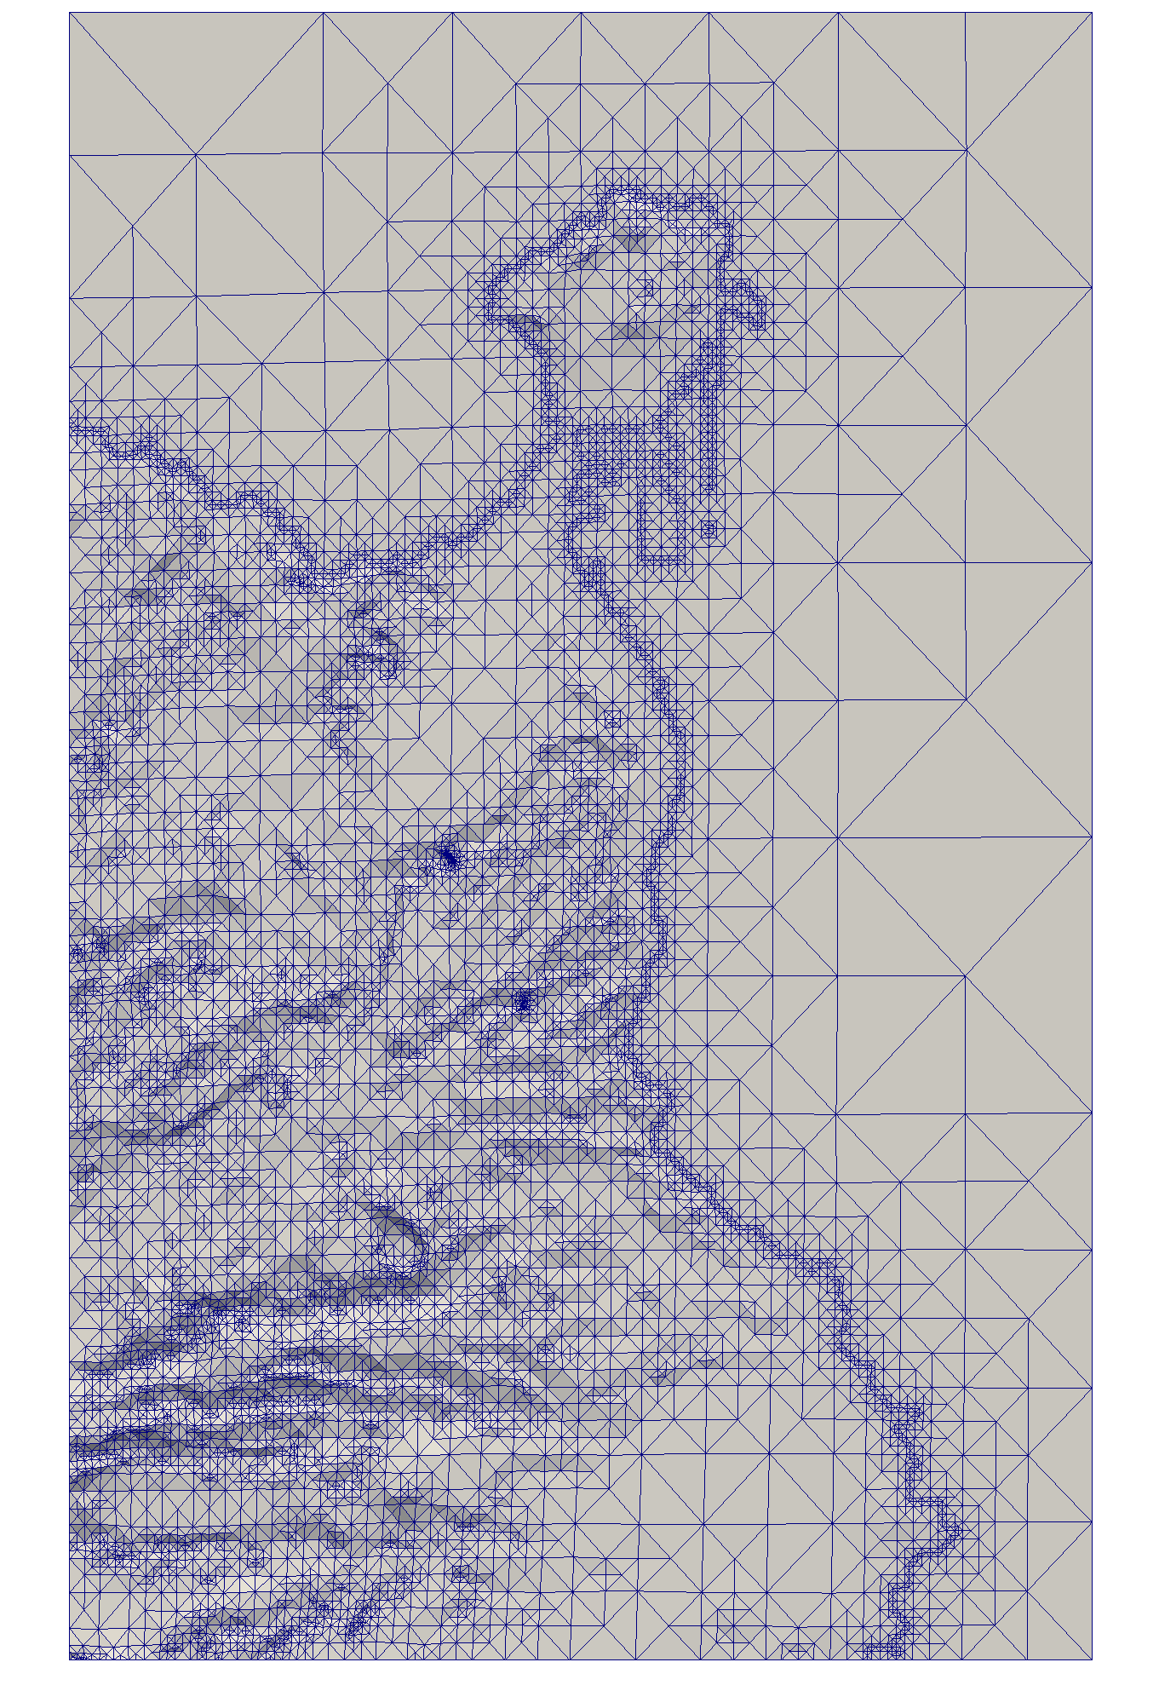
Motivation
Where we start from
  Automatic tetrahedral mesh generation of the terrain
  Digital Terrain Model
What we need
Include the information about constructions
Goal
  Add constructions to the terrain mesh

Slide 4
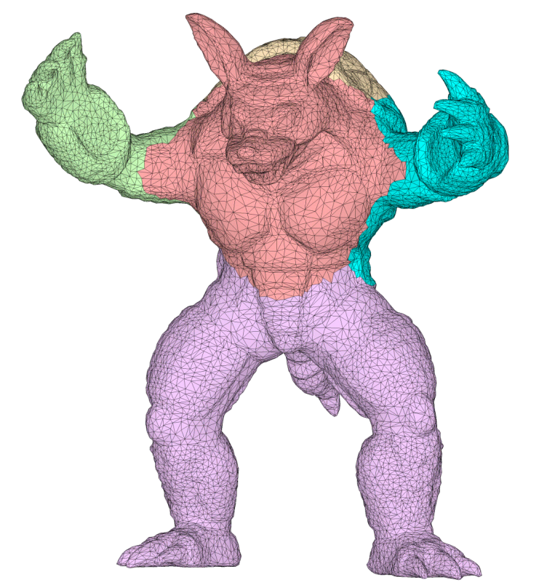
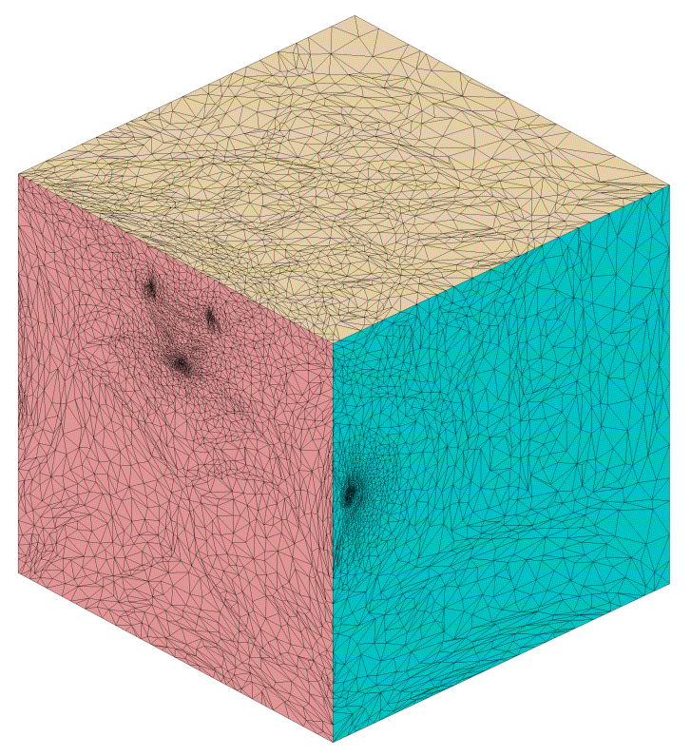
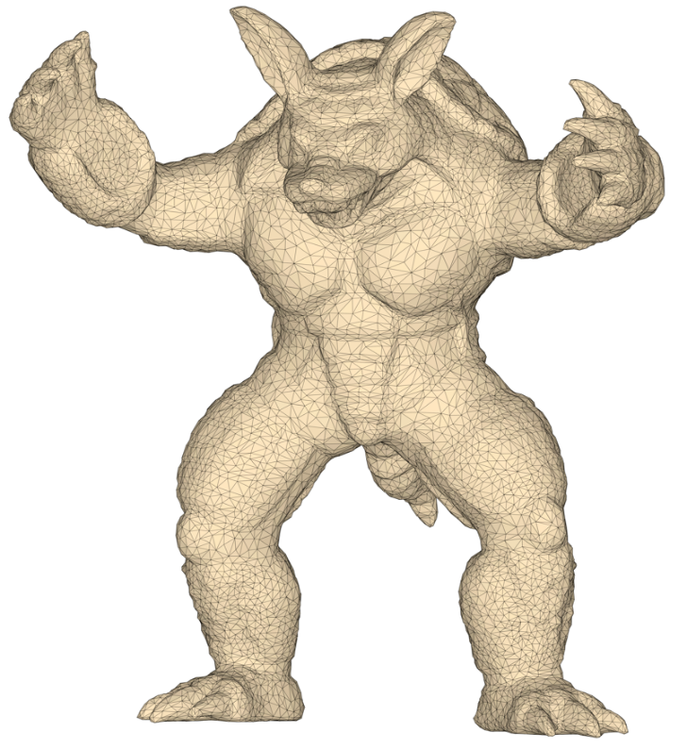
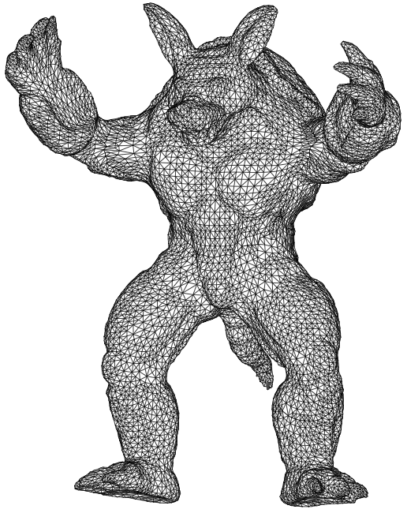
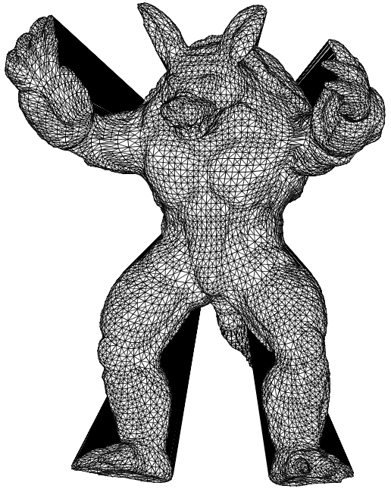
Meccano Method for complex solids
Simultaneous mesh generation and volumetric parameterization
Parameterization
Refinement
Untangling and smoothing

Slide 5
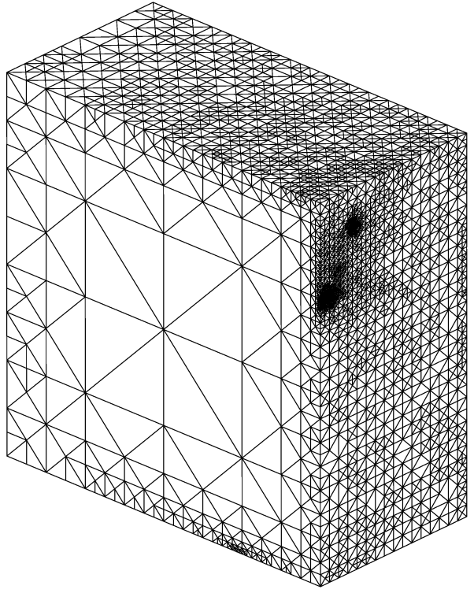
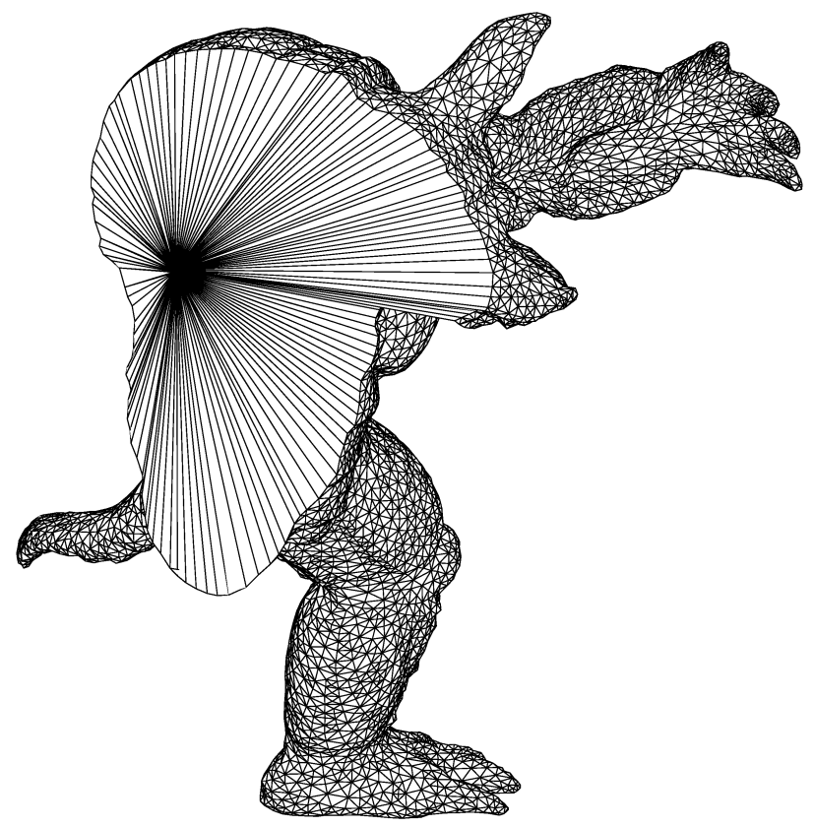
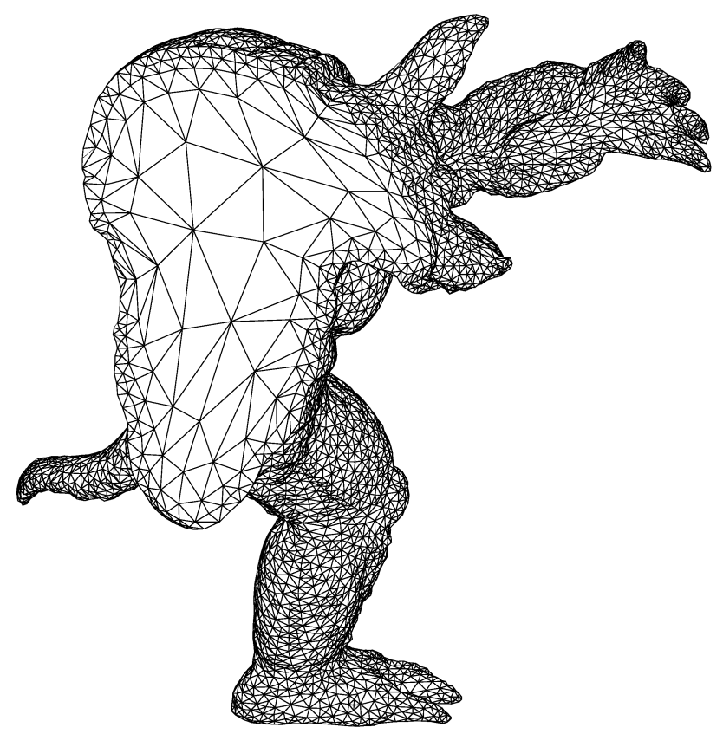
Meccano Method for complex solids
Mesh generation. SUS of tetrahedral meshes
Optimization
Parametric space (meccano mesh)
Physical space
(tangled mesh)
Physical space
(optimized mesh)

Slide 6
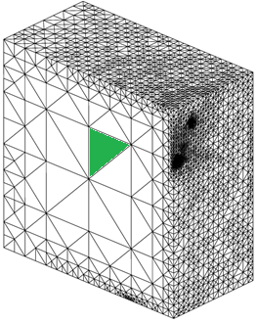
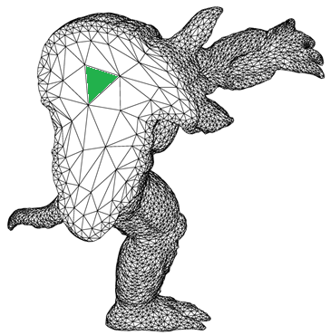
Meccano Method for complex solids
Simultaneous mesh generation and volumetric parameterization
Volumetric
parameterization
Parametric space (meccano mesh)
Physical space
(final mesh)

Slide 7
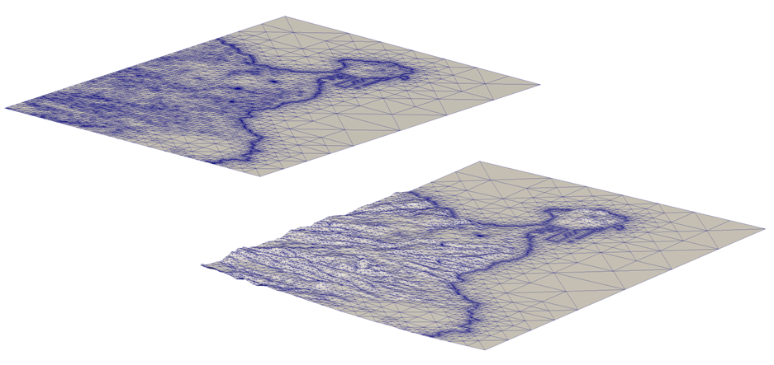
Meccano parameterization of terrain
View of parametric and physical space of Gran Canaria
parametric
physical

Slide 8
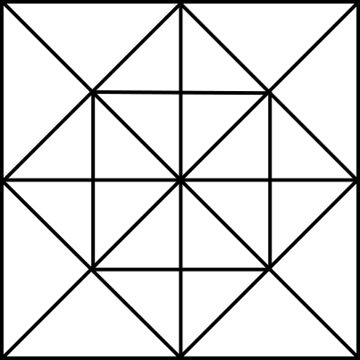
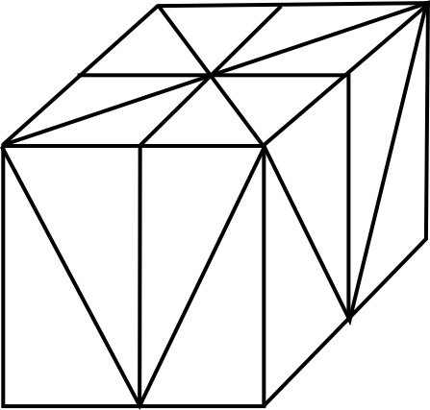
Template based insertion
Template definition
The template will consist of
Parametric space
Physical counterpart

Slide 9
Template based insertion
Insertion of templates in the terrain
Add a building to the Gran Canaria terrain

Slide 10
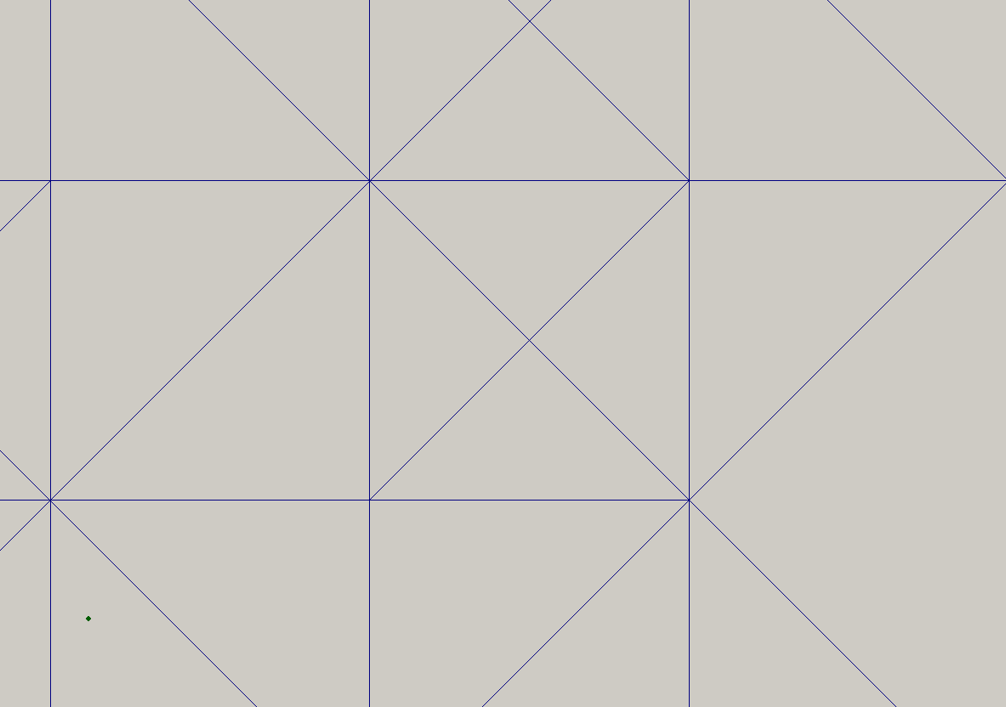
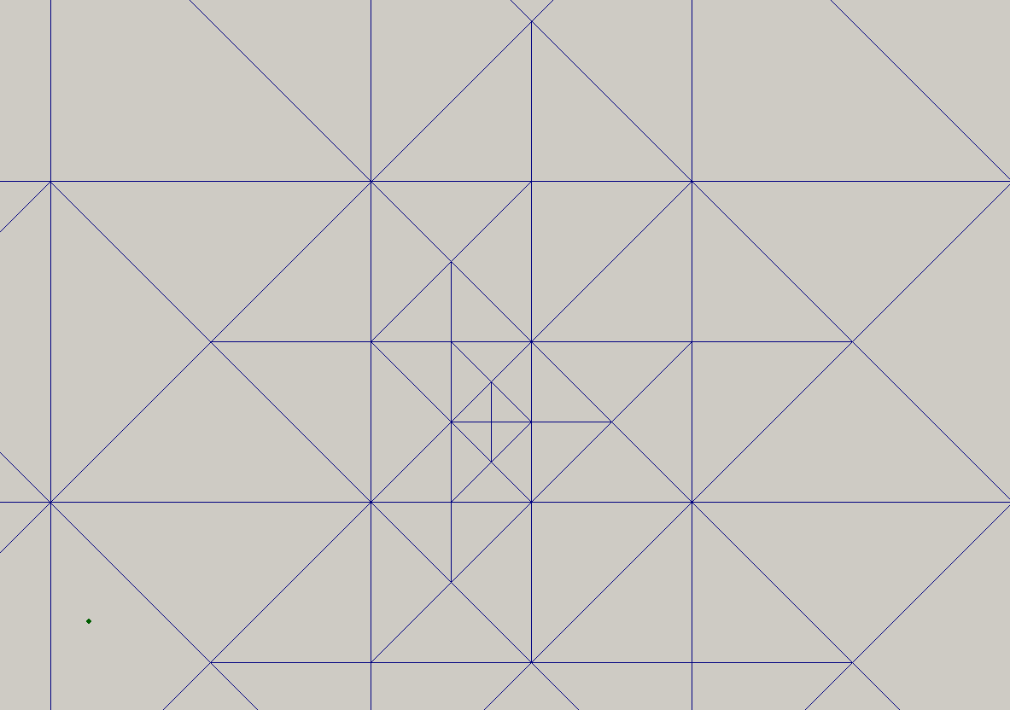
Template based insertion
Algorithm
Add a building to the Gran Canaria terrain
  Refine the mesh around the site

Slide 11
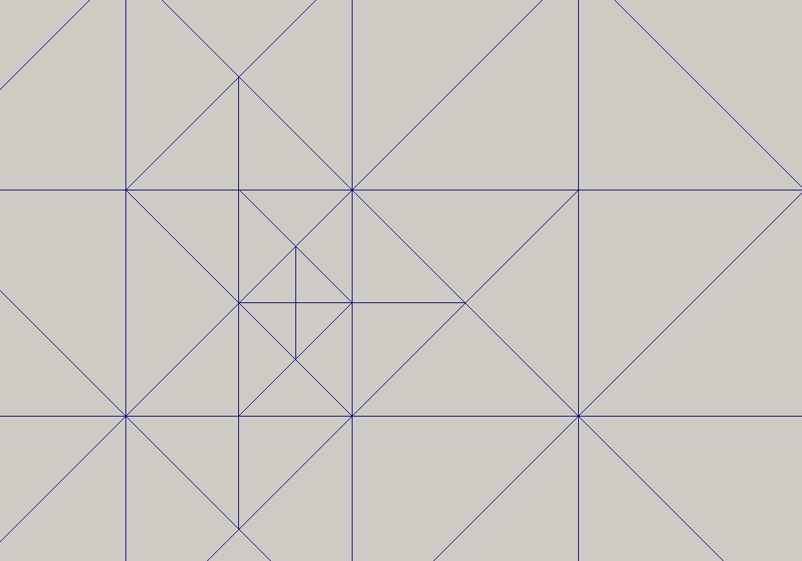
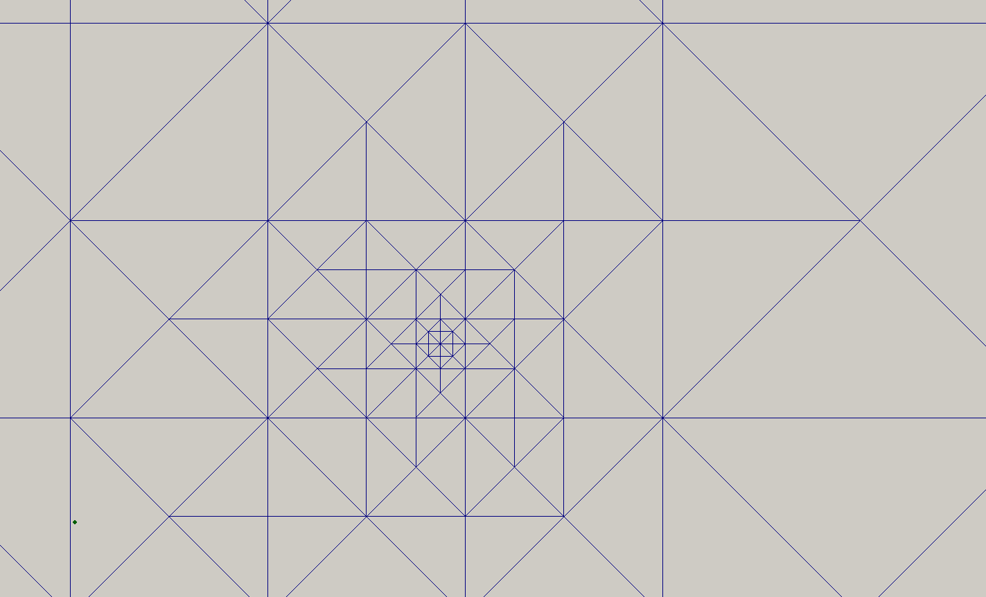
Template based insertion
Algorithm
Add a building to the Gran Canaria terrain
  Refine the mesh around the site
  Refine to create the nodes of the template

Slide 12
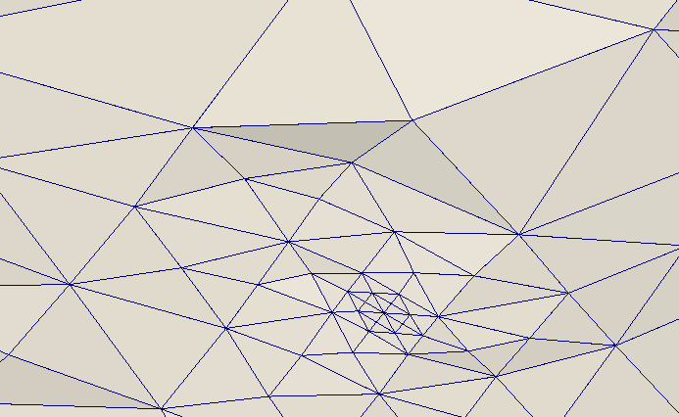
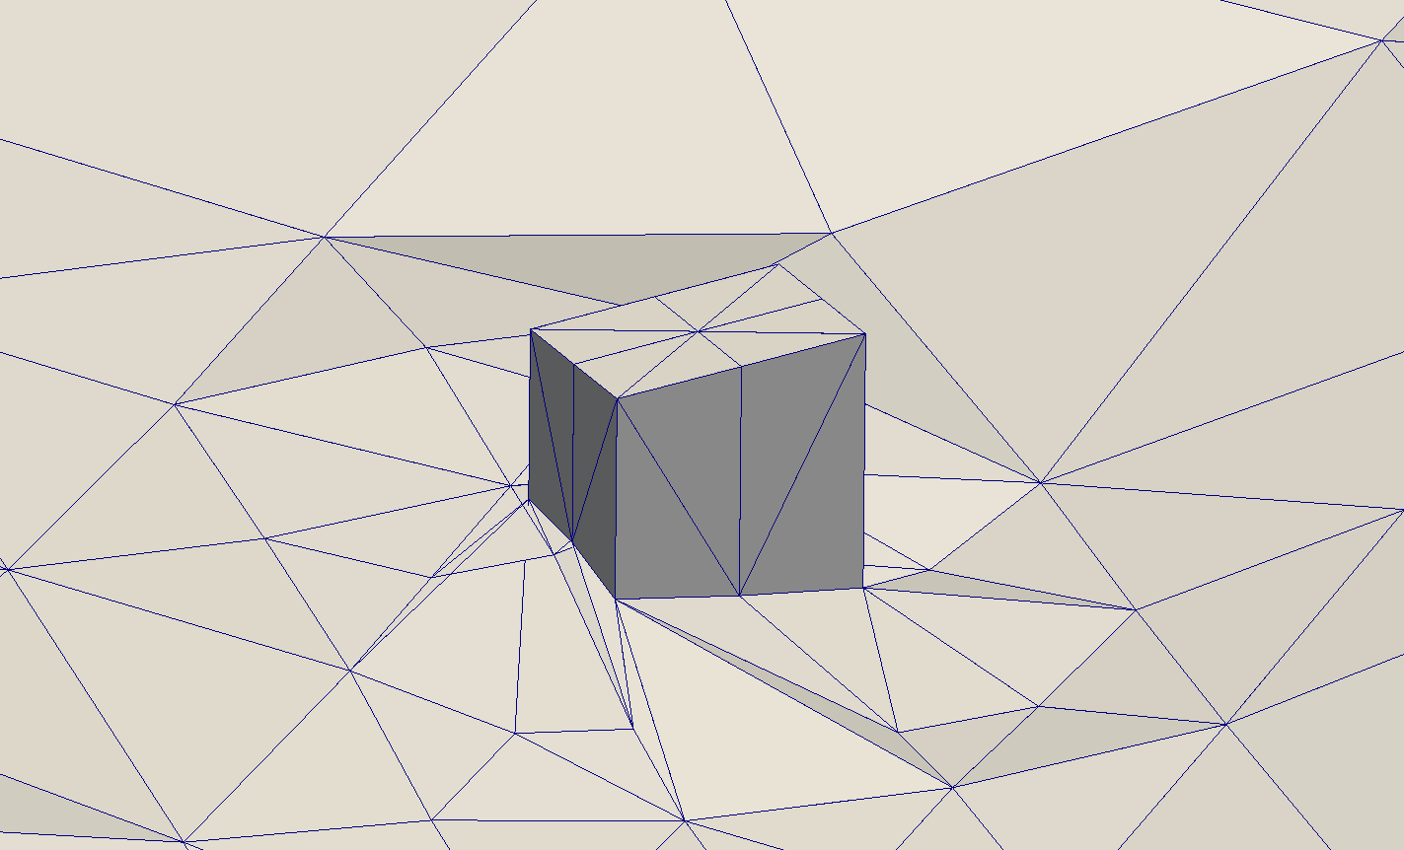
Template based insertion
Algorithm
Add a building to the Gran Canaria terrain
  Refine the mesh around the site
  Refine to create the nodes of the template
  Insert (substitute) the template
    translate nodes to their actual locations

Slide 13
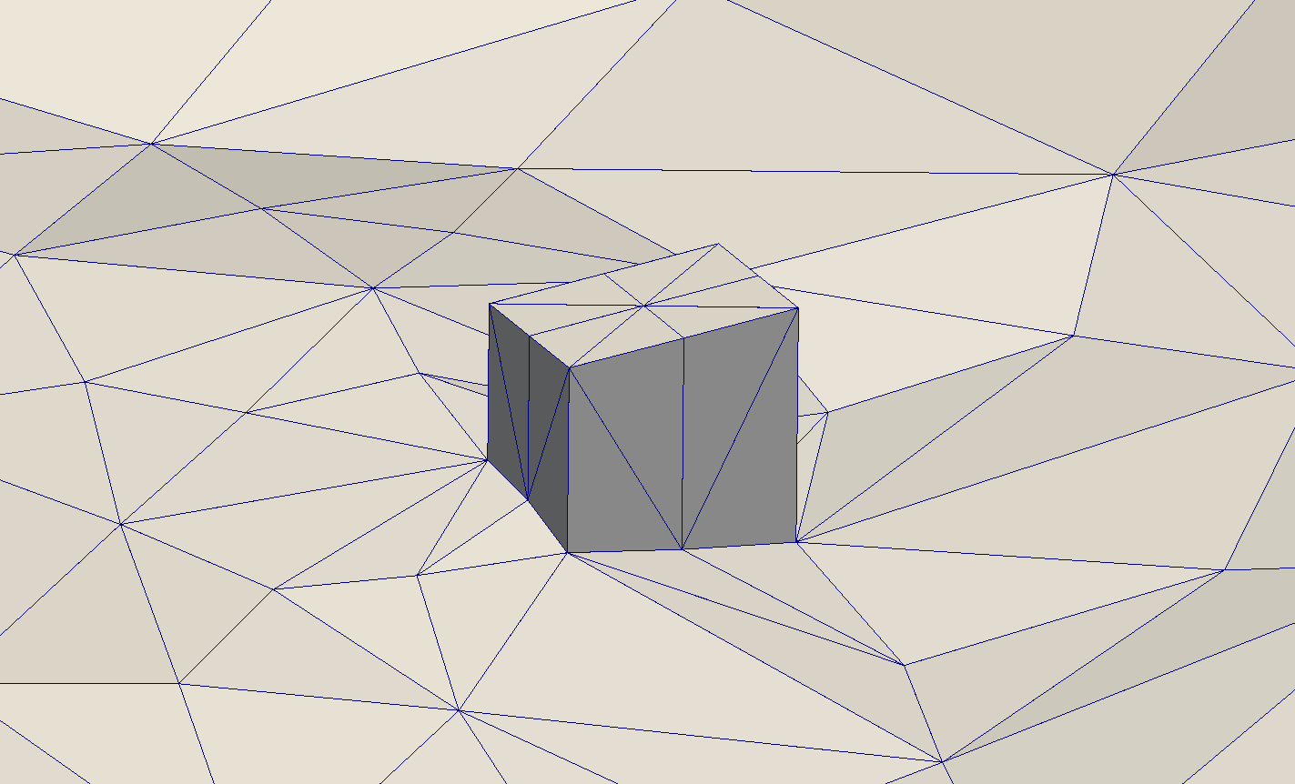
Template based insertion
Algorithm
Add a building to the Gran Canaria terrain
  Refine the mesh around the site
  Refine to create the nodes of the template
  Insert (substitute) the template
    translate nodes to their actual locations
  Untangle and smooth the mesh to
    preserve a valid parameterization
    improve mesh quality

Slide 14
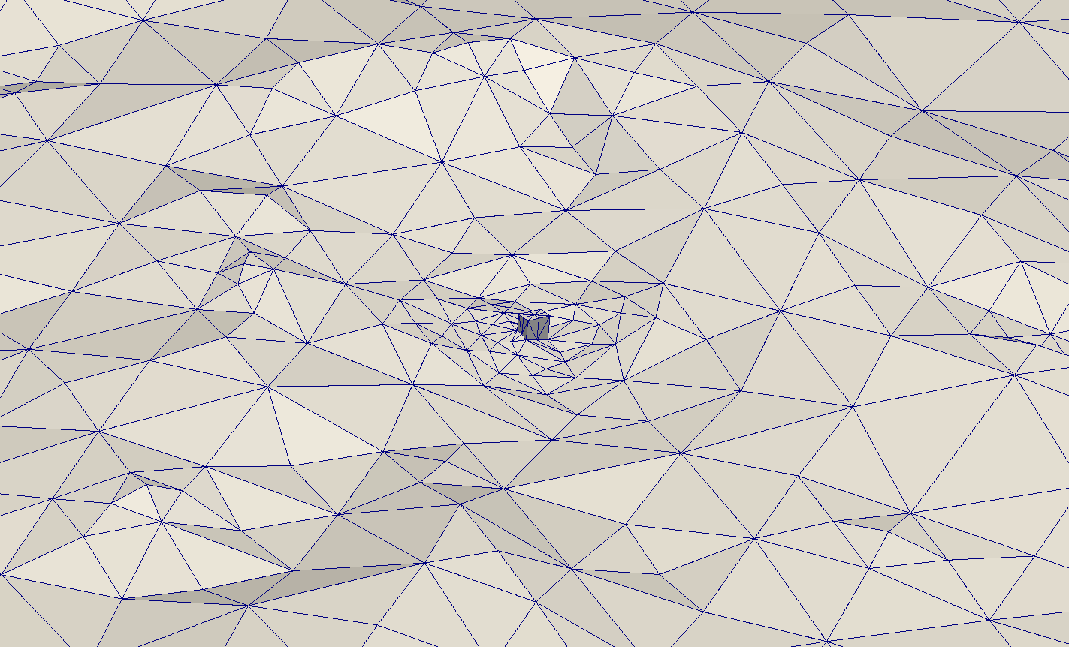
Template based insertion
Resultant mesh including the inserted construction

Slide 15
Surface Approximation
Algorithm steps
Initial approximation
Parameterization
Smoothing
Mesh-surface
intersection
Projection
SUS
Approximation
parameterization
Volumetric
Approximation
Surface
parameterization
Surface
approximation
Real surface
(input data)
Initial rough approximation
Surface projection
and smoothing

Slide 16
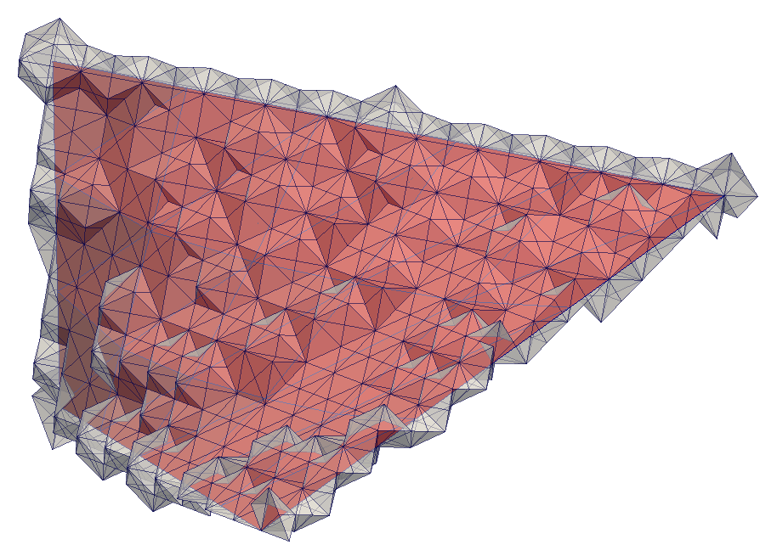
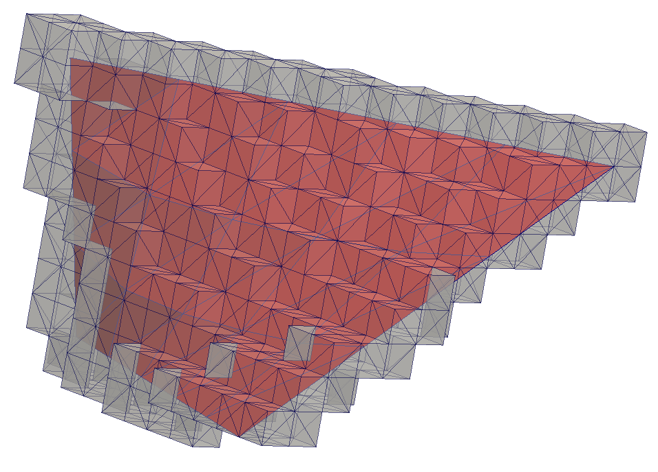
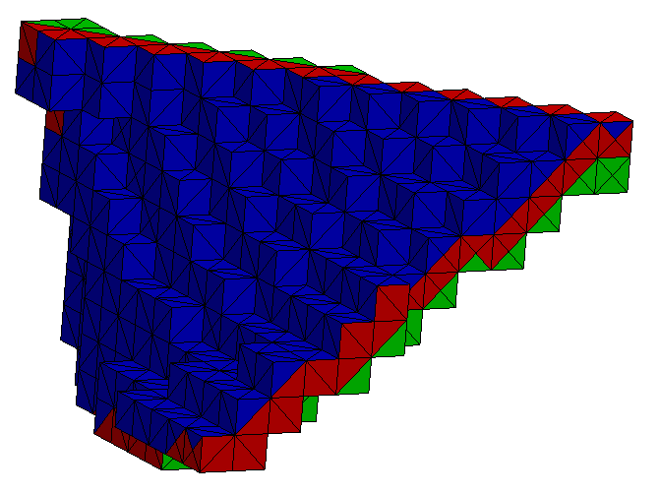
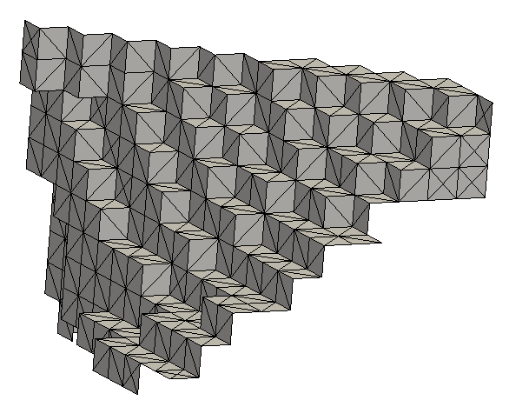
Surface initial approximation
Volumetric and surface approximations
Encapsule inmerse surface
Repair volumetric approximation
Select faces on one of the sides
Repair surface approximation

Slide 17
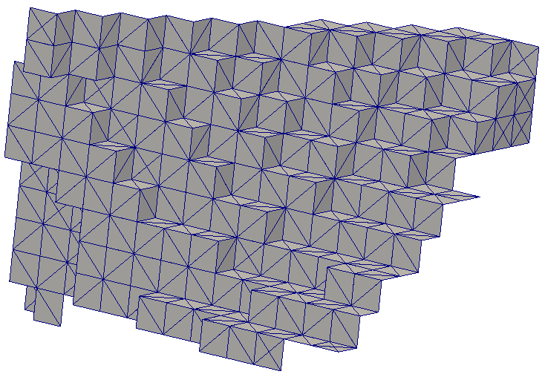
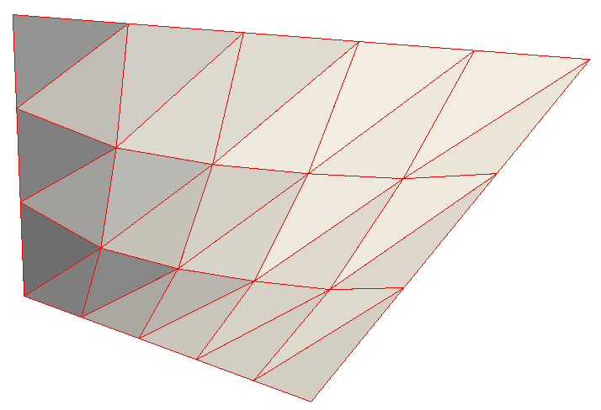
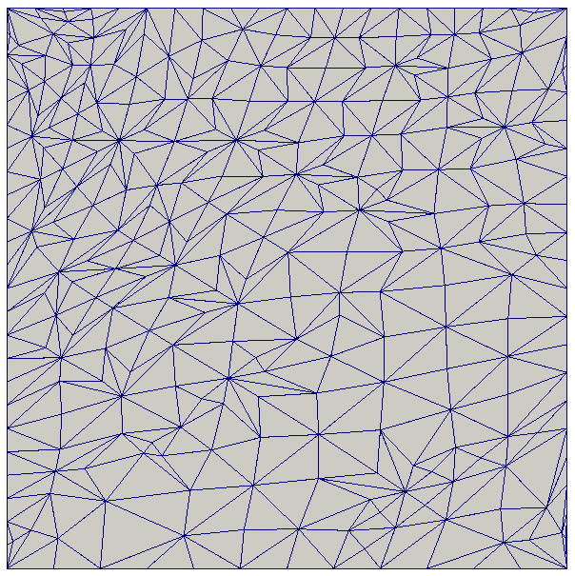
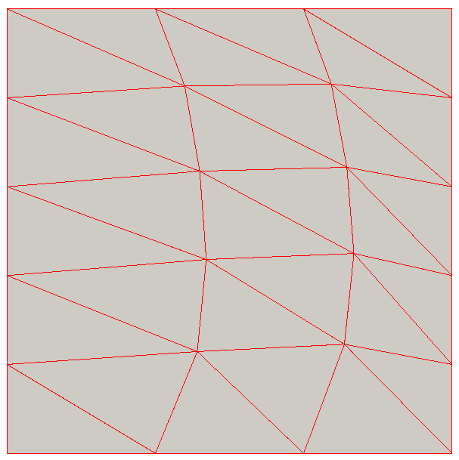
Surface parameterizations
Parameterization of actual surface and its approximation
approximation (physical domain)
surface (physical domain)
approximation (parametric domain)
surface (parametric domain)

Slide 18
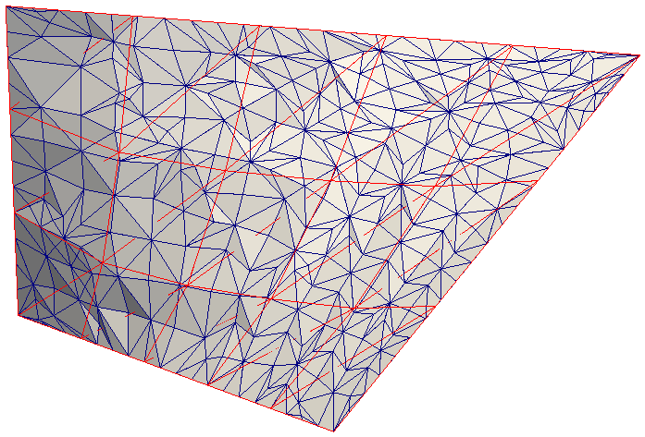
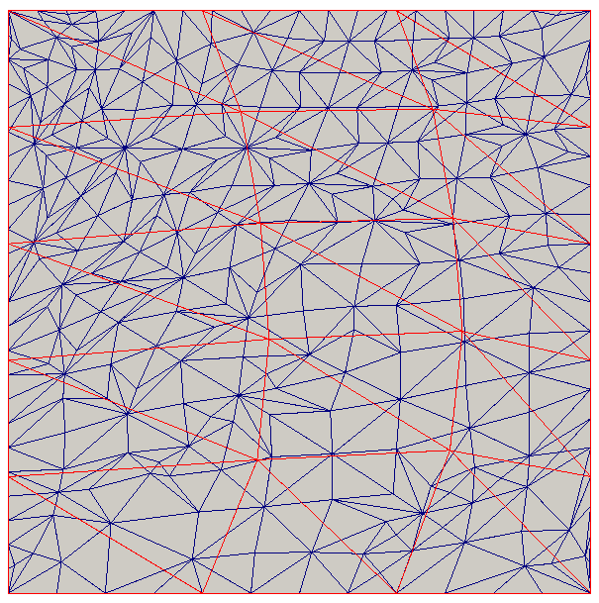
Projection
Simultaneous parameterization to project nodes
Simultaneous parameterization of the immerse surface and its initial approximation to the same parametric domain provides an initial location for nodes in the actual surface.

Slide 19
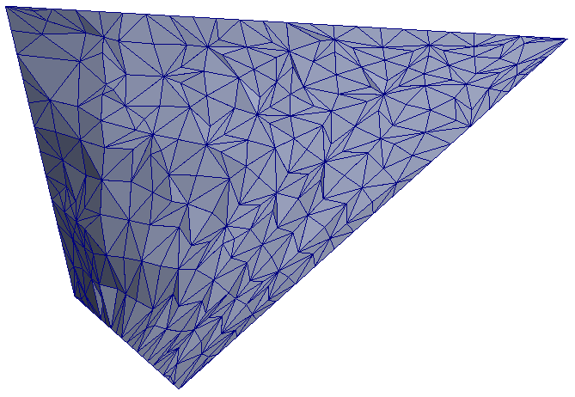
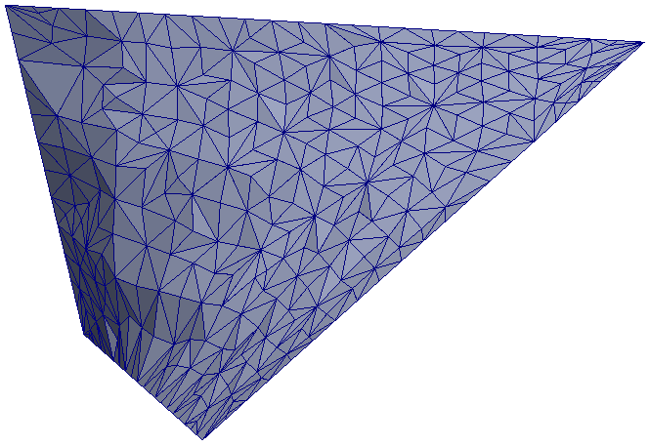
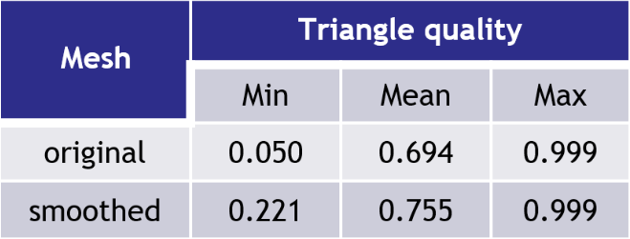
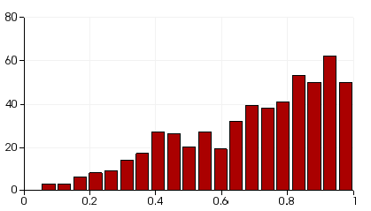
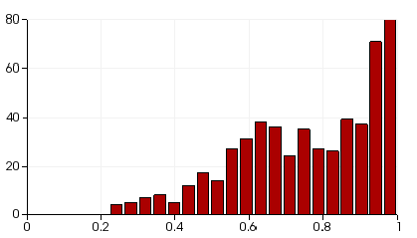
The Wind Field Model
Smoothing
Surface approximation. Triangle Quality.
Number of triangles
Number of triangles
quality
quality

Slide 20
Curve approximation insertion
Particularization to contour approximation in 2D domain
Add an stack to the Gran Canaria terrain

Slide 21
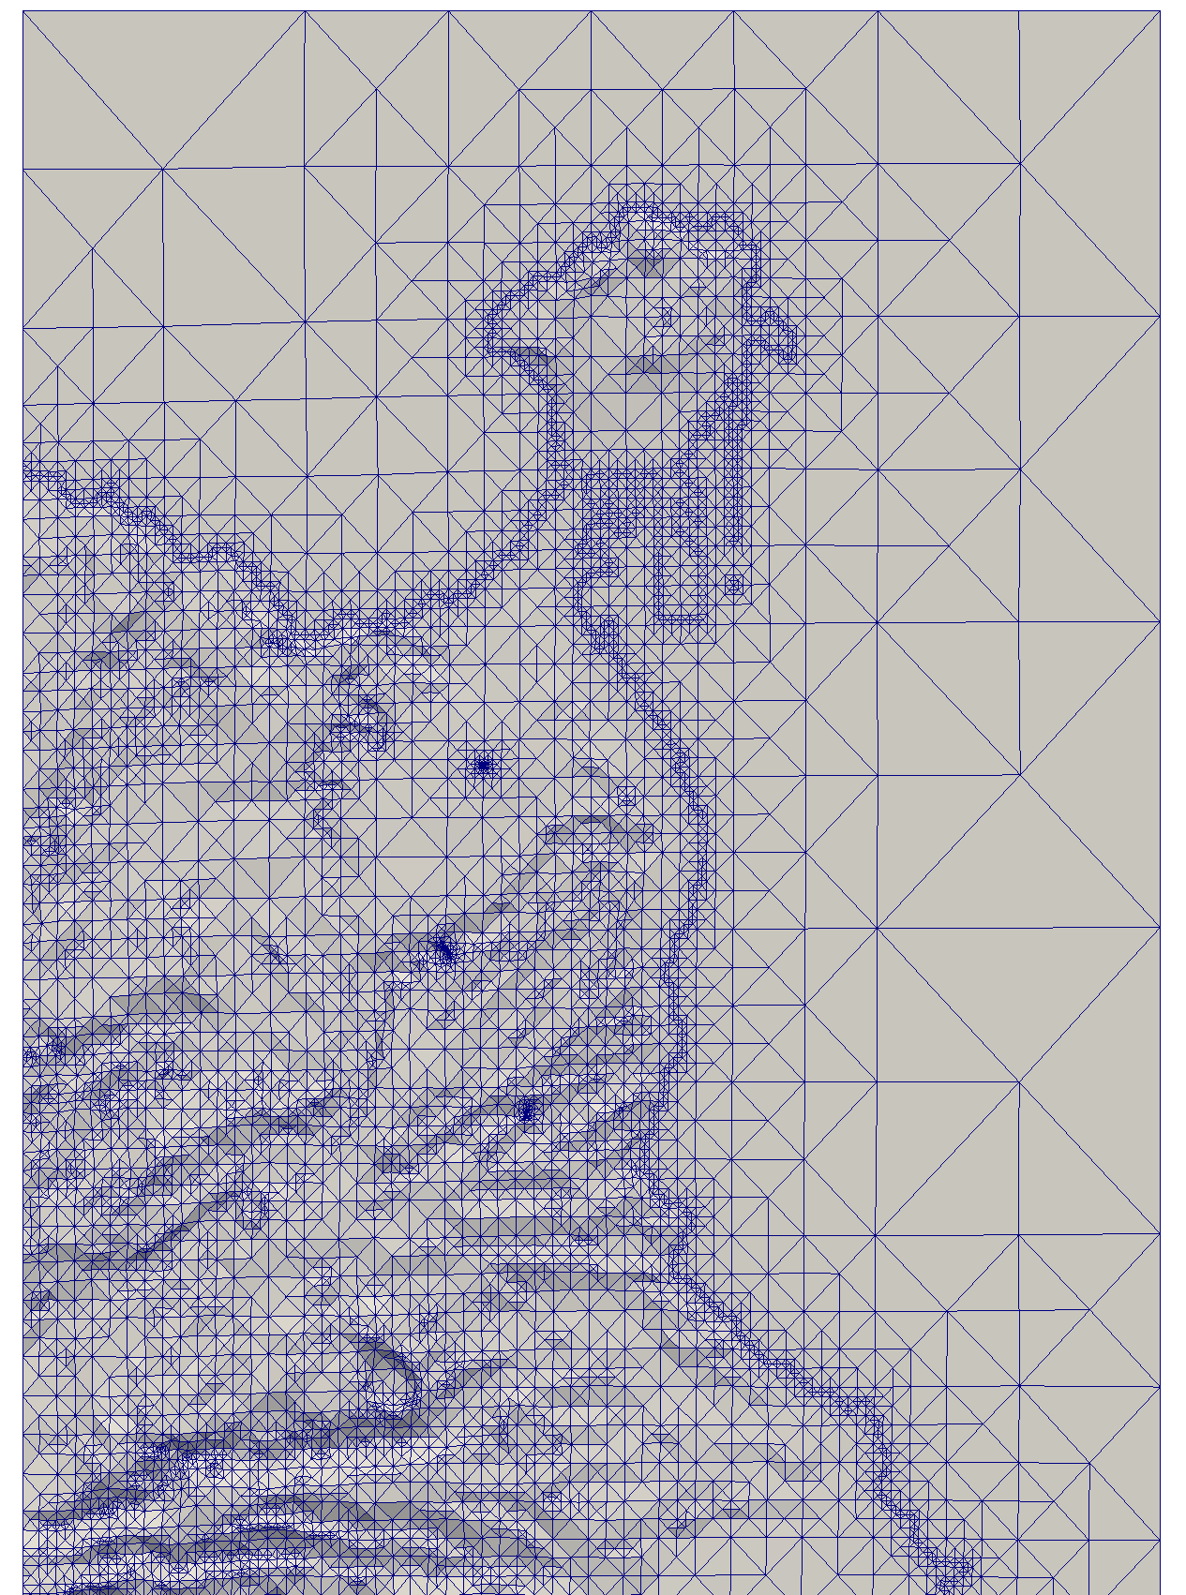
Curve approximation insertion
Algorithm
Add an stack to the Gran Canaria terrain
  Refine the mesh around the contour

Slide 22
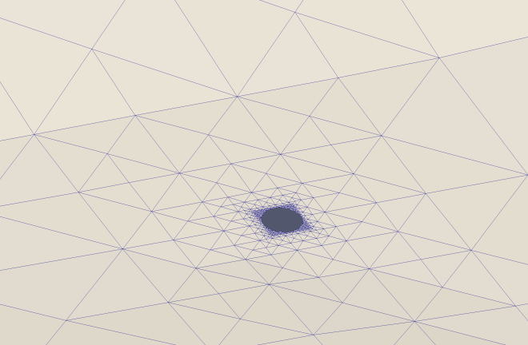
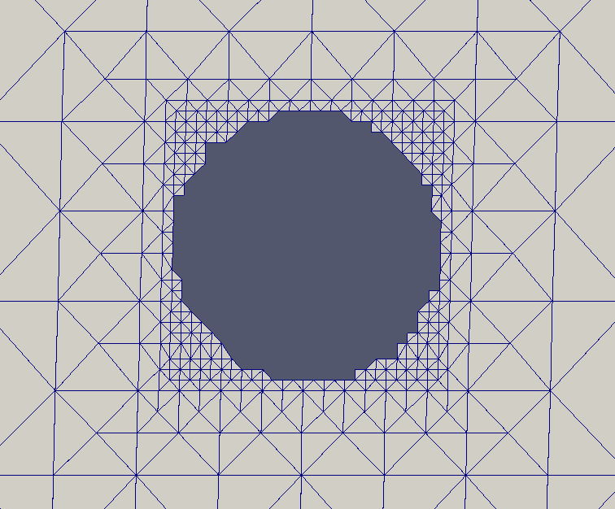
Curve approximation insertion
Algorithm
Add an stack to the Gran Canaria terrain
  Refine the mesh around the contour
  Select the edges that will form the outline

Slide 23

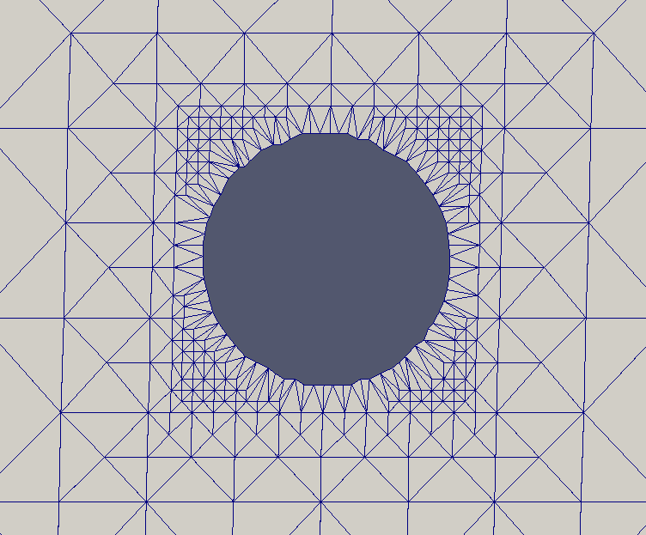
Curve approximation insertion
Algorithm
Add an stack to the Gran Canaria terrain
  Refine the mesh around the contour
  Select the edges that will form the outline
  Project the edges to the actual shape

Slide 24
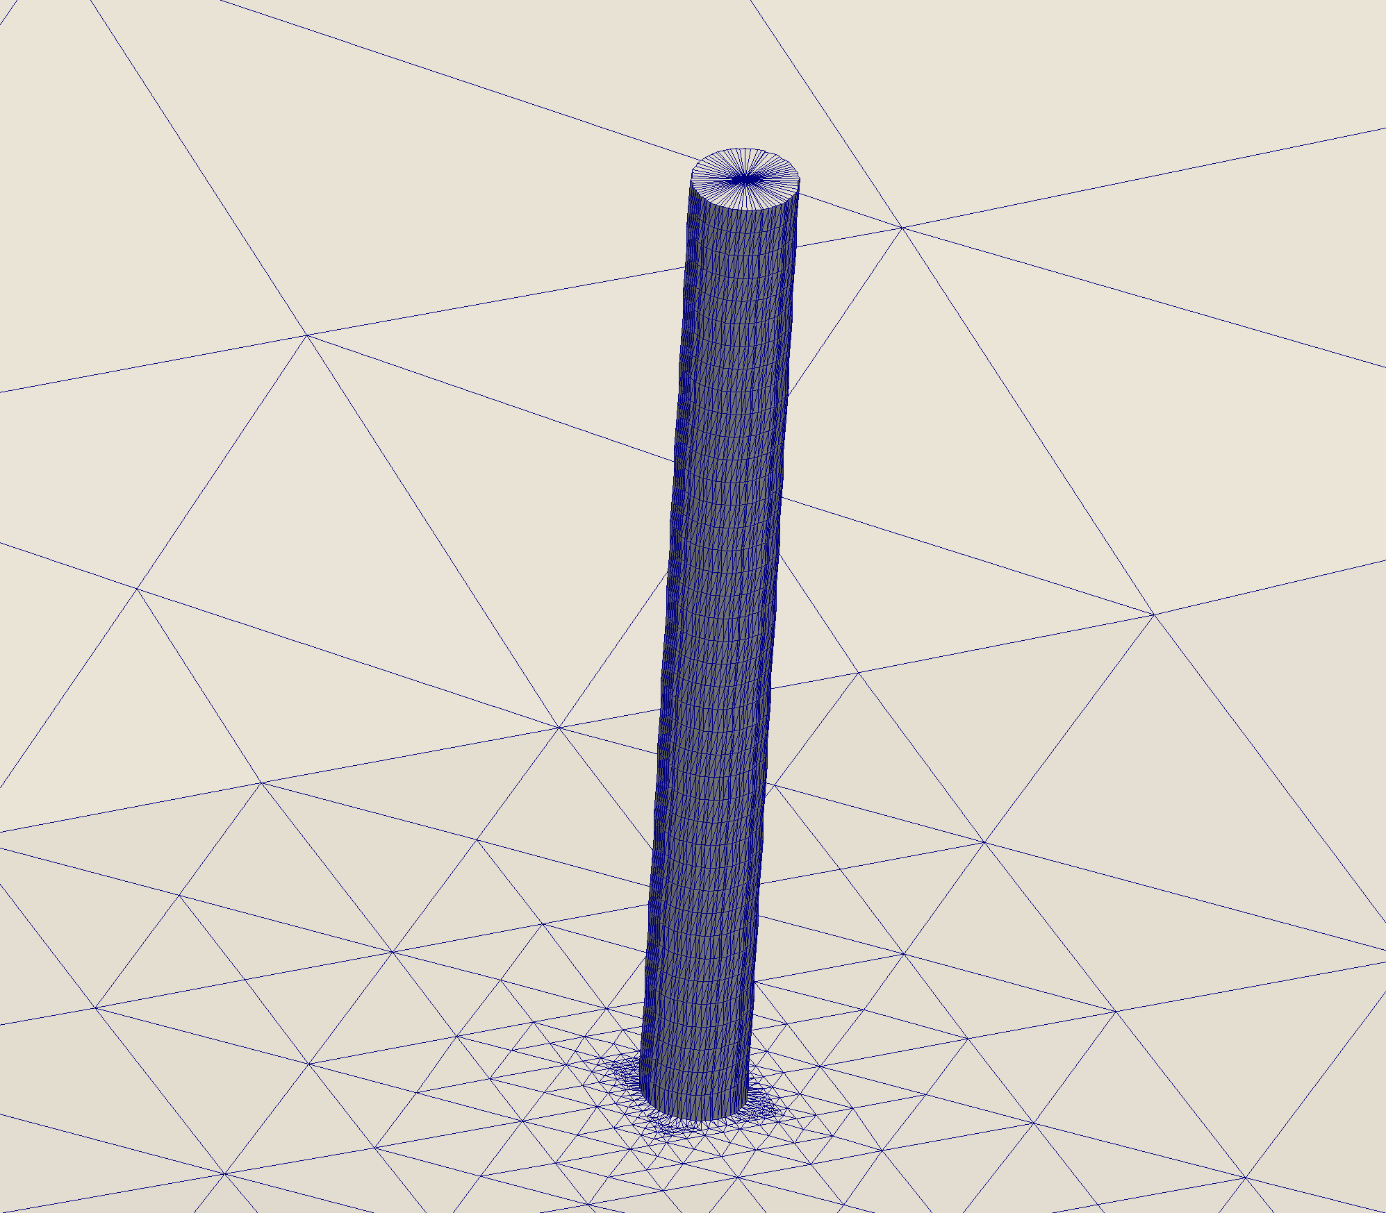
Curve approximation insertion
Algorithm
Add an stack to the Gran Canaria terrain
  Refine the mesh around the contour
  Select the edges that will form the outline
  Project the edges to the actual shape
  Extrude the walls

Slide 25
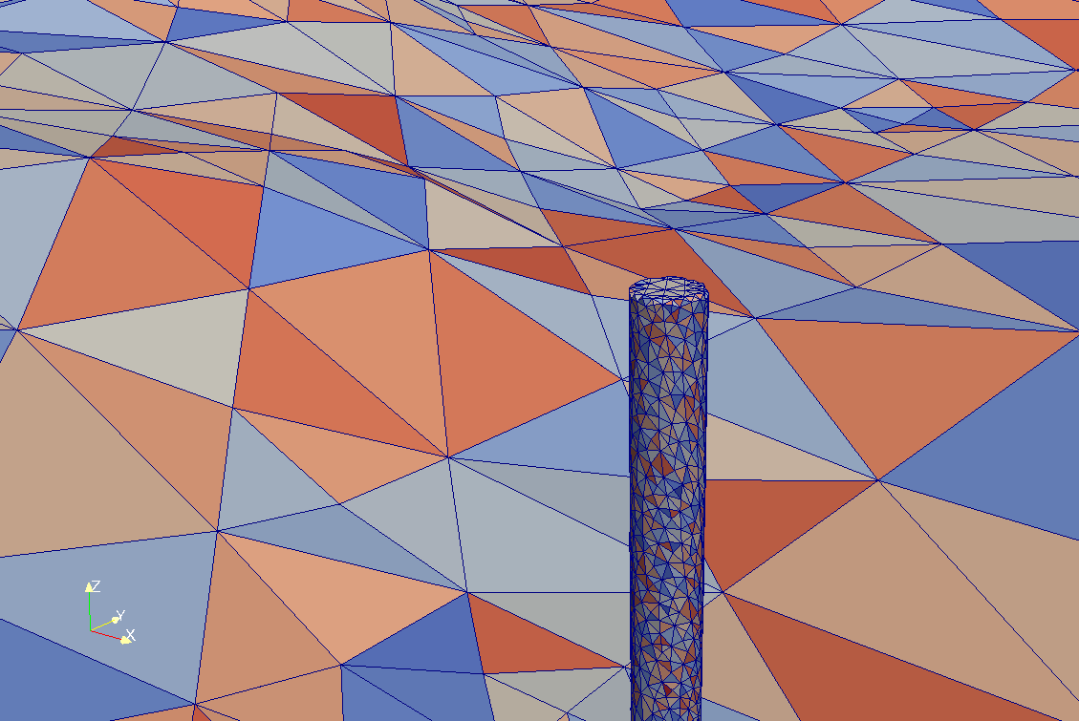
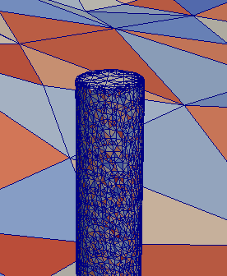
Curve approximation insertion
Algorithm
Add an stack to the Gran Canaria terrain
  Refine the mesh around the contour
  Select the edges that will form the outline
  Project the edges to the actual shape
  Extrude the walls
  Generate a mesh with the new terrain
    Two different tolerances:
      τ_{t} for terrain and τ_{c} for constructions
τ_{c} = 0.1
τ_{c} = 0.001

Slide 26
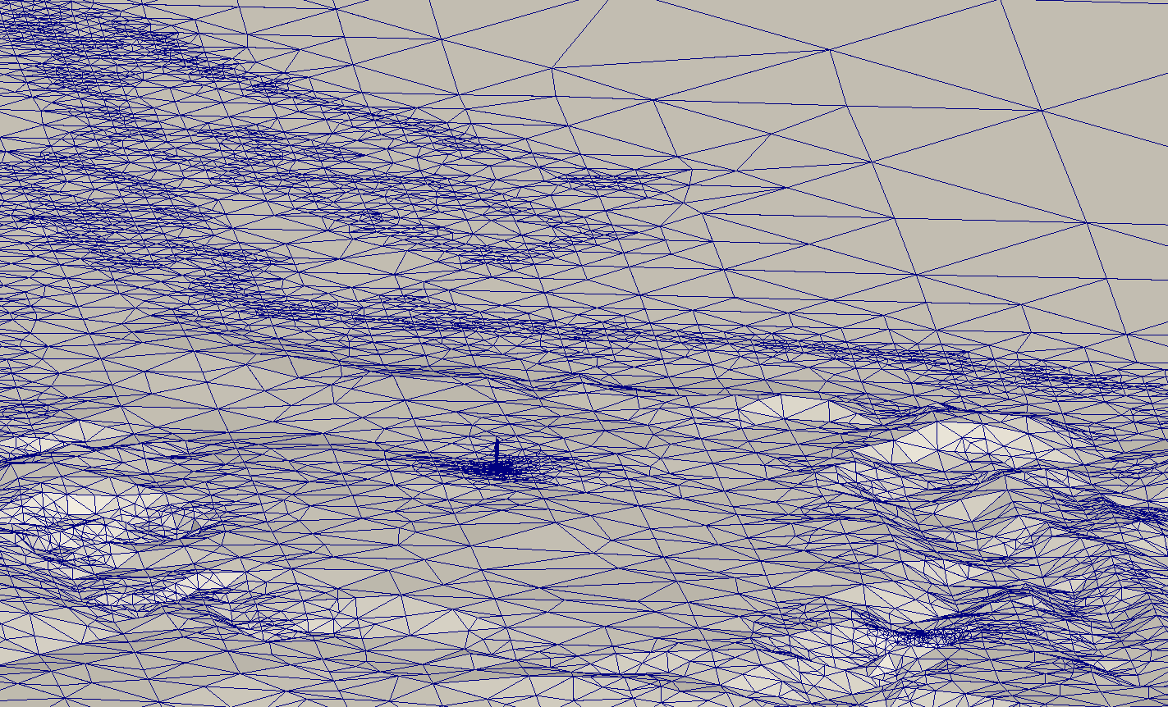
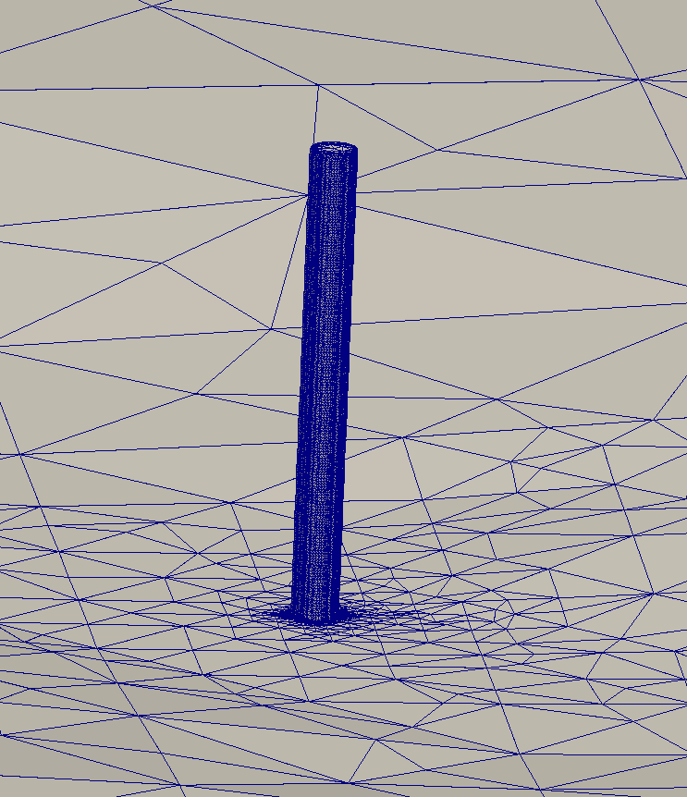
Curve approximation insertion
Modified terrain as input data for mesh generators
Remeshing the terrain with TetGen

Slide 27
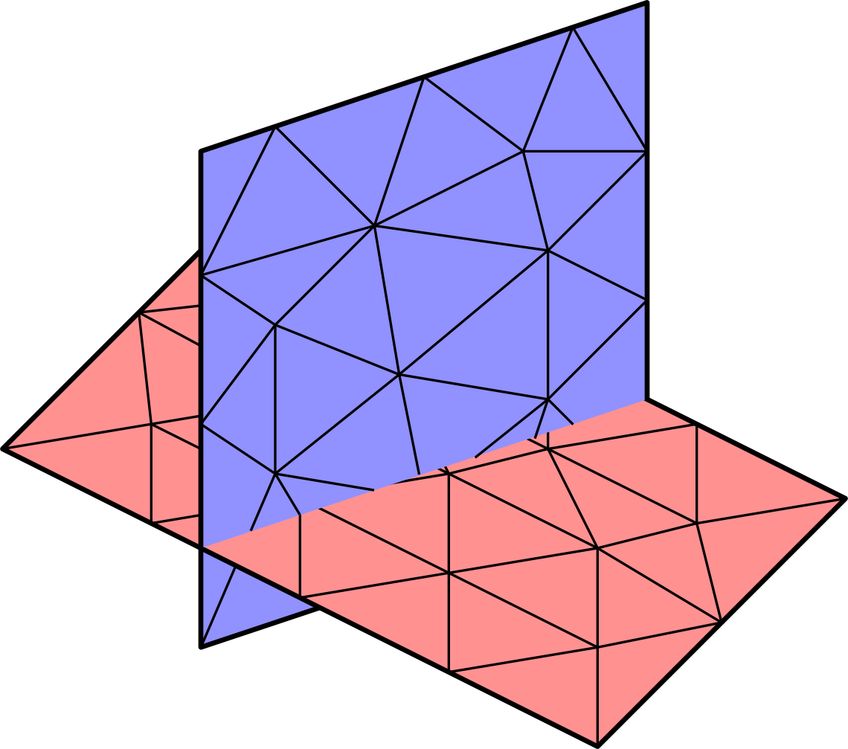
The Wind Field Model
Three dimensional inclusion
Combined surface / curve approximations
  The intersection of the construction with the terrain can be problematic
    Detection and approximation of intersections
    Parameterization management
  A closed surface cannot be captured by this technique

Slide 28
Conclusions and Future research
  The template based method is robust but not versatile:
    We need an ad hoc template for each tpye of construction
    It can be problematic dealing with torsion
  The proposed curve approximation insertion is more versatile but not enough:
    First we modify the terrain, and then we need to generate the mesh
    It only works for extrusion constructions
  The three-dimensional surface insertion is the most promising, but:
    We need to deal with intersections between terrain and walls
    We need to patch the closed surface to use the actual technique

Slide 29
The Wind Field Model
Questions ?
Thank you for your attention!
gvsocorro@siani.es

Slide 30
Insertion of anthropogenic constructions in a tetrahedral mesh of the terrain using the Meccano method
Guillermo V. Socorro-Marrero, Albert Oliver, Eduardo Rodríguez,
José M. Escobar, Gustavo Montero, and Rafael Montenegro
University Institute SIANI, University of Las Palmas de Gran Canaria, Spain
ECCOMAS Congress 2016. June 5-10, Crete
MINECO y FEDER PROGRAMA ESTATAL I+D+I ORIENTADA A RETOS DE LA SOCIEDAD: CTM2014-55014-CR3-1-R
CONACYT-SENER Project, Fondo Sectorial, contract: 163723
http://www.dca.iusiani.ulpgc.es/proyecto2015-2017

