Slide 1

Local scale air quality modelling based on CMAQ forecast data
A. Oliver, A. Perez-Foguet,
Laboratori de Càlcul Numèric (LaCàN)
Departament de Matemàtica Aplicada III
Universitat Politècnica de Catalunya - Barcelonatech

Slide 2
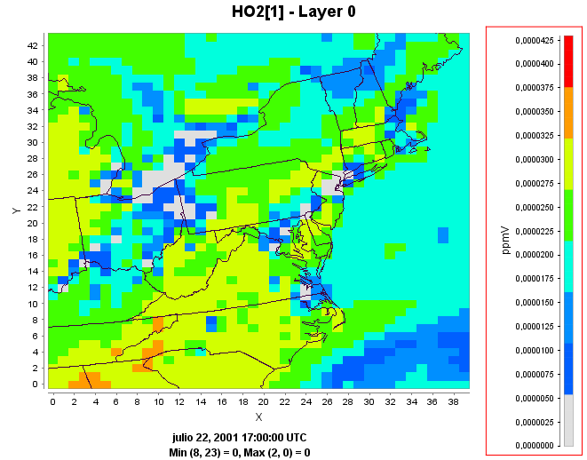
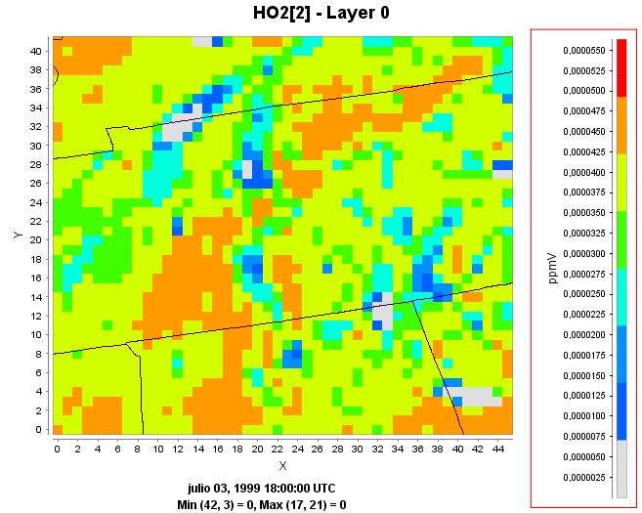
Motivation
Use CMAQ model with prediction capabilities to predict the air quality in a local scale using a Finite Element model
Local scale domain: 16x16km²

Slide 3
Algorithm
Construction of a mesh
  Mesh adapted to the terrain
  Adapted to the CMAQ layers
CMAQ data interpolation
  Horizontal and vertical interpolation from data
Wind field adjustment
  Mass consistent model
Pollutant dispersion modeling
  Wind field plume rise perturbation
  Transport and reaction pollutant simulation

Slide 4
Mesh construction
Two dimensional triangular mesh of terrain
  Stack discretization
Vertical spacing following layers
Three dimensional tetrahedral mesh creation
Smoothing and untangling in order to guarantee a minimum quality

Slide 5

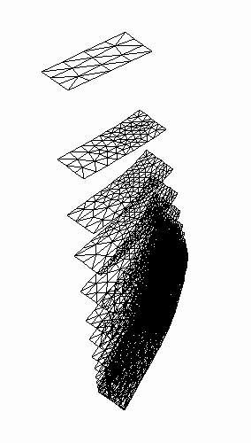
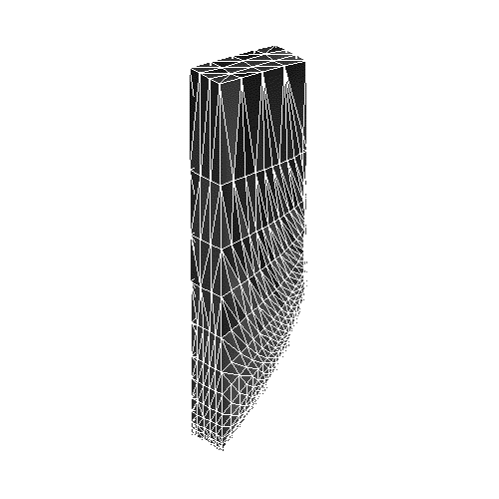
Mesh construction
Layer construction
Layer by later two-dimensional mesh
Element size depends on curvature
Layers are flattened in order to get coarser meshes in the upper layer

Slide 6
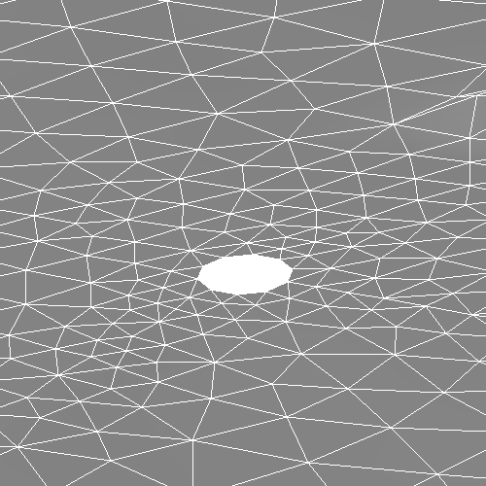
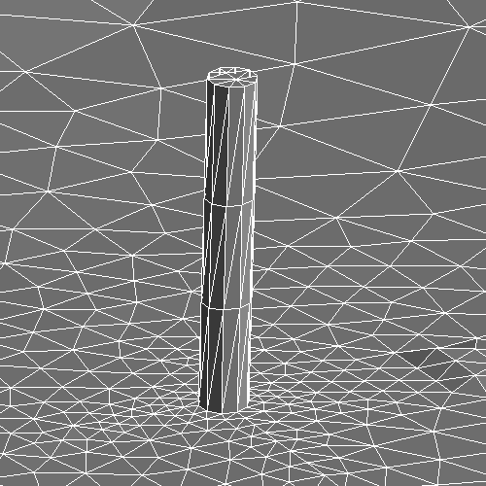
Mesh construction
Stack inclusion

Slide 7
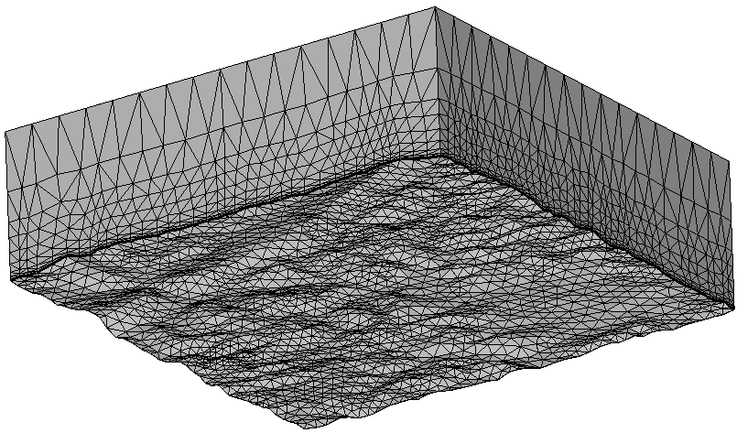
Mesh construction
Generated mesh

Slide 8
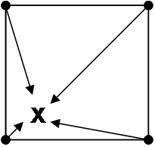
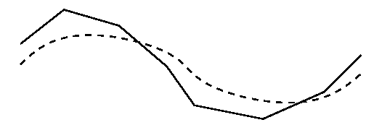
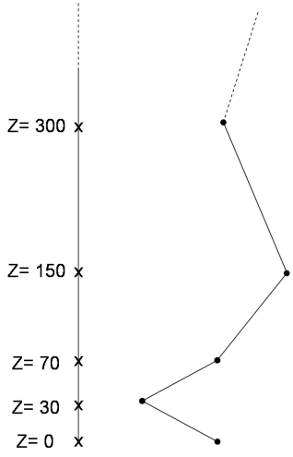
CMAQ data interpolation
Bilinear interpolation in all the layers
Height correction
Vertical linear interpolation
____
CMAQ terrain
······· Real terrain

Slide 9
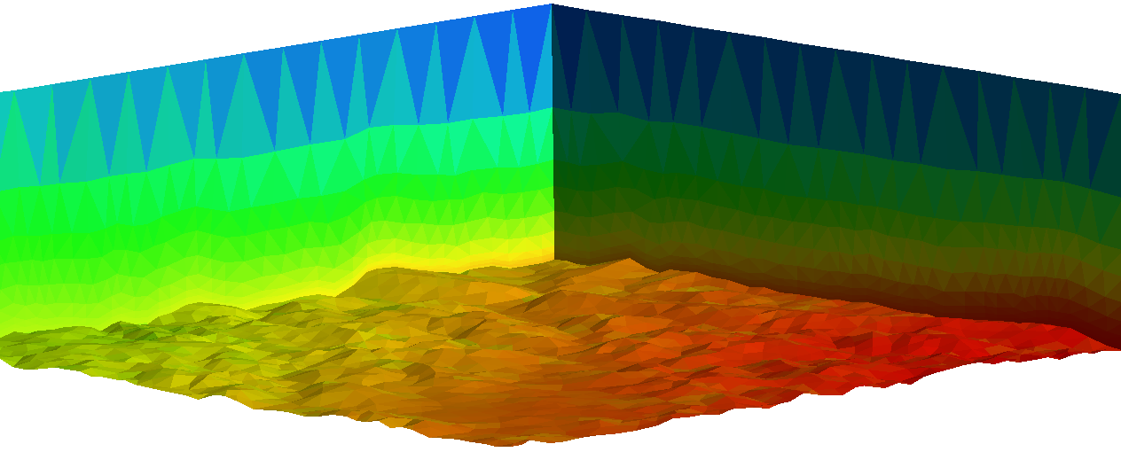
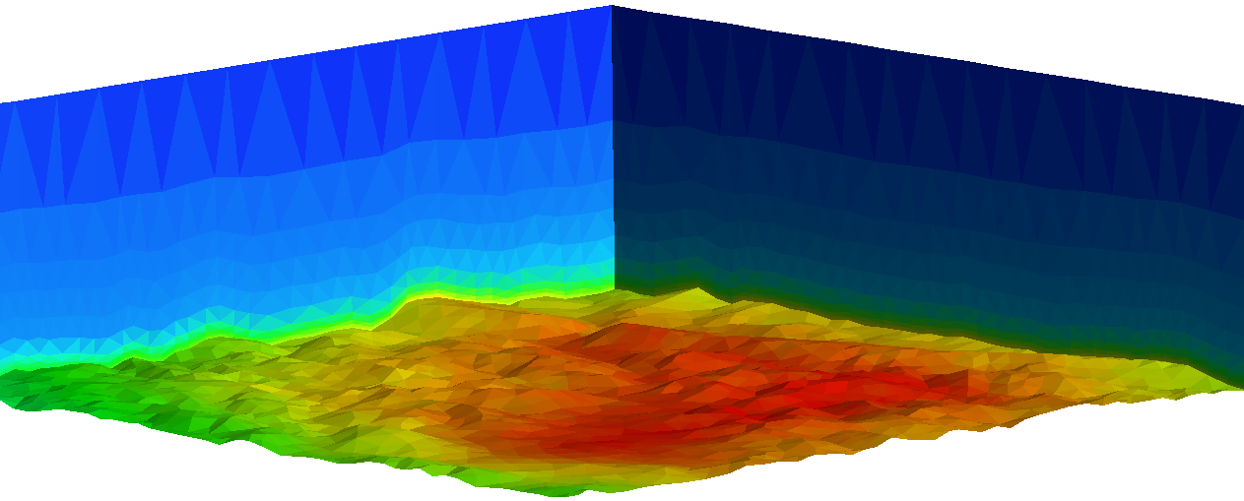
CMAQ data interpolation
Interpolated SO₂ concenctration
Interpolated SO₄ concenctration

Slide 10
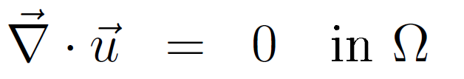
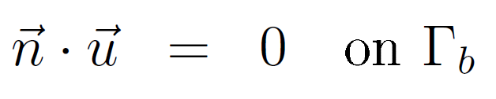
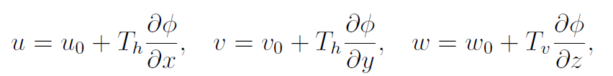
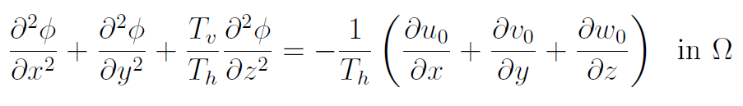


Wind field modeling
Mass-consistent model
Lagrange multiplier

Slide 11
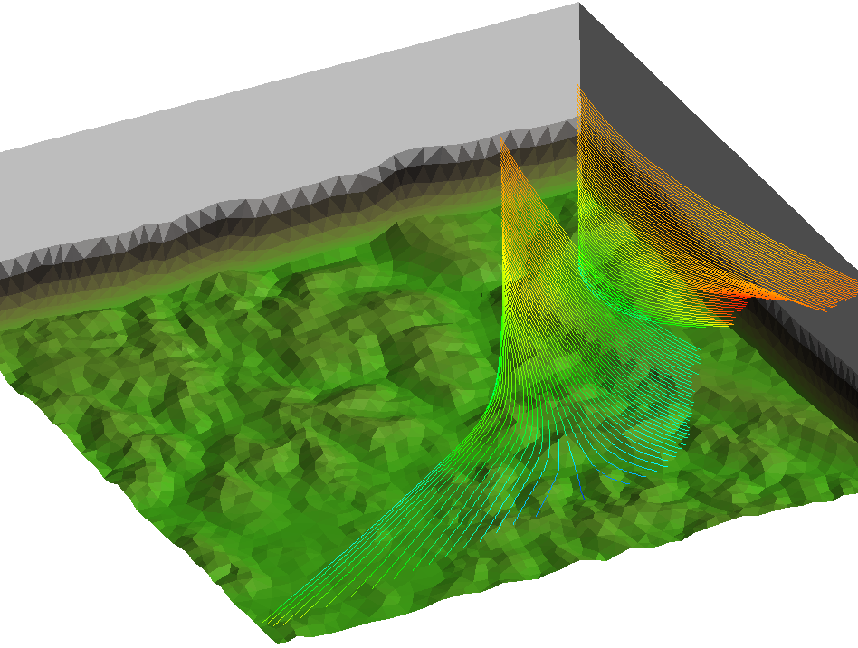
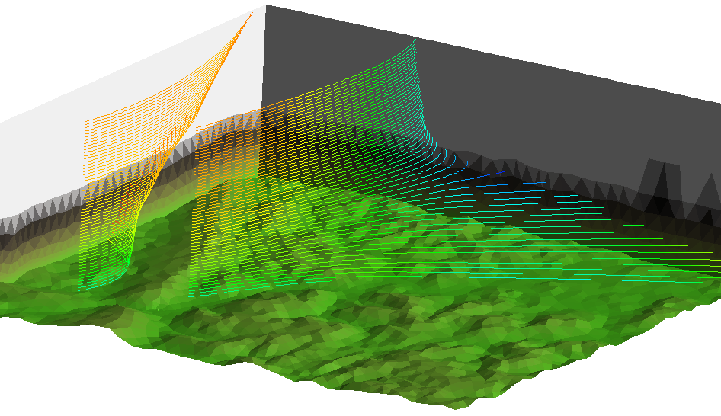
Wind field modeling

Slide 12
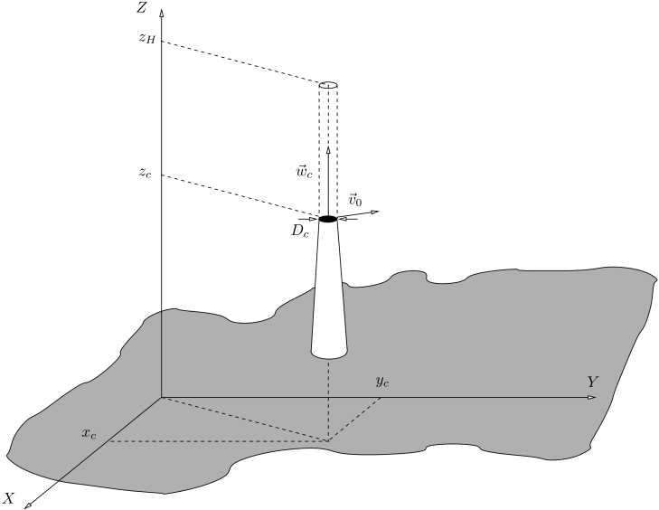
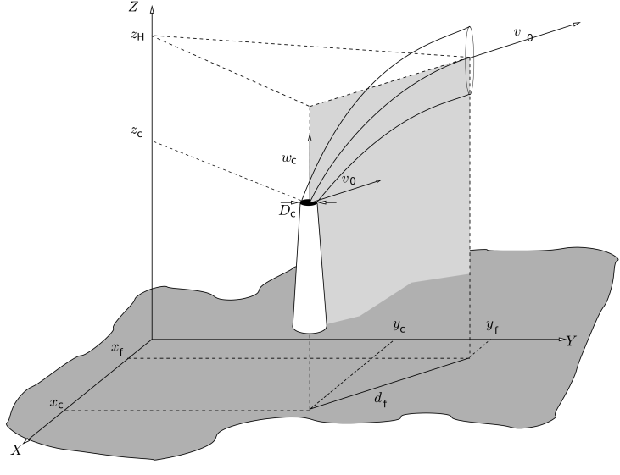
Plume rise modeling
Briggs formula
  Buoyant (wc < 4Vo)‏
    Driving-force: gas temperature difference
    Curved trajectory
  Momentum (wc > 4Vo)‏
    Driving-force: Gas velocity
    Vertical straight trajectory

Slide 13
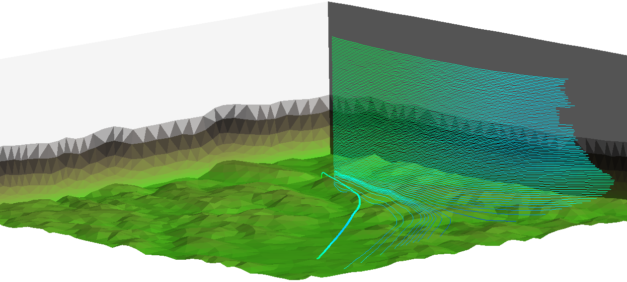

Plume rise modeling

Slide 14
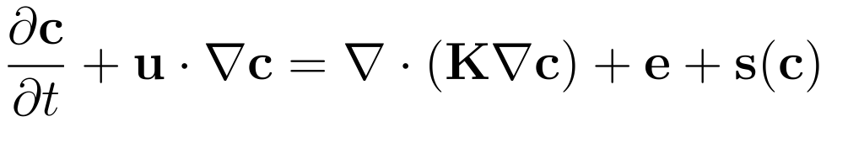
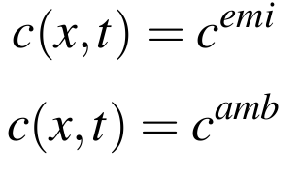

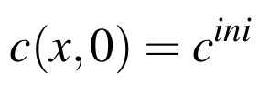
Air quality modeling
Stack outflow
Inlet wind boundaries
Outlet wind boundaries
Initial condition

Slide 15
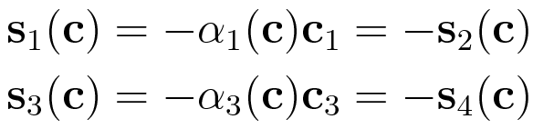


Air quality modeling
RIVAD reactive model (4 species)

Slide 16
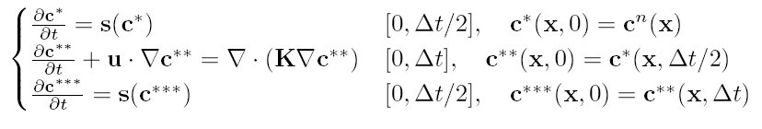
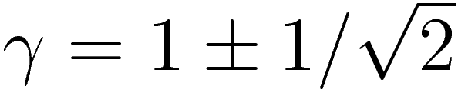

Air quality modeling
Splitting
  Strang Splitting
Rosembrock 2
J = Jacobian s(c)

Slide 17
Air quality modeling
Temporal discretization: Cranck-Nicolson
Spatial discretization: Least Squares FEM
System solver: Conjugate gradient preconditioned with an Incomplete Cholesky Factorization
Matrix storage: sparse MCS

Slide 18
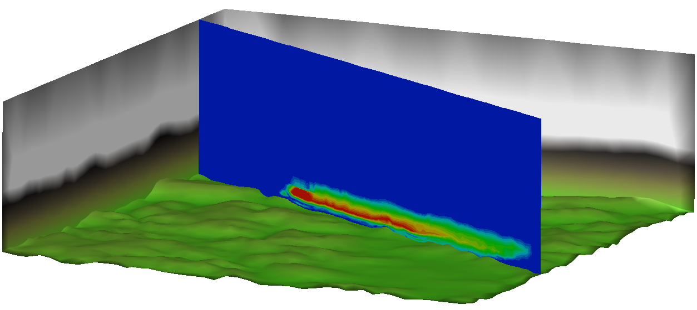
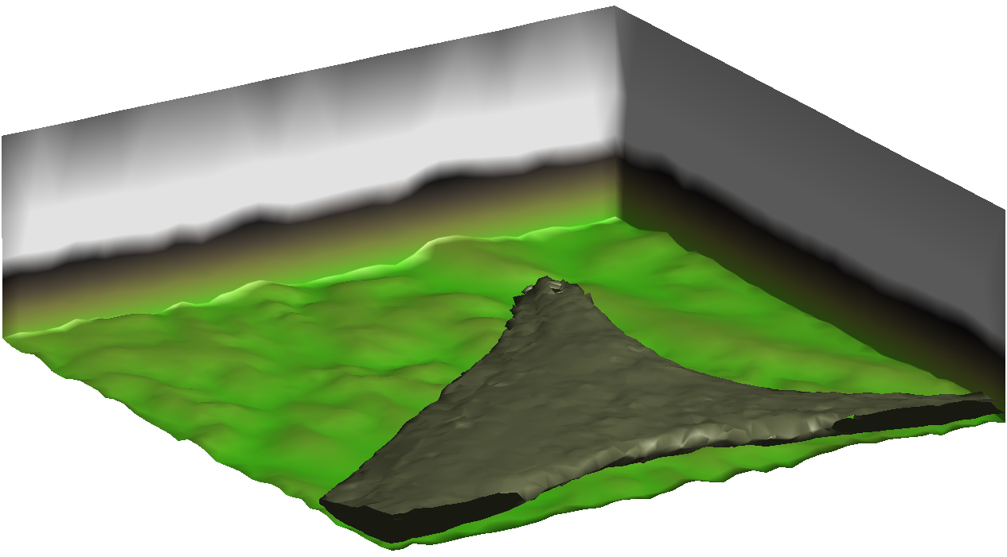
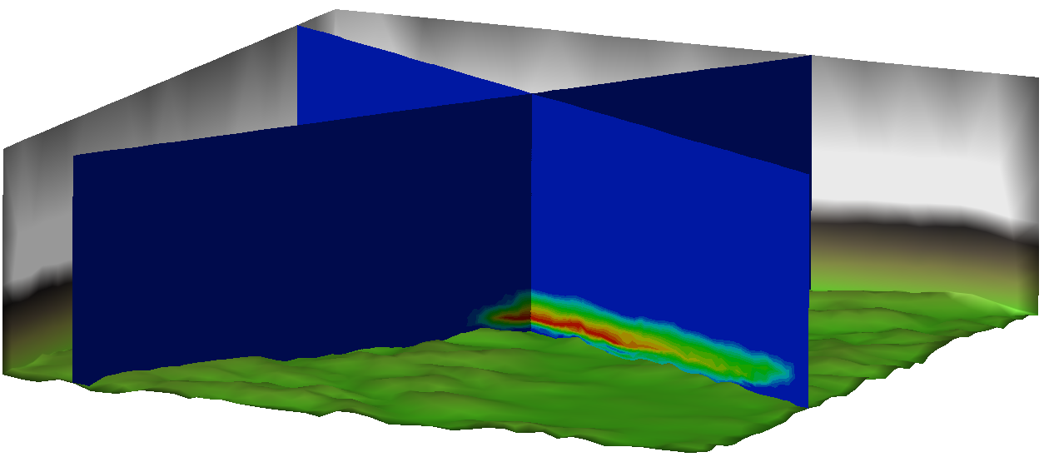
Air quality modeling
Plume evolution
Concentration slices

Slide 19
Conclusions
CMAQ forecast data can be used as the initial and boundary conditions in a local scale air quality model
At least a mass consistent model is essential
Splitting and FEM resolution is an efficient technique to solve the problem
A more realistic reactive model can be used

