Slide 1
Wind Ensemble Forecasting Using Differential Evolution
Albert Oliver, Eduardo Rodríguez, Gustavo Montero,
Guillermo V. Socorro-Marrero, and Rafael Montenegro
University Institute SIANI, University of Las Palmas de Gran Canaria, Spain
ESCO 2016. 5th European Seminar on Computing. June 5-10, Pilsen
MINECO y FEDER PROGRAMA ESTATAL I+D+I ORIENTADA A RETOS DE LA SOCIEDAD: CTM2014-55014-CR3-1-R
CONACYT-SENER Project, Fondo Sectorial, contract: 163723
http://www.dca.iusiani.ulpgc.es/proyecto2015-2017

Slide 2

Motivation
Wind field prediction
in Wind farms
Uncertainties
  Model and Physical parameters
  Initial state
We propose differential evolution and ensemble prediction
Photo by Steve Wilson (CC BY 2.0)

Slide 3
Ensemble prediction
What is ensemble prediction?
In meteorology, ensemble prediction is a stochastic–dynamic approach that couples probability with determinism

Slide 4
Ensemble prediction
A little bit of history
In 1951, a conjecture between small perturbation and results in deterministic numerical weather prediction (NWP)
[…] we never know what small perturbations may exist below a certain margin of error. Since the perturbations may grow at an exponential rate, the margin of error in the forecast (final) state will grow exponentially as the period of forecast is increased, and this possible error is unavoidable whatever our method of forecasting […] (Eady 1951)

Slide 5
Ensemble prediction
A little bit of history
In 1962, Lorenz proved right Eady conjecture, when he found out that truncation error did generate different solutions
[…] these small errors of three decimal places had amplified so much in the course of two months [simulated time] that they drowned out the signal. And I found this very exciting because this implied that if the atmosphere behaved this way, then long-range forecasting was impossible because we certainly don’t measure things as accurately as that […] (Thompson and Lorenz 1986)

Slide 6
Ensemble prediction
A little bit of history
In 1965, Lorenz proposed a method to take into account the uncertainties
Due to computational resources, this procedure was not viable until late 1990s
The proposed procedure chooses a finite ensemble of initial states, rather than the single observed initial state. Each state within the ensemble resembles the observed state closely enough so that the differences might be ascribed to errors or inadequacies in observation. (Lorenz 1965)

Slide 7
Ensemble prediction
How to perturb parameters and initial state?
Monte Carlo
Bred vectors
Singular vectors

Slide 8
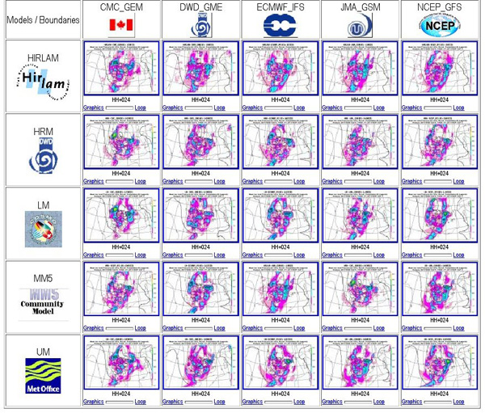
Ensemble prediction systems
Nowadays, National agencies use “Ensemble Prediction Systems”
Combination:
  Different NWP models
  Perturbed Initial states
  Perturbed Parameters
http://www.aemet.es/en/idi/prediccion/prediccion_probabilistica

Slide 9
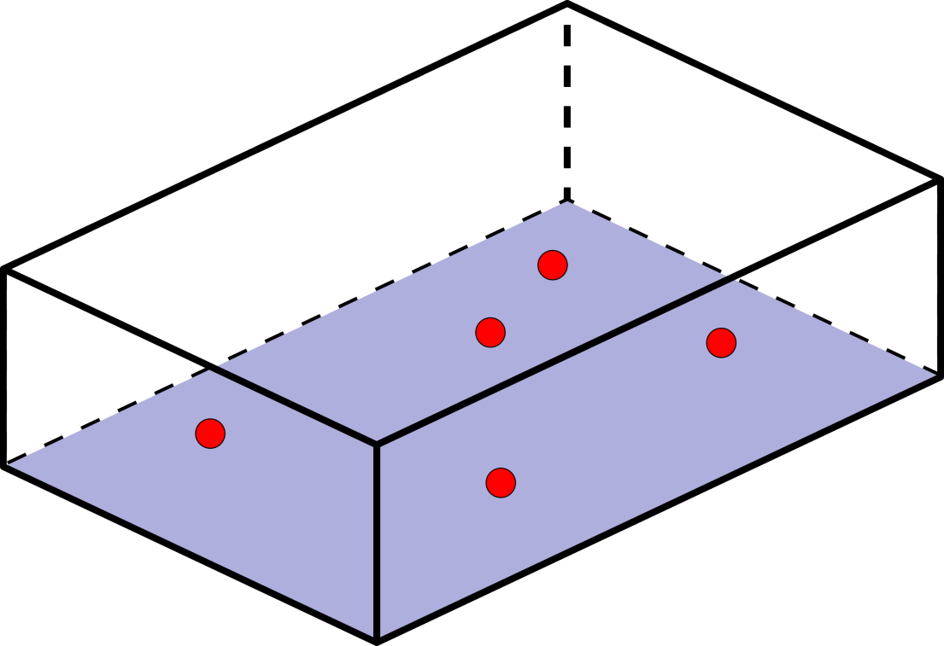
Local Wind Field Modelling
Local Wind Field Modelling
Mass consistent Finite Element Method
Given a set of wind data, a three-dimensional wind field is constructed
Three steps:
Vertical interpolation
Horizontal interpolation
Mass-consistent model

Slide 10
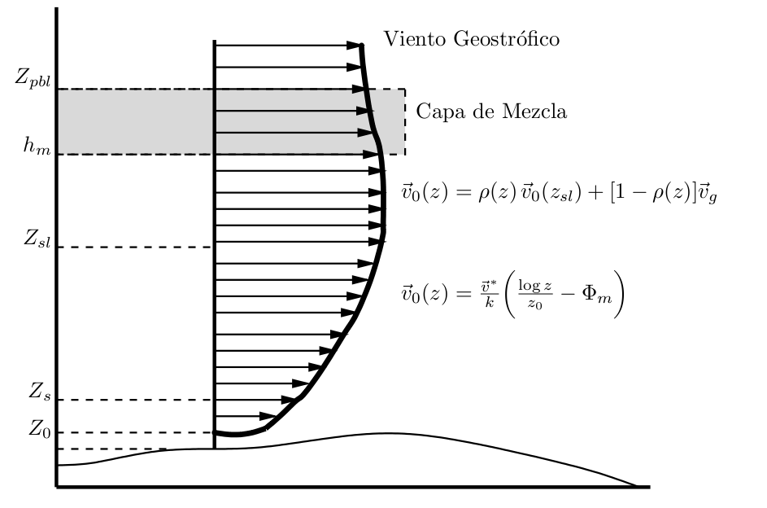

Wind Field Modelling
Vertical wind log-linear profile
geostrophic wind
mixing layer

Slide 11
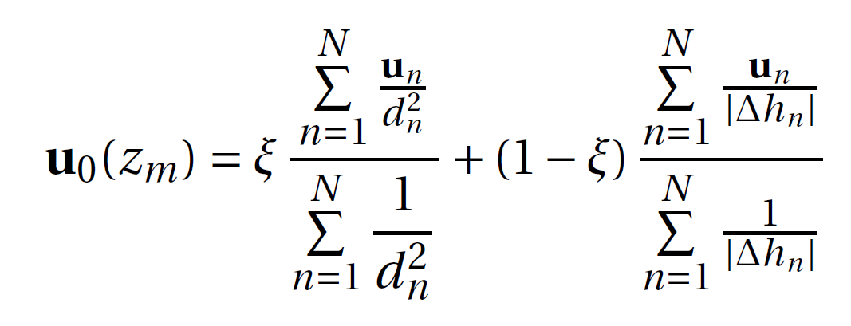
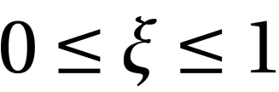
Wind Field Modelling
Horizontal interpolation
Weighting inverse to the squared distance and inverse height differences

Slide 12
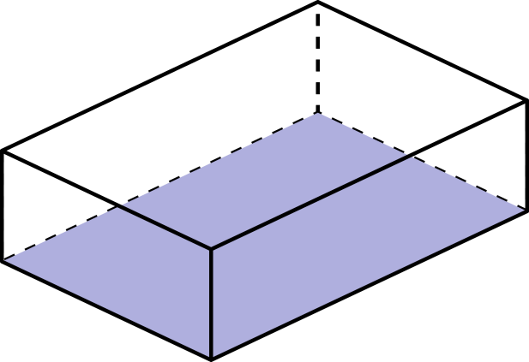



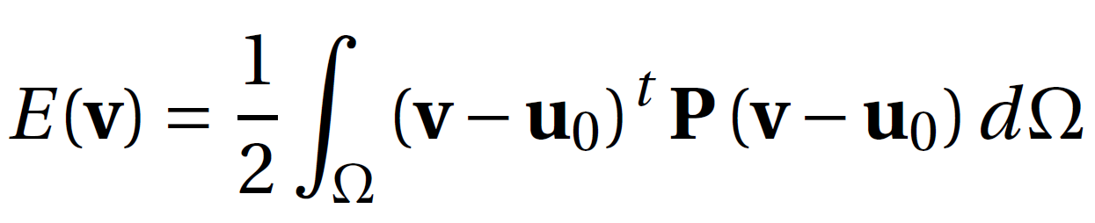
Wind Field Modelling
Mass-consistent model
Impose null divergence and impermeability in the terrain
Final wind field is adjusted to the interpolated field.
Minimise

Slide 13
Wind Field Modelling
Differential evolution
To calibrate the parameters, we propose to use differential evolution
Differential evolution is an evolutionary algorithm as genetic algorithms
The unknown parameters are z₀, d, ε, and α
The number of unknowns depends on the problem (z₀ and d depends terrain)

Slide 14
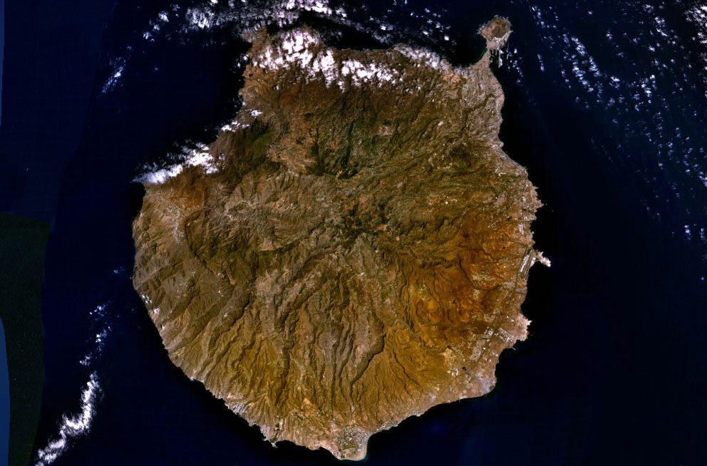
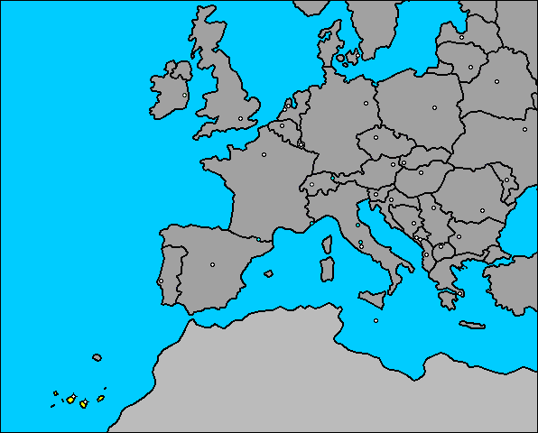
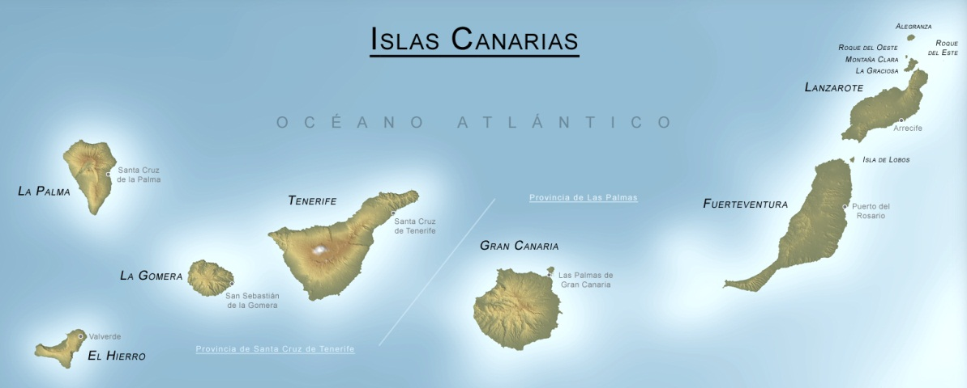
Gran Canaria Application
Application to Gran Canaria island

Slide 15
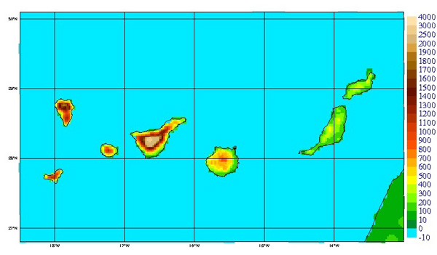
Gran Canaria Application
Harmonie NWP
Non-hydrostatic meteorological model
From large scale to 1km or less scale (under developement)
Different physical models in different scales
Assimilation data system
Run daily by Spanish Met Agency
24 hours simulation data
HARMONIE on Canary islands
(http://www.aemet.es/ca/idi/prediccion/prediccion_numerica)

Slide 16
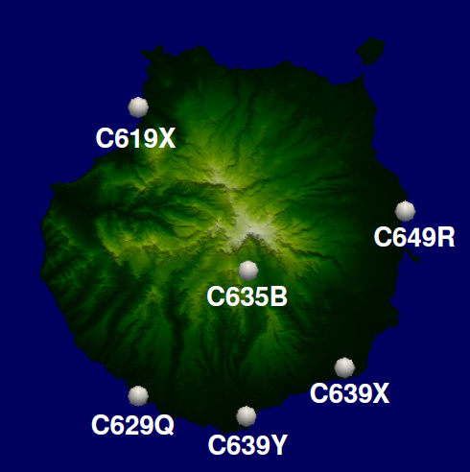
Gran Canaria Application
Measurement stations (validation)

Slide 17
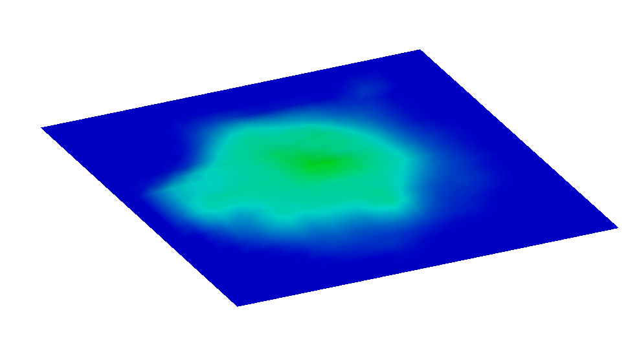
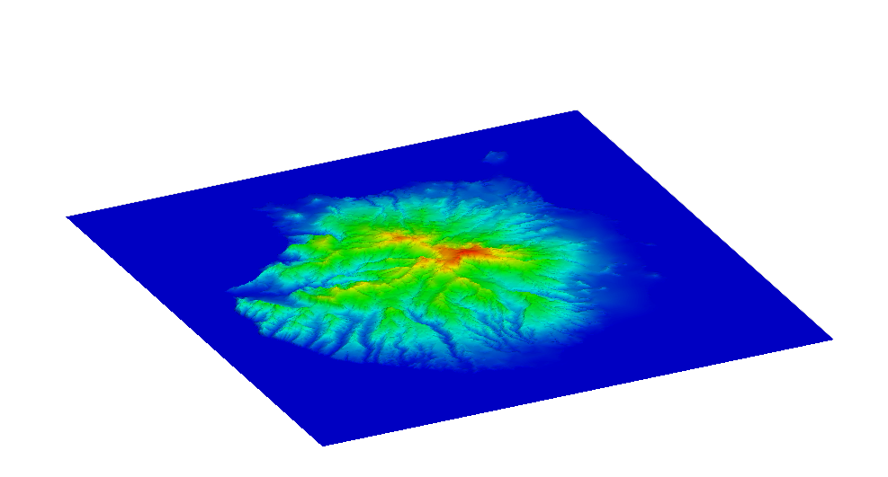
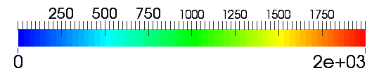
Gran Canaria Application
Max height 925m
Max height 1950m
HARMONIE discretization of terrain
Topography from Digital Terrain Model
Terrain elevation (m)

Slide 18
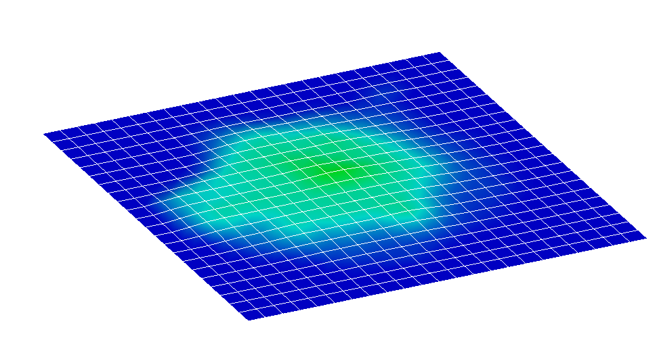
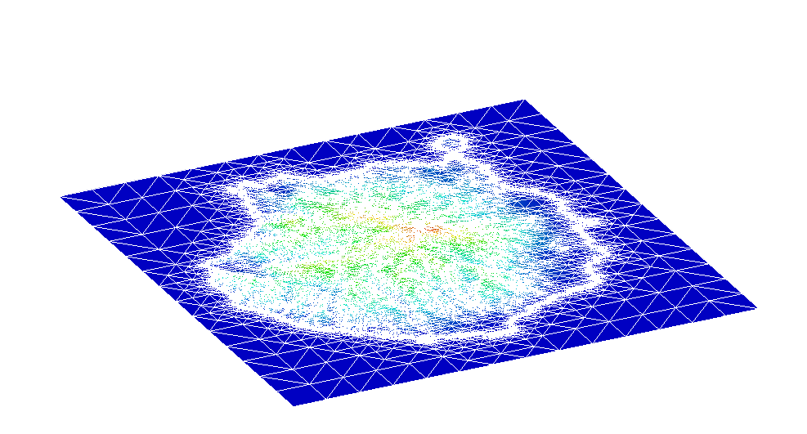
Gran Canaria Application
HARMONIE mesh
Δh ~ 2.5km
FEM computational mesh
Terrain elevation (m)

Slide 19
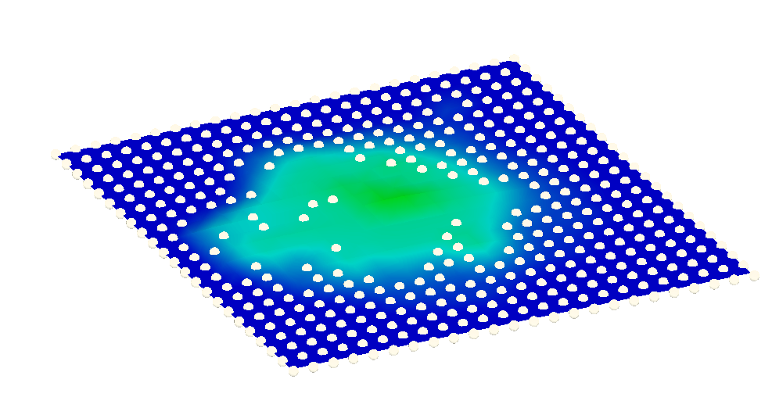
Gran Canaria Application
Which Harmonie values do we use?
Used data (Δh < 100m)

Slide 20



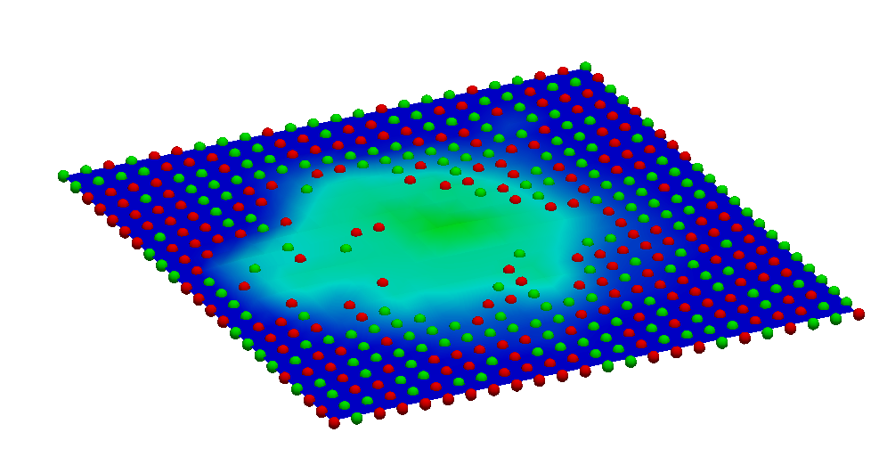

Gran Canaria Application
Stations
Control points
Number of genetic experiments
% points | Height tolerances
 | Infinite | 500 m | 100 m
100 % | 1 | 1 | 1
50 % | 10 | 10 | 10
33 experiments x 24 hours = 792 genetic experiments

Slide 21
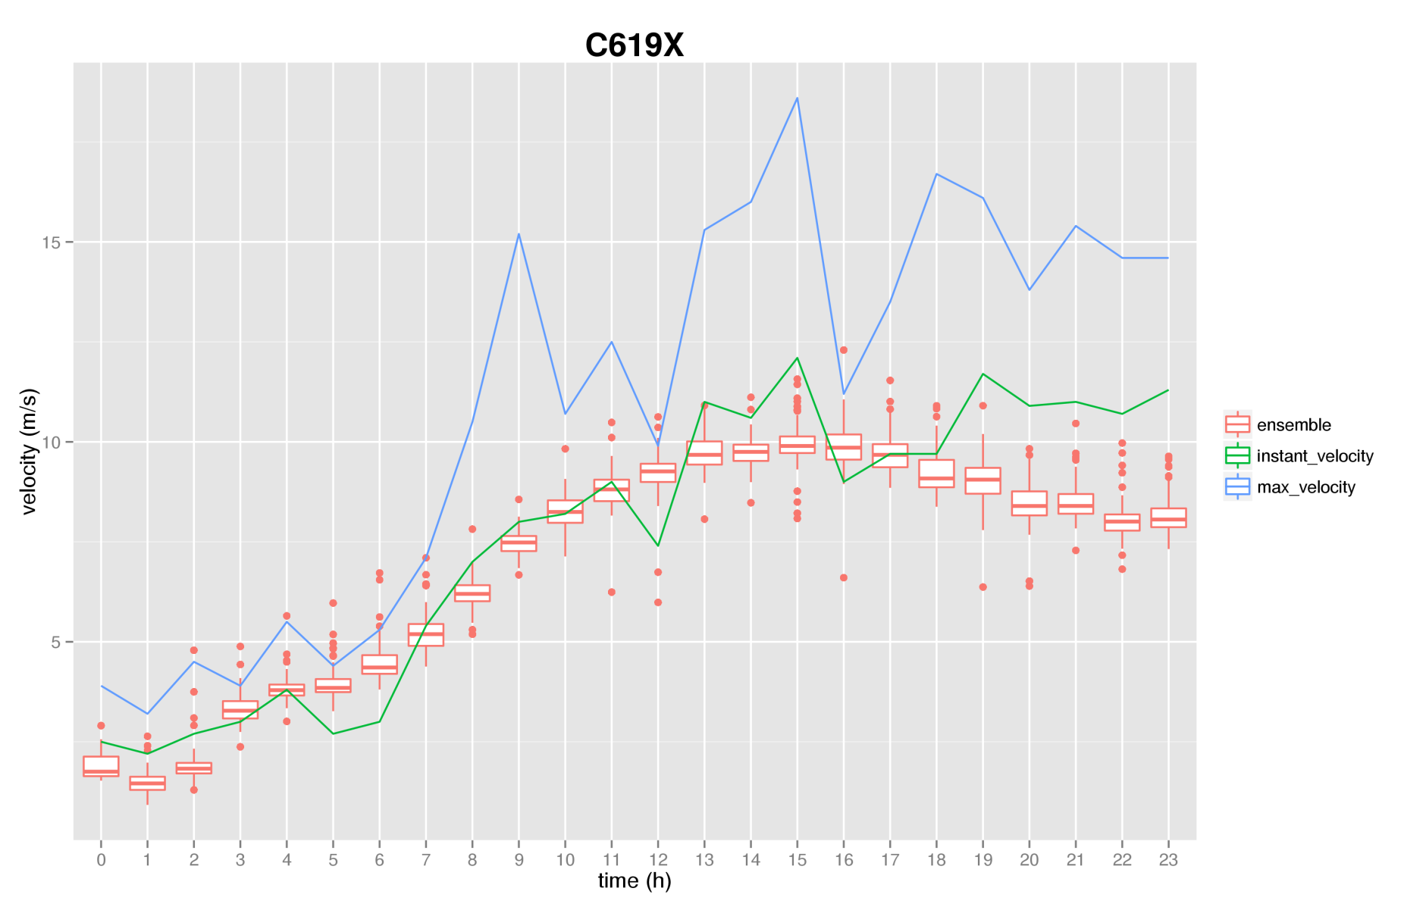
Gran Canaria Application

Slide 22
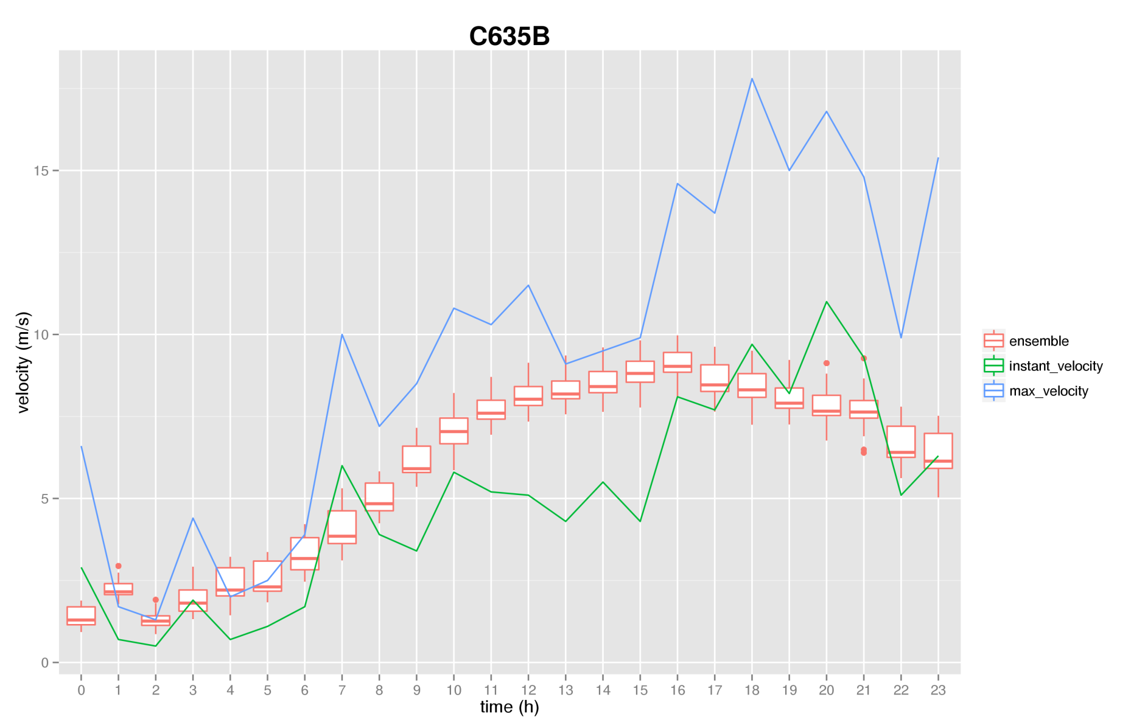
Gran Canaria Application

Slide 23
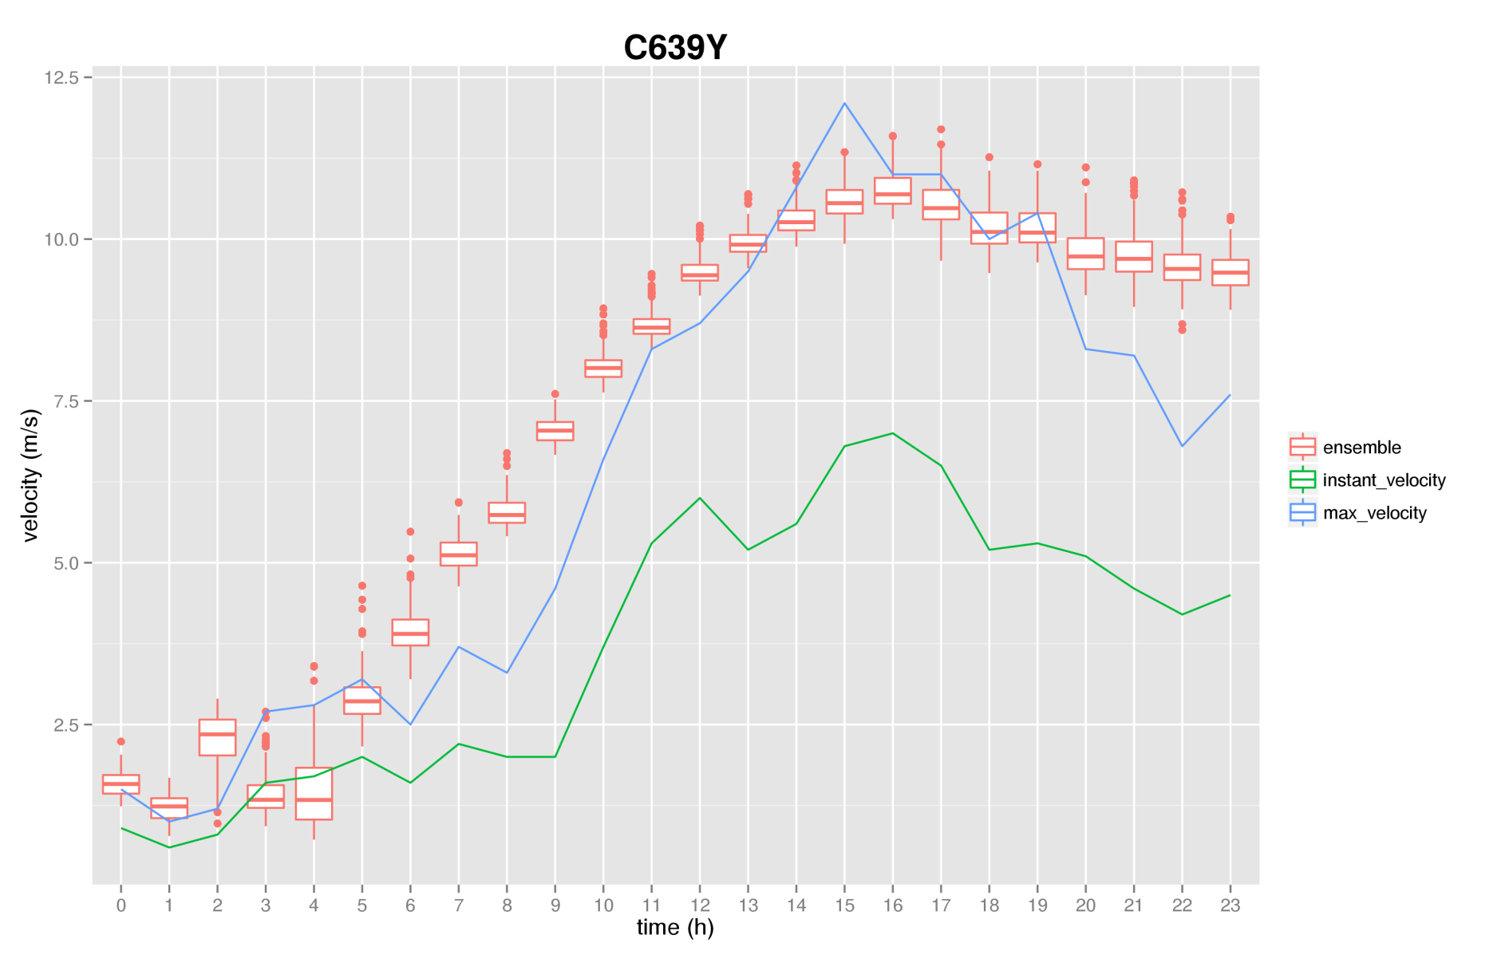
Gran Canaria Application

Slide 24
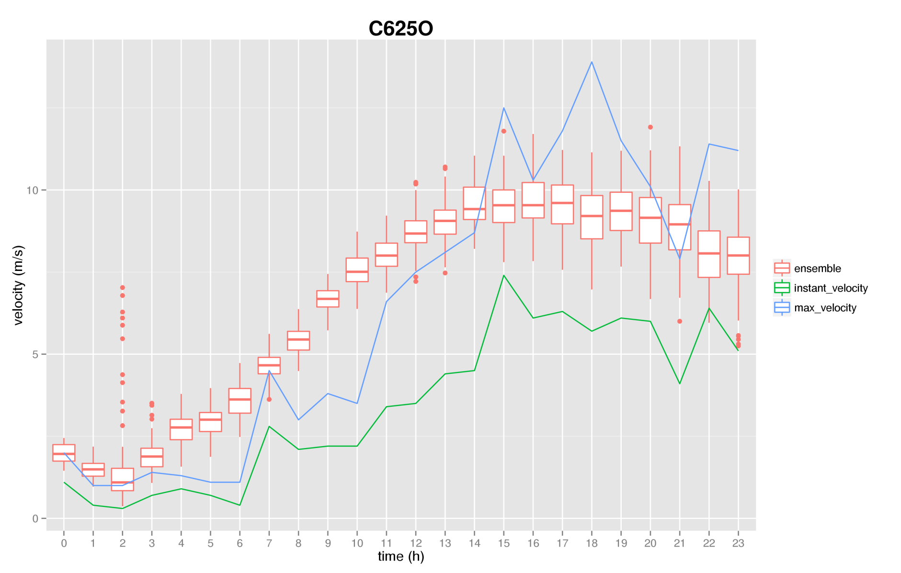
Gran Canaria Application

Slide 25
Discussion
How many experiments do we need to simulate to have a good ensemble?
Is this method enough to perturb all the parameters?
How does it compares with using a Monte Carlo analysis of all the parameters?

Slide 26
Conclusions
Conclusions
Ensemble prediction introduces the uncertainties in the solution of the problem
The mass consistent model is suitable as the local model for the ensemble prediction.
Using an ensemble of differential evolution experiments is shown to be a valid way to introduce the uncertainties in the solution
Future Work
Sensitivity analysis of the calibrated parameters using differential evolution
Compare this method with a Monte Carlo analysis

