Slide 1
Construction of polynomial spline spaces over quadtree and
octree T-meshes for its application in isogeometric analysis
J.I. López⁽¹⁾, M. Brovka⁽¹⁾, J.M. Escobar⁽¹⁾, R. Montenegro⁽¹⁾*
⁽¹⁾ University Institute SIANI, University of Las Palmas de Gran Canaria, Spain
19h International Conference on Finite Elements in Flow Problems FEF 2017
5-7 April, 2017, Rome, Italy
MINECO y FEDER Project: CTM2014-55014-C3-1-R
CONACYT-SENER Project, Fondo Sectorial, contract: 163723
http://www.dca.iusiani.ulpgc.es/proyecto2015-2017

Slide 2
Contents
Introduction and motivation of our work
Polynomial spline spaces over quadtree and octree T-meshes
Spline parameterization method for 2D and 3D domains
Computational examples
Comments and future research
Notes:
Decimos que un tetraedro es de Tipo I si está marcado con el indicador de error. Se introducen 6 nuevos nodos en el punto medio de sus aristas y se subdividen cada una de sus cuatro caras en 4 triángulos, uniendo los puntos que se han introducido.
Cuatro subtetraedros quedan determinados a partir de los cuatro vértices del tetraedro original y las nuevas aristas.
Los otros cuatro tetraedros se obtienen al unir los dos vértices opuestos más cercanos del octaedro que resulta en el interior. Estudios de Löhner y Baum aseguran que esta elección produce el menor número de tetraedros distorsionados en la malla refinada. Existen otras dos opciones para subdividir el octaedro, y se podría analizar la calidad de las divisiones, pero aumentaría el coste computacional del algoritmo.
Una vez marcados los tetraedros de Tipo I, para asegurar la conformidad de la malla nos podemos encontrar con tetraedros vecinos que pueden tener 6, 5,..., 1, ó 0 nuevos nodos introducidos.
Aquellos tetraedros que por razones de conformidad tengan marcadas sus 6 aristas pasa automáticamente al conjunto de tetraedros de Tipo I.

Slide 3
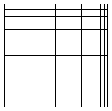
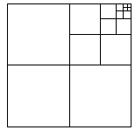
Our research: open problems of Isogeometric Analysis
Local refinement
Local refinement
Tensor product structure of B-spline spaces does not allow local enrichment of the approximation space. A strategy for construction of spline spaces with local refinement is needed.
global refinement
local refinement
Notes:
Decimos que un tetraedro es de Tipo I si está marcado con el indicador de error. Se introducen 6 nuevos nodos en el punto medio de sus aristas y se subdividen cada una de sus cuatro caras en 4 triángulos, uniendo los puntos que se han introducido.
Cuatro subtetraedros quedan determinados a partir de los cuatro vértices del tetraedro original y las nuevas aristas.
Los otros cuatro tetraedros se obtienen al unir los dos vértices opuestos más cercanos del octaedro que resulta en el interior. Estudios de Löhner y Baum aseguran que esta elección produce el menor número de tetraedros distorsionados en la malla refinada. Existen otras dos opciones para subdividir el octaedro, y se podría analizar la calidad de las divisiones, pero aumentaría el coste computacional del algoritmo.
Una vez marcados los tetraedros de Tipo I, para asegurar la conformidad de la malla nos podemos encontrar con tetraedros vecinos que pueden tener 6, 5,..., 1, ó 0 nuevos nodos introducidos.
Aquellos tetraedros que por razones de conformidad tengan marcadas sus 6 aristas pasa automáticamente al conjunto de tetraedros de Tipo I.

Slide 4
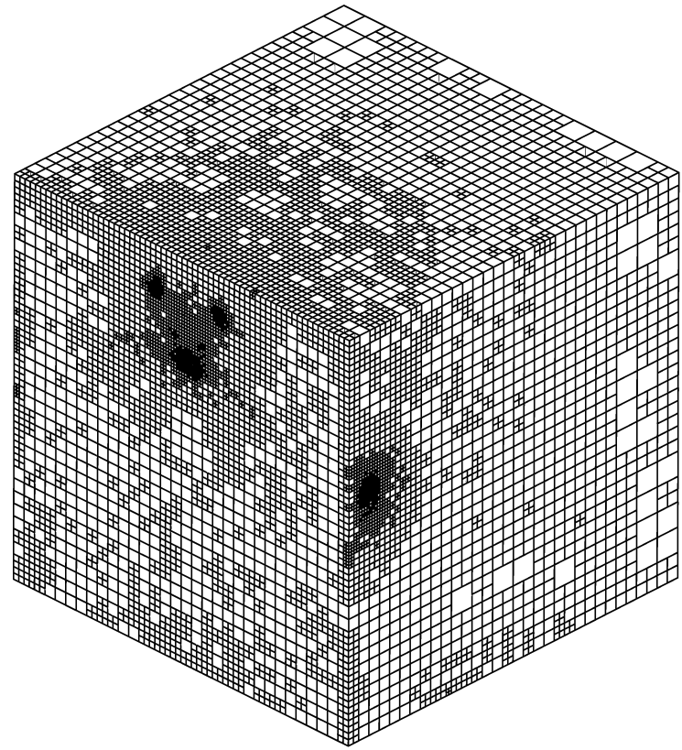
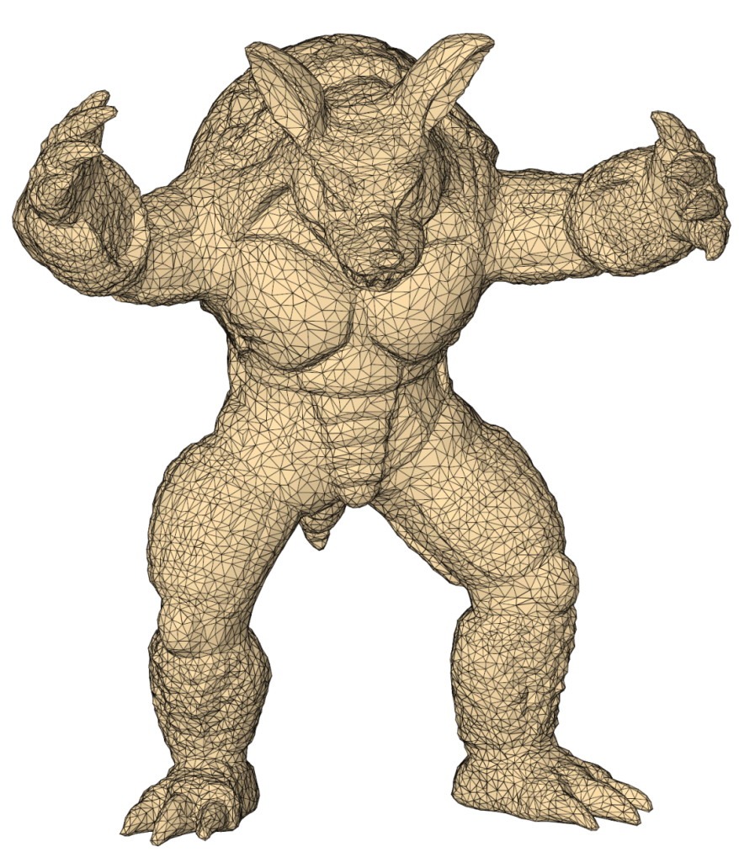
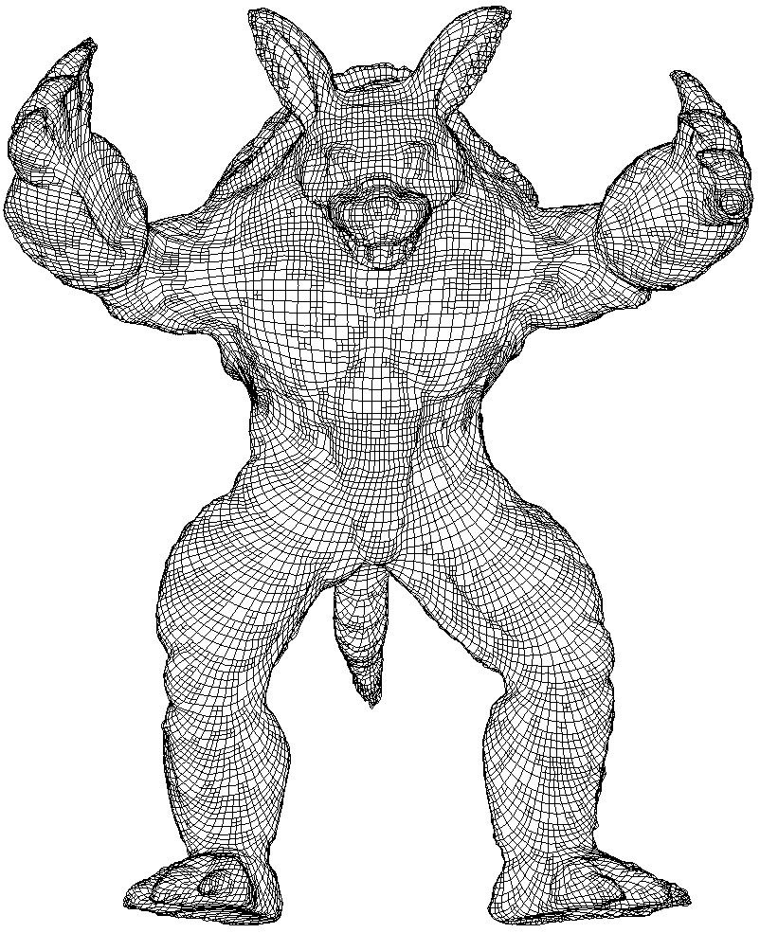
Our research: open problems of Isogeometric Analysis
Domain parameterization based on the meccano method
Parameterization of the computational domain from its boundary
representation
spline volume parameterization
Input surface
Notes:
Decimos que un tetraedro es de Tipo I si está marcado con el indicador de error. Se introducen 6 nuevos nodos en el punto medio de sus aristas y se subdividen cada una de sus cuatro caras en 4 triángulos, uniendo los puntos que se han introducido.
Cuatro subtetraedros quedan determinados a partir de los cuatro vértices del tetraedro original y las nuevas aristas.
Los otros cuatro tetraedros se obtienen al unir los dos vértices opuestos más cercanos del octaedro que resulta en el interior. Estudios de Löhner y Baum aseguran que esta elección produce el menor número de tetraedros distorsionados en la malla refinada. Existen otras dos opciones para subdividir el octaedro, y se podría analizar la calidad de las divisiones, pero aumentaría el coste computacional del algoritmo.
Una vez marcados los tetraedros de Tipo I, para asegurar la conformidad de la malla nos podemos encontrar con tetraedros vecinos que pueden tener 6, 5,..., 1, ó 0 nuevos nodos introducidos.
Aquellos tetraedros que por razones de conformidad tengan marcadas sus 6 aristas pasa automáticamente al conjunto de tetraedros de Tipo I.

Slide 5
Polynomial spline spaces (EP-splines) over hierarchical T-meshes
A new strategy for constructing cubic spline spaces
over arbitrary quadtree (2D) and octree (3D) T-meshes
For a given T-mesh, it allows to obtain a set of cubic spline functions that span
a space with nice properties: C² continuous, nested spaces, linear independence
Simple rules for inferring local knot vectors to define spline blending functions
Straightforward implementation in 2D and 3D

Slide 6
Strategy for defining polynomial spline spaces
General Scheme
Three main steps
Mesh pretreatment: 0-balancing
Inferring local knot vectors
Modification of local knot vectors

Slide 7
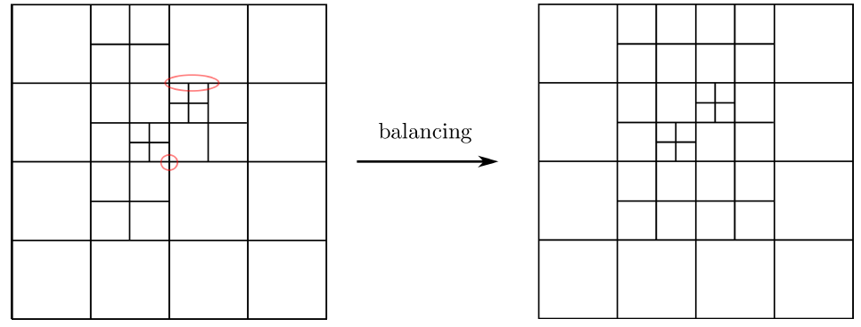
Strategy for defining polynomial spline spaces
Step 1 - Mesh pretreatment
Strongly balanced quadtree mesh
Any node is shared by cells that differ at most in one level of depth
unbalanced mesh
0-balanced mesh

Slide 8
Strategy for defining polynomial spline spaces
Step 2 - Inferring local knot vectors
Inferring local knot vectors
Local knot vectors are inferred by traversing T-mesh edges
Blending functions are associated only to regular nodes of the mesh.
Hanging nodes are skipped while walking across the mesh
Sederberg T-spline: Rational and no nested
Our strategy

Slide 9
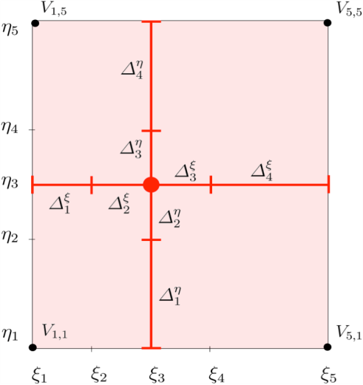


Strategy for defining polynomial spline spaces
Step 3 - Modification of local knot vectors
Modification of local knot vectors
Knot vectors of each blending function N_{α} have to fulfill two conditions:
Condition 1: Local knot vectors of the d-variate function N_{α} verify:
Condition 2: The frame of the function support should be situated over
the mesh skeleton:
Simple extension rule: If any condition is not verified, then some doubles its size

Slide 10
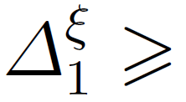
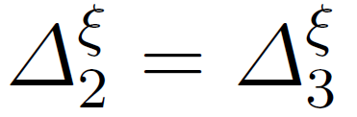
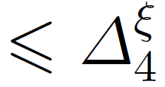

Strategy for defining polynomial spline spaces
Step 3 - Modification of local knot vectors (Examples)
Condition 1:
two central knot intervals should have the same size, and the other two exterior knot intervals should not be smaller than the central intervals:
Condition 2:
the four corners of a function support should be situated over the mesh edges
no admissible !
point is not over the mesh edges
point is over the mesh edges

Slide 11
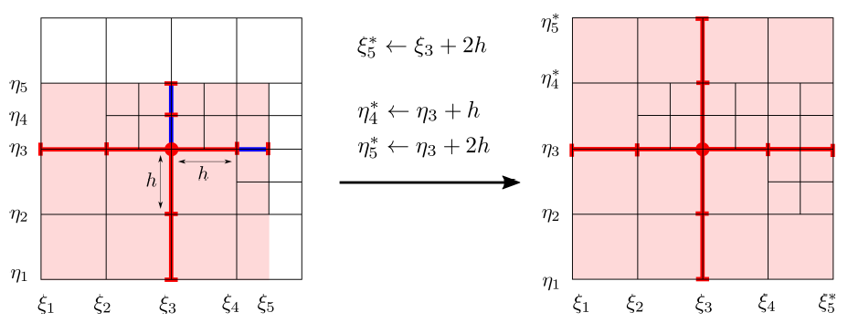

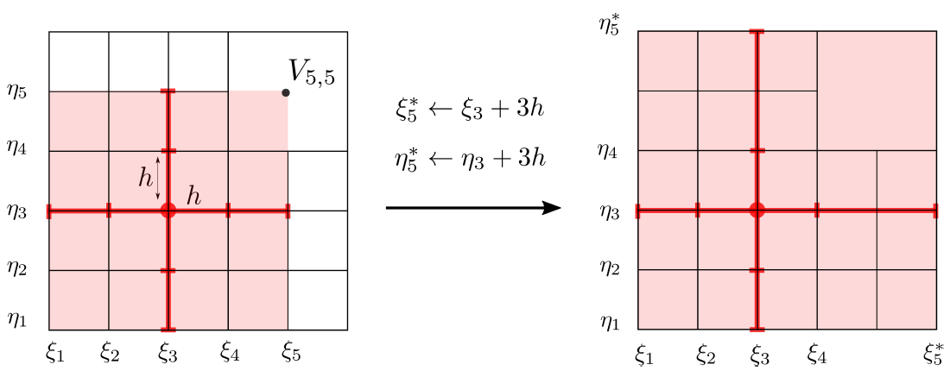

Strategy for defining polynomial spline spaces
Step 3 - Modification of local knot vectors (Examples)
Extension rule 1
Condition 1 is not satisfied
Extension rule 2
Condition 2 is not satisfied

Slide 12


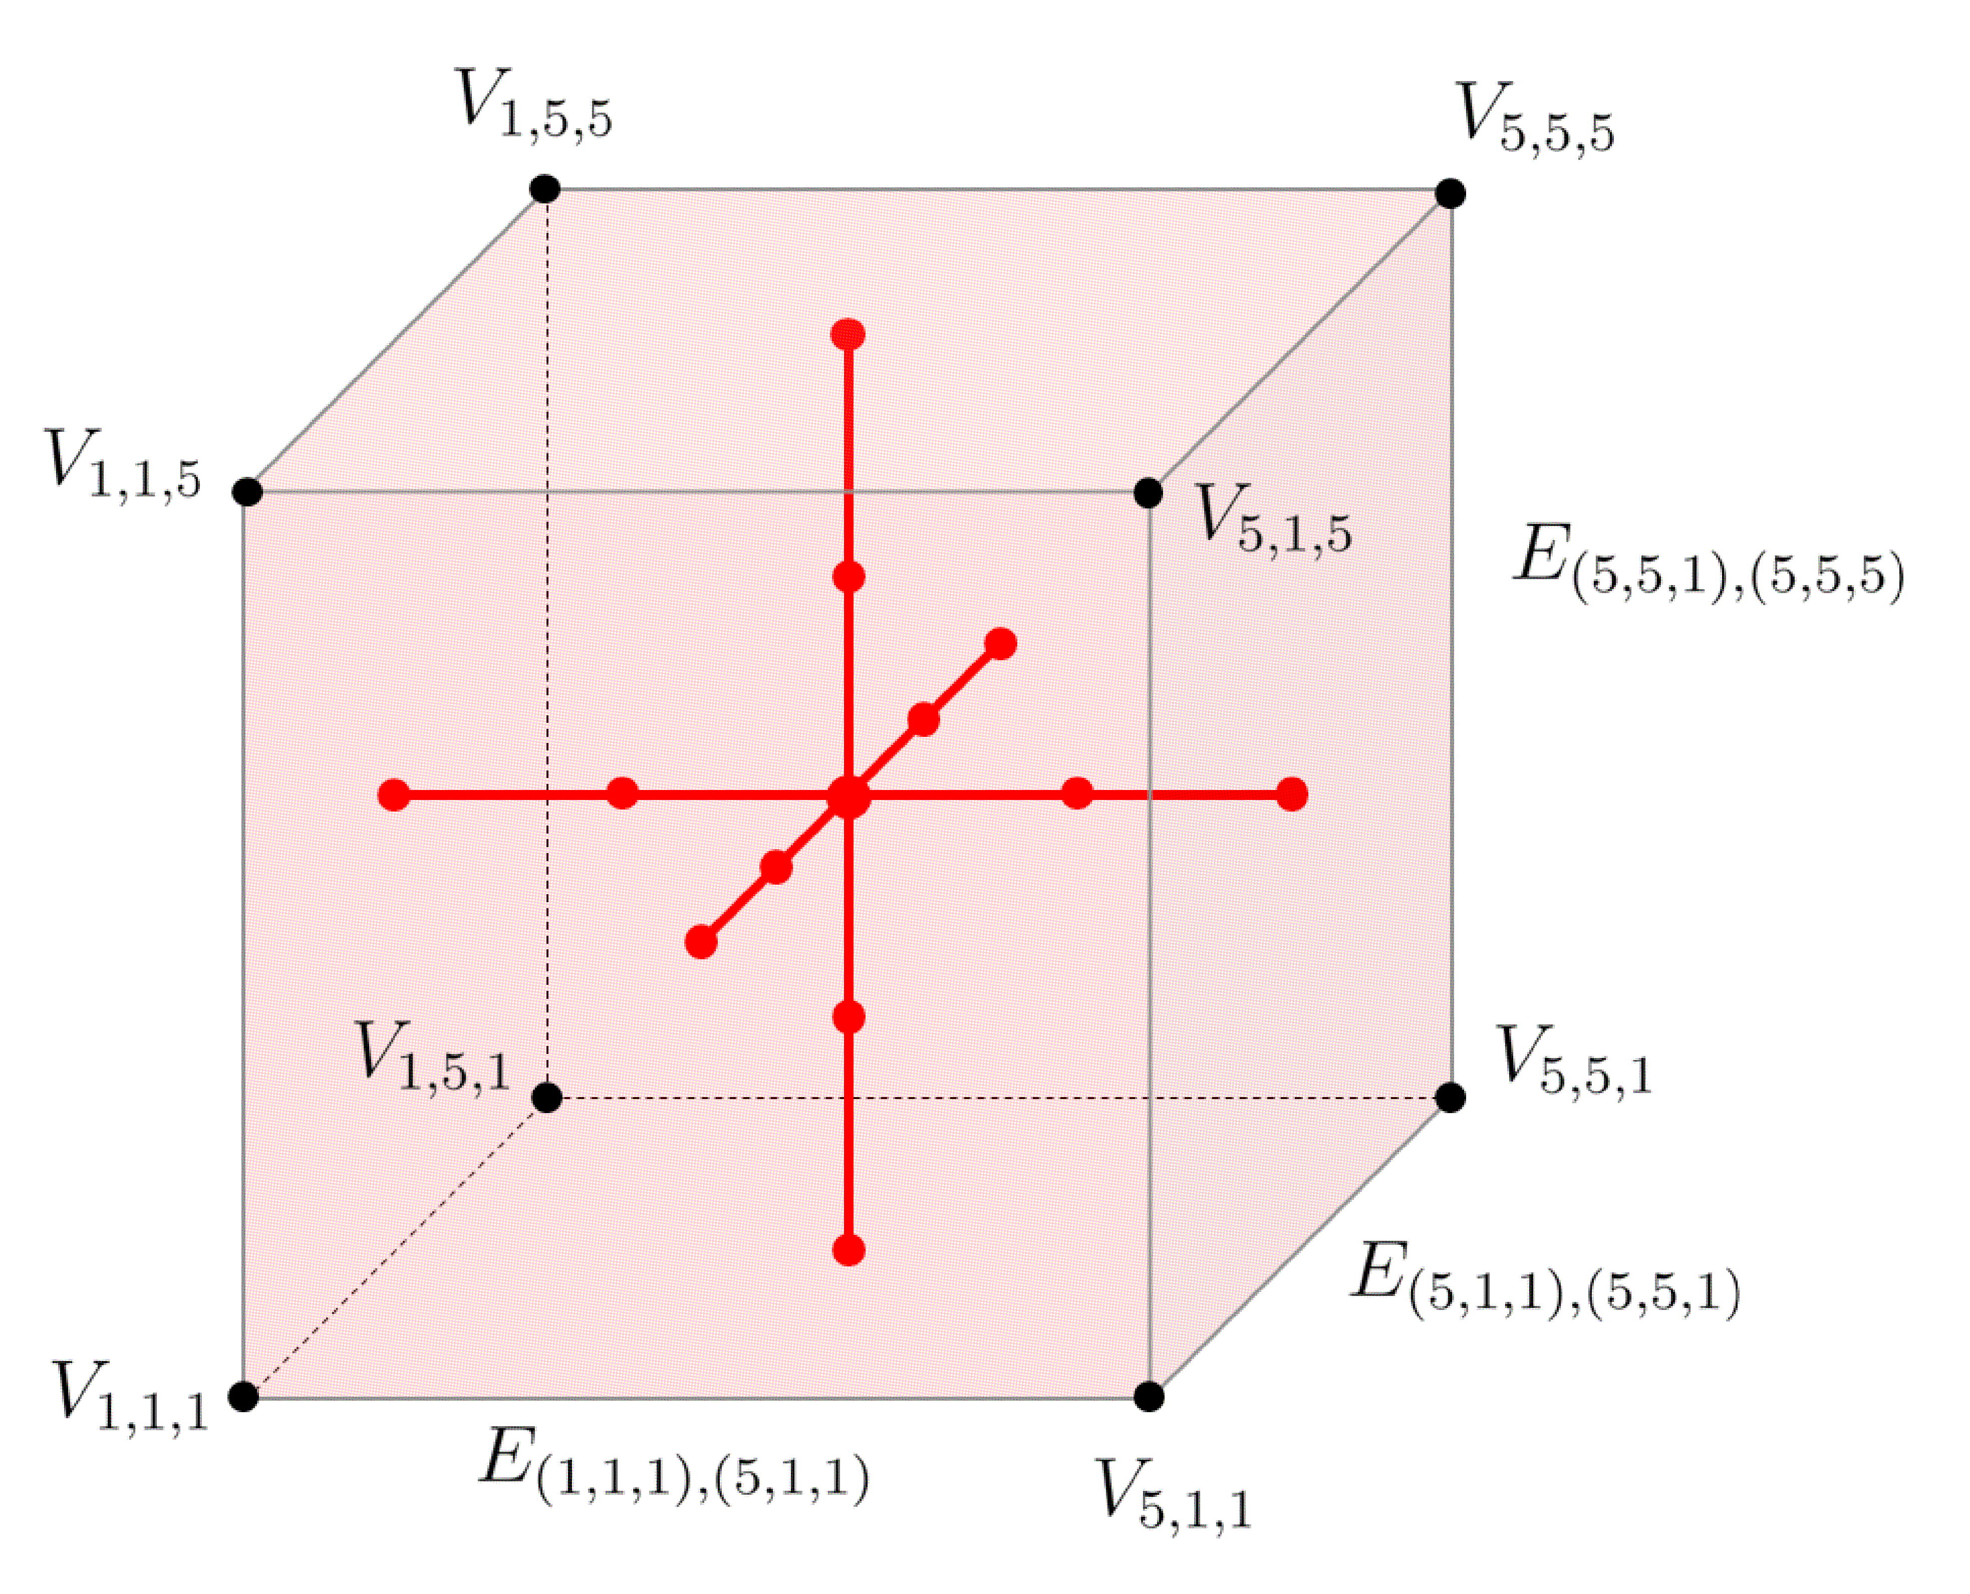
Strategy for defining polynomial spline spaces
Straightforward implementation in 3D
Support of the trivariate function N_{α} with knot vectors:
Knot intervals:
Frame of the support:
12 edges

Slide 13
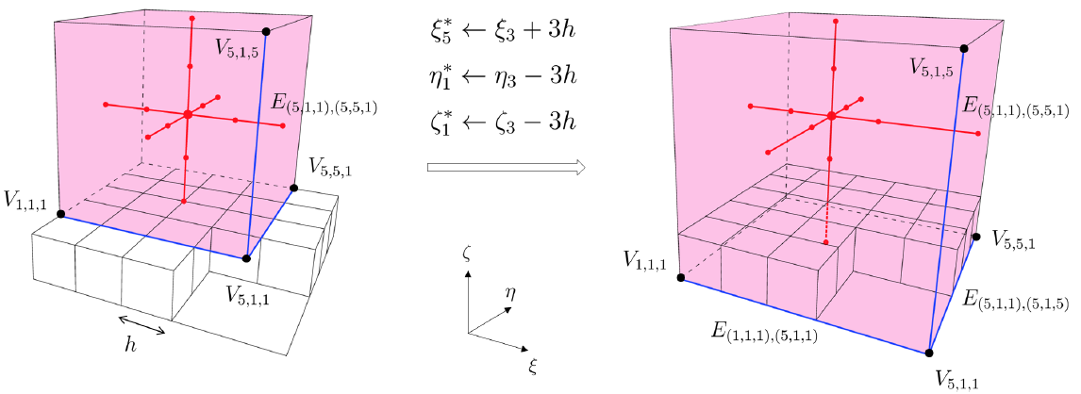
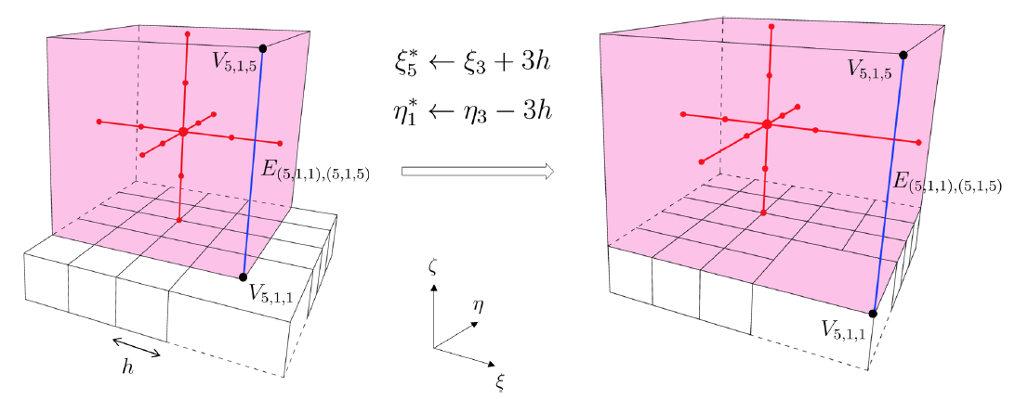
Strategy for defining polynomial spline spaces
Straightforward implementation in 3D
Condition 2: Edges of the cuboidal function support should be situated over the mesh faces.

Slide 14
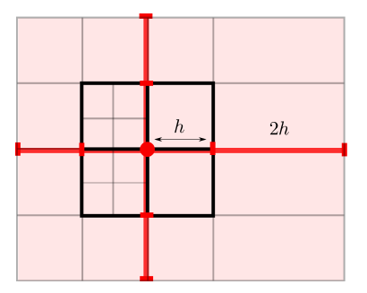
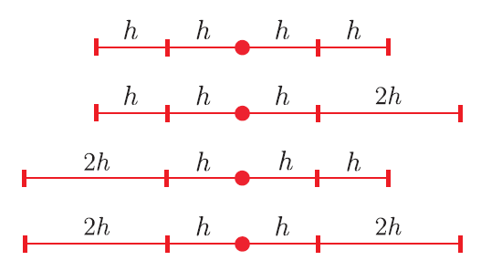
Strategy for defining polynomial spline spaces
Some remarks
Support classification
possible knot vector configuration
level of the function support is defined by its h

Slide 15

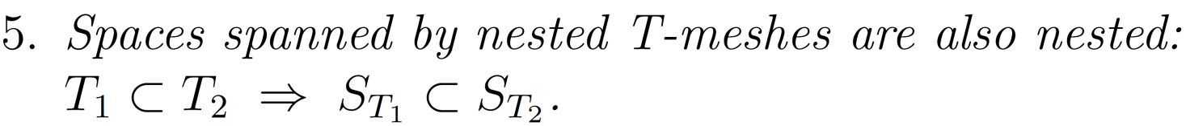
Strategy for defining polynomial spline spaces
Properties of the proposed functions

Slide 16
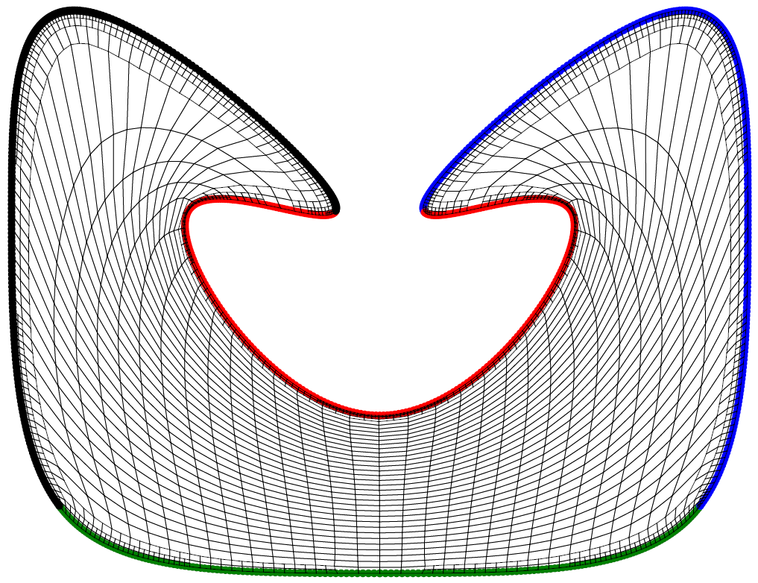
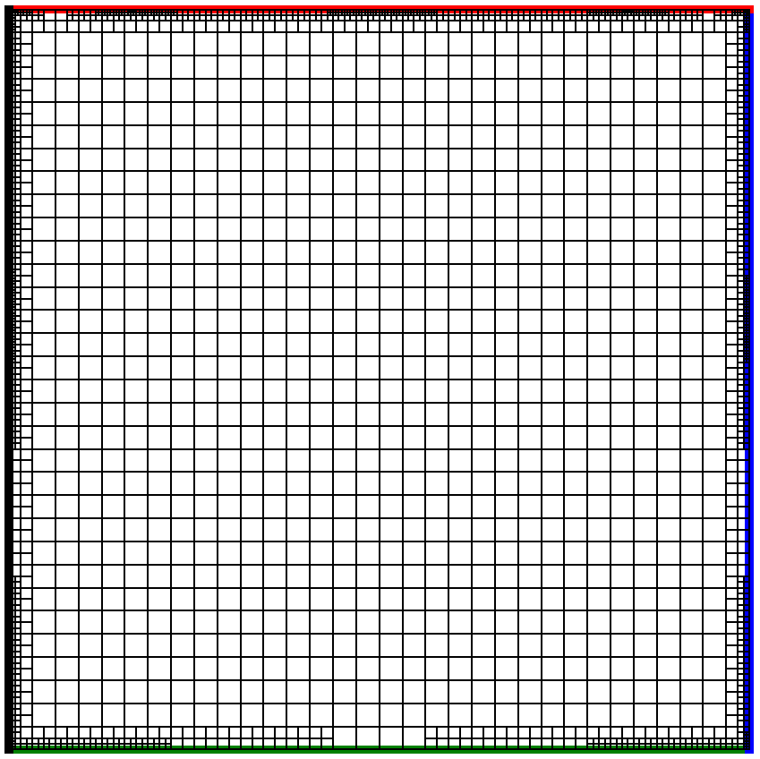
Spline parameterization method
T-mesh transformation along the SUS process
optimized physical T-mesh
parametric T-mesh

Slide 17
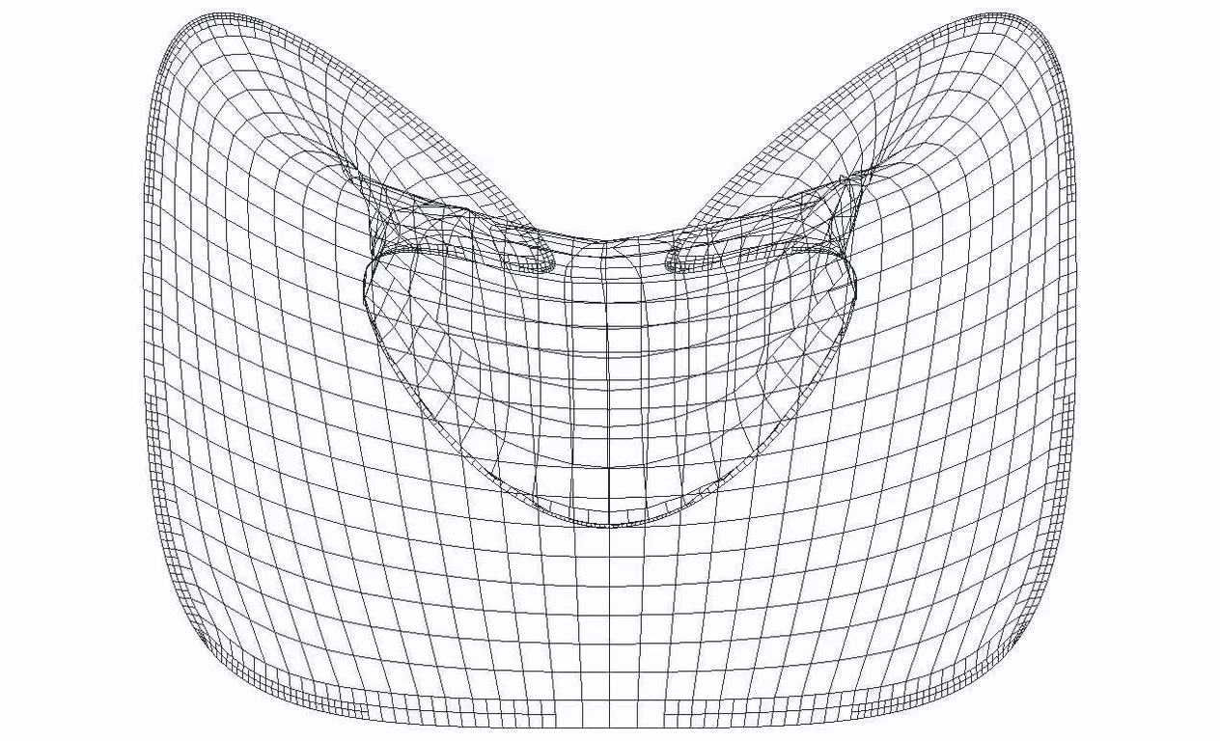
Spline parameterization method
T-mesh transformation along the SUS process: Video

Slide 18
J

Slide 19
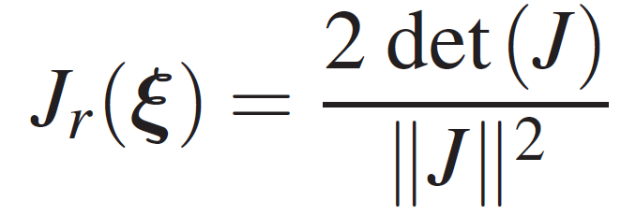
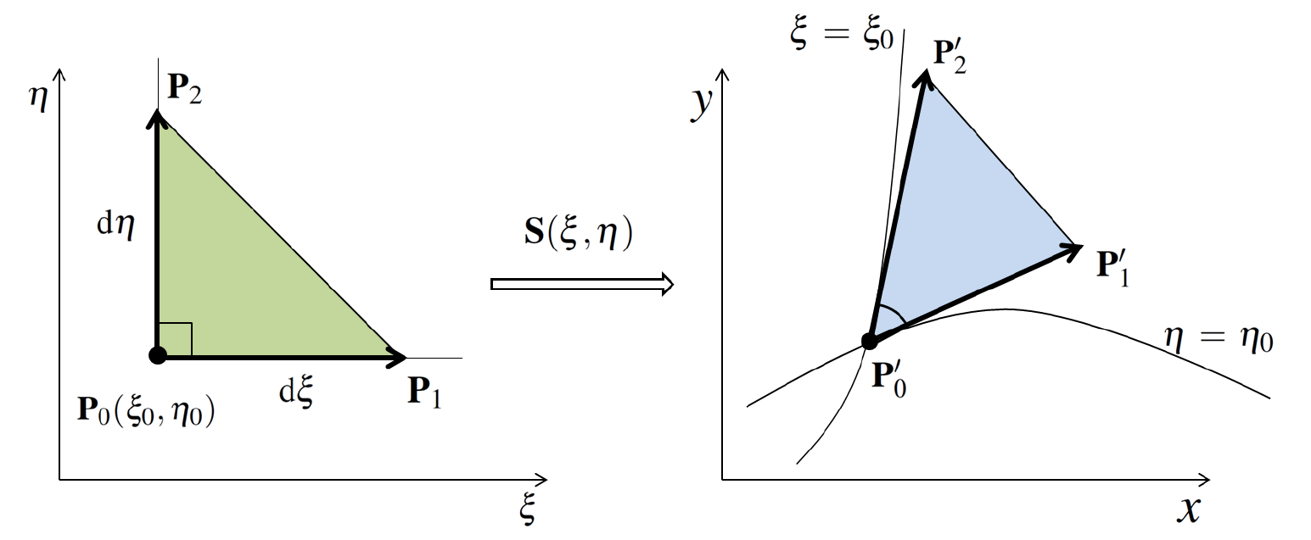
Mean Ratio Jacobian J_{r}(ξ) of parametric transformation
A quality metric of the mapping at any point P₀ (…as conformal as possible)
Valid mapping condition
0 <
≤ 1
where J is the Jacobian matrix of the
spline mapping S

Slide 20
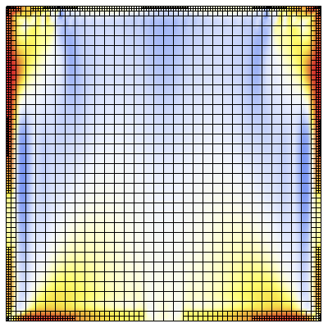
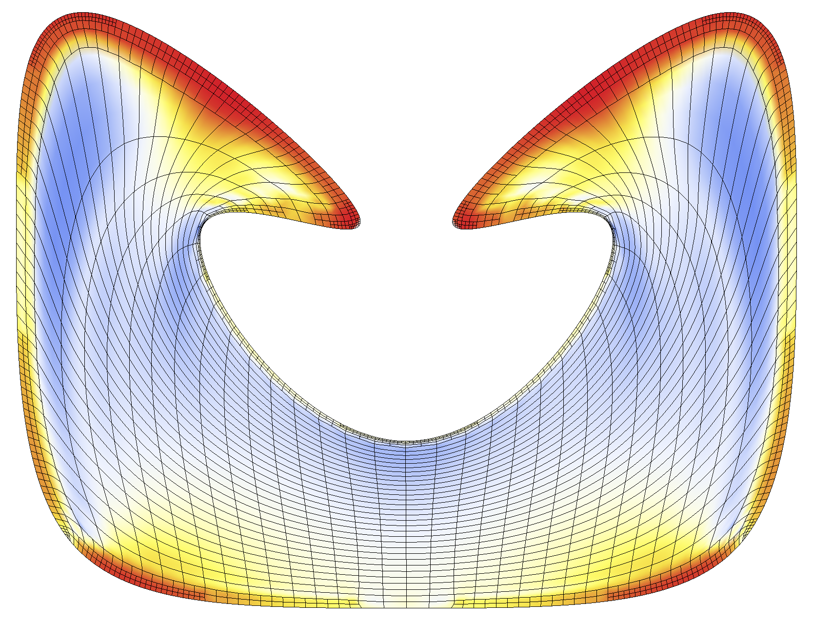

Spline parameterization method
T-mesh transformation along the SUS process: Mean ratio Jacobian
Min value of mean ratio Jacobian is 0.16

Slide 21
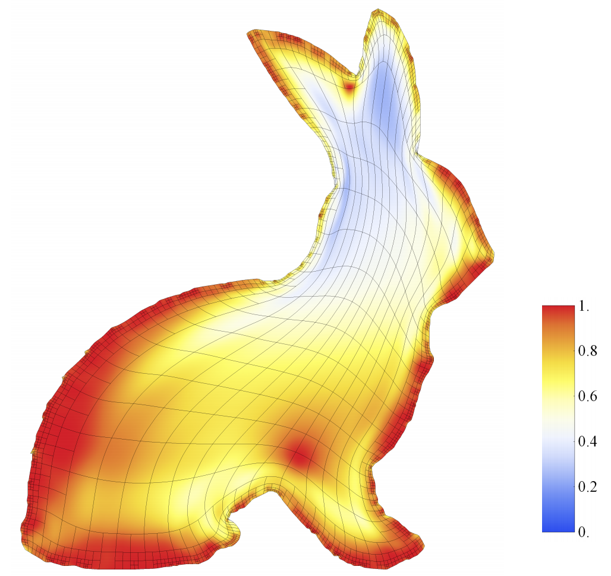
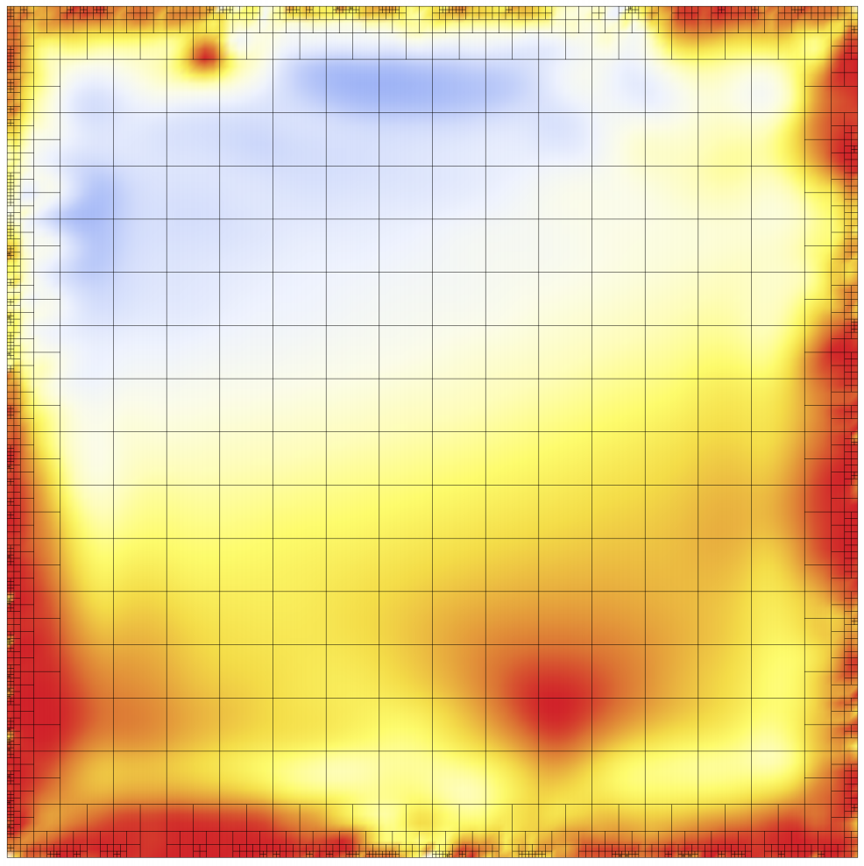
Spline parameterization of 2D geometries
Colormap of mean ratio Jacobian
Min value of mean ratio Jacobian is 0.23

Slide 22
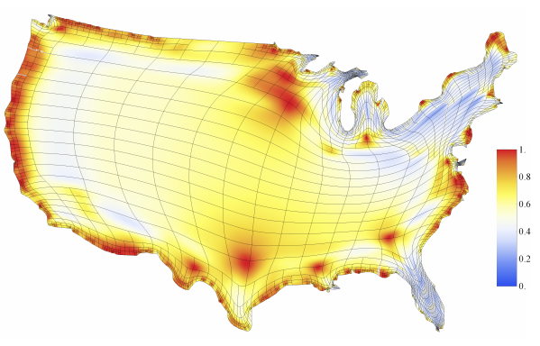
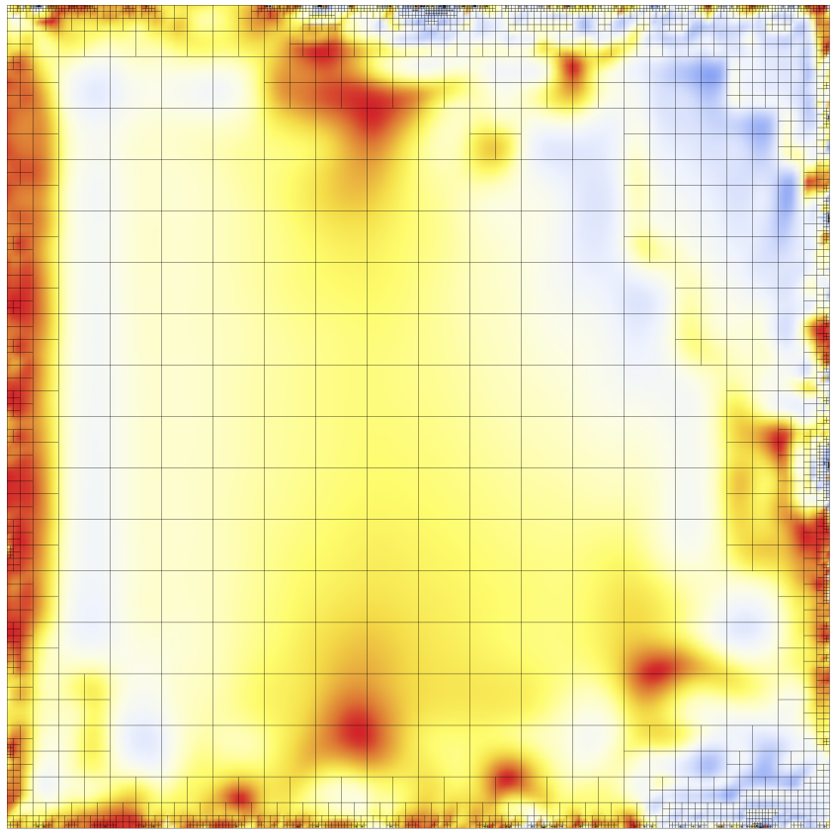
Spline parameterization of 2D geometries
Colormap of mean ratio Jacobian
Min value of mean ratio Jacobian is 0.09

Slide 23

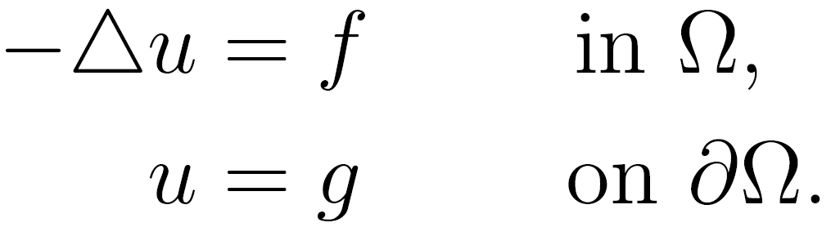
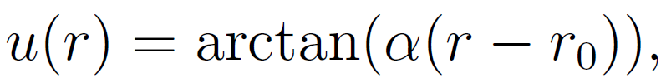


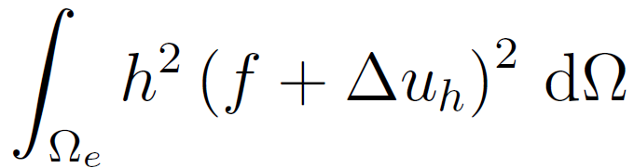
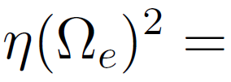
Isogeometric analysis on 2D complex domain
Poisson problem with Dirichlet boundary condition
● Analytical solution: Steep wave front given by
,
,
● Adaptive strategy: Residual-type error indicator:

Slide 24
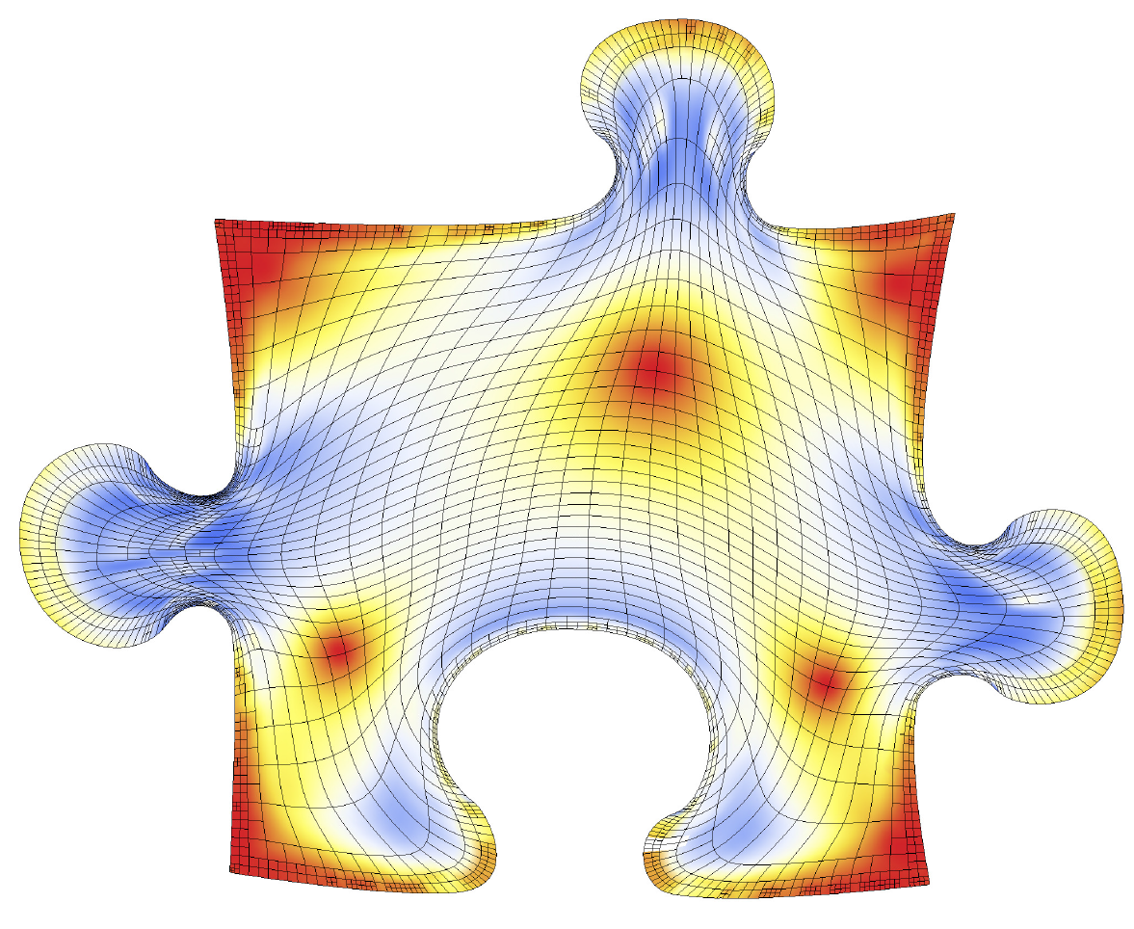
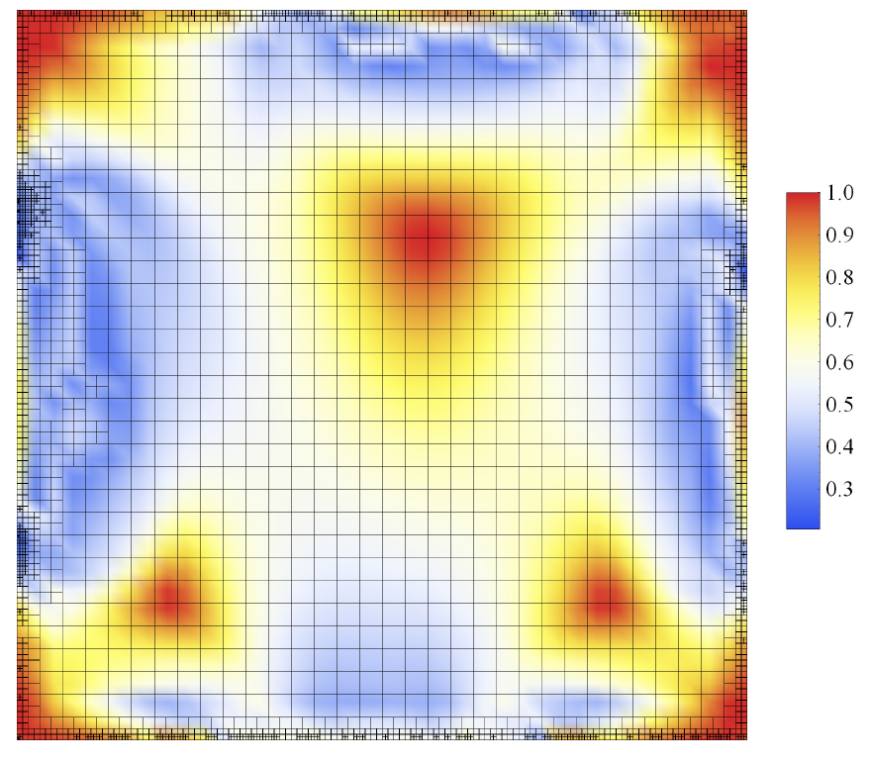
Isogeometric analysis for 2D Poisson problem
Domain parameterization. Mean ratio Jacobian
parametric domain
physical domain
Min value of mean ratio Jacobian is 0.23

Slide 25
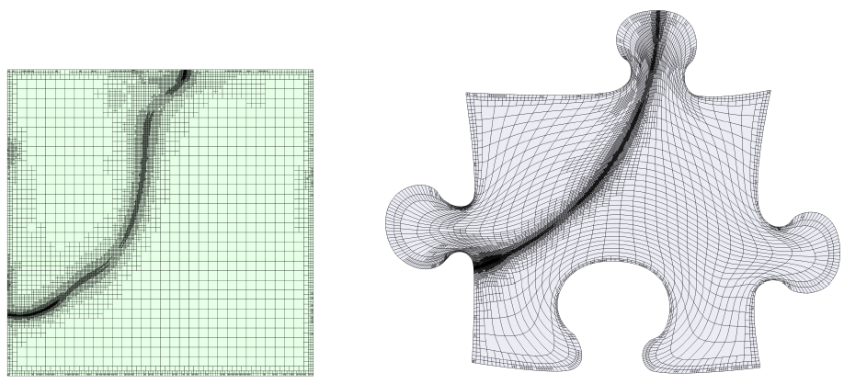
Isogeometric analysis for 2D Poisson problem
Poisson problem on puzzle piece domain
Final refinement:
parametric domain
physical domain

Slide 26

Isogeometric analysis for 2D Poisson problem
Poisson problem on puzzle piece domain
Numerical solution:
parametric domain
physical domain

Slide 27
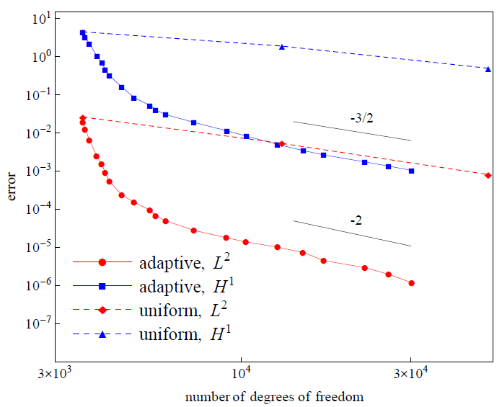
Isogeometric analysis for 2D Poisson problem
Poisson problem on puzzle piece domain
Error convergence:
adaptive and uniform refinement, IGA

Slide 28
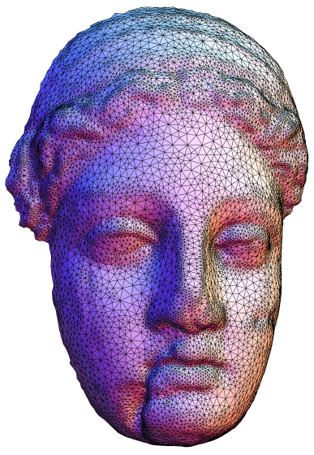
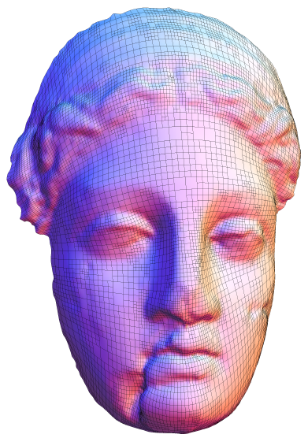
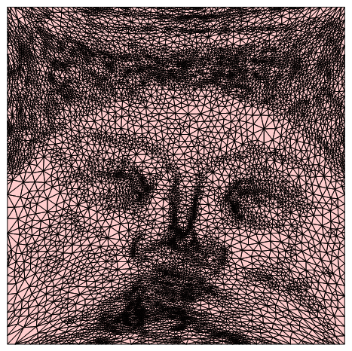
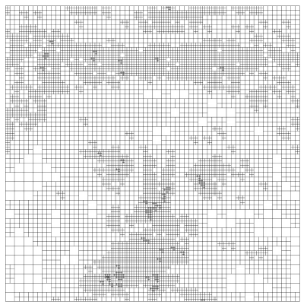
Surface modelling
Floater parameterization
parametric domain triangulation
spline representation of the surface
quadtree T-mesh
input surface triangulation

Slide 29
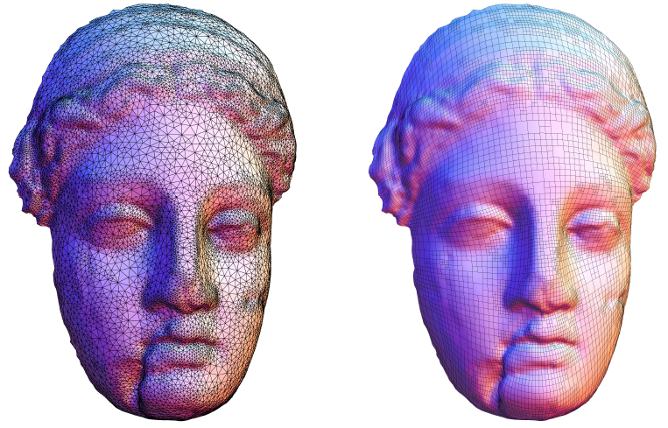
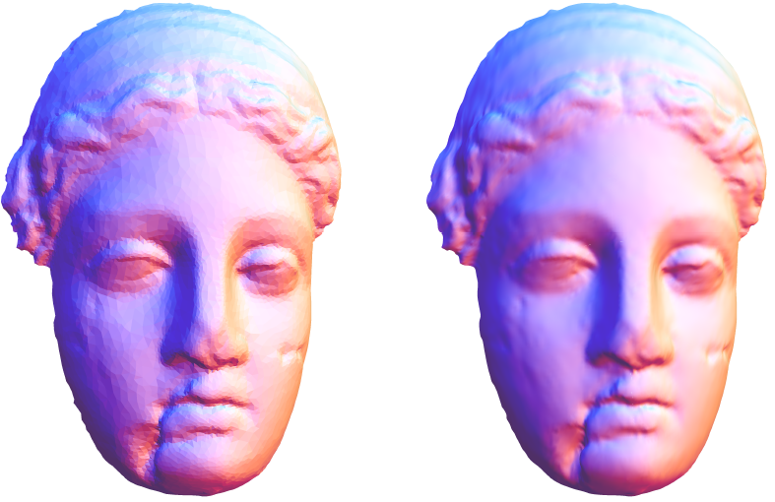
Surface modelling
input surface triangulation
spline representation of the surface

Slide 30
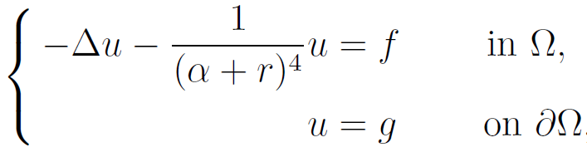
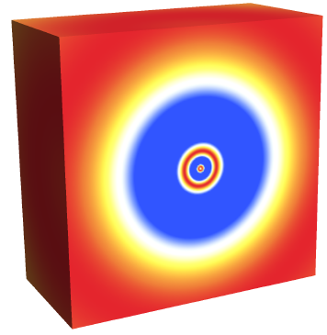
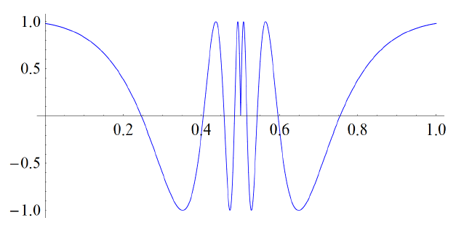
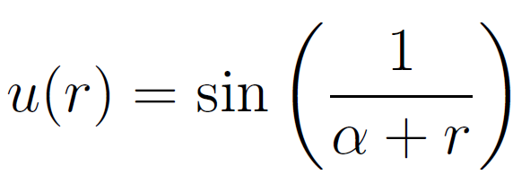
3D Helmholtz equation with variable frequency
Solution:

Slide 31
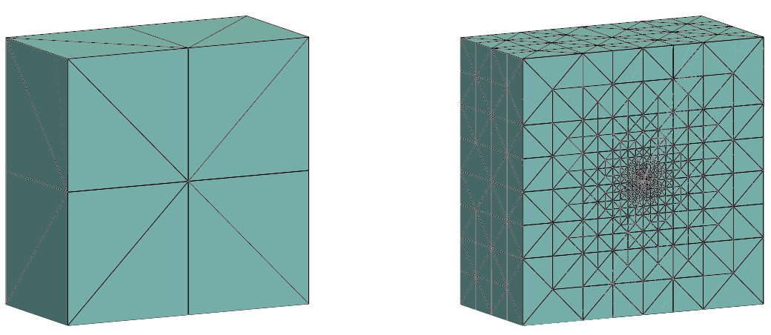
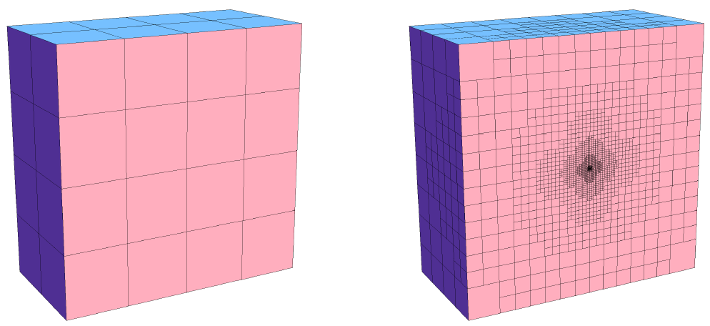
3D Helmholtz equation with variable frequency
Adaptive refinement:
initial mesh, IGA
final mesh, IGA
initial mesh, FEM
final mesh, FEM

Slide 32
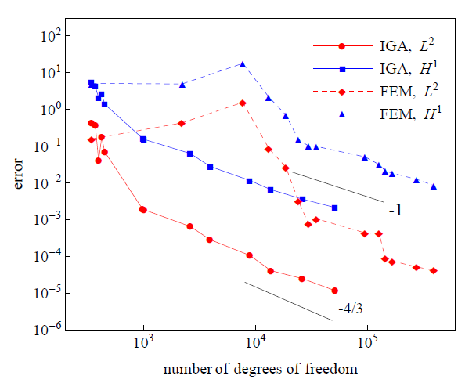
3D Helmholtz equation with variable frequency
adaptive refinement for IGA and FEM
Error convergence:

Slide 33

Isogeometric analysis on 3D complex domain
Poisson problem with Dirichlet boundary condition
● Analytical solution: Steep wave front given by
final refinement mesh
numerical solution

Slide 34

Isogeometric analysis on 3D complex domain
Poisson problem with Dirichlet boundary condition
Error convergence:
adaptive refinement for IGA

Slide 35
Wind field simulation in La Palma Island
Parametric and physical domains

Slide 36
Wind field simulation in La Palma Island
Mean ratio Jacobian
Min value of mean ratio Jacobian is 0.35

Slide 37
Wind field simulation in La Palma Island
Mass consistent model

Slide 38

T-mesh Simultaneous Untangling and Smoothing

Slide 39
Conclusions
We have proposed a new strategy for defining cubic spline
spaces over quadtree (2D) and octree (3D) T-meshes
For a given strongly balanced T-mesh, it allows to obtain a set of cubic spline
functions that span a space with nice properties: C²-continuous, polynomial
reproduction property, nested spaces, linear independence.
Simple rules for inferring local knot vectors to define spline blending functions
Straightforward implementation in 2D and 3D

