Slide 1



Parallel and Simultaneous Untangling and Smoothing of Tetrahedral Meshes
D. Benitez, E. Rodríguez, J.M. Escobar, R. Montenegro
SIANI Research Institute
University of Las Palmas de Gran Canaria, SPAIN

Slide 2
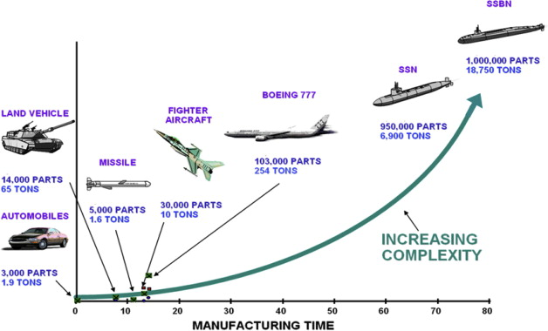
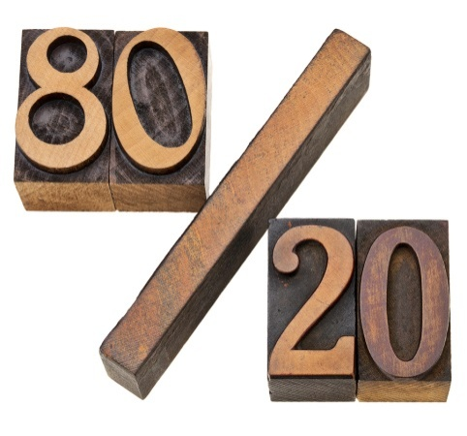
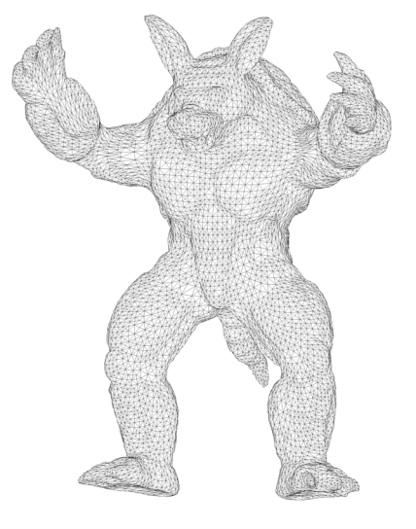
Motivation: relevance of mesh generation
Engineering modeling/design and analysis of real systems are becoming increasingly complex
  A typical automobile consists of about 3 Kparts and a nuclear submarine 1 Mparts
The “80/20” modeling/analysis ratio seems to be a very common industrial experience:
  Modeling accounts for about 80% of time
  Analysis accounts for about 20% of time
In the engineering process, there are many methods that are time consuming
Mesh generation accounts for 20% of overall time and may take as much CPU-time as field solver
Design complexity vs manufacturing time
(Von Cottrell, Hughes, Bazilevs)
Notes:
The main motivation of our paper is the following: <read the slide>
References:
Y. Bazilevs et al; Isogeometric analysis using T-splines; Comput. Methods Appl. Mech. Engrg. 199 (2010) 229–263
Von Cottrell, J. A.; Hughes, T. J. R.; Bazilevs, Y.; Isogeometric analysis: toward integration of CAD and FEA; John Wiley and Sons, 2009.

Slide 3
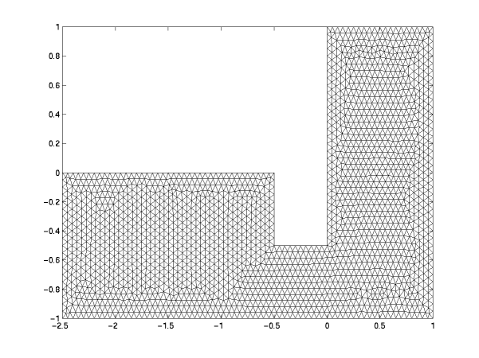
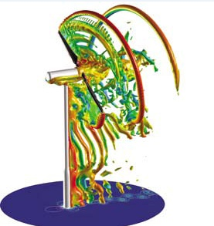
Motivation: why parallel mesh generation?
In very large engineering problems, this 20% of overall time may need of many man-months
For example, when the problem may require mesh optimization at regular intervals:
  Problems with moving bodies: Internal Combustion Engines, Shock/Structure Interaction, etc.
  Problems with moving boundaries: fluid dynamics, etc.
In our Meccano method for 3D mesh generation, the most time-consuming phase is devoted to mesh optimization
Thus, improving the speed of mesh generation with parallelism helps users solve problems faster
Reaction Diffusion Problem
(R. Li, T. Tang, P.-W. Zhang)
Airflow around a wind turbine
(Christopher Stone, Marilyn Smith)
Notes:
The main motivation of our paper is the following: <read the slide>
References:
Ravindra Duddu et al; A finite strain Eulerian formulation for compressible and nearly incompressible hyper-elasticity using high-order NURBS elements; Int. J. Numer. Meth. Engng 2010;1:1
Budd, C. J. and Huang, W. and Russell, R. D. Adaptivity with moving grids. Acta Numerica , pages 1–131, 2009
Imagen “Airflow around a wind turbine” : http://www.windpowerengineering.com/construction/simulation/simulating-the-turbine-simulating-the-site/, http://wpcore.wpe.s3.amazonaws.com/wp-content/uploads/2009/09/CFD4.jpg
Imagen “moving mesh”: http://www.math.hkbu.edu.hk/~ttang/MMmovie/harmonic/, http://www.math.hkbu.edu.hk/~ttang/MMmovie/harmonic/images/reaction1.gif

Slide 4
Motivation: parallel simultaneous untangling and smoothing
This work was mainly motivated by the most time-consuming procedure in the Meccano method, which is devoted to untangling and smoothing of tetrahedral meshes
Additionally, it was motivated by the inexistence of parallel simultaneous mesh untangling and smoothing techniques in the literature
Notes:
The main motivation of our paper is the following: <read the slide>

Slide 5

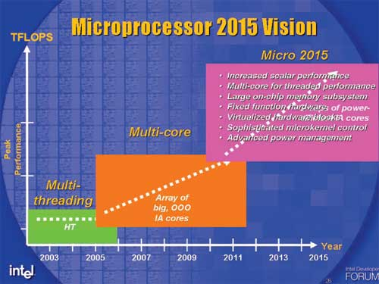
Motivation: future processor trend
On the other hand, the industry still appears to be committed to the current style of many cores
On-die memory will also trend to increase
Thus, shared-memory parallel computers will provide much opportunity for higher performance computers
As parallelism keeps increasing, mesh generation could be adapted for keeping up with the increasing concurrency in shared-memory computers
Notes:
The main motivation of our paper is the following: <read the slide>
References:
Y. Bazilevs et al; Isogeometric analysis using T-splines; Comput. Methods Appl. Mech. Engrg. 199 (2010) 229–263
Von Cottrell, J. A.; Hughes, T. J. R.; Bazilevs, Y.; Isogeometric analysis: toward integration of CAD and FEA; John Wiley and Sons, 2009.

Slide 6
Outline
We propose a new parallel algorithm for simultaneous untangling and smoothing of tetrahedral meshes (it is a tetrahedral mesh optimization method)
We also provide a detailed analysis of its parallelization on a many-core computer:
  parallel scalability
  load balancing
  parallelism bottlenecks
  influence of 3 graph coloring algorithms
Notes:
In this paper, <read the slide>

Slide 7
Summary
Our approach to tetrahedral mesh optimization
The novel parallel algorithm
Experimental methodology
Performance scalability
Load balancing
Influence of coloring algorithms on parallel performance
Conclusions and future work
Notes:
The summary of this presentation is the following: <read the slide>

Slide 8
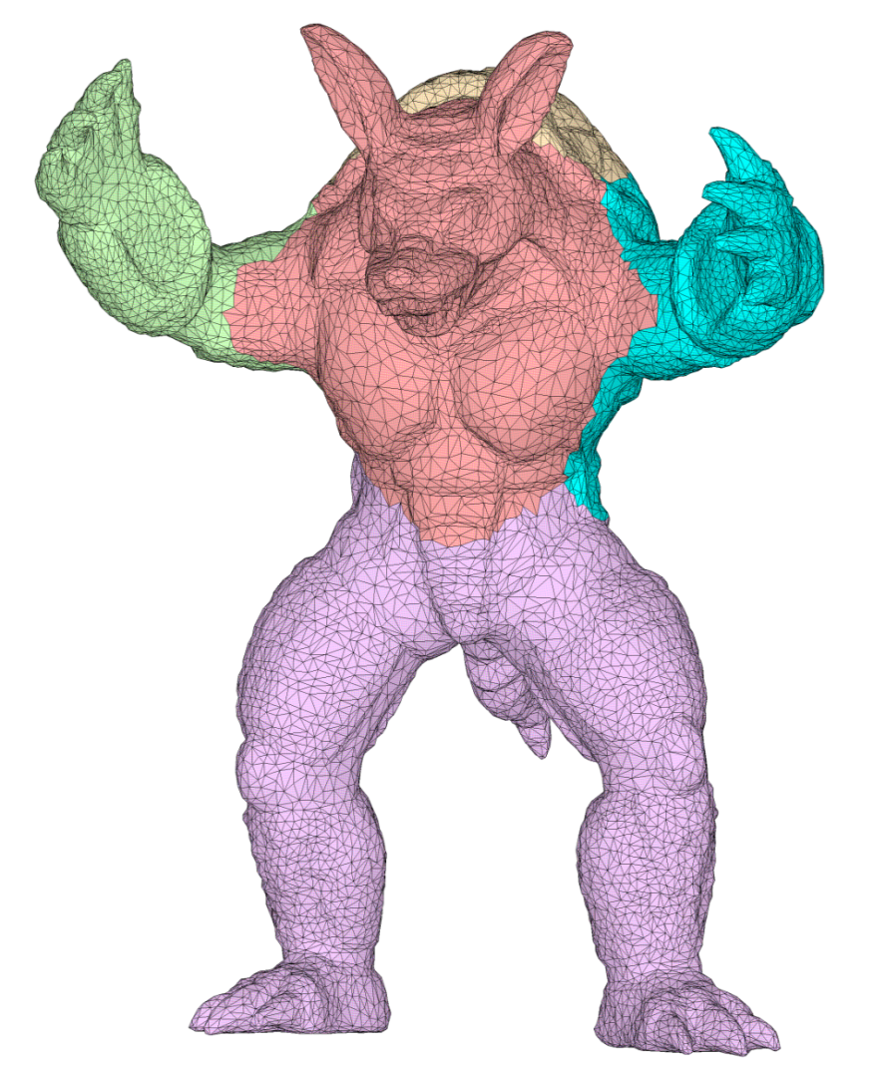
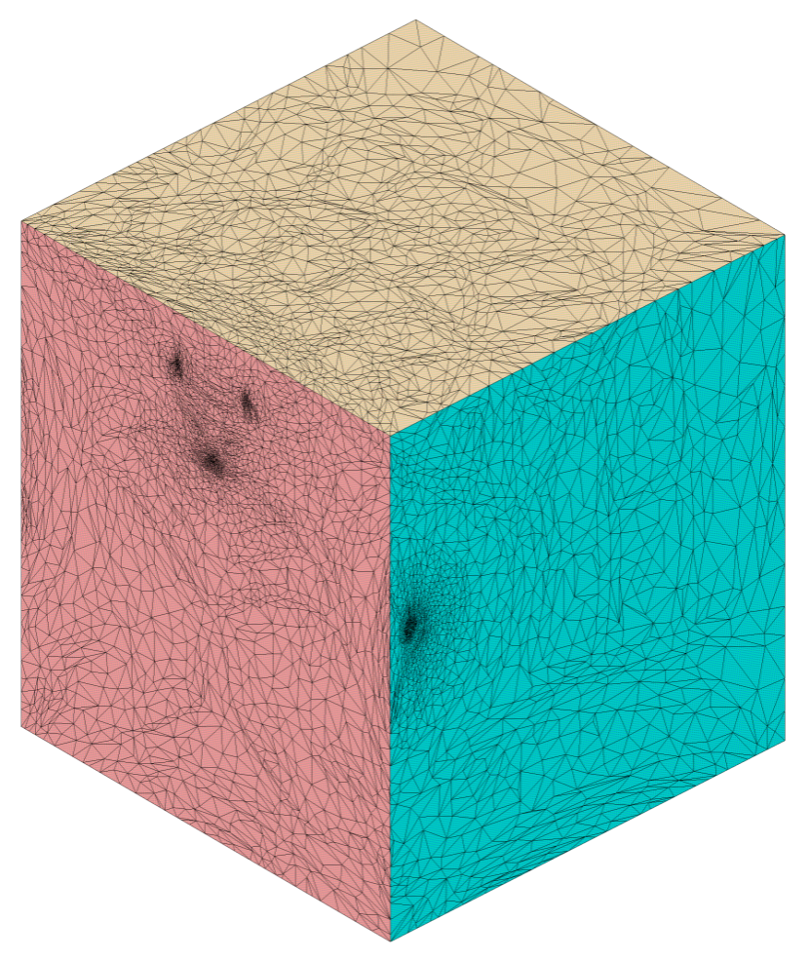
Meccano method: Partition and surface parameterization
Our approach to tetrahedral mesh optimization is part of our Meccano method, which was published in 2003.
We construct a partition of the solid surface in such away that each patch is mapped to the corresponding cube face by using the Floater parameterization technique.
Suppose that the input is a triangulation of the solid.
The first step of the process is the surface parameterization.
Parameterization of the patches onto the cube faces: Floater’s algorithm (mean value coordinates)
http://graphics.stanford.edu/data/3Dscanrep/, Stanford Computer Graphics Laboratory
Partition of the input surface triangulation
Surface parameterization
Notes:
Our approach to tetrahedral mesh optimization is part of our Meccano method, which was published in 2003.
The first step of the process is the surface parameterization.
Suppose that the input is a triangulation of the solid.
We construct a partition of the solid surface in such away that each patch is mapped to the corresponding cube face by using the Floater parameterization technique.

Slide 9


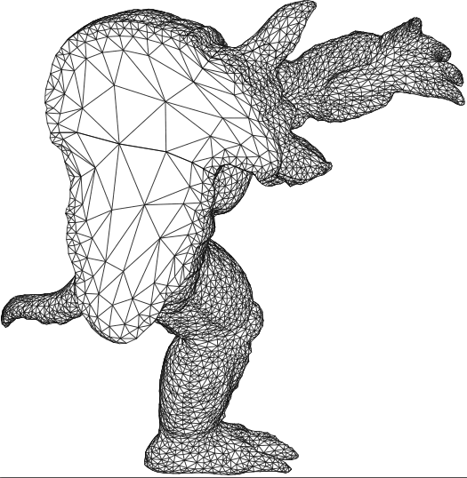
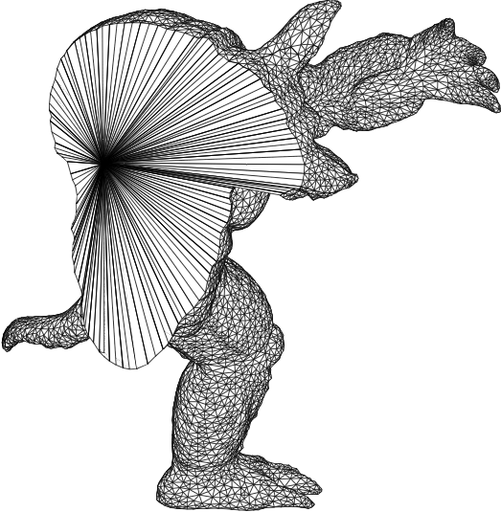
Meccano method: Main stages in volumetric parameterization
The following step consist on mapping the cube faces onto the solid surface by using mean value coordinates
And, finally, the tetrahedral mesh of the solid is optimized. In this way, we have a volumetric parameterization of the solid
This tetrahedral mesh is refined in such a way that the faces of the cube, mapped to the solid, differ no more than a user specified distance from the real surface
Once the surface parameterization is done, a coarse tetrahedral mesh of the cube is constructed
Adapted tetrahedral mesh
Kossaczky’s refinement
Volumetric parameterization
Input: Surface parameteri-zation
Surface mapping
Mesh optimization: untangling
and smoothing
Output: tetrahedral mesh
Notes:
Once the surface parameterization is done, we construct a coarse tetrahedral mesh of the cube.
This tetrahedral mesh is refined in such a way that the faces of the cube, mapped to the solid, differ no more than a user specified distance from the real surface.
The following step consist on mapping the cube faces onto the solid surface by using mean value coordinates.
And, finally, the tetrahedral mesh of the solid is optimized.
Thus, we have a volumetric parameterization of the solid, that is, a mapping between points of the cube and the points of the solid.
Note that mesh optimization is the key for achieve a good parameterization.

Slide 10
Mesh optimization for tetrahedral meshes
This process is repeated for all the nodes of the mesh several times until the global quality of the mesh is stabilized
The traditional procedure to smooth a given mesh consist on relocate the free nodes of the local mesh in a new position that optimizes certain objective function
The objective function K uses a measurement of the quality of the local mesh (q)
The mesh optimization method used in Meccano method is based on triangle optimization
2D example
Objective: Improve the quality of the local mesh by minimising an objective function
Free node
New position for the free node
v(x,y,z)
v(x,y,z)
Objective function
: quality of m-th triangle of the local mesh
Notes:
The mesh optimization method used in Meccano method is based on triangle optimization
The traditional procedure to smooth a given mesh consist on relocate the free nodes of the local mesh in a new position that optimizes certain objective function.
The objective function K uses a measurement of the quality of the local mesh (q)
This process is repeated for all the nodes of the mesh several times until the global quality of the mesh is stabilized.
Original:
The T-mesh optimization is based in the triangle optimization in which the cells are decomposed.
The traditional procedure to smooth a given mesh consist on relocate the free nodes of the local mesh in a new position that optimizes certain objective function.
This process is repeated for all the nodes of the mesh several times until the global quality of the mesh is stabilized.

Slide 11
Quality metric of tetrahedra
Weighted Jacobian Matrix
The objective function is constructed by using an algebraic quality metric of the tetrahedra
This quality metric is maximum (one) if and only if the tetrahedron is similar to ideal one and is cero if it is degenerated
This algebraic metric is based on the weighted jacobian matrix of the mapping between the ideal tetrahedron and the physical one
We use this algebraic quality metric
Reference triangle
Physical triangle
Ideal or “target” triangle
y
A
y
y
2
S = AW ⁻¹
2
2
t
t_{R}
0
1
t_{I}
1
x
x
0
1
x
0
W
: Weighted Jacobian matrix
where:
An algebraic quality metric of t
0 ≤ q ≤ 1: q = 1 if and only if t is similar to t_{I} and q = 0 iff t is degenerated
Notes:
The objective function is constructed by using an algebraic quality metric of the tetrahedra
This algebraic metric is based on the weighted jacobian matrix of the mapping between the ideal tetrahedron and the physical one
We use this algebraic quality metric
This quality metric is maximum (one) if and only if the tetrahedron is similar to ideal one and is cero if it is degenerated

Slide 12

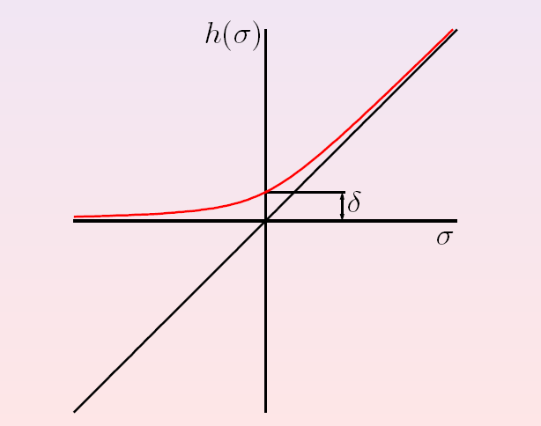

Modified objective function
We introduced a modification in this function to optimize tangled meshes
This modification consists in substituting the denominator by a positive and increasing function like this
Usual objective functions don’t works properly when the mesh is tangled due to singularities when the volume of the element is cero
Original function:
Modified function:
It allows a simultaneous untangling and smoothing of triangular and tetrahedral meshes
Notes:
Usual objective functions don’t works properly when the mesh is tangled due to singularities when the volume of the element is cero.
We introduced a modification in this function to optimize tangled meshes.
This modification consists in substituting the denominator by a positive and increasing function like this.
It allows a simultaneous untangling and smoothing of triangular and tetrahedral meshes

Slide 13
Plotting modified objective function
Original objective function (solid line) and modified (dashed lines) for several δ values.
Tangled boundary: there is not feasible region.
Notes:
This is a cut of the objective function when the free node cross this line (señalar).
Solid line corresponds to the original function, and dashed lines correspond to modified function for different delta values.
Note that the minimum of the modified and original functions are very similar.
Indeed when the boundary is tangled and, therefore, there is not feasible region, the minimum of the modified is in position that facilitates the untangling for subsequent sweeps of the process.

Slide 14
Sequential mesh optimization
When the simultaneous untangling and smoothing process is repeated for all the nodes of the mesh,
the wall-clock time on only one processor depends on ...
the number of nodes and the complexity of computation needed by each vertex
v₃
v’₃
v₂
v’₂
v₁
v’₁
v₅
v’₅
v₄
Mesh optimization
v’₄
v₆
v’₆
v₁
v’₁
v₂
v’₂
v₃
v’₃
v₄
v’₄
v₅
v’₅
v₆
v’₆
Procesor-0
t^{S}₀
t^{S}₁
t^{S}₂
t^{S}₃
t^{S}₄
t^{S}₅
t^{S}_{end}
wall-clock time
Notes:
When the simultaneous untangling and smoothing process is repeated for all the nodes of the mesh,
the wall-clock time on only one processor depends on
the number of nodes and the complexity of computation needed by each vertex.

Slide 15
The sequential algorithm
… for simultaneously untangling and smoothing a tetrahedral mesh M (SUS)
function OptimizeNode(x_{v}, N_{v})
Optimize objective function K(x_{v})
end function
procedure SUS
Q ← 0
k ← 0
while Q < λ and k < maxIter do
for each vertex v ∈ M do
x’_{v} ← OptimizeNode(x_{v}, N_{v})
end do
Q ← quality(M)
k ← k+1
end do
end procedure
INPUTS of the algorithm:
M : tangled tetrahedral mesh
K() : objective function
Notes:
The following slides show our sequential algorithm for simultaneous untangling and smoothing of a tetrahedral mesh (SUS).
The algorithm has the following inputs: M is a tangled tetrahedral mesh, and K() is the objective function

Slide 16
The sequential algorithm
… for simultaneously untangling and smoothing a tetrahedral mesh M (SUS)
function OptimizeNode(x_{v}, N_{v})
Optimize objective function K(x_{v})
end function
procedure SUS
Q ← 0
k ← 0
while Q < λ and k < maxIter do
for each vertex v ∈ M do
x’_{v} ← OptimizeNode(x_{v}, N_{v})
end do
Q ← quality(M)
k ← k+1
end do
end procedure
In the INNER PROCESSING LOOP…
This algorithm iterates sequentially over all the mesh vertices in some order
At each iteration, the spatial coordinates of a free node v is adjusted by the procedure called OptimizeNode, x_{v →} x’_{v}, in such a way that K(x_{v}) is minimized
OptimizeNode needs N_{v}, the set of tetrahedra connected to the free node v
Notes:
PROCESSING 1:
This algorithm iterates sequentially over all the mesh vertices in some order.
At each iteration, the spatial coordinates of a free node v is adjusted by the procedure called OptimizeNode, x_{v →} x’_{v}, in such a way that K(x_{v}) is minimized.
OptimizeNode needs N_{v}, the set of tetrahedra connected to the free node v

Slide 17
The sequential algorithm
… for simultaneously untangling and smoothing a tetrahedral mesh M (SUS)
function OptimizeNode(x_{v}, N_{v})
Optimize objective function K(x_{v})
end function
procedure SUS
Q ← 0
k ← 0
while Q < λ and k < maxIter do
for each vertex v ∈ M do
x’_{v} ← OptimizeNode(x_{v},N_{v})
end do
Q ← quality(M)
k ← k+1
end do
end procedure
In the OUTER PROCESSING LOOP …
This process repeats several times for all the nodes of the mesh M
maxIter : maximum number of untangling and smoothing iterations
Notes:
In the OUTER PROCESSING LOOP …
This process repeats several times for all the nodes of the mesh M
maxIter : maximum number of untangling and smoothing iterations

Slide 18
The sequential algorithm
… for simultaneously untangling and smoothing a tetrahedral mesh M (SUS)
function OptimizeNode(x_{v}, N_{v})
Optimize objective function K(x_{v})
end function
procedure SUS
Q ← 0
k ← 0
while Q < λ and k < maxIter do
for each vertex v ∈ M do
x’_{v} ← OptimizeNode(x_{v},N_{v})
end do
Q ← quality(M)
k ← k+1
end do
end procedure
Q measures the lowest quality of a tetrahedron of M
quality(M) : function that provides the minimum quality of mesh M
OUTPUT of the algorithm:
an untangled and smoothed mesh M, whose minimum quality must be larger than an user-specified threshold λ
Notes:
Q measures the lowest quality of a tetrahedron of M
quality(M) : function that provides the minimum quality of mesh M
OUTPUT:
an untangled and smoothed mesh M, whose minimum quality must be larger than an user-specified threshold λ

Slide 19
Parallel mesh preprocessing: mesh coloring
The parallel algorithm has to prevent two adjacent vertices from being simultaneously untangled and smoothed on different processors
This justifies the use of a graph coloring algorithm to find vertices of a mesh that have not computational dependency.
With this coloring method the mesh is partitioned in a disjoint sequence of independent sets: red, blue, green, etc.
This a preprocessing step in our parallel algorithm and the respective wall-clock time has been measured
The following slides show our parallel algorithm for simultaneous untangling and smoothing of a tetrahedral mesh
v₃
v₃
v₂
v₂
v₁
Mesh coloring
v₁
v₅
v₅
v₄
v₄
Coloring time
v₆
COLORED MESH
v₆
Procesor-0
INPUT MESH
wall-clock time
Procesor-1
t^{C}₀
t^{P}₀
Notes:
The following slides show our parallel algorithm for simultaneous untangling and smoothing of a tetrahedral mesh
The parallel algorithm has to prevent two adjacent vertices from being simultaneously untangled and smoothed on different processors.
This justifies the use of a graph coloring algorithm to find vertices of a mesh (M) that have not computational dependency.
With this coloring method the mesh is partitioned in a disjoint sequence of independent sets: red, blue, green, etc.
This a preprocessing step in our parallel algorithm and the respective wall-clock time has been measured

Slide 20
Parallel mesh optimization
This parallel algorithm optimize in parallel the nodes of each independent set
In a first step, the nodes of a color or independent set
When all nodes of this color have been optimized, the nodes of other color are optimized, and so on
v₃
v’₃
v₂
v’₂
v₁
v’₁
v₅
Simultanous untangling and smoothing
v’₅
v₄
v’₄
v₆
COLORED MESH
v’₆
Red vertices
Blue vertices
Green vertices
v₁
v’₁
v₂
v’₂
v₃
v’₃
Procesor-0
v₅
v’₅
v₆
v’₆
v₄
v’₄
Procesor-1
wall-clock time
t^{P}₀
t^{P}₁
t^{P}₂
t^{P}_{end}
Notes:
This parallel algorithm optimize in parallel the nodes of each independent set
In a first step, the nodes of a color or independent set.
When all nodes of this color have been optimized, the nodes of other color are optimized, and so on.

Slide 21
Parallel mesh optimization: performance improvement
Performance improvement is achieved when parallel wall-clock time including coloring time is shorter than sequential wall-clock time
Coloring time
Red vertices
Blue vertices
Green vertices
v₁
v’₁
v₂
v’₂
v₃
v’₃
Procesor-0
v₅
v’₅
v₆
v’₆
v₄
v’₄
PARALLEL wall-clock time
Procesor-1
t^{C}₀
t^{P}₀
t^{P}₁
t^{P}₂
t^{P}_{end}
Performance improvement
v₁
v’₁
v₂
v’₂
v₃
v’₃
v₄
v’₄
v₅
v’₅
v₆
v’₆
Procesor-0
SERIAL wall-clock time
t^{S}₀
t^{S}₁
t^{S}₂
t^{S}₃
t^{S}₄
t^{S}₅
t^{S}_{end}
Notes:
Performance improvement is achieved when parallel wall-clock time including coloring time is shorter than sequential wall-clock time

Slide 22
The novel parallel algorithm
Parallel algorithm (pSUS) for the simultaneous untangling and smoothing of a tetrahedral mesh M
function OptimizeNode(x_{v}, N_{v})
Optimize objective function K(x_{v})
end function
procedure Coloring(G=(V,E))
G is partitioned into independent sets I={I₁, I₂, …} using C₁, C₂ or C₃ coloring algorithm
end procedure
procedure pSUS
I ← Coloring(G=(V,E))
k ← 0
Q ← 0
while Q < λ and k < maxIter do
for each independent set I_{i} ∈ I do
for each vertex v ∈ I_{i} in parallel do
x’_{v} ← OptimizeNode(x_{v},N_{v})
end do
end do
Q ← quality(M)
k ← k+1
end do
end procedure
Its inputs are the same as described for sequential algorithm
Notes:
This is the parallel algorithm of our method for untangling and smoothing of tetrahedral meshes.
The main procedure is called pSUS.
Its inputs are the same as described for sequential algorithm
Original:
Its inputs M, maxIter, N_{v}, 𝒙_𝑣, K(), 𝒙 ̂_𝑣, Q, λ, quality() have the same meanings as described for Algorithm 1.
The parallel algorithm has to prevent two adjacent vertices from being simultaneously untangled and smoothed on different processors. On the contrary, new inverted mesh elements may be created [10]. Thus, when the sequential Algorithm 1 is parallelized, a computational dependency appears between adjacent vertices because one vertex needs to be optimized after the other.
This justifies the use in our parallel algorithm of a graph coloring algorithm to find vertices of a mesh (M) that have not computational dependency. We implemented graph coloring with procedure Coloring(). With this coloring method the mesh is partitioned in a disjoint sequence of independent sets I={I₁,I₂,…} . Three different coloring methods called “C₁”, “C₂”, “C₃” and proposed by other authors were tested and their results were compared.

Slide 23
The novel parallel algorithm
Parallel algorithm (pSUS) for the simultaneous untangling and smoothing of a tetrahedral mesh M
function OptimizeNode(x_{v}, N_{v})
Optimize objective function K(x_{v})
end function
procedure Coloring(G=(V,E))
G is partitioned into independent sets I={I₁, I₂, …} using C₁, C₂ or C₃ coloring algorithm
end procedure
procedure pSUS
I ← Coloring(G=(V,E))
k ← 0
Q ← 0
while Q < λ and k < maxIter do
for each independent set I_{i} ∈ I do
for each vertex v ∈ I_{i} in parallel do
x’_{v} ← OptimizeNode(x_{v},N_{v})
end do
end do
Q ← quality(M)
k ← k+1
end do
end procedure
Three different coloring methods called “C1”, “C2”, “C3” and proposed by other authors were tested and their results were compared
We implemented graph coloring with Coloring() procedure, which partitions the mesh in a disjoint sequence of independent sets: I₁, I₂, …
Notes:
In Algorithm 2, a parallel algorithm for our mathematical method for untangling and smoothing of tetrahedral meshes can be seen. The main procedure is called pSUS. Its inputs M, maxIter, N_{v}, 𝒙_𝑣, K(), 𝒙 ̂_𝑣, Q, λ, quality() have the same meanings as described for Algorithm 1.
The parallel algorithm has to prevent two adjacent vertices from being simultaneously untangled and smoothed on different processors. On the contrary, new inverted mesh elements may be created [10]. Thus, when the sequential Algorithm 1 is parallelized, a computational dependency appears between adjacent vertices because one vertex needs to be optimized after the other.
This justifies the use in our parallel algorithm of a graph coloring algorithm to find vertices of a mesh (M) that have not computational dependency. We implemented graph coloring with procedure Coloring(). With this coloring method the mesh is partitioned in a disjoint sequence of independent sets I={I₁,I₂,…} . Three different coloring methods called “C₁”, “C₂”, “C₃” and proposed by other authors were tested and their results were compared.

Slide 24
The novel parallel algorithm
Parallel algorithm (pSUS) for the simultaneous untangling and smoothing of a tetrahedral mesh M
function OptimizeNode(x_{v}, N_{v})
Optimize objective function K(x_{v})
end function
procedure Coloring(G=(V,E))
G is partitioned into independent sets I={I₁, I₂, …} using C₁, C₂ or C₃ coloring algorithm
end procedure
procedure pSUS
I ← Coloring(G=(V,E))
k ← 0
Q ← 0
while Q < λ and k < maxIter do
for each independent set I_{i} ∈ I do
for each vertex v ∈ I_{i} in parallel do
x’_{v} ← OptimizeNode(x_{v},N_{v})
end do
end do
Q ← quality(M)
k ← k+1
end do
end procedure
This parallel algorithm optimize in parallel the nodes of each independent set
Notes:
In Algorithm 2, a parallel algorithm for our mathematical method for untangling and smoothing of tetrahedral meshes can be seen. The main procedure is called pSUS. Its inputs M, maxIter, N_{v}, 𝒙_𝑣, K(), 𝒙 ̂_𝑣, Q, λ, quality() have the same meanings as described for Algorithm 1.
The parallel algorithm has to prevent two adjacent vertices from being simultaneously untangled and smoothed on different processors. On the contrary, new inverted mesh elements may be created [10]. Thus, when the sequential Algorithm 1 is parallelized, a computational dependency appears between adjacent vertices because one vertex needs to be optimized after the other.
This justifies the use in our parallel algorithm of a graph coloring algorithm to find vertices of a mesh (M) that have not computational dependency. We implemented graph coloring with procedure Coloring(). With this coloring method the mesh is partitioned in a disjoint sequence of independent sets I={I₁,I₂,…} . Three different coloring methods called “C₁”, “C₂”, “C₃” and proposed by other authors were tested and their results were compared.

Slide 25
The novel parallel algorithm
Parallel algorithm (pSUS) for the simultaneous untangling and smoothing of a tetrahedral mesh M
function OptimizeNode(x_{v}, N_{v})
Optimize objective function K(x_{v})
end function
procedure Coloring(G=(V,E))
G is partitioned into independent sets I={I₁, I₂, …} using C₁, C₂ or C₃ coloring algorithm
end procedure
procedure pSUS
I ← Coloring(G=(V,E))
k ← 0
Q ← 0
while Q < λ and k < maxIter do
for each independent set I_{i} ∈ I do
for each vertex v ∈ I_{i} in parallel do
x’_{v} ← OptimizeNode(x_{v},N_{v})
end do
end do
Q ← quality(M)
k ← k+1
end do
end procedure
The output of the algorithm is an untangled and smoothed mesh M, whose minimum quality must be larger than an user-specified threshold λ
Notes:
In Algorithm 2, a parallel algorithm for our mathematical method for untangling and smoothing of tetrahedral meshes can be seen. The main procedure is called pSUS. Its inputs M, maxIter, N_{v}, 𝒙_𝑣, K(), 𝒙 ̂_𝑣, Q, λ, quality() have the same meanings as described for Algorithm 1.
The parallel algorithm has to prevent two adjacent vertices from being simultaneously untangled and smoothed on different processors. On the contrary, new inverted mesh elements may be created [10]. Thus, when the sequential Algorithm 1 is parallelized, a computational dependency appears between adjacent vertices because one vertex needs to be optimized after the other.
This justifies the use in our parallel algorithm of a graph coloring algorithm to find vertices of a mesh (M) that have not computational dependency. We implemented graph coloring with procedure Coloring(). With this coloring method the mesh is partitioned in a disjoint sequence of independent sets I={I₁,I₂,…} . Three different coloring methods called “C₁”, “C₂”, “C₃” and proposed by other authors were tested and their results were compared.

Slide 26
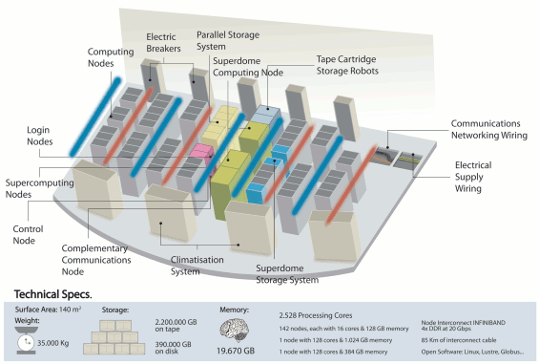
Experimental methodology
Our experiments were conducted on a high-performance computer called Finis Terrae (cesga.es) with 128 Itanium2 cores on a shared memory architecture
And on Intel® Manycore Testing Lab with 40 cores on a shared memory architecture
Notes:
Our experiments were conducted on a high-performance computer that is a HP Integrity Superdome node with 128 Itanium 2 cores, multithreading disabled, and 1TB NUMA shared memory. It is part of Finis Terrae supercomputer, the third largest supercomputer in Spain
<read the slide>

Slide 27
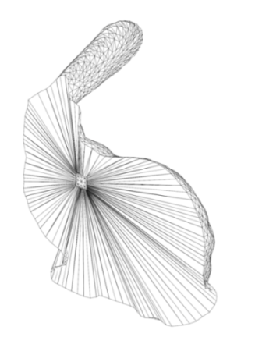
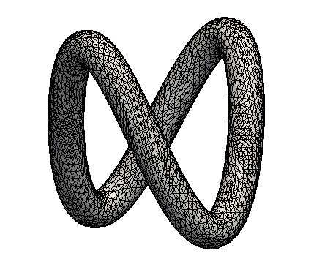
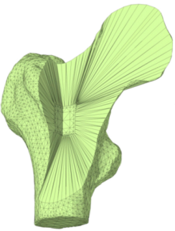
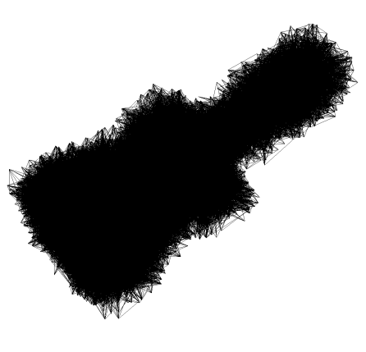
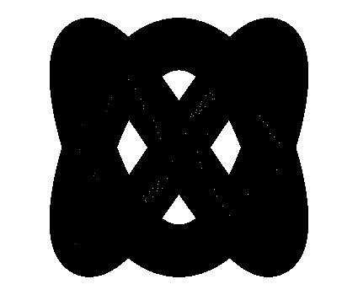

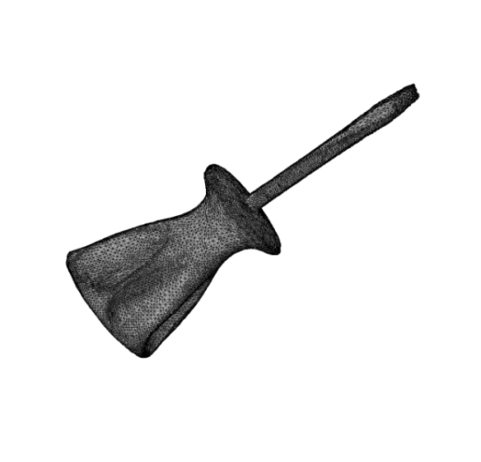

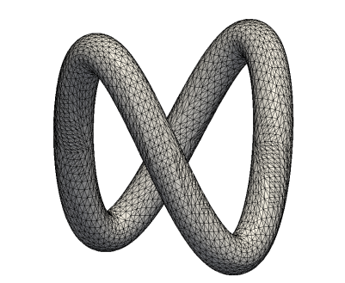

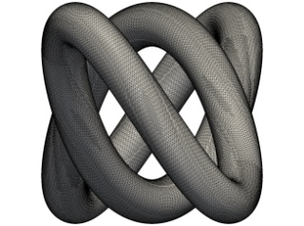

Experimental methodology
The sequential (SUS) and parallel (pSUS) algorithms of our mesh optimization method were applied on six different tangled benchmark meshes
and the untangled and smoothed mesh that is provided by our algorithm
Here, we can see for each benchmark mesh the respective tangled mesh, its number of vertices, from 6 thousand to 520 thousand
“m=6358” “m=9176” “m=11525” “m=39617” “m=201530” “m=520128”
Bunny Tube Bone Screwdriver Toroid HR toroid
Notes:
The sequential (SUS) and parallel (pSUS) algorithms of our mesh optimization method were applied on six different tangled benchmark meshes.
In this slide, we can see for each benchmark mesh the respective tangled mesh, its number of vertices, from 6 thousand to 520 thousand, and the untangled and smoothed mesh that is provided by our algorithm.

Slide 28
Experimental methodology
For each input benchmark mesh, this table shows the number of tetrahedra, from 26 thousand to more than 2 million, the average mesh quality, and the number of non-valid tetrahedra
The quality of non-valid tetrahedra is considered zero. So, the minimum quality is zero for all meshes
The maximum vertex degree is 26
Notes:
<read the slide>
Additionally, this table shows for each input benchmark mesh, the number of tetrahedra, from 26 thousand to more than 2 million, the average mesh quality, the number of non-valid tetrahedra.
The quality of non-valid elements is considered zero. So, the minimum quality is zero for all meshes.
the maximum vertex degree.

Slide 29
Experimental methodology
Intel C++ compiler 11.1 with “O2” flag
Linux system kernel “2.6.16.53-0.8-smp”.
The source code of the parallel version included OpenMP directives, which were disabled when the sequential version was compiled
Both software versions were profiled with PAPI API, which uses performance counter hardware of Itanium 2 processors
Hardware binding: processor and memory
Notes:
To run our programs, we used the Intel C++ compiler 11.1 with “O2” flag on a Linux system with kernel “2.6.16.53-0.8-smp”.
The source code of the parallel version included OpenMP directives, which were disabled when the sequential version was compiled.
Both software versions were profiled with PAPI API, which uses performance counter hardware of Itanium 2 processors.
All versions were run with software optimization based on hardware binding: processor and memory.

Slide 30
Experimental methodology
For each benchmark mesh we run the parallel version multiple times using a given maximum number of active threads between 1 and 128
Each run is divided into two phases
  The first of them completely untangles a mesh. This phase loops over all mesh vertices repetitively
  The second phase smooths the mesh until successive iterations increases the minimum mesh quality less than 5%
Notes:
For each benchmark mesh we run the parallel version multiple times using a given maximum number of active threads between 1 and 128. Since our algorithms are CPU-bound, there is little sense in using more threads than available cores. Thus, we activate the same number of cores as the number of threads is used for parallel computation.
<read the slide>

Slide 31
Performance scalability
This performance scalability is caused by the parallel processing of independents sets of vertices (colors)
This slide shows some results for one of the benchmark meshes and the body of main loop of the parallel algorithm
These results indicate that the main computation of our parallel algorithm is very scalable
As can be seen, the true speed-up linearly increases as the number of cores increases
Note that up to 128 cores, the parallel efficiency is always above 67%
Each bar represents the speed-up when a given number of threads/cores are used
True speed-up and parallel efficiency of the body of the main loop
x’_{v} ← OptimizeNode(x_{v},N_{v})
scalable
m=6358
Notes:
This slide shows some results for one of the benchmark meshes and the body of main loop of the parallel algorithm
Each bar represents the speed-up when a given number of threads/cores are used
As can be seen, the true speed-up linearly increases as the number of cores increases
Note that up to 128 cores, the parallel efficiency is always above 67%
These results indicate that the main computation of our parallel algorithm is very scalable
This performance scalability is caused by the parallel processing of independents sets of vertices (colors)
ORIGINAL:
These results were obtained when the parallel version used dynamic OpenMP thread scheduling and C₃ coloring algorithm.
This Figure also shows the parallel efficiency of the main mesh optimization procedure of the parallel Algorithm. Note that up to 128 cores, the parallel efficiency is always above 67%.

Slide 32
Performance scalability
When the execution times of the complete sequential and parallel algorithms are profiled, we obtained results for speed-up and parallel efficiency as depicted in this figure
Note that in this case, the speed-up does not increase so linearly as when the main mesh optimization procedures of algorithms are profiled
and maximum parallel efficiency is lower than 20%
True speed-up and parallel efficiency of the body of the complete parallel Algorithm
procedure pSUS
…
while Q < λ and k < maxIter do
for each independent set I_{i} ∈ I do
for each vertex v ∈ I_{i} in parallel do
x’_{v} ← OptimizeNode(x_{v},N_{v})
non-scalable
m=6358
Notes:
When the execution times of the complete sequential and parallel algorithms are profiled, we obtained results for speed-up and parallel efficiency as depicted in this Figure.
Note that in this case, the speed-up does not increase so linearly as when the main mesh optimization procedures of algorithms are profiled, and maximum parallel efficiency is lower than 20%.

Slide 33
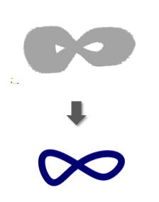
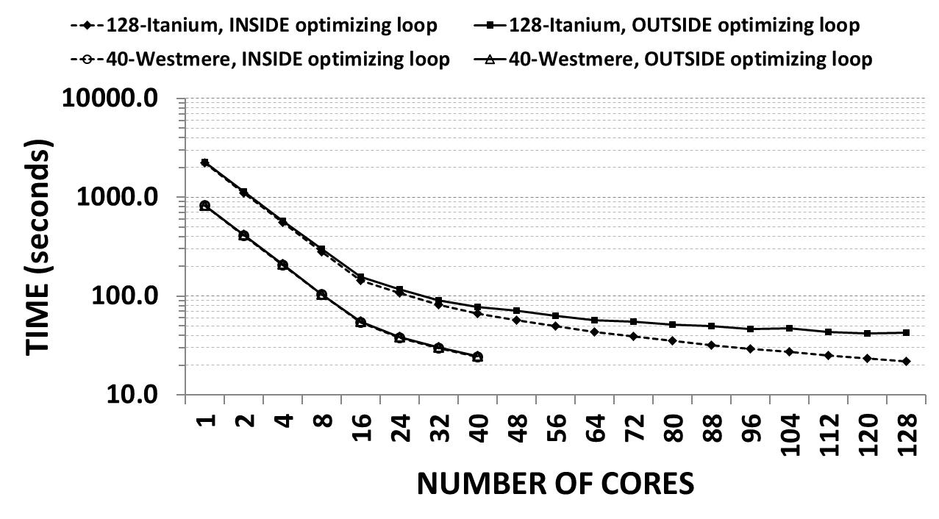
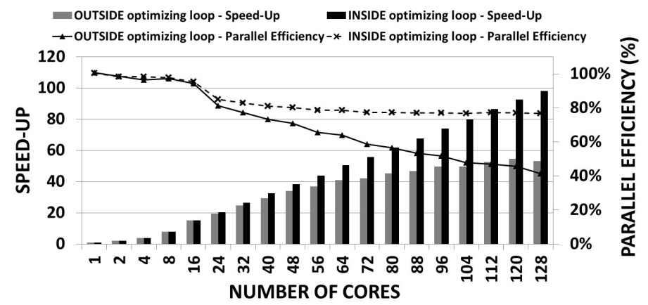
Performance scalability
For this another mesh, the scalability is better but at some number of cores, the speed-up does not increase, i.e., the execution time does not decrease
True speed-up and parallel efficiency of the body of the complete parallel Algorithm
procedure pSUS
…
while Q < λ and k < maxIter do
for each independent set I_{i} ∈ I do
for each vertex v ∈ I_{i} in parallel do
x’_{v} ← OptimizeNode(x_{v},N_{v})
m=520128
speed-up
TIME
Notes:
When the execution times of the complete sequential and parallel algorithms are profiled, we obtained results for speed-up and parallel efficiency as depicted in this Figure.
Note that in this case, the speed-up does not increase so linearly as when the main mesh optimization procedures of algorithms are profiled, and maximum parallel efficiency is lower than 20%.

Slide 34
Best runtime
This table shows the best results for all meshes
The maximum parallel efficiency is 45%, which was obtained when the biggest mesh was optimized
The number of cores with best speed-up and parallel efficiency depends on the benchmark mesh
In some cases, the highest performance results are obtained when the number of cores is lower than maximum (128)
Name of tetrahedral mesh | Serial runtime (seconds) | Best parallel runtime (seconds) | Best number of cores | Best Speed-Up | Best parallel efficiency | Best coloring algorithm | Number of colors | Number of iterations (U&S) | Minimum mesh quality | Average mesh quality
m=6358 | 17.33 | 1.49 | 72 | 11.7X | 16.2% | C₁ | 29 | 25 | 0.1319 | 0.6564
m=9176 | 37.25 | 1.17 | 88 | 31.9X | 36.3% | C₃ | 29 | 26 | 0.2580 | 0.6823
m=11525 | 33.69 | 1.13 | 120 | 29.7X | 24.8% | C₃ | 10 | 38 | 0.1109 | 0.6474
m=39617 | 87.40 | 1.59 | 128 | 54.9X | 42.9% | C₁ | 31 | 11 | 0.1698 | 0.7329
m=201530 | 2505.37 | 81.28 | 128 | 30.8X | 24.1% | C₂ | 21 | 143 | 0.2275 | 0.6687
m=520128 | 2259.72 | 41.86 | 120 | 54.0X | 45.0% | C₃ | 34 | 36 | 0.2233 | 0.6750
We investigated the causes of this performance degradation
Notes:
This table shows the best results for all meshes
The maximum parallel efficiency is 45%, which was obtained when the biggest mesh was optimized.
The number of cores with best speed-up and parallel efficiency depends on the benchmark mesh.
In some cases, the highest performance results are obtained when the number of cores is lower than maximum (128).
We investigated the causes of this performance degradation.
It is mainly due to loop-scheduling overhead of the OpenMP programming methodology

Slide 35
Main cause of performance degradation
… was found to be the loop-scheduling overhead of the OpenMP programming methodology when the main loop of our algorithm is parallelized
OpenMP program
…
#pragma parallel for
for each vertex v ∈ I_{i}
x’_{v} ← OptimizeNode(x_{v},N_{v})
…
procedure pSUS
…
while Q < λ and k < maxIter do
for each independent set I_{i} ∈ I do
for each vertex v ∈ I_{i} in parallel do
x’_{v} ← OptimizeNode(x_{v},N_{v})
Notes:
… was found to be the loop-scheduling overhead of the OpenMP programming methodology when the main loop of our algorithm is parallelized

Slide 36
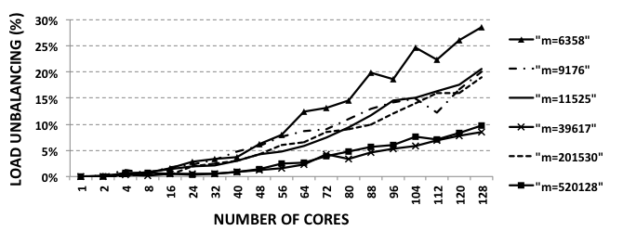
Other bottleneck: load balancing
This figure shows the load unbalancing (L_{Nc}) of our parallel algorithm for the six benchmark meshes when up to 128 processors are used
The main impact on load unbalancing is caused by the number of active threads
The higher the number of active parallel threads, the higher the load unbalancing
t_{max} > t_{avg} > t_{min} > 0
Notes:
This figure shows the load unbalancing (L_{Nc}) of our parallel algorithm for the six benchmark meshes when up to 128 processors are used.
The main impact on load unbalancing is caused by the number of active threads.
The higher the number of active parallel threads, the higher the load unbalancing.
ORIGINAL:
Load unbalancing when meshes with different number of vertices (m) and up to 128 Itanium2 cores are used. C₃ coloring algorithm and dynamic OpenMP thread scheduling are used
This figure shows the load unbalancing (L_{Nc}) of our parallel algorithm for the six benchmark meshes when up to 128 processors are used.
In all cases, dynamic OpenMP thread scheduling and graph coloring algorithm C₃ are used.
Load imbalance of N_{c} processing cores is obtained with the following formula: L_{Nc}=100%×(t_{max}-t_{min})/t_{avg}, where t_{max}, t_{min}, t_{avg} are respectively the maximum, minimum and average wall-clock execution times of the parallel threads without loop-scheduling overhead.
Note that for each one of the benchmark meshes, the main impact on load unbalancing is caused by the number of active threads. The higher the number of active threads, the higher the load unbalancing. This means that as the loop-scheduling overhead instructions increase, the main computation of threads is more unbalanced.

Slide 37
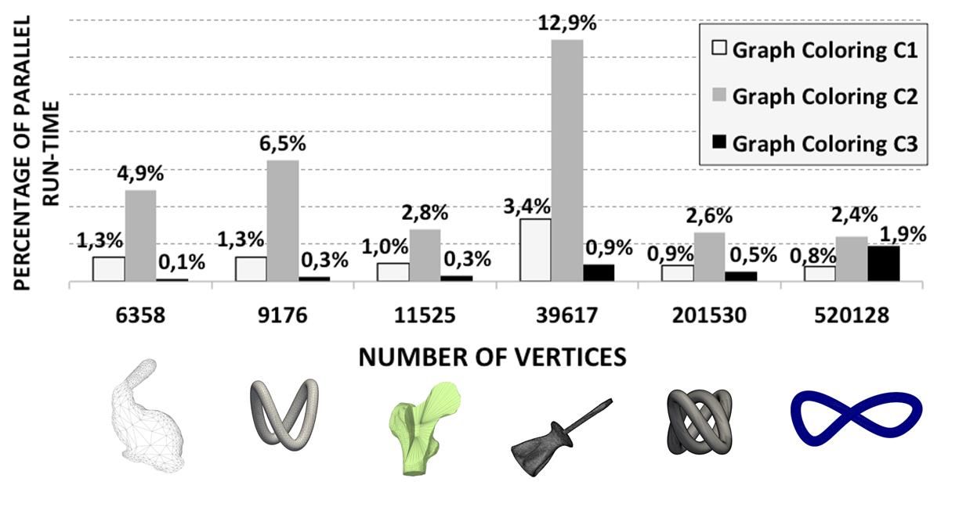
Influence of coloring algorithms on parallel performance
Percentage of total parallel runtime that is required by the three graph coloring algorithms C₁, C₂, and C₃ when the six benchmark meshes are untangled and smoothed and 128 Itanium2 processors are used
This means that selecting a low-overhead coloring algorithm, the computational load required by our parallel algorithm is much heavier than required by the graph coloring algorithm.
It depends on the coloring algorithm
… and ranges from 0.1% to 1.9% when C3 is used
Notes:
When up to 128 Itanium 2 processors and the six benchmark meshes are used, the percentage of total runtime that is required by C₁, C₂, and C₃ coloring routines ranges respectively from 0.8% to 3.4%, from 2.4% to 12.9%, and from 0.1% to 1.9%.
This means that the computational load required by our parallel algorithm is much heavier than required by graph coloring algorithms.

Slide 38
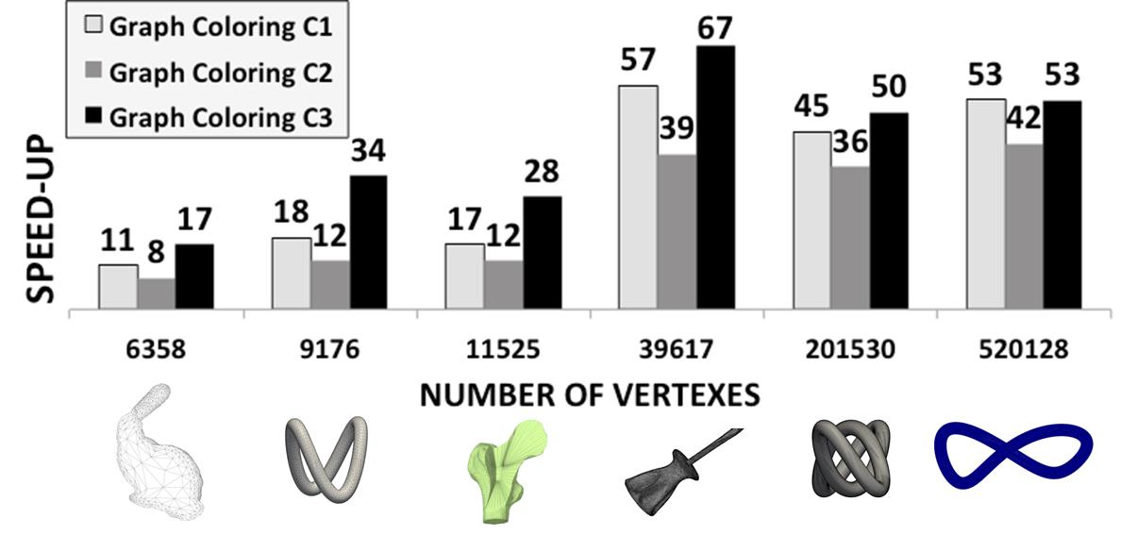
Influence of coloring algorithms on parallel performance
In conclusion, the speed-up achieved by the complete parallel algorithm (pSUS) depends on the mesh coloring algorithm
Speed-up achieved by the complete parallel algorithm (pSUS) for all six benchmark meshes when three graph coloring algorithms (C₁, C₂, and C₃) are used and all 128 shared-memory Itanium2 processors are active
C₃ coloring algorithm provides the best performance results
Notes:
This Figure shows the parallel performance for all six benchmark meshes when all 128 Itanium 2 processors are working in parallel.
In conclusion, the speed-up achieved by the complete parallel algorithm (pSUS) depends on the mesh coloring algorithm
Again, It can be observed that our parallel algorithm achieves the best performance when C₃ coloring algorithm is used.

Slide 39
Conclusions
We demonstrate that this algorithm is highly scalable when run on a high-performance shared-memory many-core computer with up to 128 Itanium 2 processors
It is due to the graph coloring algorithm that is used to identify independent sets of vertices without computational dependency

Slide 40
Conclusions
We have analyzed the causes of its parallel deterioration on a 128-core shared-memory high performance computer using six benchmark meshes.
It is mainly due to loop-scheduling overhead of the OpenMP programming methodology.
The graph coloring algorithm has low impact on the total execution time. However, the total execution time of our parallel algorithm depends on the selected coloring algorithm.

Slide 41
Future work
Our parallel algorithm is CPU bound and its demonstrated scalability potential for many-core architectures encourages us to extend our work to achieve higher performance improvements from massively parallel GPUs.
The main problem will be to reduce the negative impact of global memory random accesses when the non-consecutive mesh vertices are optimized by the same streaming multiprocessor.

Slide 42
Borrador

Slide 43
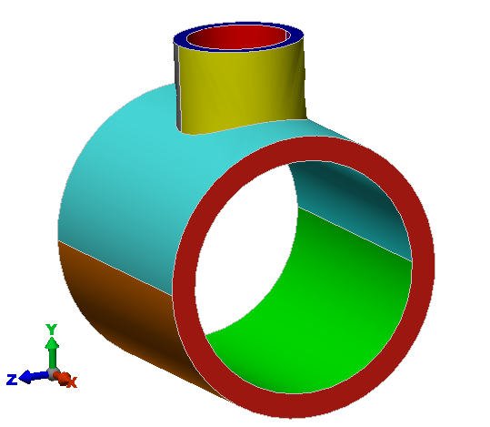
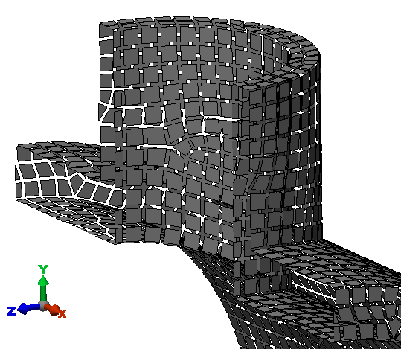
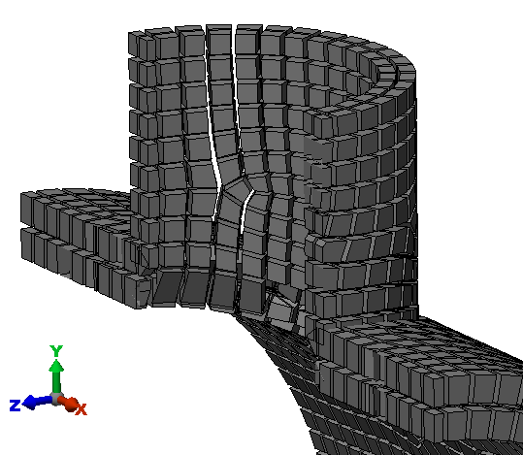
Motivation: Meccano method
Frequent tasks in mesh generation methods
  CAD model
  Surface mesh
  3D mesh
Our Meccano method for 3D mesh generation is divided into 3 tasks:
  Boundary mapping (it transforms the surface triangulation onto the faces of a cube)
  Generation of an adapted tetrahedral mesh using Kossaczky’s algorithm
  Simultaneous untangling and smoothing of the tetrahedral mesh
CAD model
Surface mesh
3D mesh
¿FIGURAS?
Notes:
The main motivation of our paper is the following: <read the slide>
References:
Escobar et al 2003

Slide 44
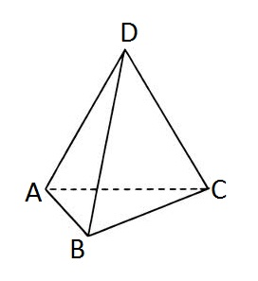
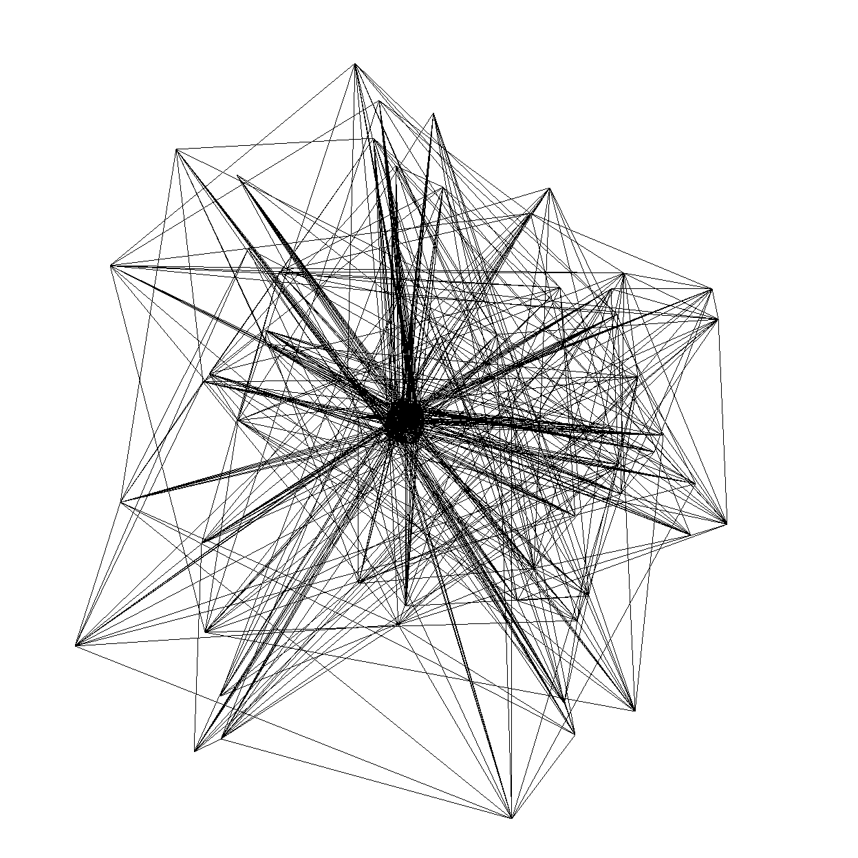
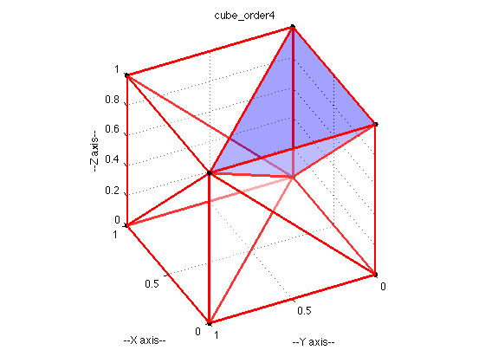
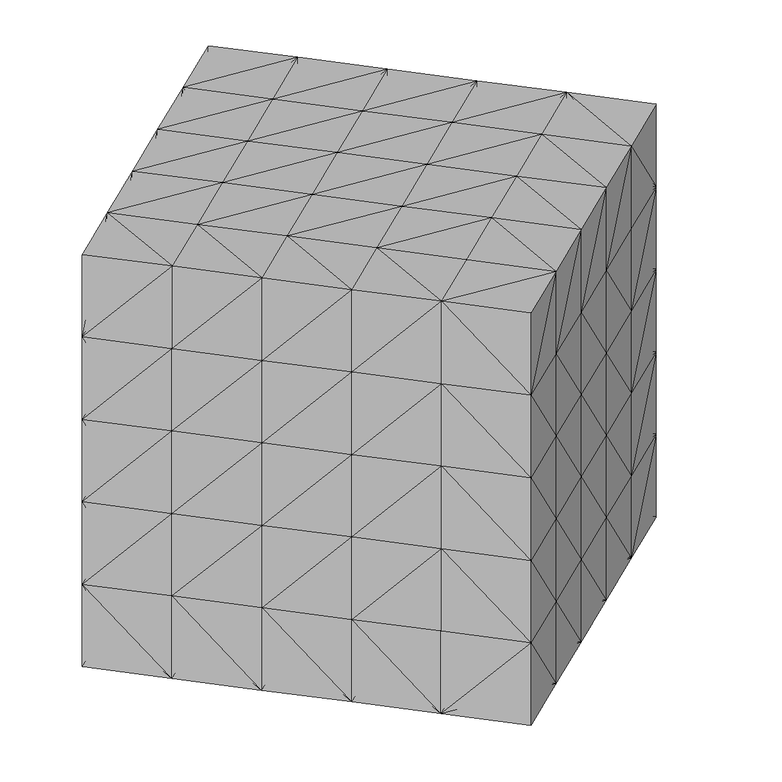
Our mathematical approach to tetrahedral mesh optimization
Equilateral tetrahedron
Tetrahedral mesh with non-valid tetrahedra (artificially tangled for our experimental tests)
Example of a valid tetrahedral mesh for a cube
Valid Tetrahedron
Optimized tetrahedral mesh without non-valid tetrahedra
A mesh vertex (node)
Notes:
Now I present you the fundamentals of our mathematical approach to tetrahedral mesh optimization.
First of all I show a Regular or equilateral tetrahedron with four equivalent equilateral triangular faces and its four vertices (A,B,C,D).
<read the slide>

Slide 45
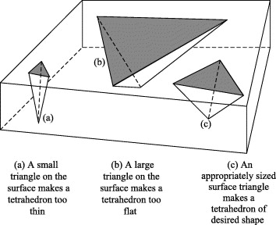
Our mathematical approach to tetrahedral mesh optimization
Equilateral tetrahedron
Its quality (q) specifies the degree to which regularity is achieved:
q=1: equilateral tetrahedron
q<1: non-equilateral tetrahedron
q < 1
q < 1
q → 1
Notes:
Our mathematical approach uses The quality of the tetrahedron to specify the degree to which regularity is achieved.
When q is 1, the tetrahedron is equilateral
When q is lower than 1, the tetrahedron is non-equilateral
<read the slide>

Slide 46
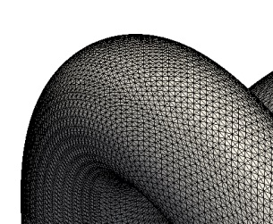
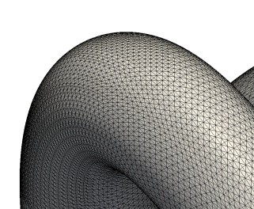
Our mathematical approach to tetrahedral mesh optimization
TANGLED MESHES
Bunny Tube Bone Screwdriver Toroid HR toroid
UNTANGLED MESHES
Notes:
In this slide, we can see SIX examples of TANGLED meshes and the respective untangled meshes

Slide 47
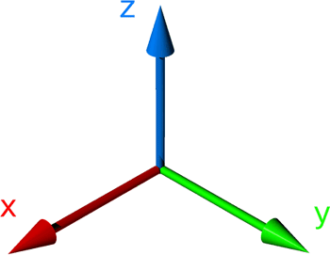
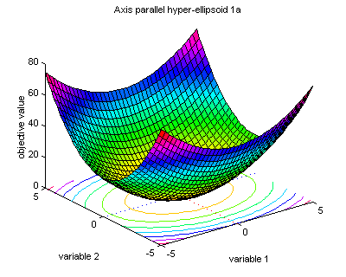
Our mathematical approach to tetrahedral mesh optimization
M : a tetrahedral mesh
v : inner mesh node
x_{v} : node position
N_{v} : the local submesh (set of tetrahedra connected to the node v)
K(x_{v}) : objetive function that measures the quality of the local submesh
Notes:
Now I present you the fundamentals of our mathematical approach to tetrahedral mesh optimization
<read the slide>

Slide 48

Modified objective function
Triangle distortion
Original function:
Modified function:
Modified function is regular in all R²:
It allows a simultaneous untangling and smoothing of triangular and tetrahedral meshes
Notes:
The usual objective functions don’t works properly when the mesh is tangled due to the singularities when the volume of the element is cero.
We introduced a modification in this function in order to be able to optimize tangled meshes.
Basically, this modification consists on substituting the denominator by a positive and increasing function like this.

Slide 49
Our mathematical approach to tetrahedral mesh optimization
Our untangling and smoothing technique finds the new position x_{v} that each inner mesh node v must hold, in such a way that K(x_{v}) is optimized
This process repeats several times for all the nodes of the mesh M
Mathematical details: J. M. Escobar , E. Rodrıguez , R. Montenegro , G. Montero , J. M. Gonzalez-Yuste (2003) Simultaneous untangling and smoothing of tetrahedral meshes. Computer Methods in Applied Mechanics and Engineering, 192: 2775-2787
Notes:
<read the slide>

Slide 50
The novel parallel algorithm
Sequential algorithm (SUS) for the simultaneous untangling and smoothing of a tetrahedral mesh M
function OptimizeNode(x_{v}, N_{v})
Optimize objective function K(x_{v})
end function
procedure SUS
Q ← 0
k ← 0
while Q < λ and k < maxIter do
for each vertex v ∈ M do
x’_{v} ← OptimizeNode(x_{v},N_{v})
end do
Q ← quality(M)
k ← k+1
end do
end procedure
Our untangling and smoothing technique finds the new position x_{v} that each inner mesh node v must hold, in such a way that K(x_{v}) is optimized
This process repeats several times for all the nodes of the mesh M
Notes:
Algorithm 1 shows our sequential optimization method for simultaneous untangling and smoothing of 3D tetrahedral meshes (SUS). The algorithm has the following inputs: M is a tangled tetrahedral mesh, maxIter is the maximum number of untangling and smoothing iterations, N_{v} is the set of tetrahedra connected to the free node v, 𝒙_𝑣 is the initial position of the free node, 𝒙 ̂_𝑣 is its position after optimization, which is implemented with procedure OptimizeNode(), Q measures the lowest quality of a tetrahedron of M when the above mentioned q tetrahedron quality function is used, and quality() is a function that provides the minimum quality of mesh M (it is 0 if any tetrahedral is tangled). The output of the algorithm is an untangled and smoothed mesh M, whose minimum quality must be larger than an user-specified threshold λ. This algorithm iterates over all the mesh vertices in some order, at each step adjusting the spatial coordinates 𝒙 ̂_𝑣 𝒐f a free node v

Slide 51
Performance scalability
Performance model for our parallel algorithm based on Amdahl’s law
Speed-up
Sequential time
Parallel time without overhead
Parallel time with overhead
CPU time
Notes:
We have analytically modeled this performance overhead (O_{p}) of our parallel algorithm using Amdahl’s law and considering these overhead instructions to be the unique cause of performance degradation.
<read the slide>
We also use the model for CPU time that is based on the number of retired instructions, the instructions executed per cycle and the clock speed.

Slide 52
Performance scalability
Performance model for our parallel algorithm based on Amdahl’s law
Conclusion:
parallel efficiency deteriorate as the number of threads increases because they tend to be dominated by the thread scheduling overhead
Notes:
Some results of this parallel performance analytical model are shown in this Figure . The real speed-ups (graphic marks) are overlapped with the predictions of our performance model (lines) when three benchmark meshes with different numbers of vertices are optimized.
we can conclude that for our parallel Algorithm 2, true speed-up and parallel efficiency deteriorate as the number of threads increases because they tend to be dominated by the thread scheduling overhead, which is caused by the compiler when the OpenMP directive that implements line 26 is compiled.

Slide 53
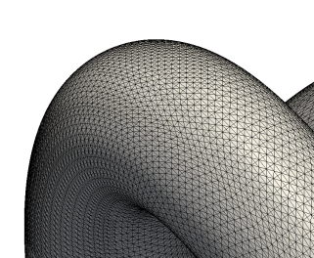
Experimental methodology
Six different tangled benchmark meshes
“m=6358” “m=9176” “m=11525” “m=39617” “m=201530” “m=520128”
Bunny Tube Bone Screwdriver Toroid HR toroid
Notes:
The sequential (SUS) and parallel (pSUS) algorithms of our mesh optimization method were applied on six different tangled benchmark meshes. In this slide, we can see for each benchmark mesh the respective tangled mesh that is optimized by our algorithm, and the untangled and smoothed mesh that is provided by our algorithm.

Slide 54
Parallelism bottlenecks
  During runtime of the main mesh optimization procedure, stall cycles of each parallel thread are in the range from 29%(1 core) to 58%(128 cores)
These computation bottlenecks are located in:
  double-precision floating-point units: from 70%(1c) to 27%(128c) of stall cycles
  data loads: from 16%(1c) to 55%(128c)
    cache memories: main source of data load stall cycles
    NUMA (Non-Uniform Memory Access) memory: less than 1% of data load stall cycles
  branch instructions: from 5%(1c) to 14%(128c)
  “no-operation” instructions (40%): caused by the long instruction format and compiler inefficiency
Notes:
We have also analyzed the performance inefficiencies caused by bottlenecks in processor functional units, cache memories, and NUMA shared memory during runtime when the main mesh optimization procedure is executed.
<read the slide>
On average, 40% of executed instructions are “no-operation” instructions.
<read the slide>
Thus, our algorithm is compute bound and memory binding techniques have low impact on our parallel algorithm.

Slide 55
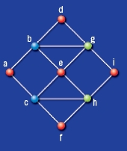
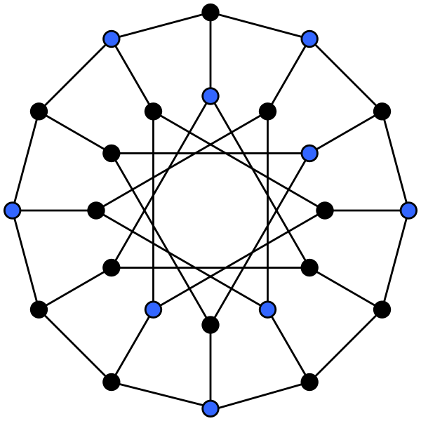
Influence of coloring algorithms on parallel performance
Distance-1 coloring : adjacent nodes do not have the same color
An independent set of a graph is a set of not adjacent vertices
Notes:
As described previously, three different graph coloring algorithms (C₁, C₂, C₃) were used by our parallel algorithm.
Graph coloring is used to identify independent sets of vertices without computational dependency.

Slide 56
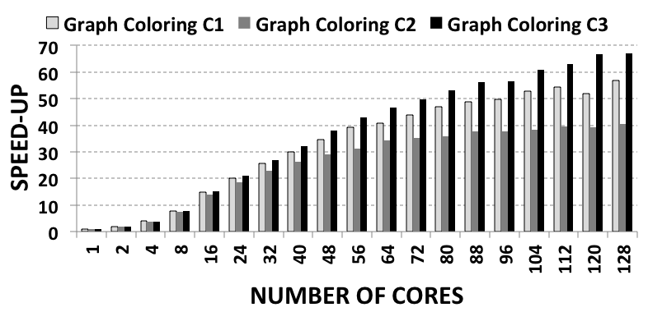
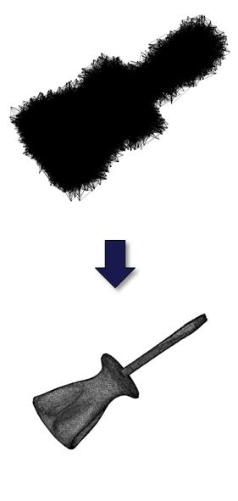
Influence of coloring algorithms on parallel performance
Speed-up achieved by the complete parallel algorithm (pSUS) depends on the mesh coloring algorithm
m=39617
Notes:
However, the total execution time of our parallel algorithm depends on the selected coloring algorithm.
This Figure shows the parallel performance for “m=39617” benchmark mesh when 1 to 128 Itanium 2 processors are working in parallel. It can be observed that our parallel algorithm achieves the best performance when C₃ coloring algorithm is used. This is due to the lowest number of different colors in which C₃ coloring algorithm groups the vertices of each graph mesh with respect to C₁ and C₂ coloring algorithms. A lower number of vertex groups allow a larger number of vertices to be processed in parallel.

