Slide 1
Local Scale Finite Element Modelling of Stack Pollutant Emissions
R. Montenegro ⁽¹⁾*, A. Oliver ⁽²⁾, E. Rodríguez ⁽¹⁾,
J.M. Escobar ⁽¹⁾, G. Montero ⁽¹⁾, A. Pérez-Foguet ⁽²⁾
⁽¹⁾ University Institute SIANI, University of Las Palmas de Gran Canaria, Spain
⁽² ⁾ Laboratori de Càlcul Numèric (LaCàN), Departament de Matemàtica Aplicada III
Universitat Politècnica de Catalunya – Barcelonatech, Spain
COUPLED PROBLEMS 2013, 17–19 Junio 2013, Ibiza, Spain
MINECO y FEDER Project: CGL2011-29396-C03-00
CONACYT-SENER Project, Fondo Sectorial, contract: 163723
http://www.dca.iusiani.ulpgc.es/proyecto2012-2014

Slide 2
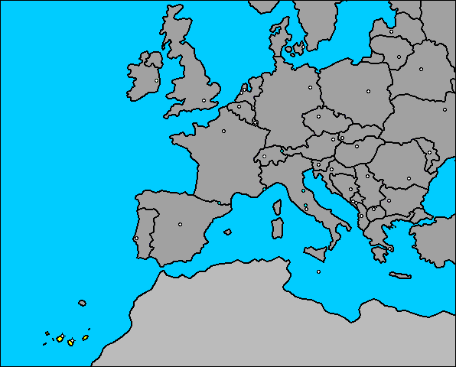
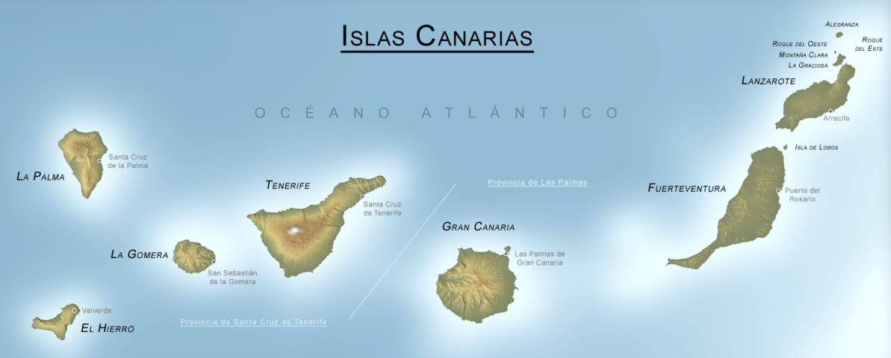
Motivation
Air Quality modeling over complex terrains
Range ~ 20km x 20km
La Palma island (Canary Islands)

Slide 3
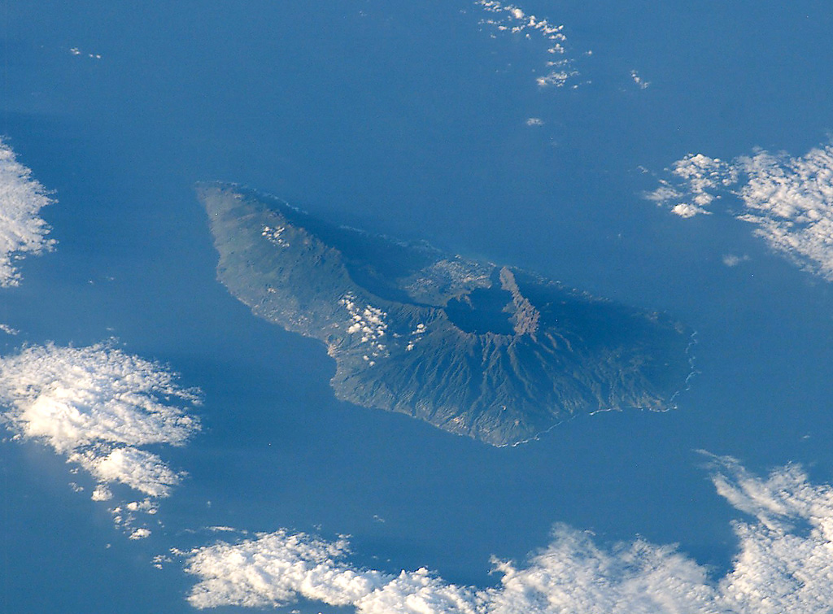
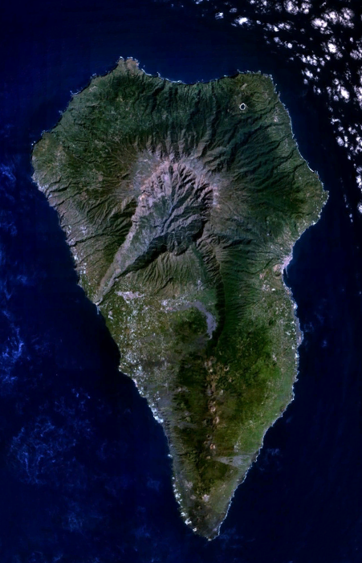
Motivation
One of the highest horizontal-vertical ratios in the world
Maximum height: 2426 m
50km
25km

Slide 4
Motivation
One of the highest horizontal-vertical ratios in the world
Maximum height: 2426 m
50km
25km

Slide 5
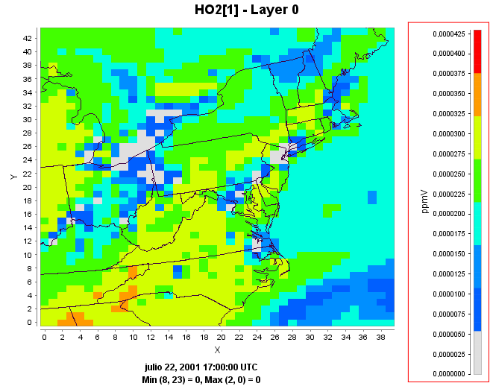
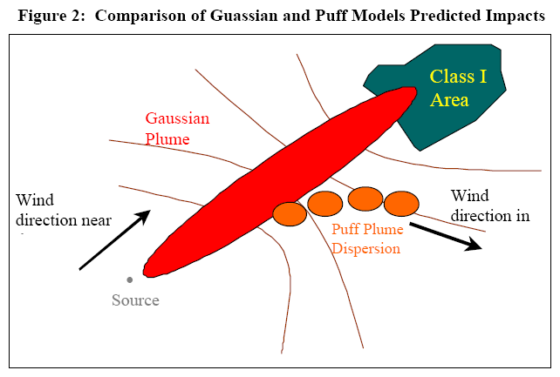
Motivation
Regional models
Eulerian
CMAQ
Mocage
Local models
Gaussian plume
Lagrangian
Calpuff
Scipuff

Slide 6
Algorithm
Wind and Air Pollution FE Modeling Algorithm
1: Construct an adaptive tetrahedral mesh of the 3D domain
2: Wind field simulation from experimental/meteorological data
3: Wind field modification including the plume rise effect
3.1: Compute plume rise trajectory
3.2: Mesh refinement along plume rise trajectory
3.3: Apply step 2 on the refined mesh
3.4: Modify the vertical wind field along the plume rise
4: Air pollution simulation from stack emission data

Slide 7
Mesh generation
Two-dimensional adaptive triangular mesh of terrain
Stack discretization
Local refinement process
Vertical distribution of points following layers
Three-dimensional tetrahedral mesh generation
Untangling and smoothing to optimize the mesh quality

Slide 8
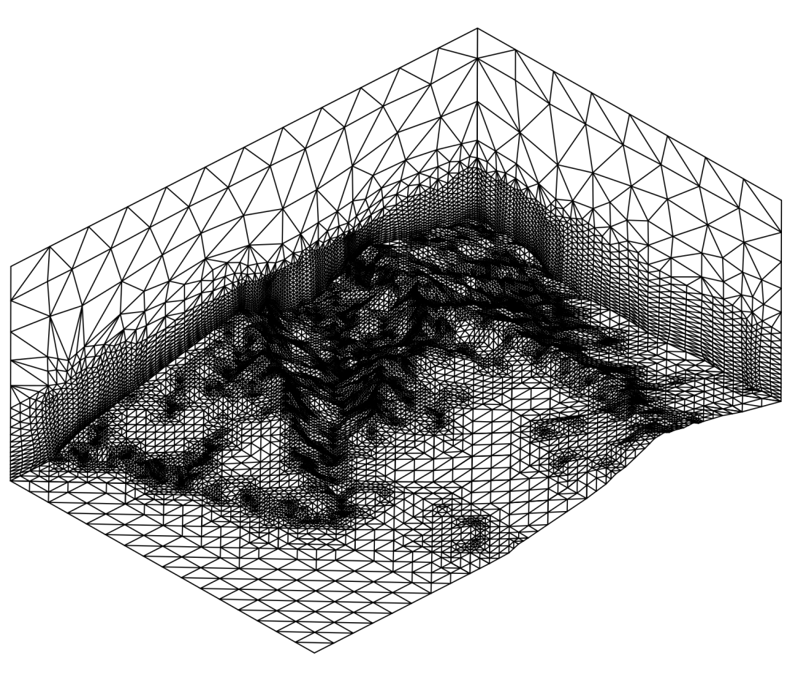
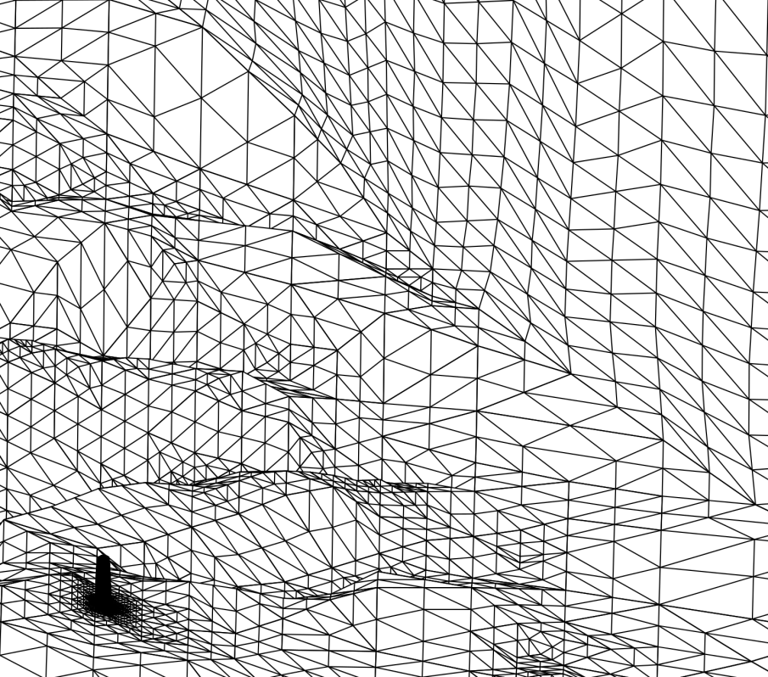
Mesh generation
~ 500.000 nodes
~ 2.700.000 elements

Slide 9
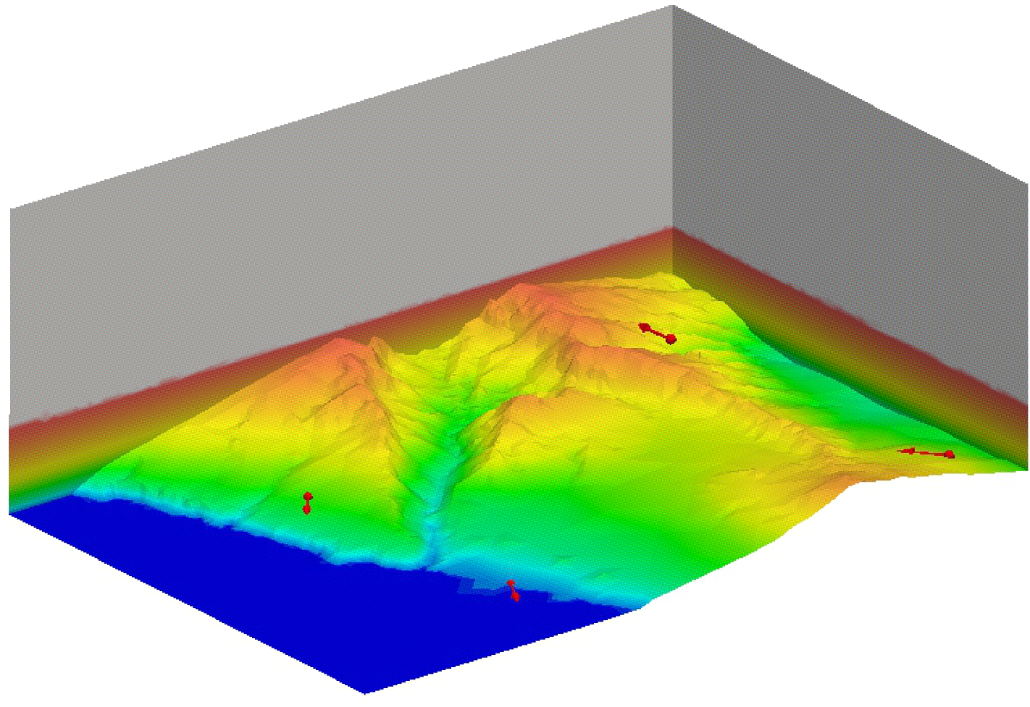
Wind field modeling
Experimental data from 4 stations (10 m over terrain)
S4
Stack
S3
S1
S2

Slide 10
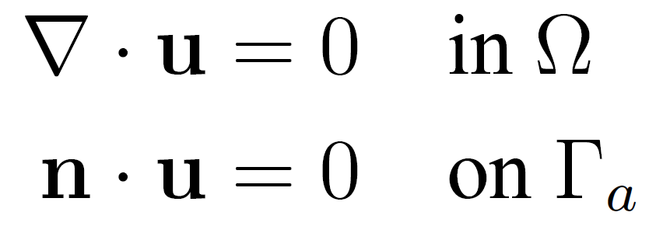
Wind field modeling
An interpolated wind field u₀ in the 3-D domain Ω
Horizontal interpolation (10 m over terrain) of data
Vertical extrapolation (log-linear wind profile)
The resulting mass-consistent wind field u verifies:
and minimizes the adjusting functional

Slide 11
Wind field modeling
Introducing the Lagrange multiplier φ
Such that it verifies an elliptic problem in Ω

Slide 12
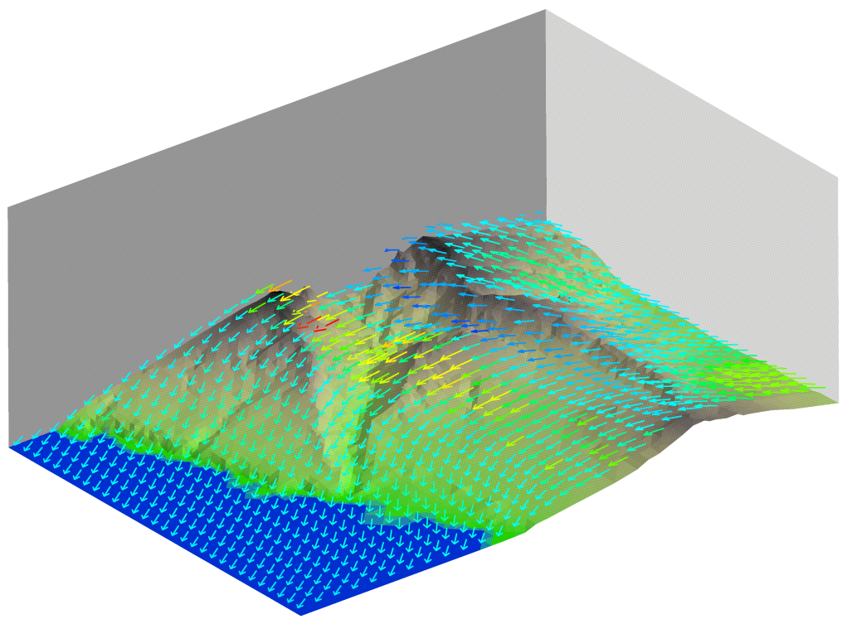
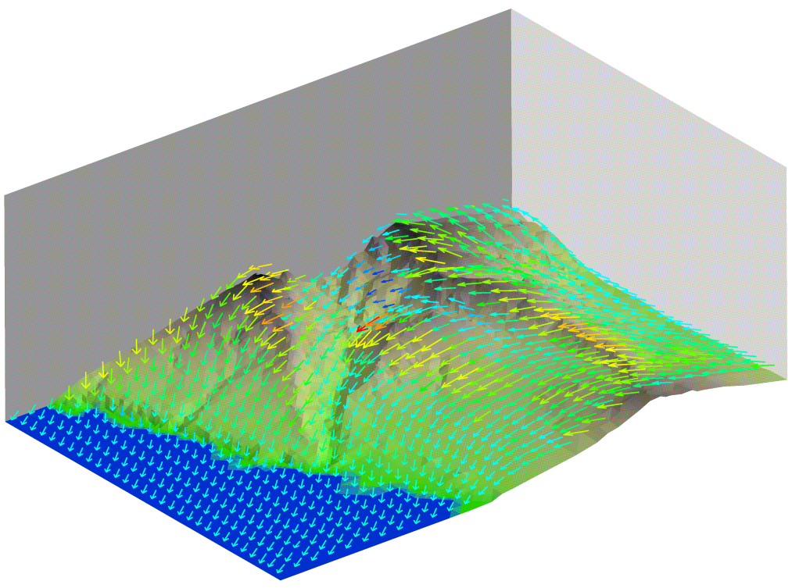
Wind field modeling
Interpolated
Resulting
400 m
m/s
2.7
8.25
4.0
6.0
8.0

Slide 13
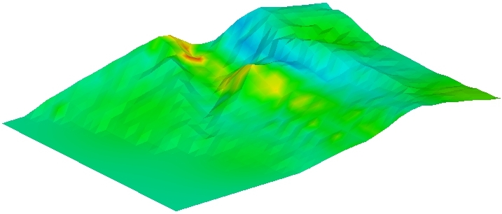
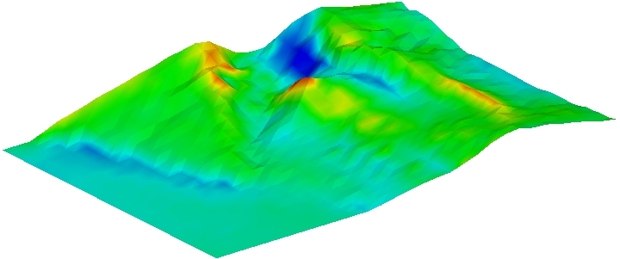
Wind field modeling
Interpolated
Resulting
400 m
m/s
2.7
8.25
4.0
6.0
8.0

Slide 14
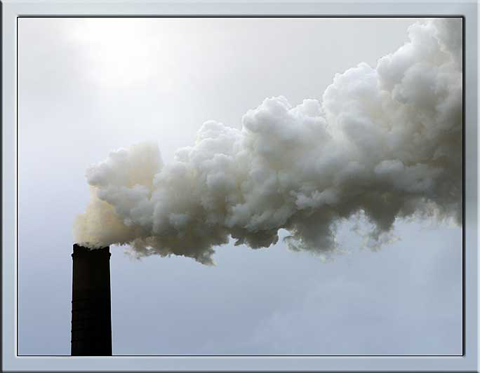
Plume rise modeling

Slide 15
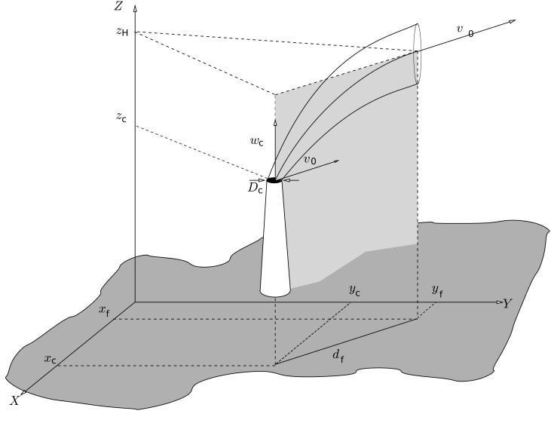
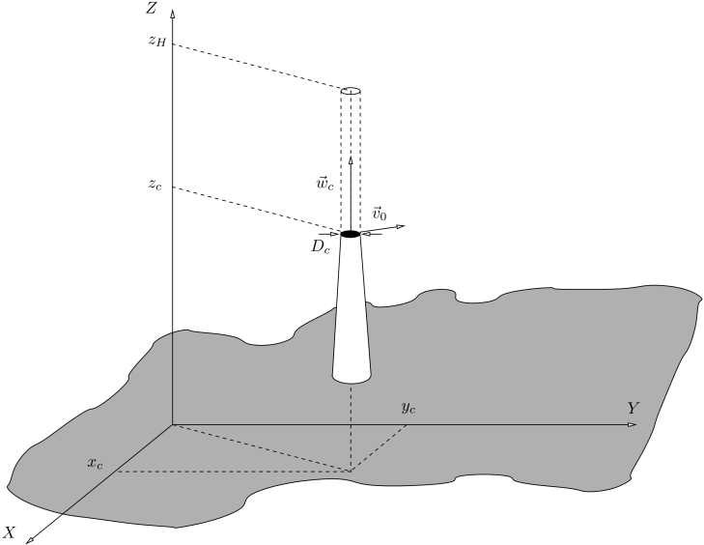
Plume rise modeling Trajectory
Briggs equations contemplate two cases:
Buoyant (w_{c} < 4v_{o})‏
Curved trajectory
Momentum (w_{c} > 4v_{o})‏
Vertical straight trajectory

Slide 16
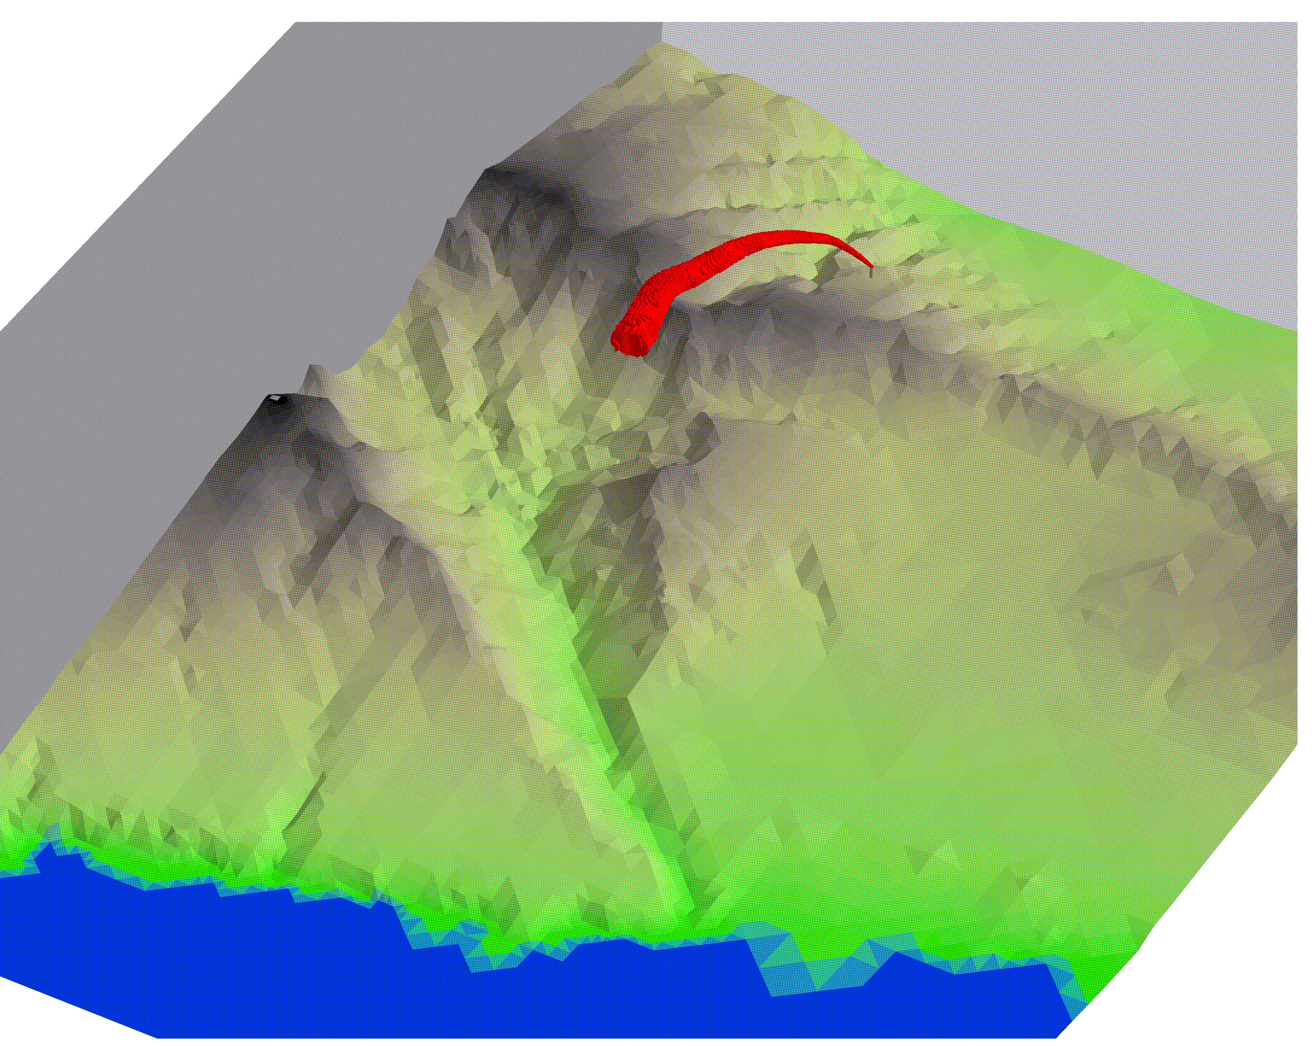
Plume rise modeling Local mesh refinement
Stack

Slide 17
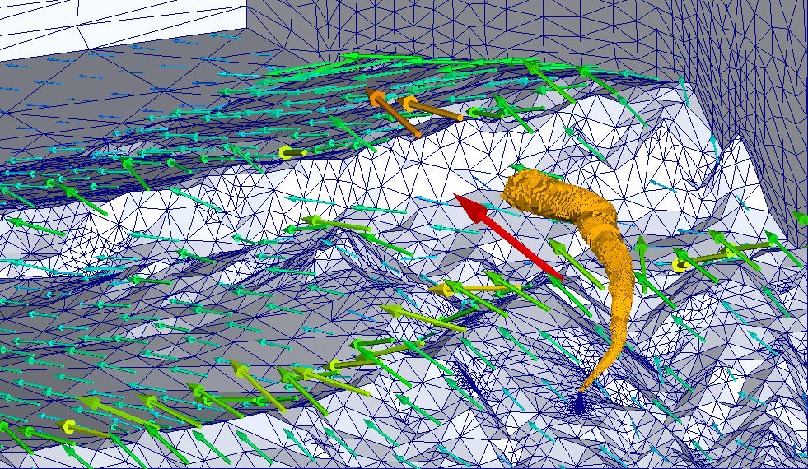
Plume rise modeling Wind and local mesh refinement

Slide 18
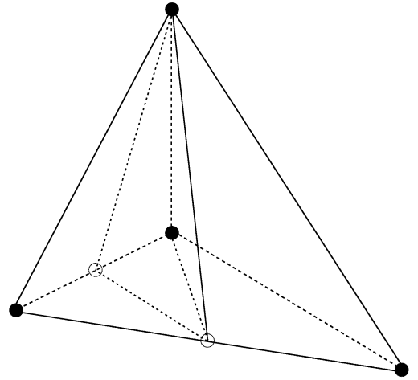
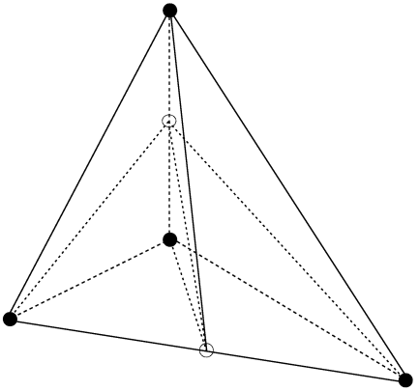
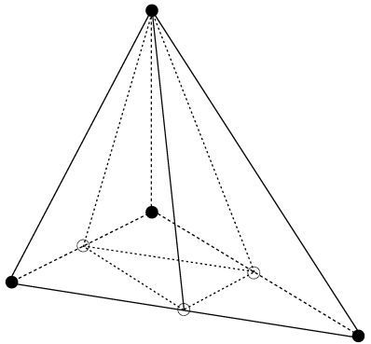
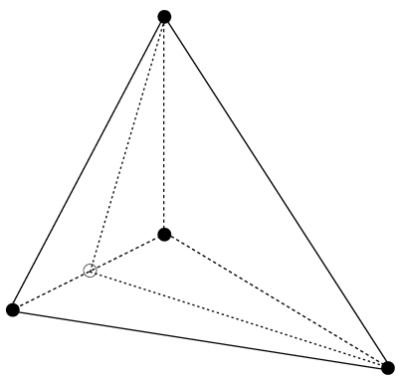
Plume rise modeling Local mesh refinement

Slide 19
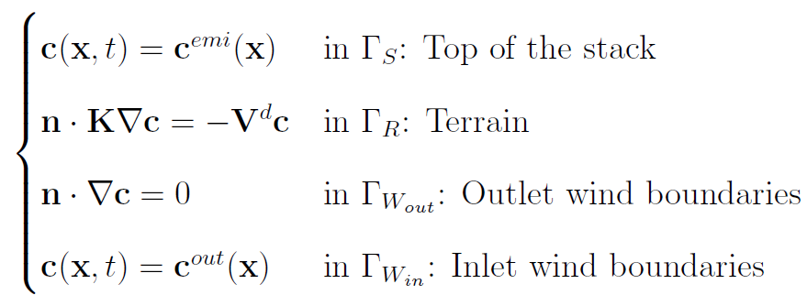
Air quality modeling
Find concentration c(x,t) for

Slide 20
Air quality modeling
Photochemical reactive model: RIVAD/ARM3 for 4 species
Temporal discretization: Cranck-Nicolson
Spatial discretization: Least Squares FEM
Non-linear problem: Strang Splitting
Sparse system solver: Preconditioned conjugate gradient

Slide 21
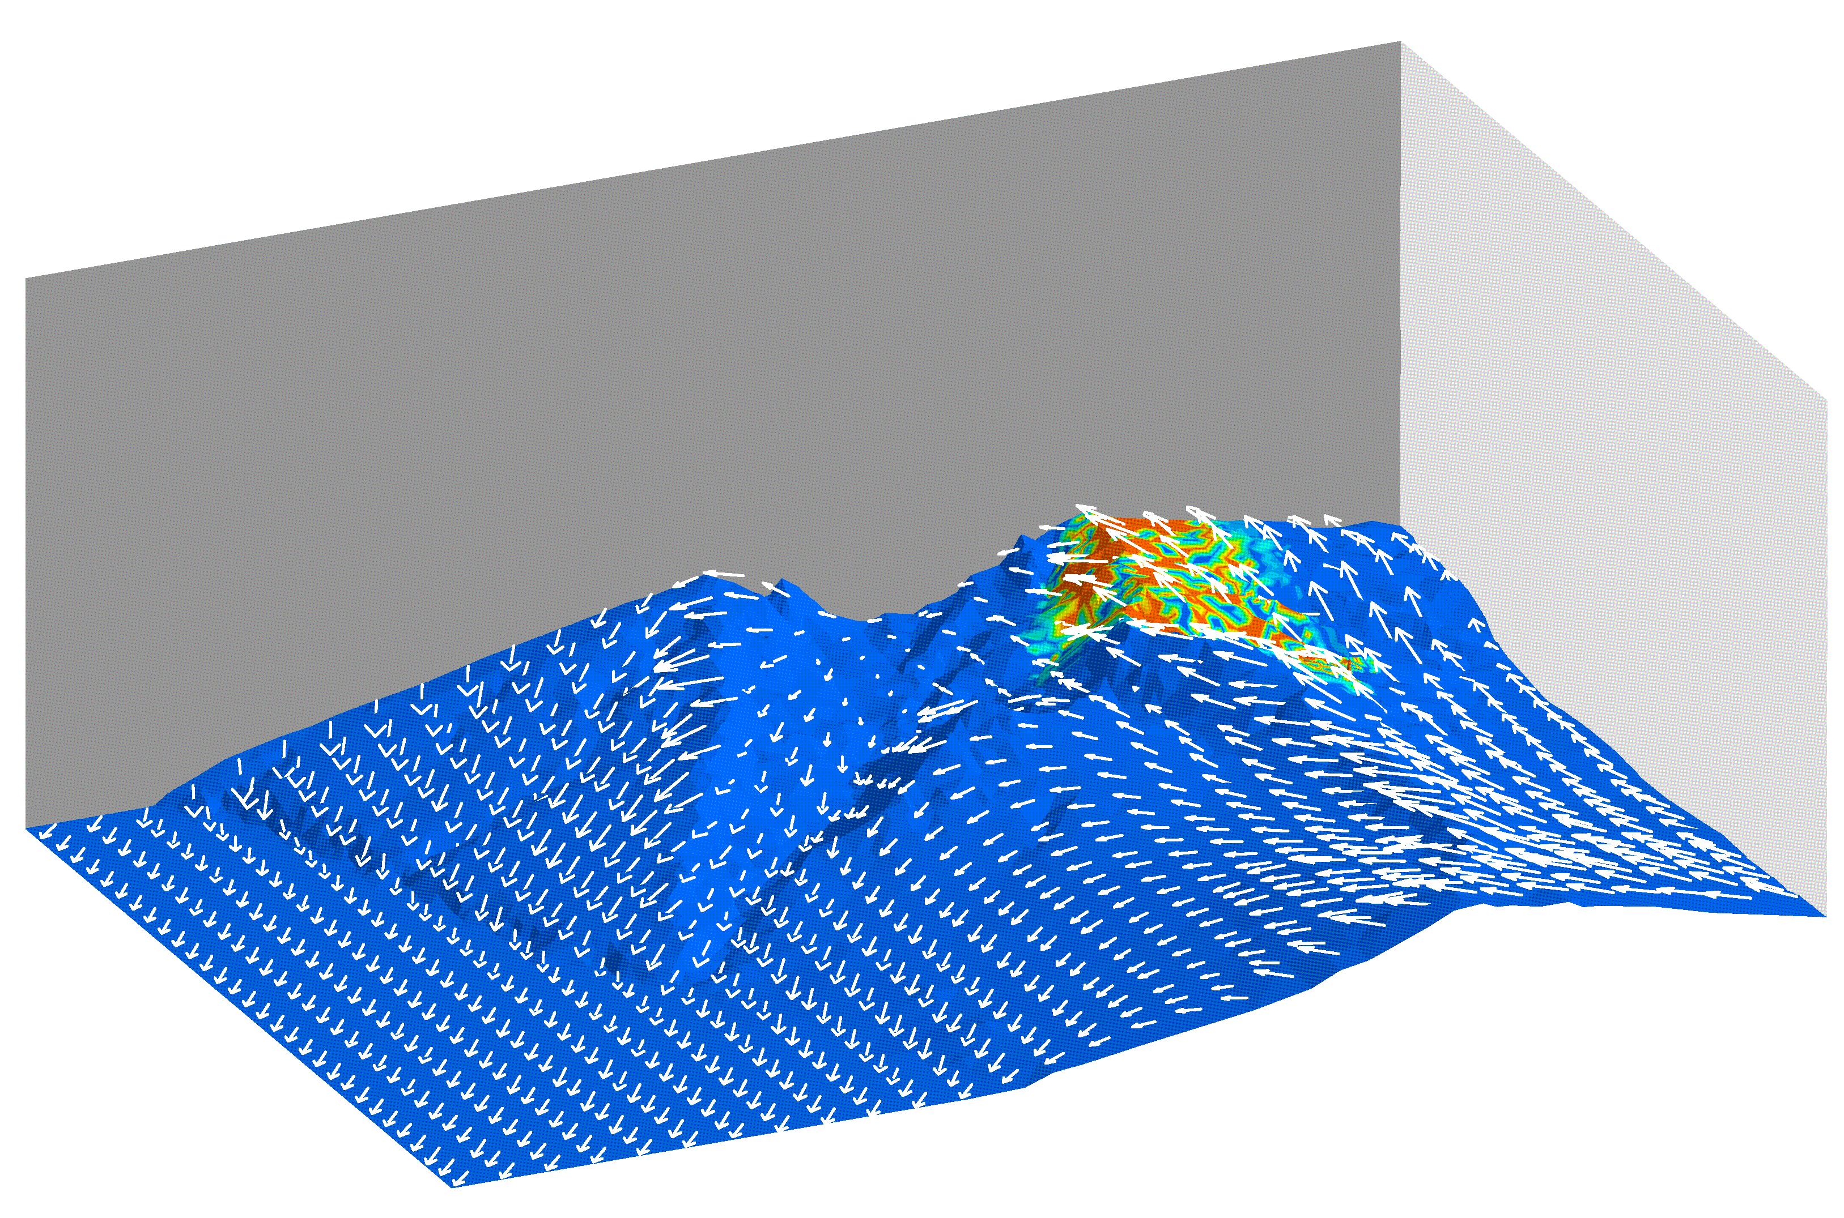
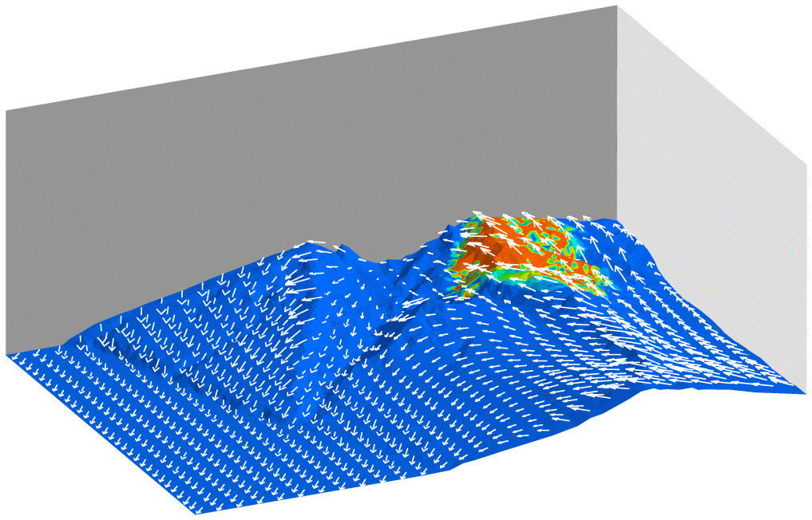
Air quality modeling
Immission concentration distribution after 1000 seconds
Primary (SO₂)
Secondary (SO₄)
g/m³

Slide 22
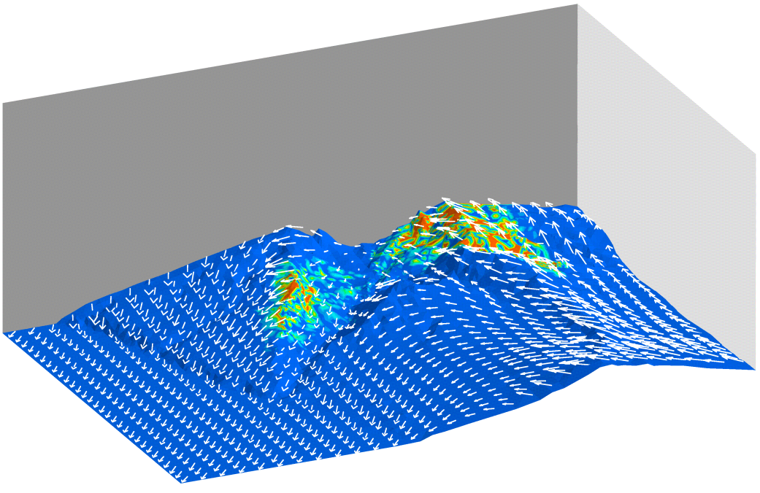
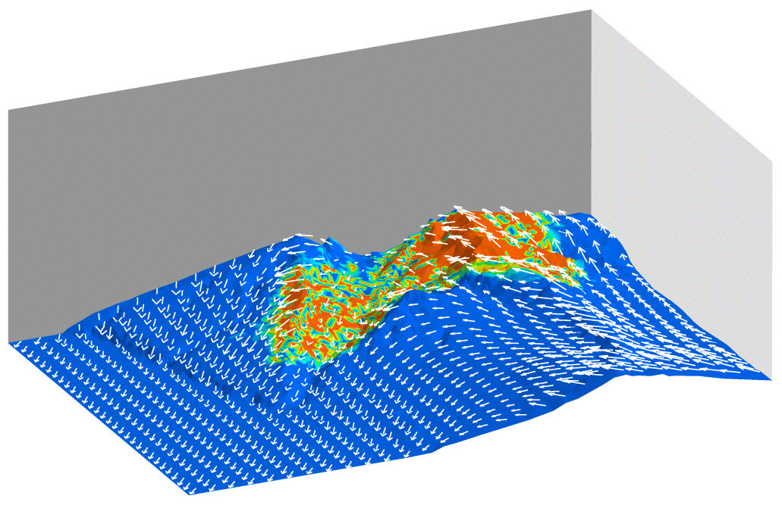
Air quality modeling
Immission concentration distribution after 2000 seconds
Primary (SO₂)
Secondary (SO₄)
g/m³

Slide 23
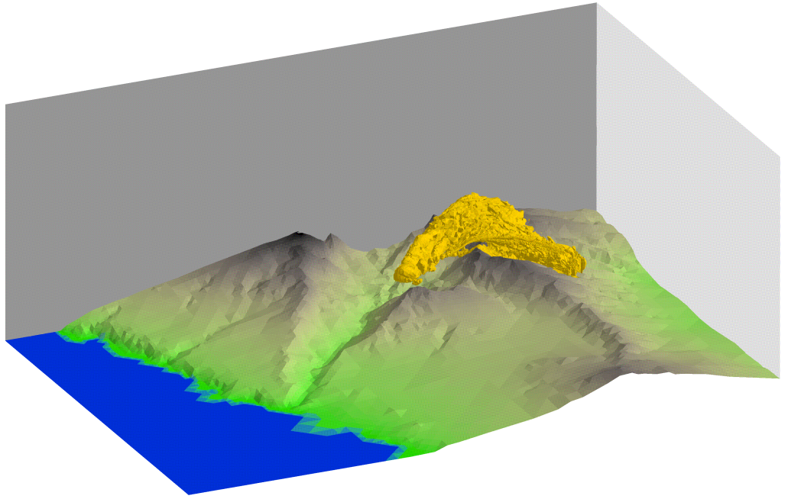
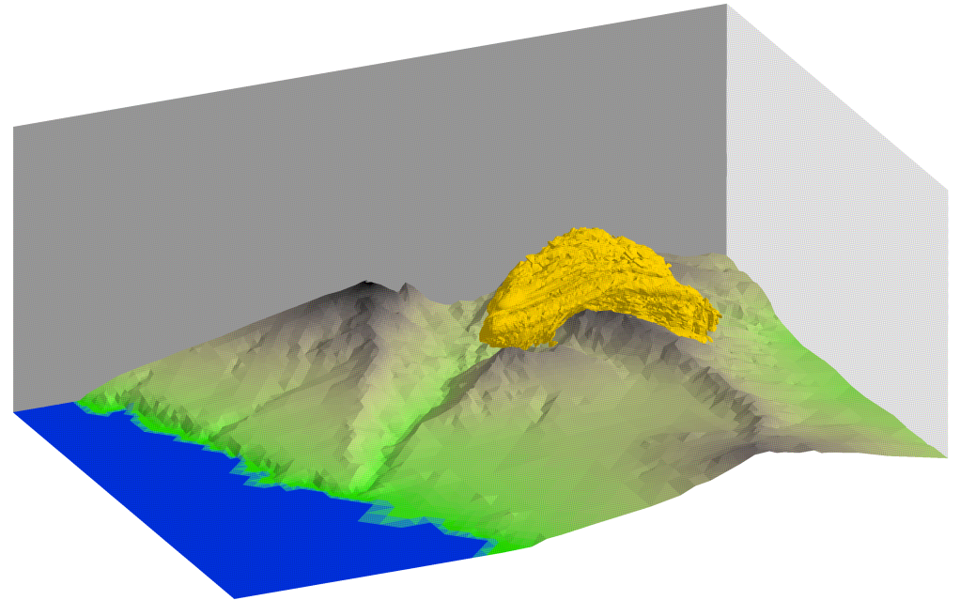
Air quality modeling
Isosurface of 50 μg/m³ after 1000 seconds
Primary (SO₂)
Secondary (SO₄)

Slide 24
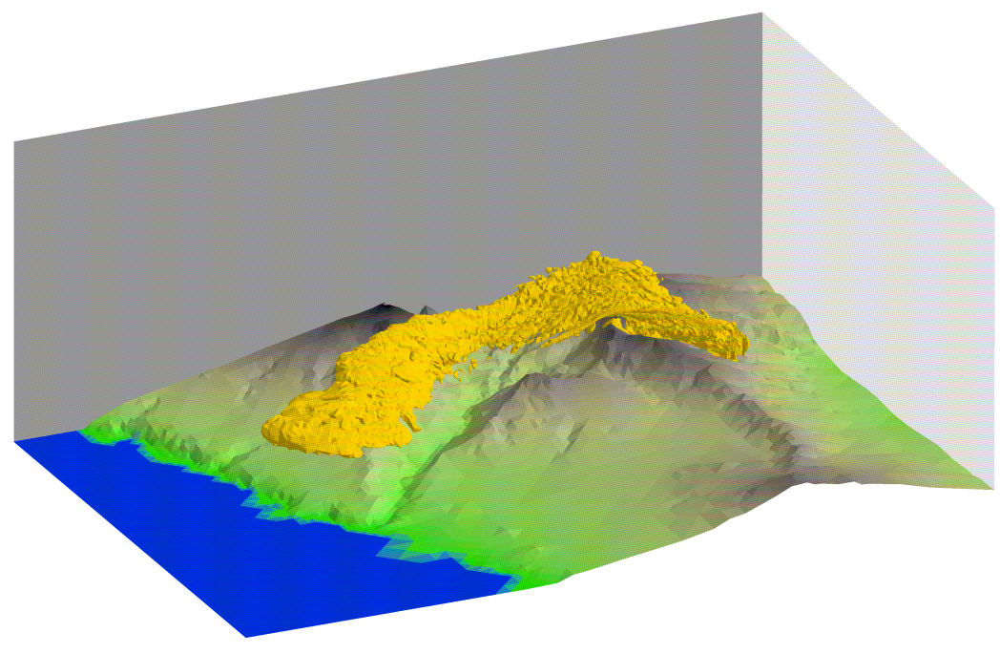
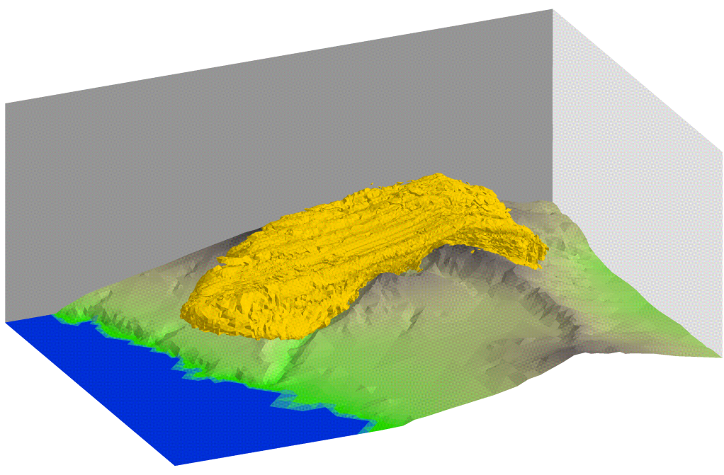
Air quality modeling
Isosurface of 50 μg/m³ after 2000 seconds
Primary (SO₂)
Secondary (SO₄)

Slide 25
Conclusions
Suitable approach for air pollution modeling
over complex terrains
The air quality model is transport dominant
Mass consistent model (compared to simple interpolation) is essential
Splitting and FEM resolution is an efficient technique to solve the problem

Slide 26
Future works
Mesh generation with the meccano method
Interaction between several stacks
Simulation of a greater number of pollutant species
Local mesh refinement/derefinement

Slide 27
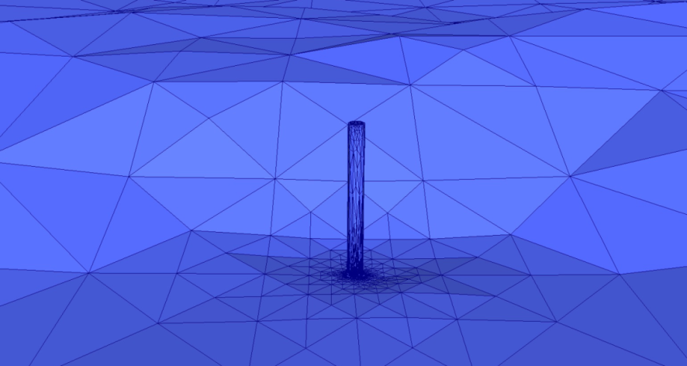
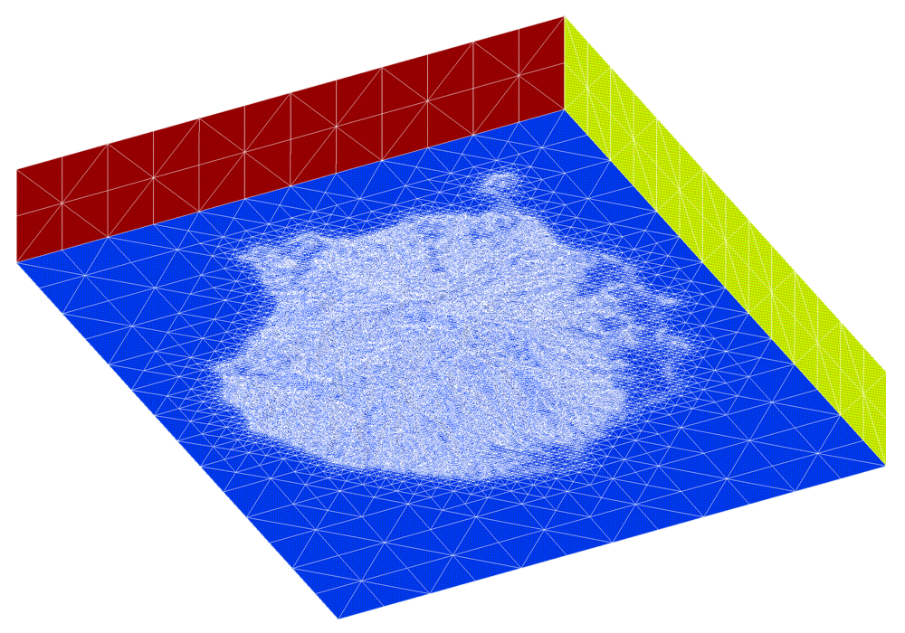
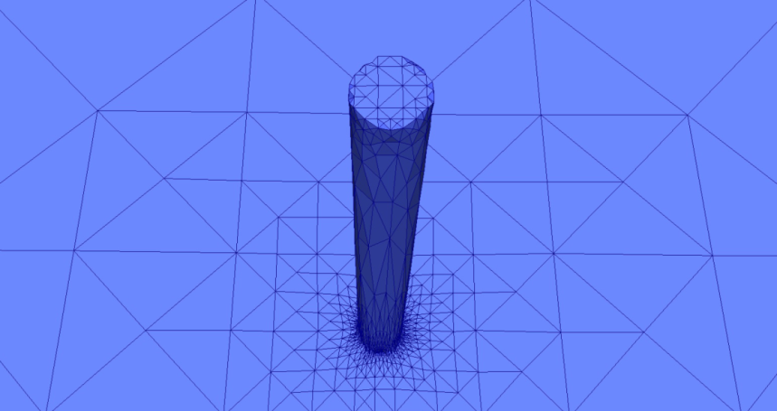
Future works
Gran Canaria Island

Slide 28
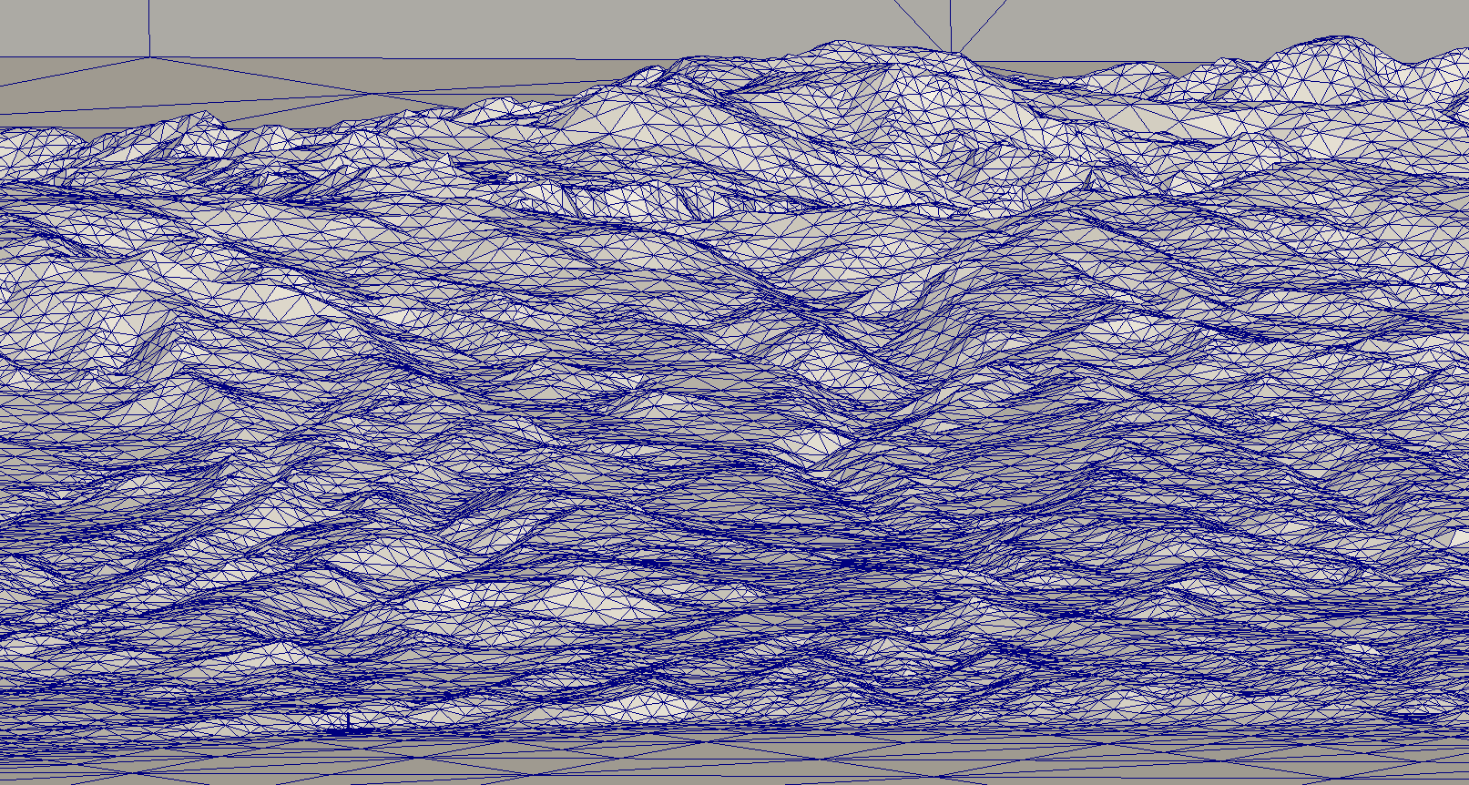
Future works
Stack

