Slide 1
Construction of polynomial spline spaces over
quadtree and octree T-meshes
M. Brovka⁽¹⁾, J.I. López⁽¹⁾, J.M. Escobar⁽¹⁾, J.M. Cascón⁽²⁾ and R. Montenegro⁽¹⁾*
⁽¹⁾ University Institute SIANI, University of Las Palmas de Gran Canaria, Spain
⁽²⁾ Department of Economics and History of Economics, University of Salamanca, Spain
23rd International Meshing Roundtable (IMR23)
October 12–15, 2014, London, UK
MINECO y FEDER Project: CGL2011-29396-C03-00
CONACYT-SENER Project, Fondo Sectorial, contract: 163723
http://www.dca.iusiani.ulpgc.es/proyecto2012-2014

Slide 2
Contents
Motivation and summary of our previous works
T-spline parameterization of 2D and 3D geometries
Application to isogeometric modeling and analysis
Polynomial spline spaces over quadtree and octree T-meshes
The main three steps of the new technique in 2D and 3D
Straightforward implementation in 2D and 3D
Application to isogeometric modeling and analysis
Comments and future research
Notes:
Decimos que un tetraedro es de Tipo I si está marcado con el indicador de error. Se introducen 6 nuevos nodos en el punto medio de sus aristas y se subdividen cada una de sus cuatro caras en 4 triángulos, uniendo los puntos que se han introducido.
Cuatro subtetraedros quedan determinados a partir de los cuatro vértices del tetraedro original y las nuevas aristas.
Los otros cuatro tetraedros se obtienen al unir los dos vértices opuestos más cercanos del octaedro que resulta en el interior. Estudios de Löhner y Baum aseguran que esta elección produce el menor número de tetraedros distorsionados en la malla refinada. Existen otras dos opciones para subdividir el octaedro, y se podría analizar la calidad de las divisiones, pero aumentaría el coste computacional del algoritmo.
Una vez marcados los tetraedros de Tipo I, para asegurar la conformidad de la malla nos podemos encontrar con tetraedros vecinos que pueden tener 6, 5,..., 1, ó 0 nuevos nodos introducidos.
Aquellos tetraedros que por razones de conformidad tengan marcadas sus 6 aristas pasa automáticamente al conjunto de tetraedros de Tipo I.

Slide 3
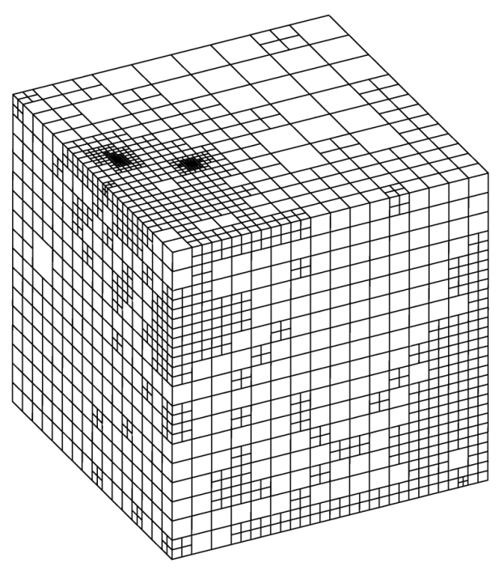
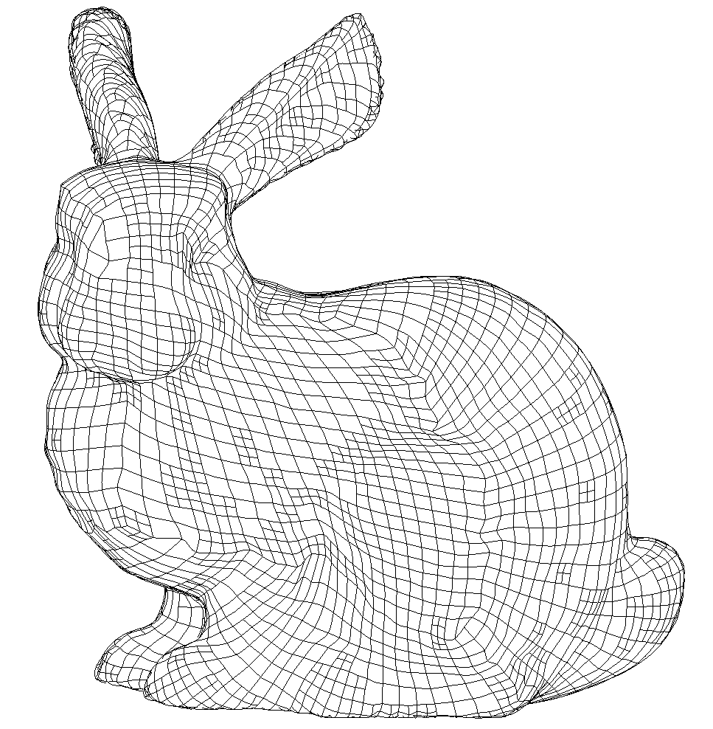
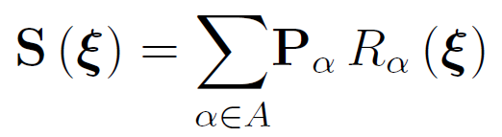
T-spline Parameterization
For a given T-mesh (0-balanced quadtree/octree)
Objective question: Is it possible to define cubic polynomial blending functions?
T-mesh
T-spline
Parameter space
Physical space

Slide 4
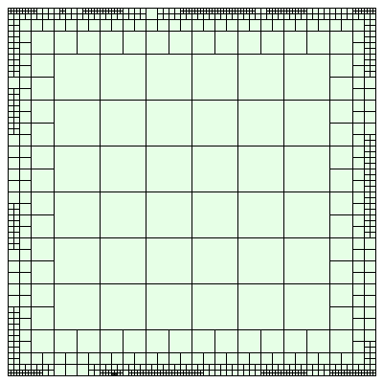
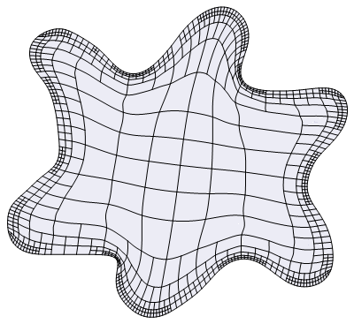

The Meccano Method on T-meshes in 2-D
Input data: Boundary representation of the object
Objective: Construction of a high quality T-spline parameterization
T-mesh
T-spline mesh
Parameter space
Physical space

Slide 5
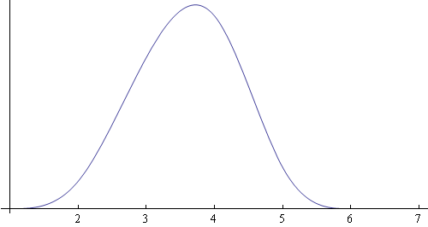
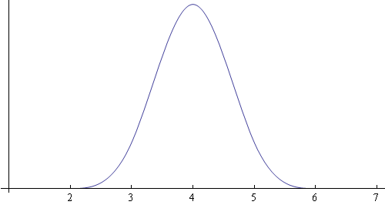
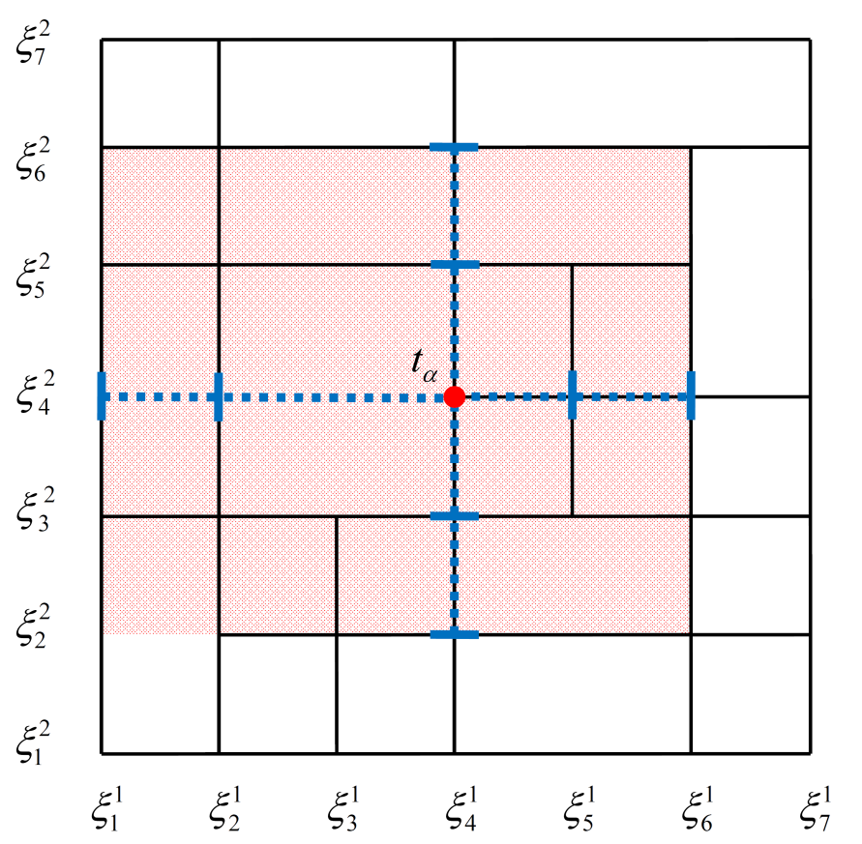
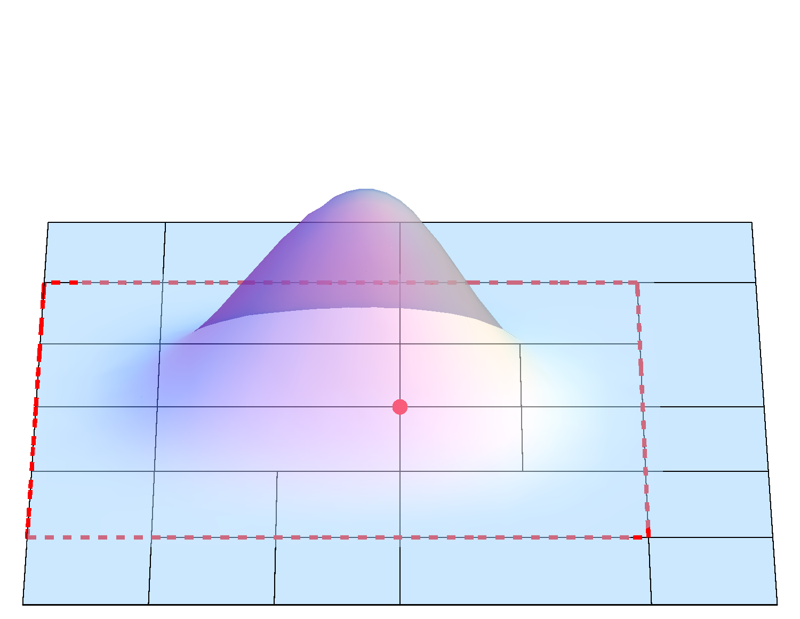
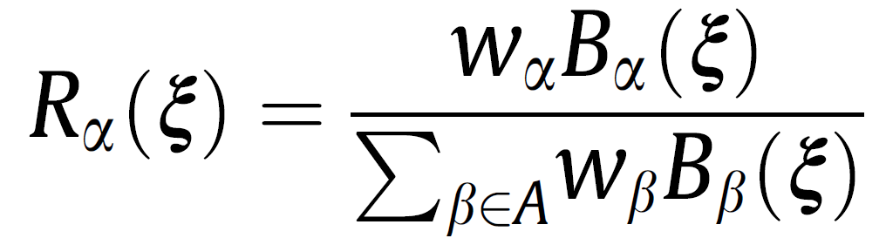
T-spline Basis Functions in 2-D
Example of a bivariate cubic basis function on a T-mesh
T.W. Sederberg (rational blending functions with local support )
T-mesh and anchor t_{α}
Bivariate Cubic T-spline Basis Function
Knots associated to anchor t_{α}
(obtaining by traversing T-mesh edges):
Rational blending function

Slide 6
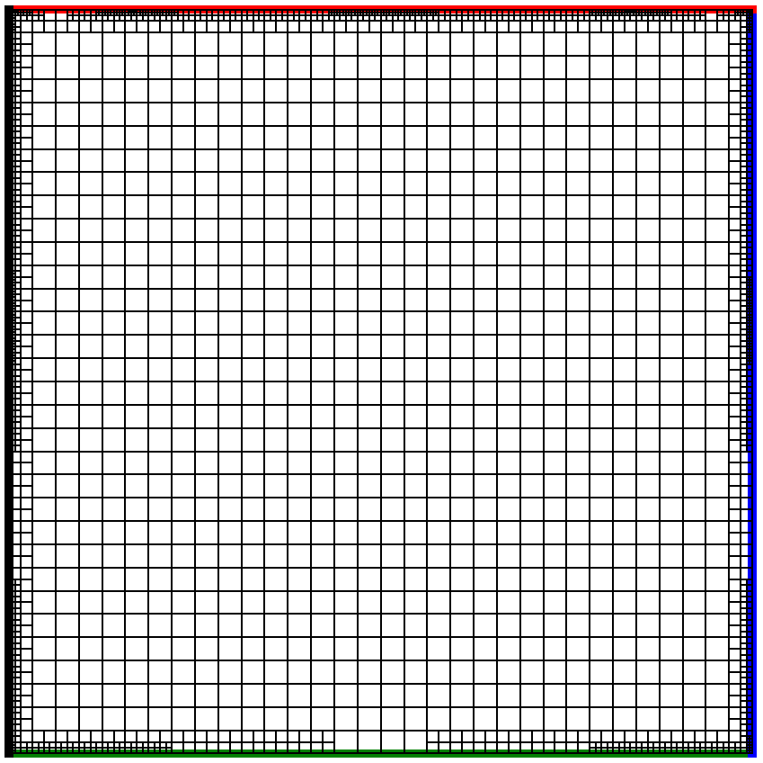
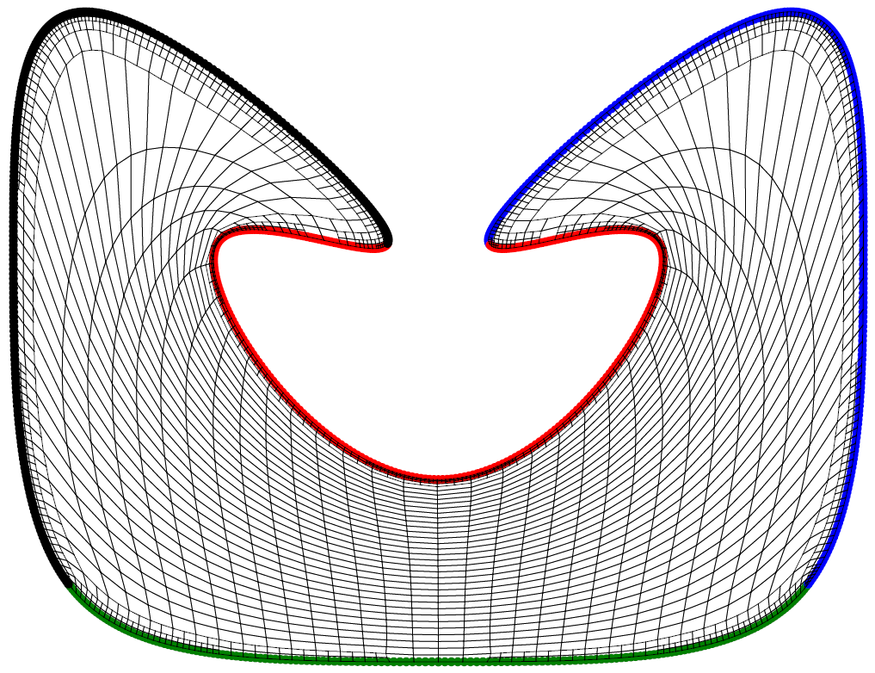
Simultaneous Untangling and Smoothing of T-meshes
T-mesh transformation along the SUS process: Example
T-mesh
T-spline
Parameter space
Physical space

Slide 7
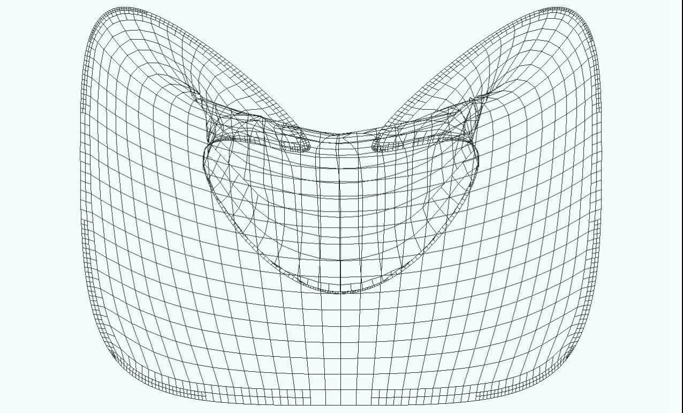
Simultaneous Untangling and Smoothing of T-meshes
T-mesh transformation along the SUS process: Video

Slide 8
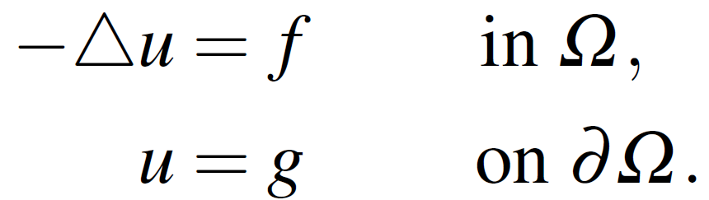
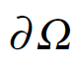
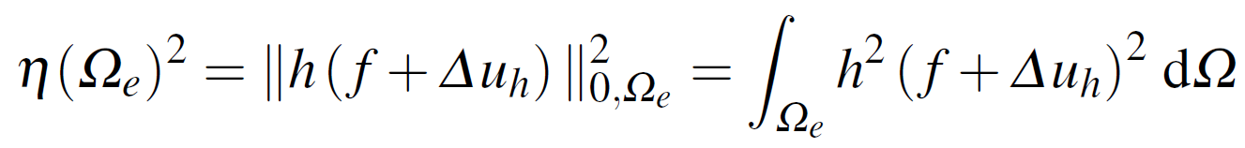
Local Nested Adaptive Refinement
Numerical solution of a Poisson problem
Concentrate source in relation to the initial mesh size
Ω
Exact solution:
Residual-type error indicator:

Slide 9
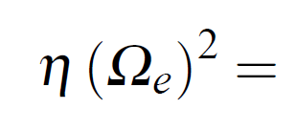
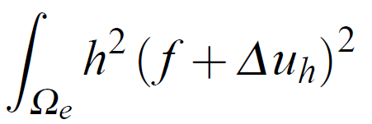

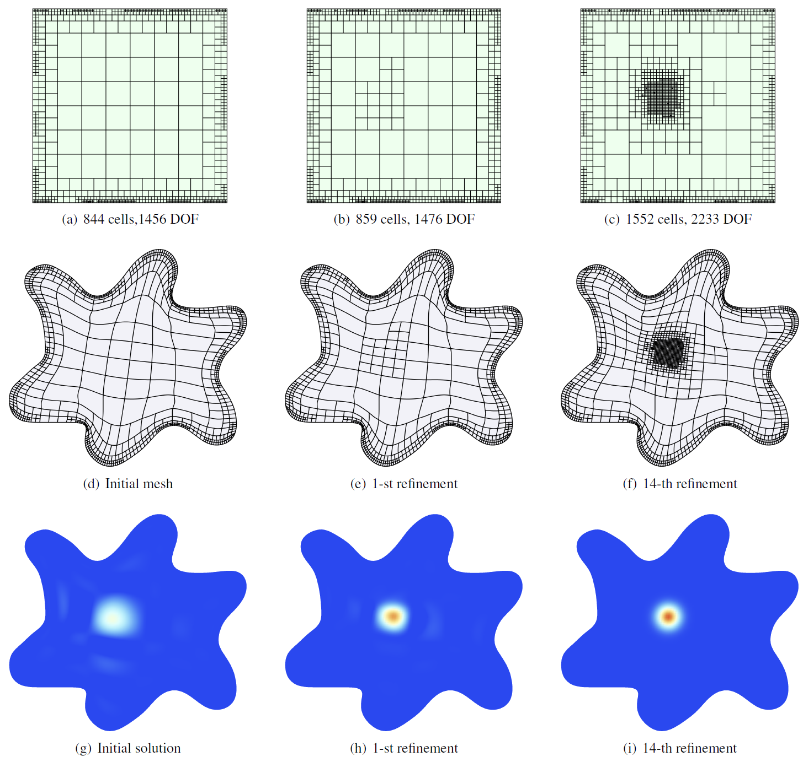
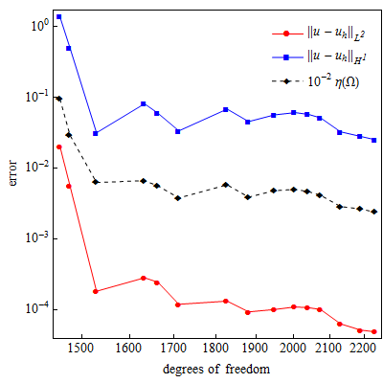
Local Nested Adaptive Refinement
Numerical solution of a Poisson problem
Error indicator :
d
Non-monotonous convergence behavior

Slide 10
Polynomial spline spaces over any quadtree and octree T-meshes
A new strategy for constructing tensor product cubic spline spaces
over arbitrary quadtree (2D) and octree (3D) T-meshes
For a given T-mesh, it allows to obtain a set of cubic spline functions that span
a space with nice properties: C² continuous, nested spaces, linear independence
Simple rules for inferring local knot vectors to define spline blending functions
Straightforward implementation in 2D and 3D

Slide 11
Strategy for defining polynomial spline spaces
General Scheme
Three main steps
Mesh pretreatment: 0-balancing
Inferring local knot vectors
Modification of local knot vectors

Slide 12
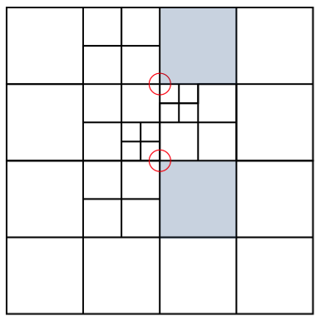
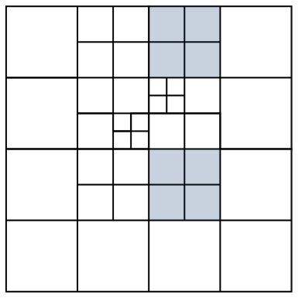
Strategy for defining polynomial spline spaces
Step 1 - Mesh pretreatment
0-balancing
Only one hanging node (T-junction) per edge
Any node is shared by cells that at most belong to two consecutive levels
Unbalanced quadtree
0-balanced quadtree
Standard procedure
(refinement)

Slide 13
Strategy for defining polynomial spline spaces
Step 2 - Inferring local knot vectors
Inferring local knot vectors
Blending functions are associated only to regular nodes
Local knot vectors are inferred by traversing T-mesh edges
Hanging nodes are skipped when “walking” along its surrounding edge
Original T-spline (Sederberg)
New strategy

Slide 14
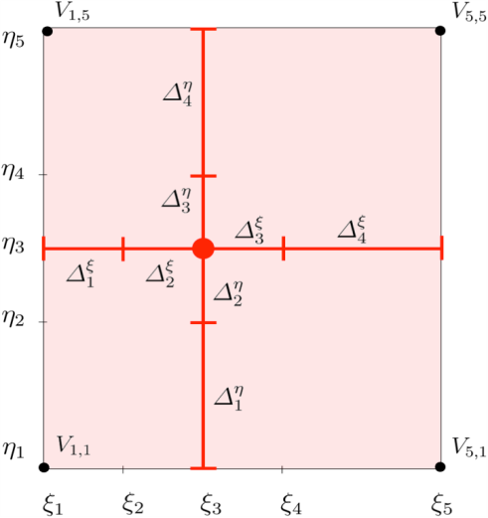
Strategy for defining polynomial spline spaces
Step 3 - Modification of local knot vectors
Support of the blending function N_{α} associated to the anchor α
_{α}

Slide 15


Strategy for defining polynomial spline spaces
Step 3 - Modification of local knot vectors
Modification of local knot vectors
Knot vectors of each blending function N_{α} have to fulfill two conditions:
Condition 1: Local knot vectors of the d-variate function N_{α} verify:
_{α}
Condition 2: The frame of the function support should be situated over
the mesh skeleton:
Simple extension rule: If any condition is not verified, then some are duplicated

Slide 16
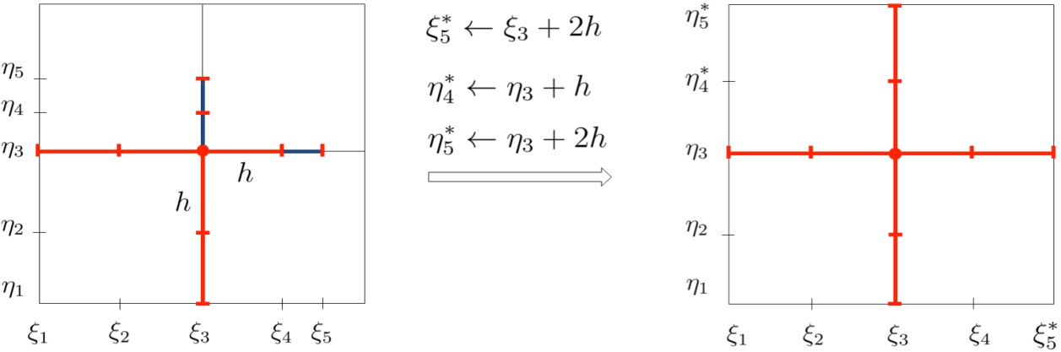

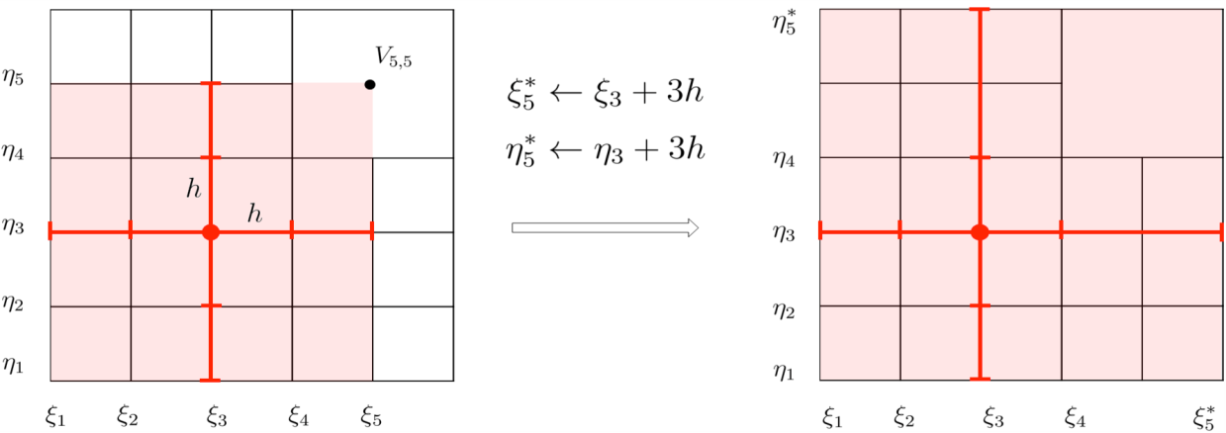

Strategy for defining polynomial spline spaces
Step 3 - Modification of local knot vectors (Examples)
Condition 1 is not satisfied
h = max(∆^{ξ}₂ , ∆^{ξ}₃) = max(∆^{η}₂ , ∆^{η}₃ )
Condition 2 is not satisfied

Slide 17
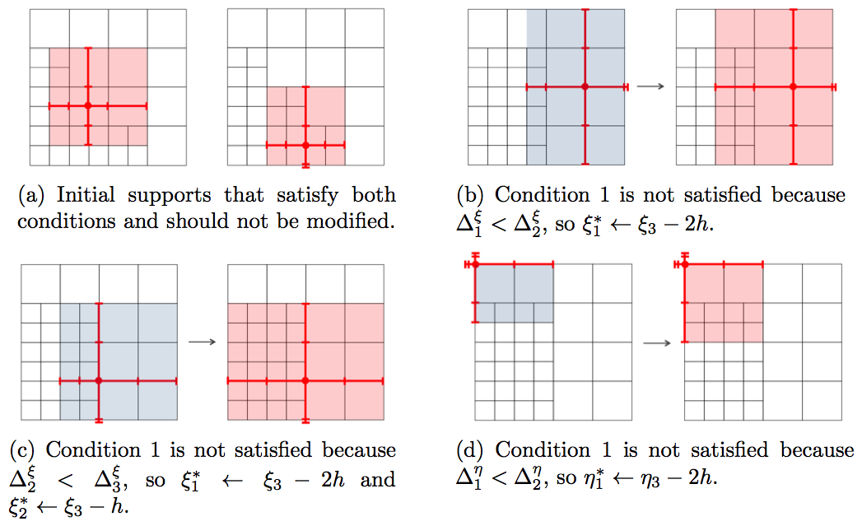
Strategy for defining polynomial spline spaces
Step 3 - Modification of local knot vectors (more examples)

Slide 18
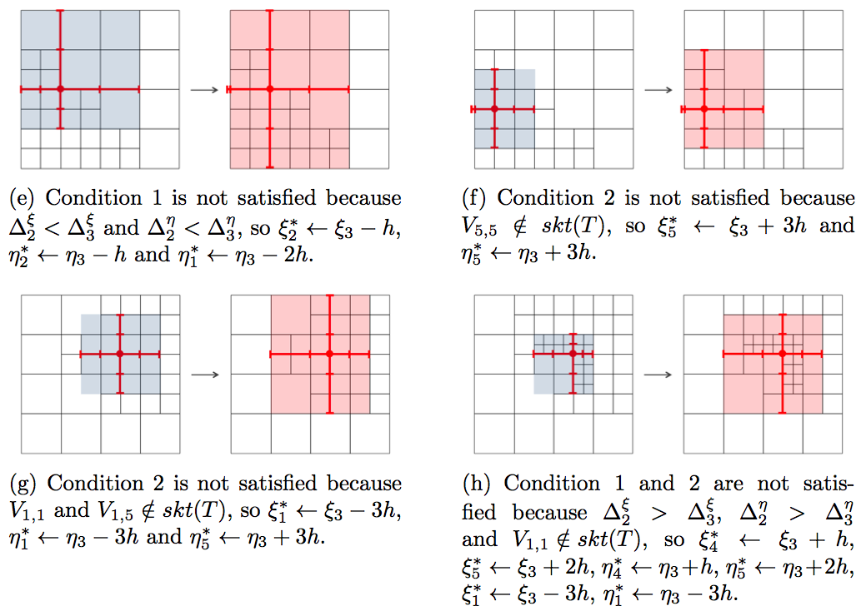
Strategy for defining polynomial spline spaces
Step 3 - Modification of local knot vectors (more examples)

Slide 19
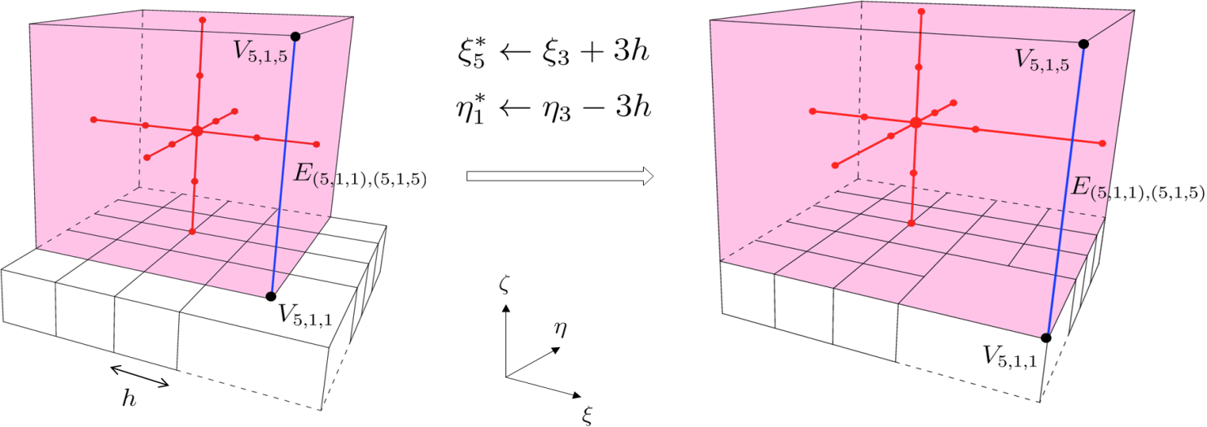
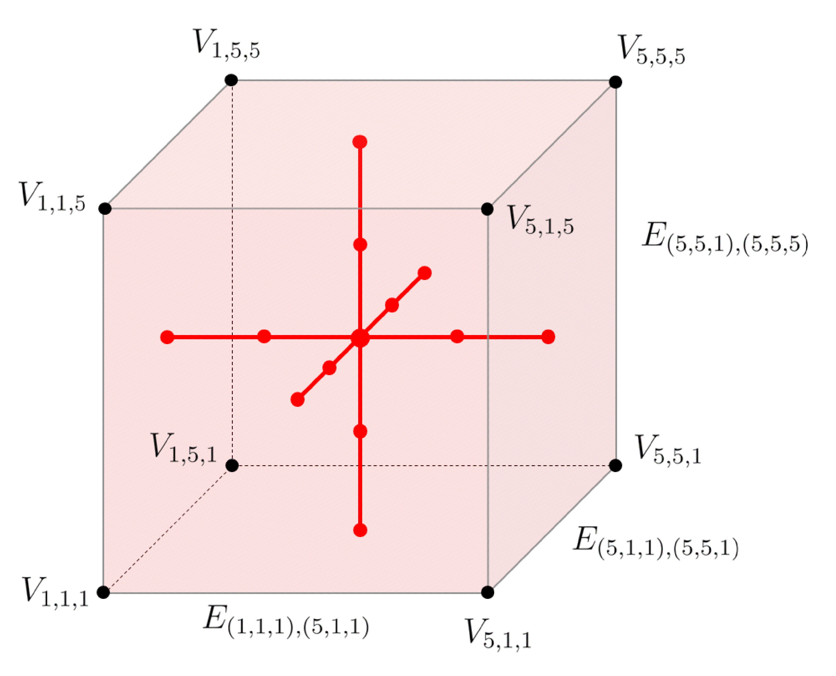
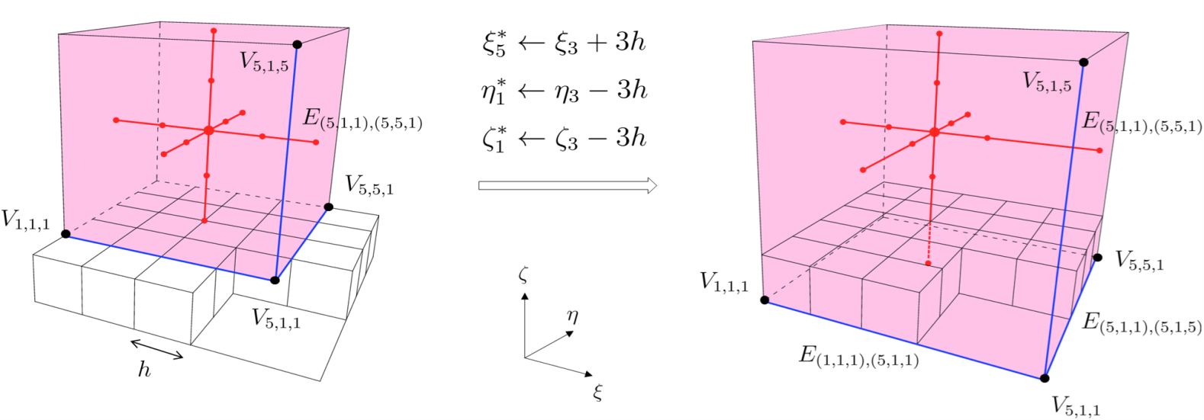
Strategy for defining polynomial spline spaces
Straightforward implementation in 3D

Slide 20
Strategy for defining polynomial spline spaces
Some remarks
Function supports can be constructed separately (in parallel)
For a given T-mesh, the resulting spline space is unique

Slide 21
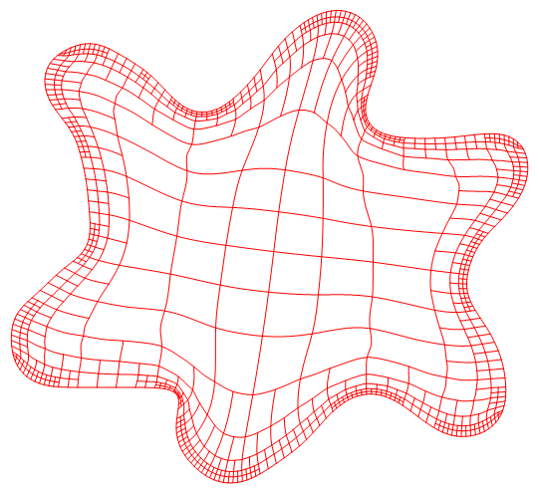
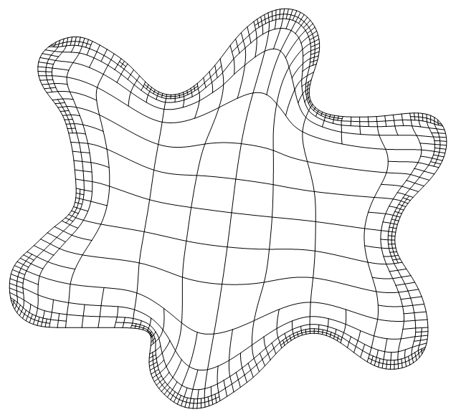
Good quality parameterization for application of IGA
Comparison of rational T-spline parameterization with the new strategy
T-spline parameterization, Sederberg
(rational blending functions )
Spline parameterization with the new strategy
(polynomial blending functions)

Slide 22
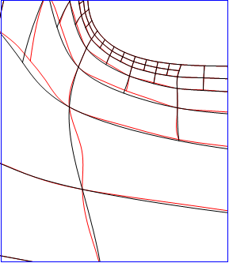
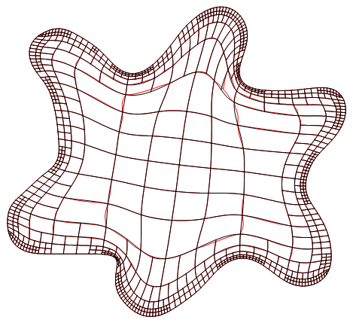
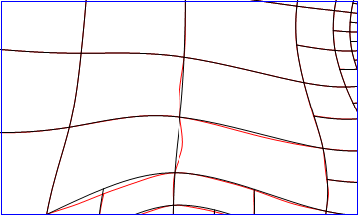
Good quality parameterization for application of IGA
Comparison of rational T-spline parameterization with the new strategy
Rational T-spline represents a little more cell oscillations

Slide 23
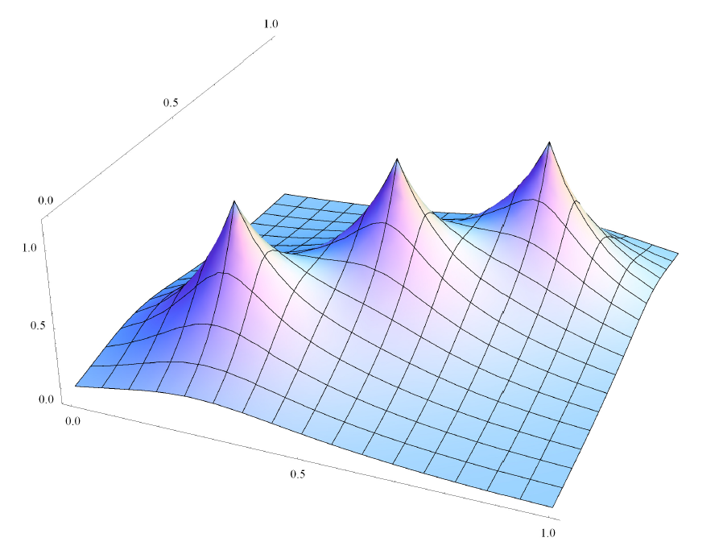
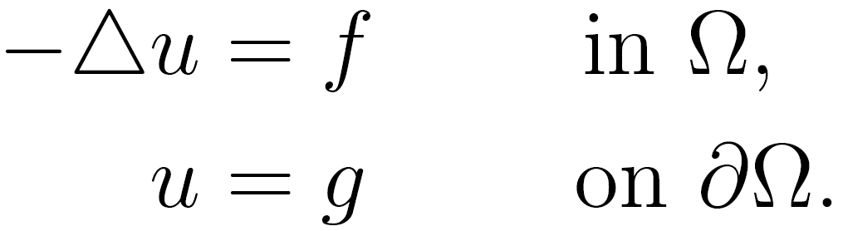
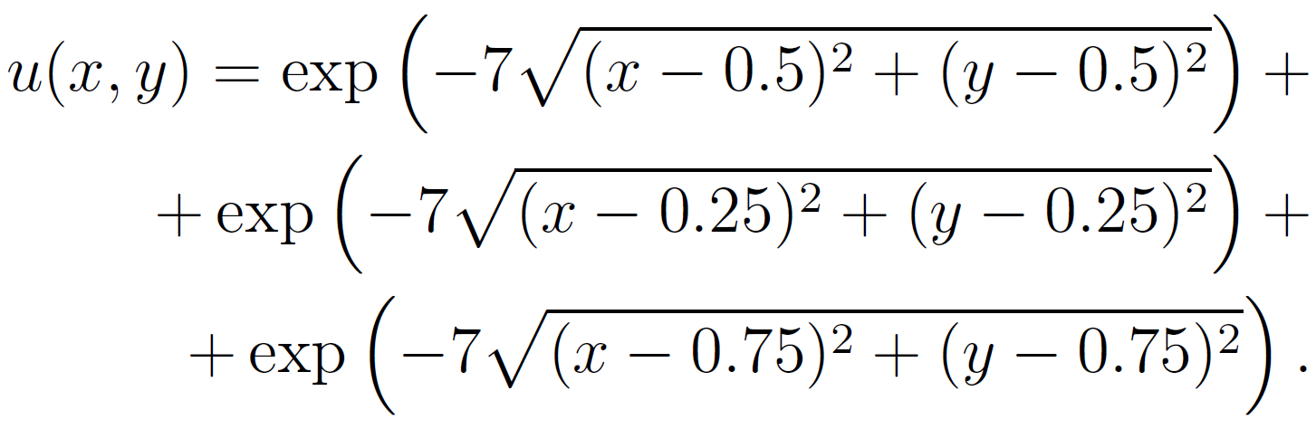
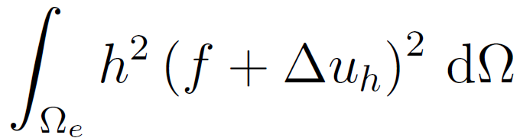
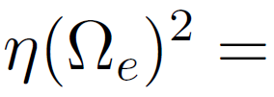
Isogeometric analysis on 2D domain
Poisson problem with Dirichlet boundary condition
Analytical solution:
Residual-type error indicator:

Slide 24
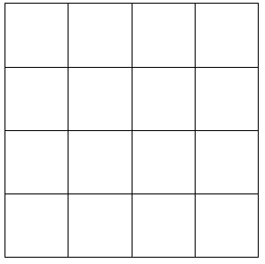
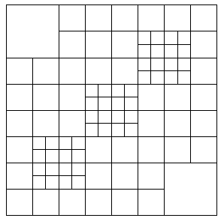
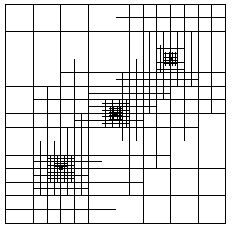
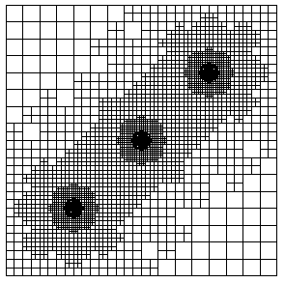
Adaptive refinement for 2D Poisson problem
Error indicator :
d

Slide 25
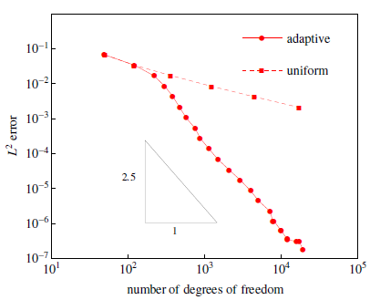
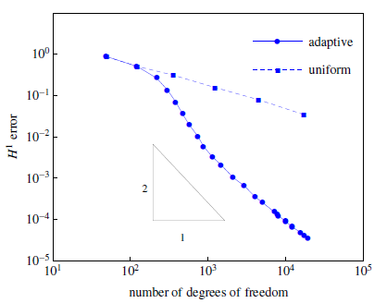
Adaptive refinement for 2D Poisson problem
Monotonous convergence: L²-norm and H¹-seminorm error

Slide 26

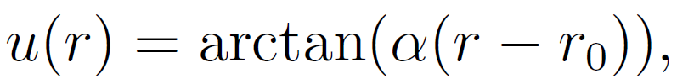


Isogeometric analysis on 2D complex domain
Poisson problem with Dirichlet boundary condition on a puzzle piece
● Analytical solution: Steep wave front given by
,
,
● Adaptive strategy: Residual-type error indicator:

Slide 27
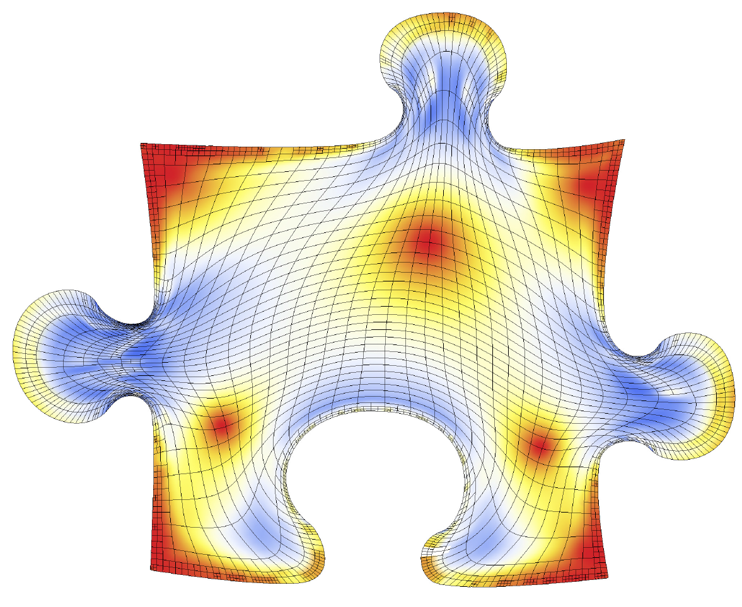
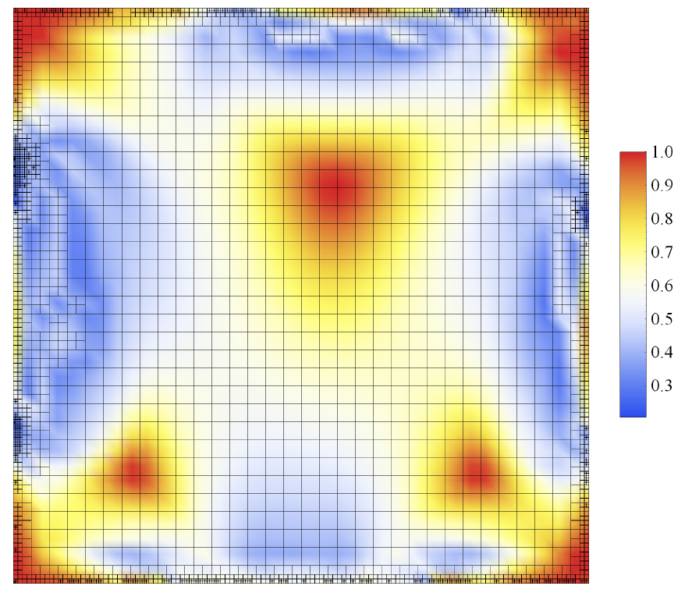
Isogeometric analysis for 2D Poisson problem
Initial adapted T-mesh and parameterization of the puzzle (Meccano method)
Mean ratio Jacobian as a quality metric

Slide 28
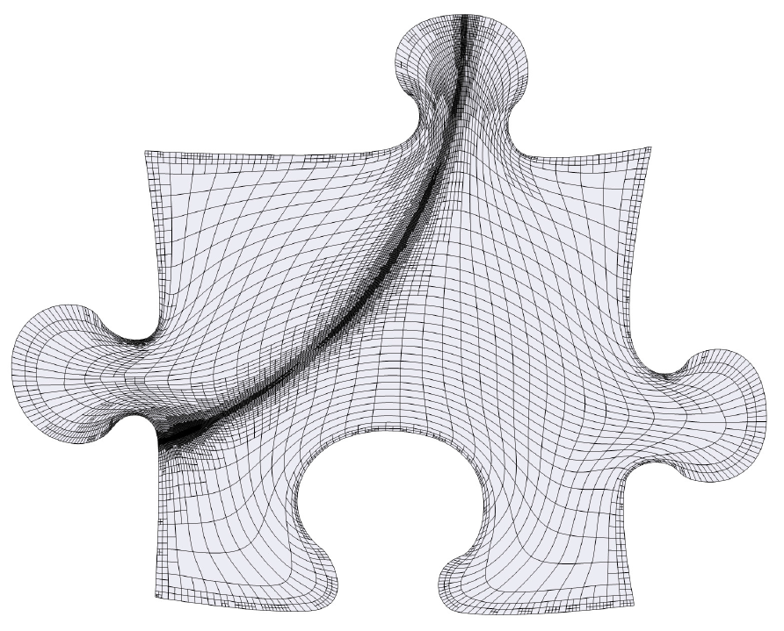

Adaptive refinement for 2D Poisson problem
Adaptive T-mesh after 13 refinement steps

Slide 29

Adaptive refinement for 2D Poisson problem
Numerical solution

Slide 30

Adaptive refinement for 2D Poisson problem
Monotonous convergence: L²-norm and H¹-seminorm error

Slide 31





Isogeometric analysis for 3D Poisson problem
Adaptive T-spline parameterization of a sphere portion
Analytical solution:
and oscillation parameter

Slide 32


Adaptive refinement for 3D Poisson problem
Numerical solution

Slide 33


Adaptive refinement for 3D Poisson problem
A section of the parametric and physical discretization

Slide 34


Adaptive refinement for 3D Poisson problem
Numerical solution on a section of the parametric and physical domain

Slide 35

Adaptive refinement for 3D Poisson problem
Monotonous convergence: L²-norm and H¹-seminorm error

Slide 36
Conclusion and Future Works
Conclusions
We have developed a new strategy for constructing tensor product cubic spline spaces over arbitrary quadtree (2D) and octree (3D) meshes
Easy implementation in 2D and 3D
Future Works
The proof of the nestedness of the spaces and their linear independence is in preparation

Slide 37
Strategy for defining polynomial spline spaces
Comment about the nestedness proof
Three basic types of a blending function of level K verifying conditions 1 and 2
Type I
Type II
Type III
Function Support of level K covers 6 (Type I), 9 (Type II) or 4 (Type III) cells of level K-1

Slide 38
Construction of polynomial spline spaces over
quadtree and octree T-meshes
M. Brovka⁽¹⁾, J.I. López⁽¹⁾, J.M. Escobar⁽¹⁾, J.M. Cascón⁽²⁾ and R. Montenegro⁽¹⁾*
⁽¹⁾ University Institute SIANI, University of Las Palmas de Gran Canaria, Spain
⁽²⁾ Department of Economics and History of Economics, University of Salamanca, Spain
23rd International Meshing Roundtable (IMR23)
October 12–15, 2014, London, UK
MINECO y FEDER Project: CGL2011-29396-C03-00
CONACYT-SENER Project, Fondo Sectorial, contract: 163723
http://www.dca.iusiani.ulpgc.es/proyecto2012-2014

Slide 39


The Meccano Method on T-meshes in 2-D
Step 1: Input boundary (image, polyline, curve, etc.) and boundary mapping
A’
B’
A
B
C
D
C’
D’
Select four points (A, B, C, D) of the input boundary
Boundary parameterization via chord-length

Slide 40

The Meccano Method on T-meshes in 2-D
Step 2: Coarse quadrilateral mesh of the meccano (parameter space)

Slide 41

The Meccano Method on T-meshes in 2-D
Step 3: Refine mesh with quadtree subdivisions to approach the boundary

Slide 42

The Meccano Method on T-meshes in 2-D
Step 4: Move the meccano boundary nodes to the object boundary

Slide 43




The Meccano Method on T-meshes in 2-D
Step 5: Inner node relocation with Coons patch to facilitate the optimization
Mesh folder

Slide 44

The Meccano Method on T-meshes in 2-D
Step 6: Simultaneous Untangling and Smoothing (SUS) of the T-mesh

Slide 45
The Meccano Method on T-meshes in 2-D
Step 7: T-spline representation of the spot

Slide 46


Mean Ratio Jacobian J_{r}(ξ) of Parametric Transformation
A quality metric of the T-spline mapping at any point P₀
-1 ≤
≤ 1
where J is the jacobian matrix of the
T-spline mapping S

Slide 47



Good quality parameterization for application of IGA
Mean ratio Jacobian as a quality metric

Slide 48

Good quality parameterization for application of IGA
Comparison of rational T-spline parameterization with the new strategy
Oscillation of mean ratio Jacobian on each cell
Representation in increasing order in the 844 cells with 64 quadrature points per cell
rational T- spline
polynomial spline

Slide 49


T-spline Parameterization
Determination of control points by imposing interpolation conditions
where

Slide 50

INPUT DATA: Surface Triangulation
http://www.cyberware.com/

Slide 51



Slide 52


T-mesh
T-spline

Slide 53



Adaptive Isogeometric Refinement (EWC 2014)
Application in Igea: Poisson problem with a central source
Exact solution:
T-mesh
T-spline

Slide 54


Adaptive Isogeometric Refinement (EWC 2014)
Igea: T-spline of Numerical Solution
Initial T-mesh
5692 cells, 9304 DOF

Slide 55


Adaptive Isogeometric Refinement (EWC 2014)
Igea: T-spline of Numerical Solution
Error indicator :
d
2nd local refinement
6021 cells, 9807 DOF

Slide 56


Adaptive Isogeometric Refinement (EWC 2014)
Igea: T-spline of Numerical Solution
Error indicator :
d
5th local refinement
6756 cells, 10838 DOF

