Slide 1



Surface insertion in a tetrahedral mesh using the Meccano method
Socorro G.V.⁽¹⁾, Ruiz-Gironés E.⁽²⁾, Oliver A.⁽¹⁾, Cascón J.M.⁽³⁾, Escobar J.M.⁽¹⁾,
Sarrate J.⁽²⁾ and Montenegro R.⁽¹⁾
⁽¹⁾ University Institute SIANI, University of Las Palmas de Gran Canaria, Spain
⁽²⁾ Laboratori de Càlcul Numèric (LaCàN), Universitat Politècnica de Catalunya – BarcelonaTech, Spain
⁽³⁾ Department of Economics and Economic History, University of Salamanca, Spain
CMN - 2015 June 29 – July 2, 2015, Lisbon, Portugal
MINECO
PROGRAMA ESTATAL DE I+D+I ORIENTADA A LOS RETOS DE LA SOCIEDAD Project: CTM2014-55014-CR3-1-R
CONACYT-SENER Project, Fondo Sectorial, contract: 163723
http://www.dca.iusiani.ulpgc.es/proyecto2012-2014

Slide 2
Contents
Presentation index
Motivation
Meccano mesher overview
Algorithm steps
    Initial approximation
    Parameterization
    Smoothing
Applications
Conclusions and future research

Slide 3
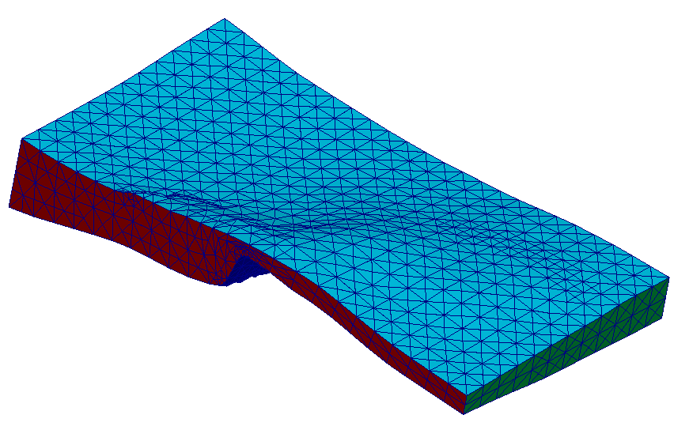
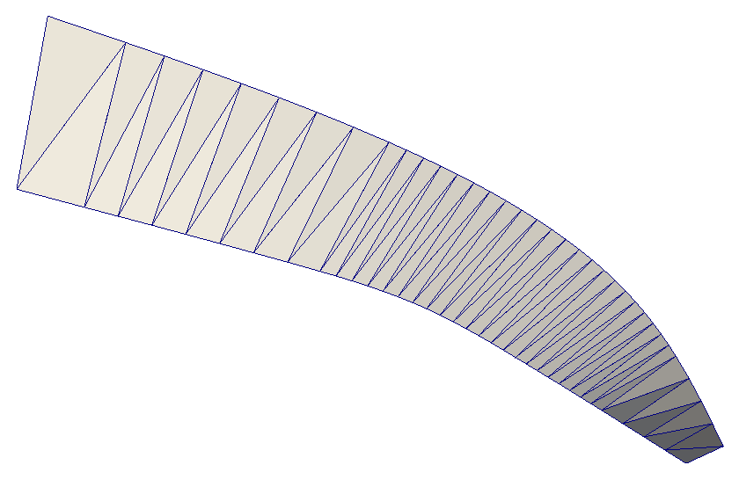
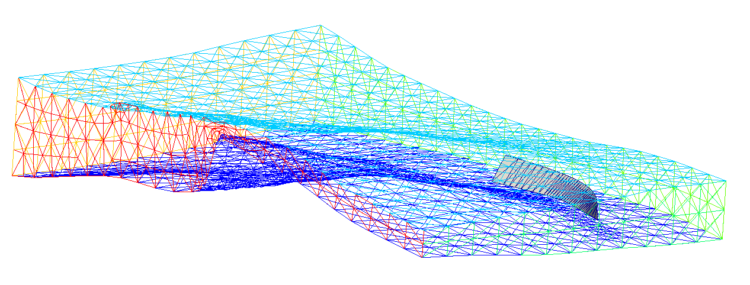
Motivation
Immerse surface insertion in tetrahedral mesh
Input data
  Tetrahedral mesh of a solid generated using the Meccano method
  immerse surface description
Requirements
  Smooth approximation
  The triangles of the approximation are mesh faces.
Volume tetrahedral mesh
Surface triangulation
immersed surface

Slide 4
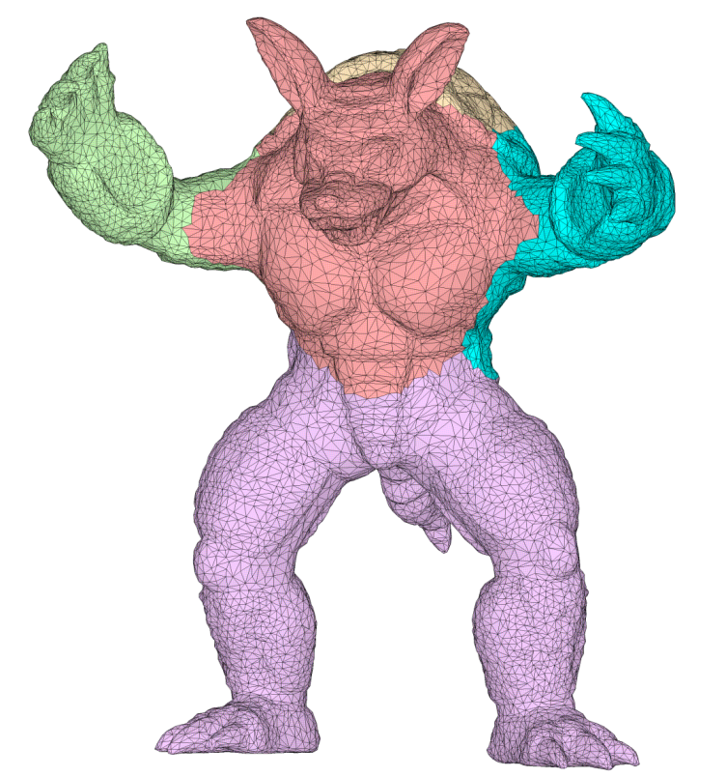
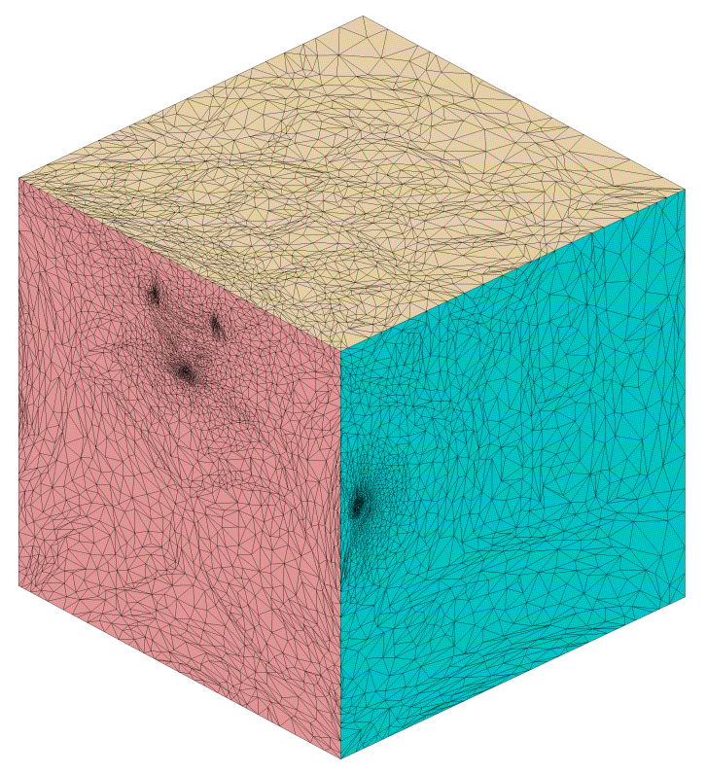
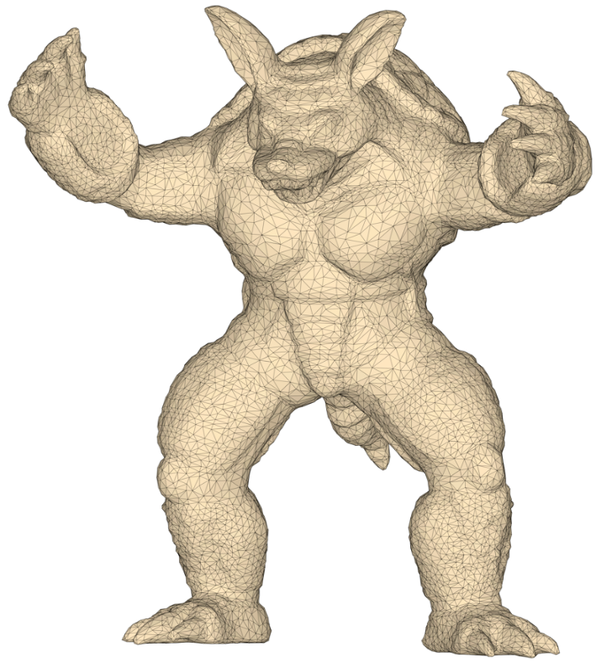
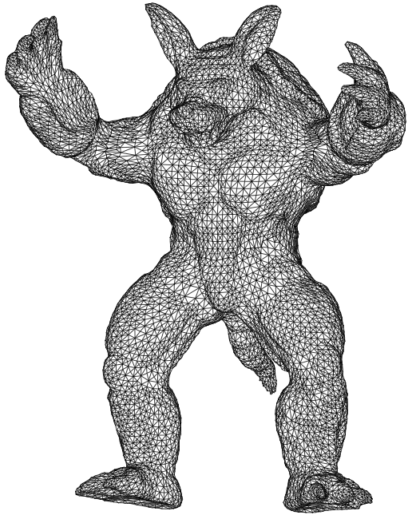
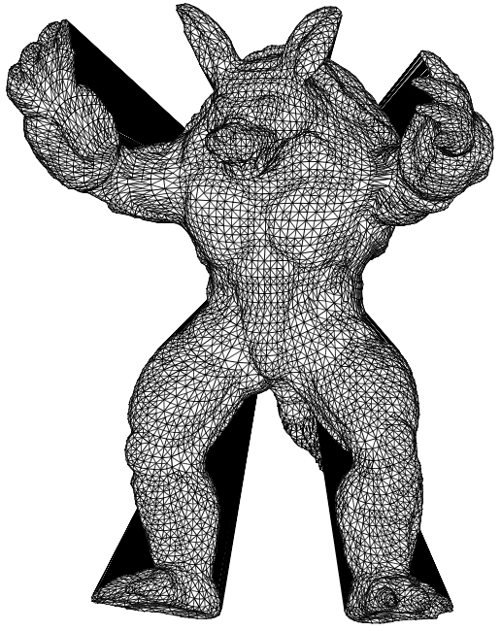
Meccano Method for complex solids
Simultaneous mesh generation and volumetric parameterization
Parameterization
Refinement
Untangling & Smoothing

Slide 5
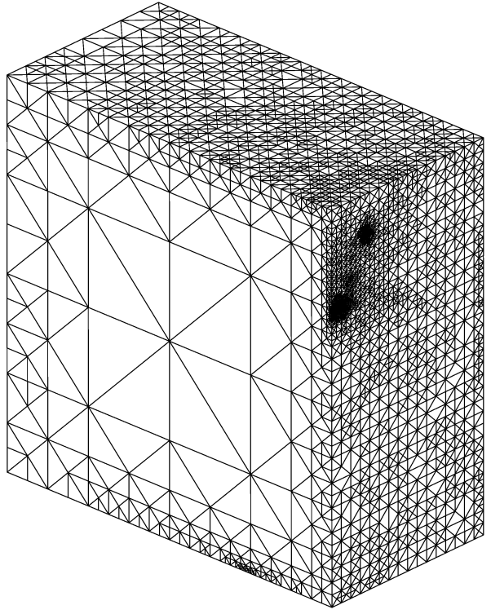
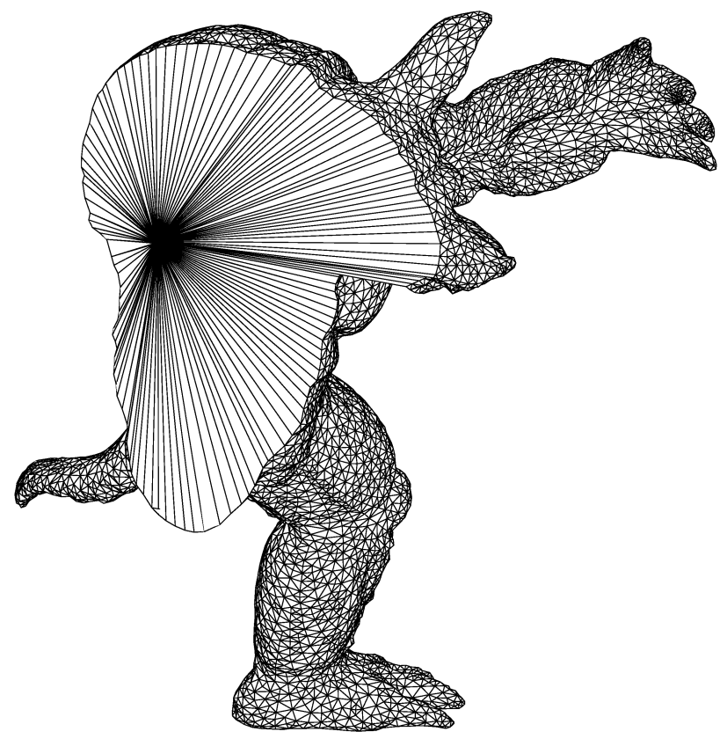
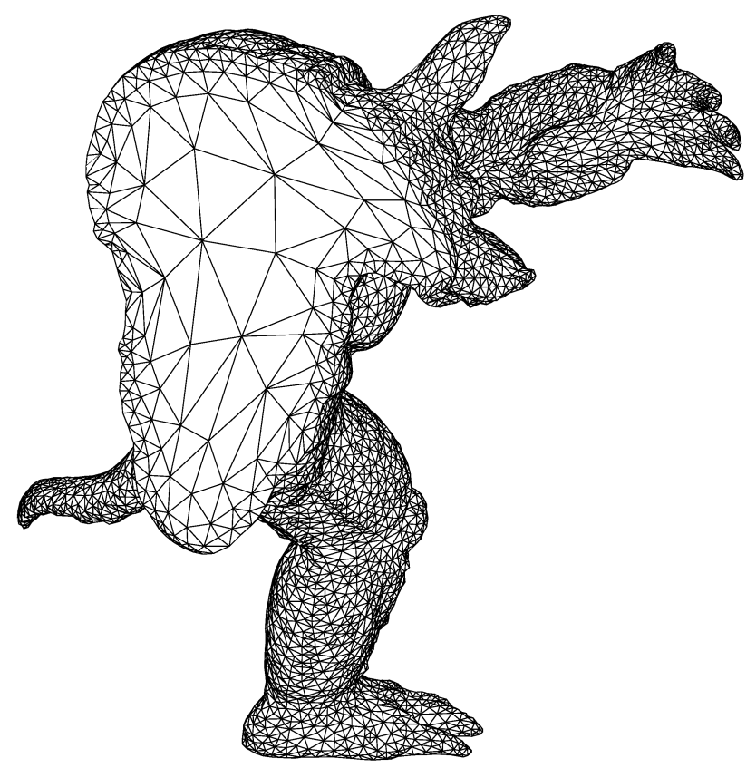
Meccano Method for complex solids
Mesh generation. SUS of tetrahedral meshes
Optimization
Parametric space (meccano mesh)
Physical space
(tangled mesh)
Physical space
(optimized mesh)

Slide 6
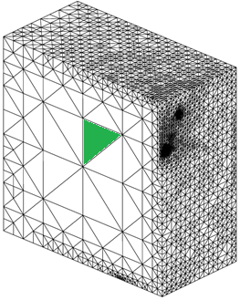
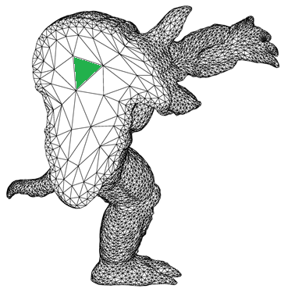
Meccano Method for complex solids
Simultaneous mesh generation and volumetric parameterization
Volumetric parameterization
Parametric space (meccano mesh)
Physical space
(final mesh)

Slide 7
Algorithm steps
Three stages: approximation, parameterization and smoothing
Initial approximation
Parameterization
Smoothing
Mesh-surface
intersection
Projection
SUS
Approximation
parameterization
Volumetric
Approximation
Surface
parameterization
Surface
approximation
Real surface
(input data)
Initial rough approximation
Surface projection
and smoothing

Slide 8
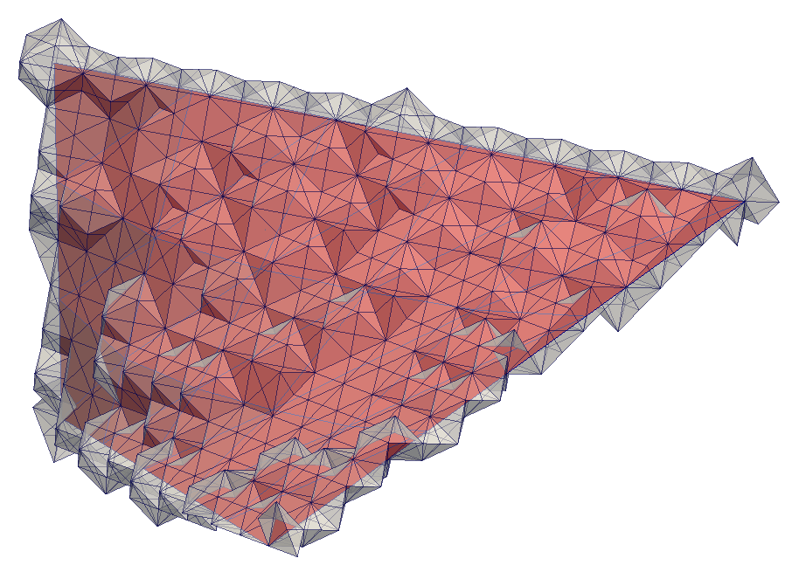
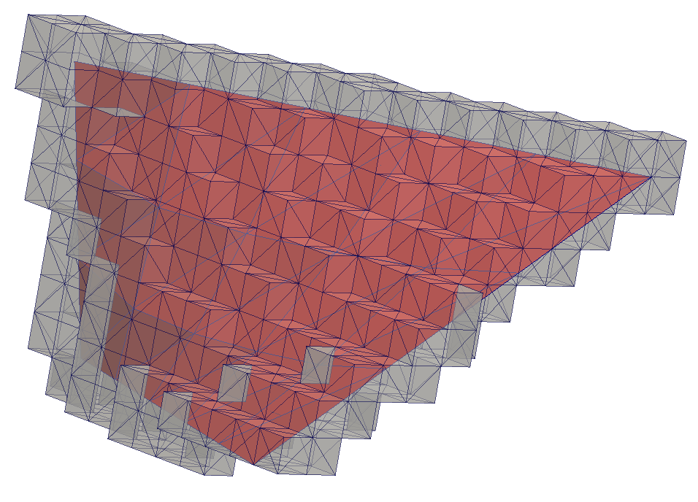
Surface initial approximation
Volumetric approximation
Calculate mesh-surface intersection
  Encapsule the immerse surface
  Adaptive Kossaczký refinement with a prescribed max size for cells intersecting the surface
Repair volumetric approximation
  Volume topologically equivalent to 3D ball (spherical volume)
  Boundary faces parallel to coordinate surfaces in parametric domain

Slide 9
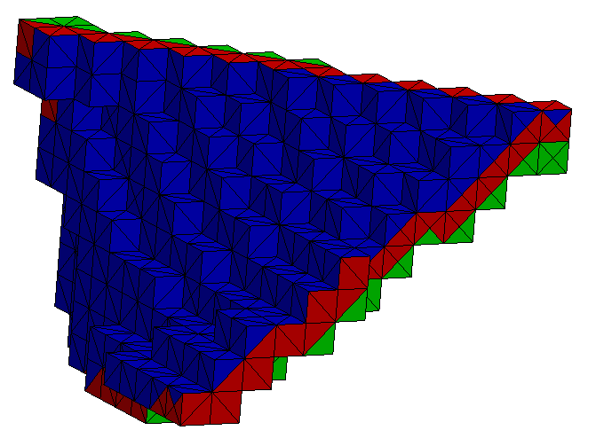
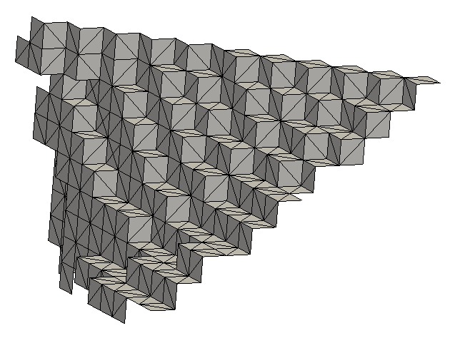
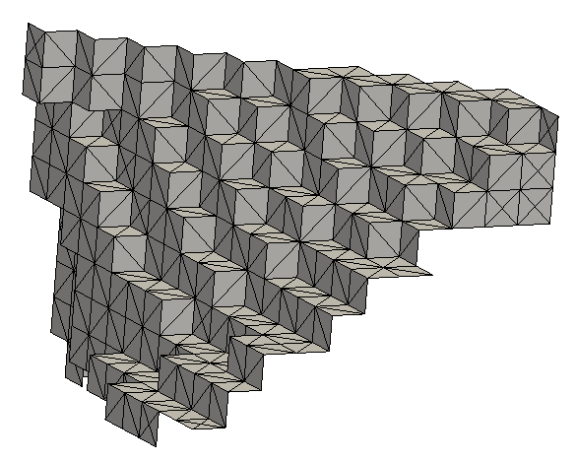
Surface initial approximation
Surface approximation
Mark boundary faces of volumetric aproximation
  Local expansion of immerse surface defines two regions
  Consider triangles with nodes in the same (arbitrary) region
Repair surface approximation
  Surface topologically equivalent to a 2D ball (disc).
  Boundary edges parallel to coordinate axis in parametric domain

Slide 10
Topological and Geometric Properties
Requirements for valid surface approximation
Mandatory properties to get a valid surface approximation
  Property 0: Surface approximation is an orientable, conex mesh topologically equivalent to a disc
  Property 1: If all the nodes of an element (tetrahedron, triangle or edge) lie in the surface approximation, then the element belongs to the surface approximation
  Property 2: If all the nodes of an element (triangle or edge) lie in the surface approximation boundary, then the element belongs to the surface approximation boundary
  Property 3: If any of the nodes of a triangle, but not all of them, lie on the surface approximation, then at least one node of the triangle must be an inner node of the tetrahedral mesh

Slide 11
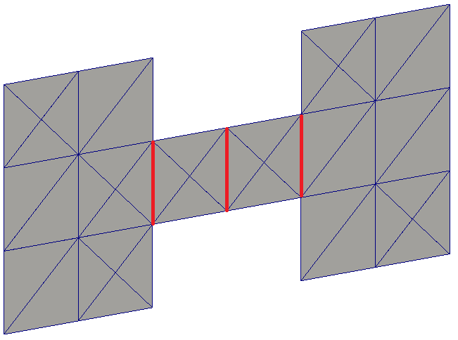
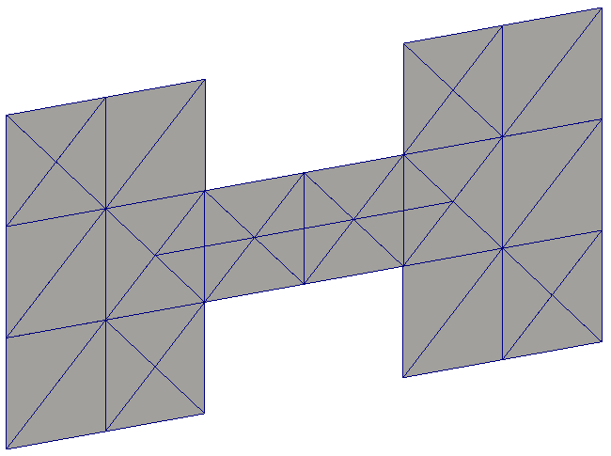
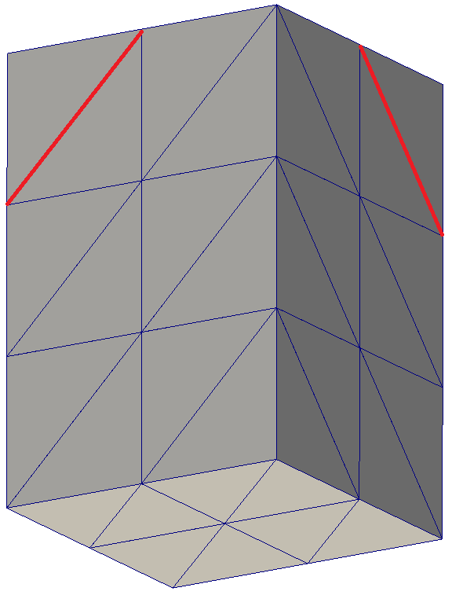
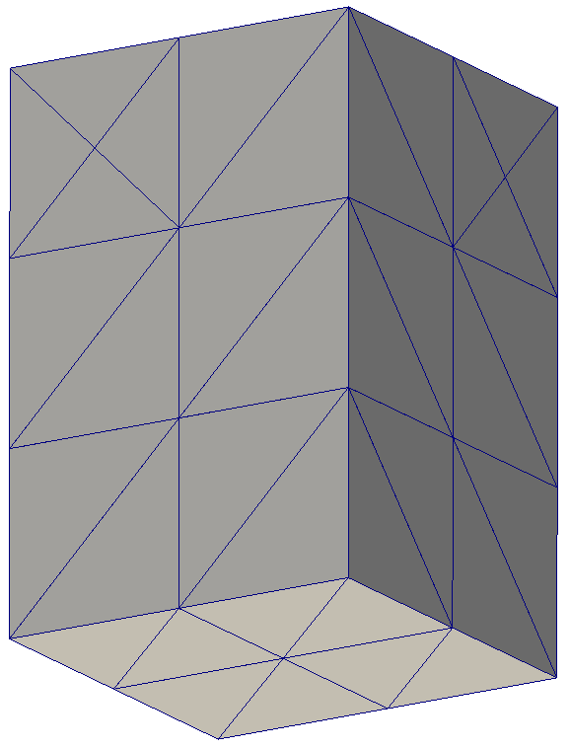
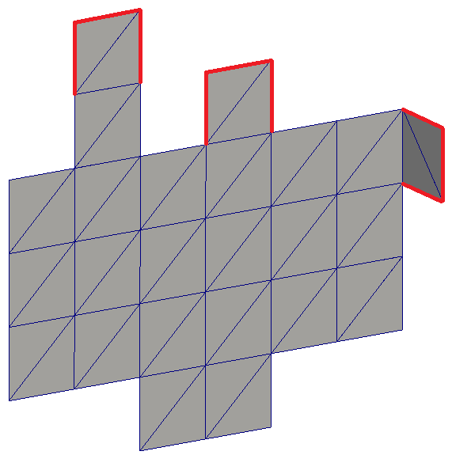
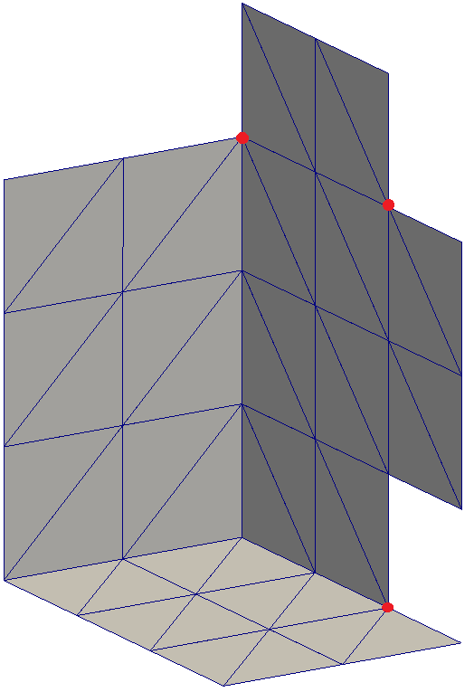
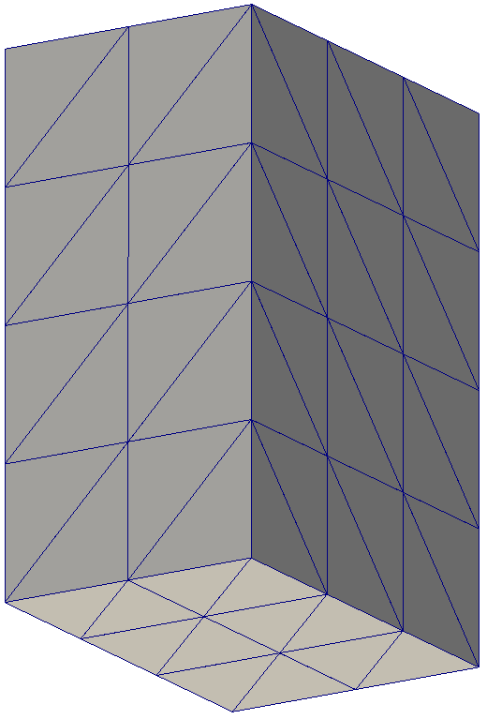
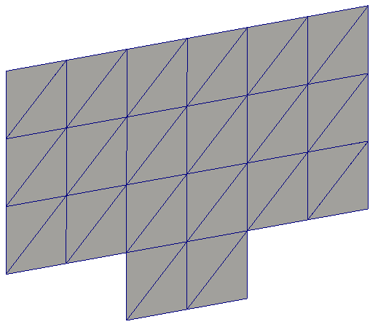
Topological and Geometric Properties
Repairing the initial surface approximation.
Avoid unsolvable cell / face collapse
Erode corbels
Erase dividing edges
Control connectivity of boundary nodes
At most one face in approximation per cell
At most one edge at boundary per face in the approximation

Slide 12
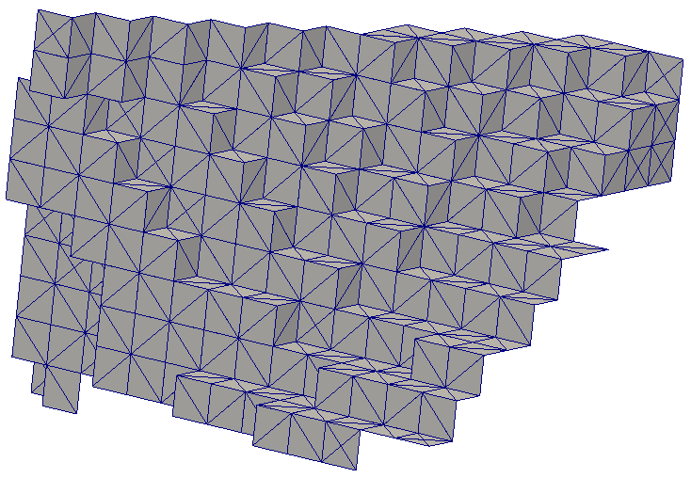
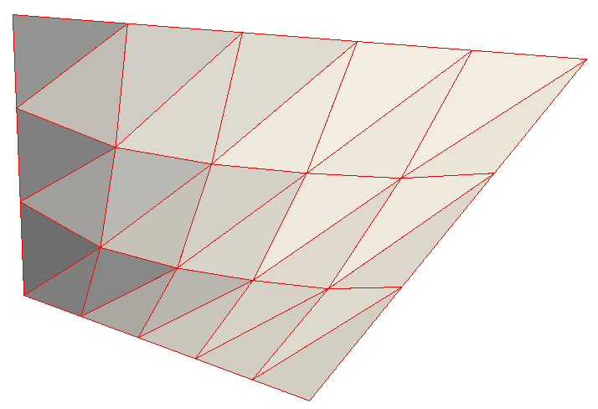
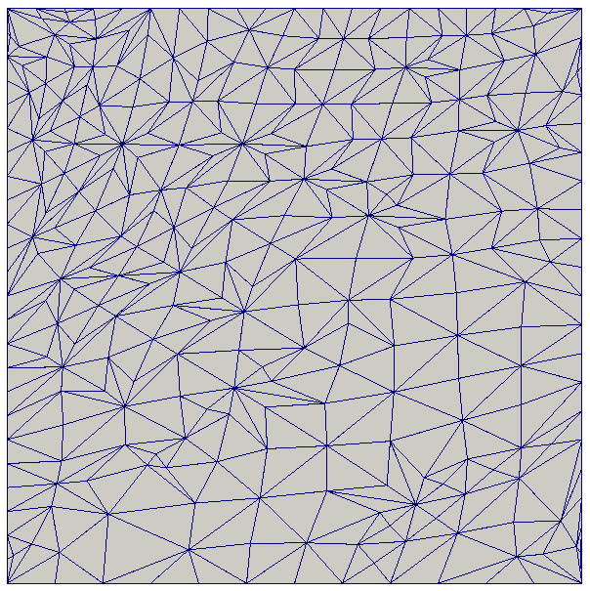
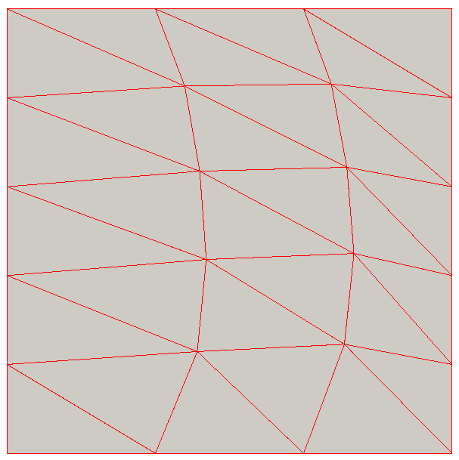
Surface parameterizations
Parameterization of actual surface and its approximation
approximation (physical domain)
surface (physical domain)
approximation (parametric domain)
surface (parametric domain)

Slide 13
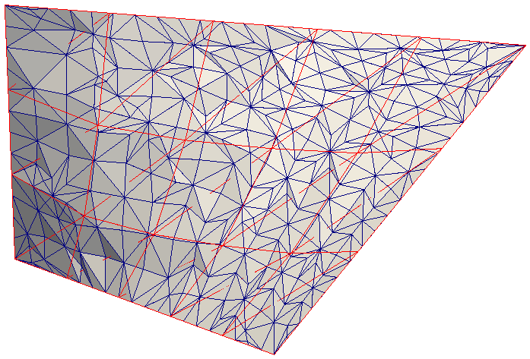
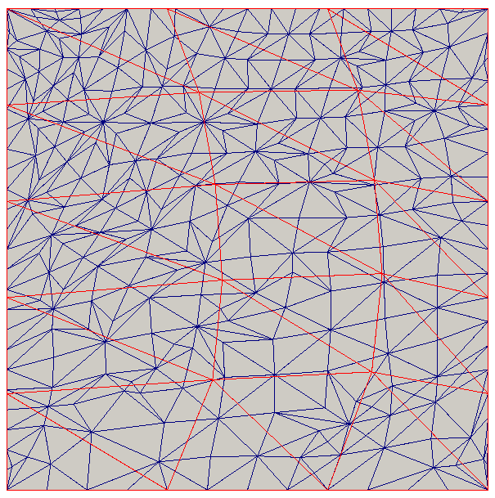
Projection
Simultaneous parameterization to project nodes
Simultaneous parameterization of the immerse surface and its initial approximation to the same parametric domain provides an initial location for nodes in the actual surface.

Slide 14
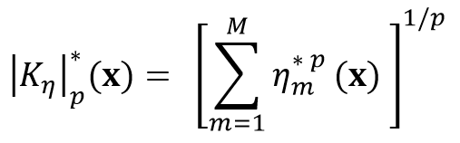
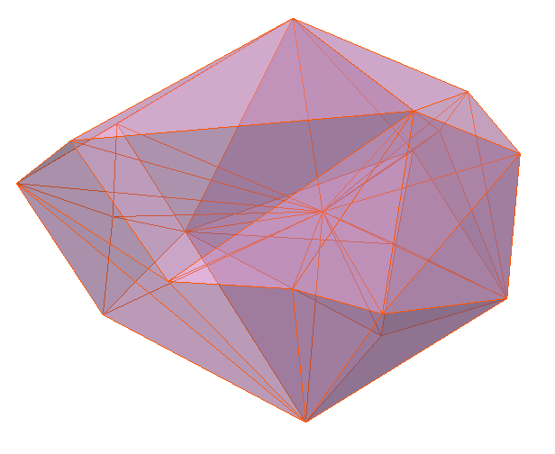
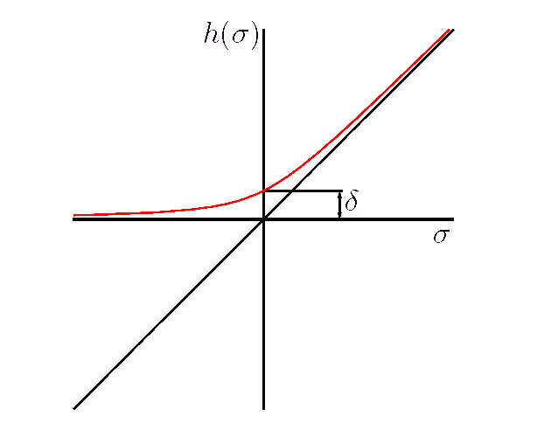
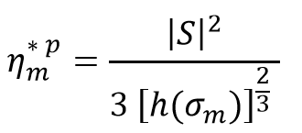
Smoothing
SUS: Simultaneous Untangling and Smoothing
SUS Code: Freely-available in http://www.dca.iusiani.ulpgc.es/proyecto2012-2014
Inner nodes
  3D optimization in the physical domain
  A term per adjacent tetrahedron, that penalties poor quality respect to the cell counterpart in the parametric domain
star in the physical domain

Slide 15
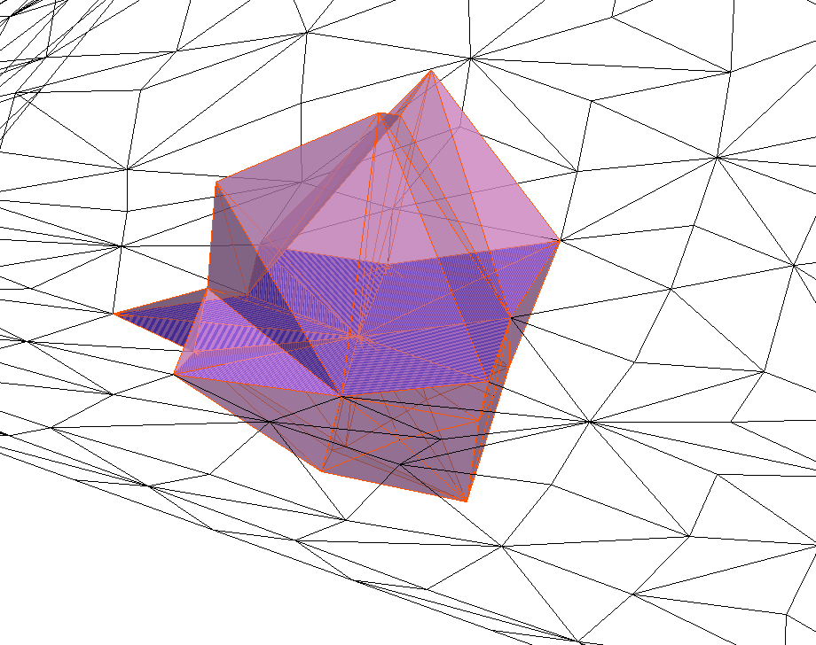
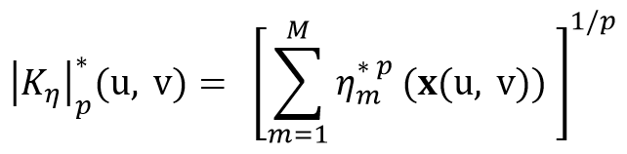
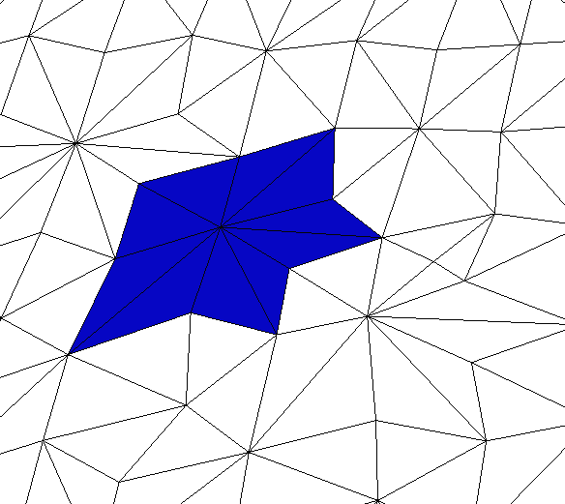
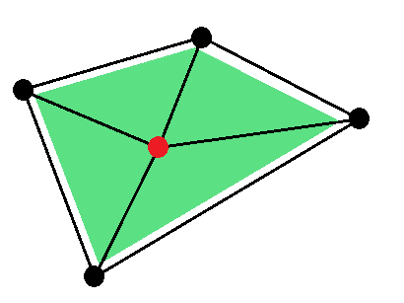

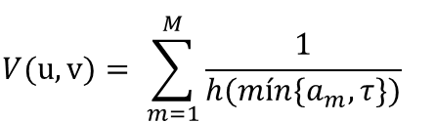
The Wind Field Model
Smoothing
SUS: Simultaneous Untangling and Smoothing
Nodes attached to surface parameterization
  2D optimization in the parametric domain
  An extra term in the objective function per triangle parametrized to the surface, that penalties collapse of the counterpart triangle in the parametric domain
star in the physical domain
$$V(u, v)= {\sum_{m=1}^{M}{\frac{1}{h(mín\{a_{m}, τ\})}}}^{}$$
$$a_{m}:area ratio over star área$$
$$τ:thickness of forbidden region$$
star in the parametric domain

Slide 16
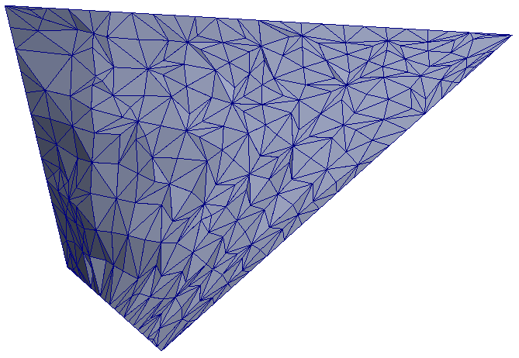
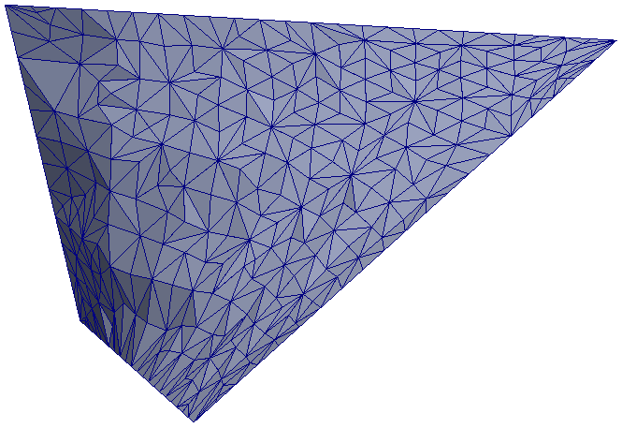
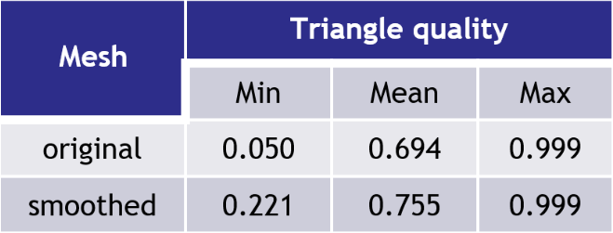
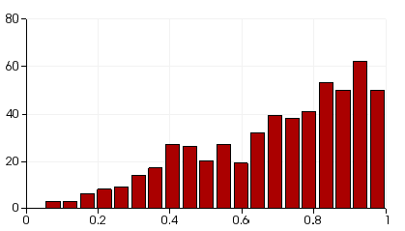
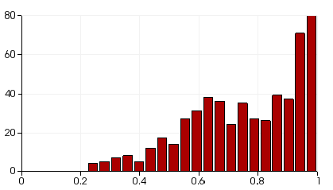
The Wind Field Model
Smoothing
Surface approximation. Triangle Quality.
Number of triangles
Number of triangles
quality
quality

Slide 17
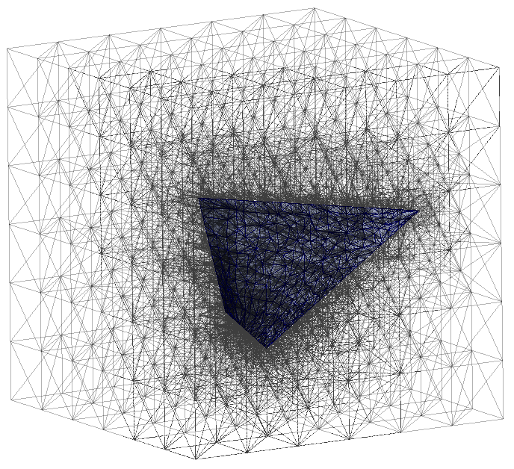
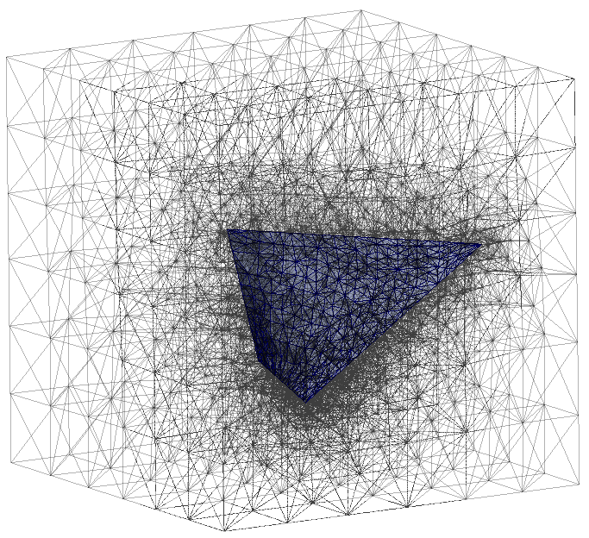
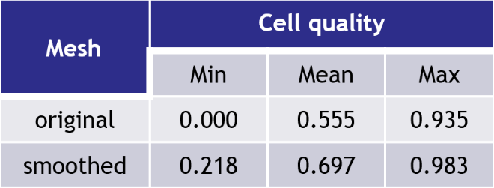
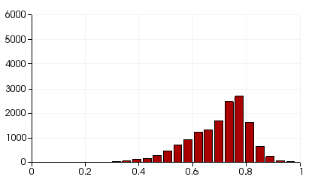

The Wind Field Model
Smoothing
Volume mesh. Cell quality.
Number of cells
Number of cells
quality
quality

Slide 18


Applications (I)
Fault approximation in oil field exploitation
Goal: Capture a fault in a subsoil stratum
Smooth approximation
Mesh size
5850 nodes
25559 cells
Cell quality
Min | Mean | Max
0,209 | 0,725 | 0,983
Rough approximation

Slide 19


The Wind Field Model
Applications (I)
Fault approximation in oil field exploitation
Surface
Rough approximation
Smooth approximation

Slide 20


Applications (II)
Interfaces between atmospheric layers in wind forecasting
Goal: Capture interfaces between atmospheric layers to force tetrahedra to be completely contained in a single layer
Region of interest (red) in the global scenario
Vertical wind profile

Slide 21

Applications (II)
Interfaces between atmospheric layers in wind forecasting
Mesh size
15286 nodes
64634 cells
Cell quality
Min | Mean | Max
0.162 | 0.757 | 0.977

Slide 22
The Wind Field Model
Conclusions and Future research
Conclusions
Conclusions
  The proposed algorithm provides a smooth aproximation of a surface immersed in a tetrahedral mesh generated by the Meccano method
  The triangles of the approximation are faces of cells of the mesh
  Simple operations are involved in the construction of the initial approximation: refinement and mesh element (cell, face, edge) selection
  The adaptive refinement, combined with the optimization of nodes constrained to the surface parameterization, allows to increase the resolution, i. e., the number of nodes in the surface approximation, while preserving quality of cells in the tetrahedral mesh

Slide 23

The Wind Field Model
Conclusions and Future research
Future research
Future research
  Extend the algorithm to manage the intersection of several immersed surfaces
  Consider not immersed surfaces, which intersect the mesh boundary
  Generalize the algorithm to arbitrary surfaces (closed surfaces, complex topologies, etc.)

Slide 24
The Wind Field Model
Questions ?
End of the presentation
Thank you for your attention!

Slide 25
Surface insertion in a tetrahedral mesh using the Meccano method
Socorro G.V.⁽¹⁾, Ruiz-Gironés E.⁽²⁾, Oliver A.⁽¹⁾, Cascón J.M.⁽³⁾, Escobar J.M.⁽¹⁾,
Sarrate J.⁽²⁾ and Montenegro R.⁽¹⁾
⁽¹⁾ University Institute SIANI, University of Las Palmas de Gran Canaria, Spain
⁽²⁾ Laboratori de Càlcul Numèric (LaCàN), Universitat Politècnica de Catalunya – BarcelonaTech, Spain
⁽³⁾ Department of Economics and Economic History, University of Salamanca, Spain
CMN - 2015 June 29 – July 2, 2015, Lisbon, Portugal
MINECO
PROGRAMA ESTATAL DE I+D+I ORIENTADA A LOS RETOS DE LA SOCIEDAD Project: CTM2014-55014-CR3-1-R
CONACYT-SENER Project, Fondo Sectorial, contract: 163723
http://www.dca.iusiani.ulpgc.es/proyecto2012-2014

