Slide 1
Tetrahedral Mesh Optimization Combining Boundary and
Inner Node Relocation and Adaptive Local Refinement
Socorro G.V.⁽¹⁾, Ruiz-Gironés E.⁽²⁾, Oliver A.⁽¹⁾, Cascón J.M.⁽³⁾, Escobar J.M.⁽¹⁾, Sarrate J.⁽²⁾ and Montenegro R.⁽¹⁾
⁽¹⁾ University Institute SIANI, University of Las Palmas de Gran Canaria, Spain
⁽²⁾ Laboratori de Càlcul Numèric (LaCàN), Universitat Politècnica de Catalunya – BarcelonaTech, Spain
⁽³⁾ Department of Economics and Economic History, University of Salamanca, Spain
http://www.dca.iusiani.ulpgc.es/proyecto2012-2014

Slide 2
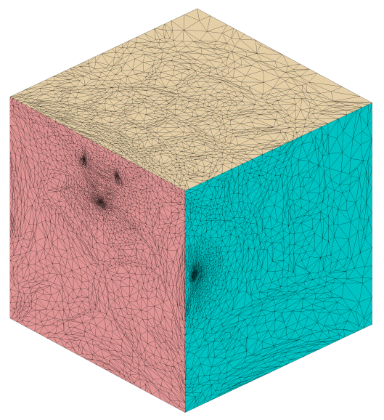
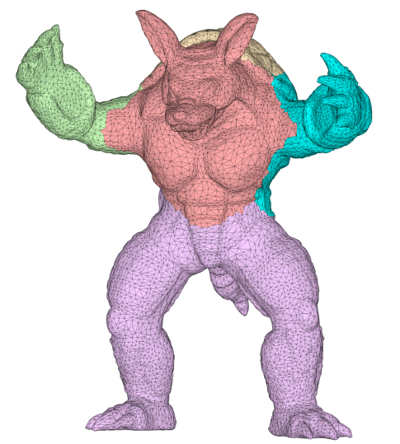
Motivation
Mesh Genus-Zero Solids
Mesh genus-zero solids and get a valid volumetric parameterization
Improve the quality of meshes generated ussing the Meccano method
Main drawback: boundary nodes attached at their location
Smooth of bondary nodes
(a) boundary surfaces
(b) parametric domain
11th World Congress on Computational Mechanics (WCCM XI). 20 – 26 July 2014.
Tetrahedral Mesh Optimization Combining Boundary and Inner Node Relocation and Adaptive Local Refinement - 2

Slide 3
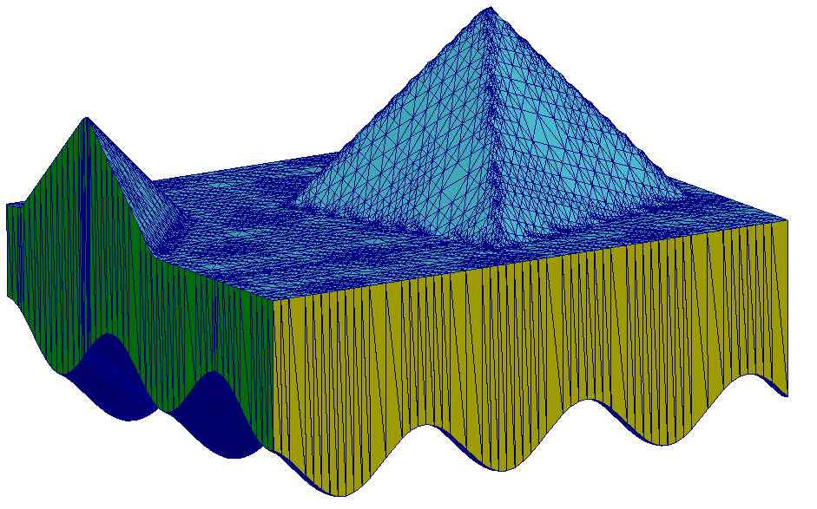
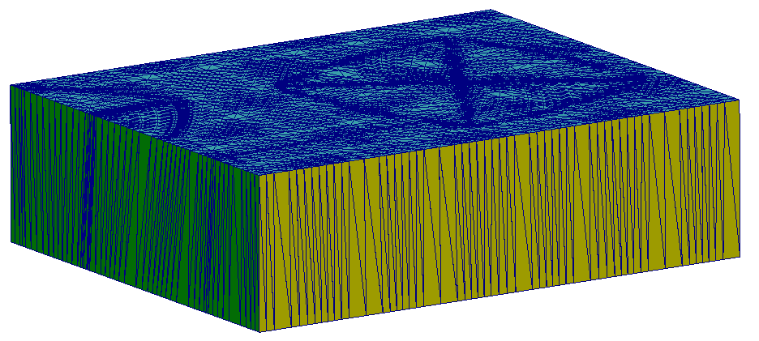
The Meccano Method
Surface Parameterization
Map physical boundary surface to meccano boundary
(a) solid boundary surfaces
(b) parametric domain
11th World Congress on Computational Mechanics (WCCM XI). 20 – 26 July 2014.
Tetrahedral Mesh Optimization Combining Boundary and Inner Node Relocation and Adaptive Local Refinement - 3

Slide 4
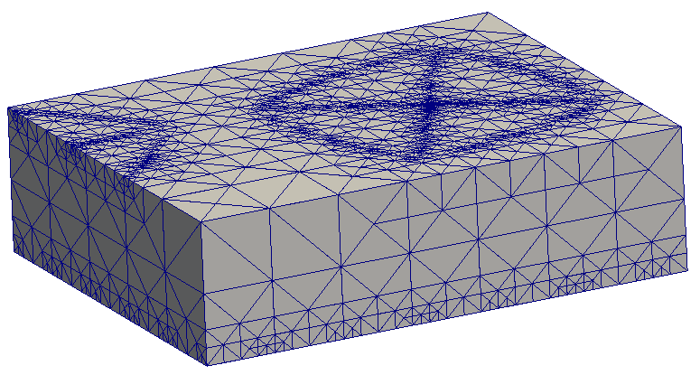
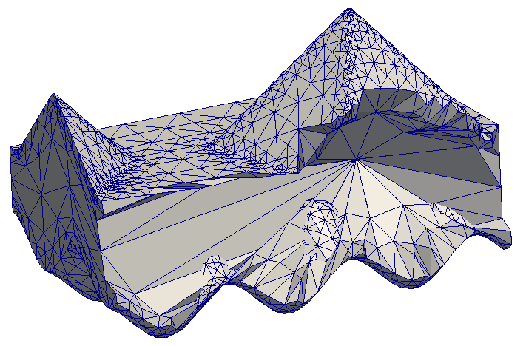
The Meccano Method
Surface Capture
Mesh and refine the meccano to capture solid surfaces
(a) refined meccano mesh
(b) solid mesh
11th World Congress on Computational Mechanics (WCCM XI). 20 – 26 July 2014.
Tetrahedral Mesh Optimization Combining Boundary and Inner Node Relocation and Adaptive Local Refinement - 4

Slide 5
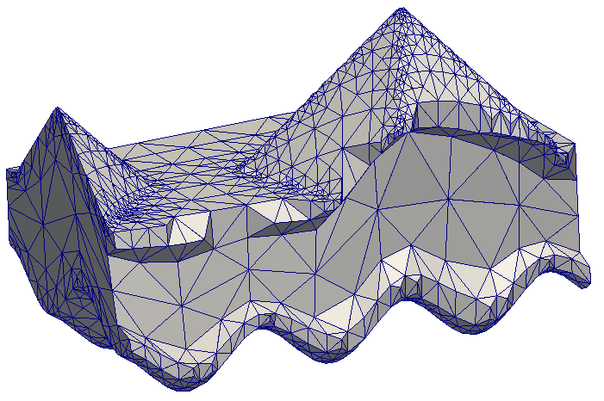
The Meccano Method
Inner Nodes Location
Apply Coons patches to get a reasonable location for inner nodes
(a) solid mesh before Coons patches
(b) solid mesh after Coons patches
11th World Congress on Computational Mechanics (WCCM XI). 20 – 26 July 2014.
Tetrahedral Mesh Optimization Combining Boundary and Inner Node Relocation and Adaptive Local Refinement - 5

Slide 6
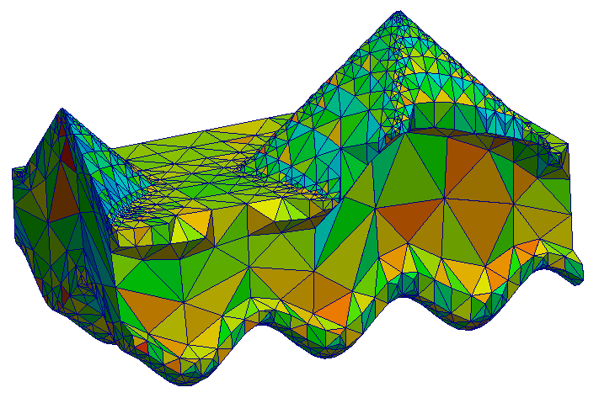
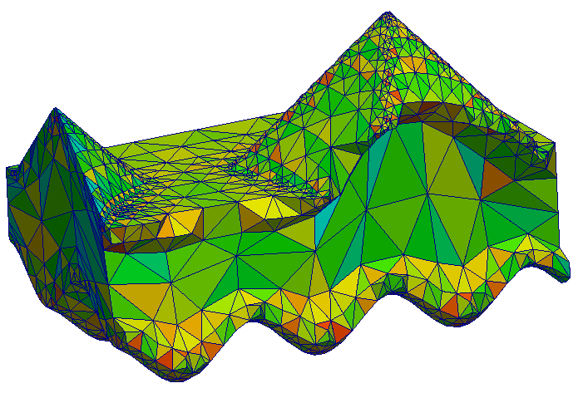
The Meccano Method
Untangle and Smoothing
Simultaneous untangle and smoothing to get a valid mesh
(a) tangled solid mesh
(b) untangled and smoothed solid mesh
11th World Congress on Computational Mechanics (WCCM XI). 20 – 26 July 2014.
Tetrahedral Mesh Optimization Combining Boundary and Inner Node Relocation and Adaptive Local Refinement - 6

Slide 7
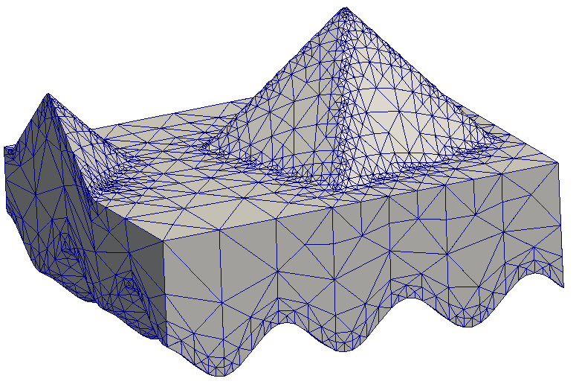
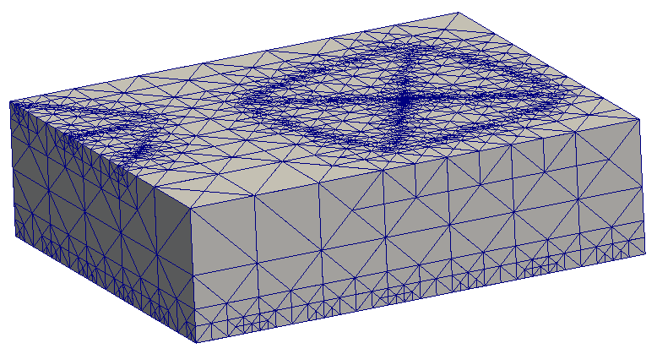
The Meccano Method
Resulting Volume Parameterization
Volumetric parameterization from uniform structure Kossascky mesh to solid in physical domain
(a) uniform Kossascky meccano mesh
(b) solid mesh in physical domain
11th World Congress on Computational Mechanics (WCCM XI). 20 – 26 July 2014.
Tetrahedral Mesh Optimization Combining Boundary and Inner Node Relocation and Adaptive Local Refinement - 7

Slide 8
Tetrahedral Mesh Smoothing
Inner Node Smoothing
Unconstrained optimization problem in 3D physical domain
Physical coordinates as optimization variables
Quality measurement in physical domain
Parametric counterpart as ideal reduce the distortion
(b) after optimization
(a) before optimization
11th World Congress on Computational Mechanics (WCCM XI). 20 – 26 July 2014.
Tetrahedral Mesh Optimization Combining Boundary and Inner Node Relocation and Adaptive Local Refinement - 8

Slide 9
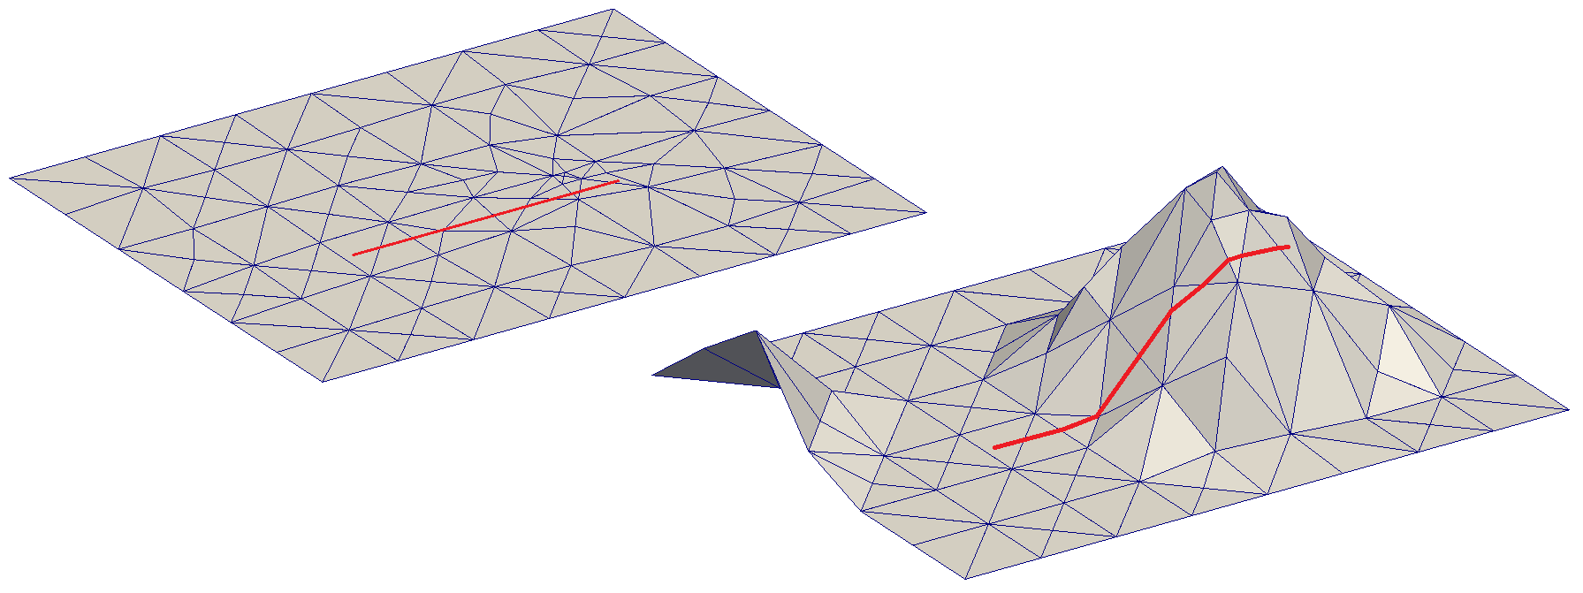
Tetrahedral Mesh Smoothing
Boundary Node Smoothing. Parameterizations
Exploit mesh parametrization to simplify the optimization problem
3D (physical)
surface constrained
mesh parameterization
2D (parametric)
rectangle constrained
(a) parametric domain
(b) physical domain
11th World Congress on Computational Mechanics (WCCM XI). 20 – 26 July 2014.
Tetrahedral Mesh Optimization Combining Boundary and Inner Node Relocation and Adaptive Local Refinement - 9

Slide 10
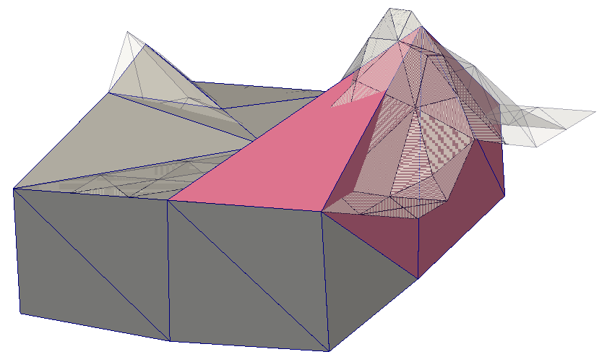
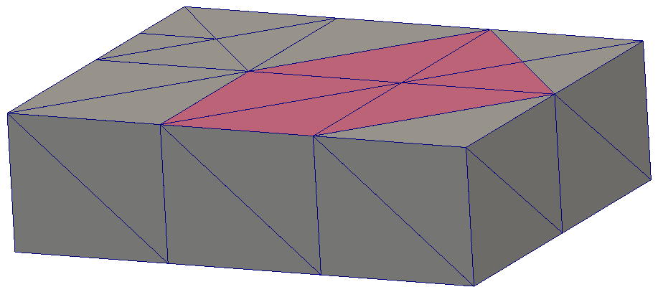
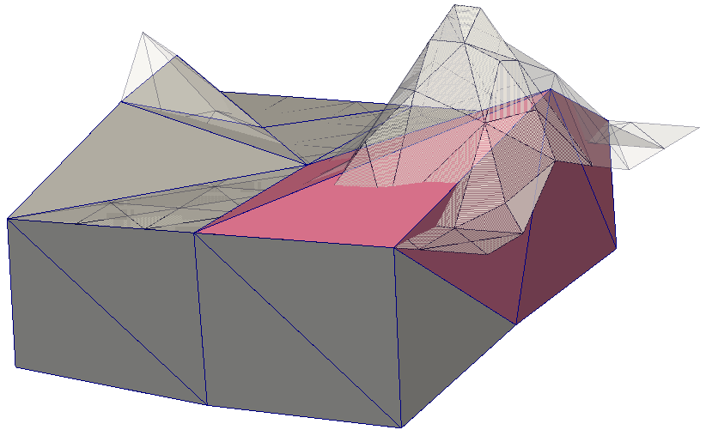
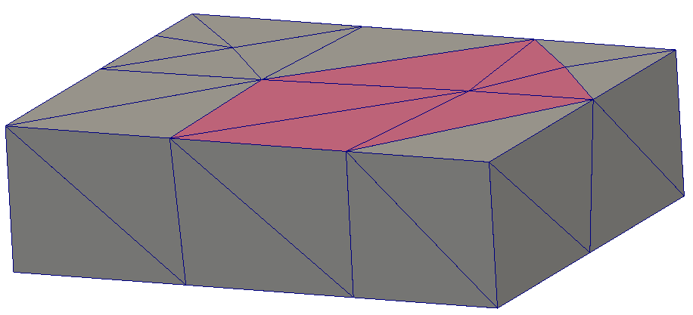
Tetrahedral Mesh Smoothing
Boundary Node Smoothing. Optimization
Optimization
Parametric coordinates as optimization variables
Quality measurement in physical domain
(a) Initial locations
(b) locations after smoothing
11th World Congress on Computational Mechanics (WCCM XI). 20 – 26 July 2014.
Tetrahedral Mesh Optimization Combining Boundary and Inner Node Relocation and Adaptive Local Refinement - 10

Slide 11
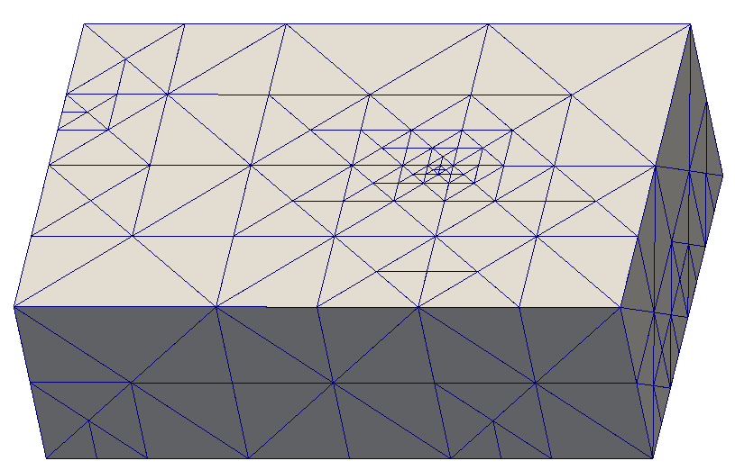
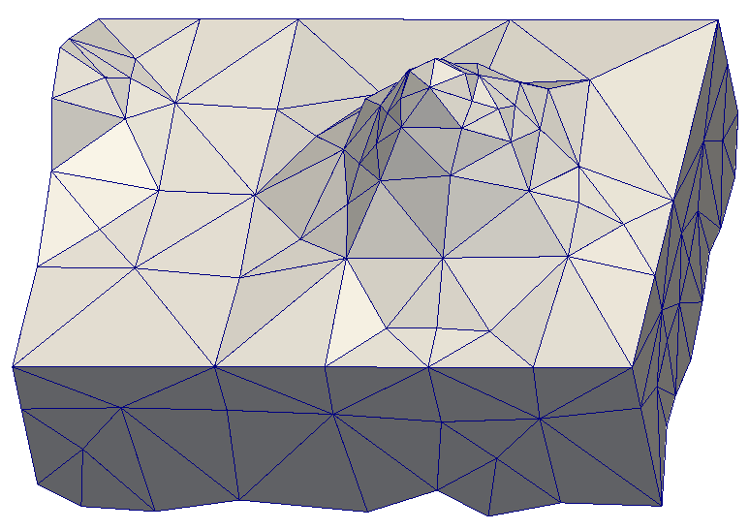
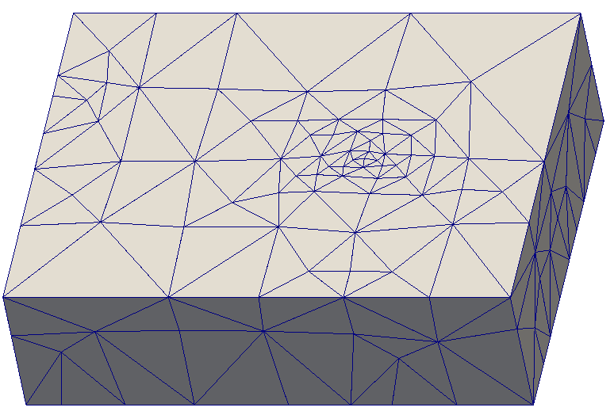
Tetrahedral Mesh Smoothing
Boundary Node Smoothing. Parametric Domains
Creating an additional parametric domain for smoothing porpouse only
volumetric
parameterization
parametric domain R
(regular Kossascky mesh)
physical domain
Floater’s
parameterization
parametric domain S
(no regular Kossascky mesh)
11th World Congress on Computational Mechanics (WCCM XI). 20 – 26 July 2014.
Tetrahedral Mesh Optimization Combining Boundary and Inner Node Relocation and Adaptive Local Refinement - 11

Slide 12
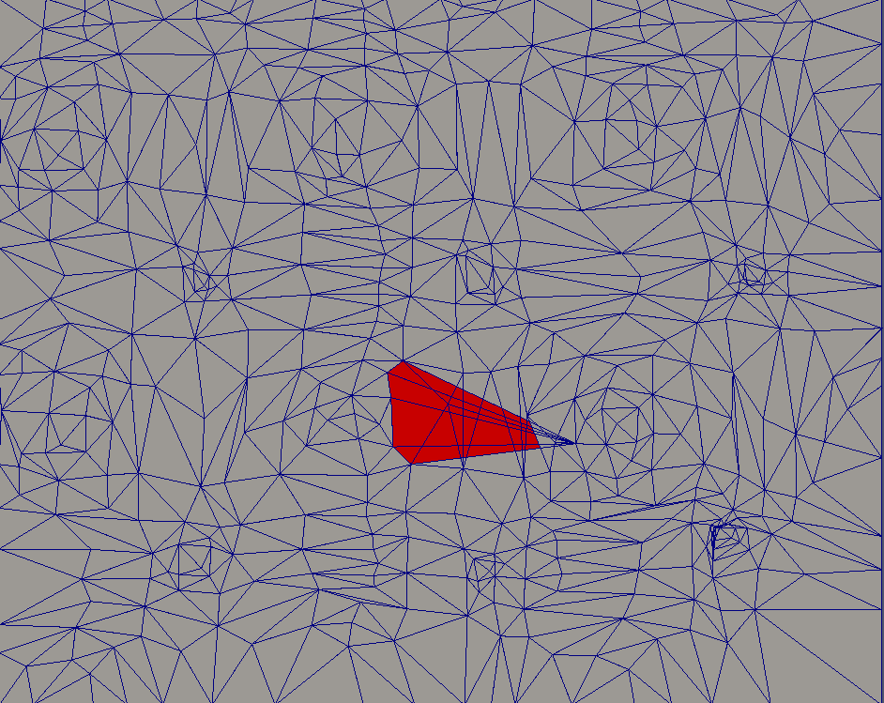
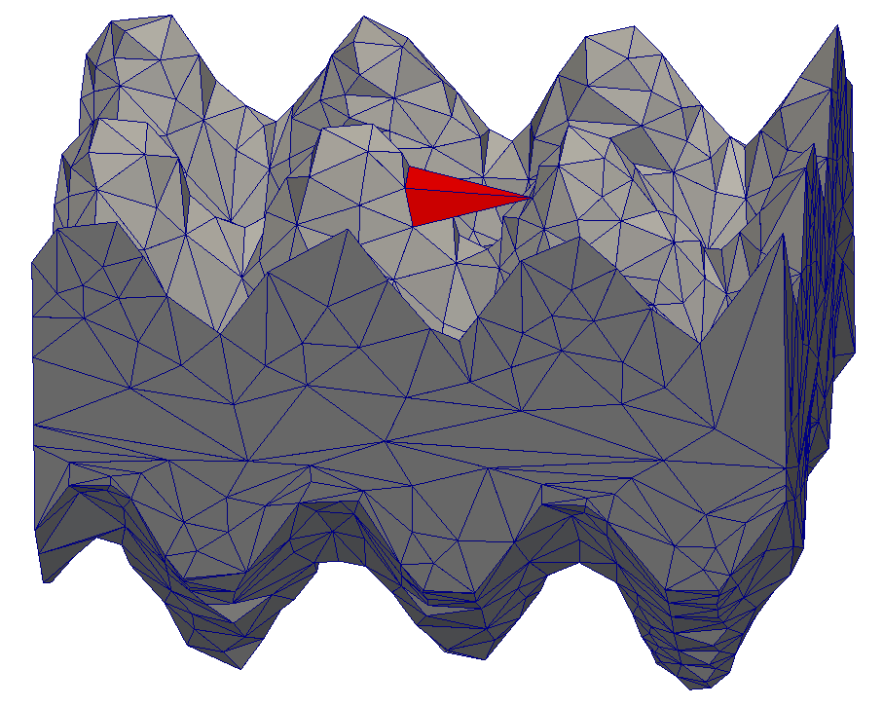
Tetrahedral Mesh Smoothing
Validity of Boundary Mesh
Geometry preservation
The resulting mesh is tangled. There are no inverted tetrahedral but some of them are overlapped no valid mesh
(a) parametric domain
(b) physical domain
11th World Congress on Computational Mechanics (WCCM XI). 20 – 26 July 2014.
Tetrahedral Mesh Optimization Combining Boundary and Inner Node Relocation and Adaptive Local Refinement - 12

Slide 13
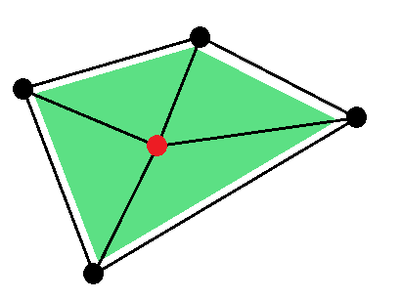
Tetrahedral Mesh Smoothing
Boundary Node Smoothing
Imposing validity for boundary faces of the meccano
${ a}_{m}:area ratio$ over star area $τ:thickness of forbidden region$
Extra term in the objective function
that penalties tetrahedral collapse in
the parametric domain.
$${\left|K_{η}\right|}_{p}^{∗}(u, v)= {\left[\sum_{m=1}^{M}{η_{m}^{∗ p}}(x(u, v)) \right]}^{1/p}$$
$$V(u, v)= {\sum_{m=1}^{M}{\frac{1}{h(mín\{a_{m}, τ\})}}}^{}$$
11th World Congress on Computational Mechanics (WCCM XI). 20 – 26 July 2014.
Tetrahedral Mesh Optimization Combining Boundary and Inner Node Relocation and Adaptive Local Refinement - 13

Slide 14
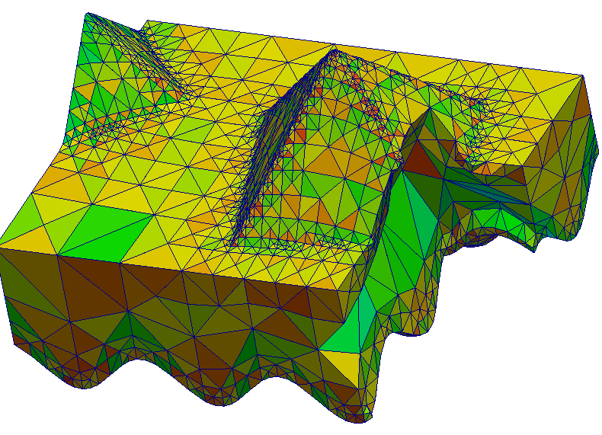
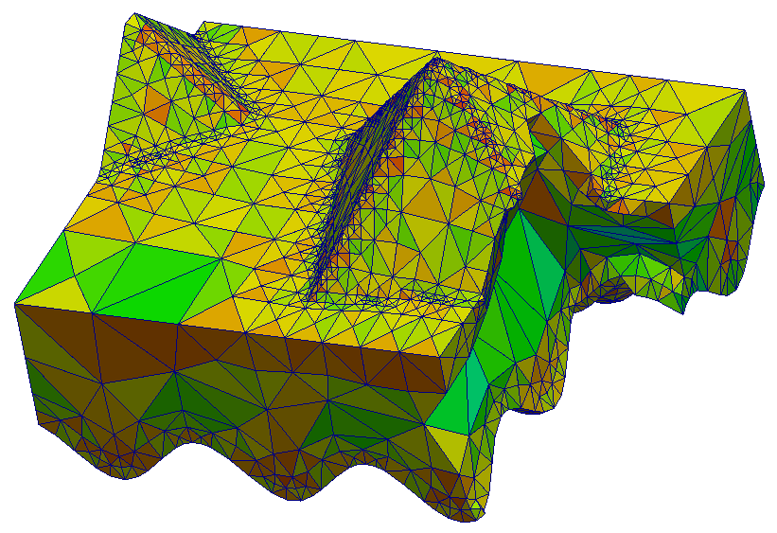
Tetrahedral Mesh Smoothing
Boundary Node Smoothing
Analogous procedure for edge (1D) optimization
Boundary nodes smoothing could cause loose of both volume and geometry
Iterative Refinement, untangle and smoothing stages
11th World Congress on Computational Mechanics (WCCM XI). 20 – 26 July 2014.
Tetrahedral Mesh Optimization Combining Boundary and Inner Node Relocation and Adaptive Local Refinement - 14

Slide 15
Tetrahedral Mesh Smoothing
Bound Smoothing Area (Buffering algorithm)
Mesh must be smoothed after refinement
Buffering algorithm focus smoothing in areas where refinement toke place
Initialize with new nodes a buffer of pending nodes to smooth
Smooth first pending node
If displacement ≥ prescribed threshold $⇒$ enqueue neighbor nodes
If any pending node $⇒$ return to 2
Drastic reduction in the number of star to smooth
11th World Congress on Computational Mechanics (WCCM XI). 20 – 26 July 2014.
Tetrahedral Mesh Optimization Combining Boundary and Inner Node Relocation and Adaptive Local Refinement - 15

Slide 16
Aplications
Oil Field Meshing
11th World Congress on Computational Mechanics (WCCM XI). 20 – 26 July 2014.
Tetrahedral Mesh Optimization Combining Boundary and Inner Node Relocation and Adaptive Local Refinement - 16

Slide 17
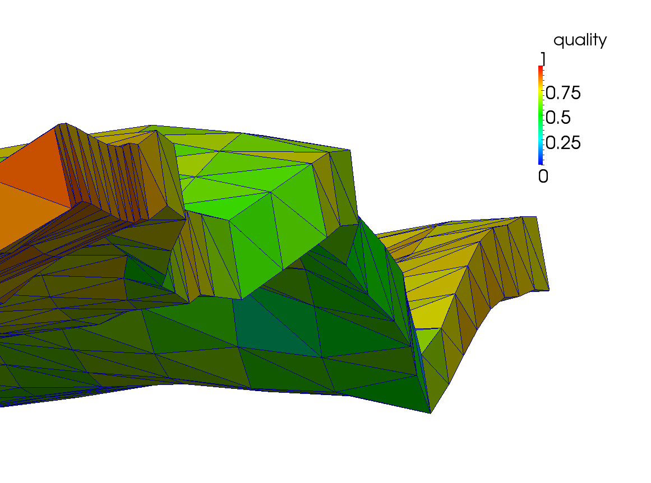
Aplications
Oil Field Meshing
Initial coarse mesh
11th World Congress on Computational Mechanics (WCCM XI). 20 – 26 July 2014.
Tetrahedral Mesh Optimization Combining Boundary and Inner Node Relocation and Adaptive Local Refinement - 17

Slide 18
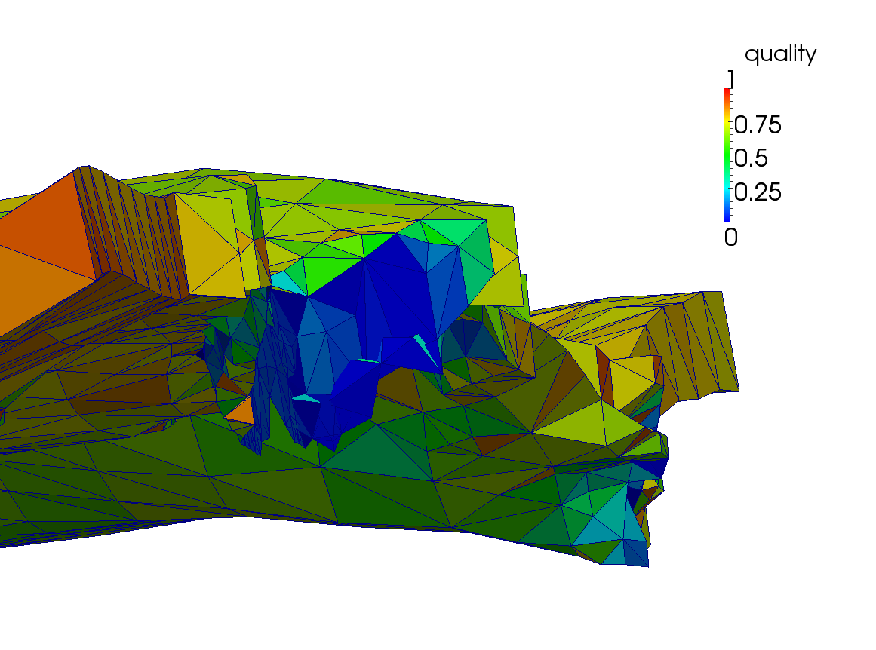
Aplications
Oil Field Meshing
Coons patches
11th World Congress on Computational Mechanics (WCCM XI). 20 – 26 July 2014.
Tetrahedral Mesh Optimization Combining Boundary and Inner Node Relocation and Adaptive Local Refinement - 18

Slide 19
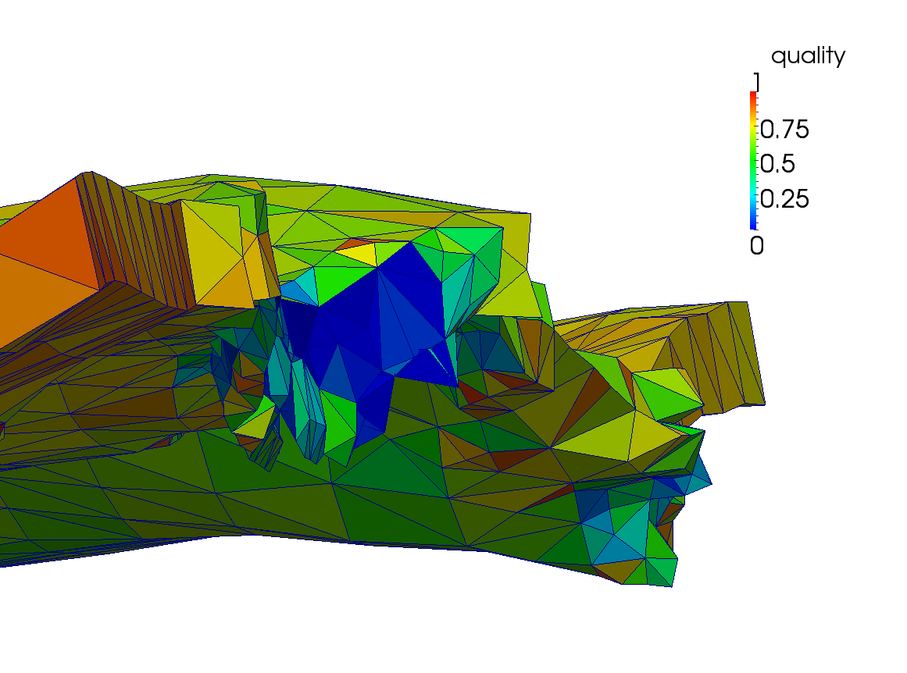
Aplications
Oil Field Meshing
Inner nodes smoothing
11th World Congress on Computational Mechanics (WCCM XI). 20 – 26 July 2014.
Tetrahedral Mesh Optimization Combining Boundary and Inner Node Relocation and Adaptive Local Refinement - 19

Slide 20
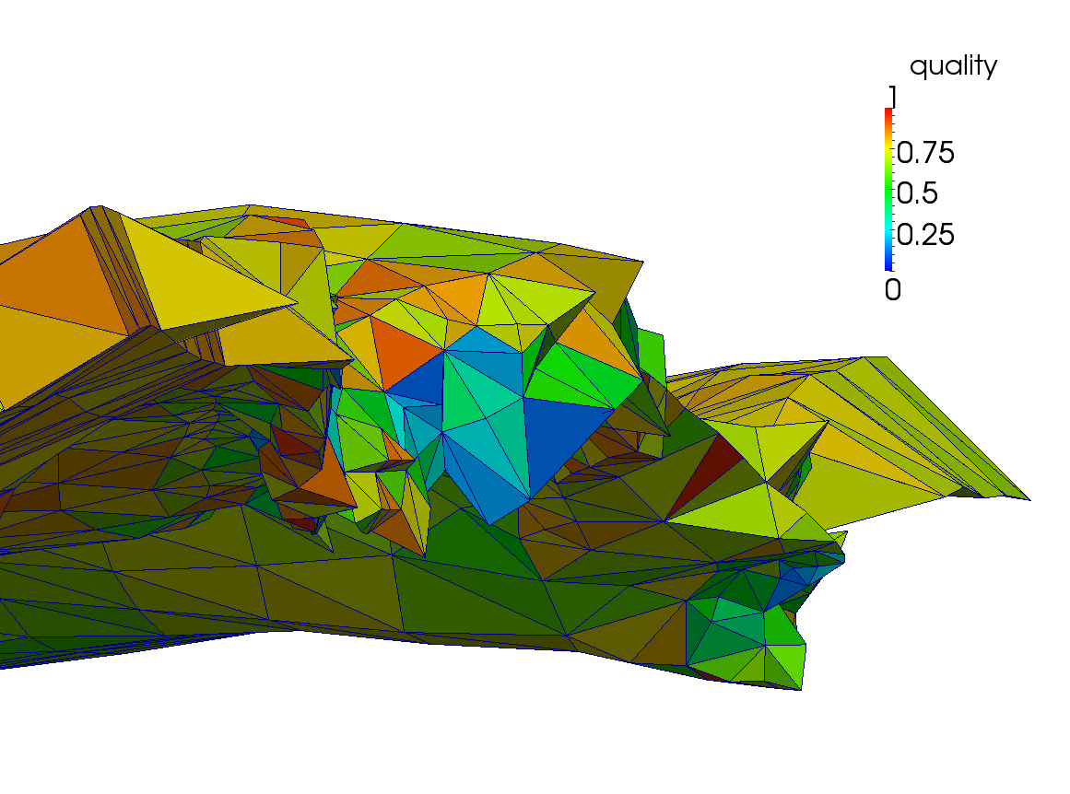
Aplications
Oil Field Meshing
Boundary nodes smoothing
11th World Congress on Computational Mechanics (WCCM XI). 20 – 26 July 2014.
Tetrahedral Mesh Optimization Combining Boundary and Inner Node Relocation and Adaptive Local Refinement - 20

Slide 21
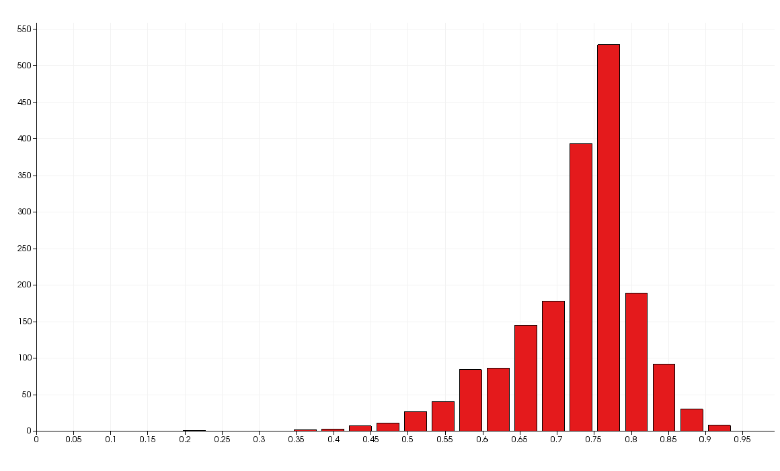
Aplications
Oil Field Meshing
Tetrahedral quality
Nbr. of nodes 8213
Nbr of cells 33104 Min quality 0.0043 Mean quality 0.649 Max quality 0.986
11th World Congress on Computational Mechanics (WCCM XI). 20 – 26 July 2014.
Tetrahedral Mesh Optimization Combining Boundary and Inner Node Relocation and Adaptive Local Refinement - 21

Slide 22
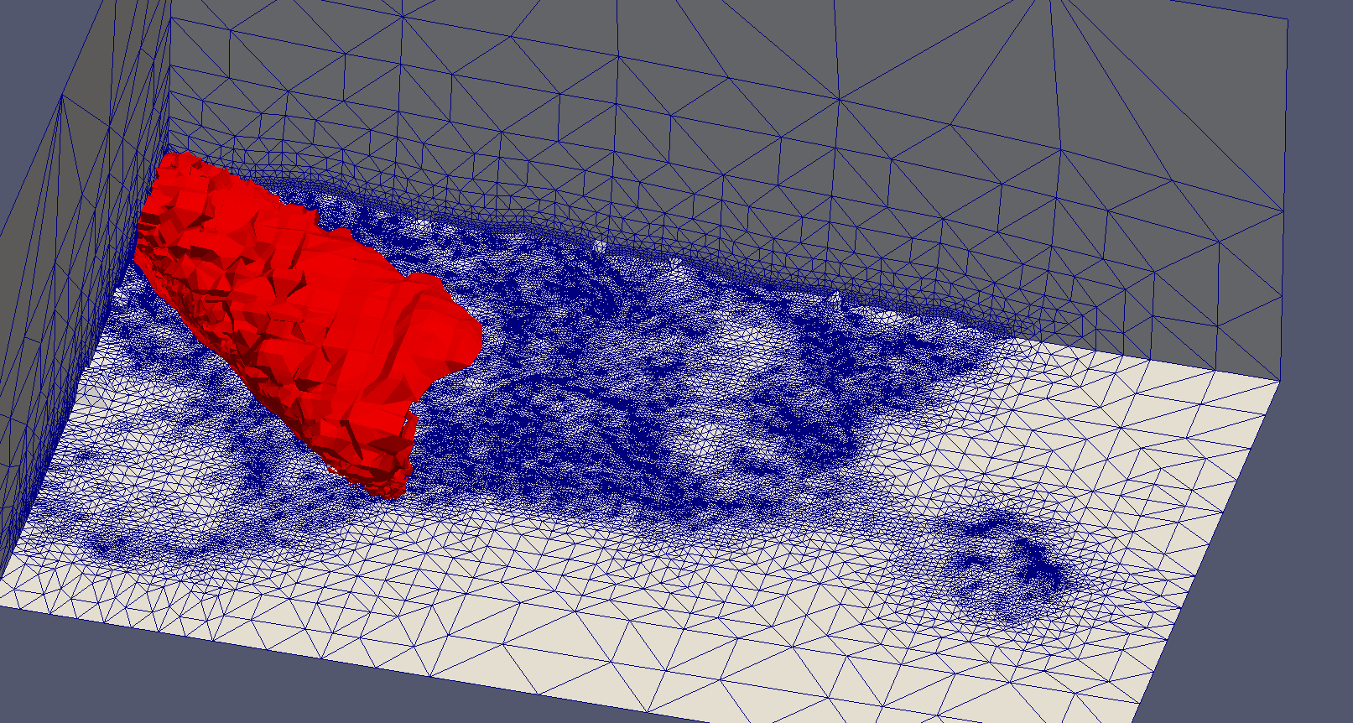
Aplications
Troposphere Meshing for Wind Forecast
11th World Congress on Computational Mechanics (WCCM XI). 20 – 26 July 2014.
Tetrahedral Mesh Optimization Combining Boundary and Inner Node Relocation and Adaptive Local Refinement - 22
Notes:
Brief presentation.

Slide 23
Conclusions
Conclusions
An innovative method has been developed for both, boundary smoothing and volumetric parametrization of genus-zero solid
This work upgrades The Meccano Method by adding boundary nodes relocation
The procedure obtains good quality meshes
The idea can be applied to any mesh generation method that uses surface parameterization
The procedure requires minimum user intervention
The algorithm has a low computational cost and admits paralellization
11th World Congress on Computational Mechanics (WCCM XI). 20 – 26 July 2014.
Tetrahedral Mesh Optimization Combining Boundary and Inner Node Relocation and Adaptive Local Refinement - 23

Slide 24
Questions?
Thanks for your attention!
11th World Congress on Computational Mechanics (WCCM XI). 20 – 26 July 2014.
Tetrahedral Mesh Optimization Combining Boundary and Inner Node Relocation and Adaptive Local Refinement - 24

