Slide 1
University Institute for Intelligent Systems and
Numerical Applications in Engineering
3-D Wind Field Simulation over Complex Terrain
Congreso de la RSME 2015 – Soluciones Matemáticas e Innovación en la Industria
2-6 febrero 2015, Granada
http://www.siani.es/

Slide 2
Meccano Method for Complex Solids
Algorithm steps
Parameterization of the solid surface
Coarse tetrahedral mesh of the meccano
Solid boundary approximation
Inner node relocation
Simultaneous untangling and smoothing
Solid boundary partition
Kossaczky’s refinement
Distance evaluation
Coons patches
SUS
Hexahedron subdivision into six tetrahedra
Meccano construction
Floater’s parameterization
Partition into hexahedra

Slide 3
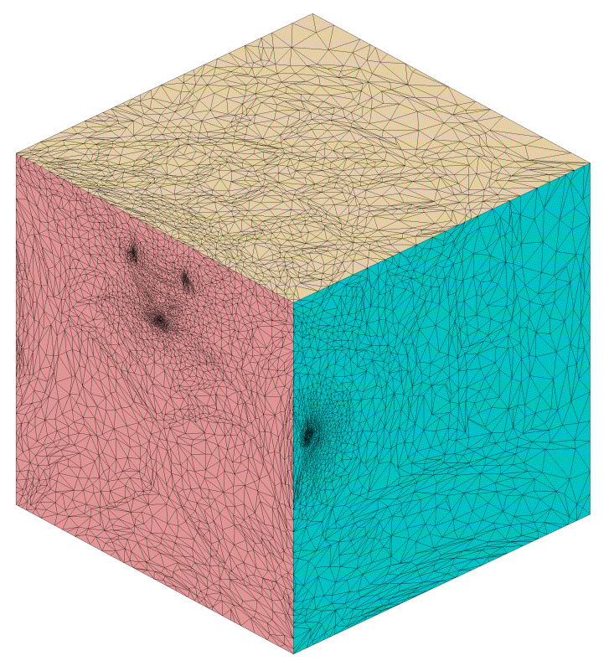
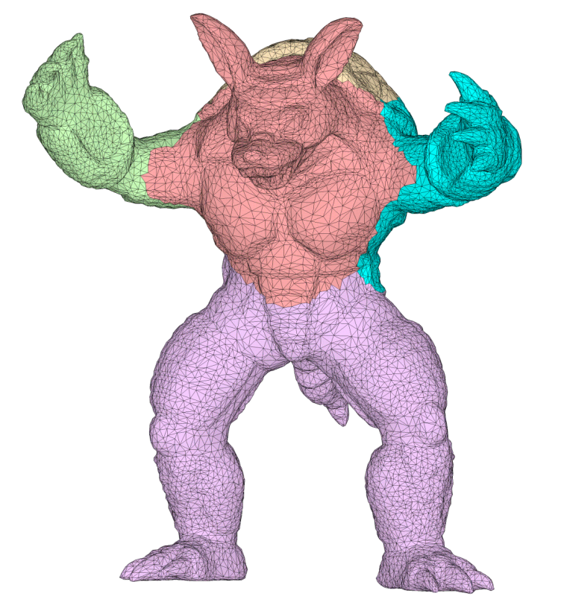

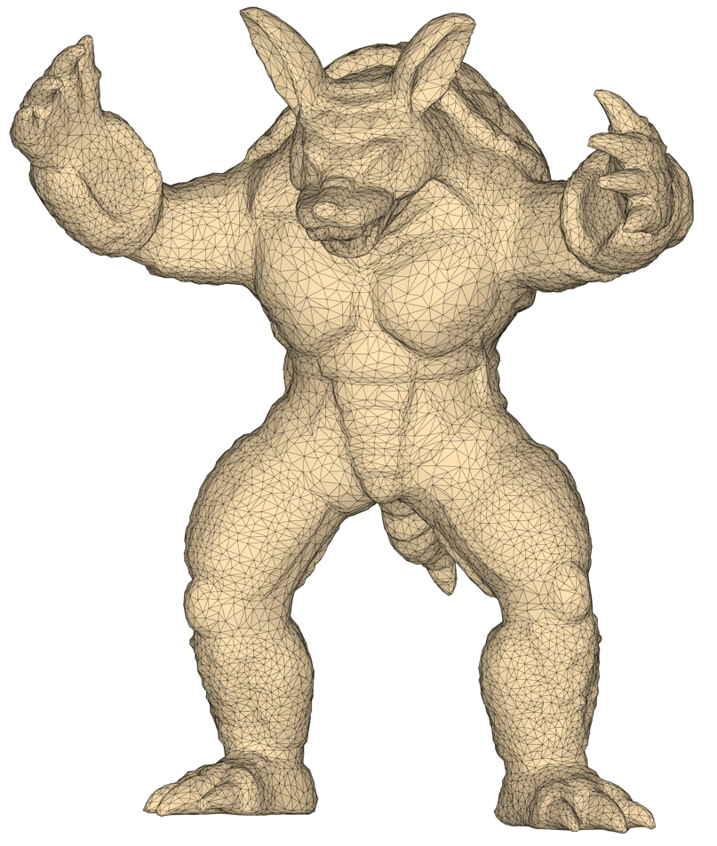
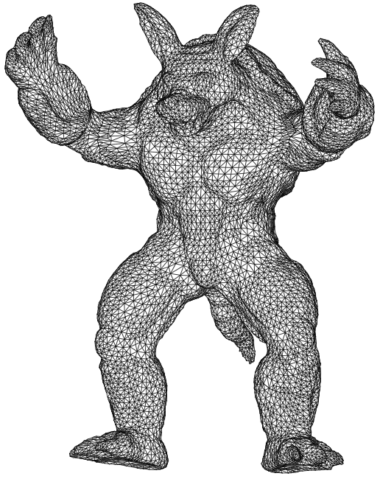
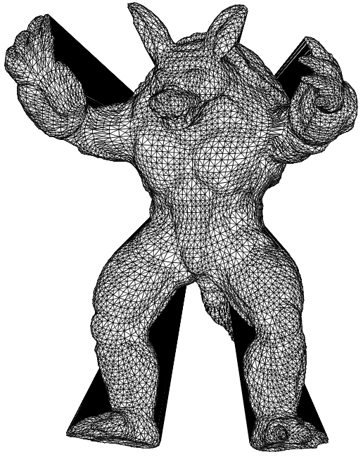
Meccano Method
Simultaneous mesh generation and volumetric parameterization
Parameterization
Refinement
Untangling & Smoothing

Slide 4
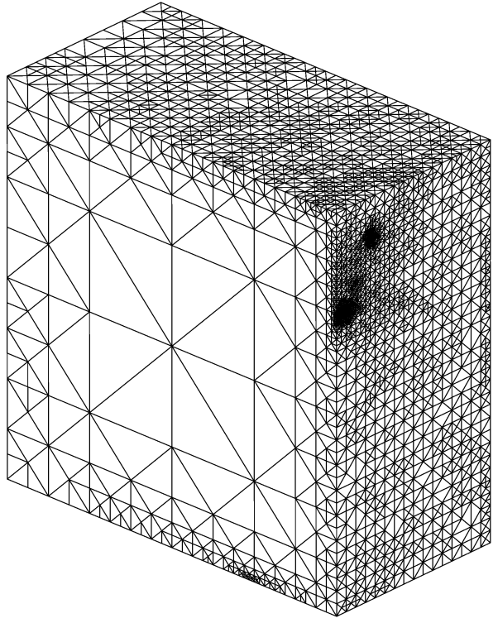
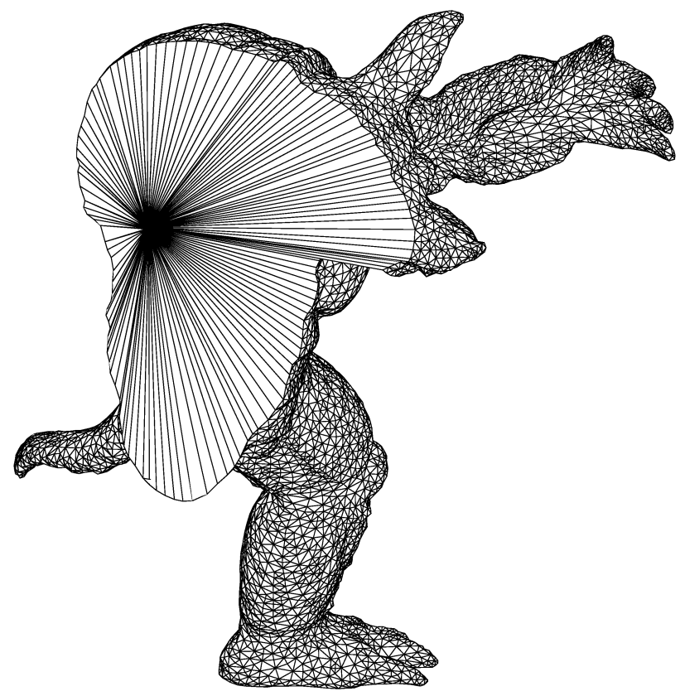
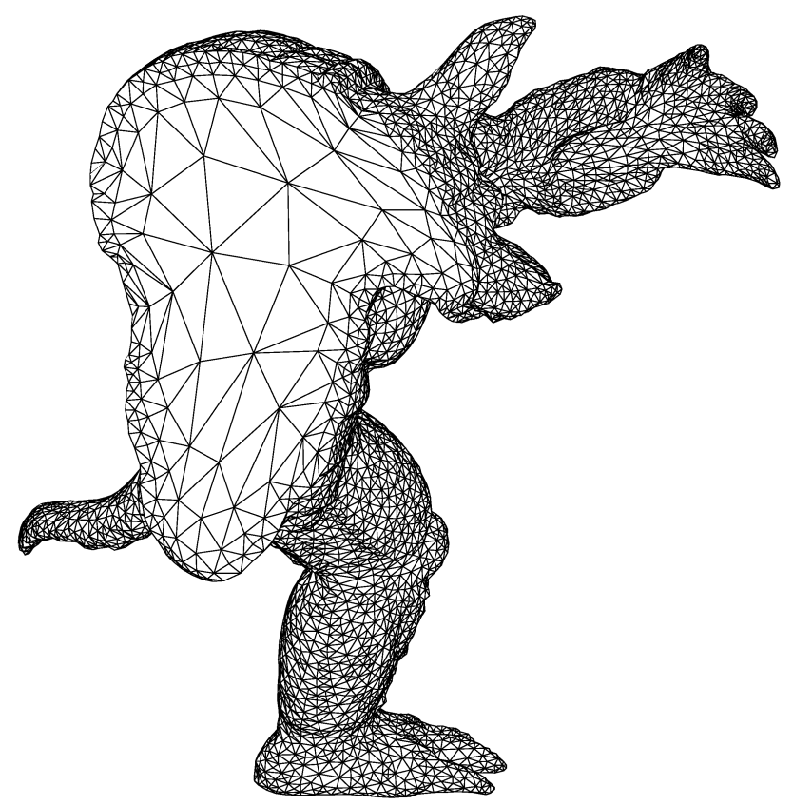
Meccano Method
Key of the method: SUS of tetrahedral meshes
Optimization
Parameter space (meccano mesh)
Physical space
(tangled mesh)
Physical space
(optimized mesh)

Slide 5


Meccano Method
Surface Parameterization of M.S. Floater (CAGD 1997)
From the i-th solid surface triangulation patch to the i-th meccano face
C
Q_{k}
C’
B’
D
Q’_{k}
B
A
Fixed boundary nodes,
D’
A’
Physical Space
Q’_{k} =∑_{j} λ_{j,k} Q’_{j}
Parametric Space
Compromise between area and shape

Slide 6
Meccano Method
Local Refinement: Kossaczky’s Algorithm (JCAM 1994)
❑ Initial cube and its subdivision after three consecutive tetrahedron bisection
6 tetrahedra
12 tetrahedra
24 tetrahedra
48 tetrahedra
Notes:
Decimos que un tetraedro es de Tipo I si está marcado con el indicador de error. Se introducen 6 nuevos nodos en el punto medio de sus aristas y se subdividen cada una de sus cuatro caras en 4 triángulos, uniendo los puntos que se han introducido.
Cuatro subtetraedros quedan determinados a partir de los cuatro vértices del tetraedro original y las nuevas aristas.
Los otros cuatro tetraedros se obtienen al unir los dos vértices opuestos más cercanos del octaedro que resulta en el interior. Estudios de Löhner y Baum aseguran que esta elección produce el menor número de tetraedros distorsionados en la malla refinada. Existen otras dos opciones para subdividir el octaedro, y se podría analizar la calidad de las divisiones, pero aumentaría el coste computacional del algoritmo.
Una vez marcados los tetraedros de Tipo I, para asegurar la conformidad de la malla nos podemos encontrar con tetraedros vecinos que pueden tener 6, 5,..., 1, ó 0 nuevos nodos introducidos.
Aquellos tetraedros que por razones de conformidad tengan marcadas sus 6 aristas pasa automáticamente al conjunto de tetraedros de Tipo I.

Slide 7
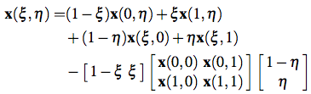


Meccano Method
Coons patches
Coons patches provide a reasonable initial location
in physical domain for inner nodes
  Segment (1D), surface (2D) and cube (3D) interpolations
(a) parametric cube
(b) bilinear interpolation in a rectangle

Slide 8
Meccano Method
Simultaneous Untangling and Smoothing (CMAME 2003)
Local optimization
Objective: Improve the quality of the local mesh by minimizing an objective function
Free node
New position for the free node
Local mesh
Optimized local mesh

Slide 9
Meccano Method
SUS Code: Weighted Jacobian Matrix on a Plane
Reference triangle
Physical triangle
Ideal triangle
y
A
y
y
2
S = AW ⁻¹
2
2
t
t_{R}
0
1
t_{I}
1
x
x
0
1
x
0
W
S
t_{I} t
: Weighted Jacobian matrix
An algebraic quality metric of t
(mean ratio)
where:

Slide 10
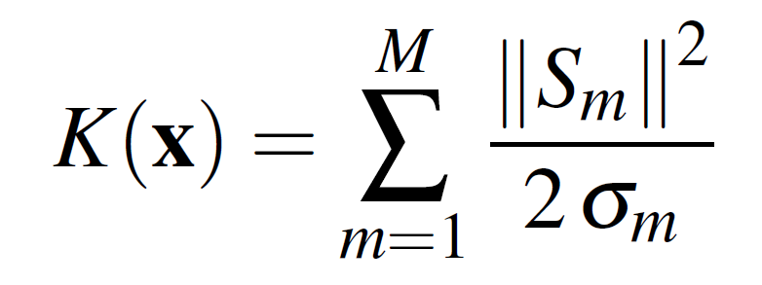
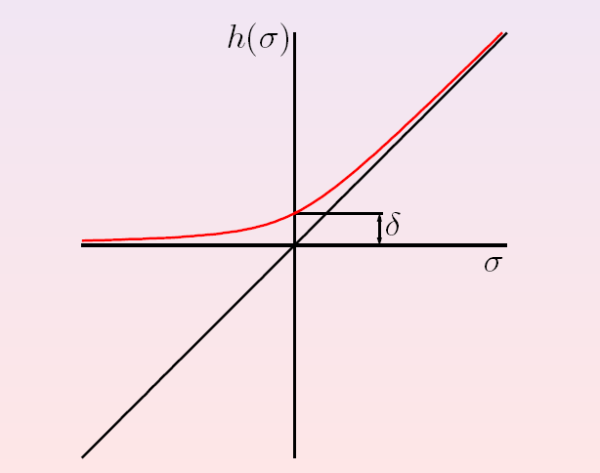
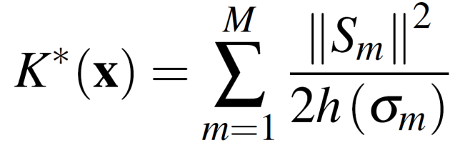

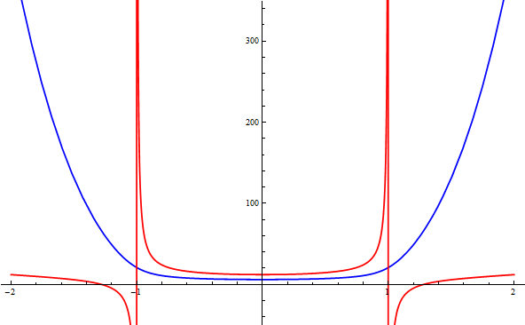
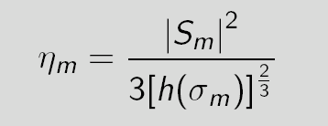
Meccano Method
SUS Code: Local objective function for plane triangulations
Original function:
Modified function:
Modified function (blue) is regular in all R² and it approximates the same minimum that the original function (red). Moreover, it allows a simultaneous untangling and smoothing of triangular meshes
The extension to tetrahedral meshes is straightforward:

Slide 11
Meccano Method
Oil field strata meshing
Boundary surfaces
Volume mesh

Slide 12
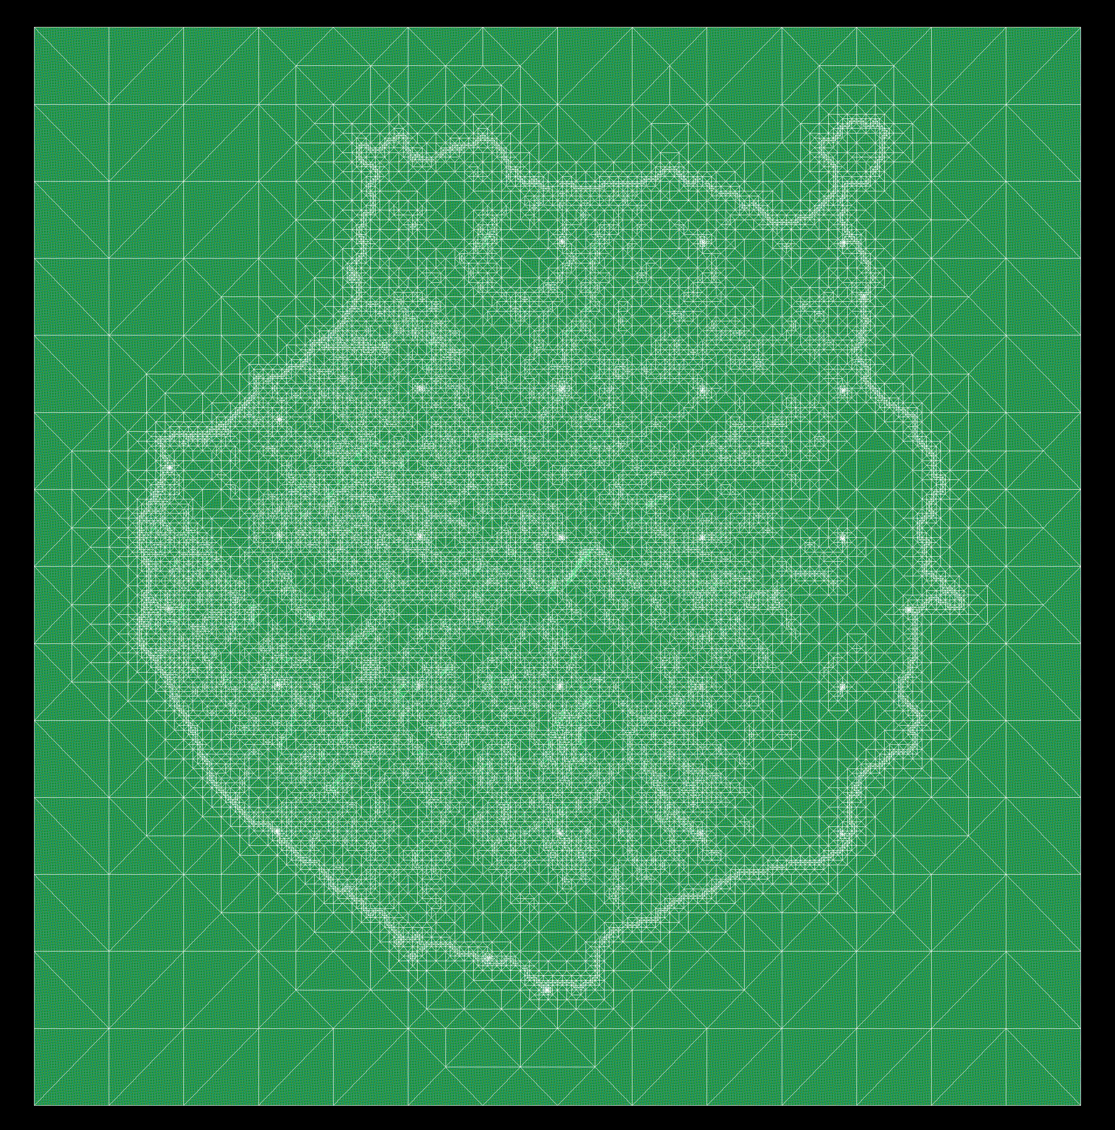
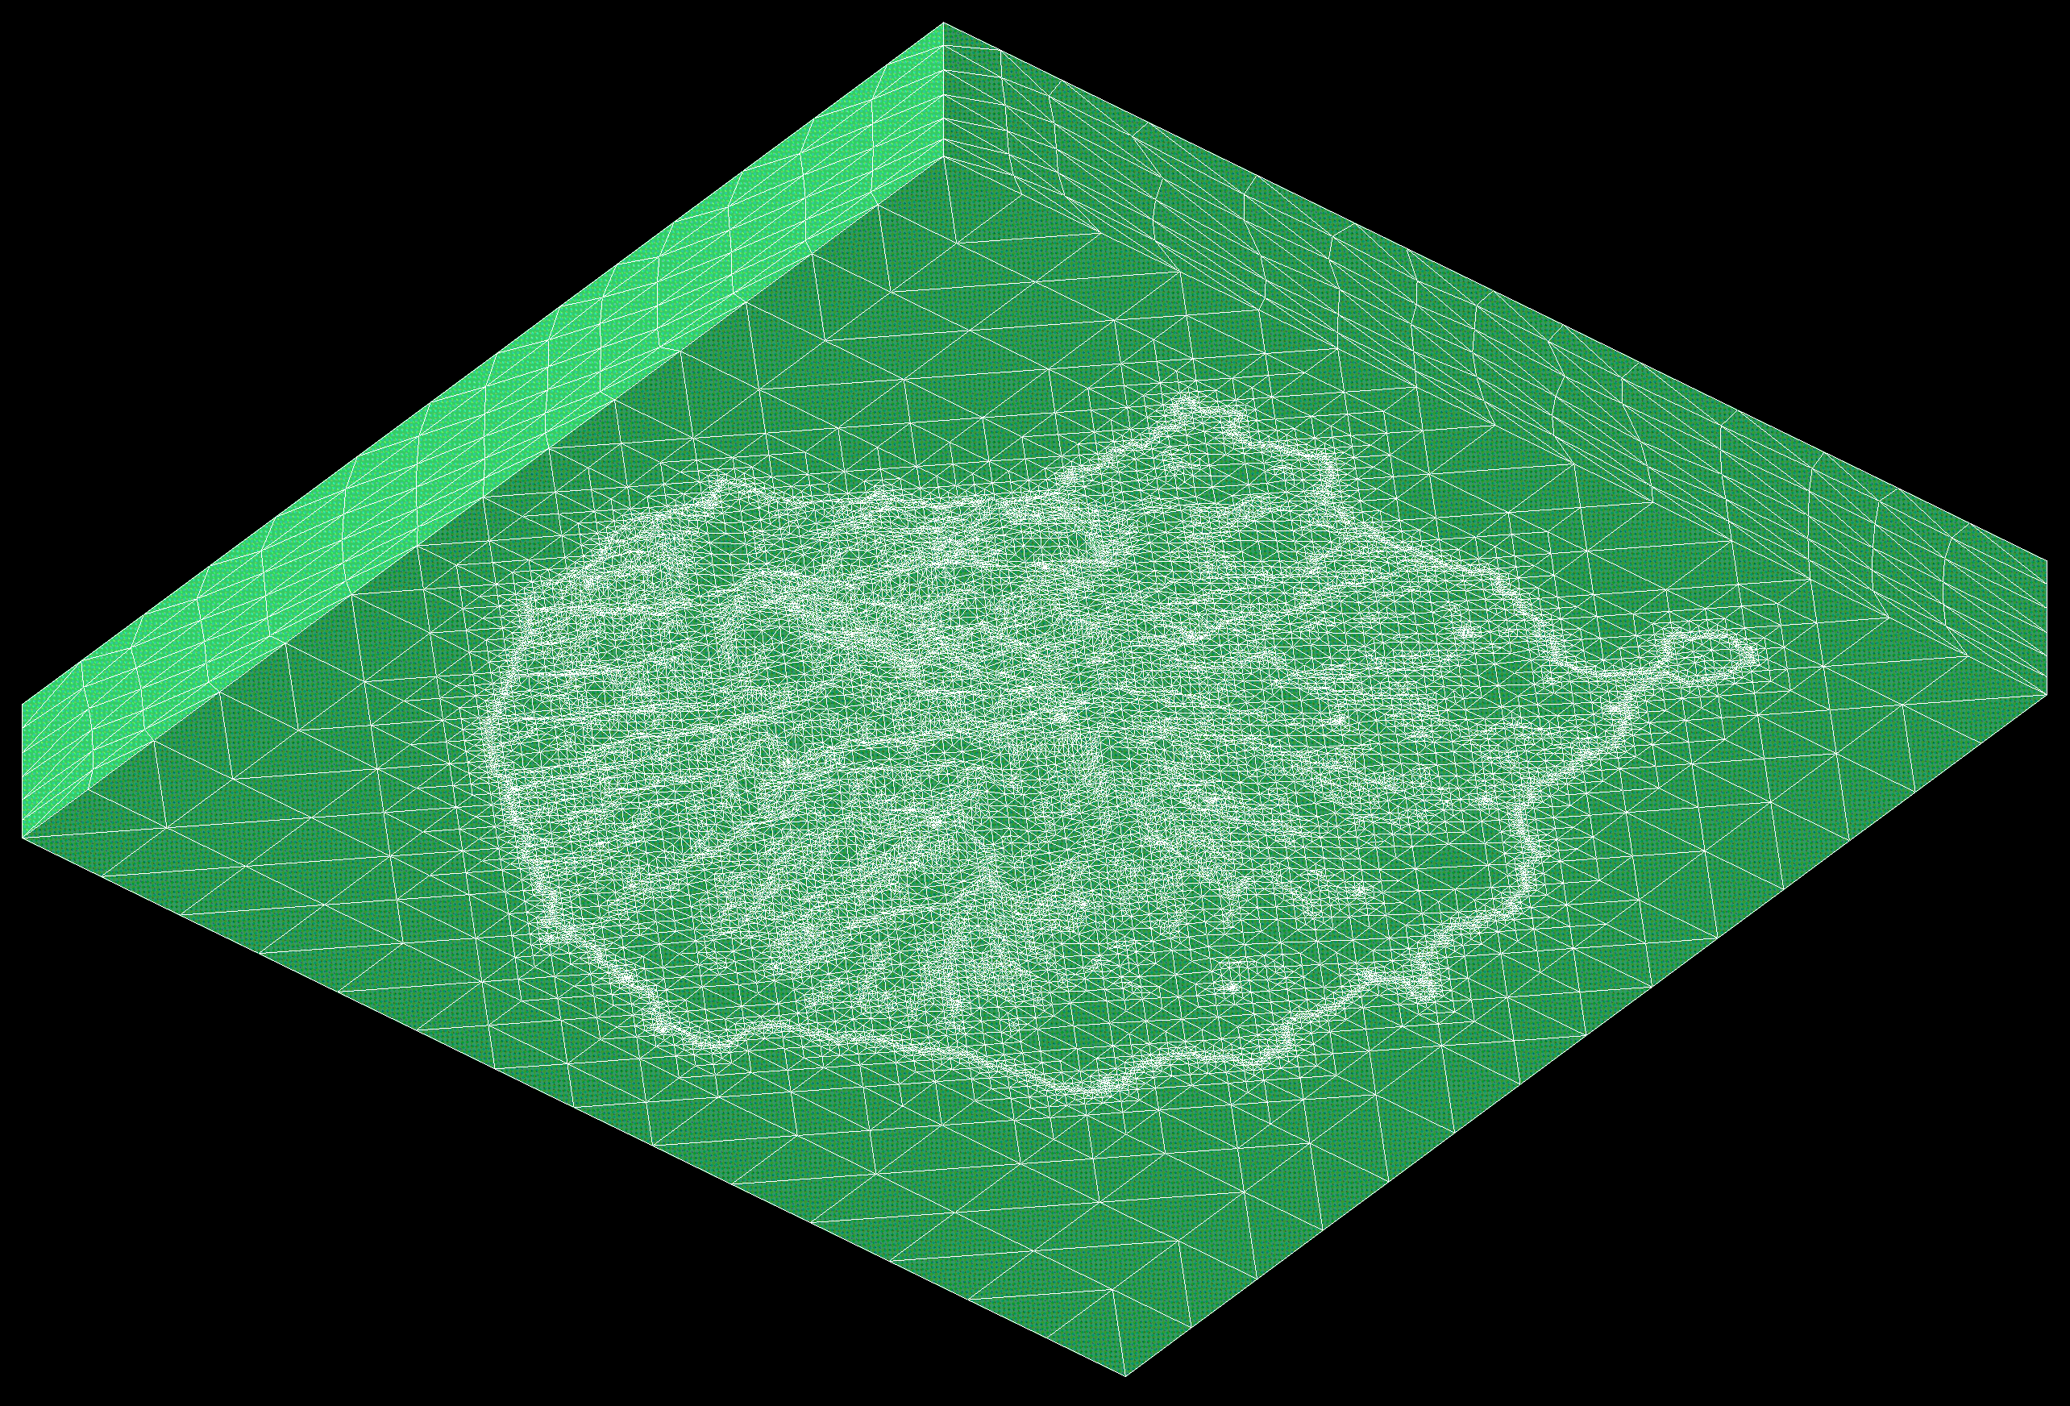

Slide 14

Wind Field Modeling

Slide 15
Wind Field Modeling
Conquered challenges
Local scale wind field model JWEIA(1998, 2001, 2010)
Mass consistent model (MMC) provides a useful method for local scale wind studies.
Local wind 3D field using data measurements.
Automatic process. Few model parameters.
Low computational cost due to use of adaptive tetrahedral meshes and efficient solvers.
Parameter estimation LNCS(2002), AES(2005)
Use of parallel GAs for parameter estimation.
Integration with mesoscale models PAG (2015)
Coupling with HARMONIE leads to predictive capabilities.
Use of HARMONIE outputs as MMC inputs.
Ensemble methods PAG (2015)
Use of ensemble methods to obtain local scale wind prediction.

Slide 16
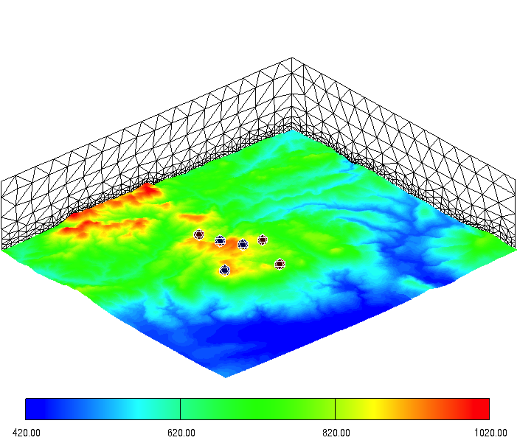


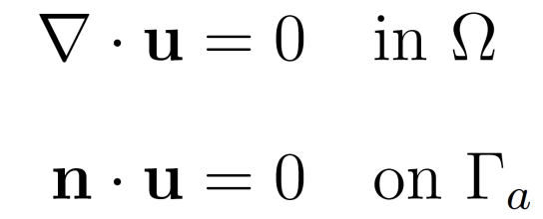
Wind Field Modeling
Mass Consistent Wind Model
: observed wind, which is obtained with horizontal interpolation and vertical extrapolation of experimental or forecasted data.
Objective: find the velocity field
that it adjusts to
verifying
- Incompressibility condition in the domain:
- Impermeability condition on the terrain:

Slide 17
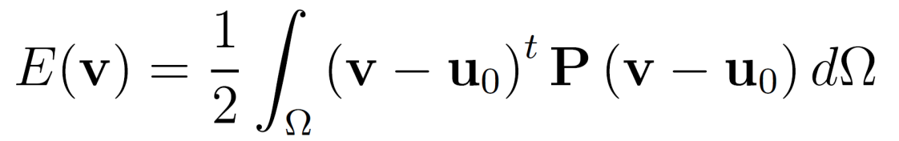

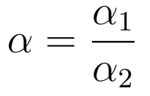
Wind Field Modeling
Mass Consistent Wind Model
Then,
is the solution of the least-square problem: Find
verifying
where
We can write E as follows

Slide 18
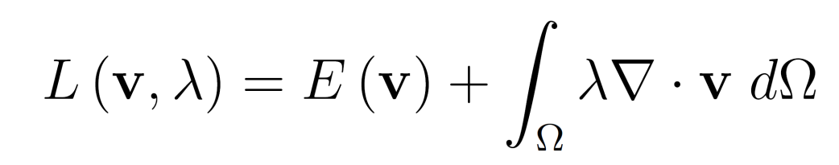

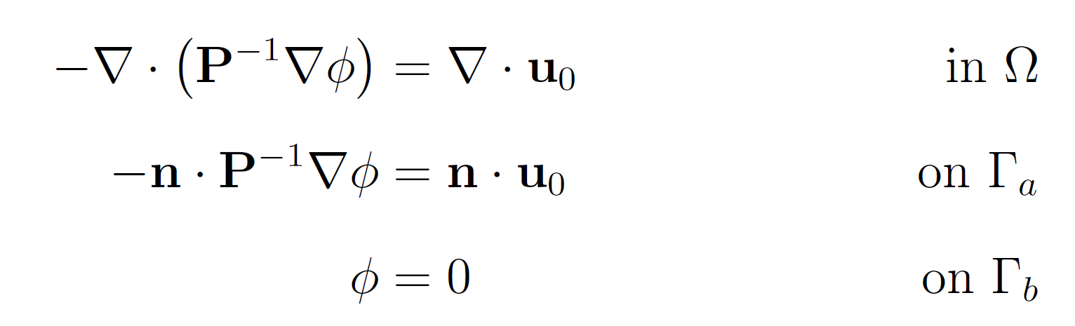
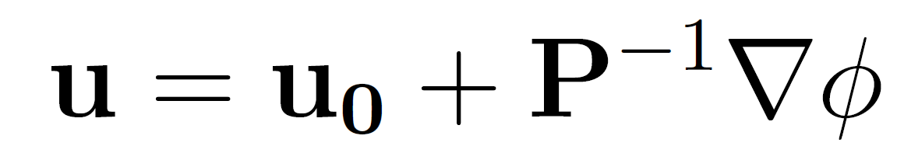
Wind Field Modeling
Mass Consistent Wind Model
Governing equations

Slide 19
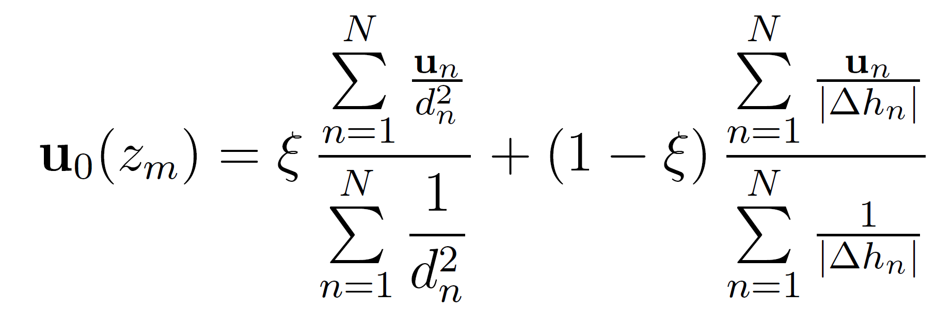

Wind Field Modeling
Mass Consistent Wind Model
Construction of the observed wind
Horizontal interpolation

Slide 20
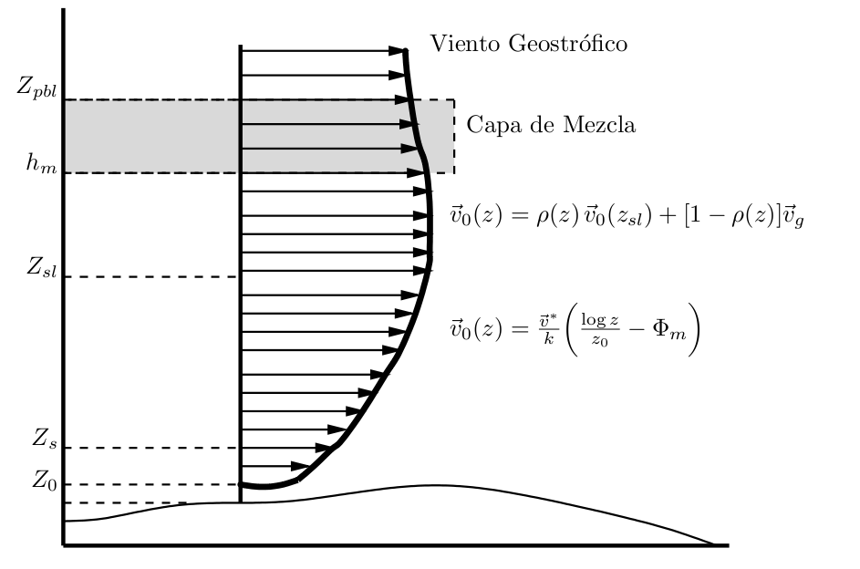




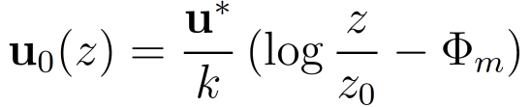


Wind Field Modeling
Mass Consistent Wind Model
Construction of the observed wind
  Vertical extrapolation (log-linear wind profile)
geostrophic wind
mixing layer
terrain surface

Slide 21
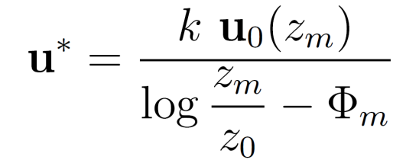
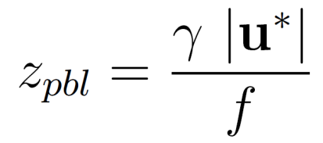





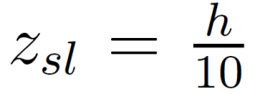
Wind Field Modeling
Mass Consistent Wind Model
● Friction velocity:
● Height of the planetary boundary layer:
is the Coriolis parameter, being
the Earth rotation and
is the latitude
is a parameter depending on the atmospheric stability
● Mixing height:
in neutral and unstable conditions
in stable conditions
● Height of the surface layer:

Slide 22
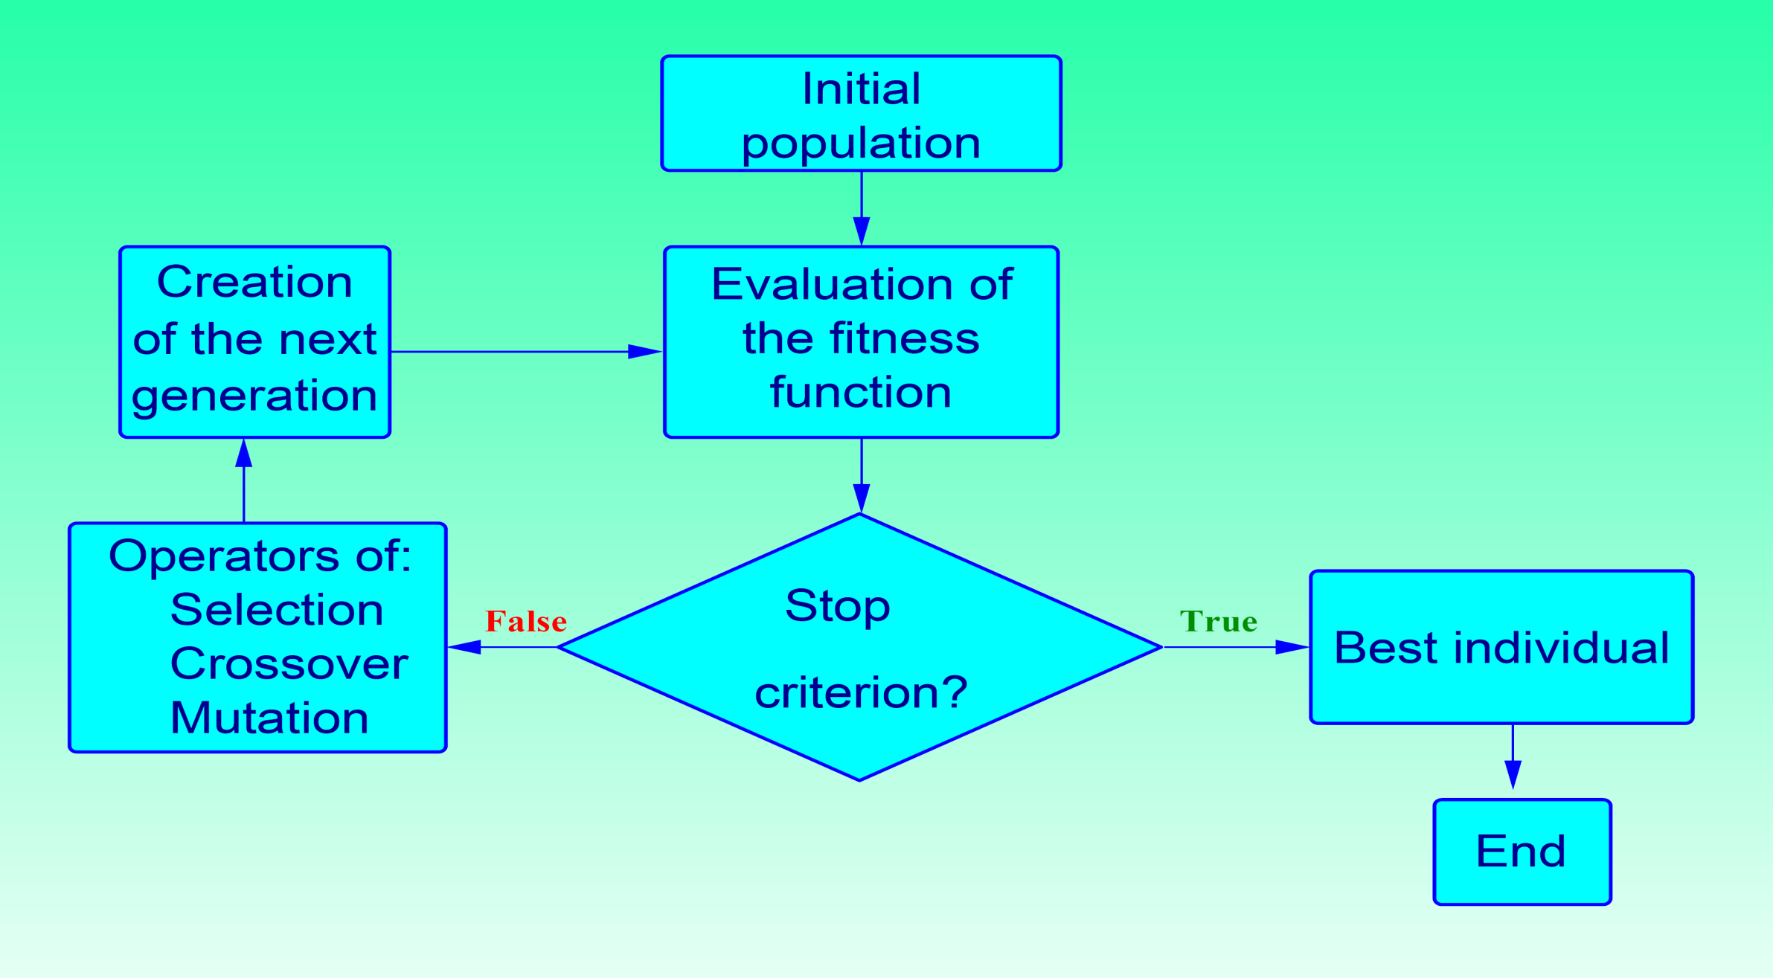
Wind Field Modeling
Estimation of Model Parameters
FE solution
is needed
for each individual
Genetic Algorithm

Slide 23




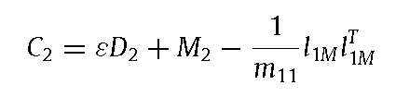

Iterative Solution of Sparse Linear Systems
IChol Preconditioner for shifted linear systems
Cheap strategy: IChol(A_{ε0})
Expensive strategy: FullIChol
IChol_{D}
IChol_{N}

Slide 24
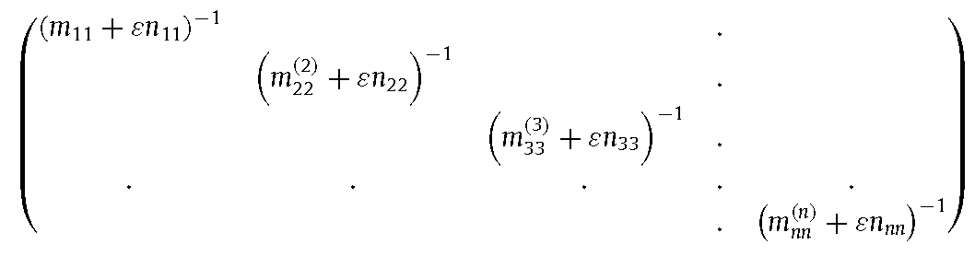


Iterative Solution of Sparse Linear Systems
IChol Preconditioner for shifted linear systems

Slide 25
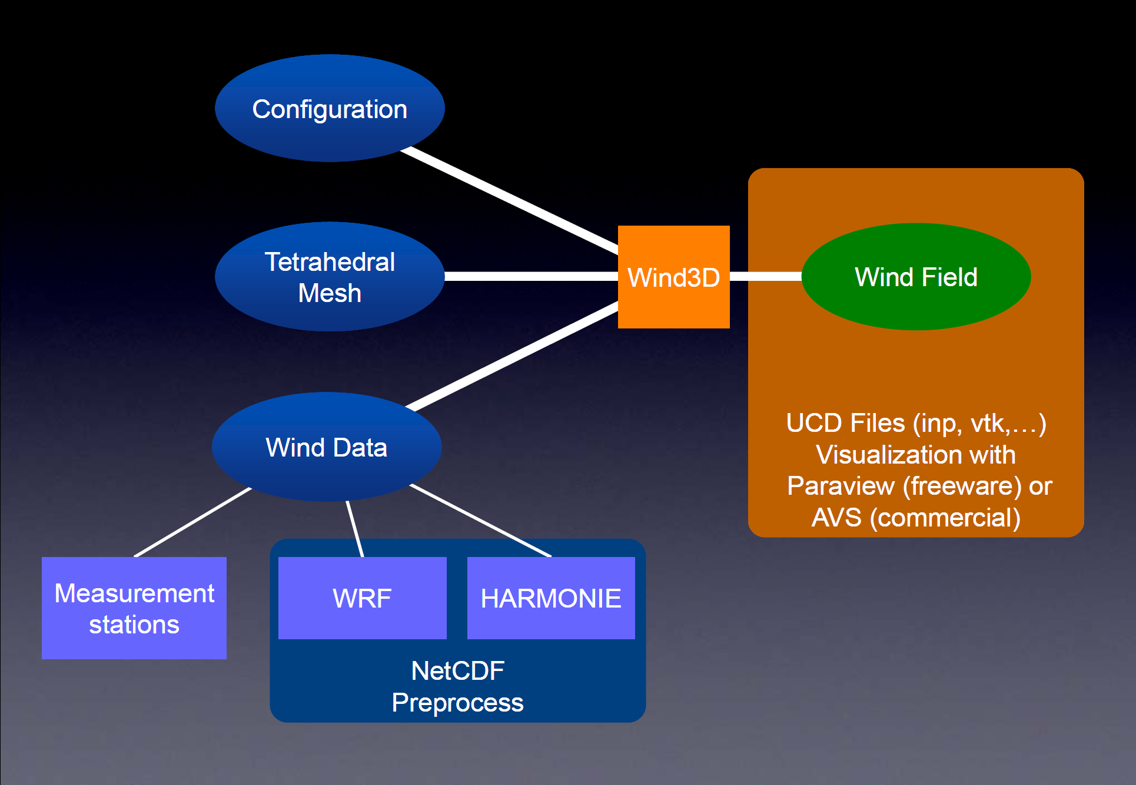
Wind Field Modeling
Forecasting over Complex Terrain
Wind3D Code (freely-available)
http://www.dca.iusiani.ulpgc.es/Wind3D/
Notes:
Decimos que un tetraedro es de Tipo I si está marcado con el indicador de error. Se introducen 6 nuevos nodos en el punto medio de sus aristas y se subdividen cada una de sus cuatro caras en 4 triángulos, uniendo los puntos que se han introducido.
Cuatro subtetraedros quedan determinados a partir de los cuatro vértices del tetraedro original y las nuevas aristas.
Los otros cuatro tetraedros se obtienen al unir los dos vértices opuestos más cercanos del octaedro que resulta en el interior. Estudios de Löhner y Baum aseguran que esta elección produce el menor número de tetraedros distorsionados en la malla refinada. Existen otras dos opciones para subdividir el octaedro, y se podría analizar la calidad de las divisiones, pero aumentaría el coste computacional del algoritmo.
Una vez marcados los tetraedros de Tipo I, para asegurar la conformidad de la malla nos podemos encontrar con tetraedros vecinos que pueden tener 6, 5,..., 1, ó 0 nuevos nodos introducidos.
Aquellos tetraedros que por razones de conformidad tengan marcadas sus 6 aristas pasa automáticamente al conjunto de tetraedros de Tipo I.

Slide 26
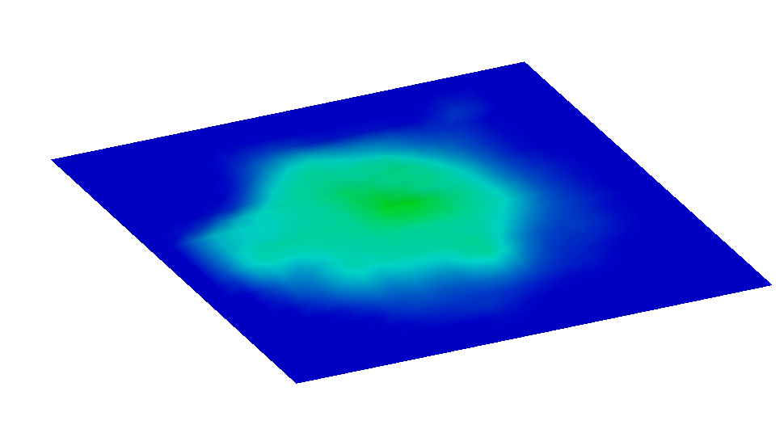
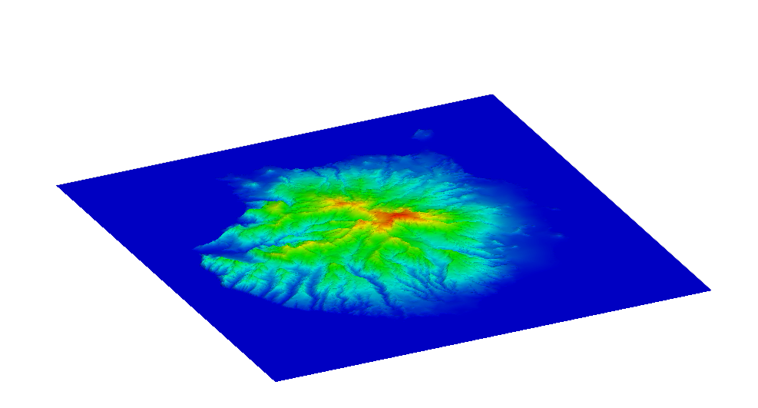
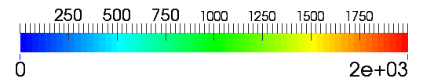
Wind Field Modeling
HARMONIE-FEM wind forecast
Terrain approximation
Max height 925m
Max height 1950m
HARMONIE discretization of terrain
Topography from Digital Terrain Model
Terrain elevation (m)

Slide 27
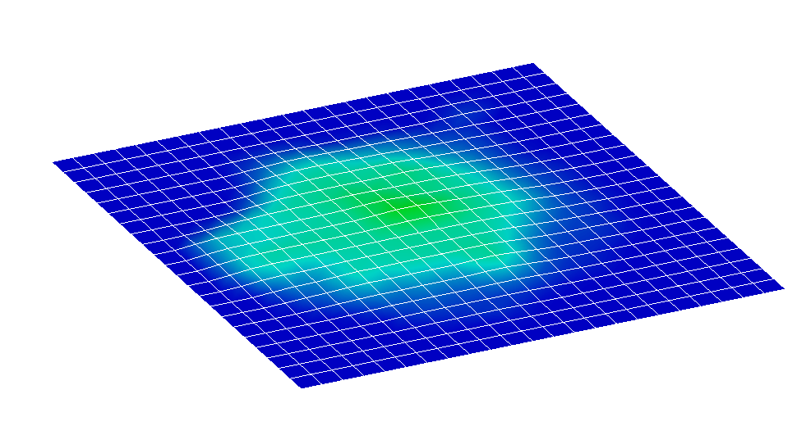
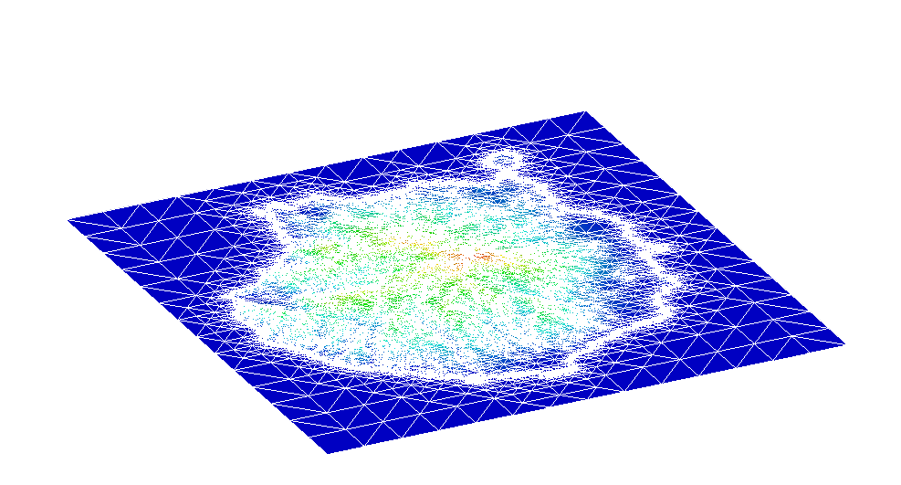
Wind Field Modeling
HARMONIE-FEM wind forecast
Spatial discretization
HARMONIE mesh
Δh ~ 2.5km
FEM computational mesh
Terrain elevation (m)

Slide 28
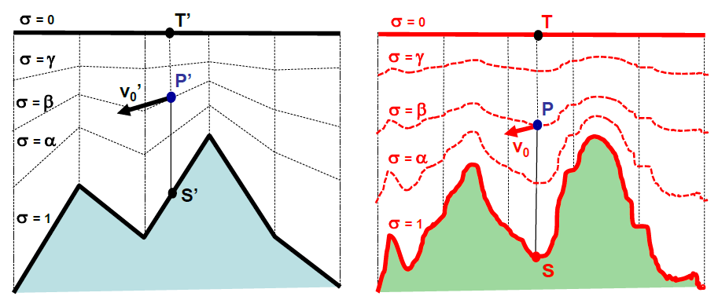
Wind Field Modeling
Data interpolation in FE domain: Problems with terrain discretization
HARMONIE FD domain
FE domain
Possible solutions for a suitable data interpolation in the FE domain:
Use U10 and V10 supposing it is 10m over the FE terrain (used in this talk)
Given a point of FE domain, find the closest one in HARMONIE domain grid
Other possibilities can be considered

Slide 29
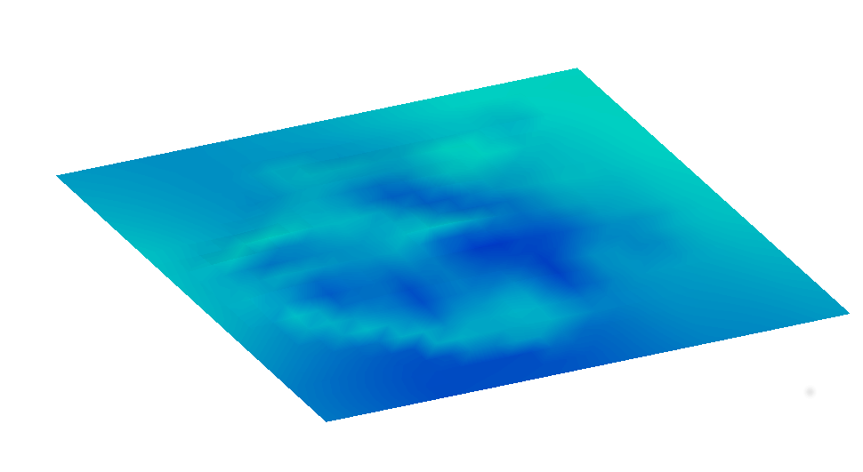
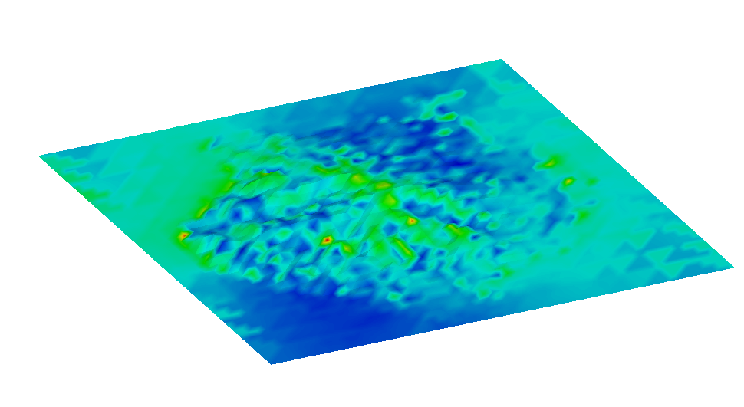
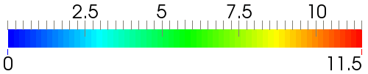
Wind Field Modeling
HARMONIE-FEM wind forecast
Wind magnitude at 10m over terrain
HARMONIE wind
FEM wind
Wind velocity (m/s)

Slide 30

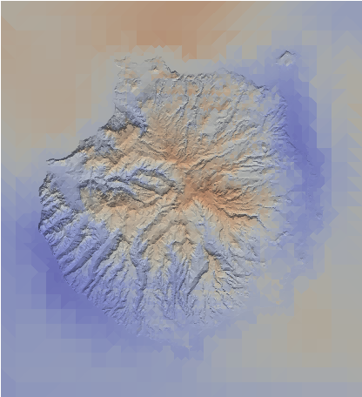
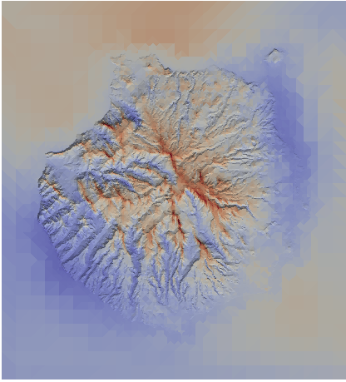

Velocity Module - 23/12/2009 - 18:00 h
Wind on the terrain surface
Interpolated field from HARMONIE
Resulting field with the mass consistent model

Slide 31
Wind Field Modeling
HARMONIE-FEM wind forecast
Multiple numerical predictions using slightly different conditions
HARMONIE data + MMC model → local wind forecast
The main idea
    Use HARMONIE data as reliable points, as stations or as control points for GAs
    Run different sets of experiments → perturbation

Slide 32
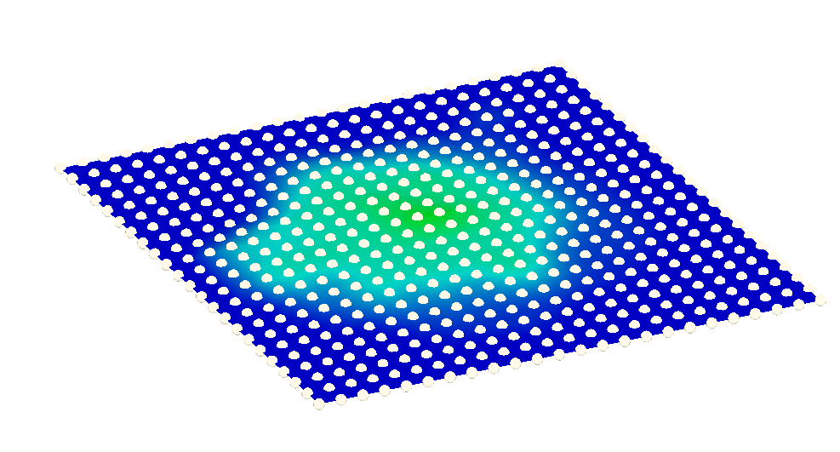
Wind Field Modeling
HARMONIE-FEM wind forecast
U₁₀ V₁₀ horizontal velocities
Geostrophic wind = (27.3, -3.9)
Pasquill stability class: Stable
HARMONIE U₁₀ V₁₀ data points
Notes:
In order to compute our wind field we have to use some data from HARMONIE i.e. U10 V10, the Geostrophic velocity, and the Pasquill stability class

Slide 33
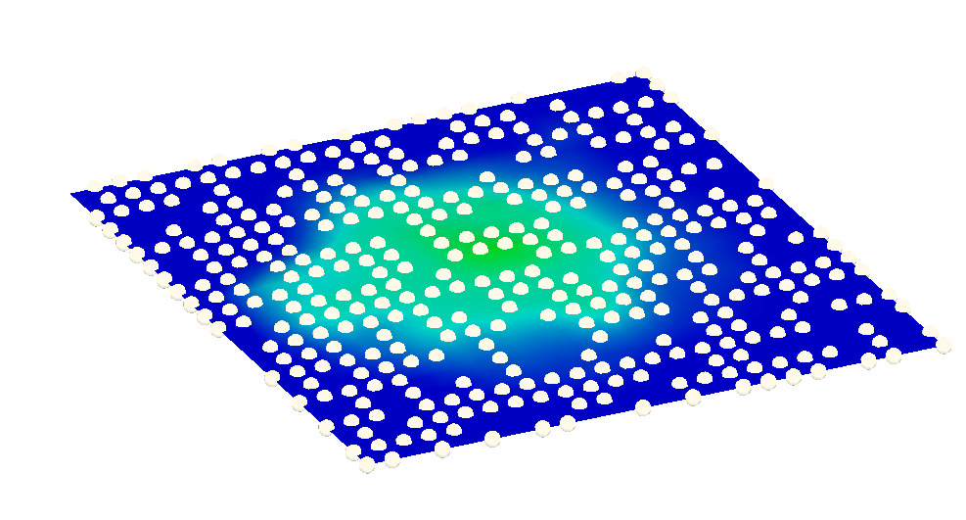
Wind Field Modeling
HARMONIE-FEM wind forecast
Used data (2/3 of total)
Notes:
There’s a total of 552 points with u10 and v10 data. We don’t want to use that much, so we discard one third of the data

Slide 34



Wind Field Modeling
HARMONIE-FEM wind forecast
Selection of Stations
Stations
Control points
Stations (1/3) and control points (1/3)

Slide 35
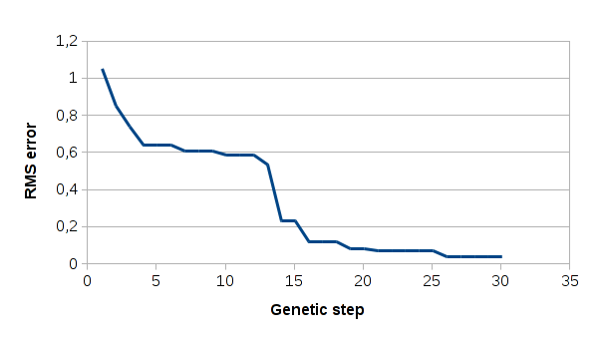
Ensemble methods
New
Alpha = 2.057920
Epsilon = 0.950898
Gamma = 0.224911
Gamma' = 0.311286
Previous
Alpha = 2.302731
Epsilon = 0.938761
Gamma = 0.279533
Gamma' = 0.432957
Small changes

Slide 36
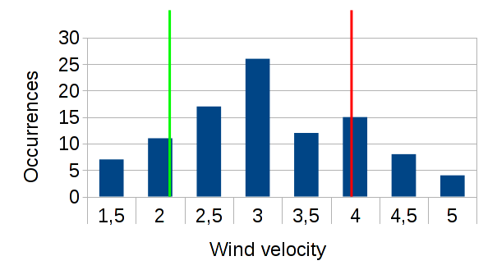
Ensemble methods

Slide 37
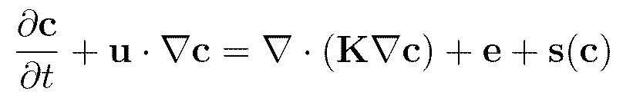
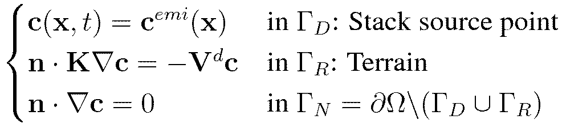

Wind Field Modeling
Air Quality Modeling
Convection-diffusion-reaction equation
Convective term
Diffusive term
Reactive term
in Ω
Emissión term
Boundary
Conditions
Initial Condition
c = concentration
c^{emi} = stack concentration
c^{ini} = initial concentration
u = wind velocity
K = diffusion matrix
e = emissión
s(c) = reactive term
V^{d} = deposition velocity

