Slide 1
Simulating large emitters using CMAQ and a local scale finite element method. Analysis in the surroundings of Barcelona

Slide 2
Motivation
To Improve the prediction at fine scales:
Large emitters
Near source transport and chemistry
Current approaches:
Nested grid modelling
Adaptive grid modelling
Hybrid modelling
Plume-in-grid modelling
Statistical models
CFD

Slide 3
Proposed approach
In this work we propose to compare two different approaches
WRF-ARW/AEMM/CMAQ
Nested grid modelling
1km – 300m
Adaptive Finite Element method
Plume-in-grid modelling

Slide 4
Proposed approach
WRF-ARW/AEMM/CMAQ
Meteorology
Emissions
Transport and reaction
Mass consistent model (Wind)
Local FEM
Transport reaction
Plume rise (Briggs)
Initial and Boundary
conditions

Slide 5
Outline
WRF-ARW/AEMM/CMAQ model
Local scale Finite Element model
Application to Barcelona surroundings
Conclusions

Slide 6
WRF-ARW
The mesoscale meteorological model used is Weather Research and Forecasting—Advanced Research (WRF-ARW) version 3.6.1
Specially suited to the subscale grid modelling
Time-splitting methods, and high order (both time and space)

Slide 7
AEMM
Air Emission Model of Meteosim (AEMM v3.0) developed by Meteosim S.L.
Numerical, deterministic, Eulerian, local-scale model
It allows to obtain the intensity of emissions in different areas, either anthropogenic (traffic, industry, residential, etc.) or natural (emissions caused by vegetation or erosion dust) for the area of interest

Slide 8
CMAQ
CMAQ v5.0.1
CB-5 chemical mechanism
AERO5 aerosol module
EBI solver
Discretization 1km
The WRF-ARW/AEMM/CMAQ approach has been used successfully in urban areas (Catalonia, Madrid), industrial areas (Tarragona, Ponferrada), and arid areas (Perú, Chile)

Slide 9
Adaptive Finite Element Method
Convection-Diffusion-Reaction equation
Wind field
Plume rise
FEM discretization
Adaptivity

Slide 10
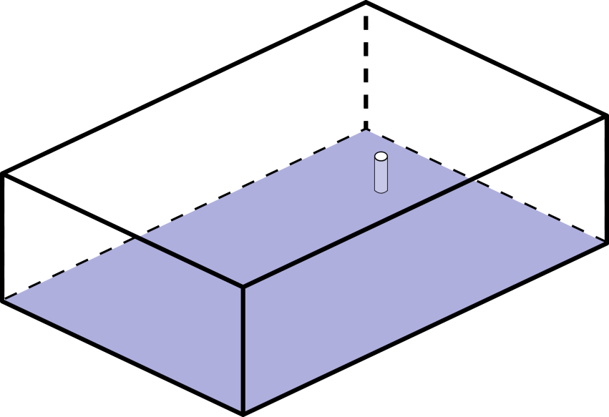
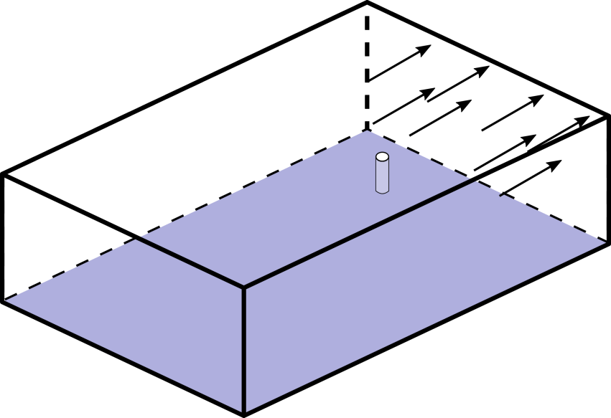
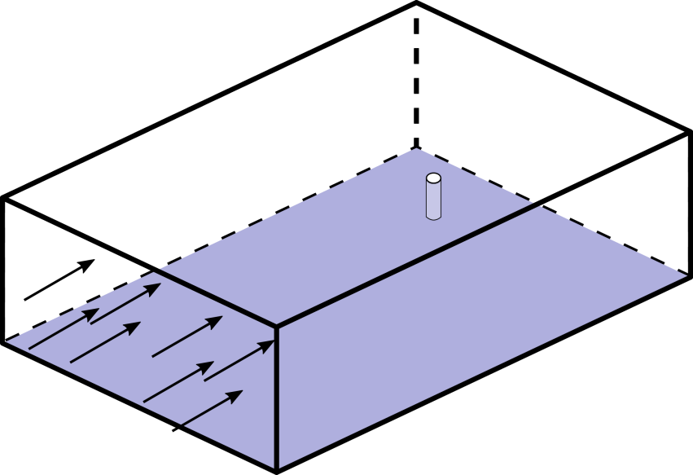
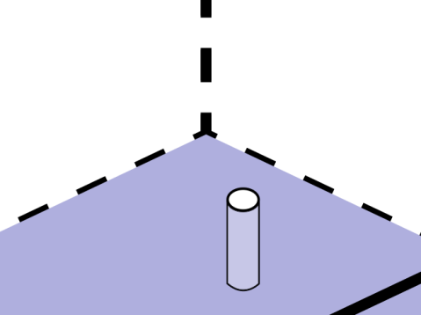
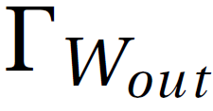
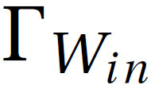
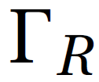
Adaptive finite element method
Convection – diffusion – reaction equation
A. Oliver et al. Adaptive Finite Element Simulation of Stack Pollutant Emissions over Complex Terrains. Energy 2013.

Slide 11
Wind field
Interpolate Wind field from WRF-ARW
Mass-consistent model

Slide 12
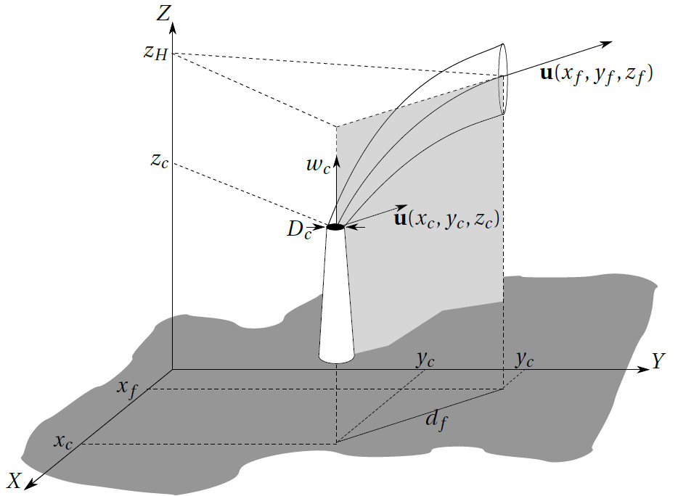
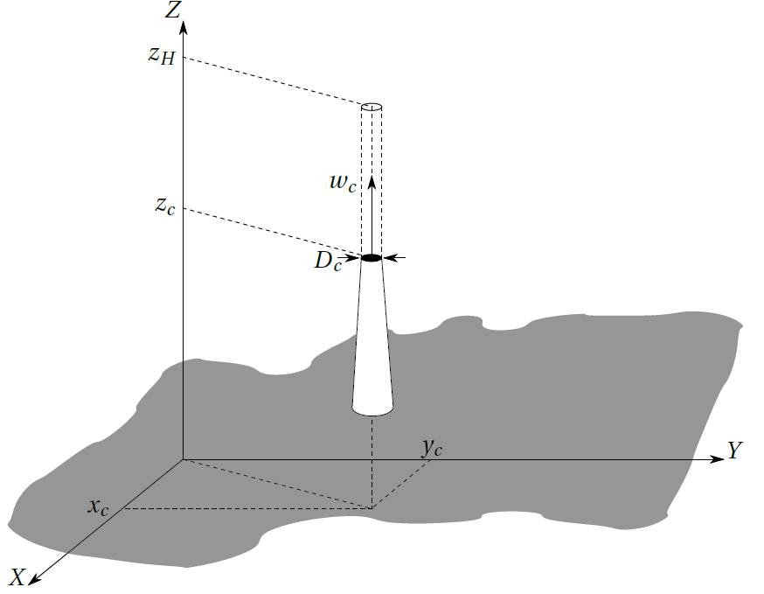
Plume rise
Briggs equations
Buoyancy Momentum

Slide 13
FEM discretization
Temporal discretization: Crank-Nicolson
Spatial discretization: Least Squares FEM
System solver: Conjugate gradient preconditioned with an Incomplete Cholesky Factorization

Slide 14
Adaptivity
Mesh adaptation
Mesh is only adapted to topography and plume rise
Necessity to adapt to the solution
Error indicator using log (wide range of solutions)
Mesh refinement fixing a minimum size
L. Monforte and A. Pérez-Foguet. A multimesh adaptive scheme for air quality modeling with the finite element method. Int. J. Numer. Meth. Fluids 2014

Slide 15
Application
Barcelona surroundings

Slide 16
Results
Barcelona surroundings
CMAQ nested domains

Slide 17
Results
Zoom of the nested domain

Slide 18
Results
Day: 2/12/2013
High concentration levels
Simulation 48h (24h spin up)
CMAQ grid resolution 1km, 32 layers
FEM domain 20x20km, resolution from 1km to ~1m

Slide 19
FEM Mesh

Slide 20
FEM Mesh

Slide 21
Max. 1h levels
FEM CMAQ

Slide 22
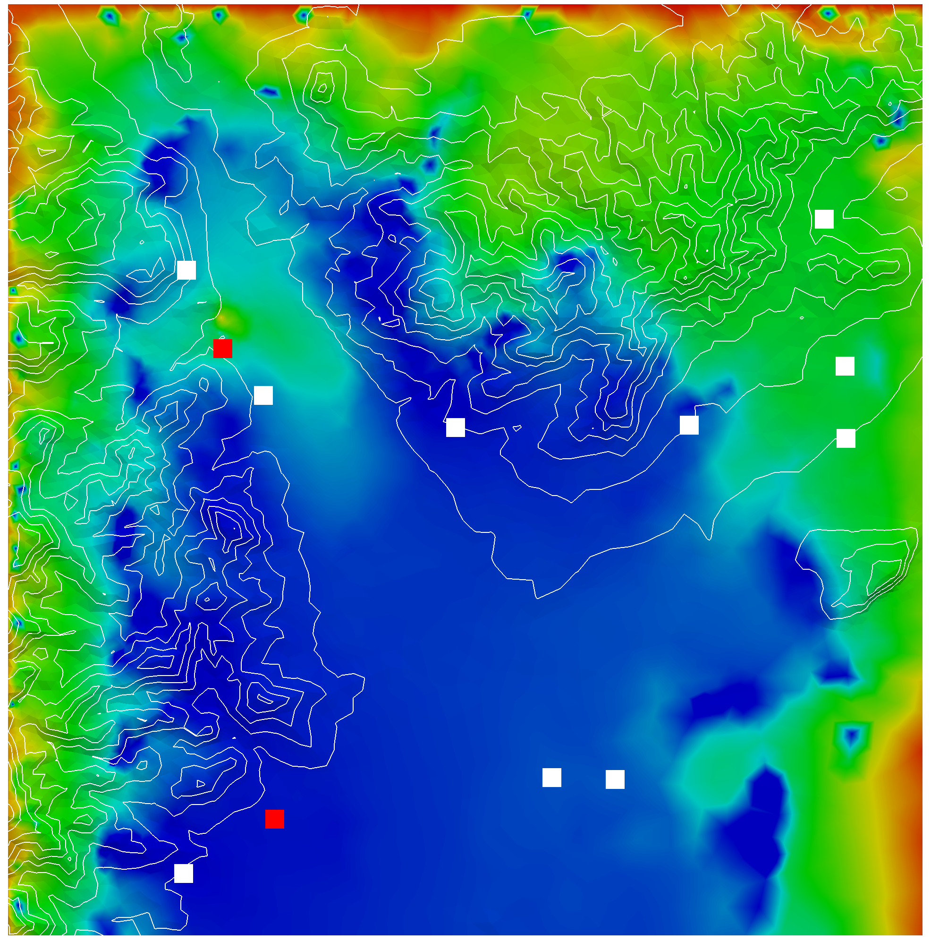
Measurement stations

Slide 23
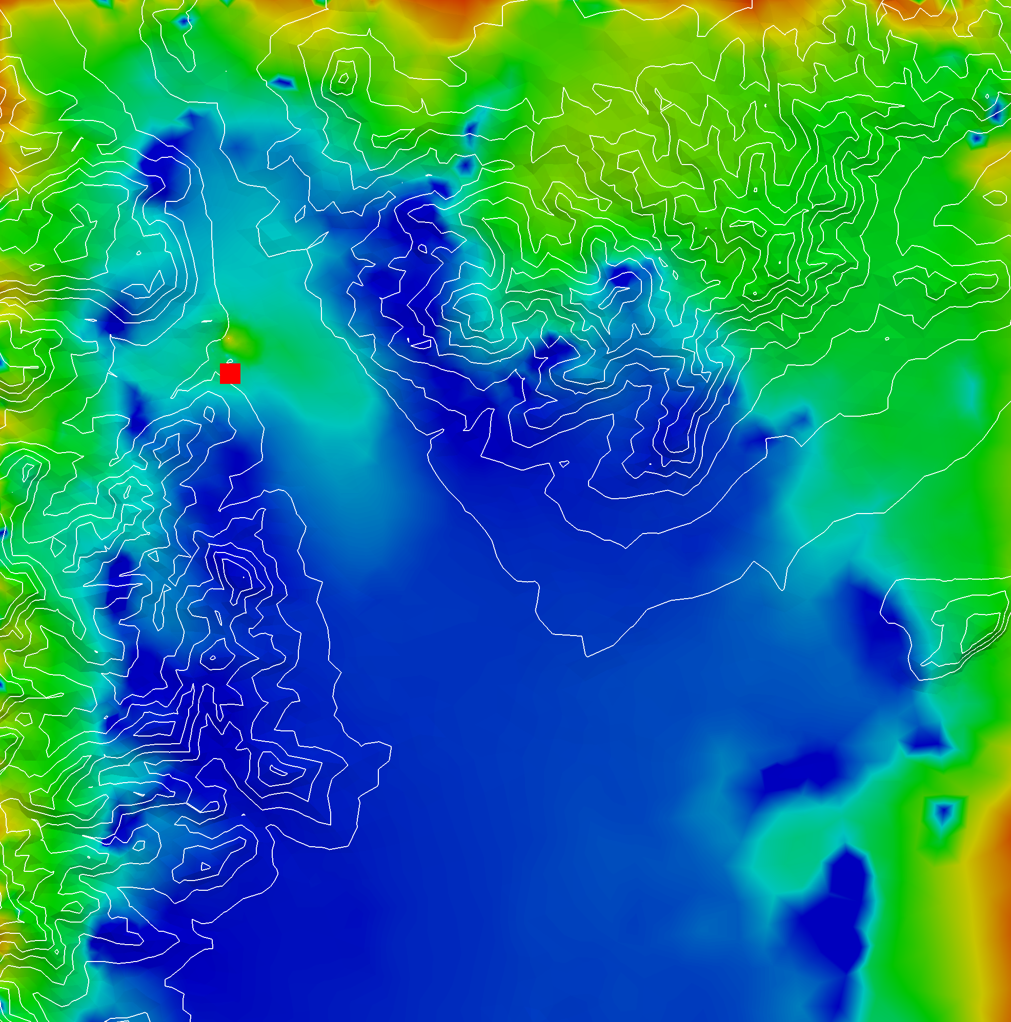
Near emitter station

Slide 24
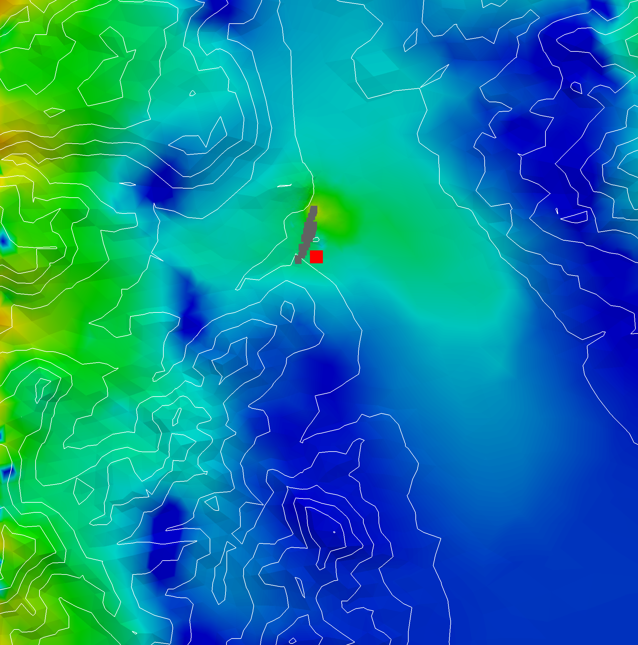
Near emitter station
Streamlines from the emitter

Slide 25
Near emitter station
Hour description of wind not enough
Streamlines from the emitter

Slide 26
Near emitter station

Slide 27
Station distant to the emitter

Slide 28
Station distant to the emitter

Slide 29
Conclusions
Combination of a nested grid and a local scale finite element model is a promising approach
The WRF-ARW/AEMM/CMAQ system using a 1km grid captures the observed data far from the emitter
Near the emitter, the finite element model is closer to the measured data, while far from the emitter the CMAQ-ARW model is better.

Slide 30
Future work
Use an smaller resolution for the wind field in the local scale model.
Explore how to combine both models, operationally, in a hybrid model.

